Slide 1
Customer Segmentation and Lifetime Value Analysis
Dibimbing
Zaky Rayadhi
Connect to LinkedIn

Slide 2
Table of contents
01
02
03
Business and Data Understanding
Data Preparation
Dashboard and Analysis
04
Insight and Recommendation

Slide 3
01
Data and Business Understanding
Apply problem-solving strategies in various contexts

Slide 4
Business Understanding
Business Problem
Global Electronics Retailer is a multinational electronics company operating across multiple countries with two sales channels: online and physical stores.
Goal
With years of accumulated data, the goal is to uncover insights on sales performance, product profitability, and customer behavior to support smarter business decisions.

Slide 5
Business Question
What is CLV distribution across customer tiers
Who are our customers and What are their demographic profiles?
Which customer segments are the most valuable?
How does CLV tier relate to RFM segments

Slide 6
Data Understanding
5 Tables (2016-2021)
Table | Rows | Description
Sales | 62,884 | Core transaction records
Products | 2,517 | Product catalog with pricing
Customers | 15,266 | Customer demographic & location
Stores | 67 | Store info; physical & online
Exchange Rates | 11,215 | Multi-currency conversion
Exchange Rates table was not used in this analysis — product prices are already standardized in USD regardless of customer's local currency.

Slide 7
02
Data Preparation

Slide 8
Data Cleaning
Table | Column | Status before cleaning | Cleaning Action
Sales | Delivery Date | There are some missing value, some purchase don’t have delivery date | Check the data, missing value show people who purchased from store
 | Order Date, Delivery Date | Format still string | Change data type into datetime
Customers | State Code | Missing value for state “Napoli” | Fill the state code with NA - Confirm the state code through source
Store | Square Meters | Missing value for StoreKey “0” | StoreKey with 0 is an online store, fill with 0
Products | Unit Price USD, Unit Cost USD | Format still string | Change data type into float
Exchange Rate | - | - | No Problem

Slide 9
Data Manipulation
Table Merge
Revenue and Profit
Order Channel
Delivery Days
Date Column
For RFM + CLV Segmentation
Recency
Frequency
Monetary
RFM Scoring (1-5)
RFM Segment
CLV Tier

Slide 10
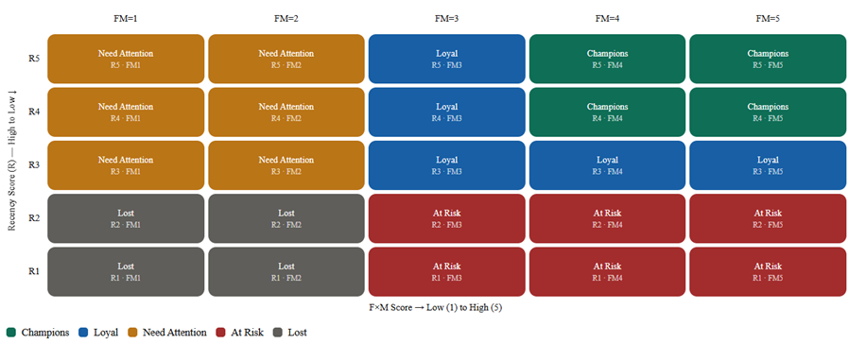
RFM Segmentation and CLV Tier mapping
RFM Segmentation Mapping
CLV Tier
Top Value (3)
Medium Value (2)
Low Value (1)

Slide 11
03
Dashboard and Analysis
Apply problem-solving strategies in various contexts

Slide 12
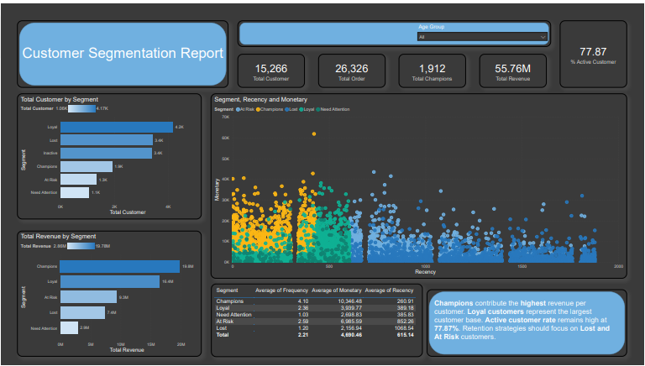
Dashboard Overview

Slide 13
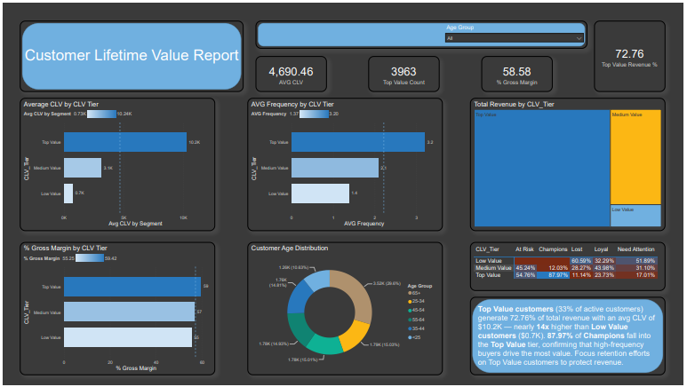
Dashboard Overview

Slide 14
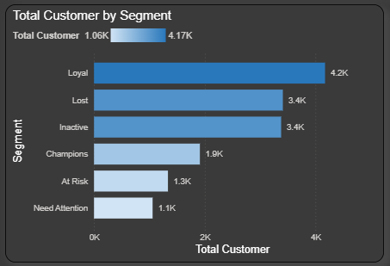
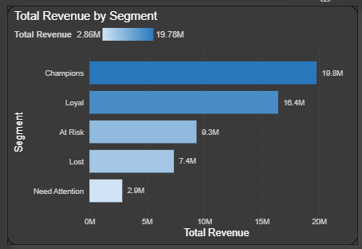
RFM Segment Distribution
Champions (12.5% of customers) generates 35% total revenue. At Risk customers hold 9.3 M in revenue at stake

Slide 15
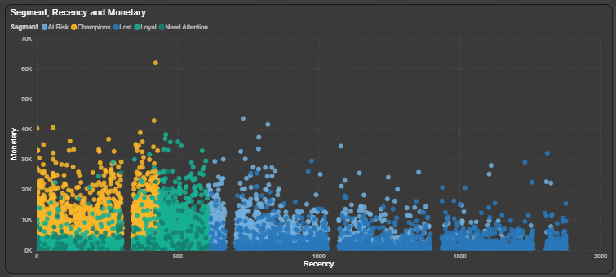
Customer behavior
High-value customers (Champions & Loyal) cluster on the left — recent buyers with the highest spending. As recency increases beyond 500 days, monetary value drops significantly, indicating customer disengagement correlates directly with lower lifetime value.

Slide 16
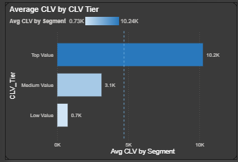
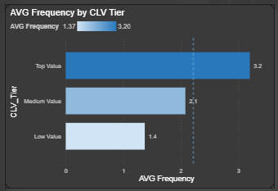
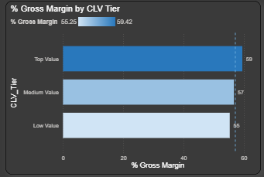
CLV Tier Distribution and Revenue
Top value customers have avg CLV of 10.2K - 14.6x higher than low value (0.7k). Higher tier also correlates with higher gross margin, confirming that Top Value customers are both more valuable and more profitable

Slide 17
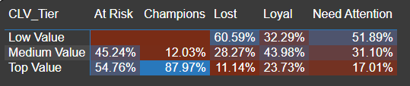
CLV Tier x RFM Segment Matrix
Key Findings
87.97% of Champions are Top Value - high value customer
60.59% of Lost are in Low Value - low spending
54.76% At Risk are Top Value - becoming inactive
43.98% of Loyal are Medium Value - potential upgrade

Slide 18
04
Insight and Recommendation
Apply problem-solving strategies in various contexts

Slide 19
Insights and Recommendations
Retain Champions
Top Value, make exclusive loyalty programs
Win-back At Risk
9.3 M at stake and 54.76% are Top Value. Personalized engagement offers before they churn
Upgrade Loyal - Top
43.93% of loyal are Medium Value. Use upselling campaigns to move them into Top Value
Re-engage Lost Customers
Run targeted re-engagement campaign, no respond deprioritize
Contact Inactive
Trigger boarding campaign, verify if contact data is still valid
Need Attention
Encourage repeat purchase via product recommendations based on first purchase category

Slide 20
Case Implementation Plan
Retain
Win-Back
Upgrade
Action
Exclusive Loyalty Program
Target Segment
Champions: 1912 Customers
KPI
Total Champions Count
Target
Maintain
Action
Personalized re-engagement offer
Target Segment
At Risk: 1335 Customers
KPI
% Upgrade to Loyal
Target
> 20 % (267 customers)
Action
Upsell to premium products
Target Segment
Loyal (Medium Value) Customers : 1835 Customers
KPI
% moved to Top Value tier
Target
10-15% (184-275 customers)

Slide 21
Documentation
Data Cleaning, Manipulation and EDA : Python
Dashboard : File and Power BI

Slide 22
Thank You

