Slide 1


Department of Computer Engineering
DJSCE
Mumbai University
2025-26
MindHaven:
Zalak Gala
60004240096
Bhavika Boddireddy
60004240061
Palak Shah
60004240196
Jiya Shah
60004240095
Under the guidance of
Prof. Nancy Nadar
Project Guide

Slide 2
AGENDA
Introduction
Need of the System
Existing Solutions
Field Survey
Literature Survey
Gaps identified in 3 & 4 & 5
Problem Statement
Proposed Solution
Flow of system
Data sources
References
Conclusion

Slide 3

Introduction
Students today face stress, confusion, and emotional pressure.
Many hesitate to open up or lack someone to talk to.
They struggle to stay consistent with habits and daily tasks.
Our app gives them a safe space to share thoughts and feelings.
It lets them track habits and set reminders for daily routines.
A virtual AI friend allows them to vent freely without judgment.
Helps students understand their emotions through regular journaling.
Supports them in building small, healthy routines step by step.
Brings thoughts, tasks, habits, and emotional support into one place.

Slide 4
Need of the System
Students face academic pressure, relationship issues, stress, and loneliness.
Many avoid sharing their feelings due to fear of judgment or not wanting to burden others.
The app offers a safe space to talk to a virtual friend anytime.
Built-in journal helps students note their thoughts easily.
Habit tracker supports building or breaking habits with reminders.
Students earn small rewards for staying consistent and can use them to customize their virtual friend.
Brings support, journaling, and habit tracking together to improve emotional well-being.

Slide 5
Literature Survey - Related to Existing Systems
Existing Solutions
Dayora
Description: AI powered journaling and mood tracking. AI gives daily summaries and insights into mood triggers.
Woebot
Description: AI chatbot for emotional support, journaling, mood tracking
Wysa
Description: Conversational AI for CBT, mood tracking, habit support, self-guided interventions.

Slide 6
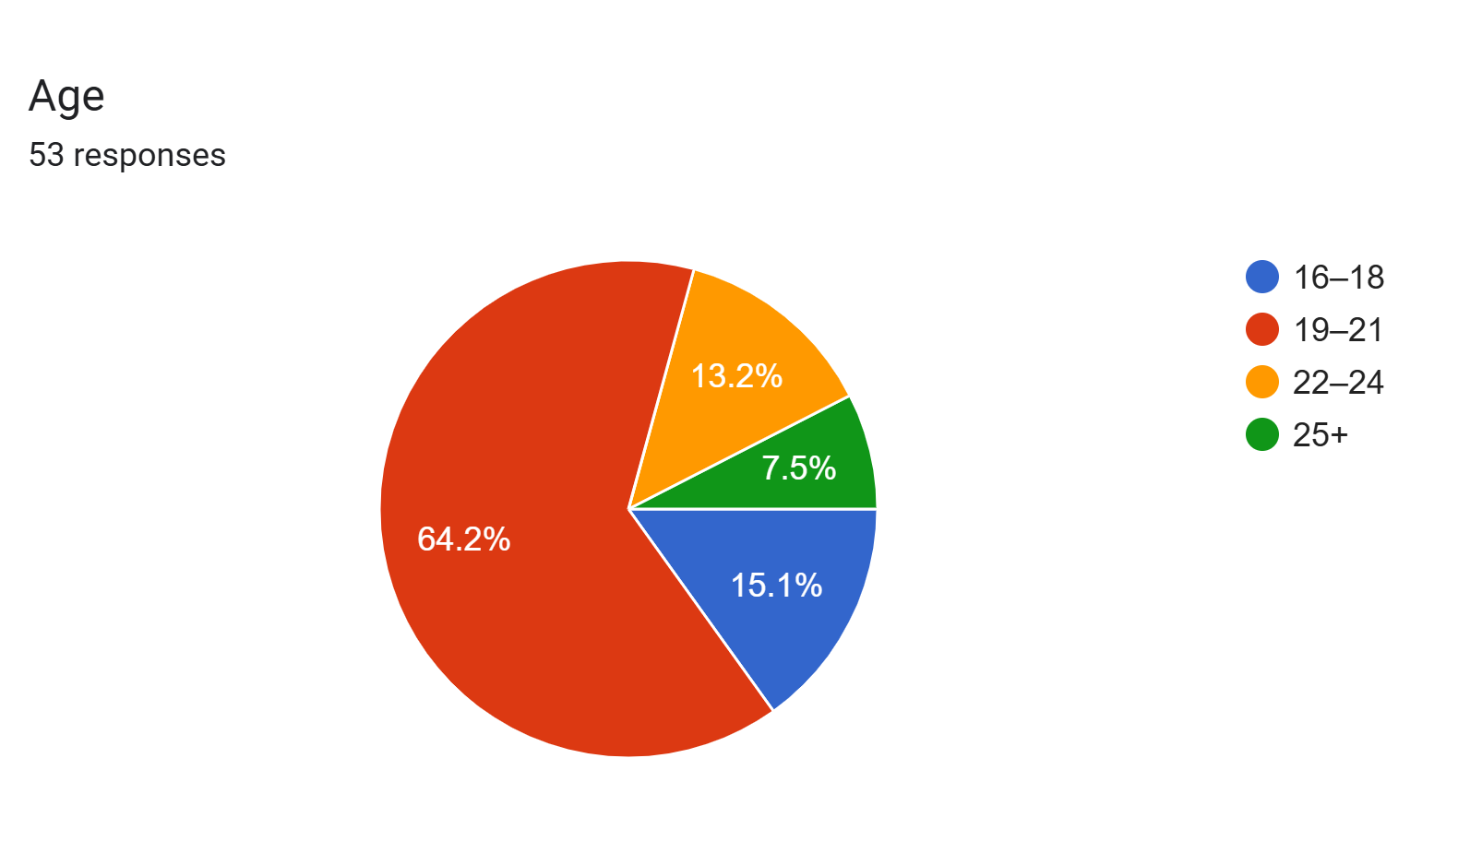
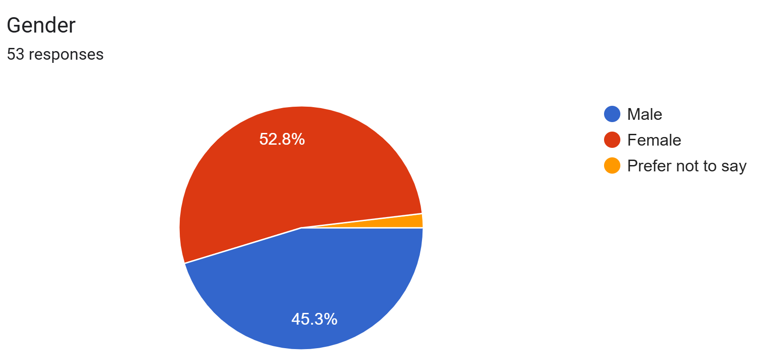
Field Survey

Slide 7
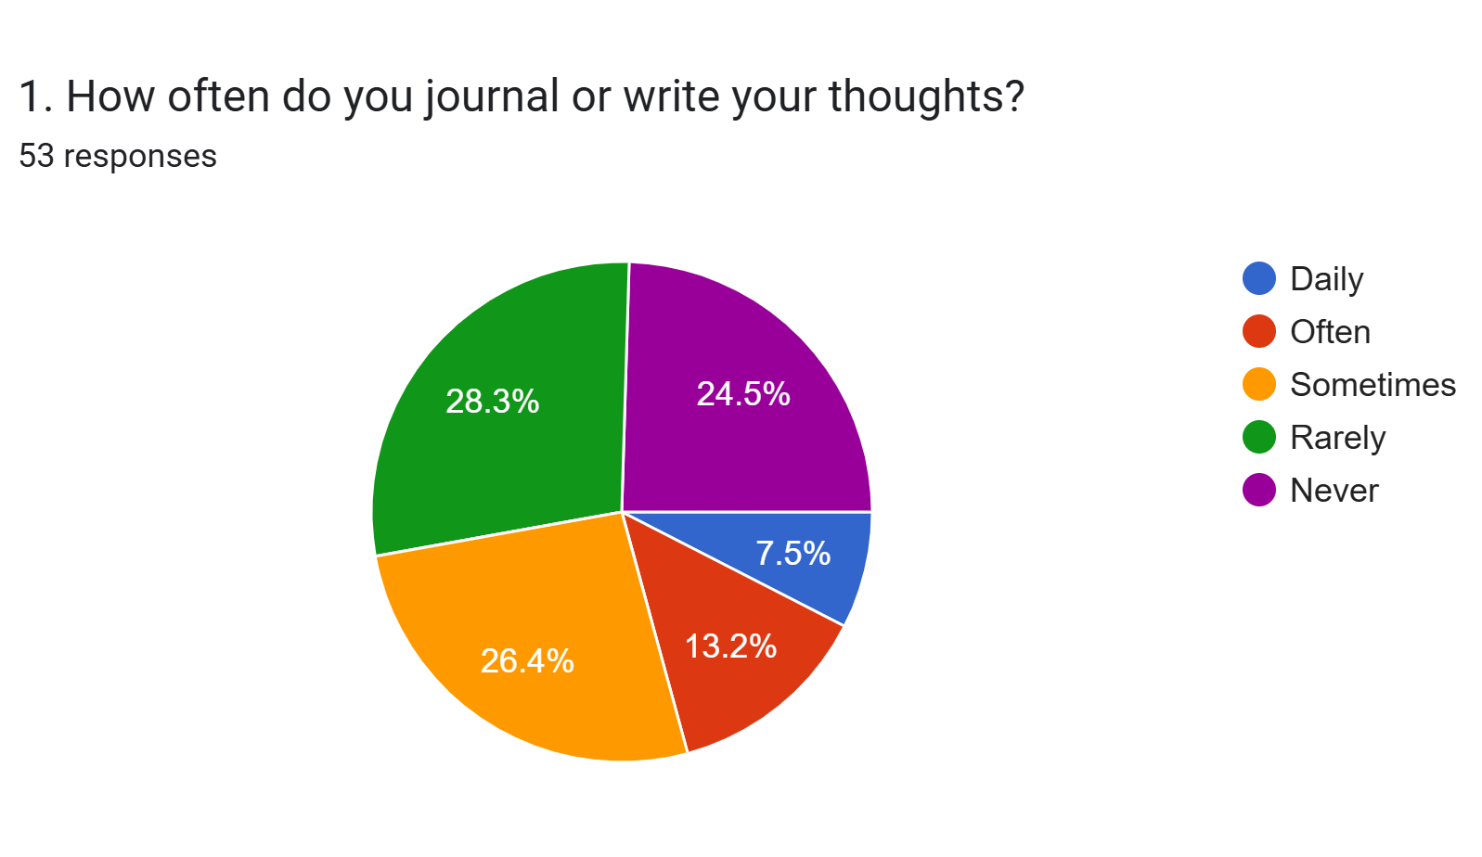
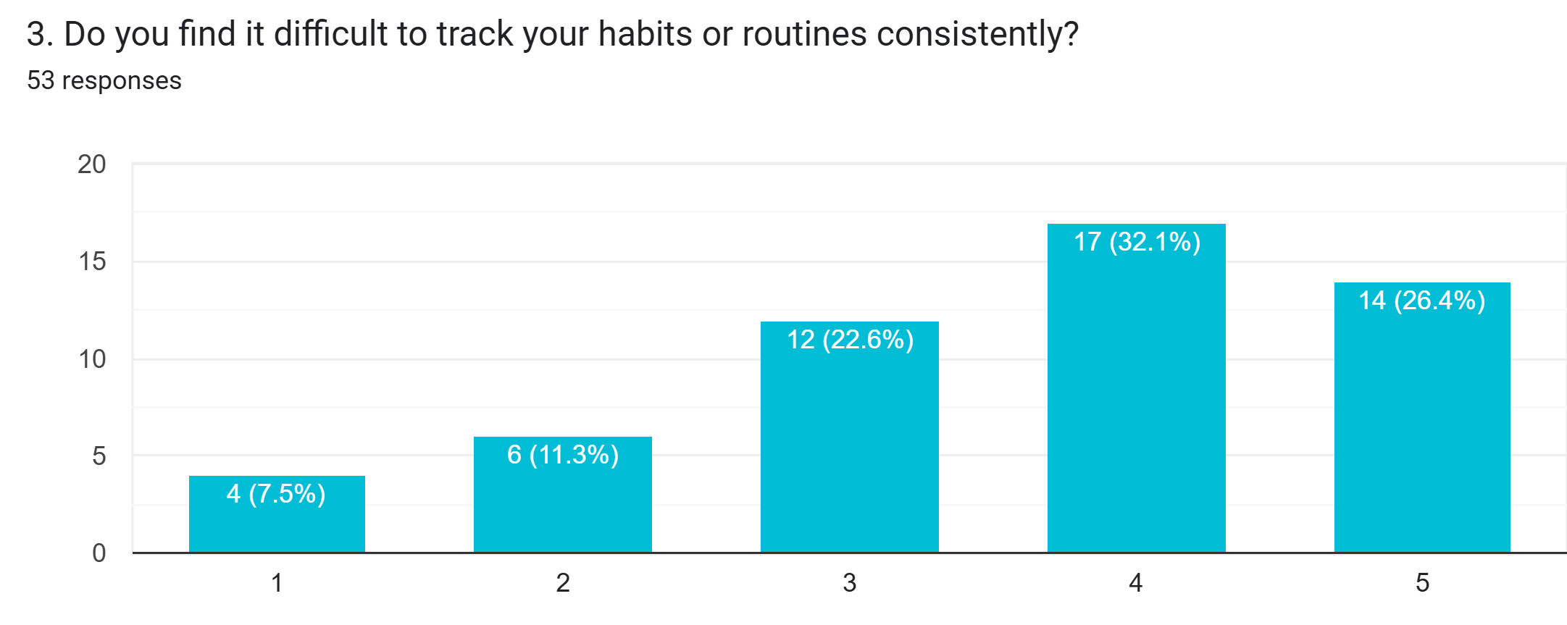
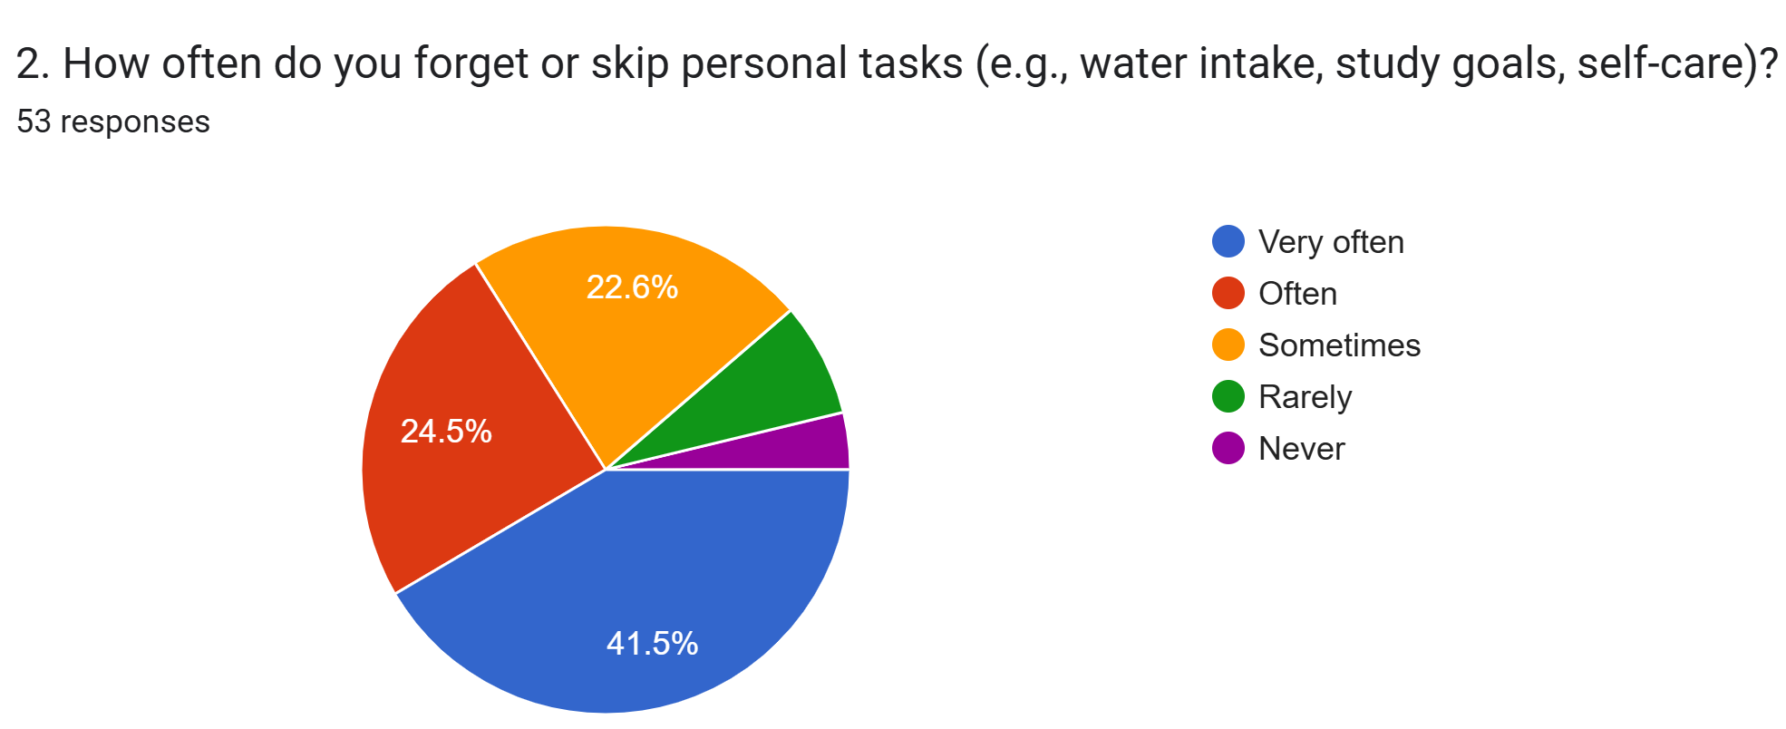
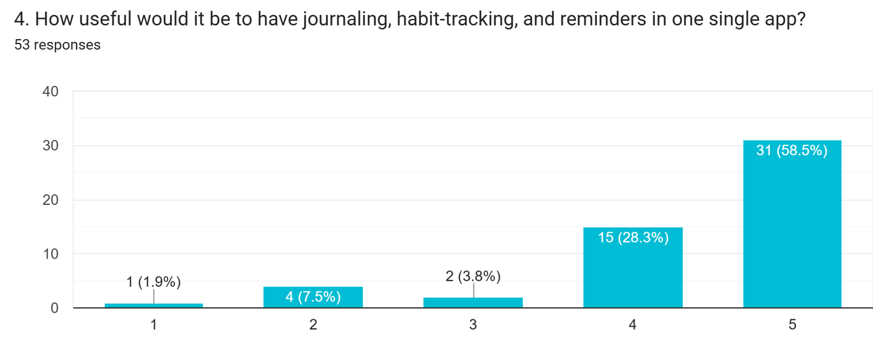
Field Survey

Slide 8
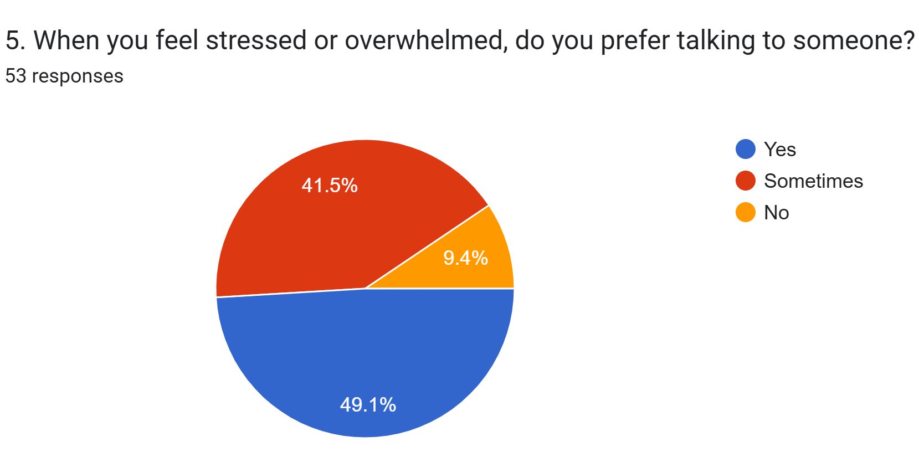
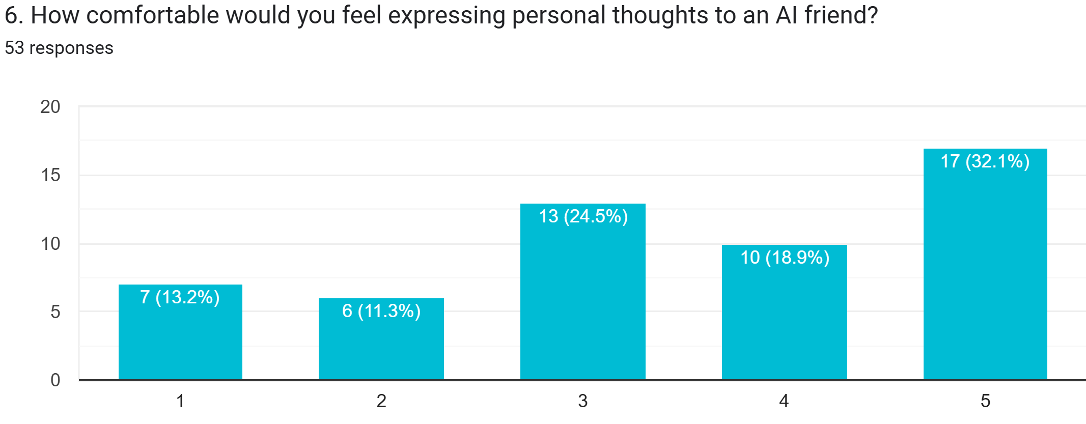
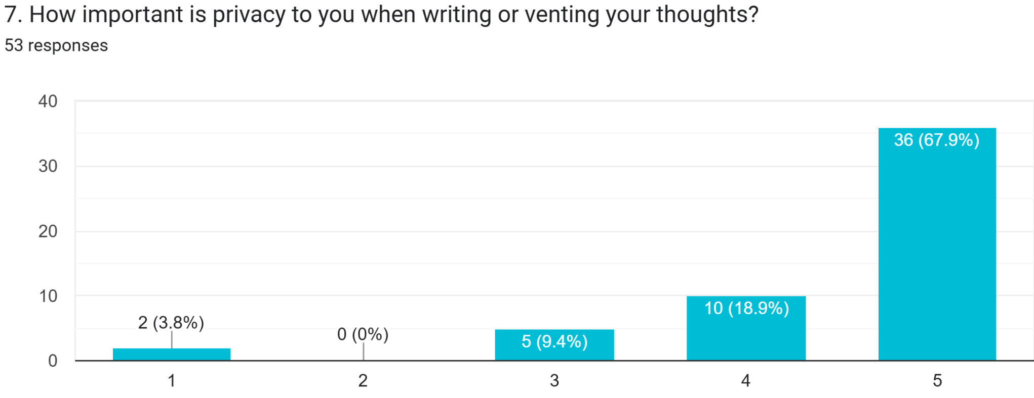
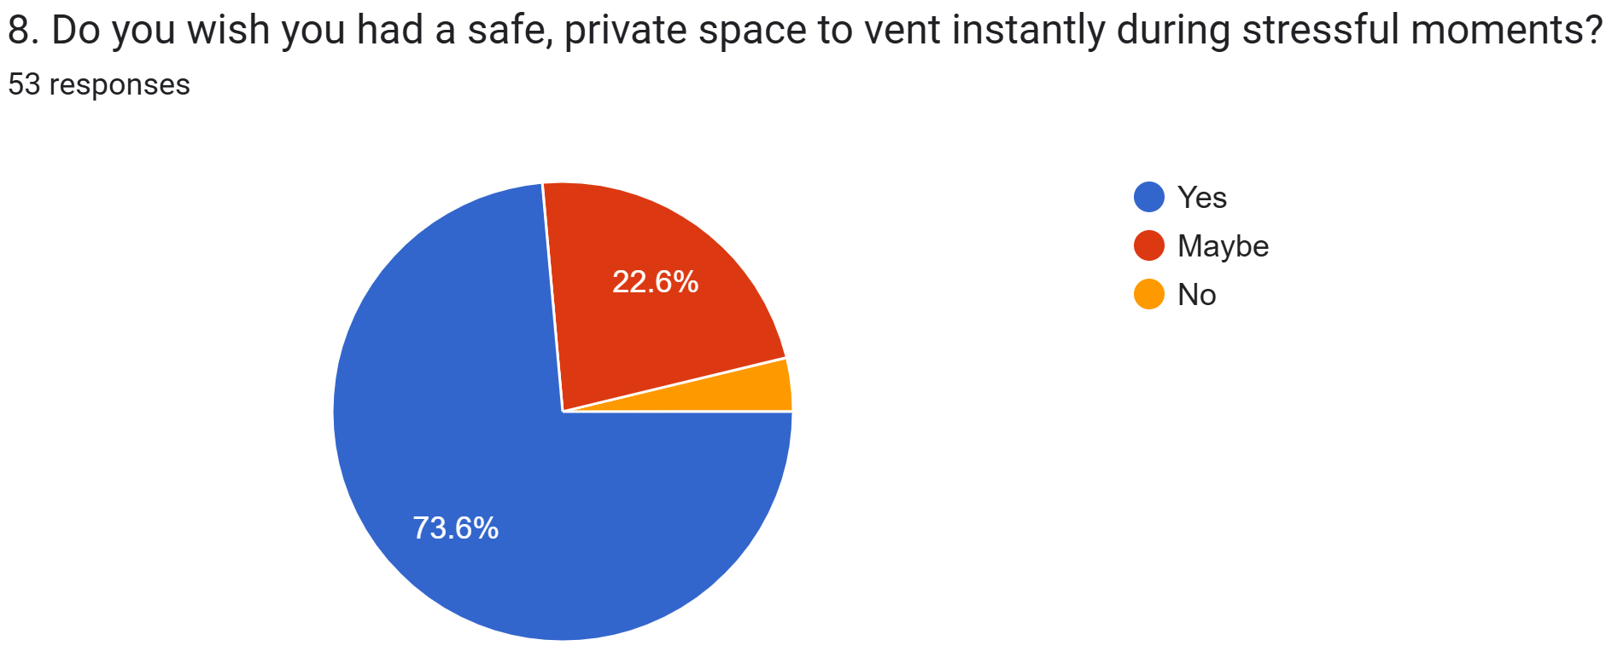
Field Survey

Slide 9
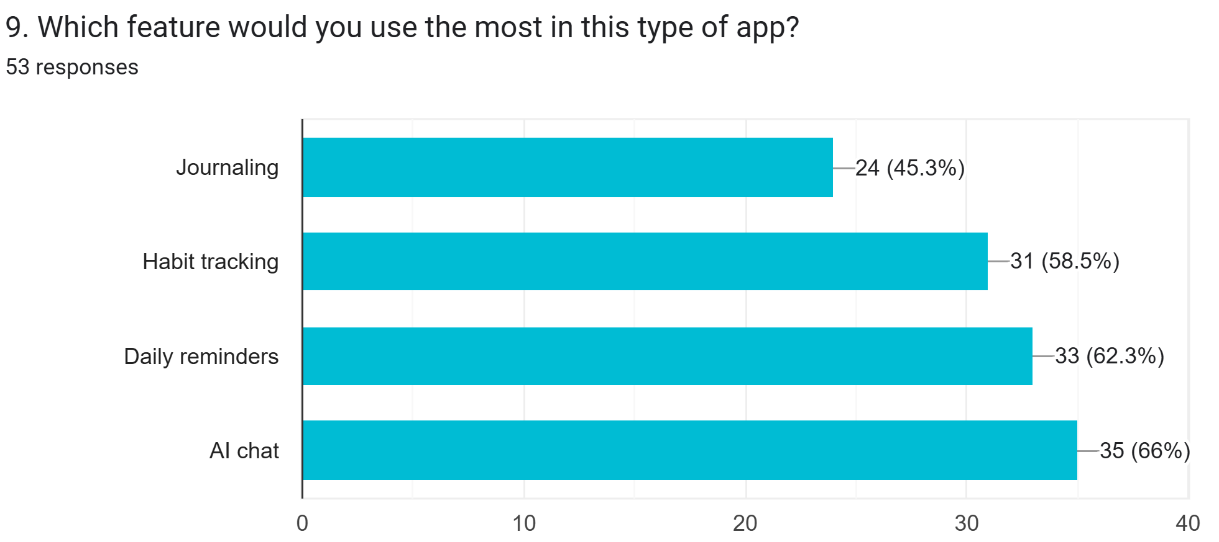
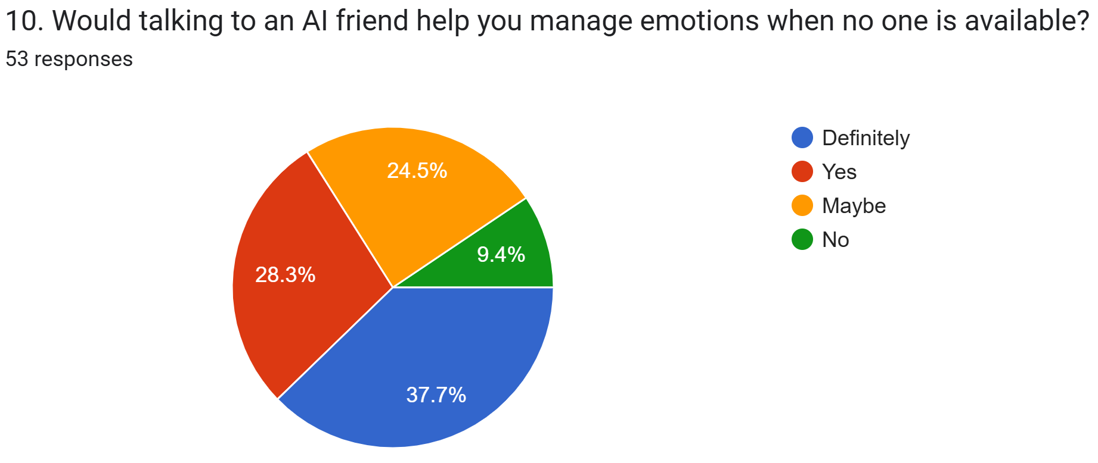
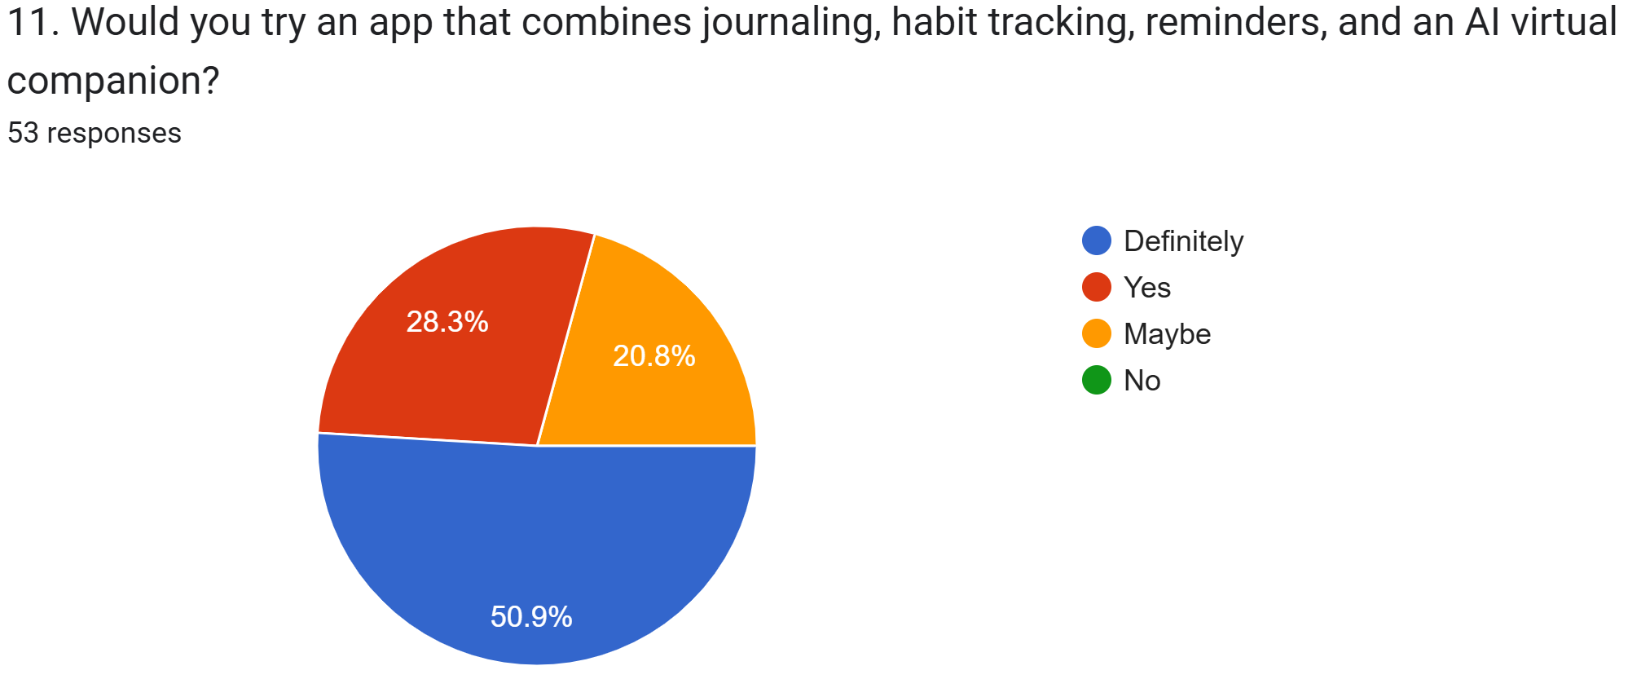
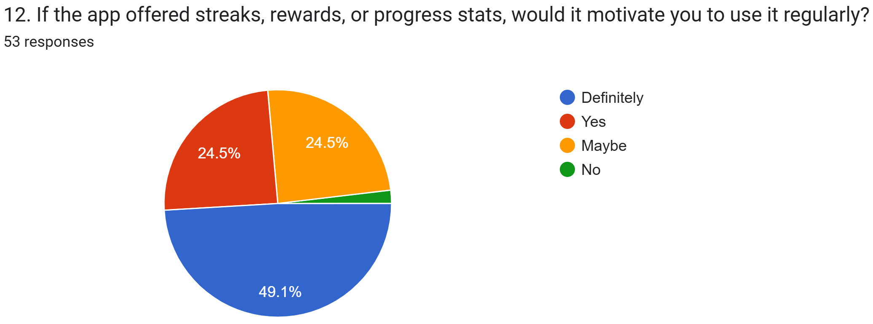
Field Survey

Slide 10
Literature Survey (in form of table)
Paper Name | Journal/Conference Name and Year/publishing house | Methodology | GAPS
Design and Implementation of an AI-Driven Mental Health Chatbot: A Generative AI Model | IEEE | Preprocessing:It uses an embeddings model (all-MiniLM-L6-v2 by OpenAI) Algorithms: The system integrates a generative AI approach using the OllamaLLM model built on the LLaMA (Llama3) large language model.Vector search via FAISS library is used Validation: Performance is evaluated with quantitative metrics such as BLEU score,precision,recall,F1 score,and accuracy across multiple conversations. | Reinforcement learning for personalization : Adapting responses based on prior interactions to become more context-aware and individualized.
AI Chatbots for Mental Health: A Scoping Review of Effectiveness, Feasibility, and Applications | Google Scholar | Preprocessing: Searched major databases, filtered out 8,442 duplicates, and excluded non-AI/scripted chat systems Algorithm: The reviewed chatbots primarily used Natural Language Processing (NLP) and Machine Learning (ML), with Deep Learning and Reinforcement Learning. Validation: The quality was assessed using the Cochrane RoB 2 (for RCTs) and ROBINS-E (for non-randomized studies) risk-of-bias tools | Need to address affective privacy (probing emotions), emotion induction (manipulation), and preventing Impostor Bias (user doubting the authenticity of the interlocutor)

Slide 11
Literature Survey (in form of table)
Paper Name | Journal/Conference Name and Year/publishing house | Methodology | GAPS
Habit Tracker and Advisor using Mobile Application for Health Monitoring | IEEE | Preprocessing: Validate user credentials. Check habit input type & scoring thresholds.Prevent duplicate entries Algorithm:Detect input type (Yes/No/Partial, Time, Number).Apply matching scoring rules. Update averages. Validation:Check score accuracy.Test usability with pilot users.Verify Firestore data consistency. Match graphs with raw data. | No reminders yet. No gamification. No reward system for motivation.
Sentiment - guided Common sense – aware Response Generation for Mental Health Counseling | Google Scholar | Preprocessing: Cleaned HOPE data and used BERT+COMET for sentiment labeling. Algorithm: Built EmpRes (GPT-2 + SC/SGCR Graphs) with attention for sentiment-aware replies. Validation: Evaluated on HOPE with baselines using ROUGE, METEOR, BERTScore, and user studies. | Narrow Emotional Range - The model mainly focuses on binary sentiment (positive/negative), ignoring complex emotions like fear, guilt, or anger. Minor Hallucinations Around 20% of users reported occasional hallucinations (irrelevant or fabricated responses).

Slide 12
Literature Survey (in form of table)
Paper Name | Journal/Conference Name and Year/publishing house | Methodology | GAPS
Mental Health Prediction Using Ensemble Learning Approaches with Rebalancing Technique | IEEE | Preprocessing: Data cleaning, SMOTE (Synthetic Minority Oversampling Technique) for rebalancing, and RFE (Recursive Feature Elimination) for feature selection. Algorithms: Gradient Boosting (GB), Random Forest (RF), and K-Nearest Neighbor (KNN) ensemble classifiers. Validation: 80:20 train-test split with 5-fold cross-validation. | Small sample size limits generalizability and increases the risk of overfitting. Key demographic factors were not examined, limiting insights. KNN classifier underperformed due to high dimensionality/residual class imbalance.
Predicting the Utilization of Mental Health Treatment with Various Machine Learning Algorithms | Google Scholar | Data cleaning and feature extraction from survey datasets. Dimensionality reduction with Principal Component Analysis (PCA). Algorithms: Support Vector Machines (SVM), Naive Bayes, K-Nearest Neighbors, Decision Trees, Random Forest, Gradient Boosting Machines, Binary Logistic Regression, Deep feedforward neural networks | Older, self-reported datasets; limited to technology workspace. Possible biases due to self-reporting. Narrow selection of features. Results not generalizable to all populations or industries.

Slide 13
Literature Survey (in form of table)
Paper Name | Journal/Conference Name and Year/publishing house | Methodology | GAPS
Use of generative AI in psychiatry and mental health care: a systematic review | Google Scholar (Cambridge University Press) | Preprocessing:Systematic search of major databases.PRISMA screening by two reviewers.Extracted key study details (model, purpose, findings).Algorithm:40 studies reviewed.Mostly prompt-based tests using ChatGPT.Main uses: knowledge checking, education, clinician support, ethics, chatbots.Validations:Compared AI answers with clinical standards.User surveys/interviews for feedback.Safety tested with sensitive scenarios. | Lack of standard definition for “generative AI” in mental health literature.Poor reporting: many papers don’t specify AI model version, or prompt design.Reproducibility issues: no consistent use of reporting guidelines.

Slide 14
Gaps identified
Existing Solution
Dayora
Drawbacks: It is a web app. Does not include habit tracking.
Woebot
Drawbacks: Algorithmic bias, limited depth, not a replacement for professional care
Wysa
Drawbacks: Limited explainability, ethical/data concerns, not always clinically validated.
Lack of reinforcement learning and personalization
There are ethical concerns like privacy of emotions, risk of manipulating feelings, and users doubting if the AI is real.
The system does not have reminders, games, or reward features to keep users motivated.Some performance issues include limited emotional understanding, occasional wrong or irrelevant responses (~20%), and certain algorithms not working well.
Research limitations include small and self-reported datasets, lack of diverse users, limited features, possible biases, poor reporting, and difficulty reproducing results.

Slide 15
Problem Statement
Students feel overwhelmed managing emotions, habits, and daily tasks because everything they need like journaling, habit tracking, reminders, and emotional support are scattered across different places.

Slide 16
Proposed solution
Provide one unified app for journaling, habit tracking, reminders, and emotional support.
Offer a virtual AI friend that listens without judgment and is available anytime.
Include a simple, guided journal to help students express thoughts easily.
Add a habit tracker with reminders to build consistency in daily routines.
Give small in-app rewards for regular habits and journaling to keep users motivated.
Allow users to personalize their virtual friend using the rewards they earn.
Create a safe, supportive space that helps students manage emotions and stay organized.

Slide 17
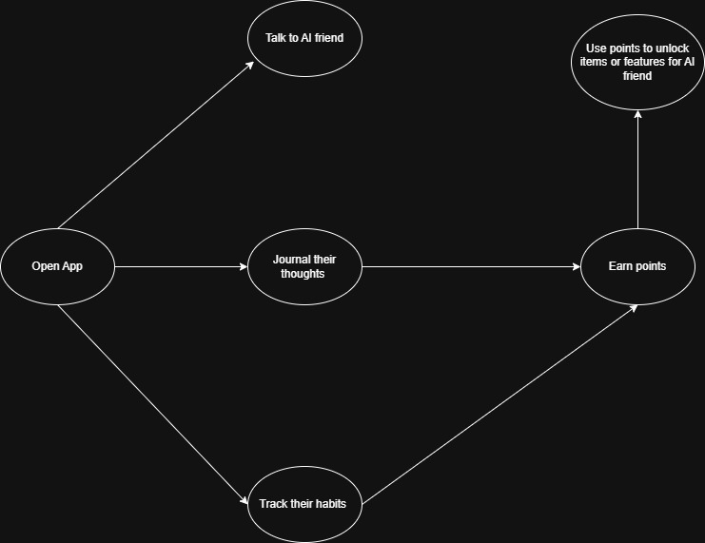
Flow of system

Slide 18
Data sources
Dataset | Description / Use | Download Link / Archive | Notes & Limitations
AI‑Driven Mental Health Literacy (India, intervention study) | This is data from an Indian study where ChatGPT-based prompts were used in mental health literacy intervention among college students | PsychArchives: “Dataset for: AI‑Driven Mental Health Literacy: An Interventional Study from India” (CSV + codebook) PsychArchives | This is more survey / intervention data (questionnaire, text responses) than physiological signals.
MoodMirror | MoodMirror is a video-journaling app that lets users record their thoughts, then uses AI to analyze facial expressions and spoken text to infer their emotions. Mood Me It’s designed for private self-reflection: journal entries are stored on the user’s device, not centrally. | https://ieee-dataport.org/documents/moodmirror-dataset-sentiment-and-emotion-analysis | Emotional analysis is done via proprietary AI (facial + text), but the model details, accuracy, or datasets used for training are not public. Privacy concerns: since emotion data (face + speech) is sensitive, ethical / consent issues would be important if data were shared. Potential sample bias: users who choose to journal may not be representative of the general population.
Student stress monitoring dataset | A survey-based dataset containing psychological, academic, social, and environmental stress factors among students. It includes two combined datasets (~1,900 records) with features and labeled stress levels (low/medium/high). Useful for stress analysis and machine-learning classification. | https://www.kaggle.com/datasets/mdsultanulislamovi/student-stress-monitoring-datasets | Modest sample size → limited generalizability No physiological sensor data; only questionnaires Possible class imbalance May not represent all student populations
Emotional Monitoring dataset | A dataset created for emotional-monitoring research in educational settings. It is intended to capture students’ emotional or cognitive states (likely through behavioral or physiological signals), but the Kaggle page provides minimal details about data structure, collection methods, or participant demographics. | https://www.kaggle.com/datasets/ziya07/emotional-monitoring-dataset | Very limited documentation on features, sensors, or data collection Unknown sample size and participant diversity May not generalize beyond the specific educational context

Slide 19
References
Paper Name | Author(s) | Journal/Publication Source
Use of generative AI in psychiatry and mental health care: a systematic review | Sara Kolding, Robert M. Lundin, Lasse Hansen, Søren Dinesen Østergaard | Google Scholar (Cambridge University)
Mental Health Prediction Using Ensemble Learning Approaches with Rebalancing Technique | Nurmi Adilah Amiludin, Marshima Mohd Rosli, Nurain Ibrahim, Waleed A Hammood | IEEE
Predicting the Utilization of Mental Health Treatment with Various Machine Learning Algorithms | Meera Sharma, Sonok Mahapatra, Adeethiya Shankar, Xiaodi Wang | Google Scholar
Sentiment - guided Common sense – aware Response Generation for Mental Health Counseling | Aseem Srivastava, Gauri Naik, Alison Cerezo, Tanmoy Chakroborty, Md. Shad Akhtar | Google Scholar

Slide 20
Conclusion
This project aims to build a supportive mobile app that helps youth and college students stay organized while also taking care of their emotional well-being. By combining journaling, habit tracking, reminders, and an AI companion, the app gives users a helpful space to manage their daily tasks and express their feelings. Although the AI is not a replacement for professional help, it offers friendly conversations and a place to share thoughts without judgment. Overall, the app is designed to encourage healthier routines, reduce stress, and provide students with a reliable tool they can turn to every day.

Slide 21
THANK YOU !!

