Slide 1
Handwritten Kanji Recognition
Deep learning project work

Slide 2
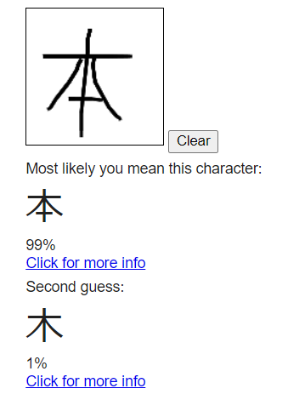
Ultimate goal
Recognize handwritten kanji

Slide 3
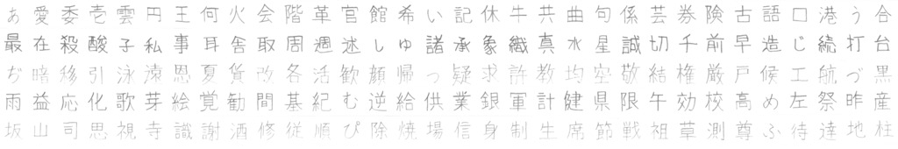
Dateset
ETL Character Database
881 most commonly used Kanji
Your audience will listen to you or read the content, but won’t do both.
Notes:
The dataset I used was the ETL character Database, which contains lots of handwritten characters. This is free to use for research purposes and it is also a very clean dataset, with very few outliers.
The concrete dataset I used was this so called ETL-8G. It contains the most used 881 kanjis, each of them written hundreds of times. It was not trivial to parse the raw data, but there were good documentation about it, so it was manageable.

Slide 4
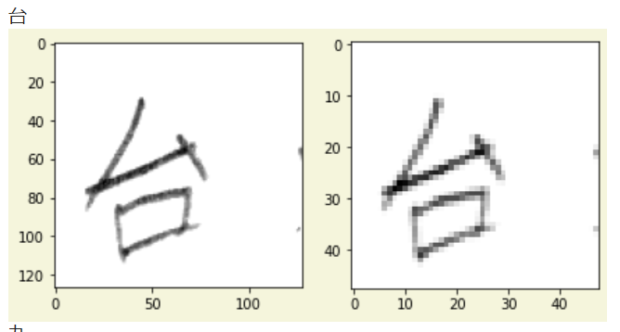
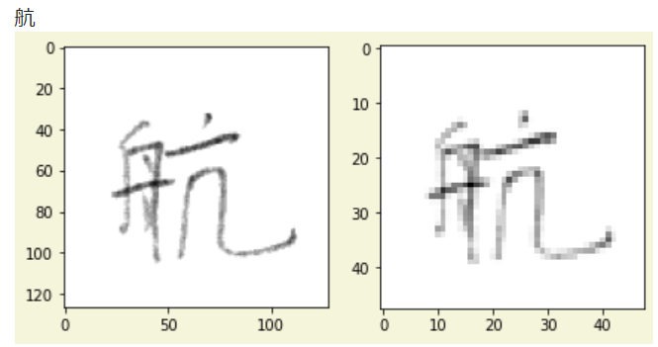
Image preprocessing
Originally 128 × 127 pixels, 4 bit grayscale information
Downscale to 48 × 48 pixels, and to 0-1 interval

Slide 5
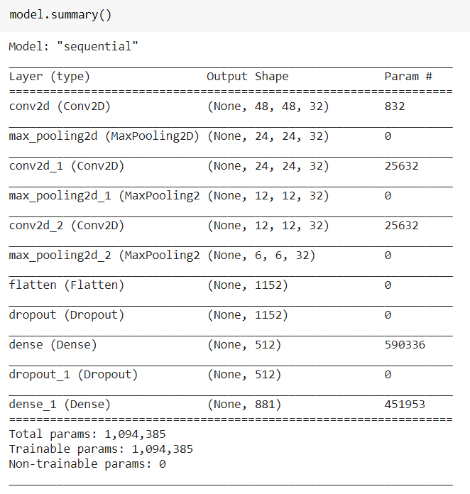
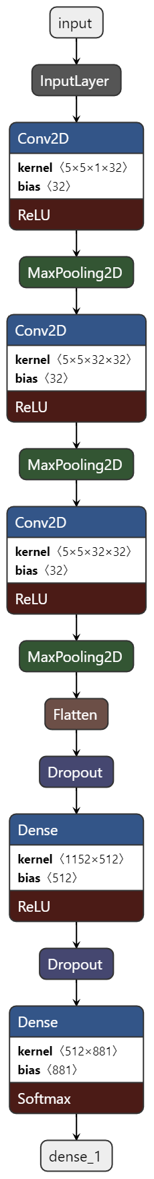
The network

Slide 6
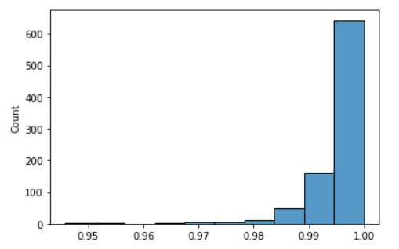
Results
40 min ~ 99.3% accuracy
Recall/Precision per class
Most misclassified elements
輪 - 輸
末 - 未
申 - 中
葉 - 薬
間 - 問

Slide 7
Actual usage of the model
HTML canvas
JavaScript

Slide 8
Thanks!
Any questions?
Contact:
Márton Zalavári
zalavarm@gmail.com
github.com/zalavari

Slide 9
Credits
Special thanks to all the people who made and released these awesome resources for free:
Presentation template by SlidesCarnival

