Slide 1
Opening a Gym in New York
Applied Data Science Capstone Project

Slide 2
Introduction
The decision to open a new gym or fitness center requires the consideration of several factors to determine the feasibility of the opening.
For example, an entrepreneur must consider the right timing, location, services provided, size of gym or fitness center, and branding/marketing campaign.
Of those factors the location of the opening must be studied thoroughly to maintain the successfulness of the new business.
In this project, New York City will be explored for the best place to open a new gym or fitness center.
The targeted stakeholders for this project would be business corporation or entrepreneurs interested in open a new gym or fitness center at New York.

Slide 3
Dataset
New York Neighborhood dataset from the repository of NYU
https://geo.nyu.edu/
This dataset is needed to explore the neighborhoods segments at New York in addition to the latitude and longitude of each neighborhood.
FourSquare API to get the venues in a given borough at New York https://developer.foursquare.com/
This dataset will be used as the source for location data.

Slide 4
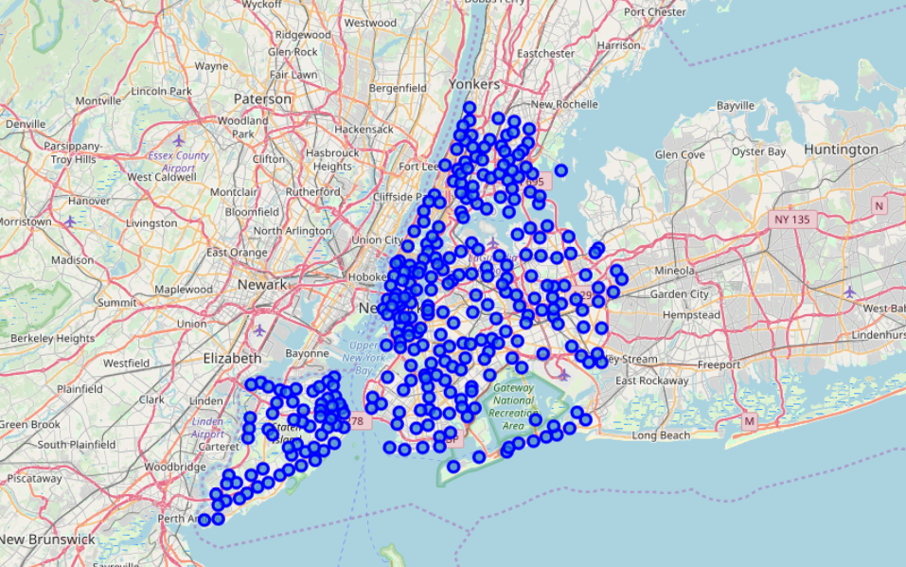
Methodology
The New York Neighborhood dataset was organized using four columns borough, neighborhood, latitude, and longitude using pandas dataframe.
The GeoPy library was used in Python to get the coordinates of New York and the Folium Library was used to visualize the map of New York with neighborhoods

Slide 5
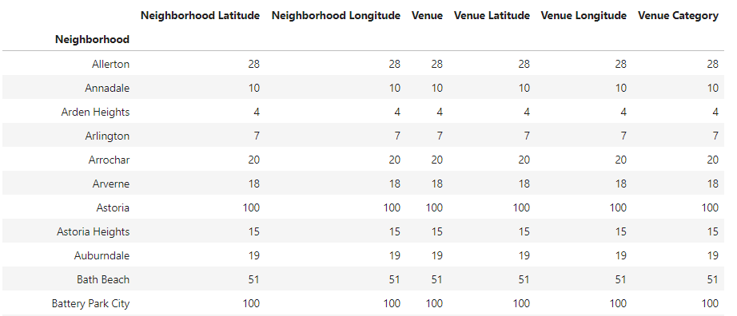
Results
The original dataset consisted of five boroughs and 306 neighborhoods. When further explored with FourSquare API, New York had 10,412 venues in all neighborhoods.

Slide 6
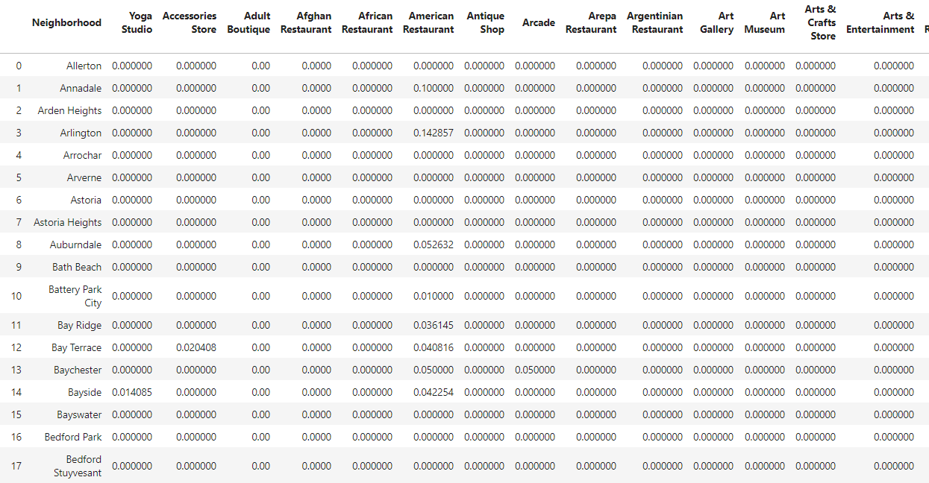
Results
Neighborhoods were grouped and results of the mean of frequency of occurrences for each category resulted in 300 neighborhoods and 431 different categories.

Slide 7
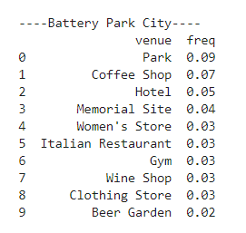
Results
A sample for a neighborhood with top 10 venues displayed is show below:

Slide 8
Results
From the results four terms for venues referring to gym-related activities were found:
Gym
Gym / Fitness Center
Gym Pool
Gymnastics Gym
The results of the k-mean clustering displayed the neighborhood in each cluster along with the top 10 venues in order.

Slide 9
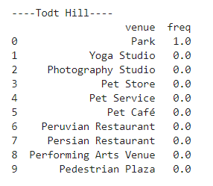
Discussion
Based on the results from the above analysis, it is recommended to open a gym or fitness centers on neighborhoods such as Todt Hill where the top 10 venues suggest there is no gym or fitness center. Moreover, there are three pet stores and no junk food restaurants. This makes it a recommended neighborhood.
Recommended
Not Recommended

Slide 10
Conclusion
In this project, the location opening a new gym or fitness center was discussed.
The New York City dataset was be explored for the best place to open a new gym or fitness center.
Based of the results of the analysis several neighborhoods were found as good candidates for locations to open a gym or fitness center.
Those neighborhoods had no gyms listed as the top 10 venues, nor any junk food within a proximity distance.

