Slide 1
Customer Churn Project
Anastasia Sosnovskikh, PPG

Slide 2
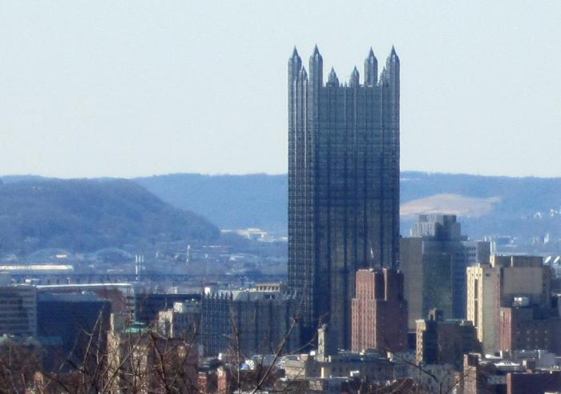
PPG Industries
Fortune 500 Company
Largest Coatings Company
in the World by Revenue
Headquarters in Pittsburgh, PA
70+ countries around the globe
Notes:
PPG Industries, Inc. is an American Fortune 500 company and global supplier of paints, coatings, and specialty materials. With headquarters in Pittsburgh, Pennsylvania, PPG operates in more than 70 countries around the globe. By revenue it is the largest coatings company in the world

Slide 3

Customer Churn
Idea: predict a probability if some customer will stop buying
Data: sales transaction history
Notes:
? How to define churn

Slide 4

Customer Churn
Motivation
Select effective retention actions
Keep the Customer

