Slide 1
Zishan Ali
22AprEnable1
Car Management System Project

Slide 2
Introduction
The overall objective of the project is the following:
To create an OOP-based application with utilisation of supporting tools, methodologies and technologies that encapsulate all core modules covered during training.
More specifically, you are required to create a full-stack web application following the enterprise architecture model:
An application back-end developed using Java (Spring Boot framework).
A test suite utilising JUnit and Mockito for integration and unit tests of the back-end as well as Selenium for automated front-end tests
A managed MySQL database hosted locally or within a cloud provider examined during Cloud Fundamentals module.
A front-end developed using JavaScript, HTML and CSS.

Slide 3
Developers Journey
I had previous experience with Java programming and other languages which I was able to utilise for this project, however as the training was intense I was able to gain a lot of knowledge and experience with Java, Github, Cloud Servers, MySQL and Maven and Junit which I didnt know much about.
Overall I have learnt a lot about how to create an intermediate Java application and how to integrate and build this as I was not aware of this before.

Slide 4
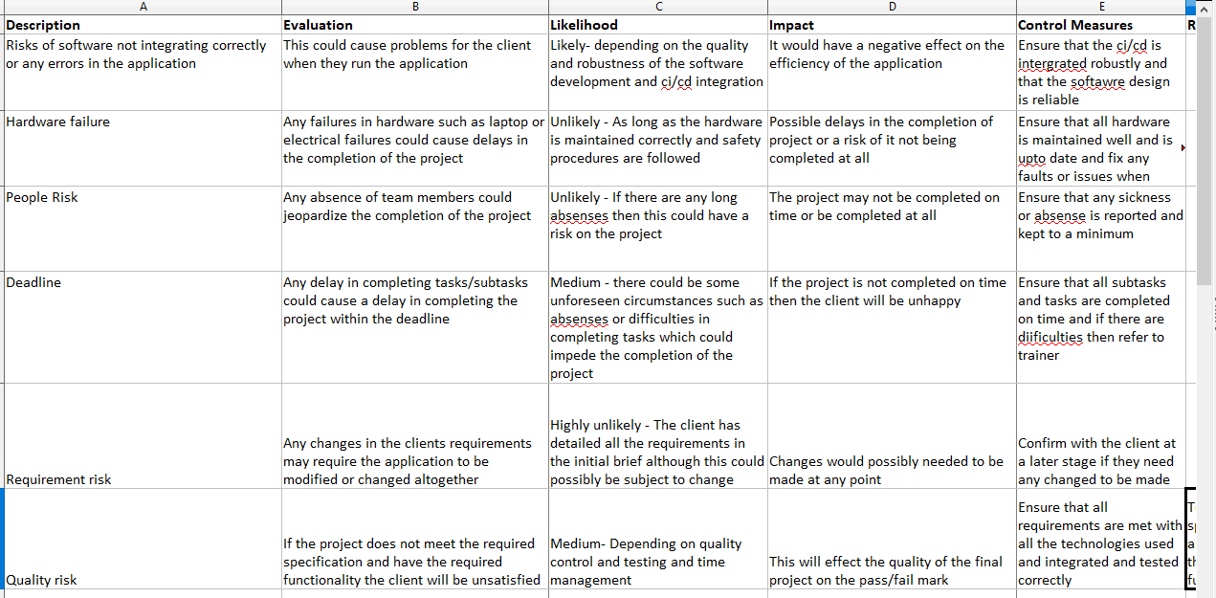
Risk Assessment

Slide 5
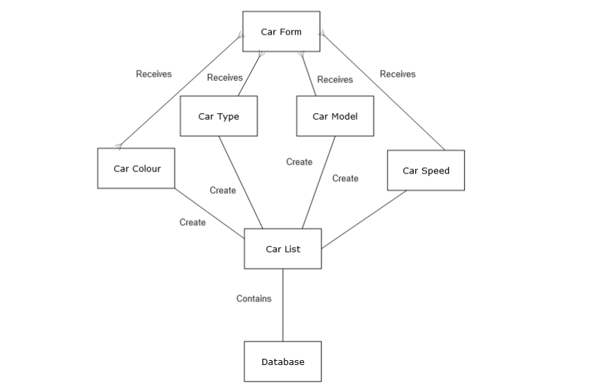
ERD

Slide 6
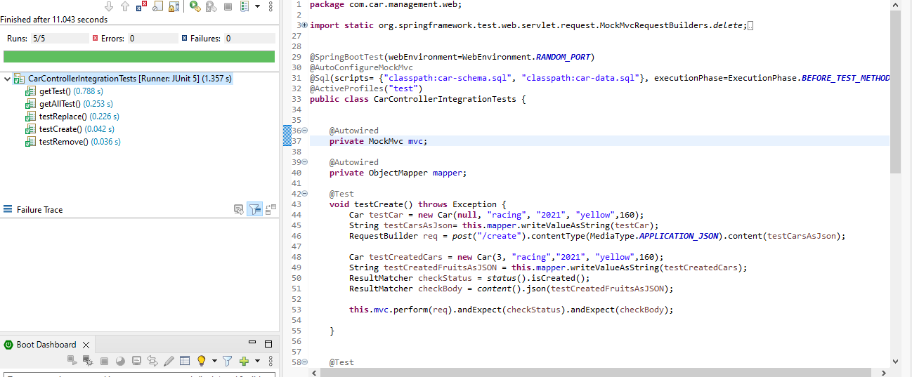
Junit Testing
There were 5 Junit tests without any errors as can be seen in the screenshot above.

Slide 7
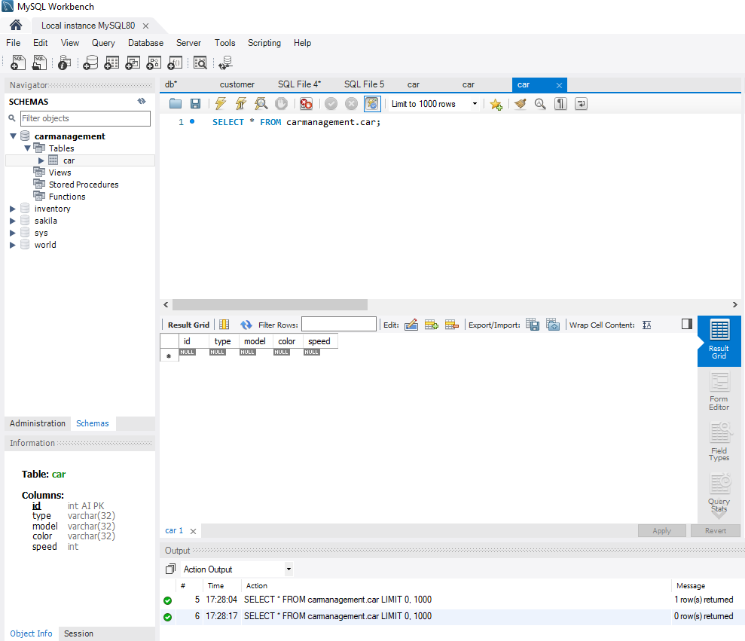
My SQL Database
This shows the SQL script being run where all the data for the website has been stored

Slide 8
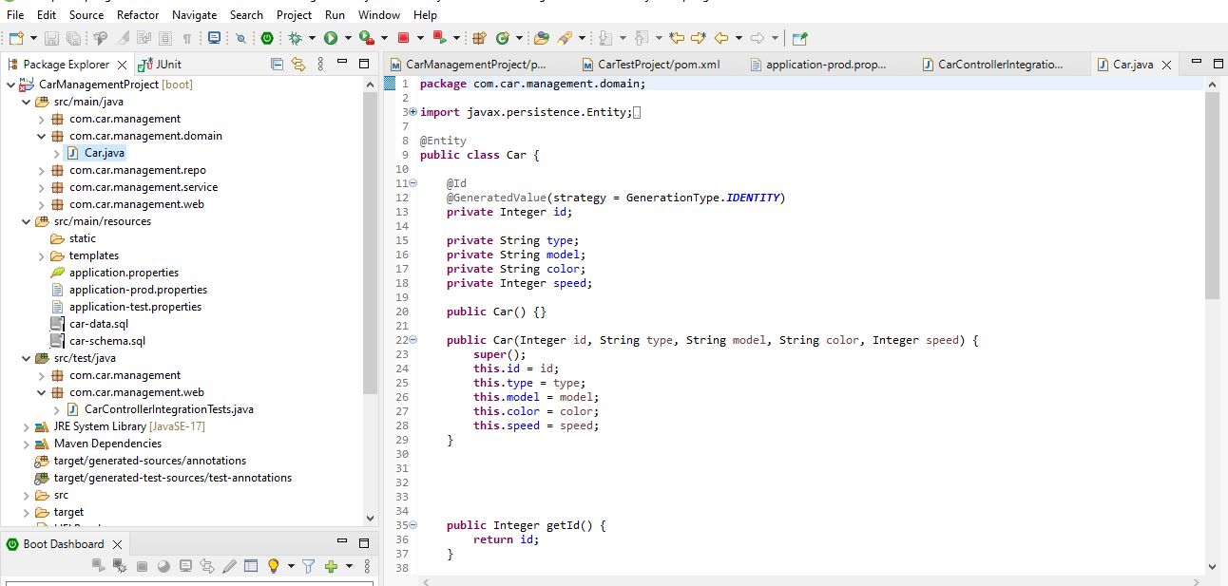
Java code
This shows the Java code and main class

Slide 9
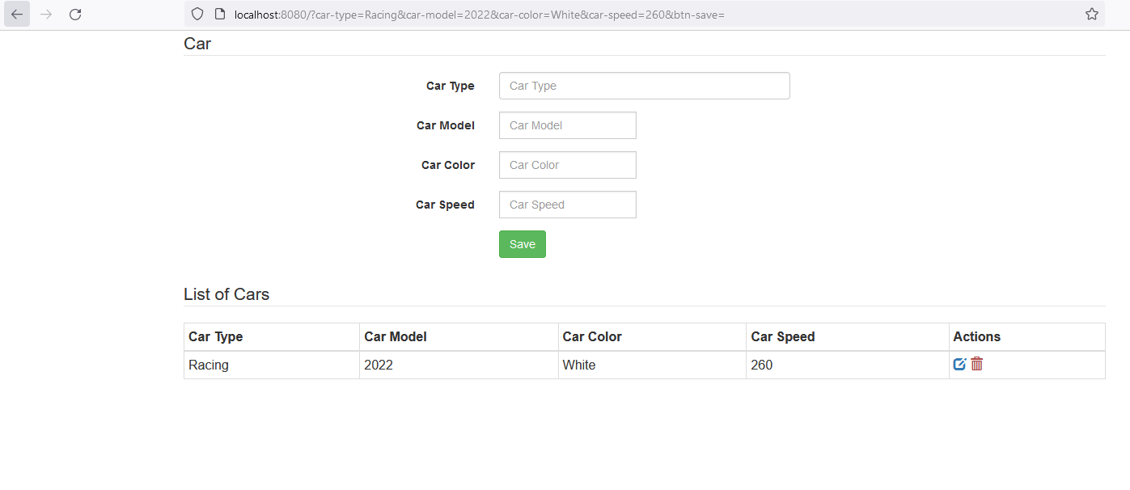
Front-End Application
This shows the front-end HTML webpage which stores information about cars inputted by the user into the MySQL database and displays this onto the HTML webpage

Slide 10
Thank you for your time
Feel free to ask any questions???

