Slide 1
F1 in numbers
Group project
01 / 19
From raw race results
to a FAIR, quality-assured knowledge graph
Formula 1 World Championship results, 1950–2025. Data Management, Winter 2026/27.
Chirag Adhikari
Student A: FAIR assessment and metadata design
Manohar Zalki
Student B: Data quality and profiling
Nicolas Bonilla
Student C: Data cleaning and pipeline
Data Management, Winter 2026/27, SRH University
Notes:
Good morning, we are Chirag Adhikari, Manohar Zalki and Nicolas Bonilla. We take 75 years of Formula 1 results from raw files to a FAIR, quality-assured dataset, a knowledge graph, a dashboard and an assistant that answers questions with evidence. Lights out.

Slide 2
F1 in numbers
The dataset
02 / 19
76 seasons of F1 results with real quality issues
Every World Championship Grand Prix from Silverstone 1950 to Abu Dhabi 2025, from the Ergast database as served by the Jolpica-F1 API.
25,907
1,149
817
77
race results, one row per car per race
championship Grands Prix
drivers and 203 constructor entries
circuits in 34 countries
Relational
One fact table and four reference tables: joins and keys matter.
Real defects
76 seasons of rule changes and file exports, not planted errors.
A natural network
Drivers, teams, circuits and countries connect into a graph.
The curated package covers Grands Prix; sprint races are out of its scope.
Presenting Chirag Adhikari
Data Management, Winter 2026/27, SRH University
Notes:
Our dataset is the Ergast Formula 1 database, which the group downloaded from its successor, the Jolpica API. The core table has 25,907 race results: one row for every car in every championship Grand Prix since 1950, 1,149 races in total. We chose it because it is relational, so keys and joins matter; its quality problems are real, coming from decades of rule changes and file exports; and drivers, teams and circuits form a natural network.

Slide 3
F1 in numbers
Method
03 / 19
CRISP-DM + Medallion architecture & automated execution
Three zones that only read the zone before them, and every CRISP-DM phase backed by evidence.
Bronze Raw zone
Silver Clean zone
Gold Served zone
25,907
55/55
30,141
rows extracted, values unchanged, lineage to file and line
validation gates before 25,873 clean rows are written
graph edges, plus the FAIR record, the dashboard and the assistant
1
Business understanding
research questions, FAIR goals
2
Data understanding
profiling: 29 issues with file and line
3
Data preparation
55 gates, an audit record per step
4
Modelling
property graph, podium-probability model
5
Evaluation
28 tests, assistant 25/25 benchmark
6
Deployment
dashboard and grounded assistant
python run_all.py --from-scratch
byte-identical reruns, 28 automated tests, no network needed
Presenting Nicolas Bonilla
Data Management, Winter 2026/27, SRH University
Notes:
We followed CRISP-DM inside a medallion layout. Bronze keeps the raw archive exactly as received, with lineage to the file and line. Silver is only written when every validation gate passes. Gold holds what people use: the FAIR record, the graph, the dashboard and the assistant. Each CRISP-DM phase has its own evidence, from the issue register to the tests and the assistant benchmark, and one command rebuilds everything with byte-identical results.

Slide 4
F1 in numbers
Data engineering
04 / 19
Data engineering: zones, contracts and controls
The issue register is the contract between profiling and cleaning; the schema module is the contract between cleaning and metadata.
Source
Raw zone
Quality
Clean zone
Served zone
Ergast / Jolpica
public F1 API
CC BY-NC-SA 4.0
Step 0: extract
format detection,
file + line lineage
Profiling
29 issues,
7 dimensions
Cleaning
12 audited steps
FAIR record
DataCite 4.5, PROV-O
Property graph
30,141 edges
racing_f1_data.zip
DOI 10.5281/zenodo.23416916
SHA-256 pinned
data/raw
5 CSV tables,
values unchanged
Issue register
contract B to C:
evidence + fix step
Validation gates
55 checks, fail-fast
Dashboard + assistant
7 views + Ask
Feedback loop: issue B29 came back from the dashboard
data/cleaned
25,873 x 35
+ 4 reference tables
Report and slides
generated from outputs
Schema as code
one contract for C and A
Orchestration
run_all.py, byte-identical reruns
Automated tests
28 tests on key decisions
Lineage
file + line, checksums, PROV-O
Presenting Nicolas Bonilla
Data Management, Winter 2026/27, SRH University
Notes:
Here is the architecture behind it. Data move through zones: an immutable raw zone that keeps the source values and their lineage, a clean zone that is only written when every validation gate passes, and served products. Two contracts hold it together: the issue register between profiling and cleaning, and one schema module shared by cleaning and metadata. Underneath are four controls: the schema as code, one orchestrated command, automated tests, and lineage down to the source line.

Slide 5
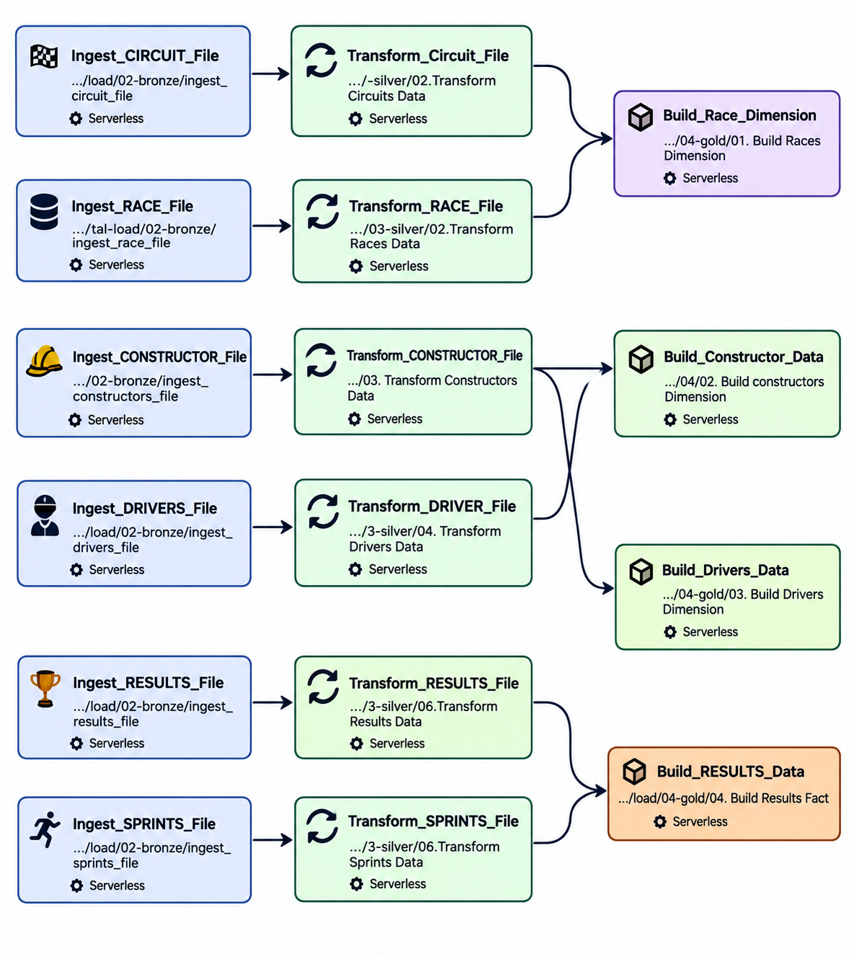
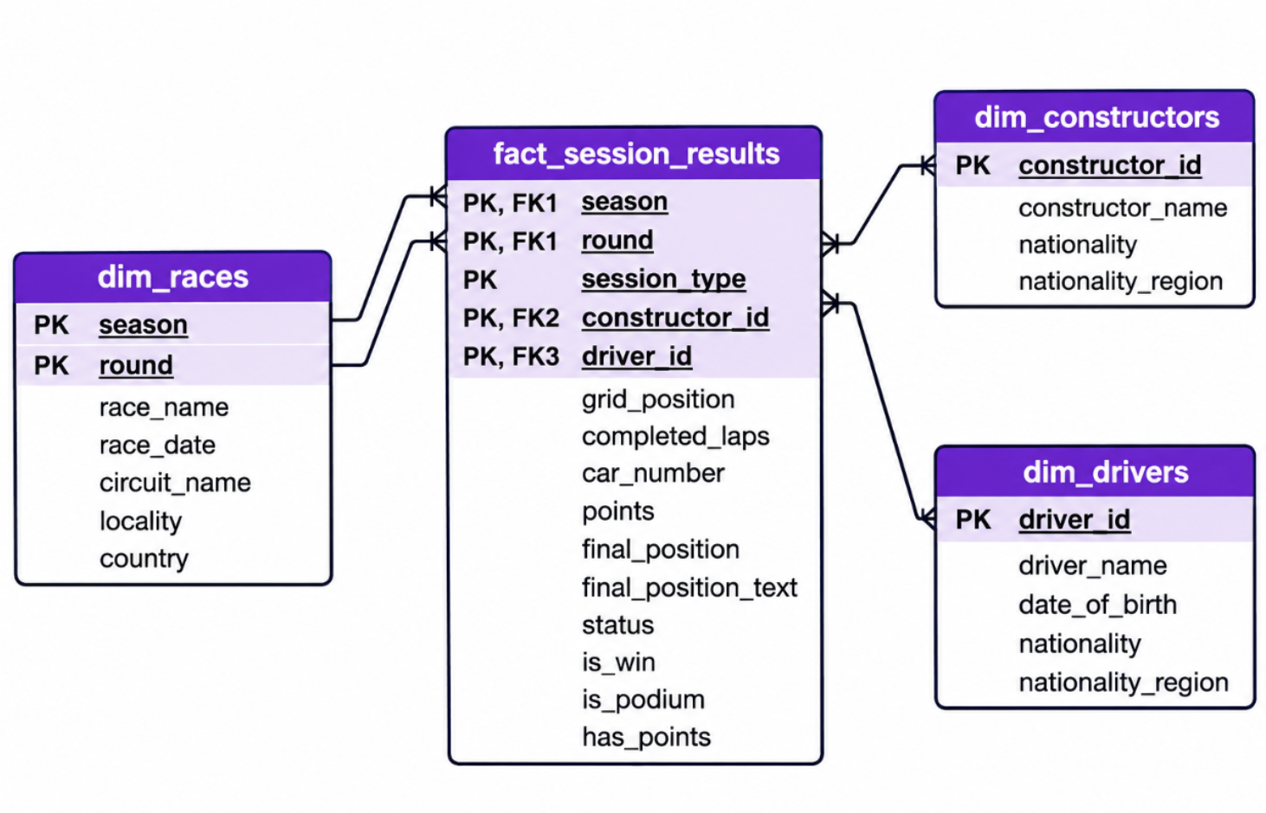
F1 in numbers
Data engineering
05 / 19
The Spark medallion pipeline and its gold star schema
The incremental batch pipeline in PySpark notebooks: ingest each landing file to bronze, conform it in silver, model it as a star schema in gold.
Gold also holds sprint sessions (session_type) and feeds the classic dashboard (RQ1-RQ6) and the ML prototype; the curated FAIR package covers Grands Prix only.
Presenting Chirag Adhikari
Data Management, Winter 2026/27, SRH University
Notes:
Next to the curated pipeline, the repository also contains the Spark implementation of the medallion idea. Every landing file is ingested into bronze, transformed in silver and modelled in gold as a star schema: one fact table of session results with race, constructor and driver dimensions. It runs in incremental batches and feeds the classic dashboard and the machine-learning prototype. Note that gold also holds sprint sessions, while the curated FAIR package covers Grands Prix only.

Slide 6
F1 in numbers
Sector 1: FAIR
06 / 19
Same archive, two homes: 42.3% on GitHub, 84.6% on Zenodo
F-UJI 4.0.1 with metrics v0.8 (as on f-uji.net) on the four locations of the data; the Zenodo record has a DOI.
Group Zenodo record
DOI, published 16 Oct 2026
84.6%
54% → 93%
F 86 A 86 I 67 R 100
RDA maturity over 41 indicators: as obtained → our package
Kaggle mirror
public copy of Ergast
84.6%
F 57 A 100 I 100 R 83
6/20 → 12/20
Group GitHub repository
raw zip, no identifier
42.3%
essential indicators met
F 43 A 43 I 33 R 50
Findable stays at RDA level 0 until the curated package has its own DOI; the raw archive already has one.
Jolpica API
where the data was downloaded
11.5%
F 14 A 29 I 0 R 0
F-UJI checks machine-readable signals only: it scores a licence as present, not as compatible. The RDA model also weighs licences and provenance.
Presenting Chirag Adhikari
Data Management, Winter 2026/27, SRH University
Notes:
We measured FAIRness twice. First automatically with F-UJI, using the same metric version as the public service, on four locations of the data. The Jolpica API scores 11.5 percent and our GitHub repository 42.3. The same zip on Zenodo, deposited by our group with a DOI, scores 84.6 percent, the same total as the Kaggle mirror but far more findable. Because F-UJI only sees what is online, we also scored all 41 RDA indicators with written evidence: our package lifts maturity from 54 to 93 percent.

Slide 7
F1 in numbers
Sector 1: FAIR
07 / 19
Eliminating licensing ambiguity and metadata gaps
Five places publish the same results under four different terms. The data must stay CC BY-NC-SA 4.0.
Ergast (original source)
non-commercial use only
Origin
Persistent identifiers
Jolpica-F1 (our download)
CC BY-NC-SA 4.0
Binding
10.5281/zenodo.23416916
DOI of the raw archive, byte-identical to our source (MD5 checked), cited as IsDerivedFrom
Kaggle mirror
claims CC0, public domain
Conflict
98.7%
drivers linked to Wikidata (constructors 98.1%, circuits 100%)
Group GitHub repository
MIT licence for everything
Conflict
4.5
DataCite record validated against the official XSD
Group Zenodo record
CC BY 4.0
Correct it
Resolution data CC BY-NC-SA 4.0 with attribution; code MIT
Zenodo licence to be corrected to CC BY-NC-SA 4.0: a metadata edit, the DOI does not change
Next
own DOI for the curated package, ORCID iDs, ROR
Presenting Chirag Adhikari
Data Management, Winter 2026/27, SRH University
Notes:
Licences were the biggest gap. Ergast allowed only non-commercial use and Jolpica, where we downloaded the data, licenses it CC BY-NC-SA 4.0. Yet the Kaggle mirror claims public domain, our own repository says MIT for everything, and our Zenodo record says CC BY 4.0. Share-alike means the data must stay CC BY-NC-SA, so that is what our package declares, with MIT for code only, and the Zenodo licence will be corrected without changing the DOI. On identifiers: the raw archive has a DOI, 98.7 percent of drivers are linked to Wikidata, and the DataCite record validates against the official schema.

Slide 8
F1 in numbers
Sector 2: Quality
08 / 19
Uncovering disguised nulls behind surface completeness
The results table looks 99.9% complete. It is not: most of its gaps wear the costume of data.
Explicit nulls
18
Disguised missing values
9,913
9,646
'positions' that are really retirements, withdrawals or disqualifications
267
cars on a fictitious 'grid slot 0'
18th
is how a model would read a car that retired
Presenting Manohar Zalki
Data Management, Winter 2026/27, SRH University
Notes:
I profiled every column of all five tables and ran 29 quality rules. The first lesson: completeness is deceptive. Only 18 cells are empty, so the table looks almost perfect. But 9,913 values only pretend to be data: the position column is filled for 9,646 drivers who did not finish, and 267 cars start from a grid slot zero that does not exist. A model would learn that a retirement is eighteenth.

Slide 9
F1 in numbers
Sector 2: Quality
09 / 19
A naive duplicate check deletes real history
Rows sharing season, round and driver: true duplicates in red, legitimate shared drives in blue.
34
true duplicates, all from 1960
11
of them hidden behind blanked keys
172
valid rows: one driver, two cars in one race
Correct key season, round, driver and car number
Presenting Manohar Zalki
Data Management, Winter 2026/27, SRH University
Notes:
Uniqueness needs domain knowledge. 23 rows of the 1960 United States Grand Prix were appended twice, and 11 rows of the 1960 Italian Grand Prix are copies whose season and round were blanked. The red bar is the real problem. The blue bars are not: 172 rows share season, round and driver because in the 1950s a driver could take over a team-mate's car and be classified twice. The correct key includes the car number.

Slide 10
F1 in numbers
Sector 2: Quality
10 / 19
Valid history can look like bad data
Points for winning a race, season by season: the same achievement, a different currency in every era.
8–50
2014 Abu Dhabi: double points, 50
points for the same race win
270
lap 'outliers', all valid Indianapolis 500 results: flag them, never delete
Impact on data science and AI
Inflated win counts
from duplicated rows
Biased targets
a retirement read as 18th
Era bias
raw points favour recent decades
Presenting Manohar Zalki
Data Management, Winter 2026/27, SRH University
Notes:
Some issues are not errors at all, but they still break analyses. A race win was worth 8, 9, 10, 25 or even 50 points depending on the era, so raw points are not comparable over time. All 270 statistical outliers in laps are valid Indianapolis 500 results, so we flag them instead of deleting them. For data science the impact is concrete: inflated win counts, biased prediction targets and era bias in all-time rankings.

Slide 11
F1 in numbers
Sector 3: Cleaning
11 / 19
Order matters: repair keys, then de-duplicate
The same two steps in the opposite order leave a third of the duplicates in the data.
Naive order
Our order: steps C02 → C03
1 Remove exact duplicates
2 Repair missing keys
1 Restore season (5) and round (7) by exact lookup
2 Remove exact duplicates
11
34
duplicates survive, hidden by the blanked keys
duplicates removed, none left; a unit test locks it in
No invented values
Grid 0 becomes missing plus a flag (267 rows); no statistical imputation anywhere.
Keys come only from deterministic lookups: the file name and races.csv.
Presenting Nicolas Bonilla
Data Management, Winter 2026/27, SRH University
Notes:
The most important design decision was the order of operations. If you remove duplicates first and repair keys afterwards, 11 duplicates survive, because their season and round were blanked. So step C02 restores the season from the file name and the round by an exact lookup in the races table, and only then does step C03 remove all 34 copies. A unit test documents both orders, and no value is ever invented.

Slide 12
F1 in numbers
Sector 3: Cleaning
12 / 19
Every issue closed, every output validated
How the 29 quality issues were resolved, per dimension. Flag, don't delete.
55/55
validation gates passed; one failure blocks publishing
18 of 29
issues fixed; the rest flagged, kept or verified
25,873
clean rows, 35 documented columns
Presenting Nicolas Bonilla
Data Management, Winter 2026/27, SRH University
Notes:
Every one of the 29 issues is now closed: 18 are fixed, 3 are mitigated or flagged, 5 are kept and documented, and 3 were verified as non-errors. Our rule is flag, don't delete: Indianapolis 500 rows and shared drives stay, with flags. Status went from 136 free-text values to 8 groups, and 55 validation gates must all pass before anything is published as clean.

Slide 13
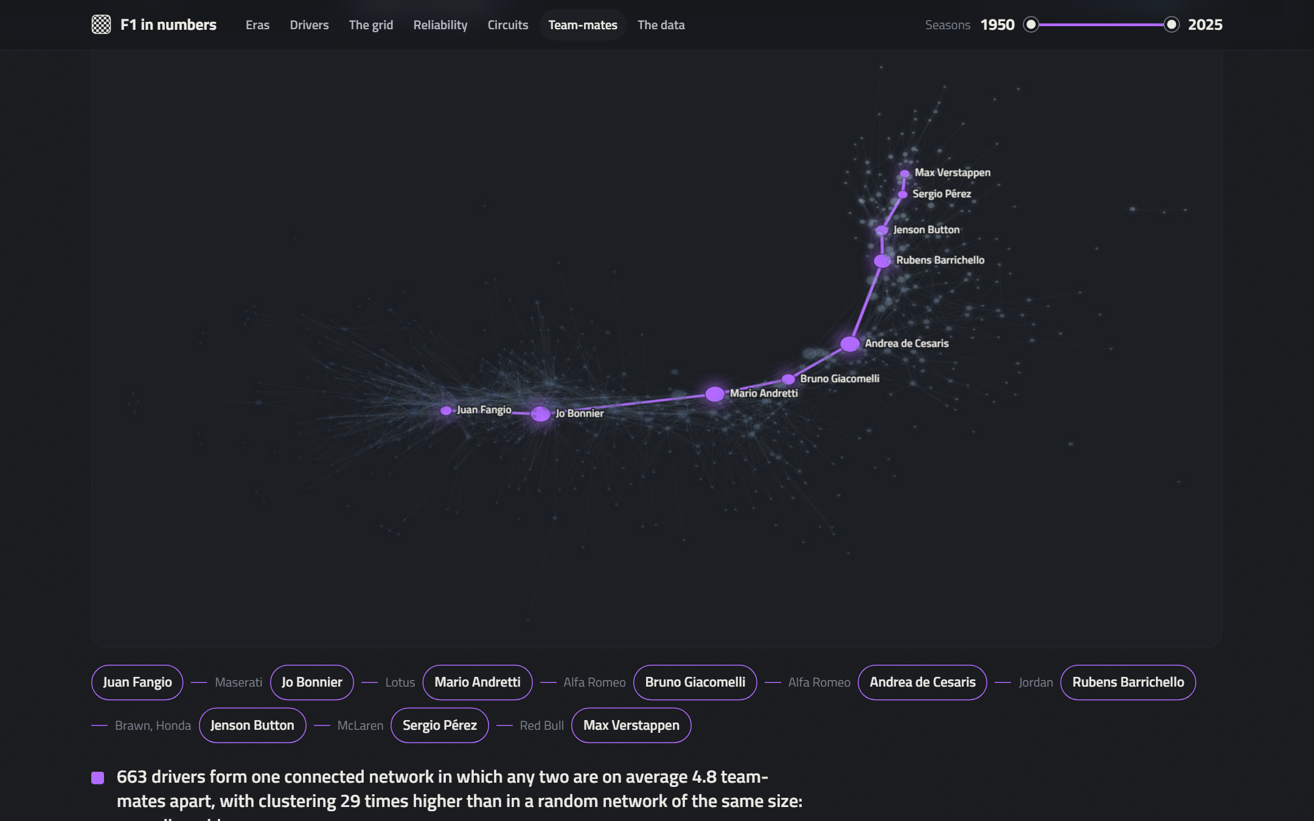
F1 in numbers
The graph
13 / 19
75 years of F1 form a small world
A NetworkX property graph of 2,297 nodes and 30,141 typed edges; drivers linked when they shared a team in a Grand Prix.
0.41
clustering, against 0.014 in a random graph
4.8
team-mate links between two drivers on average
Fangio to Verstappen in 8 steps
Fangio → Bonnier → Andretti → Giacomelli → de Cesaris → Barrichello → Button → Pérez → Verstappen
Presenting Manohar Zalki
Data Management, Winter 2026/27, SRH University
Notes:
We modelled the cleaned data as a property graph: drivers, races, constructors, circuits and countries, with results on the edges and a derived team-mate relationship. Indianapolis 500 rounds are excluded from the team-mate projection, a direct consequence of the quality analysis. The result is a small world: clustering is 0.41 against 0.014 for a random graph, yet two drivers are on average only 4.8 links apart. Fangio reaches Verstappen in 8 steps.

Slide 14
F1 in numbers
The graph
14 / 19
Communities rediscover the eras by themselves
Louvain communities of the team-mate network: the algorithm never sees a date, yet each community is an era.
11
Louvain communities, modularity 0.70
0.15
highest betweenness; bridges between eras: Bonnier, Brabham, de Cesaris
Caveat
Before the 1970s 'constructor' was the chassis make shared by private entrants, which inflates early degrees.
Presenting Chirag Adhikari
Data Management, Winter 2026/27, SRH University
Notes:
Louvain community detection finds 11 communities with a modularity of 0.70. The algorithm never sees a date, yet the large communities line up with eras, from the fifties around Stirling Moss to the present grid around Sergio Pérez. Betweenness highlights bridges between eras such as Jo Bonnier. One caveat links back to data quality: before the seventies the constructor field records the chassis make shared by private entrants, so early drivers look more connected than they were.

Slide 15
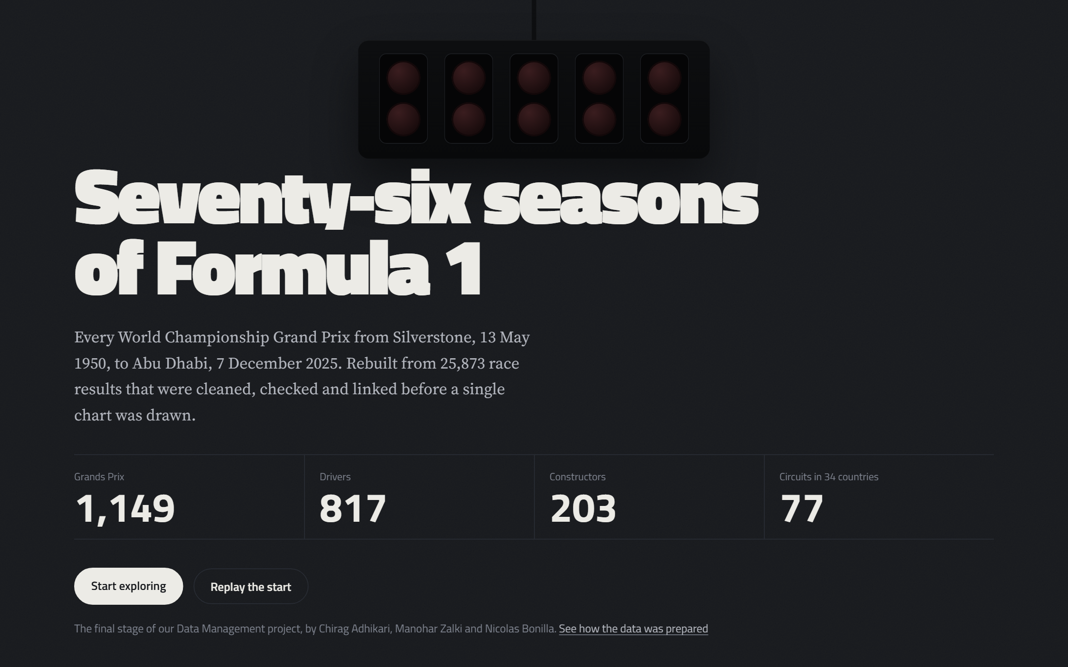
F1 in numbers
Served zone
15 / 19
The project, live: our interactive dashboard
Seven views and an assistant, built only from validated outputs and rebuilt by run_all.py.
Validated data only
build_web_data.py reads the clean tables, graph metrics, issue register and FAIR scores
A quality instrument
its reliability view revealed issue B29: retirement causes not recorded from 2023
Live demo
streamlit run app.py
then localhost:8501
Presenting Nicolas Bonilla
Data Management, Winter 2026/27, SRH University
Notes:
Everything we showed ends here, in an interactive dashboard that opens with one command. It reads only validated outputs, and run_all rebuilds it as its last step. It also paid back: the reliability view showed mechanical failures vanishing after 2022, which turned out to be the source no longer recording why cars retired. That became issue B29. If time allows, we open it live.

Slide 16
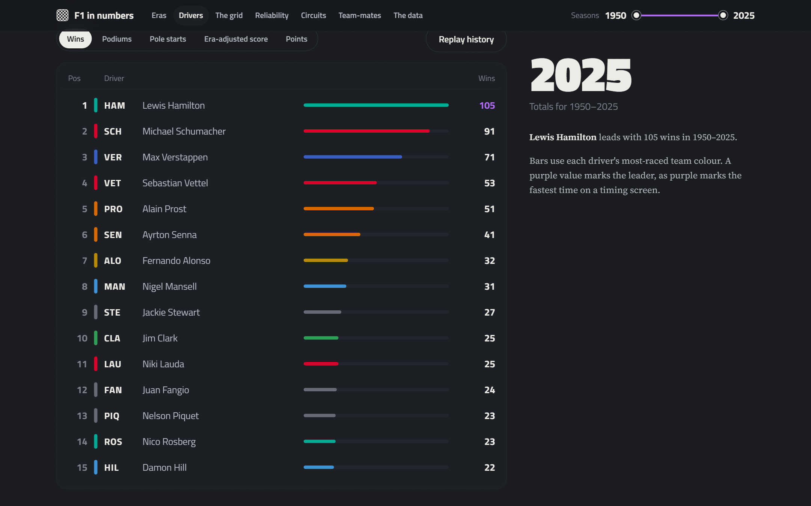
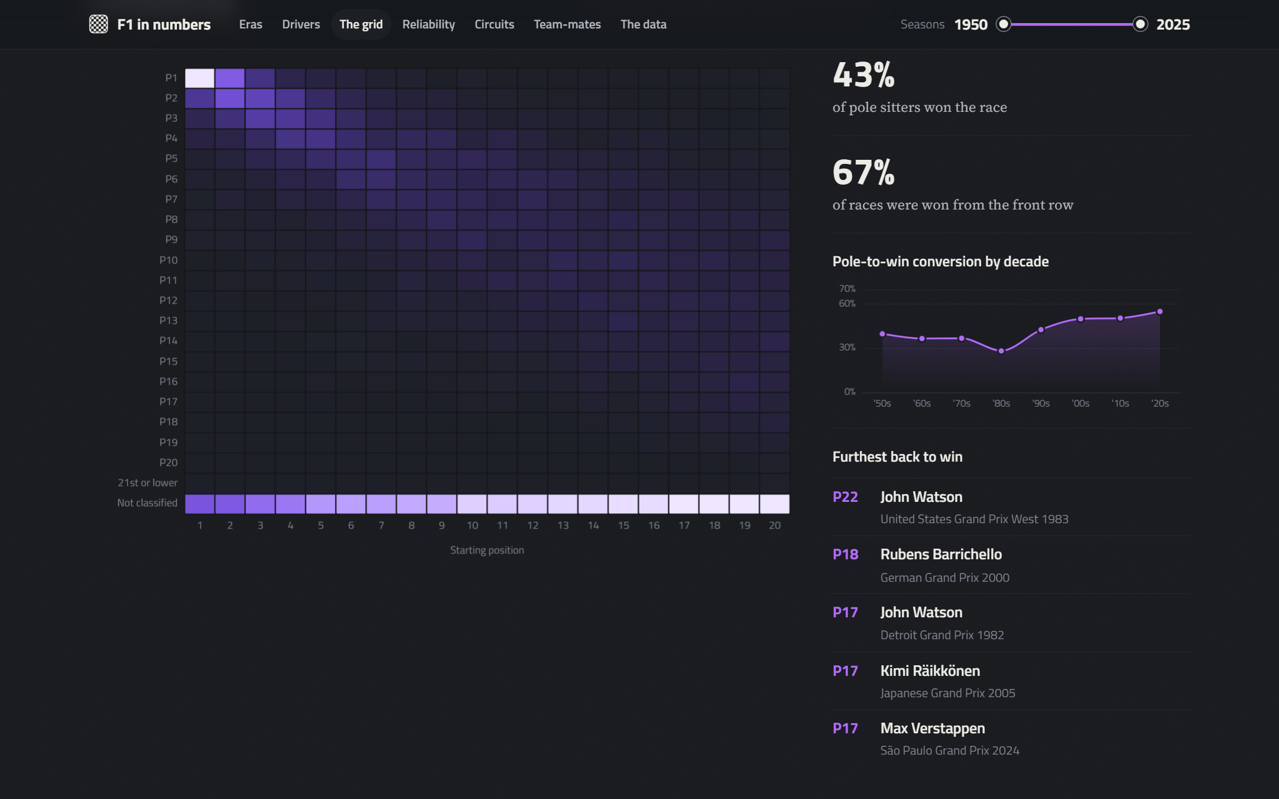
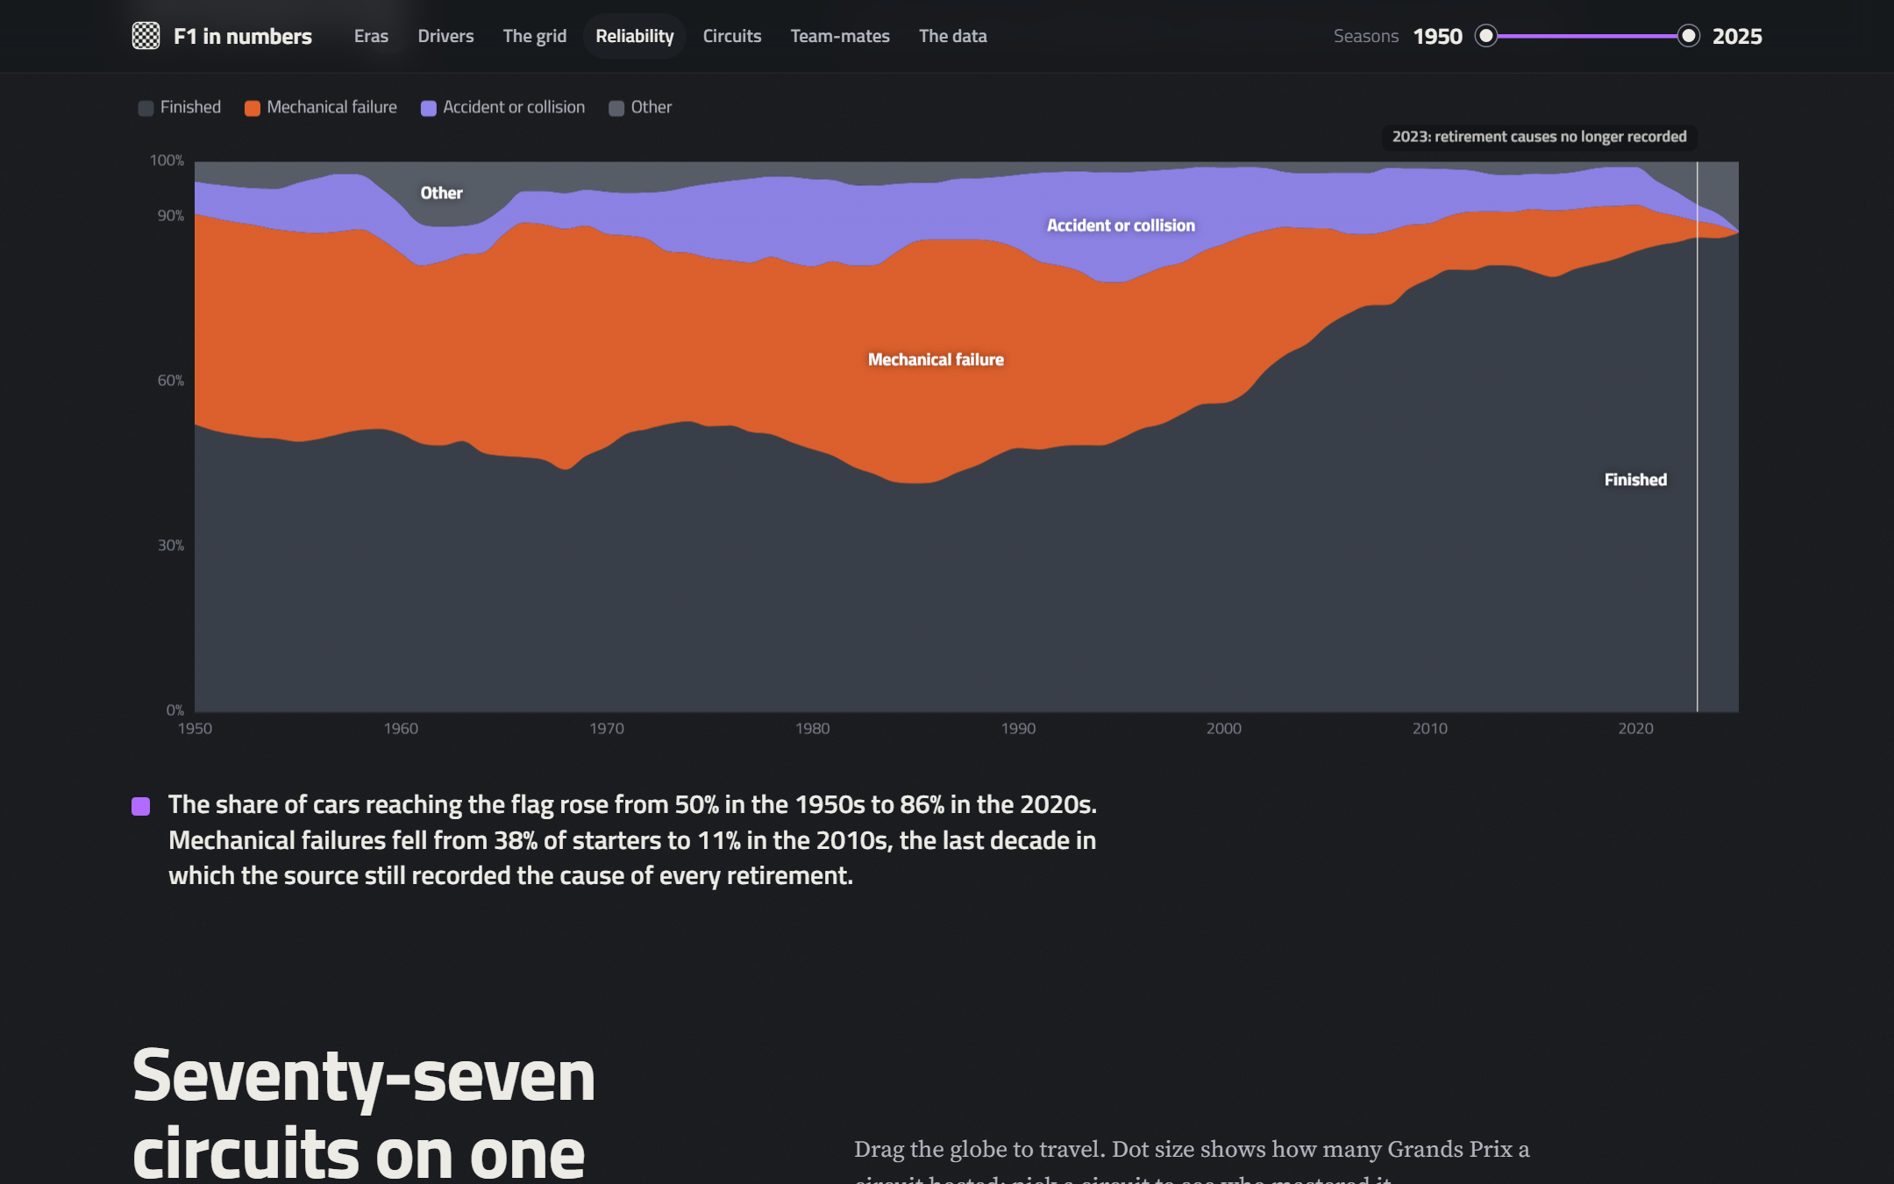
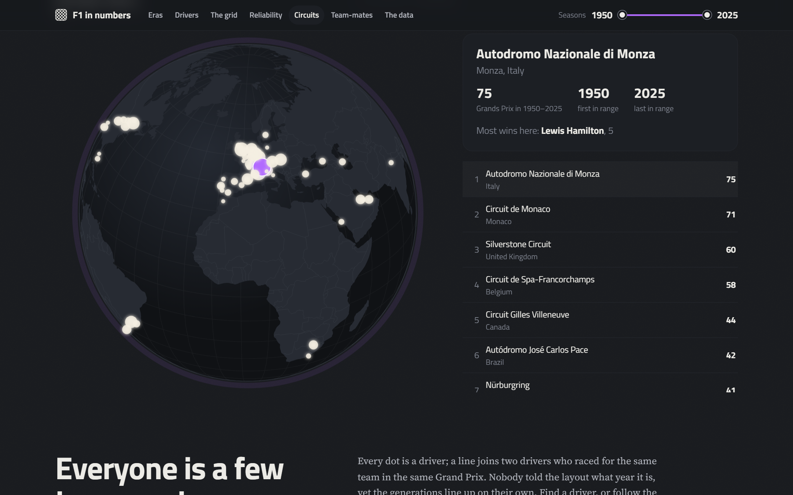
F1 in numbers
Served zone
16 / 19
Inside the dashboard: every chart reads validated data
Timing tower: wins, podiums, era-adjusted score
Grid to finish, pole conversion, furthest-back wins
Reliability, with the 2023 break (B29) marked
77 circuits on a rotating globe
Presenting Manohar Zalki
Data Management, Winter 2026/27, SRH University
Notes:
Four more views. The timing tower ranks drivers by wins or by our era-adjusted score. The grid view shows where cars finish from each starting slot, using classified positions only, which is exactly the fix for issue B11. The reliability view marks the 2023 break that became issue B29, and the globe places all seventy-seven circuits.

Slide 17
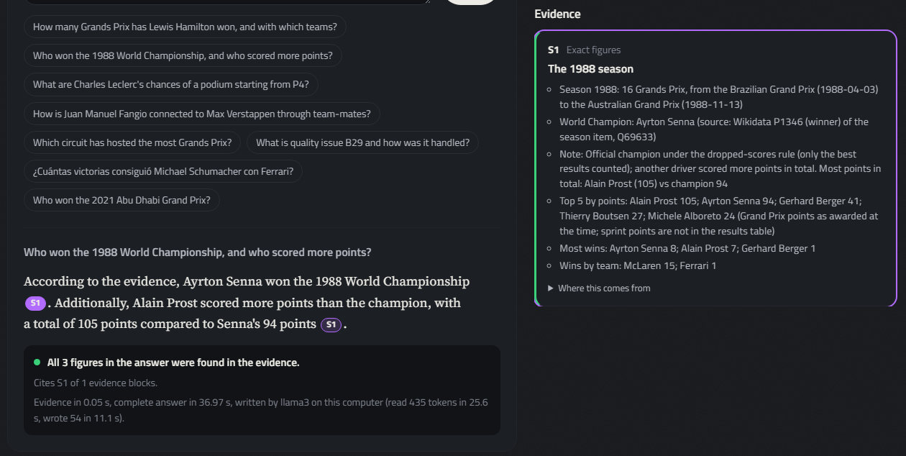
F1 in numbers
Served zone
17 / 19
Ask the data: an LLM that cannot invent numbers
A local Llama 3 phrases the answer; the figures come from code over the validated data and are checked afterwards.
25/25
benchmark answers correct, written by the model
49/49
figures in the answers traced to the evidence
26 s
median per answer on a laptop CPU, no GPU
Understand
names, seasons, intent
Evidence
pandas, graph, model, documents
Write
Llama 3, cites [S1]
Check
every figure traced
Podium model, tested on 2020-2025
log loss 0.219 vs 0.254 for the grid alone, but no better podium picks: we say so
Idea and prototype: Manohar Zalki (Graphic-LlmRag)
Presenting Manohar Zalki
Data Management, Winter 2026/27, SRH University
Notes:
The last view lets anyone question the data, in English or Spanish. It grows out of the LLM and RAG prototype from our group, rebuilt so that the language model never supplies a number. The question is parsed, the evidence is computed with pandas from the cleaned tables, with the file and raw line of every figure, plus the team-mate graph and a podium model. Llama 3 runs locally and only phrases that evidence, and every figure is checked afterwards. On 25 benchmark questions with independently computed answers, 25 were right, and it declined the question about 2030.

Slide 18
F1 in numbers
Finish
18 / 19
What we learned
1
Quality is contextual
Outliers, duplicates and short grids were often valid history.
2
Order of operations matters
11 duplicates hid behind blanked keys.
3
FAIR gaps sit around the values
Identifiers, licences and provenance, not the numbers.
4
Automate the evidence
Audit log, 55 gates, 28 tests, metadata from code.
5
A language model needs a data layer
Code computes every figure; the model only phrases it, and a check follows.
Presenting Nicolas Bonilla
Data Management, Winter 2026/27, SRH University
Notes:
Five lessons. Quality is contextual: outliers, duplicates and short grids were often valid history. The order of operations matters, as the 11 hidden duplicates show. The largest FAIR gaps sit around the values: identifiers, licences and provenance. Automating the evidence turns cleaning into something an examiner can verify. And a language model needs a data layer: code computes, the model only phrases. Next steps are a DOI for the curated package and reporting the source defects upstream.

Slide 19
F1 in numbers
Finish
19 / 19
Questions?
Lights out. Code, data, metadata, report and dashboard:
github.com/zalkimanohar/Formula1-Racing-Analytics
Chirag Adhikari
Manohar Zalki
Nicolas Bonilla
Data Management, Winter 2026/27, SRH University
Notes:
Thank you. We are happy to take your questions; each of us will answer on our own component.

