Slide 1

Curved, Warped, and Lumpy: Some Initial Results from the American Social Fabric Project
Carter T. Butts
Departments of Sociology, Statistics, and EECS, and
Institute for Mathematical Behavioral Sciences
University of California, Irvine
University of Chicago, 10/21/13
This research was supported in part by NSF awards BCS-0827027 and OIA-1028394, and by ONR award N00014-08-1-1015.

Slide 2









ASFP Team
Carter T. Butts
Professor, Sociology,
Statistics, EECS, and Institute for
Mathematical Behavioral Sciences
School of Social Sciences
University of California, Irvine
buttsc@uci.edu
John R. Hipp
Associate Professor, Criminology,
Law, and Society
School of Social Ecology
University of California, Irvine
hippj@uci.edu
John R. Hipp
Associate Professor, Criminology,
Law, and Society
School of Social Ecology
University of California, Irvine
hippj@uci.edu
Nicholas N. Nagle
Assistant Professor, Geography
University of Tennessee
nnagle@utk.edu
Zack W. Almquist
Assistant Professor, UMN
zalmquist@gmail.com
Christopher Marcum
Staff Scientist, NIH
cannivaltinea@gmail.com
Adam Boessen
Graduate Researcher, UCI
aboessen@uci.edu
Ryan M. Acton
Assistant Professor,
UMass-Amherst
Emma Smith
Graduate Researcher, UCI
emilyjs@uci.edu
Notes:
SMILE!

Slide 3
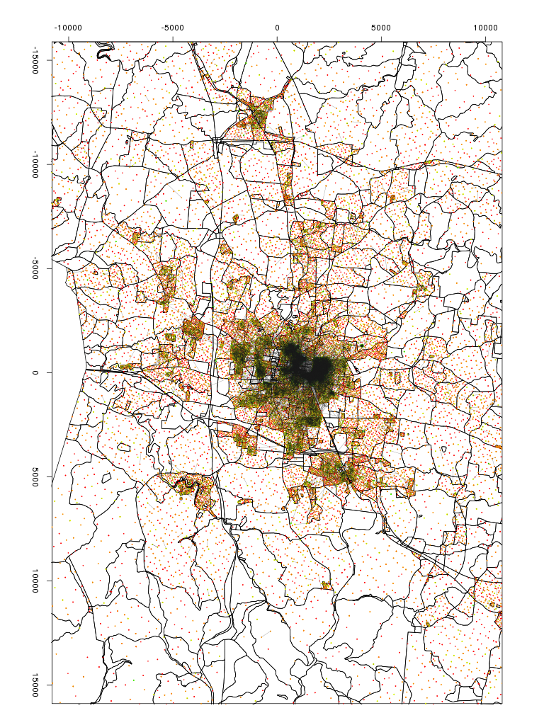
Road Map
Introduction
A “first-order” look at spatial network structure
Measuring network “distortions” in the western US
Conclusions and such

Slide 4
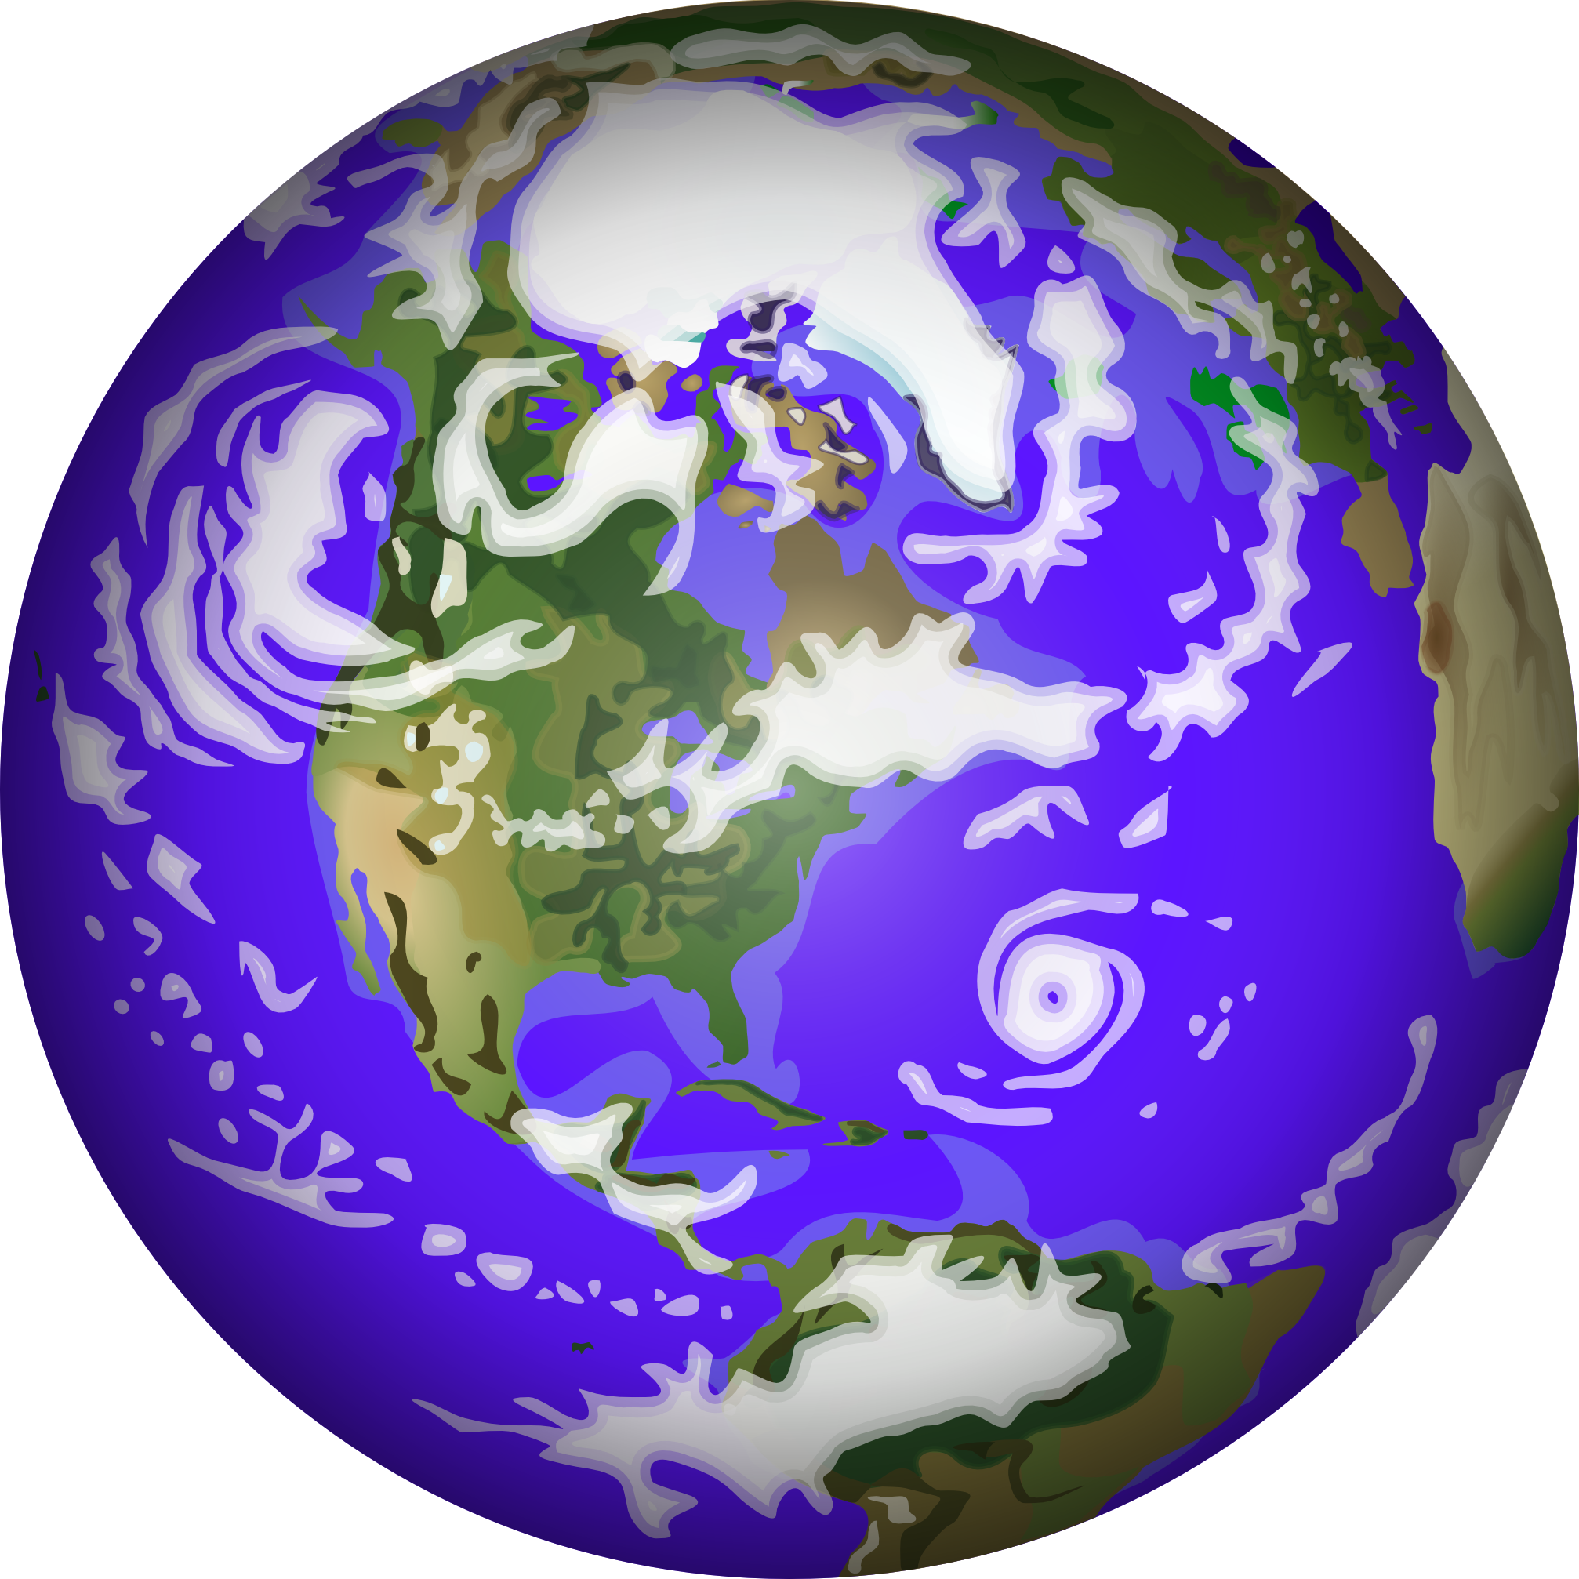
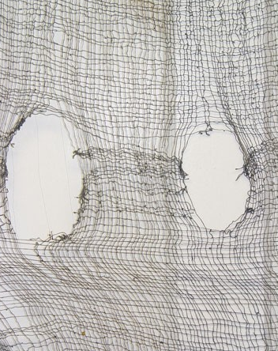
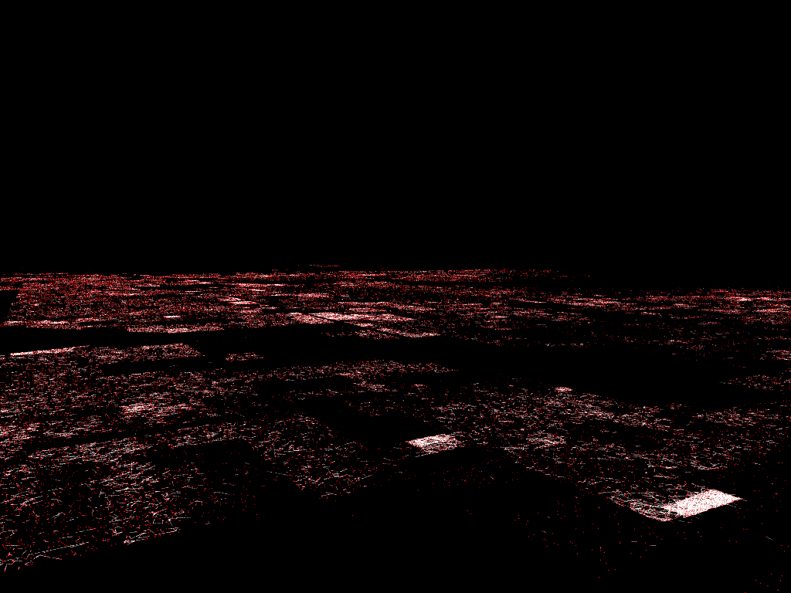
"Social Fabric" - Structure Across Space
Little known fact: social systems exist in a physical world (!)
  Even computer-mediated interactions have physical elements
Accounting for spatial influences on interaction
  Studies by Festinger, Hägarstrand, Latané, Zipf, Stewart, Freeman, Wellman, and many others suggest powerful effects of distance on interaction
  Powerful predictor – or confounder
Measuring spatial macrostructure
  New (“fabric-like”) properties emerge at the macro level which demand to be treated directly

Slide 5
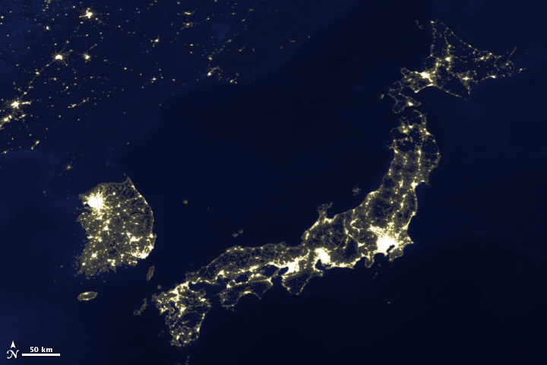
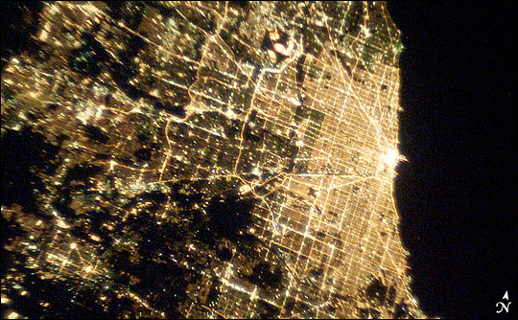
The American Social Fabric Project
NSF-funded effort to examine the spatial structure of large-scale interpersonal networks
Egocentric network survey
  Spatially stratified (apx uniform) samples from SoCal, western US
  Random sample of LA residents
  Elicitation for 6 relational types; geographical information for ego/alter
  Fairly large (N=3370), good spatial coverage

Slide 6
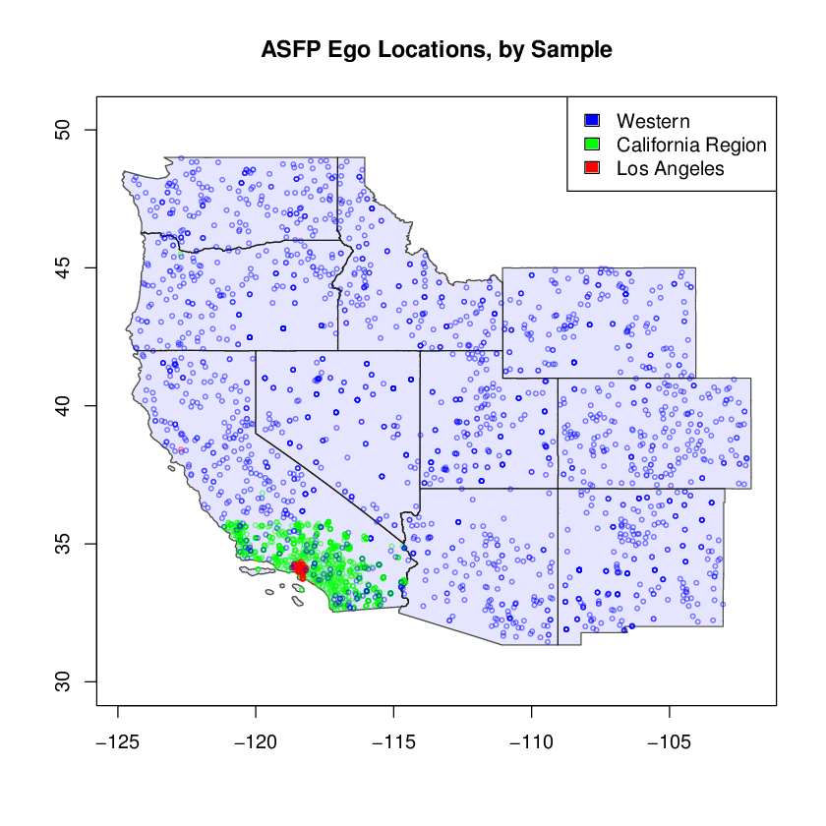

Slide 7
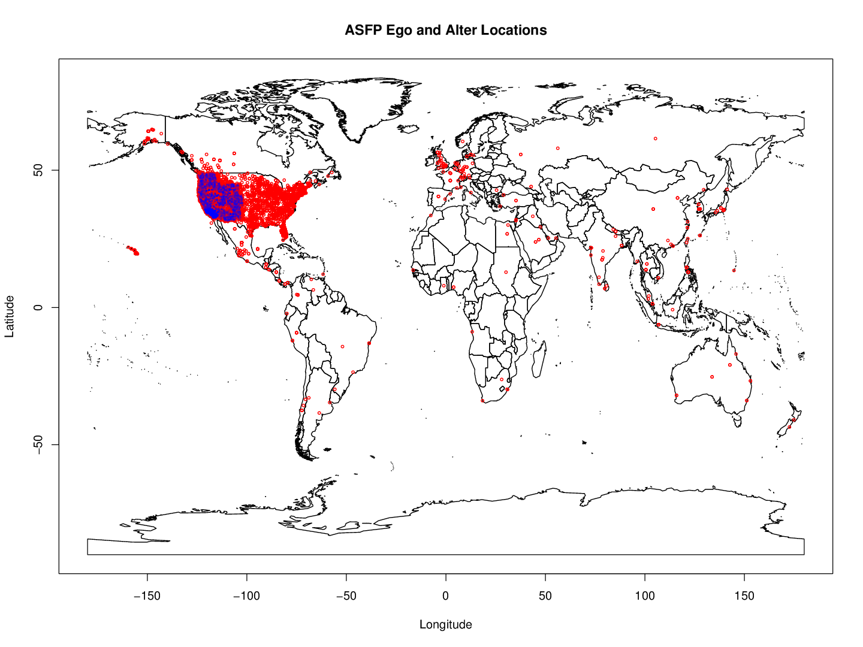

Slide 8
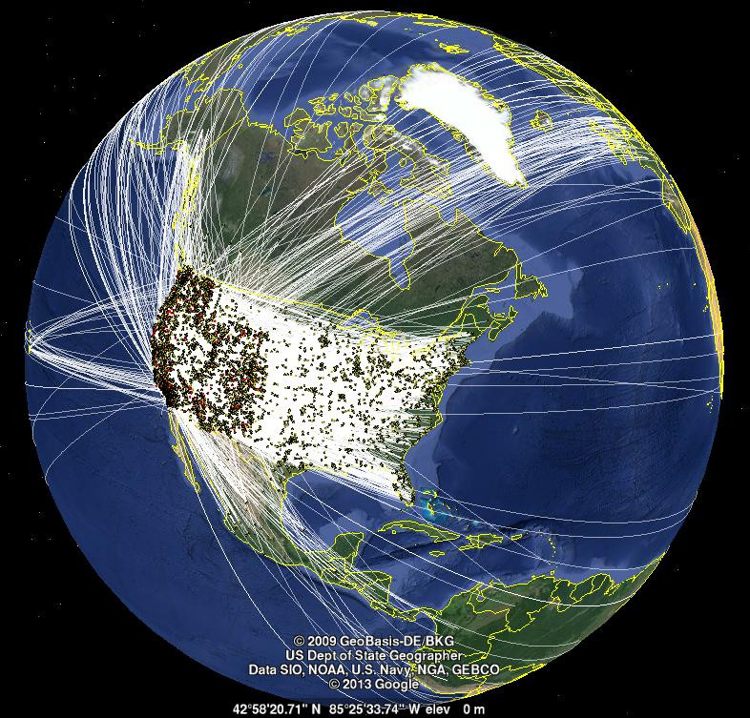
ASFP Egos and Alters
OGG

Slide 9
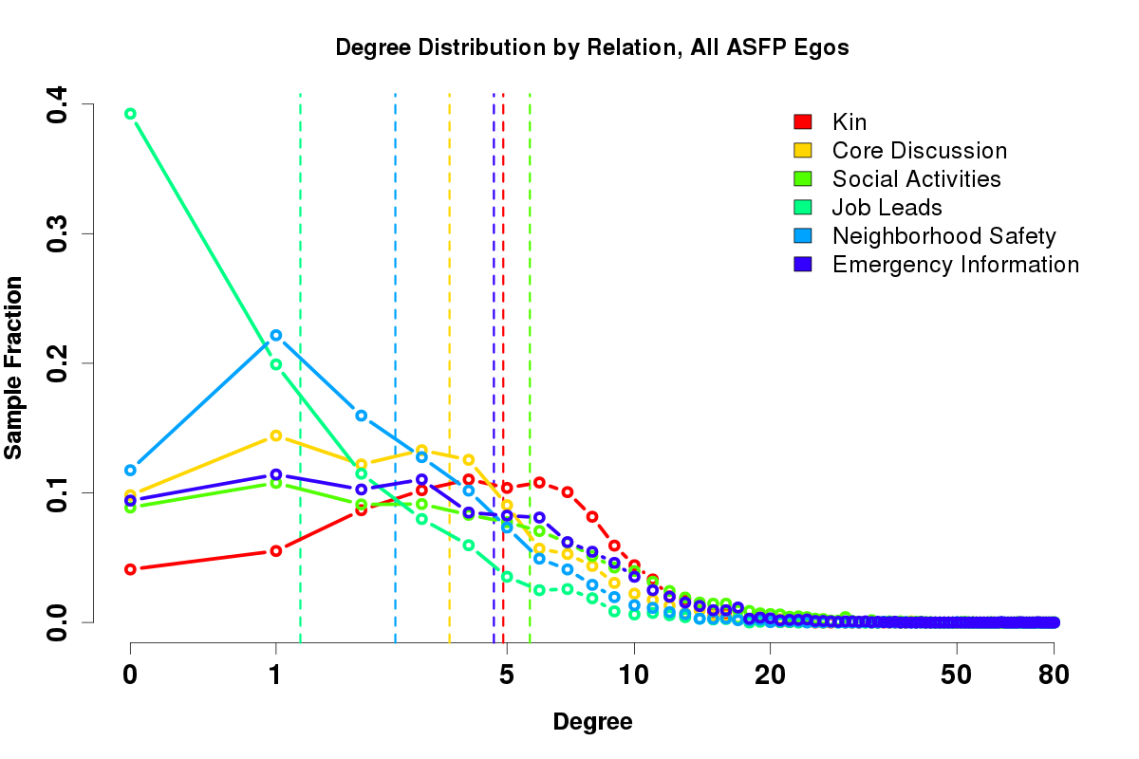
ASFP Degree Distribution

Slide 10
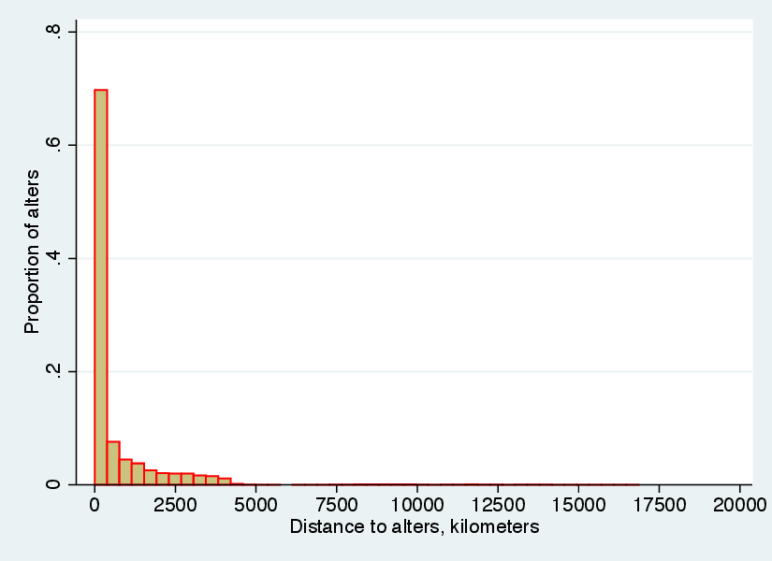
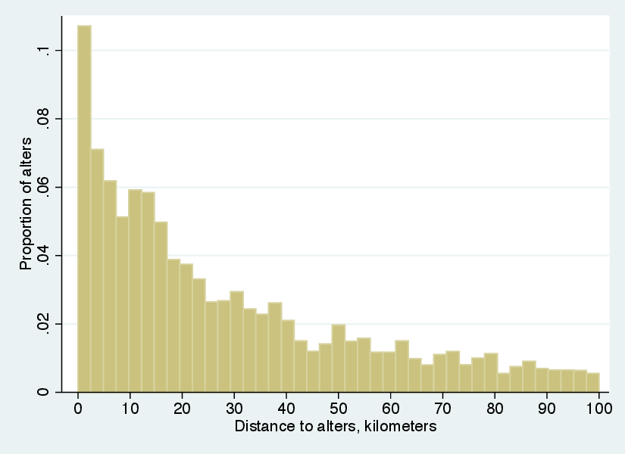
Ego/Alter Distances, all ASFP Relations
All Distances
Distances<100km

Slide 11
Road Map
Introduction
A “first-order” look at spatial network structure
Measuring network “distortions” in the western US
Conclusions and such

Slide 12
Spatial Structure in Networks - a “First Order” View
Many complexities: let's start simple
  Populations in space; each individual associated with a location
  For two randomly selected individuals at distance d, marginal tie probability given by some function F(d) (the spatial interaction function, or SIF)
    First-order approximation to network structure; summarizes expected degree of interaction through space
d
F(d)
SIF
d

Slide 13
A Simple First Question
If we choose a random individual, how many ties will he or she have between distance d and d+δ?
  Useful tool: Ripley's K function. K(d) is the expected number of points within distance d of a randomly chosen point.
    First derivative, K'(d) gives expected number of points at distance d (proportional to pair correlation function in point process literature)
  Expected number of ties given by
    Can interpret as product of baseline opportunities for interaction (Mayhew, 1984) with conditional probability of interaction; F(d) depends on relation, K'(d) on population
      Two “main ingredients” of structure
What should K' be like for a real population? Let's start with the most naive thing imaginable....

Slide 14


Slide 15

Interaction Opportunity in a Flat World
Ego
K'(d)
d
d

Slide 16
Interaction Opportunity in a Flat World
Ego
K'(d)
d
d
Interaction opportunities grow without bound, forever!

Slide 17

(NASA VIRS Image)

Slide 18
(Not flat.)
(NASA VIRS Image)

Slide 19
Interaction Opportunity in a Round World
Ego
d
K'(d)
d
R
0
d
πR

Slide 20
Interaction Opportunity in a Round World
Ego
At short range, a round world looks like a flat one - but at global scales, curvature matters!
d
K'(d)
d
R
0
d
πR

Slide 21
Curved

Slide 22
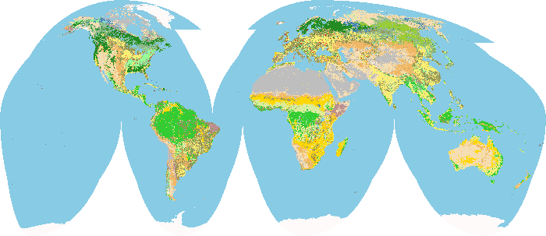
The World
USGS Landcover Institute - Global 1km Landcover Map

Slide 23
The World
Oceans
USGS Landcover Institute - Global 1km Landcover Map

Slide 24
The World
Deserts
USGS Landcover Institute - Global 1km Landcover Map

Slide 25
The World
Ice*
(*For Now)
USGS Landcover Institute - Global 1km Landcover Map

Slide 26

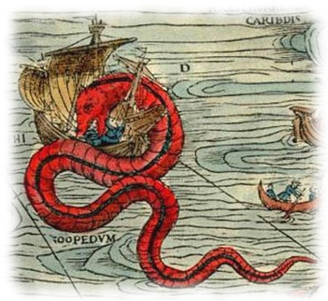
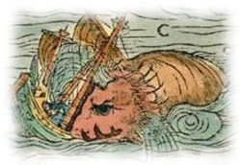

The World
USGS Landcover Institute - Global 1km Landcover Map

Slide 27
(*And Lumpy)
Curved*

Slide 28
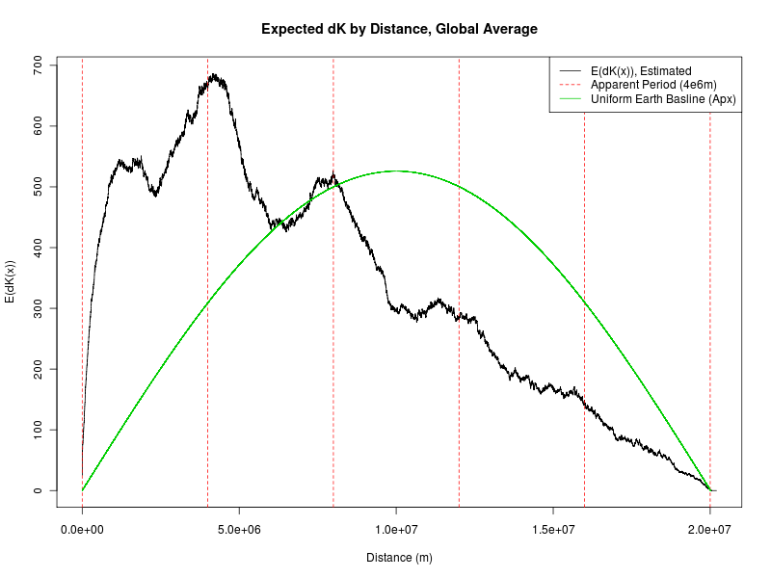

Slide 29
“Lumps”
Excess “local” mass

Slide 30
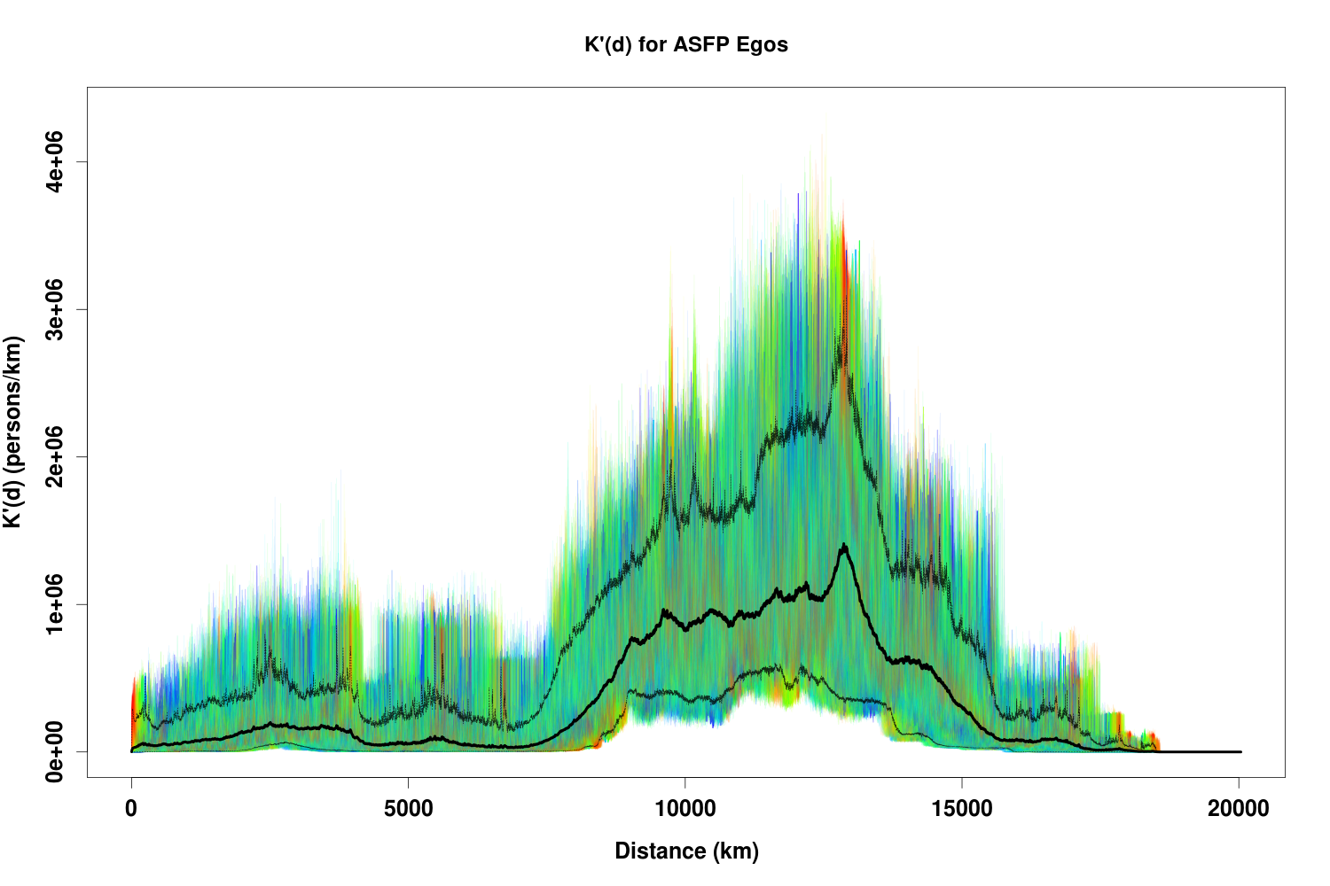

Slide 31
Large “hump” at apx 10,000-15,000km
Function for each ego very rough

Slide 32
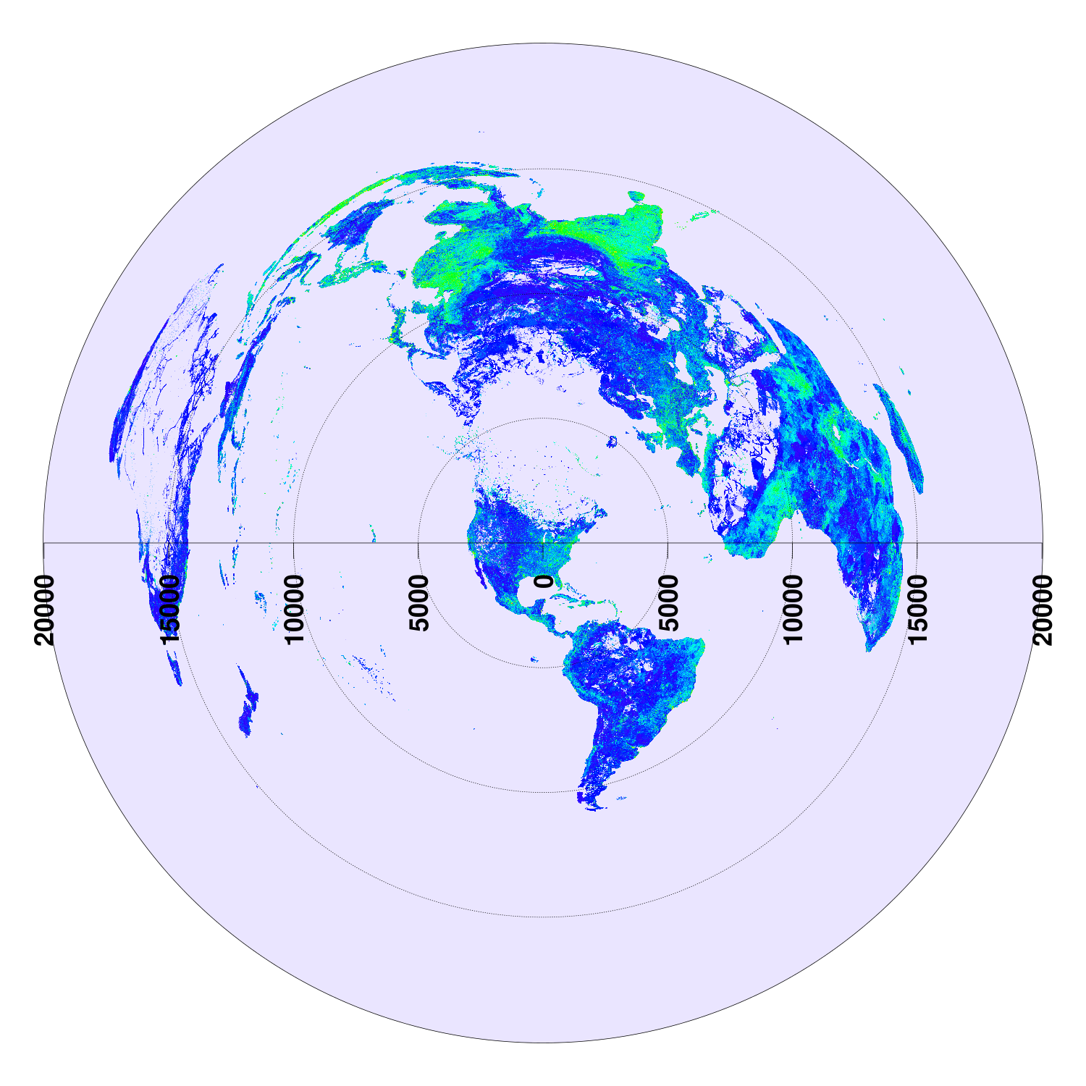

Slide 33
(Most People Are Here)
You Are Here

Slide 34
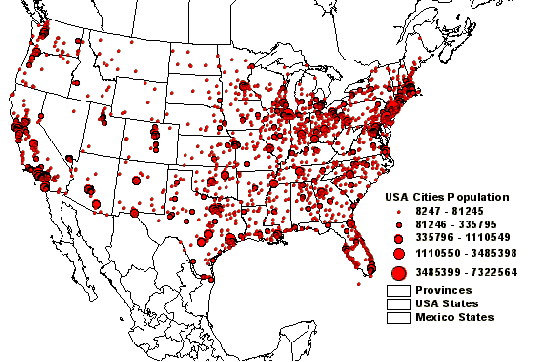
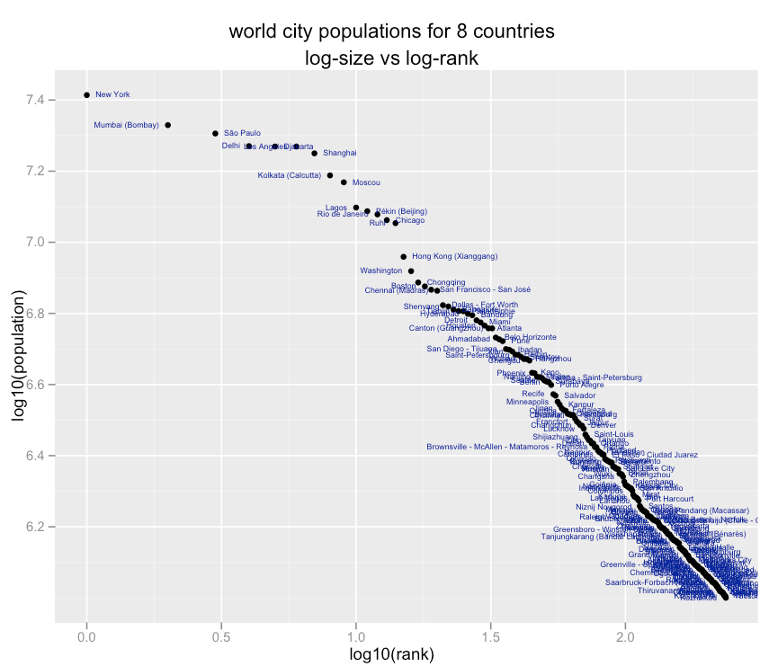
But Why So Rough?
The “humped” form of K'_{i} is easy to see, but why is it such a rough function?
Answer: population distribution is very, very “lumpy”
  Variation at multiple scales
  Variation by orders of magnitude; extremely heavy tails
High-density regions are sparse on the landscape - so a given circle hits few or none (little averaging out)
(Tortosa, 2002)
(O'Connor, 2009)

Slide 35
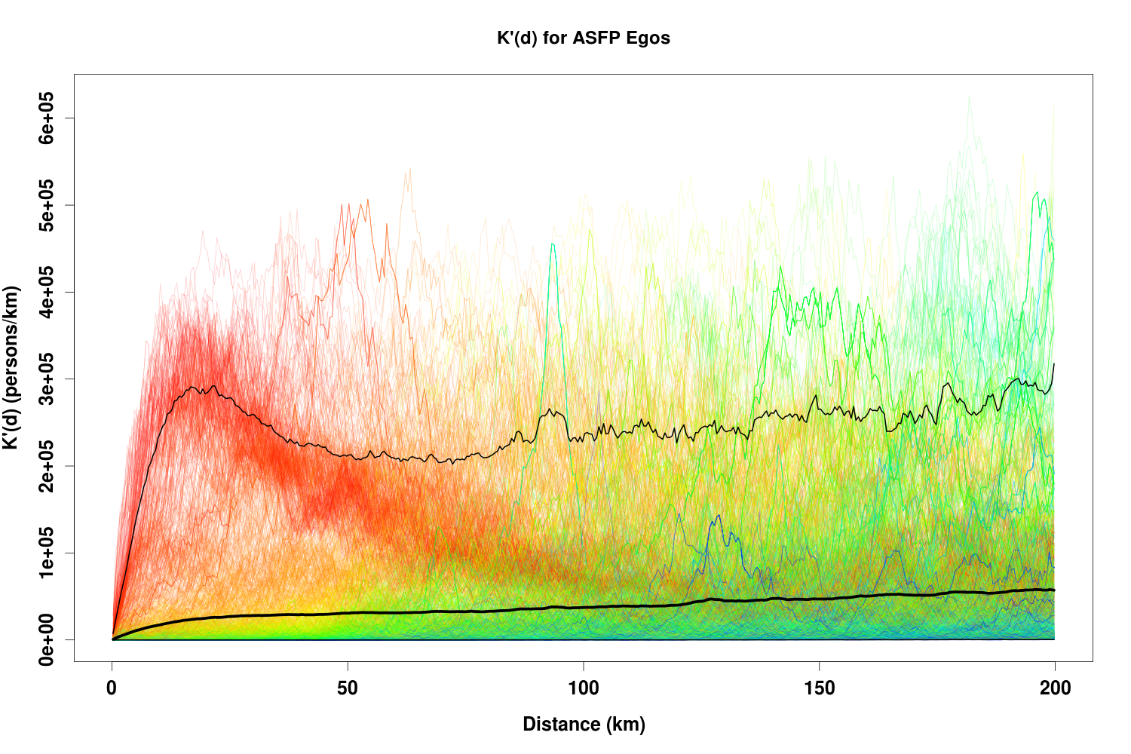

Slide 36
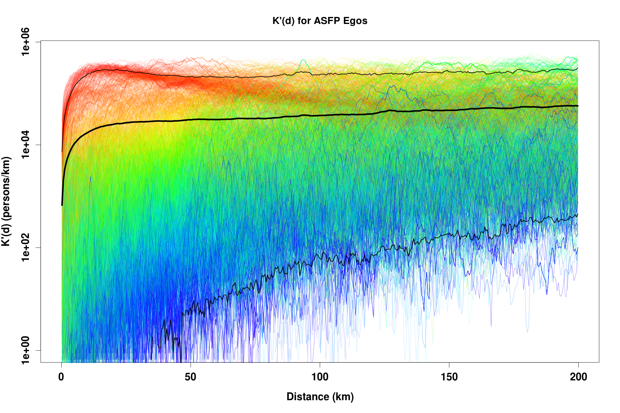

Slide 37
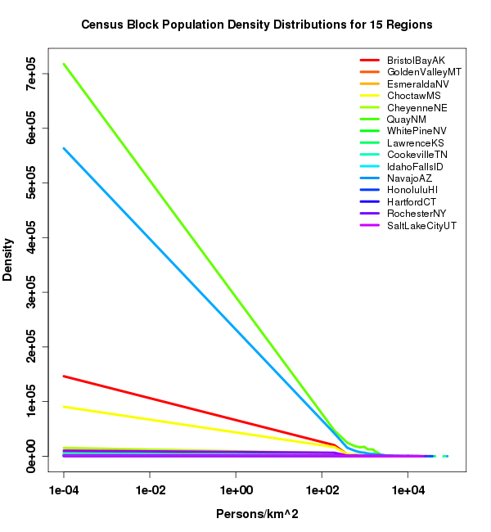
Why K' is Still Rough on Small Scales
Useful illustration: distribution of population densities within US census blocks
  Small, relatively compact areas
  Selected (to an extent) for social "function"
Distribution for area/density stratified sample of 15 micro/metropolitan areas (from Butts et al., 2012)
  Roughly,
    Shouldn't trust this form! But clearly very heavy-tailed
  Even within a community, population unevenly dispersed

Slide 38
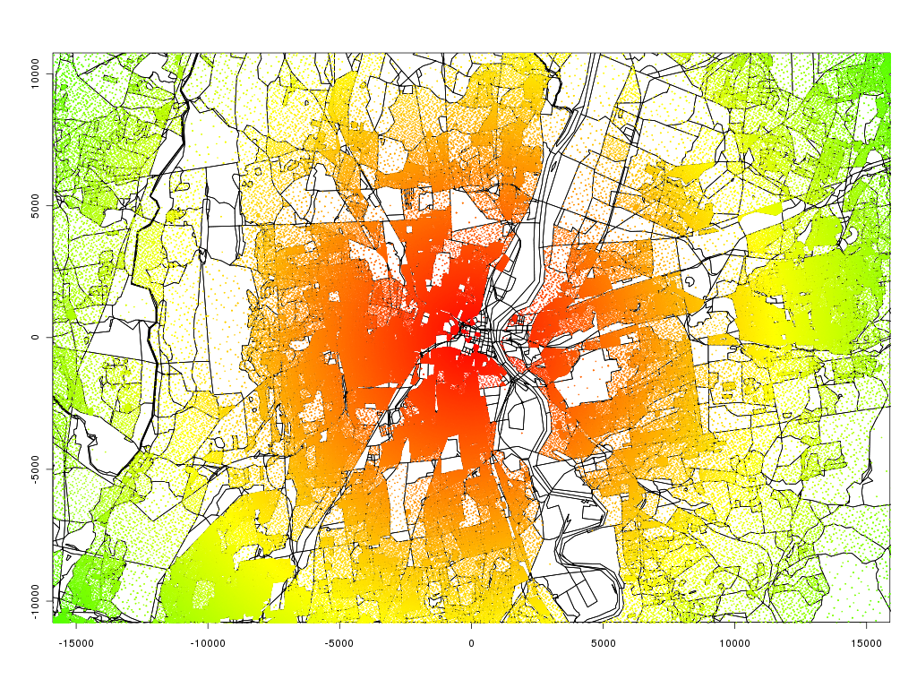
Sample Population Distribution (Hartford, CT)

Slide 39
From Opportunity to Realization
Few opportunities lead to ties, but some are more likely than others
Given K_{i}' and realized ties for each ego, can estimate marginal SIF
  Simple but flexible procedure: logarithmic binning of distances, with counts of realized/potential ties used to estimate mean SIF over interval (here, beta-binomial model w/Jeffreys prior)
  500m resolution used for K' calculation (Landscan ~1km raster data used, w/subpixel smoothing)
  31,080 geocoded ego/alter ties over 0-16,850km range
Six ASFP relations:
  Kin: Parents, children, siblings
  Core Discussion: alter with whom ego “discussed matters important” to him/her in past 6 months (Burt, 1984)
  Social Activities: alter ego “engages in social activities with,” e.g. meals, visiting, “going out” (Fischer, 1982)
  Job Leads: alter ego “would contact to obtain job leads or other information” re:employment
  Emergency Information: alter ego “would seek to immediately contact to pass on” warning information
  Neighborhood Safety: alter ego would contact to discuss “crime or other event” raising concern about safety of ego's neighborhood

Slide 40
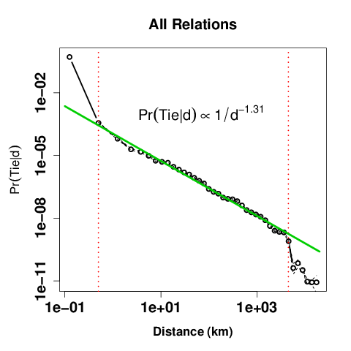
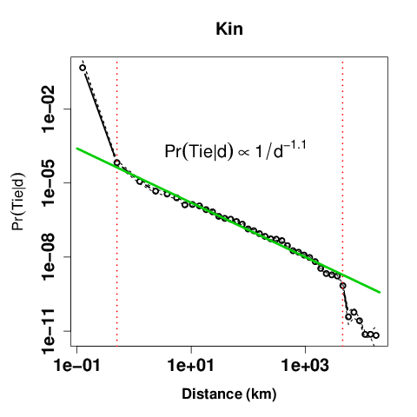
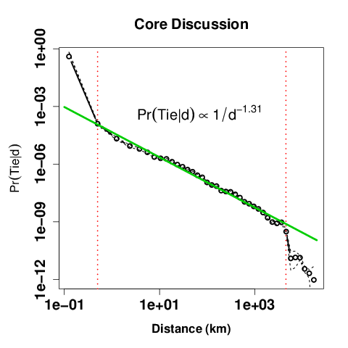
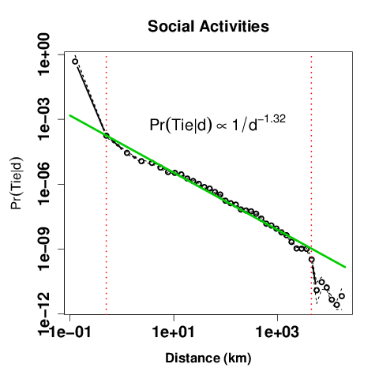
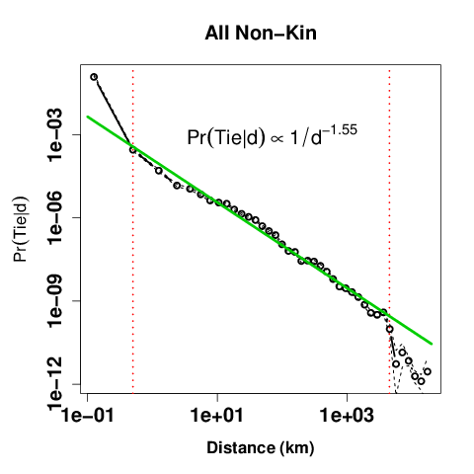
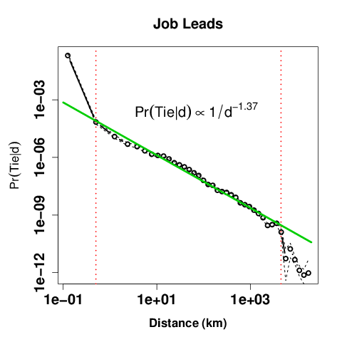
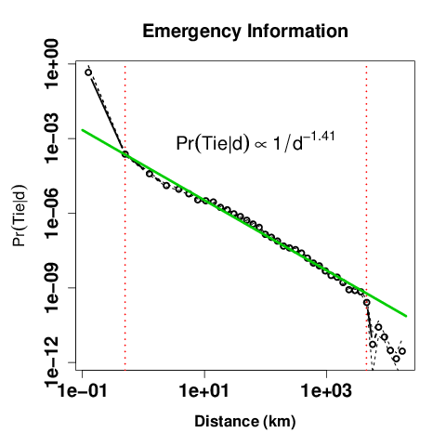

ASFP - Estimated SIFs

Slide 41
ASFP - Estimated SIFs

Slide 42
ASFP - Estimated SIFs

Slide 43
ASFP - Estimated SIFs
Current resolution limit (~0.5km)
Apx diagonal length of continental US (~4500km)

Slide 44
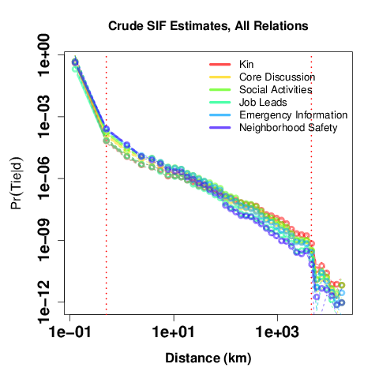
ASFP SIFs: Consistent, Heavy, and Truncated
All relations show similar pattern, with quantitative differences
Kin, core have heaviest tails, with emergency information and neighborhood safety least
Form of SIF consistent with earlier work, but much longer tails
“Crash” at 4500km - qualitative change in interaction barriers

Slide 45
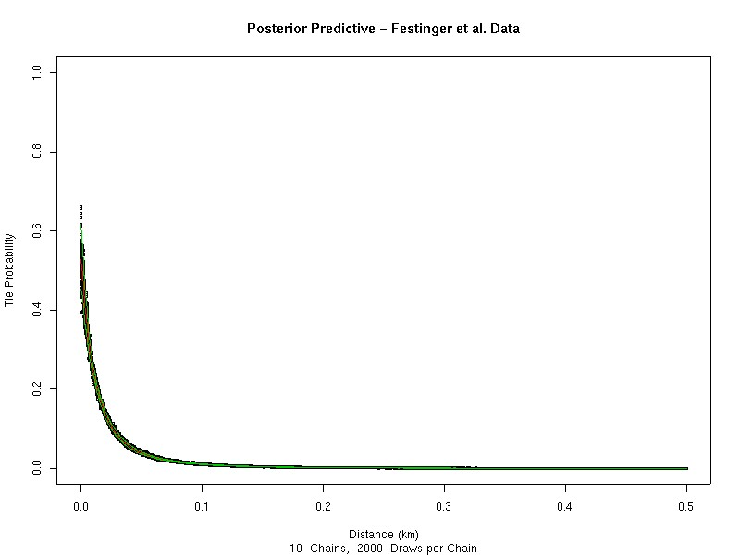
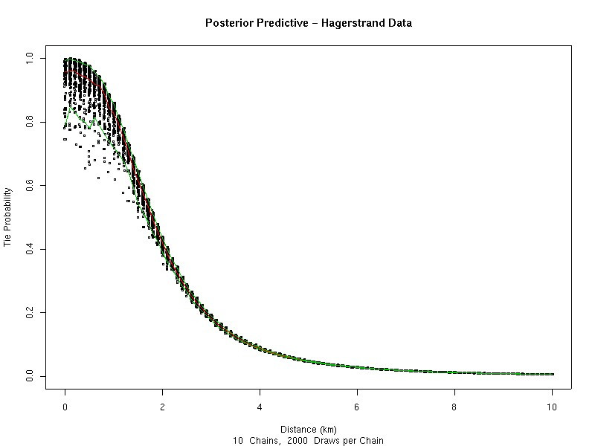
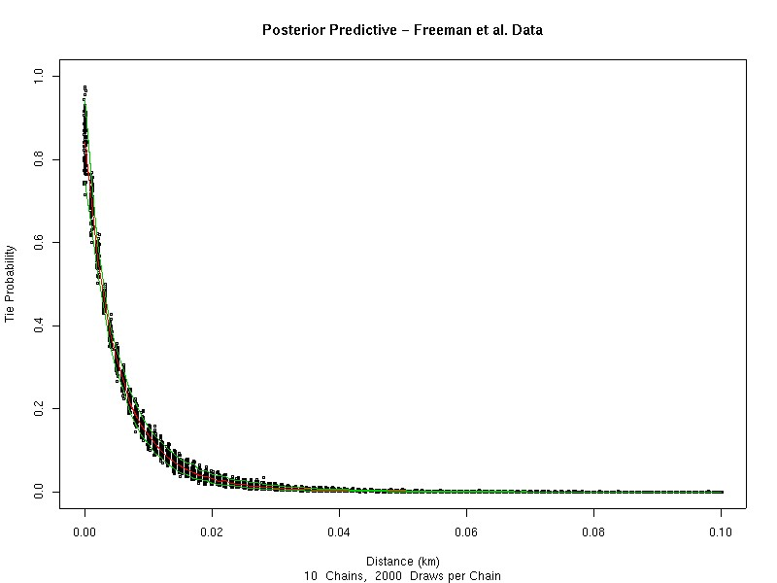
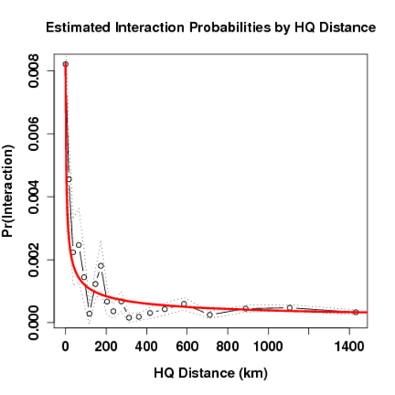
Friendship (scales with d⁻³)
Weak Contacts
(scales with d⁻³)
(Butts, 2002)
(Butts, 2002)
Face-to-Face Interaction
(scales with d^{-6.5})
Organizational
Collaboration
(scales with d^{-0.7})
(Butts, 2002)
(Butts and Acton, 2011)

Slide 46
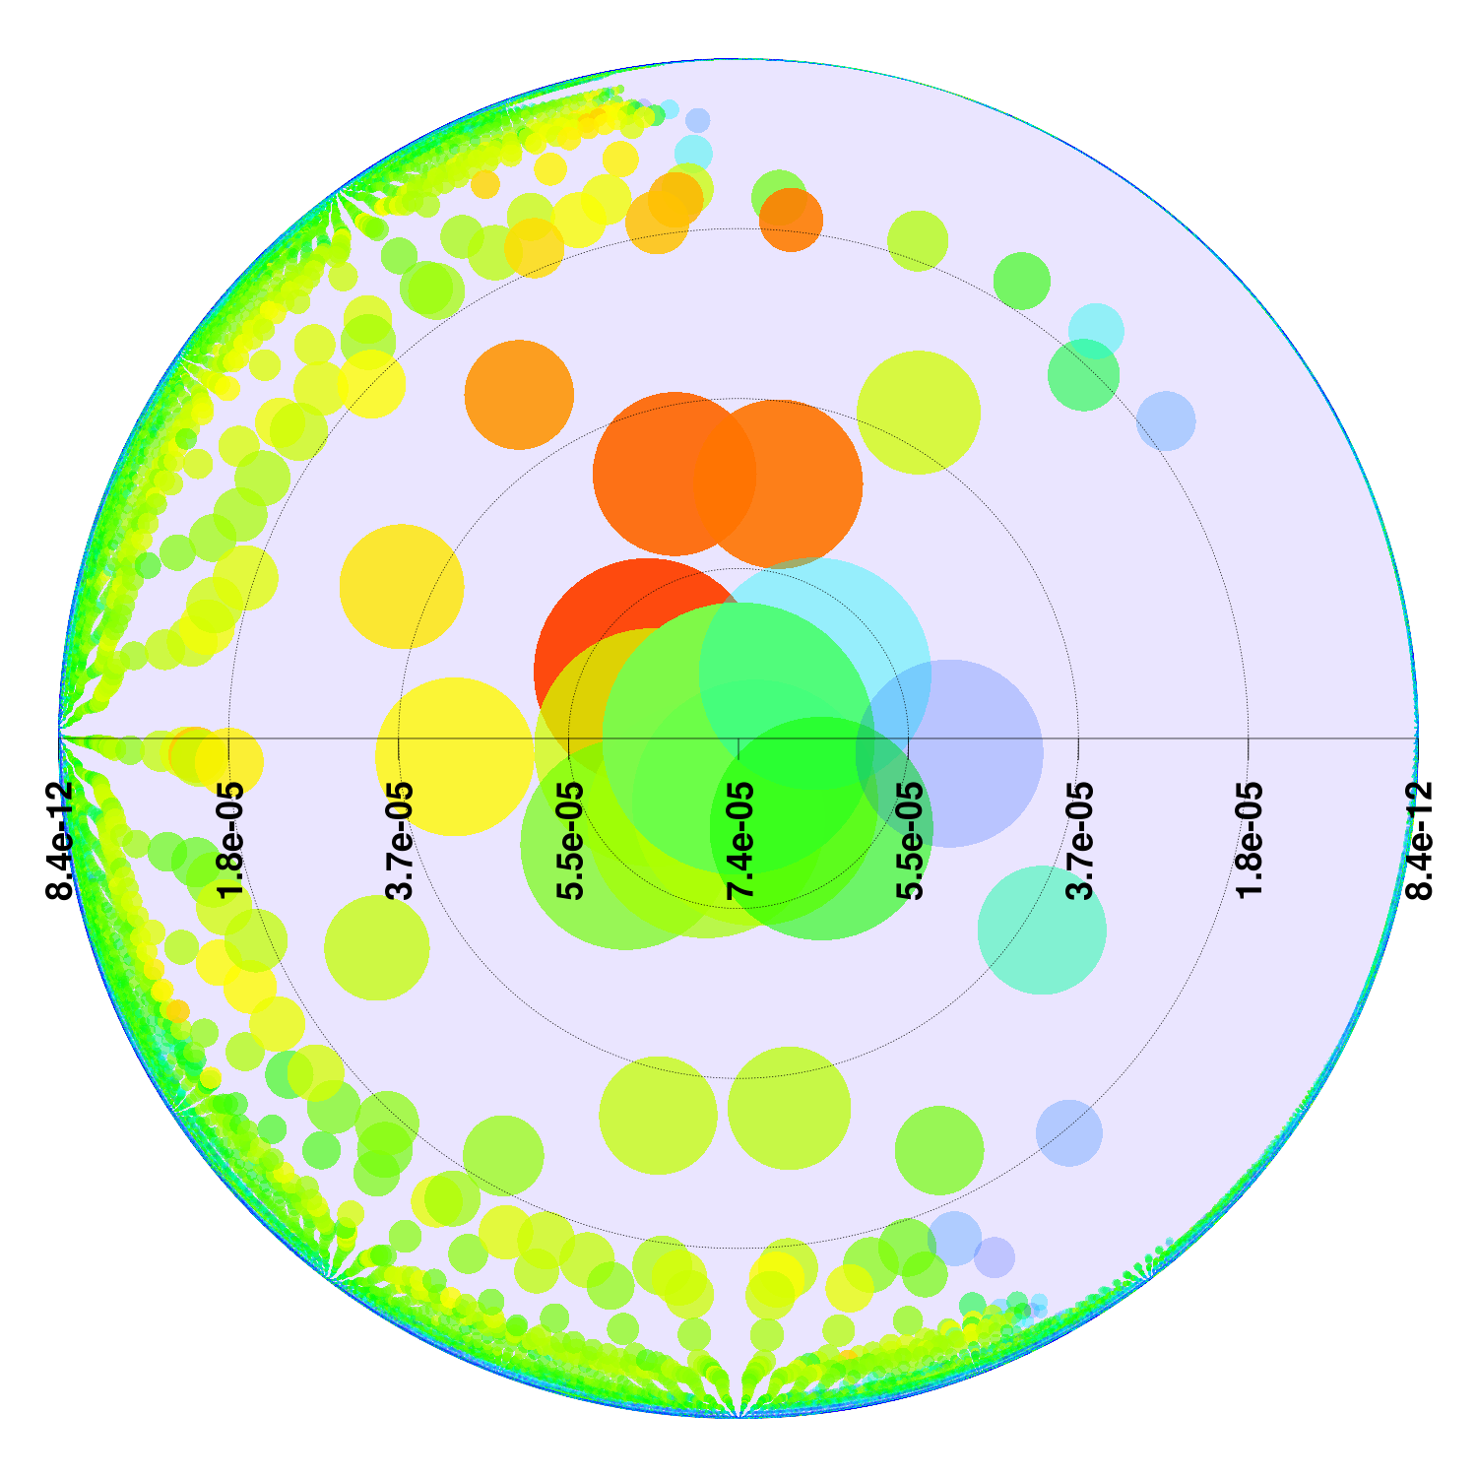
Mixing Ingredients: the SIF as a Spatial Transformation
Physical Space:
Population by Proximity
Social Space: Population
by Propinquity

Slide 47
Warped,
(*and Lumpy)
Curved*

Slide 48
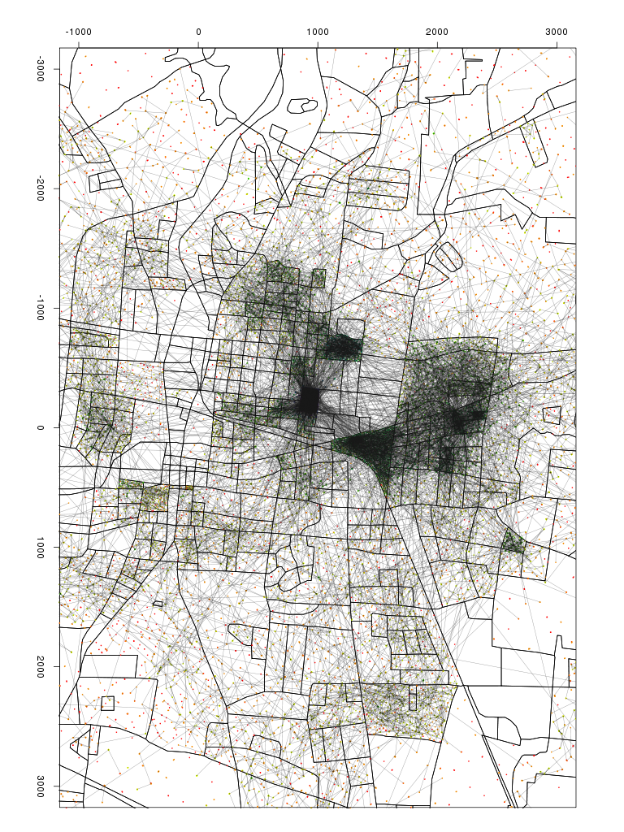
What Does All This Imply?
Populations are unevenly distributed in space
  Interaction opportunities vary greatly w/distance...
  ...and with place!
Probability of interaction varies systematically with distance
...So, we should see large-scale distortions in social networks associated with population distribution
(Butts et al., 2012)

Slide 49
Measuring Distortion in the Social Fabric
Anisotropy in the population distribution should alter network structure
  Ties “pulled” toward dense regions, creating net average direction
Direction of net tie “flow”
  For small region A, treat all edges of G w/one endpoint in A as outwardly directed vectors
  Tie “flow” is in the mean direction of the vector:

Slide 50
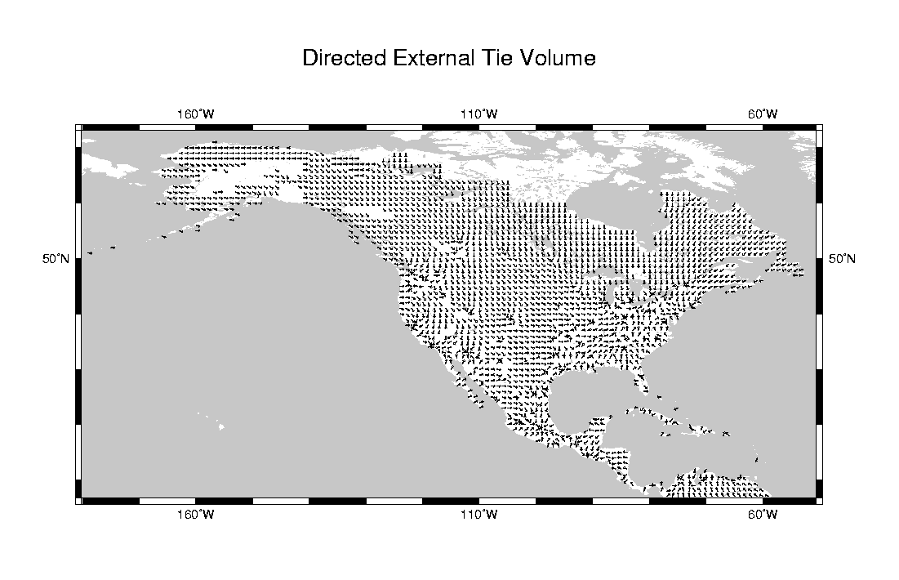
Predictions from an Old Model....
Expected tie flow, social friendship model (Butts, 2002)

Slide 51
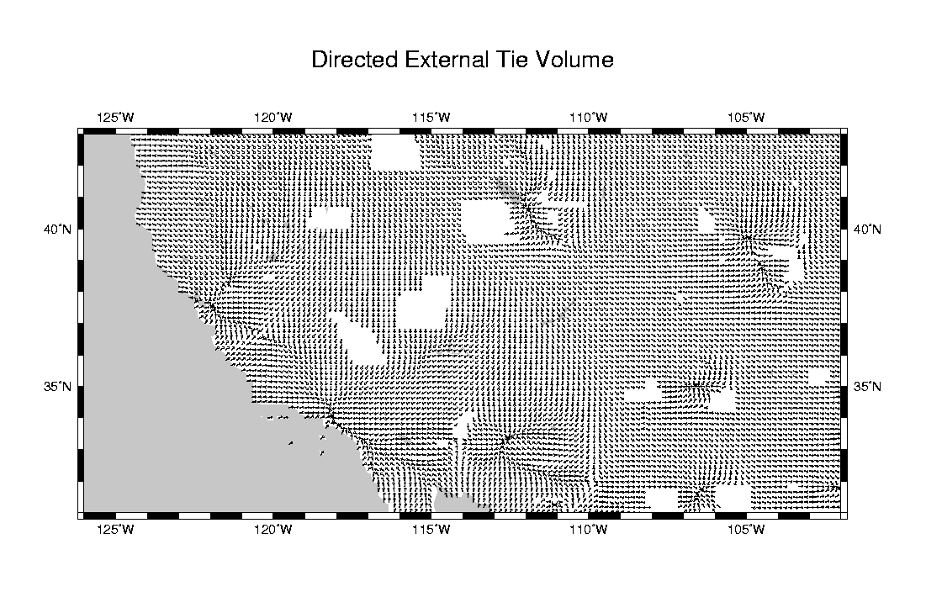
Predictions from an Old Model....
Expected tie flow, social friendship model (Butts, 2002)

Slide 52
Predictions from an Old Model....
Expected tie flow, social friendship model (Butts, 2002)

Slide 53
From Prediction to Measurement
Initial estimates from the ASFP data
  Mean bearings taken for all egos w/at least 1 alter at >5km (bearings taken over all alters >5km distant)
    N=2,234
  Ego mean bearings converted to complex representation (i.e., exp(i*θ)=cos(θ)+i*sin(θ)); observations treated as marked point process with two marks (real, imaginary components)
  Real, imaginary angular components processed using a Gaussian spatial smoother (smooth.ppp, bandwidth selected by cross-validation) to estimate spatial mark means
  Angles evaluated (i.e., Arg of complex components) on a regular grid over ASFP study area
  Angular map shows variation in network structure through space

Slide 54
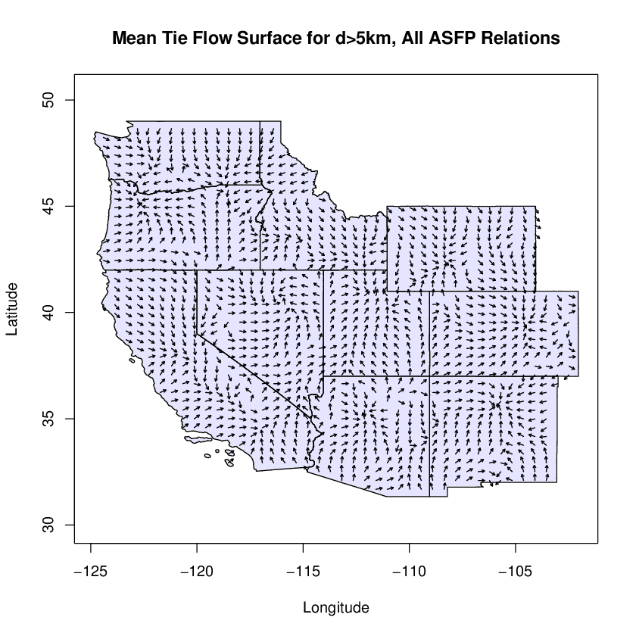

Slide 56
Elko
Salt Lake City
Portland
Riverton
Denver
Sacramento
Los Angeles
Santa Fe
Phoenix

Slide 57
“Whorls” - a new feature?

Slide 58
Warped,
(*and Lumpy)
Curved*
...and
Twisted!

Slide 59
Road Map
Introduction
A “first-order” look at spatial network structure
Measuring network “distortions” in the western US
Conclusions and such

Slide 60
Some Initial Take-Aways
It's a messy, crumply world...
  Interaction opportunities vary wildly over space, creating complex distortions in network structure
...but some order persists
  We find stable power law SIFs for the ASFP data on six relations, over a ~4,500km range
    Upper tail “collapse” suggests additional barriers (language, cost) becomes as important as distance at continental scales
    Heavy tails indicate that some relations assumed to be local have a long-range component
First glimpses of angular distortions in network structure show both confirmation and surprises
  Many features predicted in prior models, but some (e.g., “whorls”) not seen; estimates suggest importance of small communities in remote areas

Slide 61
Directions/Work in Progress
Bringing other covariates back in
  Effects of age, race, income, education, gender on mixing
  How much attribute-related structure can be explained by population distribution (e.g., segregation)? How much residual heterogeneity is there?
  Linking network, spatial, demographic, and neighborhood contexts (e.g., vis a vis perceived cohesion, res. tenure)
    Have had success predicting crime rates, regional identification using crude SIF models;can we do better by leveraging new data?
Mapping more characteristics of social space
  Areal unit estimates of density, mean degree, social isolation, etc.
  Studying structure in rural and remote area populations
Further data collection
  Extending to the entire US; intensive sampling of MSAs

Slide 62
ASFP Team
Carter T. Butts
Professor, Sociology,
Statistics, EECS, and Institute for
Mathematical Behavioral Sciences
School of Social Sciences
University of California, Irvine
buttsc@uci.edu
John R. Hipp
Associate Professor, Criminology,
Law, and Society
School of Social Ecology
University of California, Irvine
hippj@uci.edu
John R. Hipp
Associate Professor, Criminology,
Law, and Society
School of Social Ecology
University of California, Irvine
hippj@uci.edu
Nicholas N. Nagle
Assistant Professor, Geography
University of Tennessee
nnagle@utk.edu
Zack W. Almquist
Assistant Professor, UMN
zalmquist@gmail.com
Christopher Marcum
Staff Scientist, NIH
cannivaltinea@gmail.com
Adam Boessen
Graduate Researcher, UCI
aboessen@uci.edu
Ryan M. Acton
Assistant Professor,
UMass-Amherst
Emma Smith
Graduate Researcher, UCI
emilyjs@uci.edu
Notes:
SMILE!

Slide 63
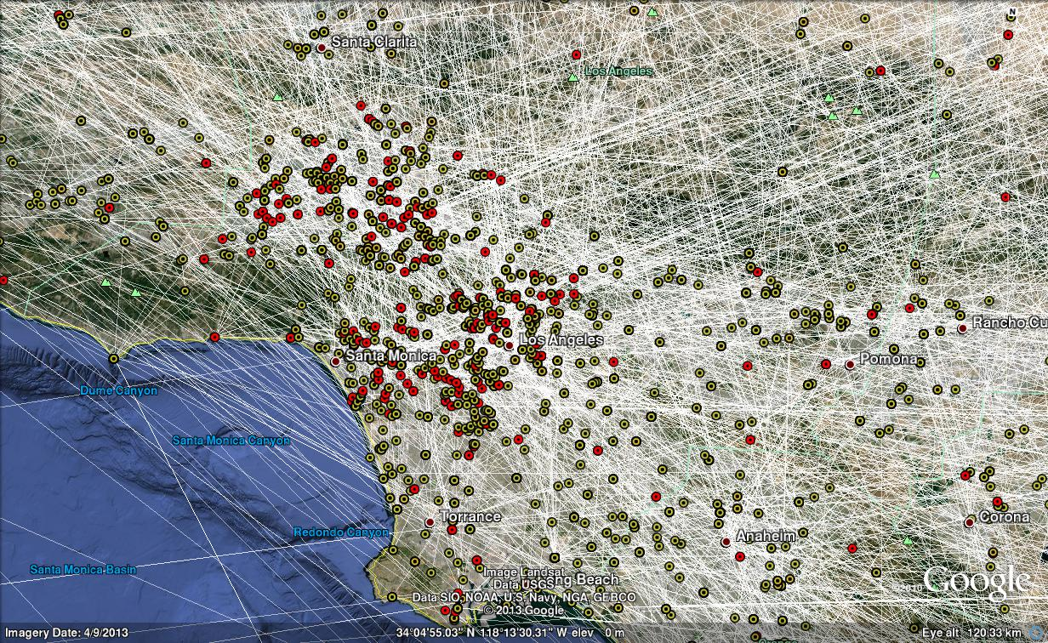
Thank you for your attention!

Slide 64
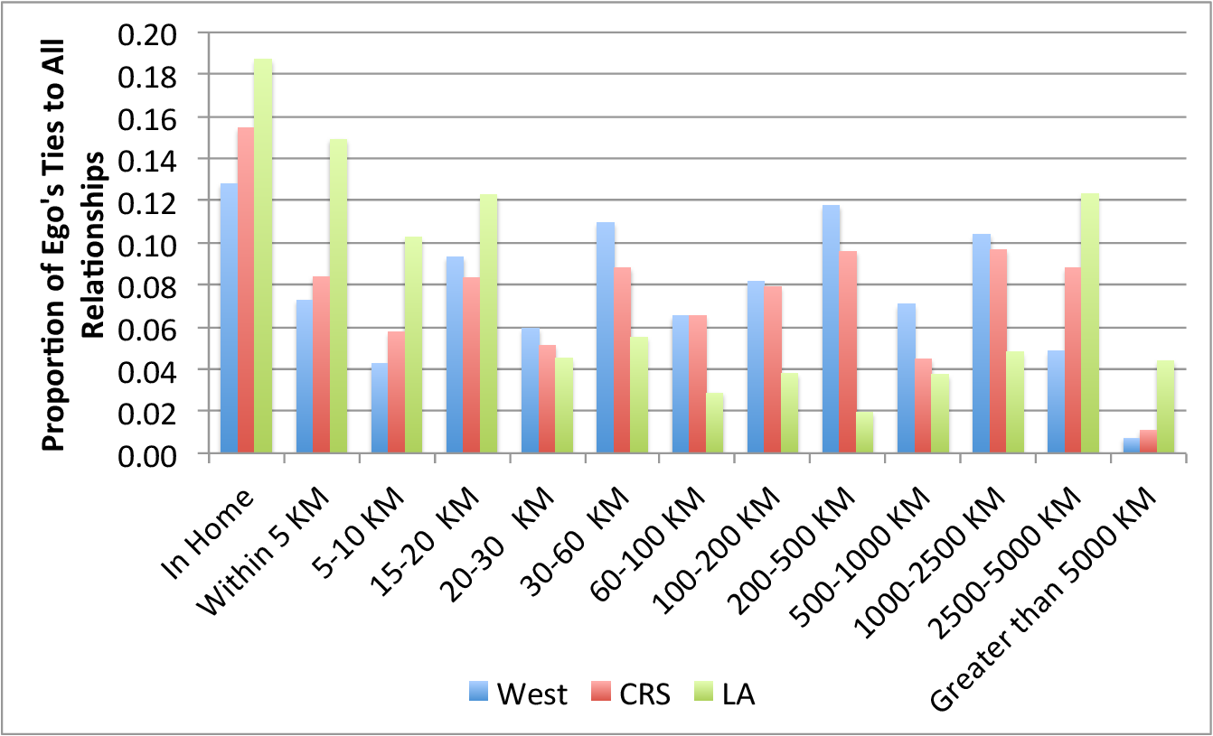
Egocentric Distance Distribution, by Subsample

Slide 65
What Does the SIF Give Us?
Assuming (for the moment) that the estimated SIFs capture edgewise marginals for the distance/tie probability relationship, how much would this tell us about global network structure?
  Theorem: if edge probability bounded by  for dyads at distances >r_{c}, lower bound on fraction of entropy explained by d approaches mean Pr(d_{ij}>r_{c}) as 0
    In practice, <0.001 is sufficient; scaling is w/ 1-I(B())
  For uniform population on ℓxℓ region, can explain over 90% entropy so long as r_{c} is less than about 20% of ℓ
    Fitted models easily meet this for 10-100km regions
Intuition: at large scales, spatial effects dominate
  Distant dyads almost certainly null
  Realized graph stochastically approximates subgraph of graph induced by contiguity

Slide 69
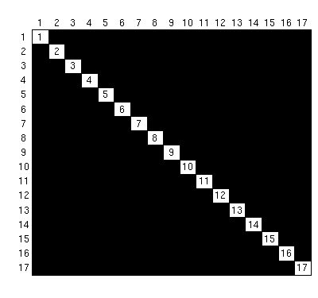
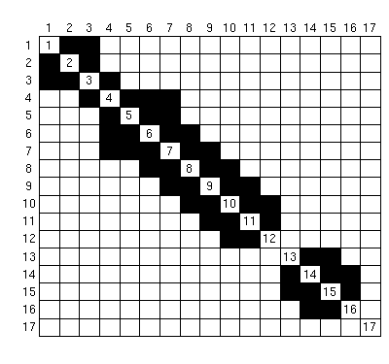
Or, In Matrix Form....
Without Distance
With Distance

Slide 70
An Inhomogeneous Bernoulli Family for Spatially Embedded Networks
A simple family of models for spatially embedded social networks:
  where Y{0,1}^{NxN}, d[0,∞)^{NxN}, ℱ: [0,∞)[0,1], B Bernoulli pmf
Special case of the inhomogeneous Bernoulli graph family with parameter matrix Φ_{ij}=ℱ(d_{ij})
  Assumes that dependence among edges absorbed by distance structure – edges conditionally independent
Related to the gravity models, i.e.
  where P is an interaction potential, and F is an impedance or spatial interaction function

Slide 71
Generalization to Curved Exponential Random Graph Models
Increasingly widely used approach – ERG form
Our likelihood can be rewritten as a curved ERG
  Sufficient statistics are the edge indicators of Y; canonical parameters () are logits of marginal edge probabilities
    O(N²) canonical parameters – computational savvy advised
General curved model: space + other effects
  Allows for integration of complex edge dependence, degree distribution constraints, other covariate effects, etc. (through t)
  Can use to control for social mechanisms when seeking spatial effects, or spatial effects when seeking social mechanisms

Slide 72
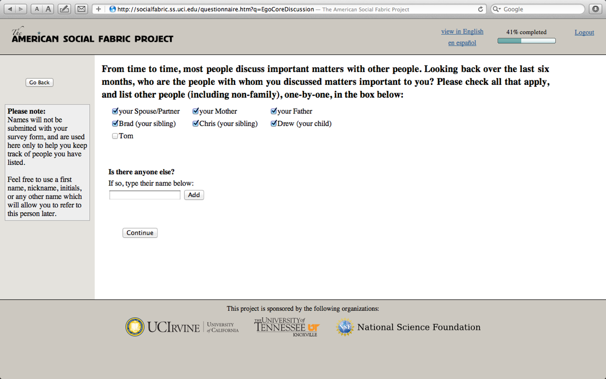
Core Discussion Network

Slide 73
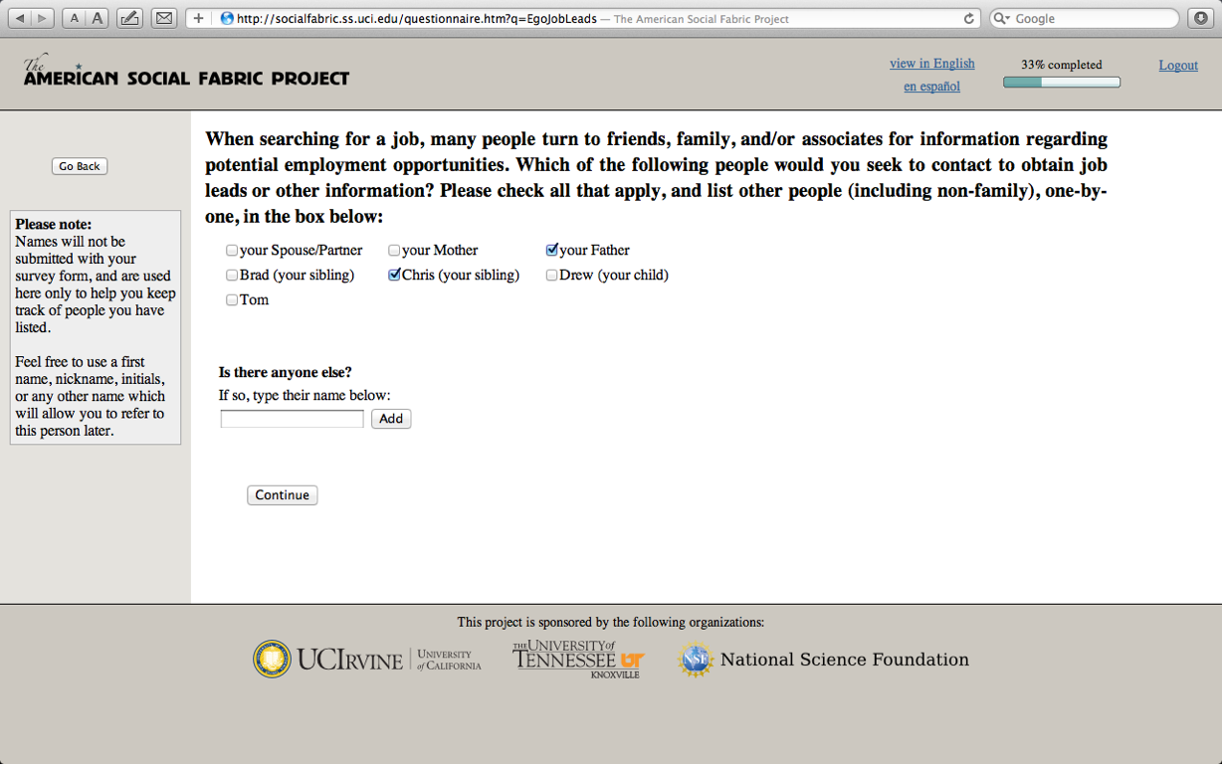
Job Leads Network

Slide 74
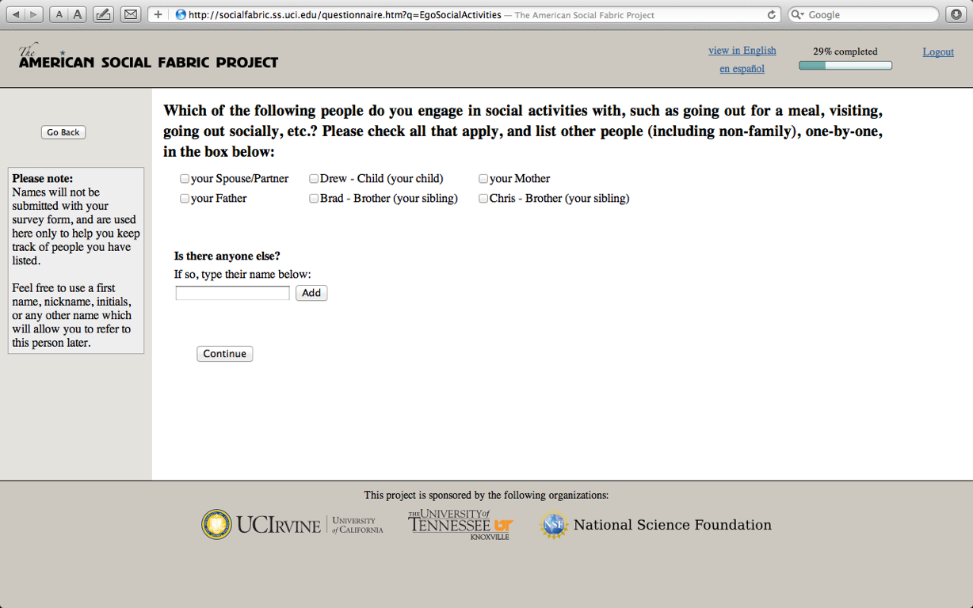
Social Activities Network

Slide 75
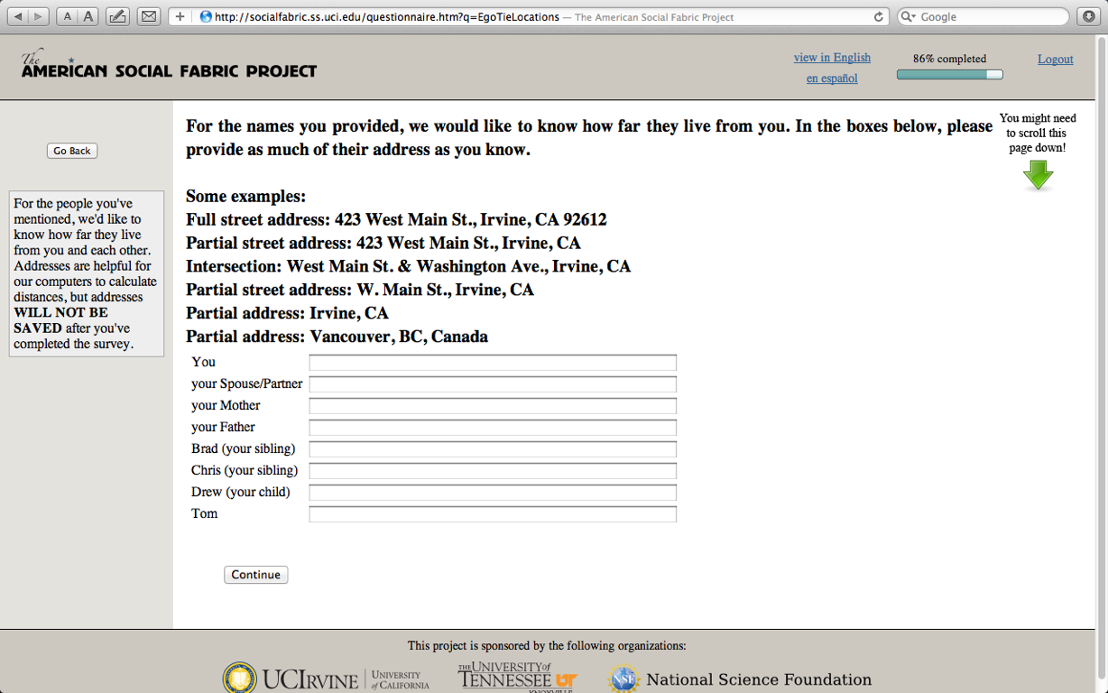
Eliciting Spatial Location

Slide 76
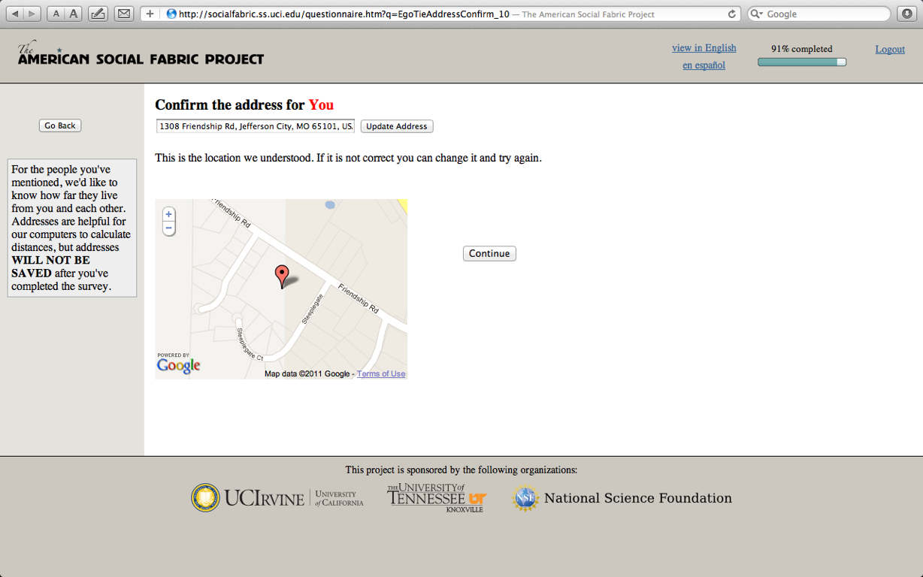
Confirming Location

Slide 77
Prelude I: Moreno's Vision
“If we ever get to the point of charting a whole city or a whole nation, we would have an intricate maze of psychological reactions which would present a picture of a vast solar system of intangible structures, powerfully influencing conduct, as gravitation does bodies in space. Such an invisible structure underlies society and has its influence in determining the conduct of society as a whole.....”
- Jacob Moreno, NYT, April 3 1933

Slide 78

Prelude II: Large-Scale Structure in Nature
(Springel et al., 2006)

Slide 79

Spectral Decomposition of the Tie Volume Laplacian
Tie volumes for raster cells estimated using Horvitz-Thompson; self-ties removed
Row-normalized Laplacian (L=D-A) formed (D_{ii} being outdegree)
Nontrivial eigenvectors with smallest eigenvalues give orthogonal dimensions such that cells with more different values have less total interaction
  Random walk interpretation: messages would take longer to go between dimensionally distant cells
  Reveal inhomogeneous connectivity at large scales

Slide 80

Areal Clustering from Laplacian Spectrum
6 highest weight Laplacian eigenvectors used to characterize each cell
  Values on each normalized to reduce outliers while preserving direction relative to 0
Bayesian Gaussian mixture model used to cluster cells based on position in normalized eigenspace
  Cells with low Mahalanobis distance tend to be grouped together
  LA, Denver, Albuquerque, Phoenix, Salt Lake City, Seattle, San Francisco used to “seed”/orient clusters
  Clusters show urban “reach”

