Slide 1

Entity Framework Core
Code First
Lukáš Kubíček

Slide 2
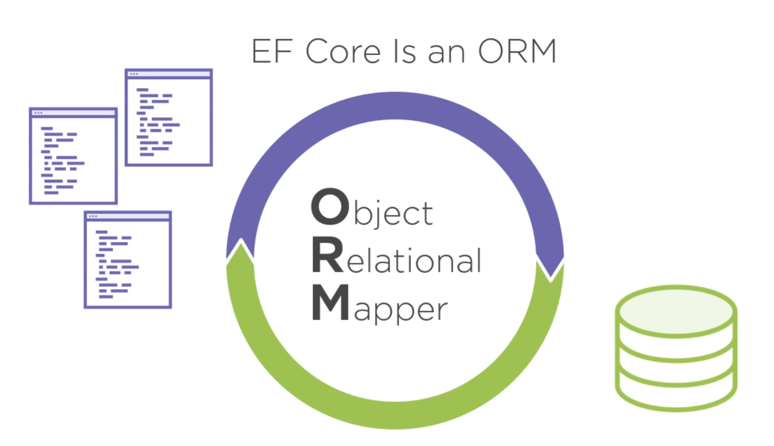

Slide 3
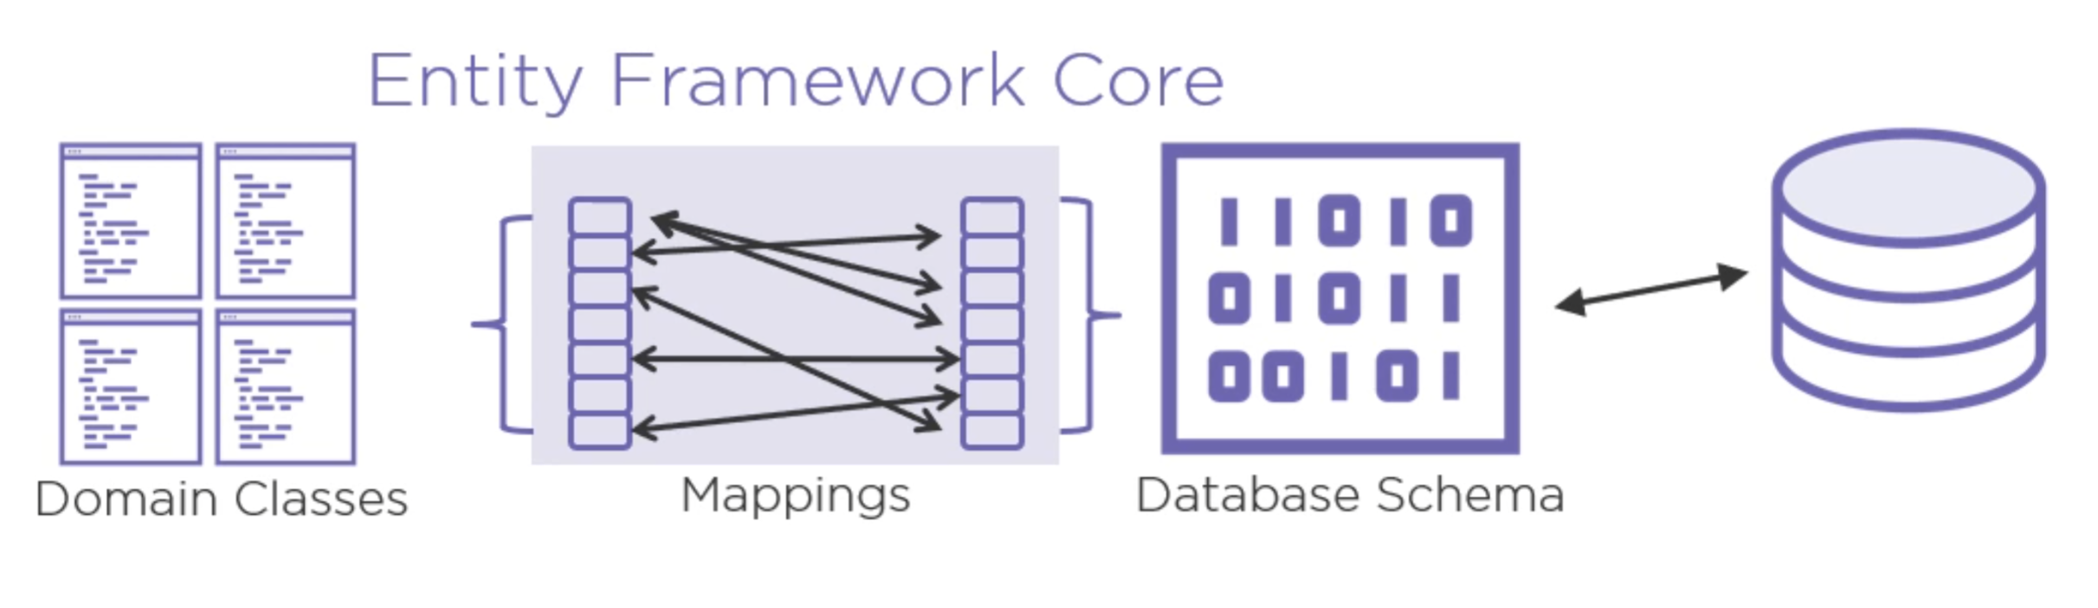

Slide 4
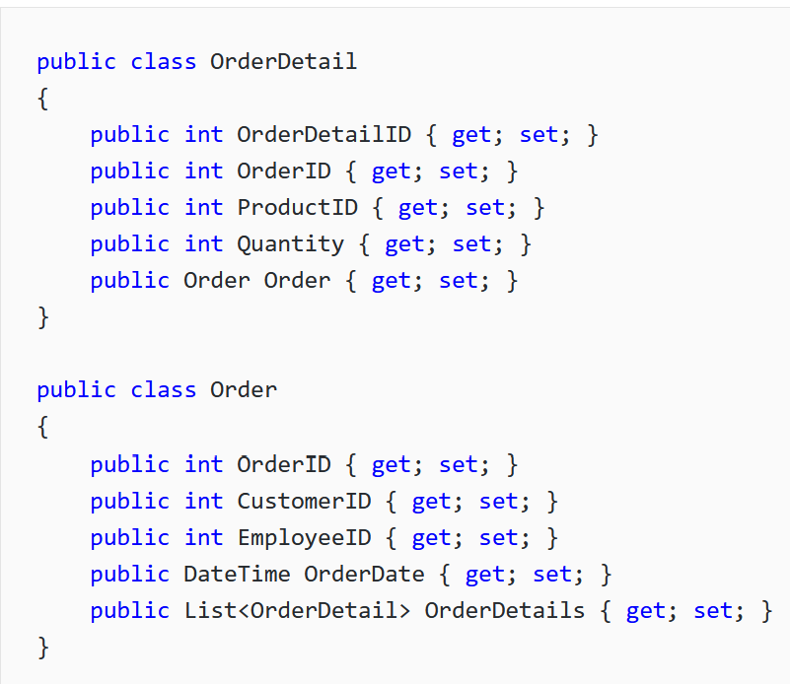
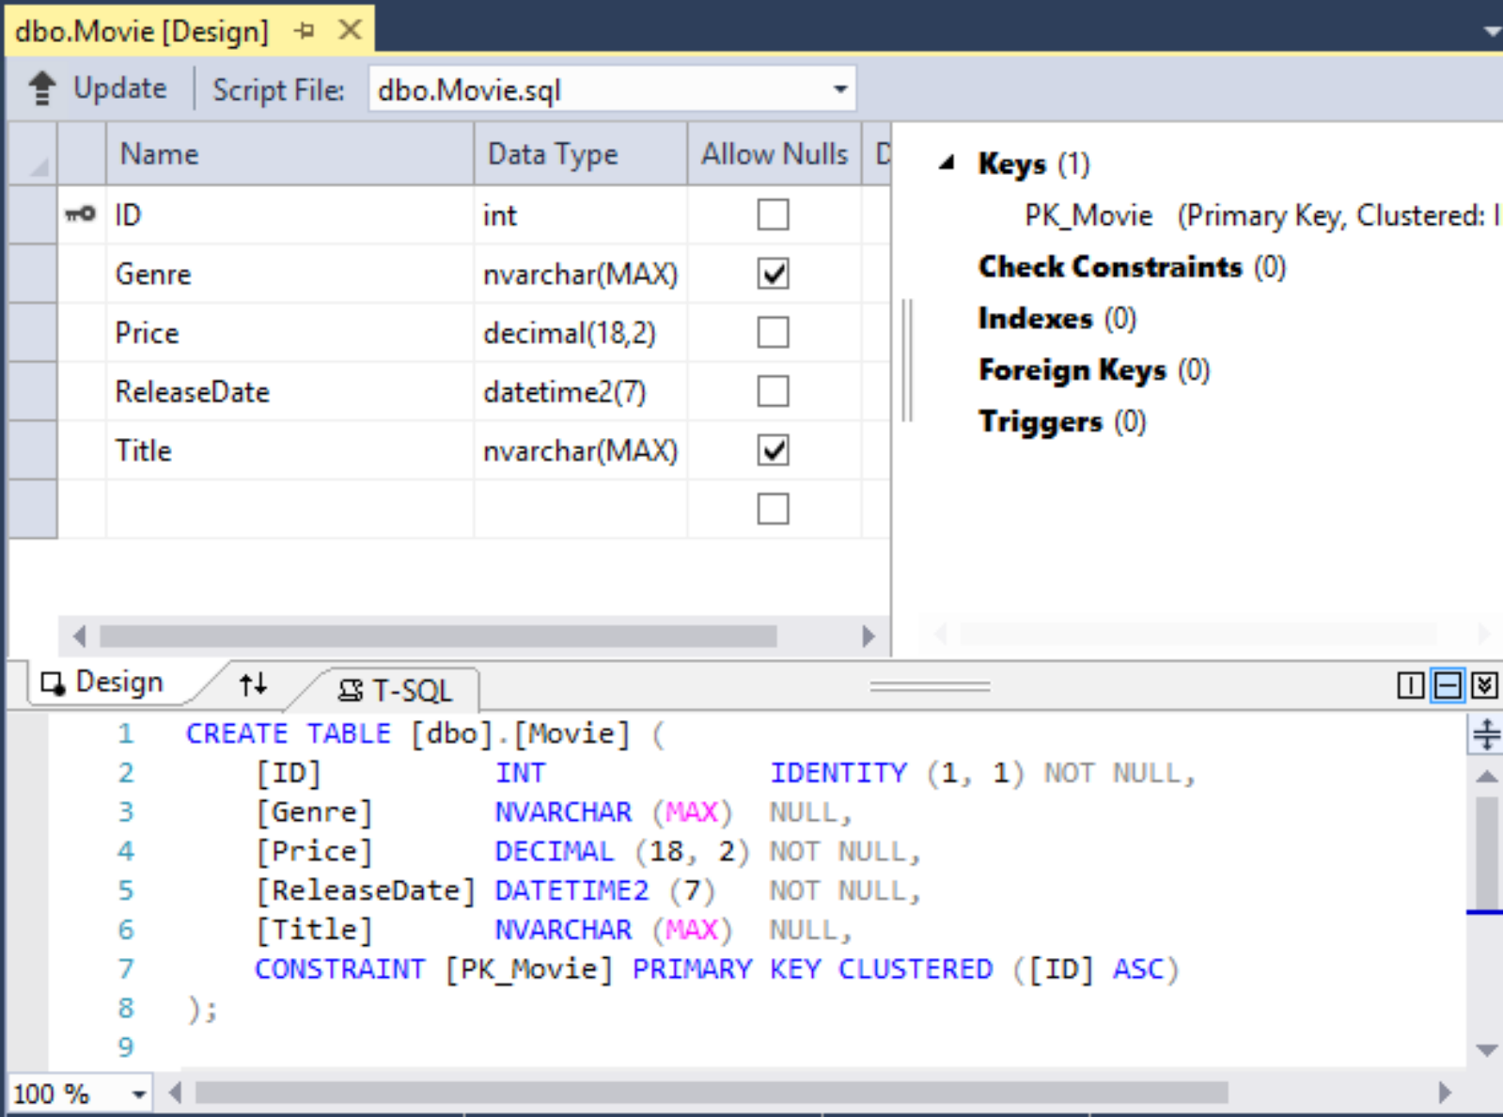
Obousměrné mapování mezi
Classes/OOP ↔ SQL DB
↔

Slide 5
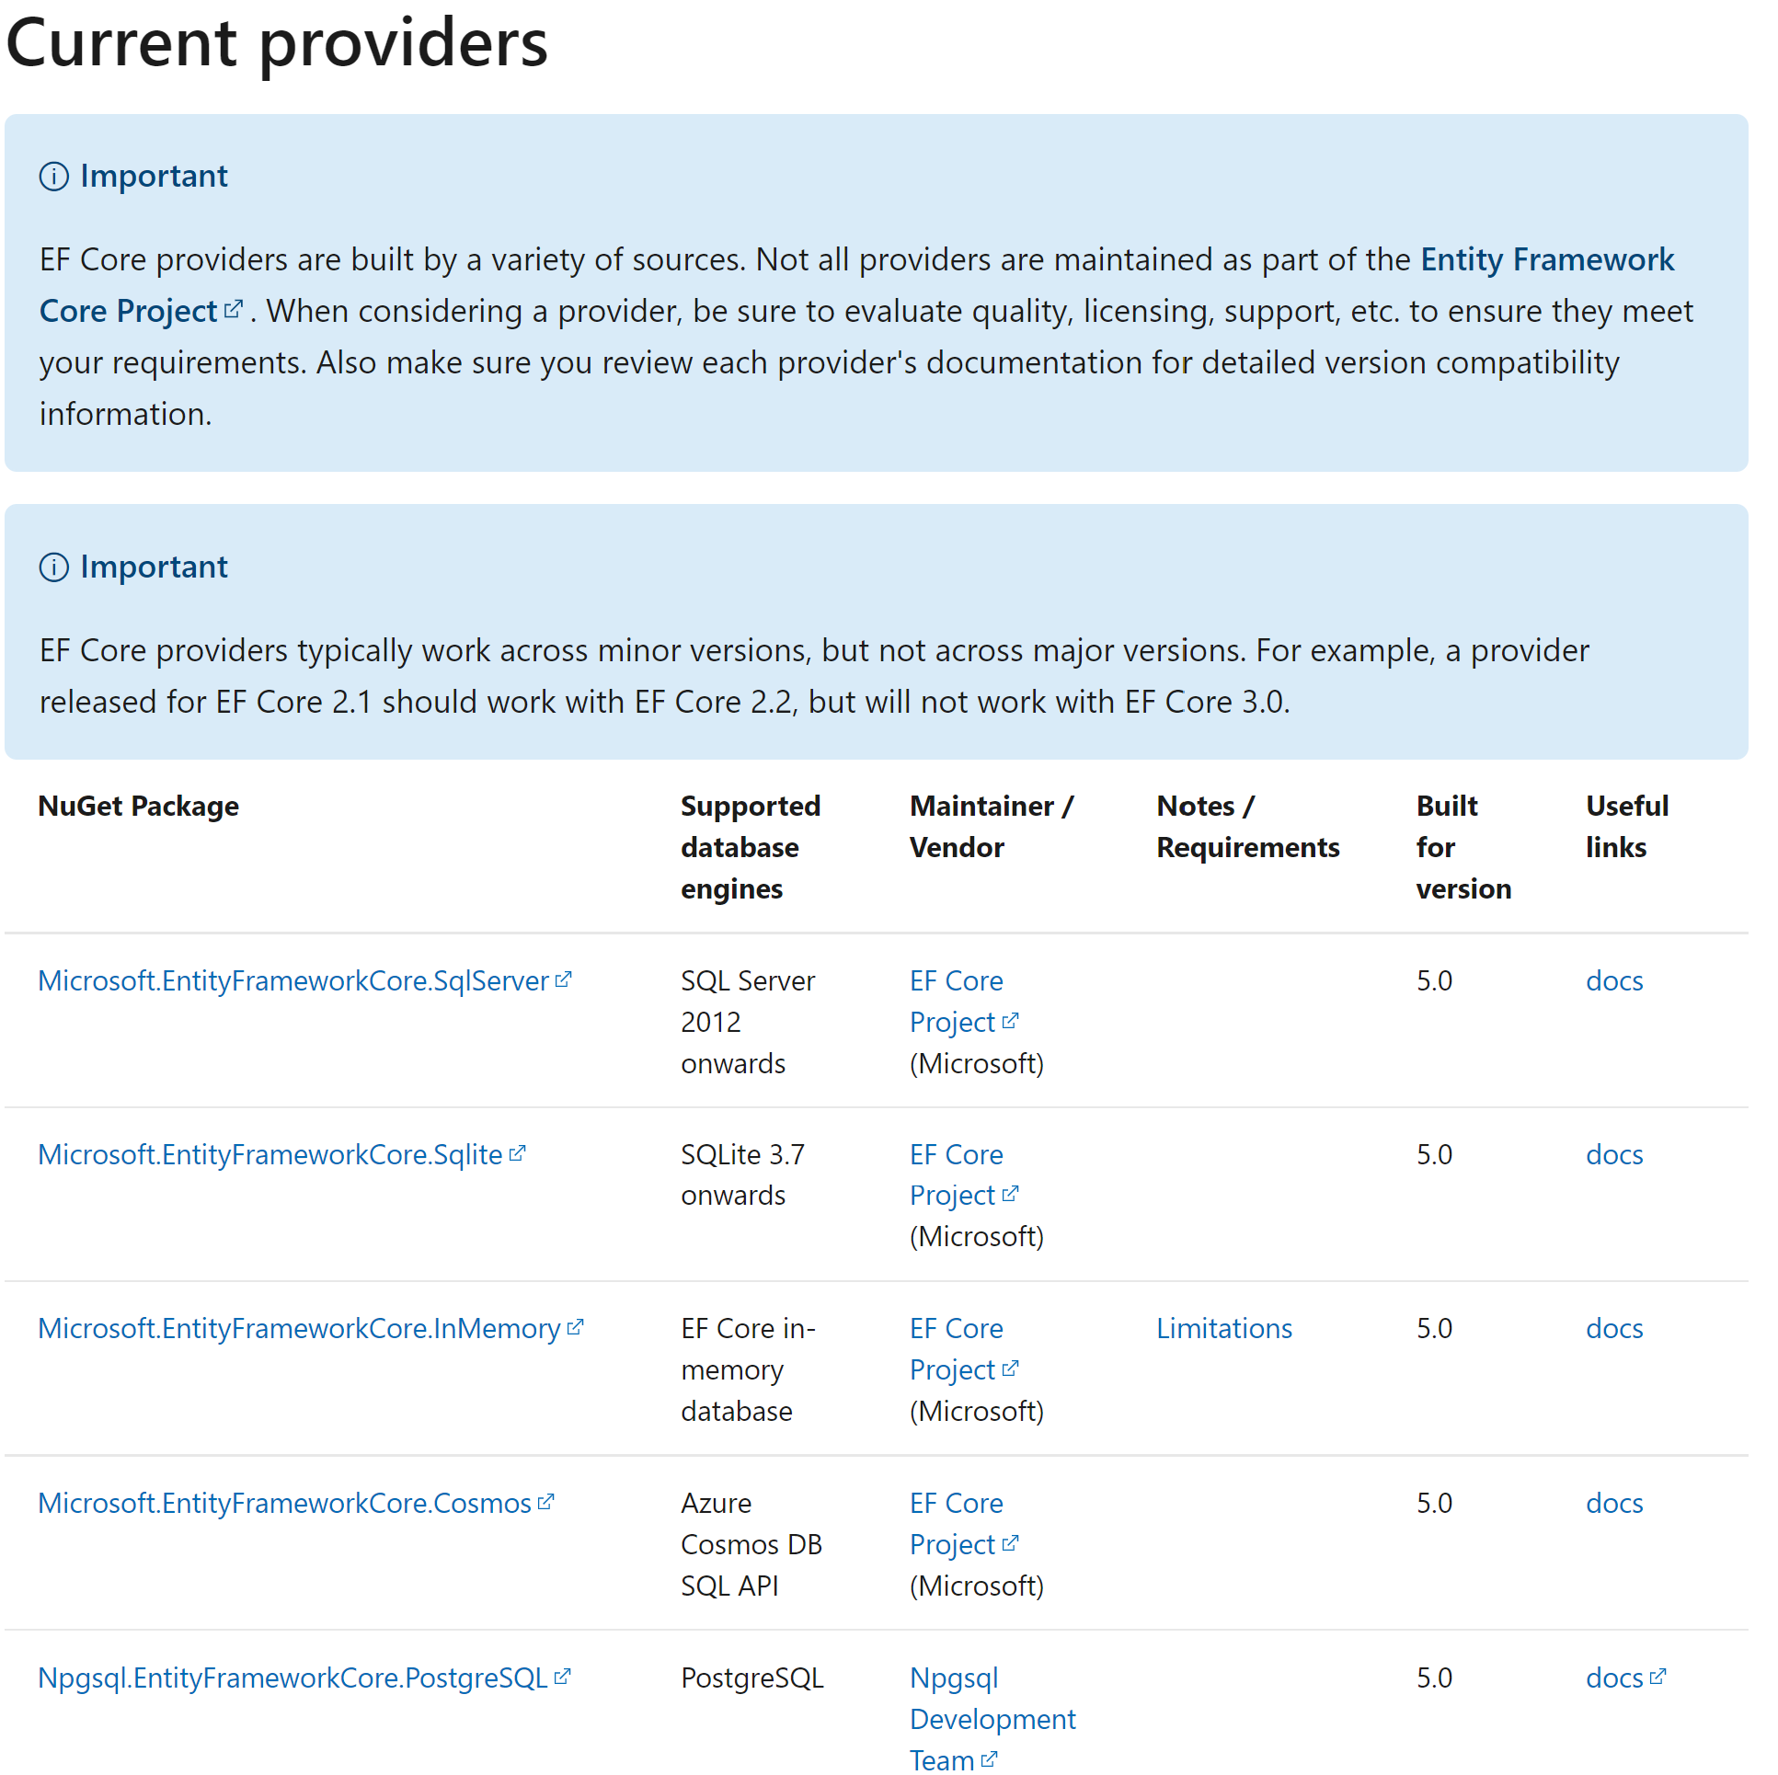
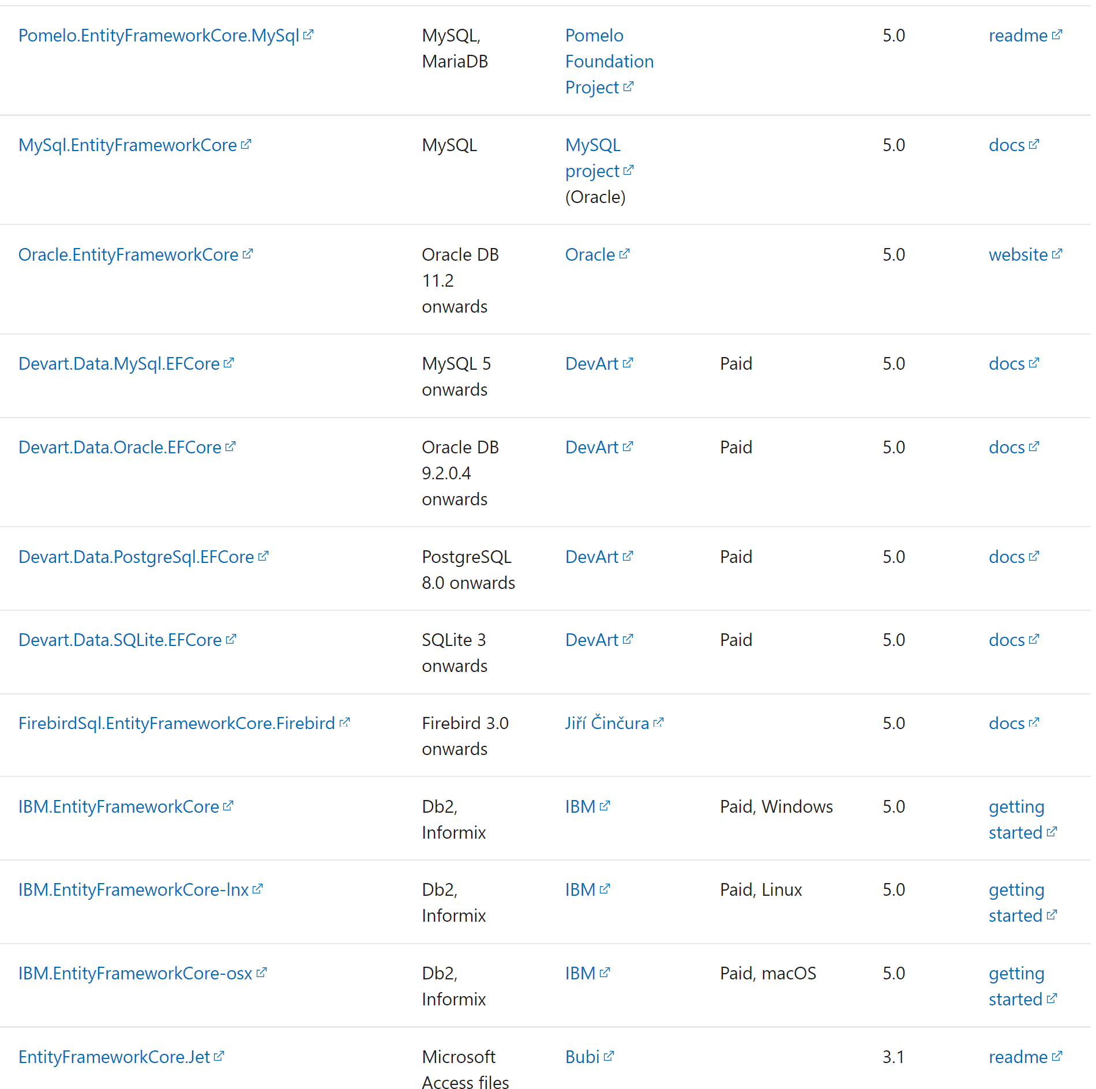
https://docs.microsoft.com/en-us/ef/core/providers/

Slide 6
https://docs.microsoft.com/en-us/ef/core/
https://www.codemag.com/Article/2010042/EF-Core-5-Building-on-the-Foundation
https://www.learnentityframeworkcore5.com/

Slide 7
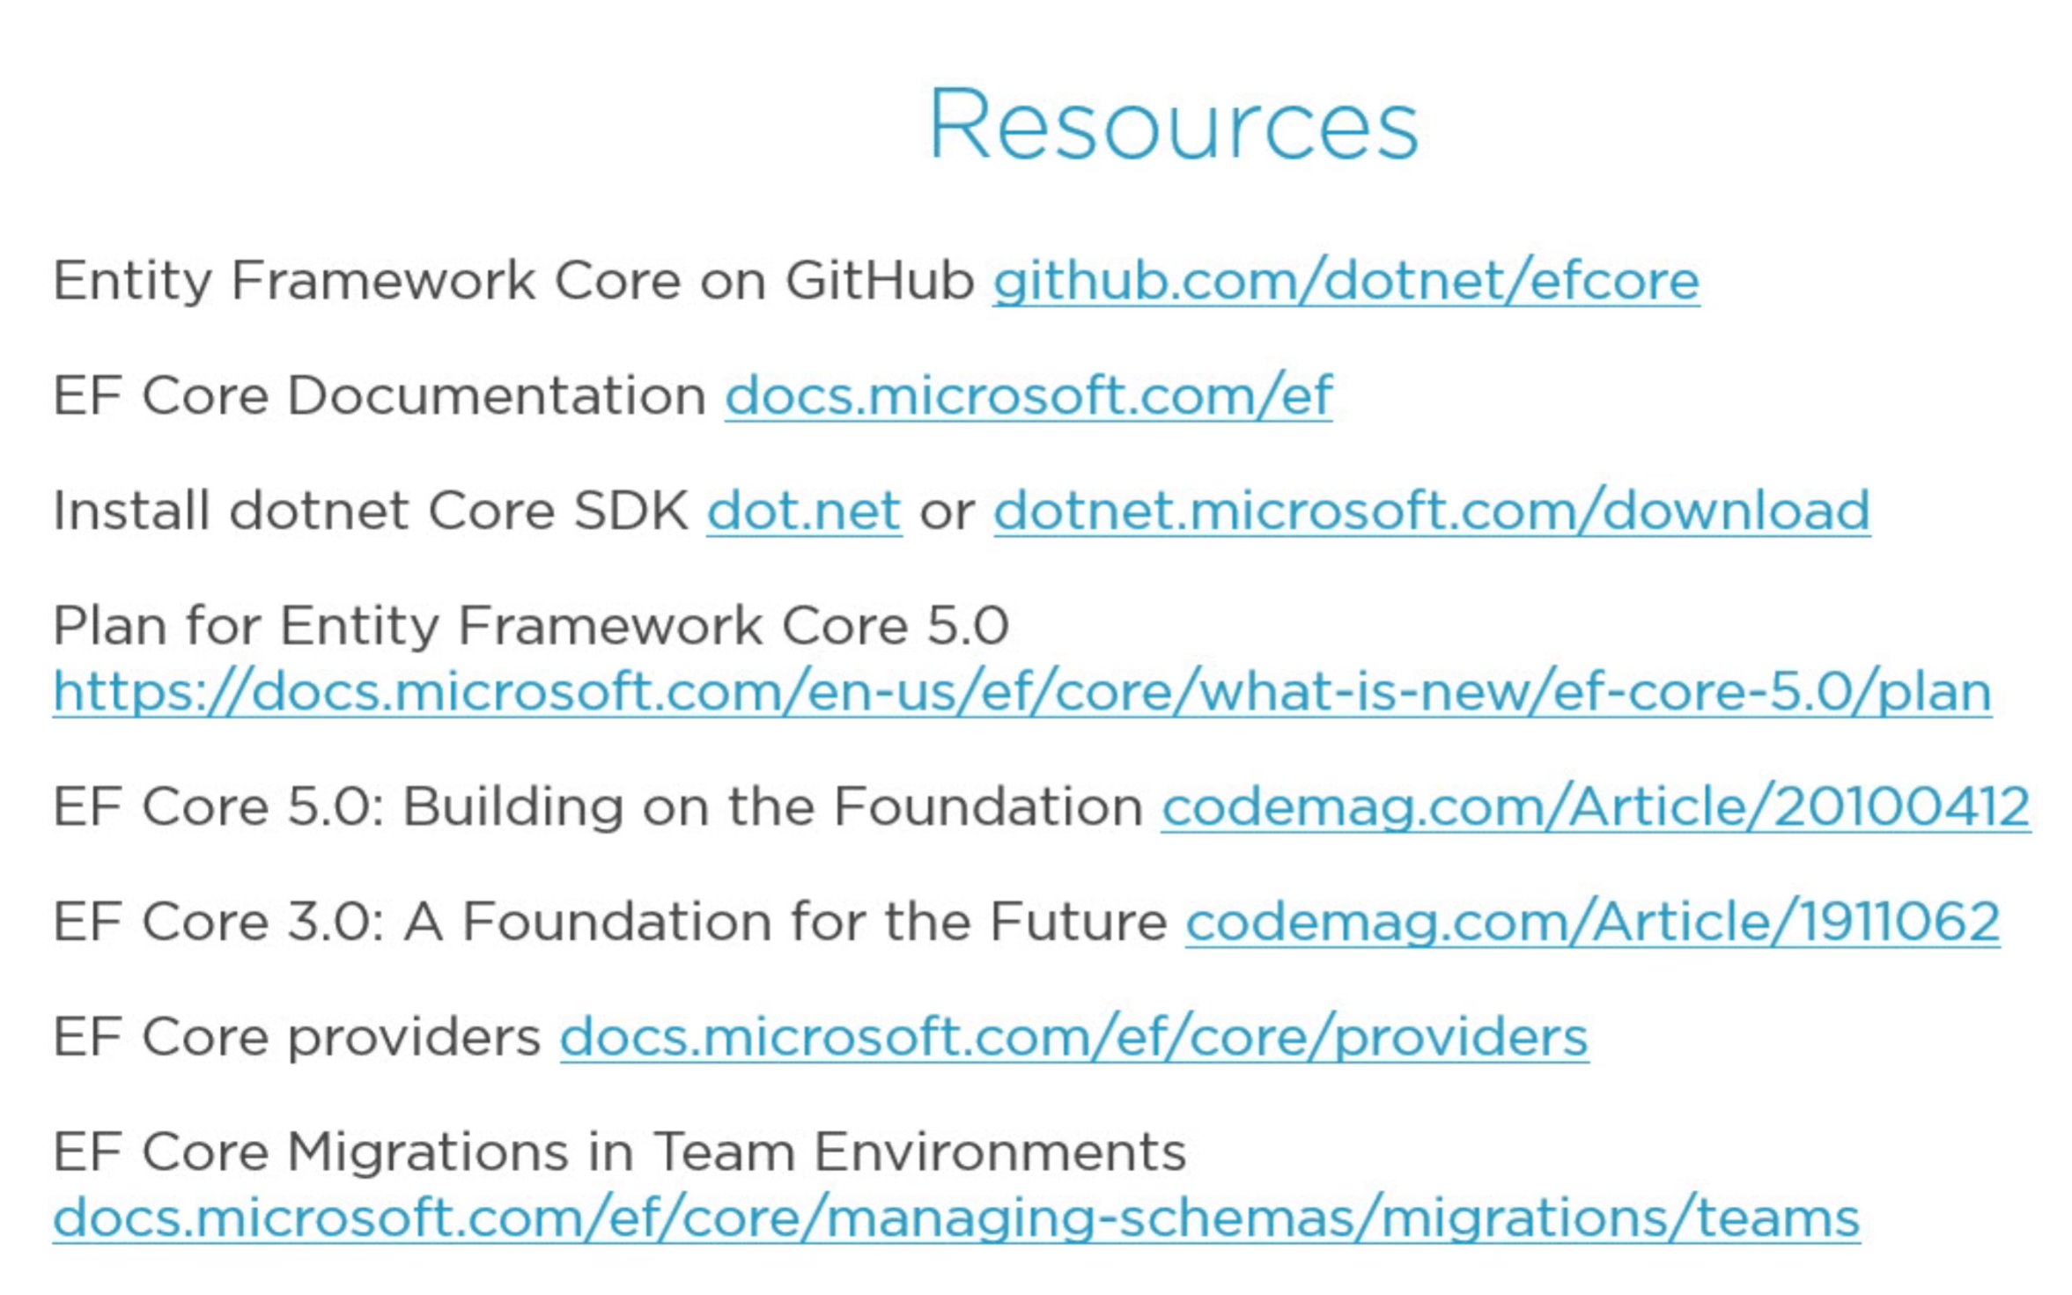

Slide 8
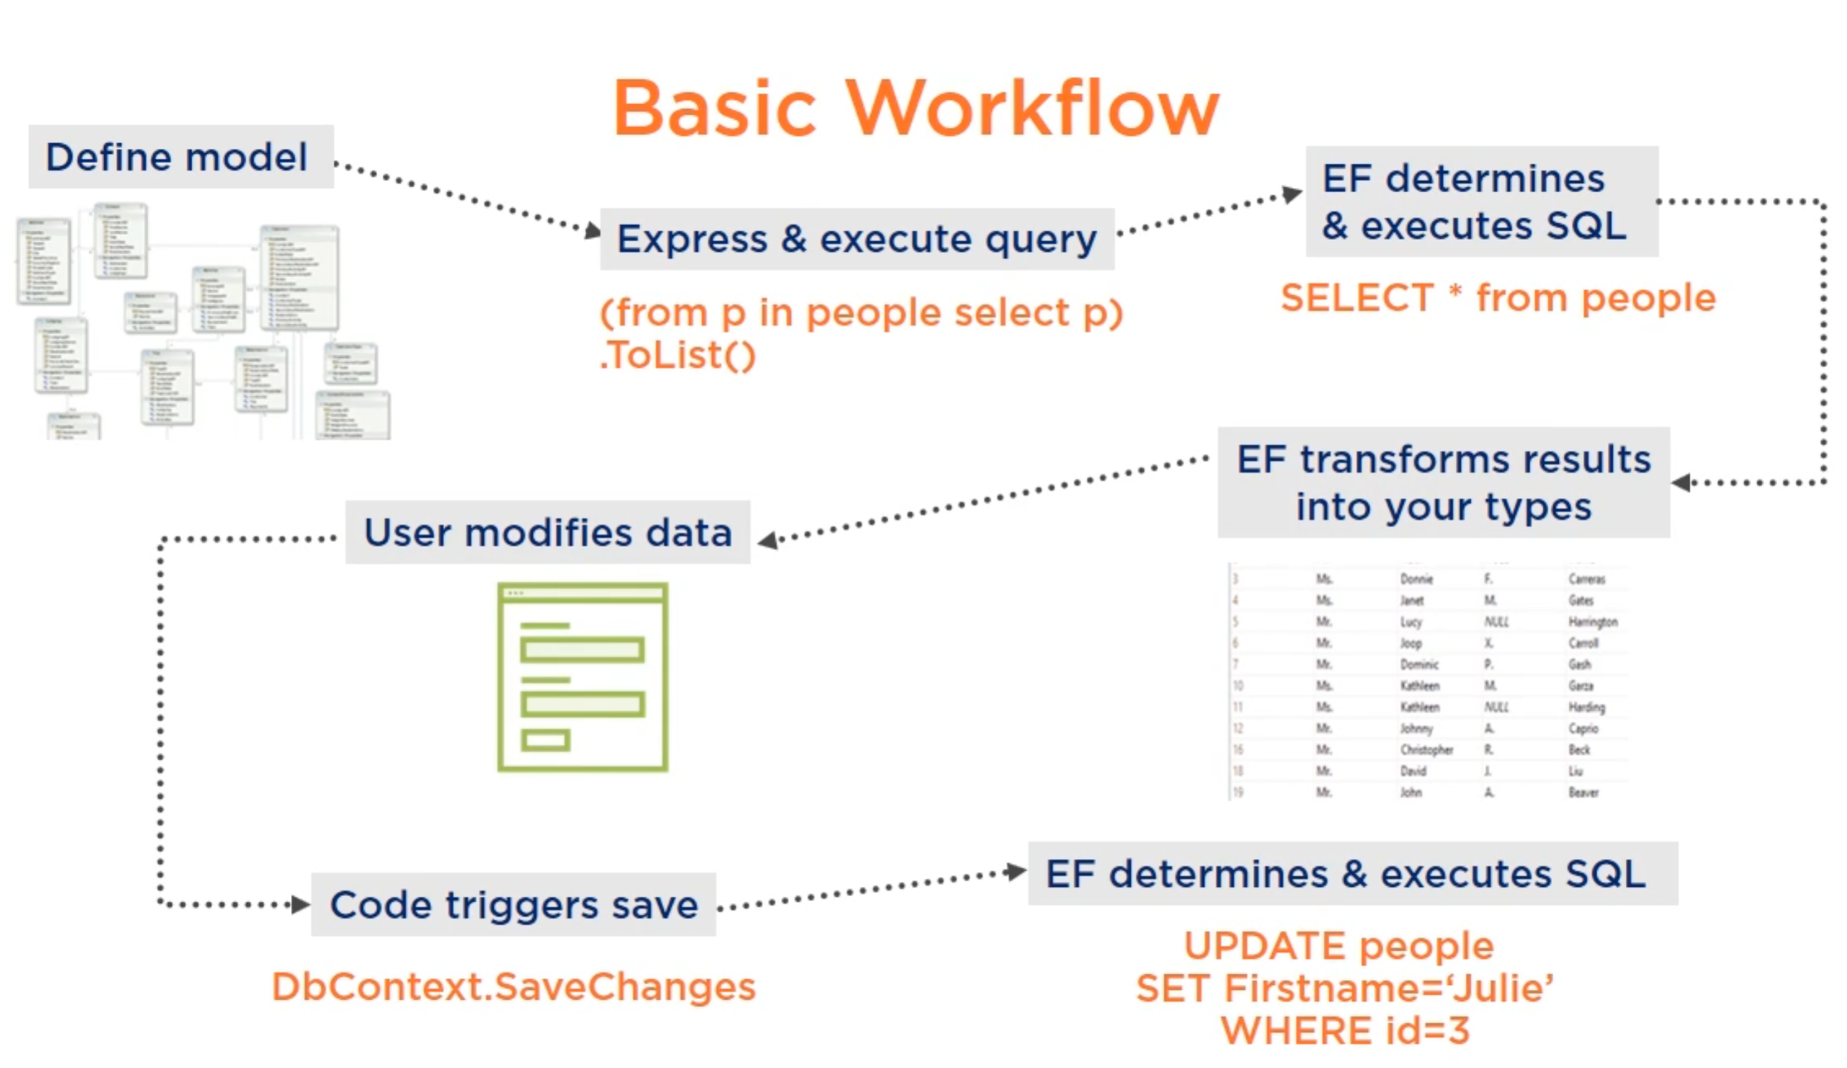

Slide 9
Code First
DB First
Model First

Slide 10
Model –
Domain Classes (Person,...)
+
DbContext

Slide 11
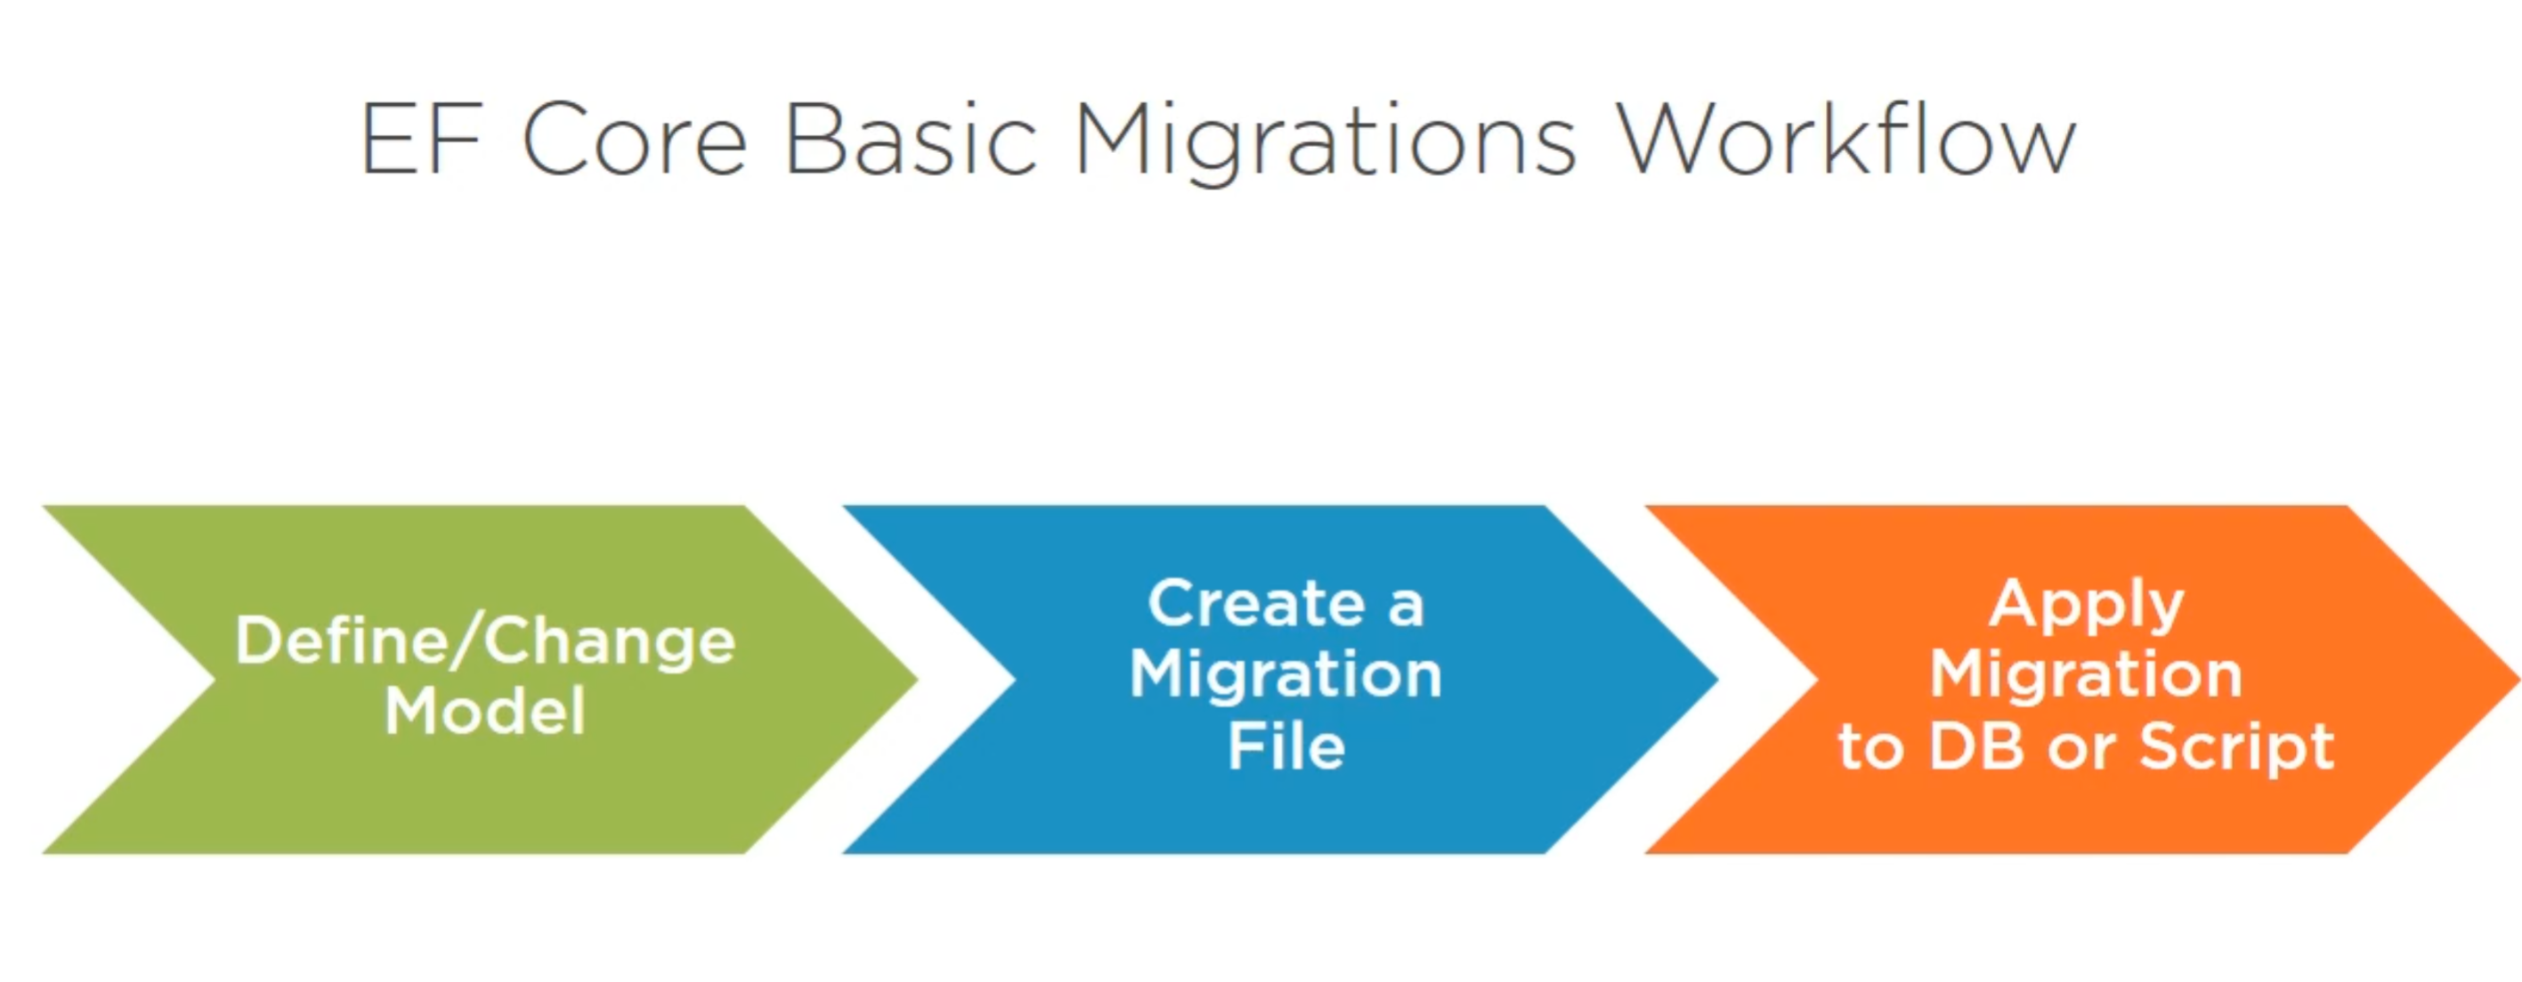
Migrace – změna modelu

Slide 12
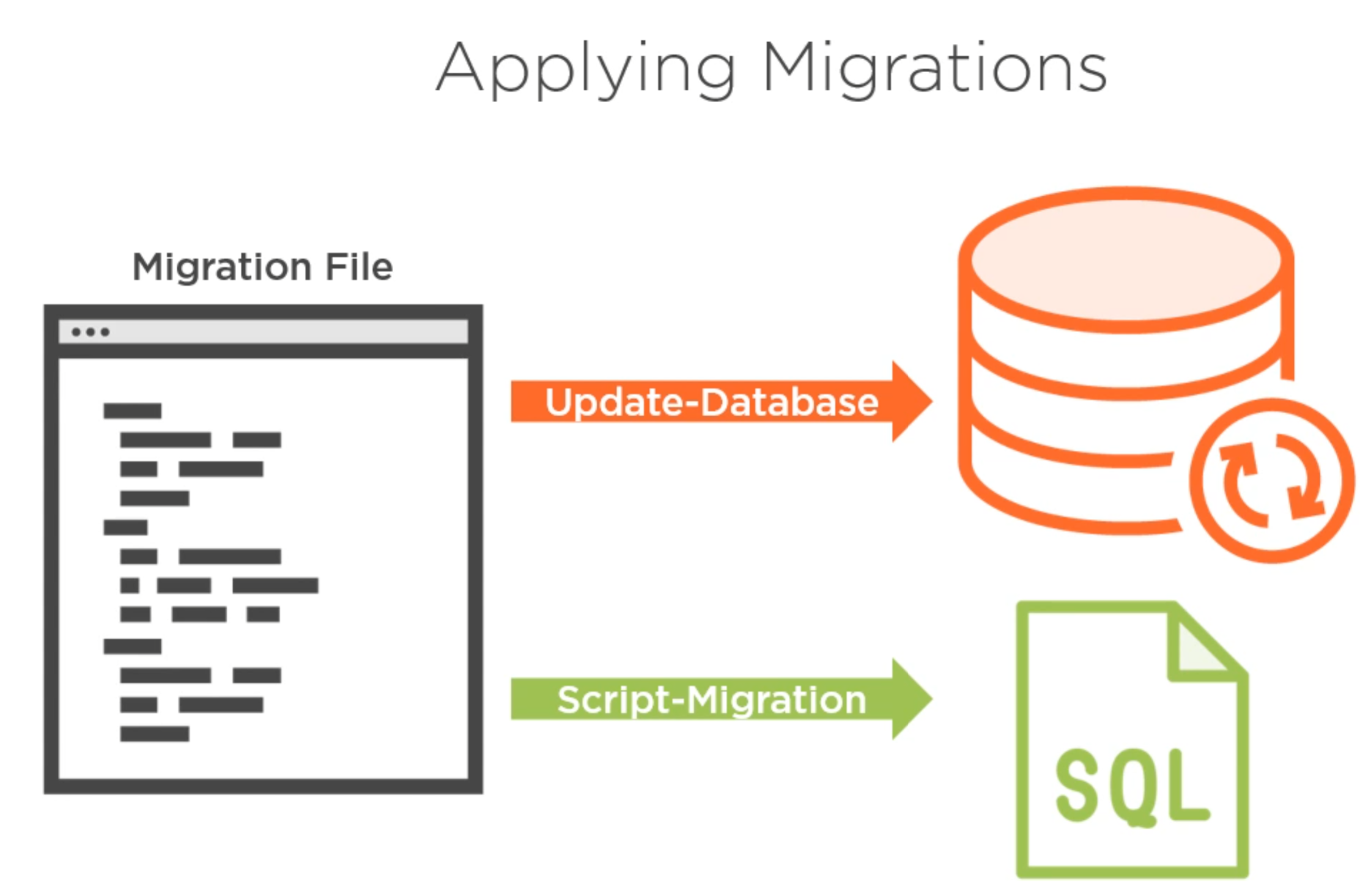

Slide 13


