Slide 1
BLUESTOCK FINTECH
Mutual Fund Analytics Dashboard
Final Capstone Project — Data Analyst Internship
Prepared by Zalsabilah Amelia
Role Data Analyst Intern
Submission Date 10 August 2026

Slide 2
PROJECT FOUNDATION
Problem Statement & Objective
Project Objectives
Why This Project Matters
1
Analyze the mutual fund ecosystem at an industry level
India's mutual fund industry has grown steadily in scale and investor participation, making it harder to track performance and behavior through spreadsheets alone.
Investors and internal stakeholders need consolidated, comparable insight — not raw numbers scattered across scheme-level reports.
Data-driven decision-making depends on having risk, return, and behavioral data in one place, refreshed and filterable on demand.
This project was scoped to turn that need into a working, interactive dashboard rather than another static report.
2
Evaluate fund performance on a risk-adjusted basis
3
Understand investor behavior and transaction patterns
4
Identify SIP and market trend movements
5
Build an interactive, filterable Power BI dashboard
BLUESTOCK FINTECH
Mutual Fund Analytics Dashboard | Data Analyst Internship
2

Slide 3
FOUNDATION
Data Sources & Preparation
Datasets Used
Mutual fund master data
Scheme information
NAV history
Investor transaction data
SIP data
Category-level fund data
CSV
Files
Preprocessing
SQLite
Database
Raw CSV exports move through preprocessing before landing in a queryable SQLite store — the foundation the Power BI model is built on.
Data Pipeline Notes
Data quality checks — standardized category and fund-house naming, numeric-format consistency, and validation of transaction ranges — were applied before any table was connected to the dashboard.
Sourced as CSV files, staged before transformation
Consolidated into a SQLite database for structured querying
Cleaned and standardized prior to modeling in Power BI
BLUESTOCK FINTECH
Mutual Fund Analytics Dashboard | Data Analyst Internship
3

Slide 4
PIPELINE DESIGN
Architecture & ETL Workflow
Raw Data Source CSV exports & application data
How the Pipeline Works
Raw data is pulled from source files and application records — the starting point for every downstream step.
A Python-based ETL layer handles extraction and orchestrates the movement of data between stages.
Cleaning validates formats, standardizes naming (fund house, category) and removes inconsistencies before data is trusted.
Cleaned data is loaded into a SQLite database, giving the project a single structured source of truth.
Power BI connects to this database to build the data model, KPIs, and the four dashboard pages.
The output feeds directly into business insights — investment trends, performance monitoring, and decision support.
Python ETL Scripted extraction & processing
Data Cleaning Standardization & validation
SQLite Database Structured, queryable storage
Power BI Dashboard Modeling, KPIs & visuals
Business Insights Trends, performance & decisions
BLUESTOCK FINTECH
Mutual Fund Analytics Dashboard | Data Analyst Internship
4

Slide 5
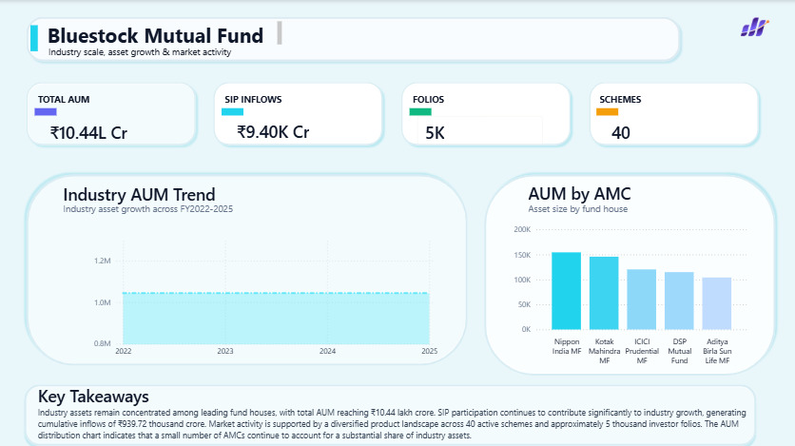
EXPLORATORY DATA ANALYSIS
EDA Findings — Industry Overview
Business Observations
Total AUM stands at ₹10.44L Cr across 40 active schemes — a mature, sizeable industry base.
SIP inflows of ₹9.40K Cr confirm systematic investing is a meaningful, recurring contributor to industry assets.
5K investor folios reflect a broad, though not yet mass-market, base of active participants.
Industry AUM has held a stable band across FY2022–2025, without sharp swings in the trend shown.
Asset size across the top five AMCs is closely clustered, led by Nippon India MF, pointing to a competitive rather than dominated landscape.
Industry Overview dashboard page
BLUESTOCK FINTECH
Mutual Fund Analytics Dashboard | Data Analyst Internship
5

Slide 6
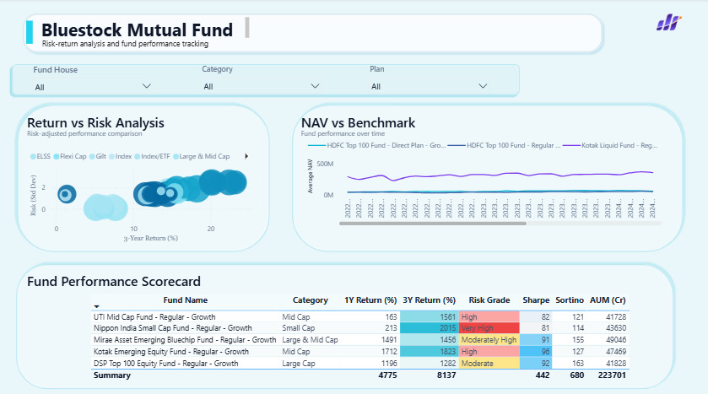
EXPLORATORY DATA ANALYSIS
EDA Findings — Fund Performance
Analytical Insights
Risk and return move together: categories with wider return dispersion in the bubble chart also sit further out on the risk axis.
Small Cap and Mid Cap funds lead on returns — Nippon India Small Cap and UTI Mid Cap post the strongest 3-year returns, both at High/Very High risk grade.
DSP Top 100 Equity Fund is the outlier on the safer side, with the most moderate risk grade and the lowest 3-year return of the five funds shown.
NAV vs Benchmark tracking lets any fund's trajectory be checked against the Nifty 50 directly on the same page.
Fund Performance dashboard page
BLUESTOCK FINTECH
Mutual Fund Analytics Dashboard | Data Analyst Internship
6

Slide 7
PERFORMANCE METRICS
Fund Performance Analysis
Fund | Category | 1Y Ret. % | 3Y Ret. % | Risk Grade | Sharpe
UTI Mid Cap Fund | Mid Cap | 163 | 1561 | High | 82
Nippon India Small Cap Fund | Small Cap | 213 | 2015 | Very High | 81
Mirae Asset Emerging Bluechip | Large & Mid Cap | 1491 | 1456 | Mod. High | 91
Kotak Emerging Equity Fund | Mid Cap | 1712 | 1823 | High | 96
DSP Top 100 Equity Fund | Large Cap | 1196 | 1282 | Moderate | 92
Business-Oriented Interpretation
Return comparison: Nippon India Small Cap Fund posts the highest 3-year return (2015%) of the five funds tracked, followed by Kotak Emerging Equity Fund (1823%).
Risk comparison: the strongest returns come with High or Very High risk grades — none of the top performers sit in a low-risk category.
Best risk-adjusted profile: Kotak Emerging Equity Fund shows the highest Sharpe ratio (96) in the scorecard, indicating efficient return relative to risk taken.
Best performing category overall: Mid Cap and Small Cap funds dominate the top of the return table, while Large Cap (DSP Top 100) remains the steadiest, lower-return option.
BLUESTOCK FINTECH
Mutual Fund Analytics Dashboard | Data Analyst Internship
7

Slide 8
PERFORMANCE METRICS
Investor Behavior Analysis
Transaction Type Distribution
Key Commentary
Lumpsum dominates transaction value: 58.49% of transactions are lumpsum, well ahead of redemptions (35.34%) and SIP (6.17%).
SIP participation is steady across age groups: average SIP value stays close to ₹11K–12K regardless of age bracket, with the 56+ group marginally highest.
Transaction value by state is closely spread: Punjab and Tamil Nadu lead, but the top eight states sit within a narrow ₹0.29bn–0.32bn range — no single region dominates.
Monthly transaction volume fluctuates between roughly ₹180M and ₹240M from early 2024 through mid-2025, without a clear seasonal spike.
Average SIP by Age Group (₹, thousands)
Geographic and demographic patterns together suggest SIP is a habit distributed broadly across investor segments, while lumpsum activity is what currently drives transaction value.
BLUESTOCK FINTECH
Mutual Fund Analytics Dashboard | Data Analyst Internship
8

Slide 9
DASHBOARD WALKTHROUGH
Dashboard Overview — Pages 1 & 2
Page 1 — Industry Overview Gives a top-level snapshot of industry scale — AUM, SIP inflows, folios and schemes — so any viewer starts from the same baseline before drilling into individual funds.
Page 2 — Fund Performance Lets users filter by Fund House, Category and Plan to compare funds on return, risk grade and risk-adjusted ratios side by side.
BLUESTOCK FINTECH
Mutual Fund Analytics Dashboard | Data Analyst Internship
9

Slide 10
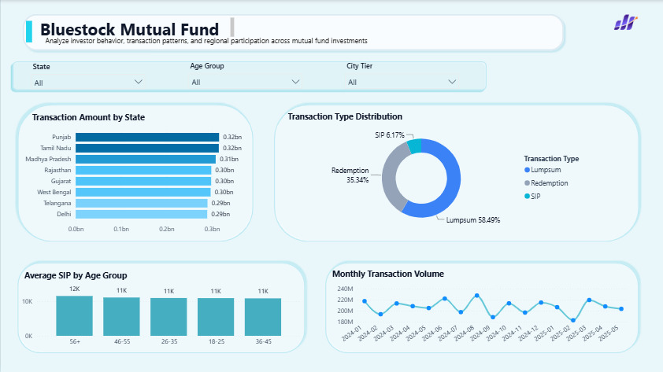
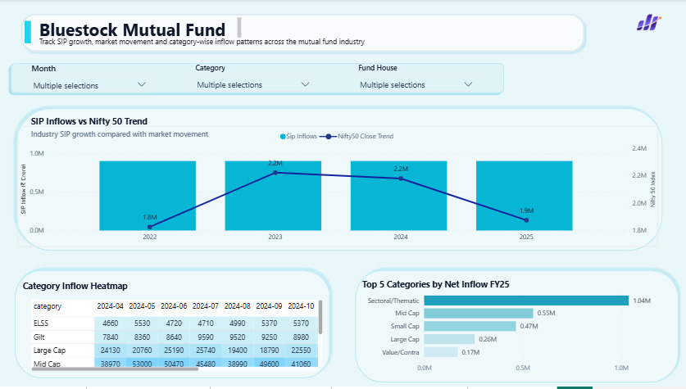
DASHBOARD WALKTHROUGH
Dashboard Overview — Pages 3 & 4
Page 3 — Investor Analytics Filters by State, Age Group and City Tier to reveal transaction patterns, transaction type mix, and monthly volume trends.
Page 4 — SIP & Market Trends Tracks SIP inflows against the Nifty 50 and surfaces which fund categories are drawing the strongest net inflow in FY25.
BLUESTOCK FINTECH
Mutual Fund Analytics Dashboard | Data Analyst Internship
10

Slide 11
CLOSING ANALYSIS
Key Findings & Recommendations
Key Findings
Recommendations
Industry assets (₹10.44L Cr) are fairly evenly spread across the top five AMCs, not concentrated in one player.
Higher returns consistently track with higher risk grades — Small Cap and Mid Cap funds lead returns and risk alike.
Lumpsum transactions drive the majority of transaction value (58.49%), while SIP participation remains steady across all age groups.
Sectoral/Thematic funds lead FY25 net inflow, ahead of Mid Cap and Small Cap — a clear tilt toward growth categories.
Integrate real-time or near-live data feeds to keep AUM and SIP trend figures current
Add predictive analytics for SIP inflow and AUM forecasting
Build more granular investor segmentation beyond state, age and city tier
Introduce automated alerts for sharp shifts in SIP inflows or fund risk grade
Expand benchmarking beyond Nifty 50 to additional market indices
BLUESTOCK FINTECH
Mutual Fund Analytics Dashboard | Data Analyst Internship
11

Slide 12
Thank You
Questions & Discussion
Zalsabilah Amelia | Data Analyst Intern | Bluestock Fintech

