Slide 1
Numerical Methods

Slide 2
state the purpose and benefits of numerical methods
read and apply pseudocode conventions;
understand how numerical data is managed in computers;
define absolute/relative errors and use them in error reporting;
understand and apply the error propagation formula error analysis;
realize the computer representation of numbers in different bases;
distinguish the difference between chopping and rounding;
determine and apply the concept of significant digits;
state the difference between accuracy and precision;

Slide 3
discuss the effects of rounding on floating-point arithmetic operations;
understand the concept of loss of significance and how to avoid it;
determine the convergence rate of sequences;
explain the significance of the condition of a problem and the stability of a method;
determine the truncation error of a series approximation;
apply the mean value theorems to practical problems;
investigate and identify the truncation error of a positive and alternating series

Slide 4
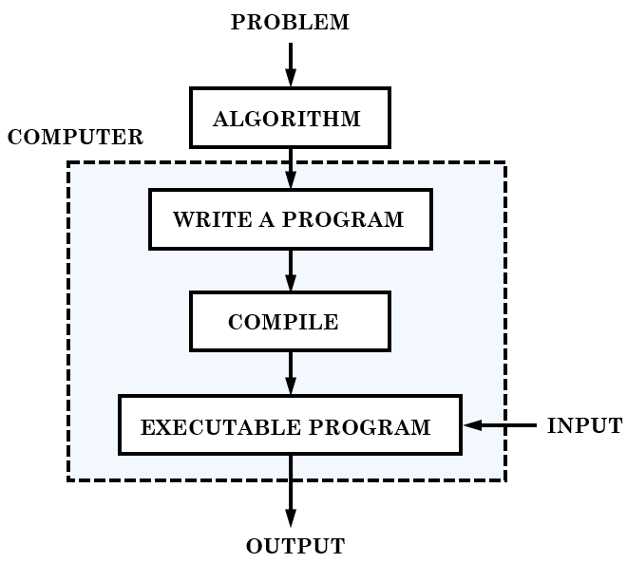
1.1 Numerical Algorithms as Pseudocodes

Slide 5
Elements of a Pseudocode
DEFINITENESS: Every step must be specified and should follow a sequence of instructions in the right order;
FINITENESS: A pseudocode must terminate after a finite number of steps with either an output or error message, and it should not go into an infinite loop or terminate without any clue;
EFFECTIVENESS: A pseudocode must be free of unnecessary or redundant steps or instructions.

Slide 6
Pseudocode Constructs
SEQUENTIAL CONSTRUCTS: Statements are processed and executed in the same sequential order they are written;
SELECTION (BRANCHING) CONSTRUCTS: These constructs (If-Then and If-Then-Else) decide which of the two sets of expression blocks will be processed. The selection constructs start by testing a condition (a Boolean result: True or False). Depending on the result, the program is directed down one of the two available paths;
ITERATION (REPEATING) CONSTRUCTS: There are two kinds of repetition structures: count-controlled iteration (For-construct) and condition-controlled iteration (While- and Repeat-Until). A block of instructions is repeated a number of times until a condition is met.

Slide 7
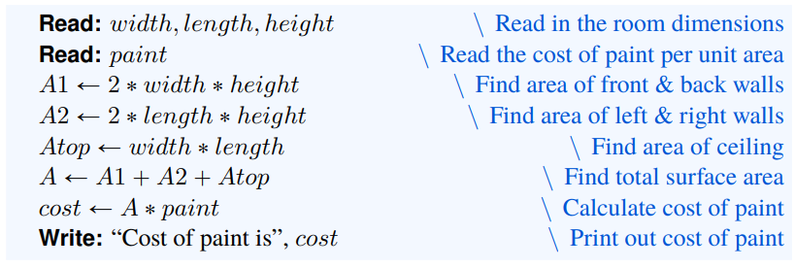
Sequential Constructs

Slide 8
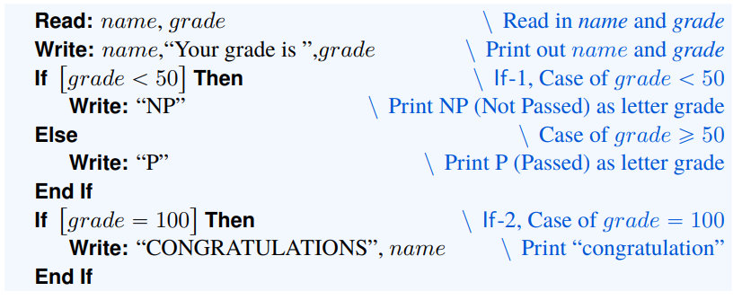
Conditional Constructs

Slide 9
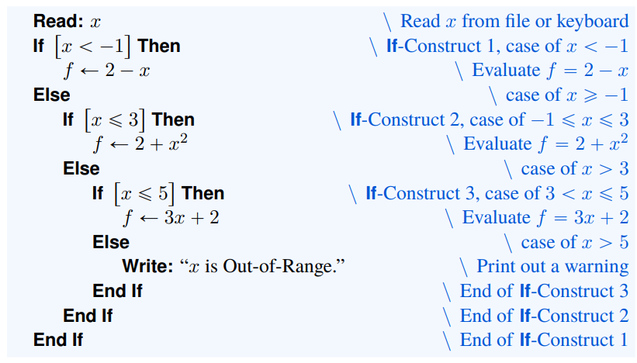
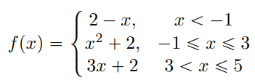
Conditional Constructs

Slide 10
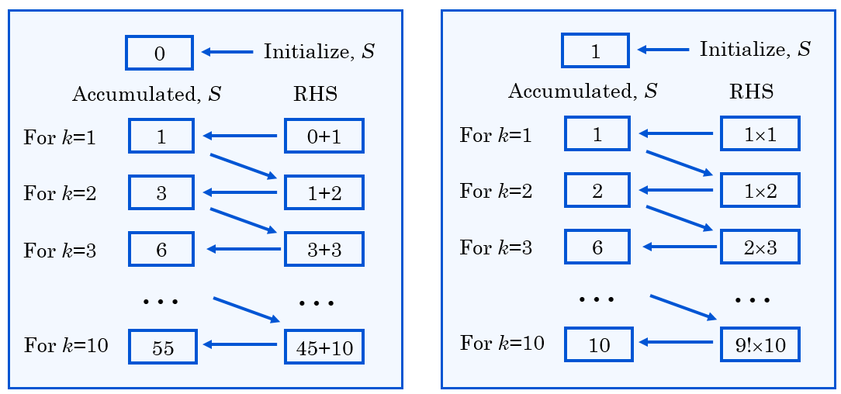
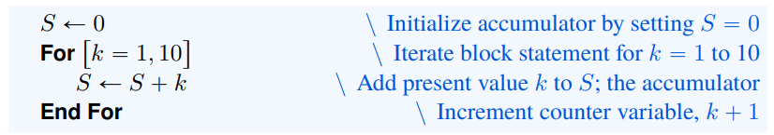
Loops and Accumulators

Slide 11
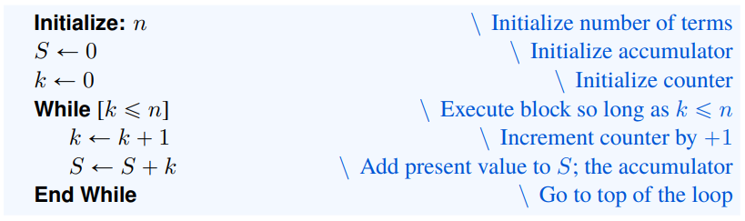
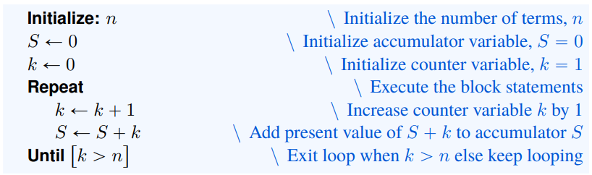
Loops and Accumulators

Slide 12
In programming, the letters i, j, k, m, n, etc. are generally adopted as counter variables because they are also used as index variables in mathematics. Declare a counter variable as Integer because it is operationally easier and faster to increase the value of an integer-type variable.

Slide 13
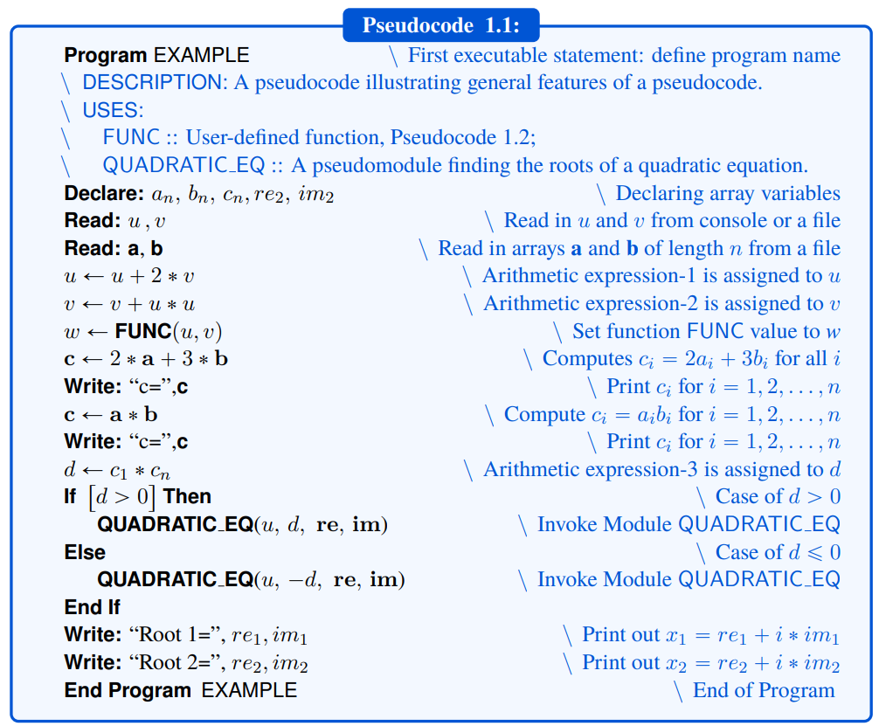
PSEUDOCODES, FUNCTION MODULES AND MODULES

Slide 14
Modular Programming
A module can be reused as many times as needed; program complexity is reduced by eliminating repetition of tasks;
It makes reading and understanding a code simpler and easier;
Maintaining or debugging codes is easier;
Software development is easier;
A module can also be used in other;
Having a library of modules that work reduces the project completion time.
Modular programming may require extra time and/or budget for the program development;
It is a critical, yet cumbersome, task to prepare “complete and detailed documentation” for each module, which is communicated between the design teams;
Preparing a collection of modules can be a challenging task.

Slide 15
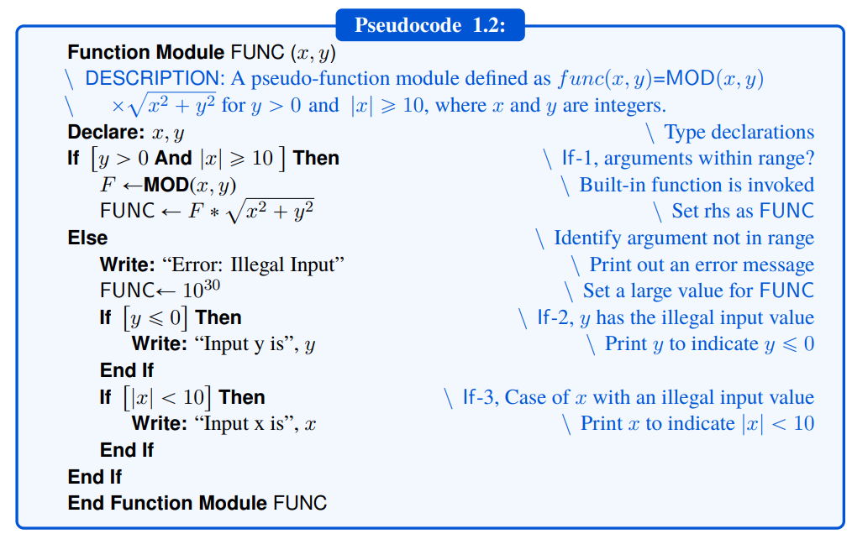
Pseudo-Function Module

Slide 16
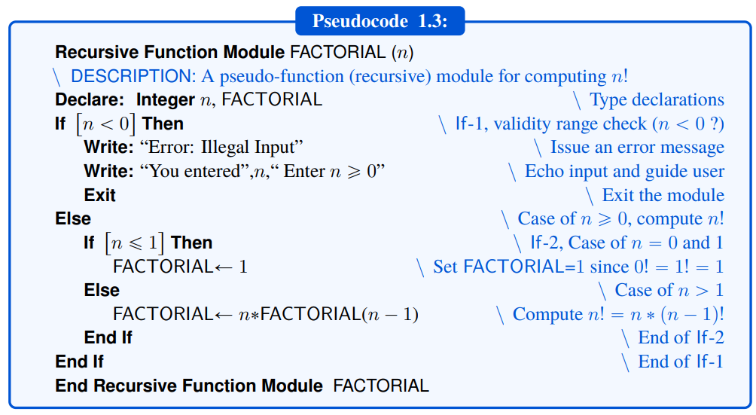
Pseudo-Recursive Function Module

Slide 17
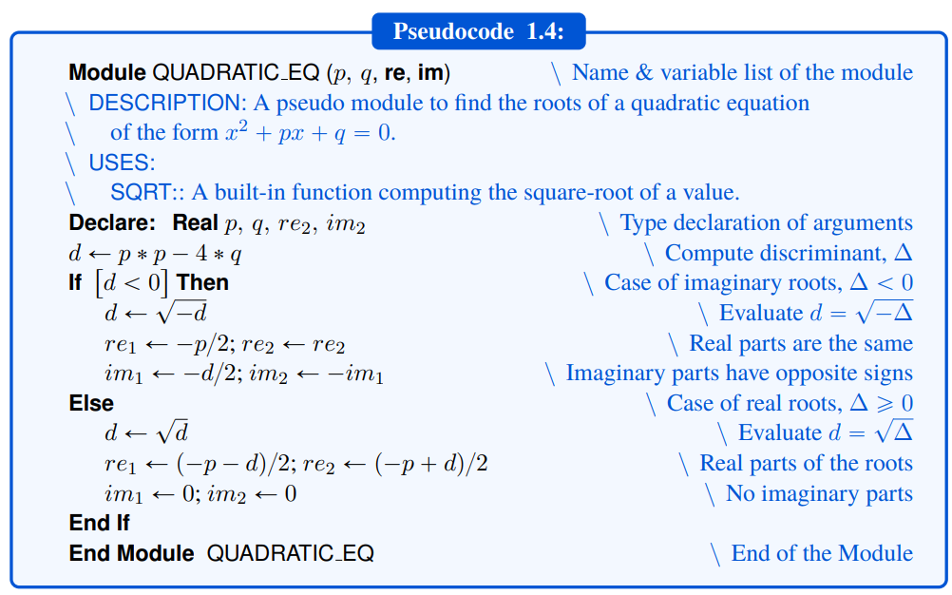
Pseudo-Module

Slide 18
TIPS FOR EFFICIENT PROGRAMMING
Take your time
Establish a list of variables for each program or module
Echo all input variables
Split large programs' tasks into smaller sub-programs
Design programs to reduce memory requirements
Design programs to reduce cpu-time

Slide 19

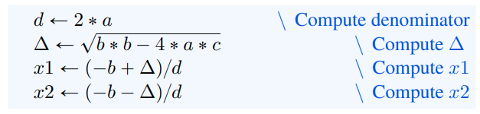
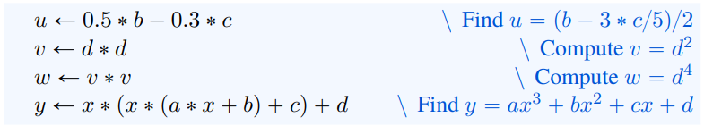
Cpu-time reduction measures

Slide 20
Minimize the number of conditional constructs and indefinite loop constructs due to the cpu-time devoted to the evaluation of the logical expressions. In this regard, For-constructs are faster than While- or Repeat-Until constructs.

Slide 21
BASIC DEFINITIONS AND SOURCES OF ERROR
Modelling Error
Experimental Error
Numerical Error

Slide 22
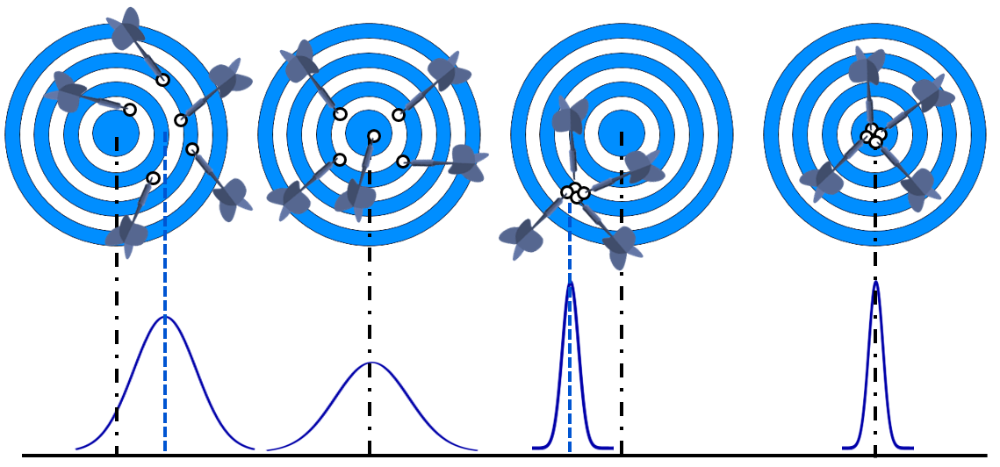
MEASUREMENT ERROR, ACCURACY AND PRECISION
Figure 1.3: (a) Accuracy-low, Precision-low, Bias present (on the east of the target);
(b) Accuracy-high, precision-low (No bias),
(c) Accuracy-low, Precision-high, Bias present (on the SW of the target),
(d) Accuracy-high, Precision-high (No Bias)

Slide 23
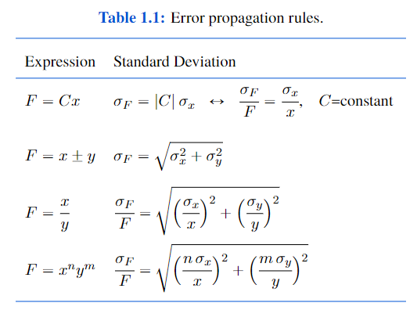
PROPAGATION OF ERROR

Slide 24
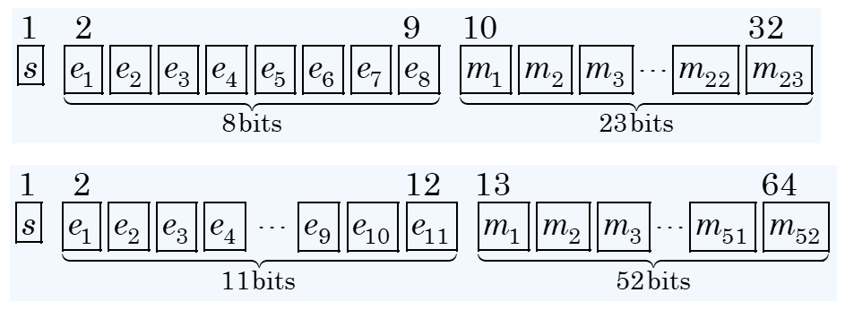
Single-/Double-Precision

Slide 25
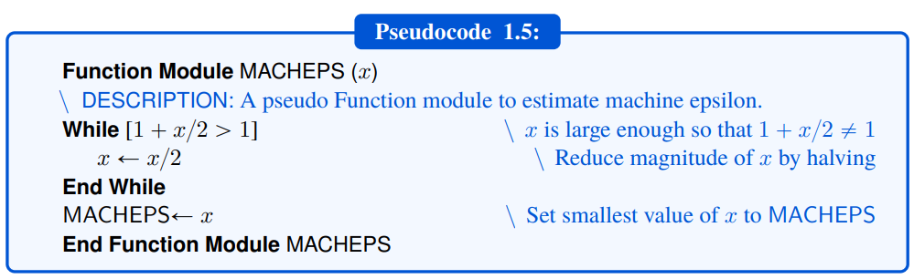

Slide 26
Utilizing the machine epsilon, ϵ_{m}, in computer programs makes the programs portable, i.e., machine-independent. In other words, the programs become independent of the computer hardware or systems for which they were designed.

Slide 27
A more prudent approach is to base an equality test on the relative error, , rather than absolute error, especially when dealing with very small or very large numbers.

Slide 28
ROUNDING-OFF AND CHOPPING

Slide 29
Significant Digits
All non-zero digits 1, 2, …, 9 are significant; e.g., 123 and 1.234 have, respectively, three and four significant digits;
Zeros between any two non-zero digits are significant; e.g., 102 and 1.02 have three significant figures, while 12.003 has five significant digits;
Zeros to the left of the first non-zero digit in a number are not significant; e.g., 0.01, 0.012, 0.00123, and 0.01234 have one, two, three, and four significant digits, respectively;
Zeros to the right of the last non-zero digit in a number (i.e., trailing zeros) with a decimal point are significant; e.g., 1.30 and 123.000 have, respectively, three, and six significant digits;
The significance of trailing zeros in an integer depends on the measurement; e.g., 12300 is ambiguous, but it becomes more meaningful when expressed as 1.23×10⁴ (three-significant digits), 1.230×10⁴ (four significant digits), or 1.2300 ×10⁴ (five significant digits).

Slide 30
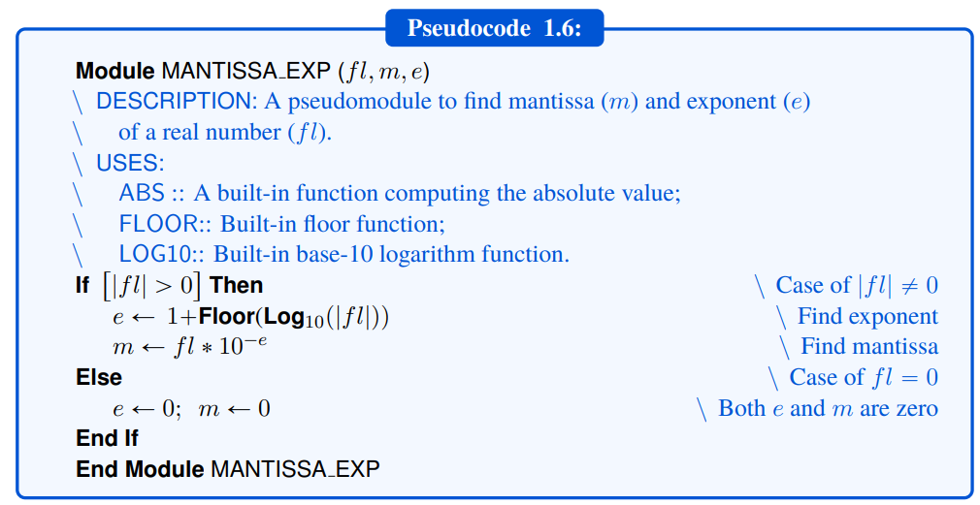
Floating-point Number

Slide 31
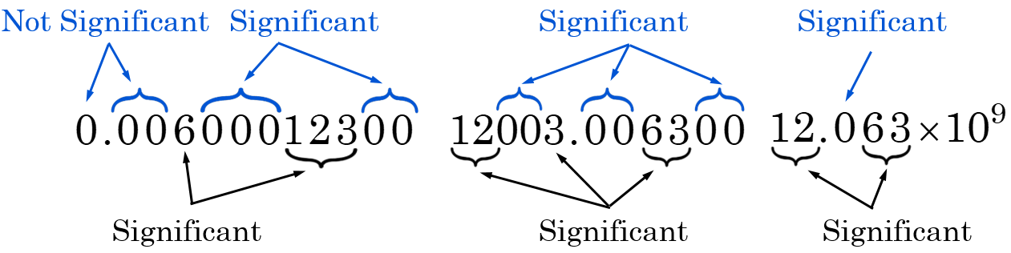
ROUNDING-OFF AND CHOPPING

Slide 32
