Slide 1
#GlobalAzure
#CloudGenVerona

Slide 2




Thanks to all the sponsors
PREMIUM SPONSOR
BASIC SPONSOR

Slide 3
Reactive Programming
Gestiamo una flotta di veicoli in movimento

Slide 4

Who I am
@riccardozamana
https://github.com/zama202
RICCARDO ZAMANA
https://www.linkedin.com/in/riccardozamana/

Slide 5

Intro
..where are we going?..
Why reactive architecture is important?
What problem it's trying to solve?
How are Reactive Systems related to Reactive Programming?
… Is "wrong" the answer, really?

Slide 6
The past and the present
Key factor | Yesterday | Today
Size of Installation | Large inst - Few nodes | Small inst – many nodes
Among of data | Gbs | Tbs/Pb
Data change | Nightly (batches) | Constantly change
Maintenance Window | 3 hours … Comeback later! | 101% SLA
User patience | < 30sec | < 3sec
Notes:
Size of Sw installation is grown (multi node..ten)
Among of data (gb of data)
Data at REST: non cambiava frequentemente (batch notturno)
Long mantenance windows is changed (reduced)
Oggi
NEWER sistem
small installation + scaleout
petabytes! il dato czmbia costanatemente

Slide 7
Whats happen
In case of failure, is difficult to recover data stream
100% SLA is achievable
Small maintenance, no more hours
Micro Deployments are born
User patience is less then 3seconds
Software must respond… otherwise user search for alternatives
Notes:
se c'è un fallback, non siamo in grado di recuperare..troppi dati
100% uptime è raggungibile.
No more mantenance per ore.. per aggiornamenti
NON ACCEPTABLE
DEployment è cambiato
Natura del cambiamento.
Utente odierno
Cambiata l'aspettativa dell'utente.
poche ore di down.. gran casini ora!
gmail giu? github giu? o365 giu?
In quanto tempo devono rispondere?
30secondi? noooooo
utenti non vogliono aspettare. Sito è giu, passa dopo... MORTO!
il software eve rispondere. altrimenti oggi.. ne ccerco un altro.

Slide 8

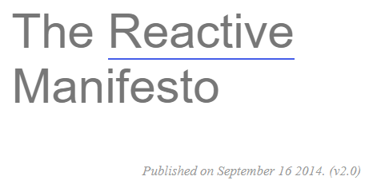
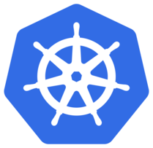





REACTIVE Does!
PROVIDE THE SAME EXPERIENCE IN EVERY KIND OF CONDITION
Notes:
Non cambia in qualsiasi condizione!

Slide 9
PRINCIPLES
RESPONSIVE (faster then ever)
Generate USER CONFIDENCE
RESILIENT (remain responsive in case of failure)
Replication,Isolation, Containment, Delegation
Only recovery may be delegated to external components
ELASTIC (active during deployments or scaling)
responsive during scale out or scale down
predictive auto scaling tecnique
MESSAGE Driven (async, non blocking)
Decouple everything, isolation, location transparency
Failures isolated in every single component
cost effectiveness
Resource Consumption only when are «active and «GREEN LIGHT»
Notes:
RESILIENT (remain responsive in case of failure)
ELASTIC (rimane attivo anche se lo cambio sotto) << Scalability sia in scale UP, ma anche in SCALE DOWN << MOOOLLTO DIFFICILE!!
MESSAGE Driven (async, non blocking)
GREENLIGHT = CIRCUIT BREAKER con semaforo di stato

Slide 10
Programming vs Architecture
Reactive Programming VS Reactive Systems/Architecture
Reactive SYSTEMS: Apply principles to Architecture
Reactive Programming: Used to implement Reactive Systems
RX.NET is only a programming tecnique
You can do a ReactiveSystem WITHOUT ReactiveProgramming
REACTIVE Systems (based on Reactive Microservice) are separated throw Async mimic and boundaries

Slide 11
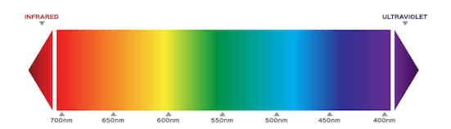
REACTIVE MICROSERVICES
My Opinion: No Black, nor white.
But a spectrum of capabilities between Monolith and MicroServices
Remember the SOA dream?
MicroServ is a SOA subsystem… but the difference?
Independent Govern
Async communication
Continuous deloyment
Independent team delivery
SINGLE RESPONSABILITY PRICIPLE <||> BOUNDED CONTEXT
Entities/Domains with dedicated services, with different Database, using other services throw API.
Notes:
Remember the SOA dream?
Entità/Dominio hanno servizi staccati, ognuno con un DB - mai dritti sul DB ma sempre via API
MicroServ è un sottoinsieme di SOA. Deploy è indipendente, questa è la differenza e ognuno scala come vuole.
MicroServ è govern independent
comunicazione async
continuous deloyment
team delivery in modo indipendente (tramite versioni di api differenti)
i model comuni..... sono il primo errore per me!!!
CQRS ragazzi, CQRS!!
SINGLE RESPONSABILITY PRICIPLE
BOUNDED CONTEXT

Slide 12
KEYWORD n.1: ISOLATION
ISOLATION IN STATE
No backdoor straight to other DBs
Evolve internally throw API version
Health State API embedded
ISOLATION IN SPACE
Discovery or Gateway to find out the MS Location – not hard coded
Independent scale out/down
ISOLATION IN TIME
No wait for other MS. Async message Driven mimic and Not Blocking also.
Eventual consistency is a MUST
ISOLATION IN FAILURE
Other consequences on other MS if there is a failure
Notes:
ISOLATION!
STATE, SPACE, TIME, FAILURE
Quindi devo dare ad ognuno una dimensione propria.
Il problema quindi è la correlazione!
ISOLATION IN STATE
no backdoor per andare drritti verso DB
evolve internally tru API versioni
ogni ms deve avere il proprio API di stato
SPAZIO
non devo avere il punto fisico dove c'è un Microservice (discovery? Gateway?)
scale out/down indipendente
TIME:
no wait altri microservices. Async message Driven. async and Non Blocking
Eventual consistency between
ISOLATION IN FAILURE
gli altri non devono fallire se uno fallisce

Slide 13
ISOLATION TENCHIQUES
BULK HEADING
Failure is isolated in failure zones (made by more ms)
Failure is not propagated
It admits a degraded flow but not dead flow => doubling the way or Health API
CIRCUIT BREAKER
Problem: OverLoaded Services? pMaybe other MS could retry and worse the situation.
With a 3 state semaphore, I can send the retry time or predict it !!
COMPETING CONSUMER
Message Driven: Enqueue, Exchange, Dequeue with Async messaging
Notes:
BulkHEading (scompartimenti della nave)
failure is isolated in failure zone (fatte da piu microservizi)
non propaga fallimento
teoricamente sta in piedi cn degrado ma non fallimento totale
=> doppia strada? oppure chiamo API Status, e avviso che non è su.
OverLoaded Services?
chiamo un ms già stressato, e faccio retry... e peggioro solo lo stato di stress
CIRCUIT BREAKER: Il ms ha un semaforo che dice se è verde/giallo/rosso dando info per il retry o il fail.
(chiamami poco, chiamami pure quanto vuoi, chiamami tra un po sono fallito)
MEssageDriven Architecture
Async messaging

Slide 14
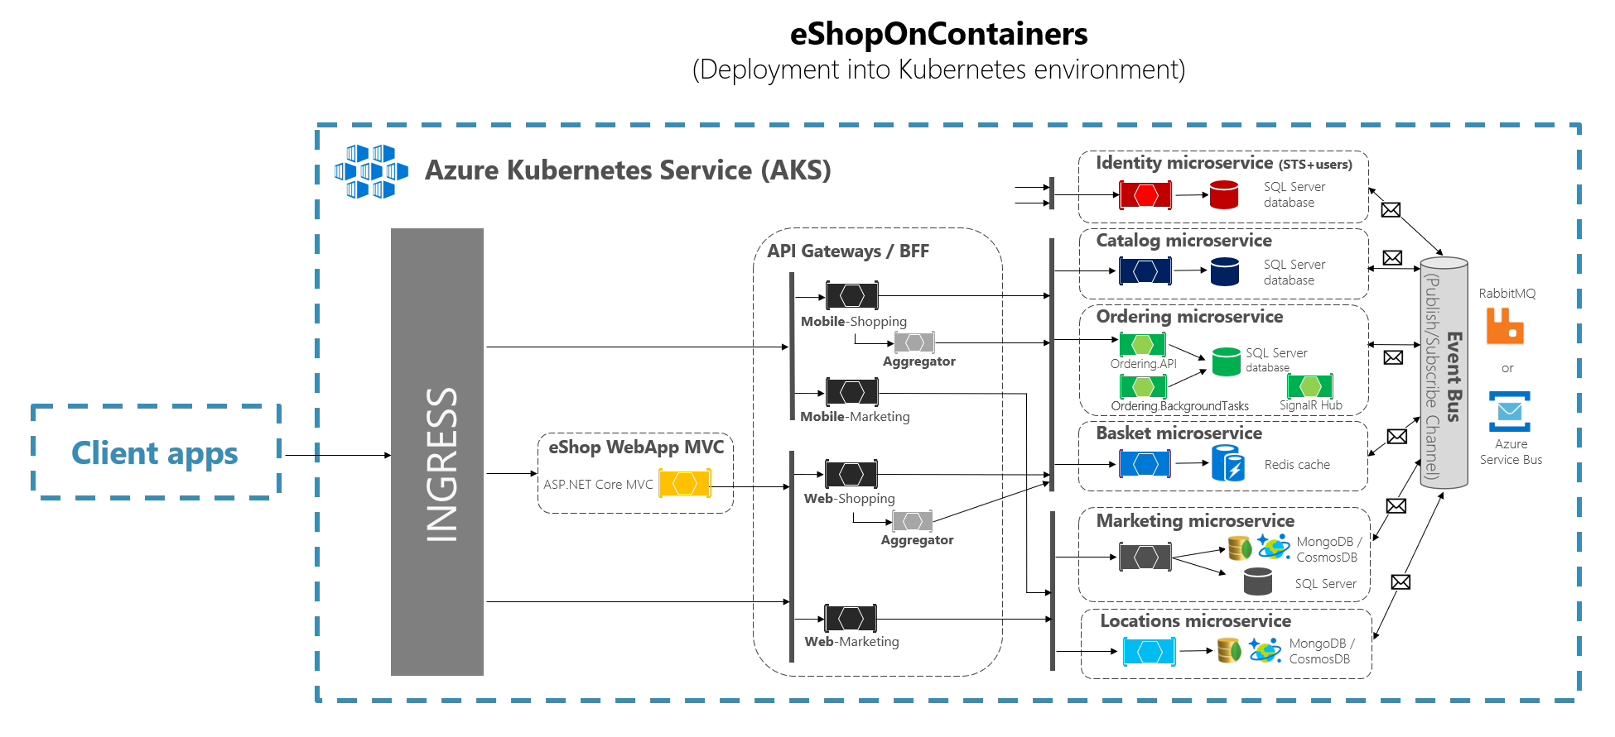
ISOLATION TECNIQUES
GATEWAY SERVICES
Managing complexitty: Who aggregates MS.API in macro services? Should client know how to aggregate MS.API? i client hanno bisogno di gestire loro i casini di disponibilità dei micro servizi? PROXY/GATEWAY: not only binding! But aggregation also.
AUTONOMY:
Every service must have strategies to solve its wn problem (mantaining internal state, with eventual consistency, avoiding direct dependencies on external services
Notes:
AUTONOMY:
Autonomous Service – every service must have strategies to solve its wn problem (mantaining internal state, with eventual consistency, avoiding direct dependencies on external services
GATEWAY SERVICES
Managing complexitty: Who aggregates MS.API in macro services? Should client know how to aggregate MS.API? i client hanno bisogno di gestire loro i casini di disponibilità dei micro servizi?
i PROXY/GATEWAY: non fanno SOLO binding!!! ma fanno aggregazione! così il client rimane ignorante

Slide 15
REACTIVE PROGRAMMING
Small discrete steps
async based, with CALLBACK:
- FUTURE/PROMISES
- STREAMS

Slide 16
ANY DOUBT?
Is it possible to have ReactiveProgramming without a Reactive System?
YES. Examples:
1) One unique node => No Resilience
2) Local cache and no way to sync cache with other nodes => NO Elasticity
Notes:
Is it possible to have ReactiveProgramming without a Reactive System?
YES. Examples:
1) One unique node => No Resilience
2) Local cache e no way per fare sync con altri nodi... => NO ELASTIC

Slide 17
ACTOR MODEL
An Actor is a primitive unit of computation
Actors are completely isolated from each other
They will never share memory.
Actor can maintain a private state
They come in systems, never alone
They need to have addresses
It will just execute one at a time
Concurrence means Actor of Actors
Communicate with asynchronous messages
A) Create more actors
B) Send messages to other actors
C) Designate what to do with the next message
When an actor receives a message, it can do one of these 3 things:

Slide 18
LOCATION TRANSPARENCY
LOCATION TRANSPARENCY:
Local or remote, it doesnt matter.
They ca be ROUTEE, routed by a ROUTER
YES. I can send msgs to a Router, without knowing about the subscribers.
WE HAVE TO COMBINE REACTIVE Systems, message driven, in order to have Location Transparency. Location TRANSPARENCY = Elasticty + Resilience

Slide 19
REACTIVE SYSTEMWITHOUT ACTORS?
Could be…
Service Registry
Load Balancer
Message BUS
Service that interchange msgs using a BUS
IT’s a reactive system... But not inside the Microservices, because they lack of an Observer, and there isnt an entity alive.

Slide 20

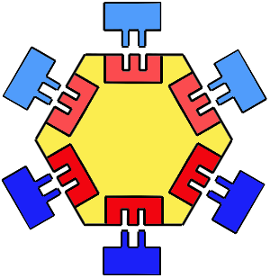
HEXAGONAL ARCHITECTURE
Is the answer

Slide 21
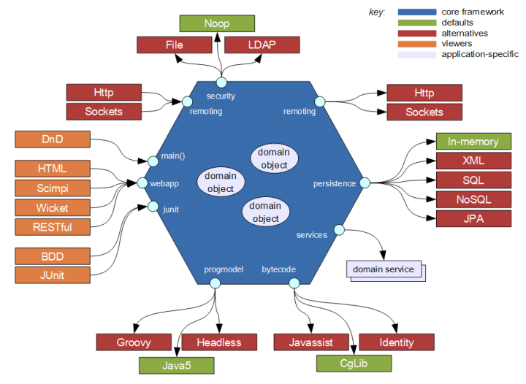
WHAT’S ABOUT THE REAL DESIGN?
HEXAGON Fulcrum is DOMAIN
2 SIDES, RIGHT & LEFT
FIRST SIDE: DATA SIDE API with ADAPTERS to DBs, Fs, etc. consumed by DOMAIN
SECOND SIDE: USER SIDE API, where PORTS (they are API) that serve Domain data to USER (interface, API, message broker)
INFRASTRUCTURE: where Adapters maps PORTS
REAL DECOUPLING || REAL PORTABILITY || REAL SCALING
Notes:
DOMMINIO => API => Infrastructure (che adapts incoming e outcoming traffic into the ports)
fa in modo che il domian sia portable (cambio il DATA SIDE tra cloud e onprem)
FACCIO Adattatori verso DATI
li chiamo come librerie dentro il DOMAIN
nel DOMAIN mappo verso i dati
POI FAccio le API verso i DOMINI
API non sanno ildb , ma sanno solo che usi un dominio
il dominio è fatto di ATTORI?
1) DOMINIO CHIAMA ADAPTERS verso API (PORTS) DEI DATASOURCE
2) USER CHIAMA API (PORTS) CHE MAPPANO API di DOMINIO

Slide 22
My 2 cents ..

Slide 23
DEMO
Notes:
DEMO DI RX.NET
ARCHITETTURA LAMBDA SU AZURE con MAPPA

Slide 24
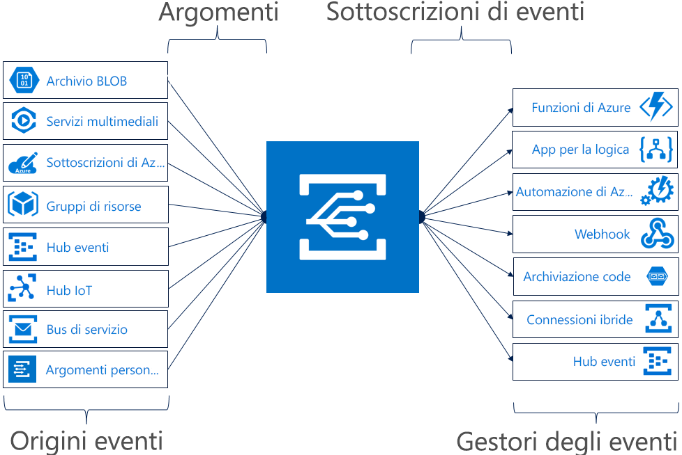
Event GRID

Slide 25
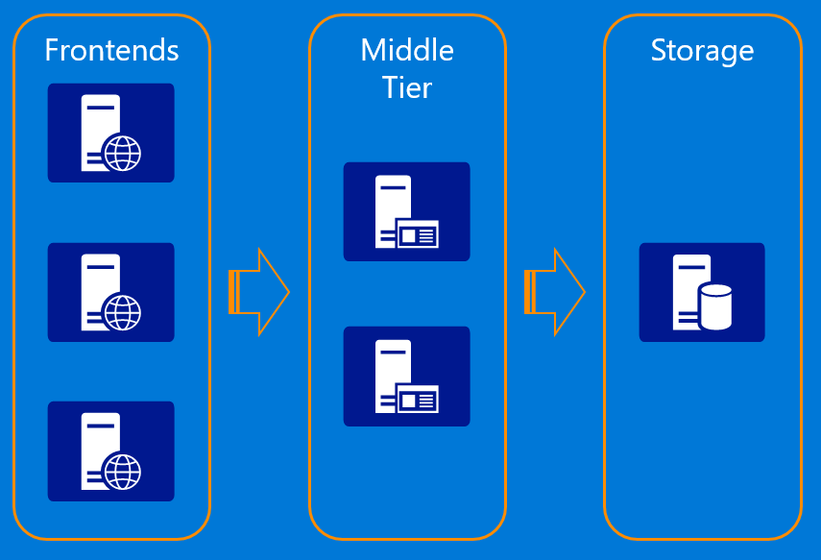
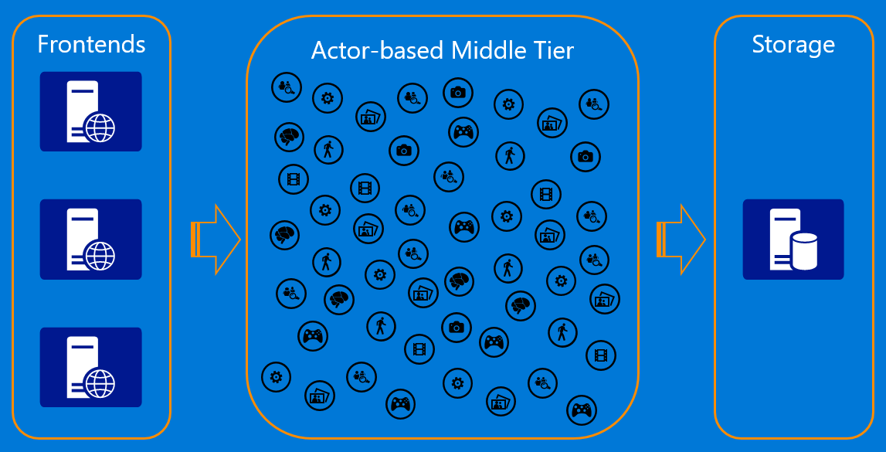
ORLEANS
Everything is an actor.
Computational entity that, in response to a message it receives, can concurrently:
send a finite number of messages to other actors;
create a finite number of new actors;
designate the behavior to be used for the next message it receives.
Asynchronous communication and control structures
Recipients of messages are identified by address, sometimes called "mailing address". Thus an actor can only communicate with actors whose addresses it has.

Slide 26
Event GRID
QUESTA E' la chiamata da mettere nel WebHook del EventGrid
https://{functionappname}.azurewebsites.net/runtime/webhooks/eventgrid?functionName={functionname}&code={systemkey}
COME SI FA ad ottenere la system key? QUESTA è la chiamata GET per ottenere la SystemKEY
http://{functionappname}.azurewebsites.net/admin/host/systemkeys/eventgrid_extension?code={masterkey}
DA DOVE PRENDI LA MASTER KEY? Pubblichi la funzione, vai su MANAGE e trovi la _Master
ESEMPIO COMPLETO:
http://FuncAppEventTrigger20190422124458.azurewebsites.net/admin/host/systemkeys/eventgrid_extension?code=Sri9IKxvpbbpJdFn6dF3dlXZoAuk4DF6URWYf5g1yVGw1A0q0787AQ==
ECCO LA RISPOSTA:
QUINDI:
https://FuncAppEventTrigger20190422124458.azurewebsites.net/runtime/webhooks/eventgrid?functionName=StartSession&code=Bks9oZKL9VS9aB2O/Poir073bW671UBZhGc34//vdK9ZtMqw2ZwQiQ==
{
"name": "eventgrid_extension",
"value": "Bks9oZKL9VS9aB2O/Poir073bW671UBZhGc34//vdK9ZtMqw2ZwQiQ==",
"links": [{
"rel": "self",
"href": "https://funcappeventtrigger20190422124458.azurewebsites.net/admin/host/systemkeys/eventgrid_extension"
}]
}

Slide 27
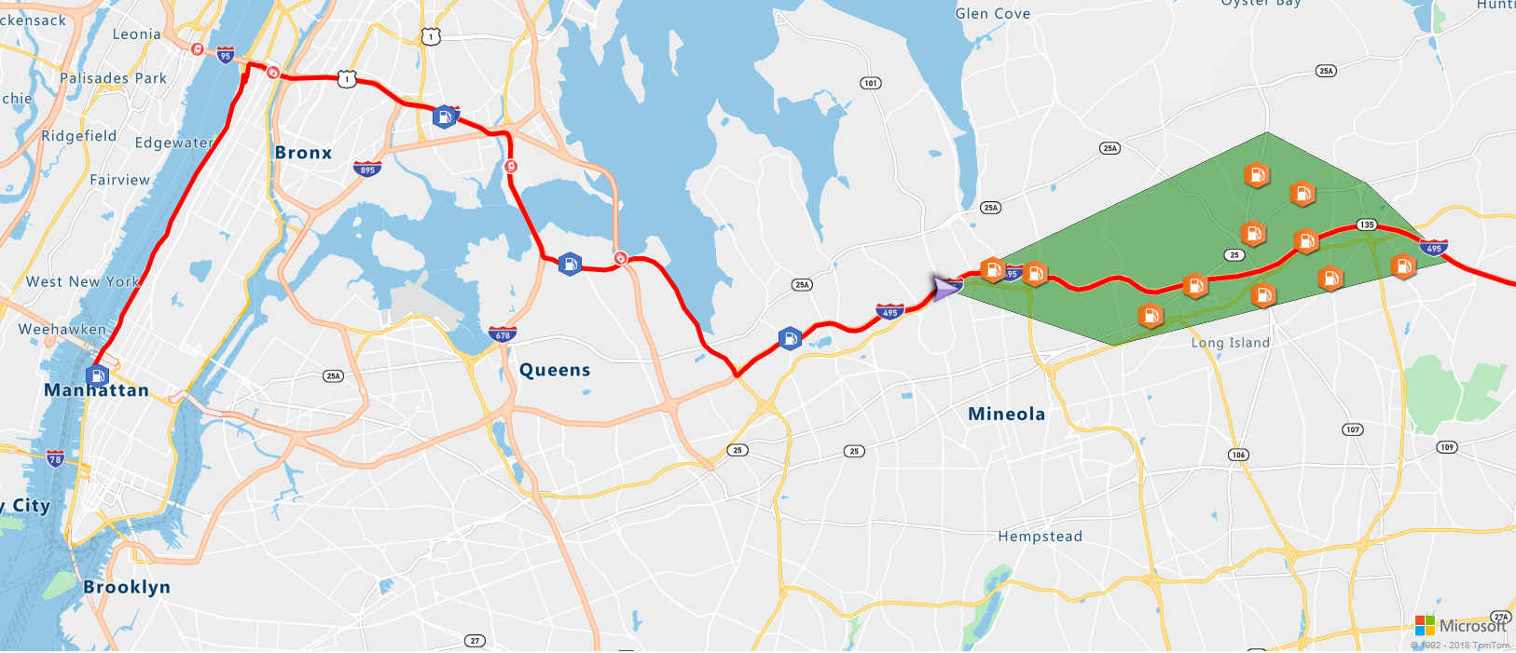
Azure Maps
Map controls
Android SDK
Azure Maps Services
Rendering service
Route planning service
Research service
Time zone service
Traffic information service
IP to location (country)
Batch geocoding service
Batch routing service
SDK WEB
API REST

Slide 28
Azure Container Instances
Great solution for
- isolated containers
- including simple applications
- task automation
- jobs
NEWS: Virtual network deployment (preview)
NOTES:
Persist state with Azure Container Instances, we offer direct mounting of Azure Files shares.
Azure Container Instances can schedule both Windows and Linux containers with the same API
Co-scheduled groups that share a host machine, local network, storage, and lifecycle
Advantages:
- Start containers in seconds => NO NEED to provision VMs.
- Simple Public IP connectivity and DNS name
- Exact specifications of CPU cores and memory
- Get billed by the second

Slide 29
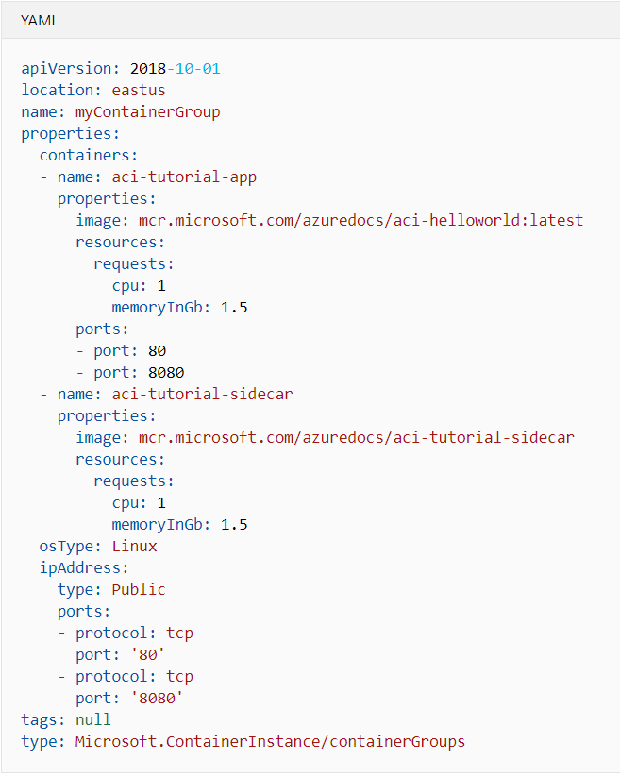
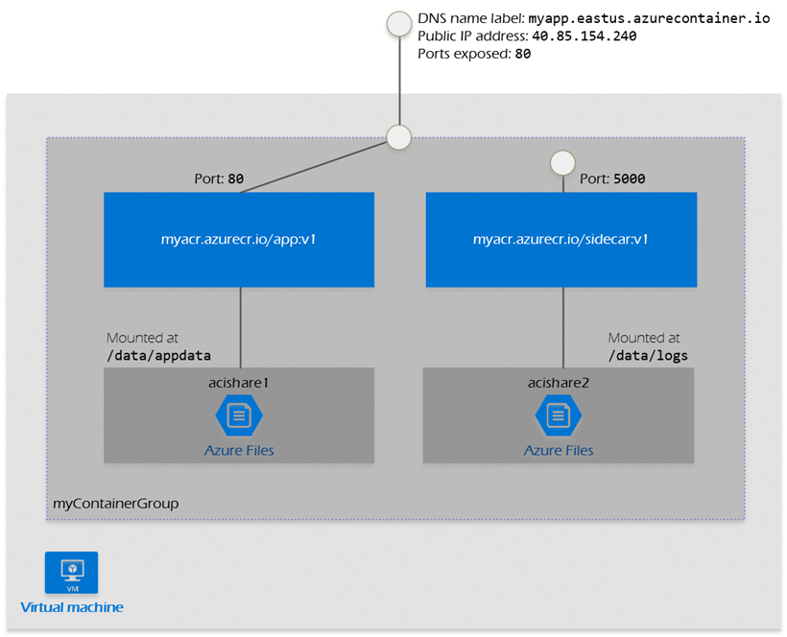
Azure Container Instances
Co-scheduled groups that share a host machine, local network, storage, and lifecycle
az container create --resource-group myResourceGroup --file deploy-aci.yaml

Slide 30
DEMO

Slide 31
USE CASE

Slide 33
https://github.com/zama202
@riccardozamana
https://www.linkedin.com/in/riccardozamana/

