Slide 1
Autism screening data Predicting Autistic Spectrum Disorder (ASD) Zahid Amadxarif PSAIL Interview

Slide 2
The Brief
Autistic Spectrum Disorder (ASD) is a neurodevelopment condition with significant healthcare costs.
Early diagnosis can reduce healthcare costs but procedures are length and not cost effective.
A dataset with patient characteristics and behavioural traits could vastly improve the efficiency of diagnosis.

Slide 3
Sample
N = 674 (80%/20% Training-Testing split)
Target: ASD
Categorical features:
Gender, Ethnicity, Country of residence
Numerical / Binary features:
Age, Family, Jaundice, Binary behavioural features
Cleaning:
One-hot encoding of categorical features
Dropped ‘Age desc’ and ‘Relation’ variables
Reduced number of categories for country of residence (from 67 to 10)

Slide 4
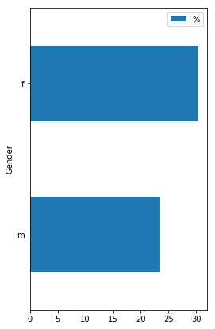
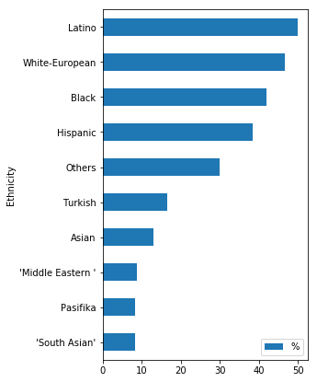
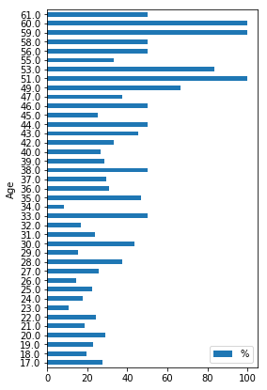
ASD diagnosis varies by gender, ethnicity, age

Slide 5
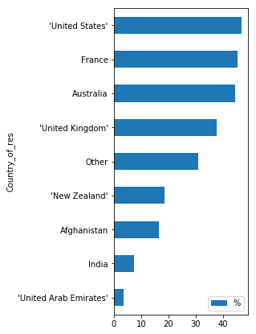
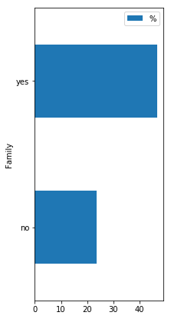
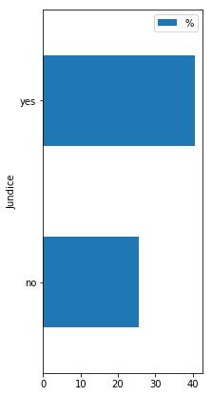
ASD diagnosis also varies by country of residence, jaundice status and if a family member has PDD

Slide 6
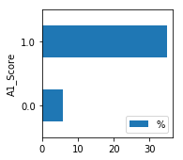
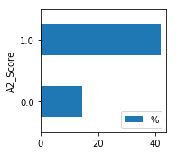
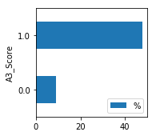
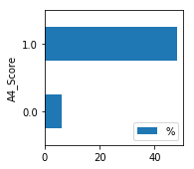
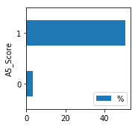

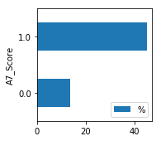
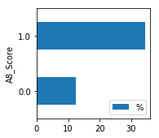
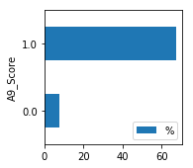

Behavioural traits likely to be strong predictors of ASD

Slide 7
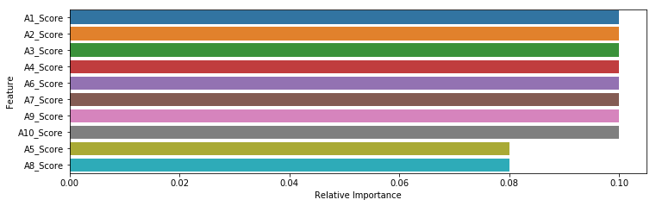
Which model performs best and which features are most important?
Model | Accuracy | Precision | Recall | F Test
Decision Tree Classifier | 0.86 | 0.73 | 0.83 | 0.75
AdaBoost Classifier | 1.00 | 1.00 | 1.00 | 1.00
Ridge Classifier | 0.93 | 0.86 | 0.90 | 0.87
Logistic Regression | 0.99 | 0.98 | 0.98 | 0.98
Notes:
[NEED COEFFICIENTS FROM LINEAR REGRESSION]

Slide 8
Thank you

