Slide 1
Airbnb Listings Data Price Prediction and Improving Customer Reviews Zahid Amadxarif

Slide 2
The Brief
Price Prediction
The firm intends to use a model to advise their clients on how to set a competitive price for their first listing on Airbnb.
Improving Customer Reviews
The firm would like to use a second model to help advise their clients on how to maximise positive consumer response to their first Airbnb listing.

Slide 3
Listing Data
77135 observations and 76 variables
Variables include:
Listing identifiers, host details
Location details
Availability of listing
Property details
Review scores

Slide 4
Model 1: Predicting Rent Price

Slide 5
Sample
N = 70,969
Target: Rent Price
Categorical features:
Neighbourhood, Room Type, Amenities, Instant Bookable
Numerical features:
Longitude, Latitude, Accommodates, Bathrooms, Bedrooms, Beds, Price, Minimum nights, Maximum Nights
Cleaning:
One-hot encoding of categorical features; extracting bathrooms quantity; removing currency from target
Dropped host details, review scores, urls, property type and identifier variables
Log transformation and normalisation of target and numerical features

Slide 6
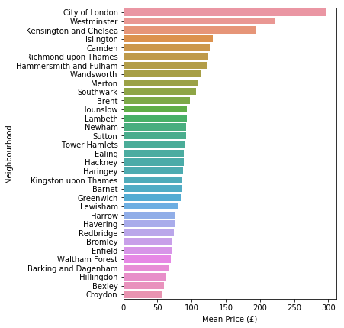
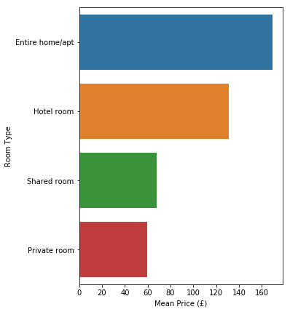
Prices vary by neighbourhood and room type

Slide 7
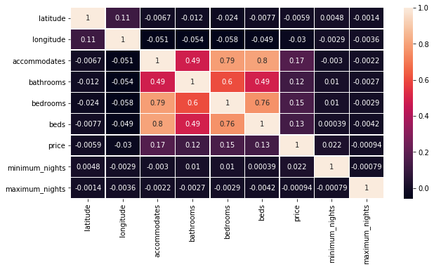
Correlation among numerical variables
Weak individual correlation with price.
Accommodates, Bathrooms, Bedrooms and Beds are strongly correlated with each other.

Slide 8
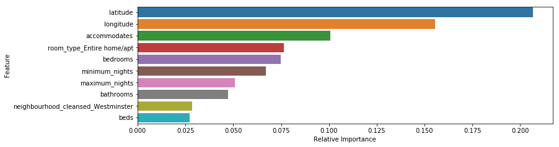
Which model performs best and which features are most important?
Model | R2 Train | R2 Test | MSE Train | MSE Test
Linear Regression | 0.59 | 0.61 | 0.25 | 0.25
Gradient Boosting Regressor | 0.63 | 0.64 | 0.23 | 0.23
Linear SVR | 0.59 | 0.60 | 0.26 | 0.25
Ridge CV | 0.59 | 0.61 | 0.25 | 0.25
K Nearest Neighbours | 0.73 | 0.61 | 0.17 | 0.25
Notes:
[NEED COEFFICIENTS FROM LINEAR REGRESSION]

Slide 9
Model 2: Improving Customer Reviews

Slide 10
Sample
N = 49,378
Target: Total Review Rating
Categorical features:
Neighbourhood, Room Type, Amenities, Instant Bookable
Numerical features:
Longitude, Latitude, Accommodates, Bathrooms, Bedrooms, Beds, Price, Minimum nights, Maximum Nights, Number of words in ‘Description’, Number of words in ‘Neighbourhood Overview’, Number of amenities, Review categories
Cleaning:
One-hot encoding of categorical features; extracting bathrooms quantity; removing currency from target
Dropped host details, urls, property type and identifier variables
Log transformation and normalisation of target and numerical features

Slide 11
Do review sub categories affect the overall review score?
All sub-categories significantly affect the overall review score except the location score.
Sub-category scores explain 99.7% of the variation in the overall review score.
An increase in score by 1 for cleanliness marginally improves the overall review score by 11%.
Variable | Marginal impact¹ | p-value
Value score | 2% | 0.000
Accuracy score | 5% | 0.000
Cleanliness score | 4% | 0.000
Communication score | 11% | 0.000
Check in score | 9% | 0.000
Location score | 16% | 0.122
¹From a 1 unit increase in the dependent variable Specification: OLS for Log(overall review score) on review sub-categories

Slide 12
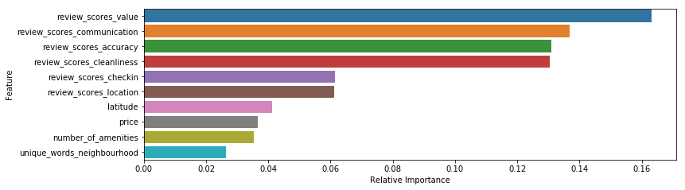
Which prediction model performs best and which features are most important under the full specification?
Model | R2 Train | R2 Test | MSE Train | MSE Test
Linear Regression | 0.84 | 0.82 | 0.003 | 0.004
Gradient Boosting Regressor | 0.86 | 0.82 | 0.003 | 0.004
Linear SVR | 0.83 | 0.81 | 0.004 | 0.005
Ridge CV | 0.84 | 0.82 | 0.003 | 0.004
K Nearest Neighbours | 0.80 | 0.69 | 0.005 | 0.008
Notes:
[NEED COEFFICIENTS FROM LINEAR REGRESSION]

Slide 13
Potential improvements
Model 1 – Price Prediction:
Image analysis for listing could help explain which features in images help drive the rental price.
Analysis of the amenities variable could yield categories which may further explain variation in rental price.
Model 2 – Improving customer reviews:
LDA for description and neighbourhood overview variables could yield useful topics which further explain variation in customer review scores.
Image analysis for listing could help investigate the effect of images on accuracy review scores.
Analysis of the amenities variable could yield categories which may further explain variation in customer review scores.

Slide 14
Thank you

