Slide 1
Working with Xilinx Spartan 3
Embedded Systems Lab 2009

Slide 2
Lab Objectives
To familiarize with a Xilinx Development Board
To get comfortable with Verilog HDL
To go through a design flow from conception to prototyping
To use Xilinx ISE and Modelsim tools

Slide 3
What will we learn today?
1st Hour:
Familiarize with the board
See how verilog modules and test benches are written
Demonstrate how Matlab and Modelsim can be used in a design
2nd Hour:
Make a counter on the board (with variations)

Slide 4
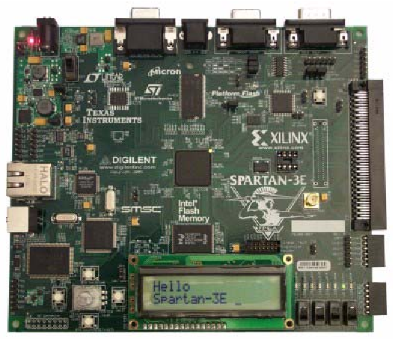

Slide 5
Familiarizing with the board
Program through a USB cable : Use JTAG protocol
Needs a DC supply : 3.3V provided via an adapter
Has IO ports: Switches and Buttons and LEDs
The FPGA IC is connected to various external chips (eg ADC) via specific pins
Jumpers present for easy change of settings

Slide 6
Writing modules and test benches
Verilog and VHDL are two popular languages
Use any text editor
File extension is <modulename>.v
Use Xilinx simulator or Modelsim or Verilog-XL (Cadence) or any simulator you like to check the correctness (syntax)
Use a test bench to verify functional correctness
Synthesis issues

Slide 7
Designs
Counter
Multiplier (Horner’s rule)
Filter (FDA toolbox and HDL Coder)
Cordic using Picoblaze
AD-Verilog-DA using Picoblaze

