Slide 1
A Presentation on
Document Sharing System

Slide 2
Team members
NAME: MOST. UMME SALMA ARJU ID:1902018
NAME: MD. OYATHINUR ZAMAN ID:1902032
NAME: AHLA MONG MARMA ID:1902038
NAME: MD. NAFIS SADIK HAQUE ID:1902048
NAME: ABUBAKAR SAIDU ID:1902077

Slide 3
About
The project's core objectives encompass creating an intuitive interface to share documents within a certain group of members. By enabling seamless communication and document sharing, the system aims to enhance team synergy. With the flexibility to adapt to individual preferences and the capacity to generate insightful reports, it strives to elevate task-oriented decision-making.

Slide 4
document sharing system
Document sharing is the public or private sharing of documents on a computer connected to a network. Documents can easily be shared outside a network via removable media, but the term document sharing almost always refers to sharing documents on a network. Document sharing allows several people to use the same documents’ data.

Slide 5
Objectives
Ability to organize files and develop a document-sharing project to streamline collaboration, enhance efficiency, and facilitate seamless sharing of documents among team members, fostering a more interconnected and productive work environment.

Slide 6
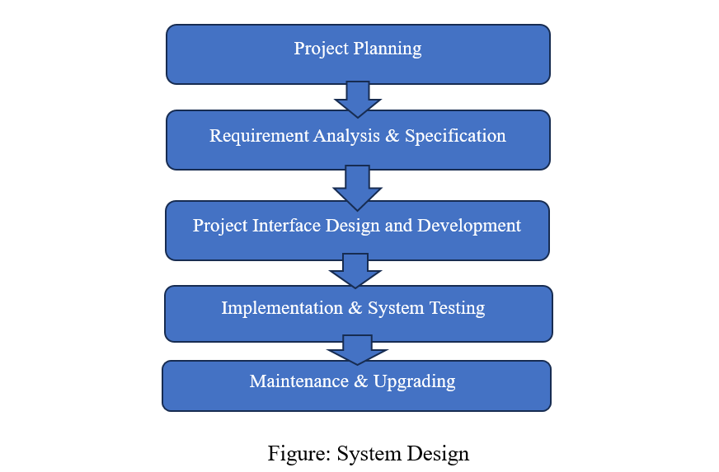
Software development life cycle

Slide 7
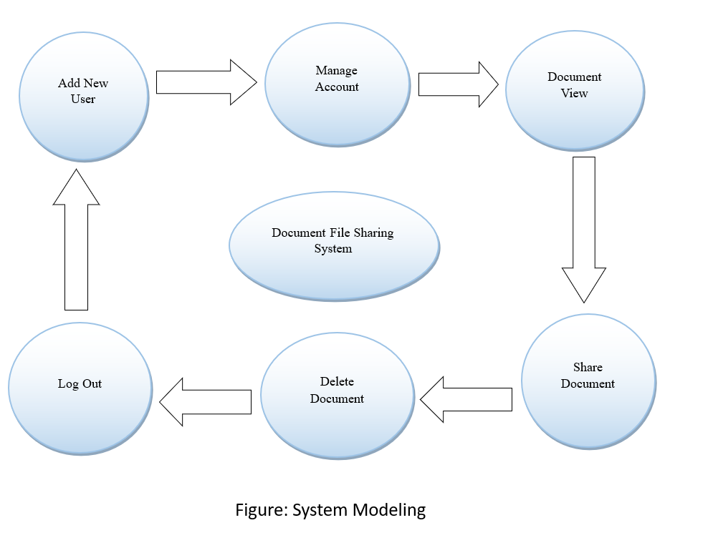
System Modeling

Slide 8
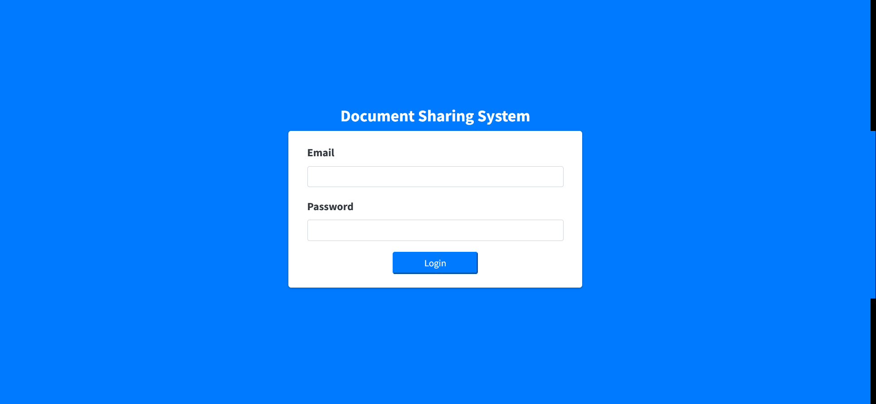
Login

Slide 9
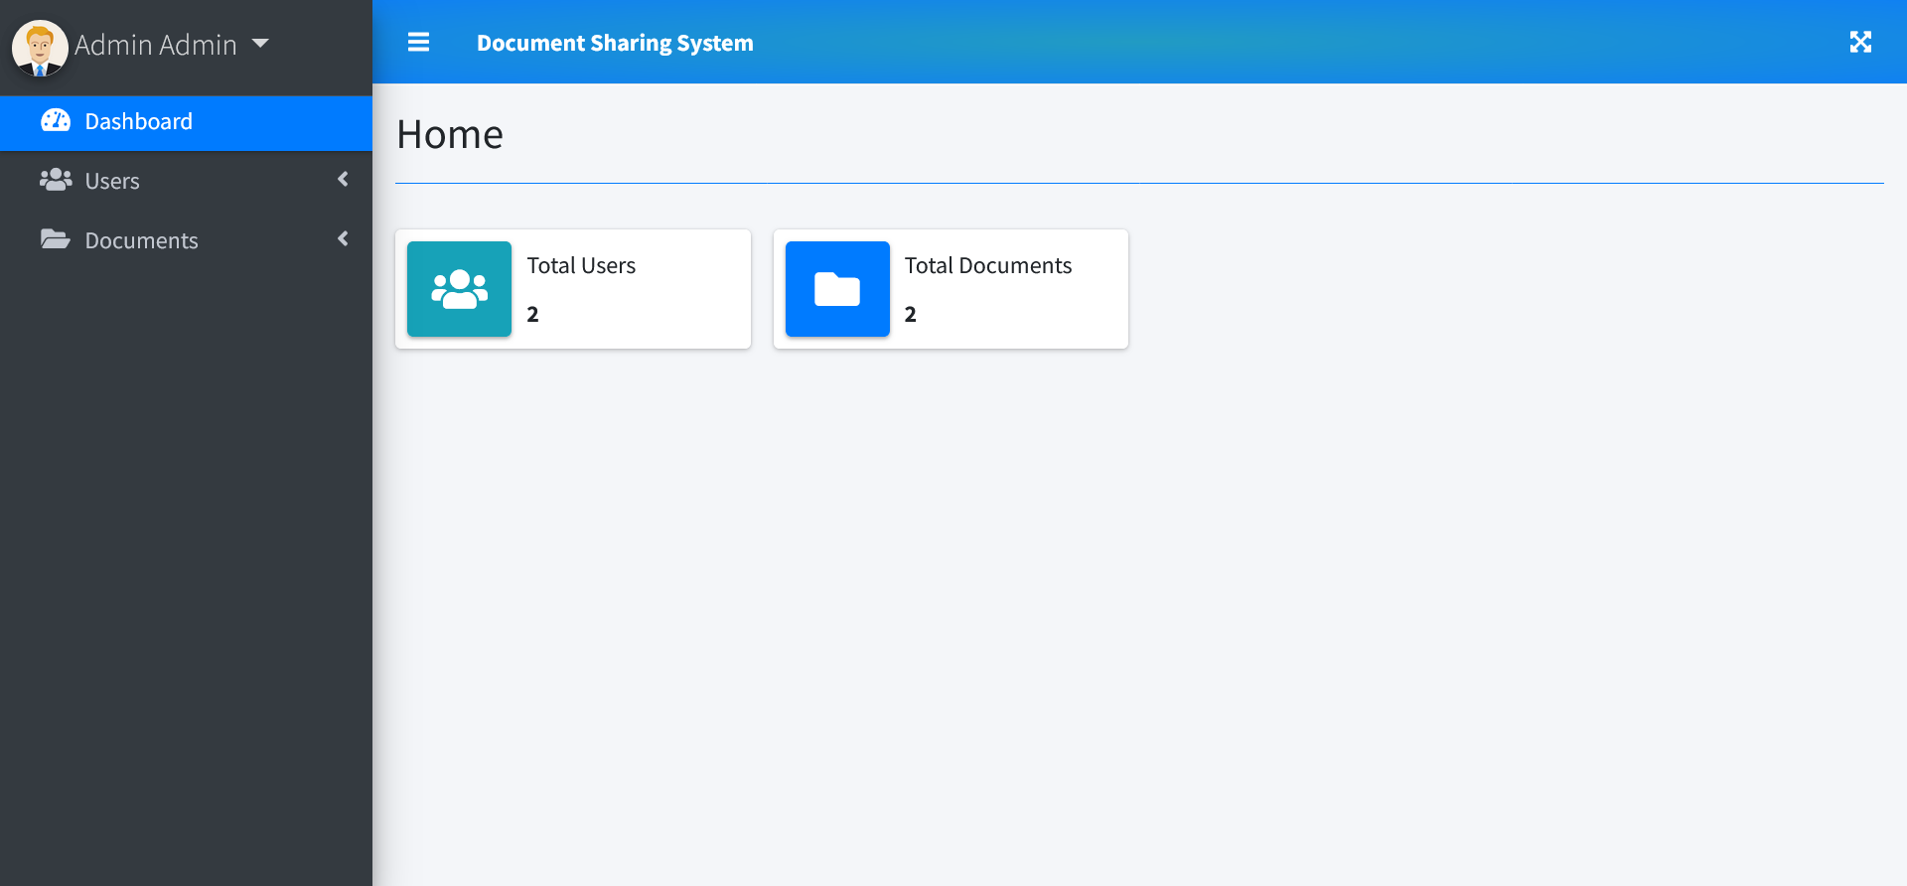
dashboard

Slide 10
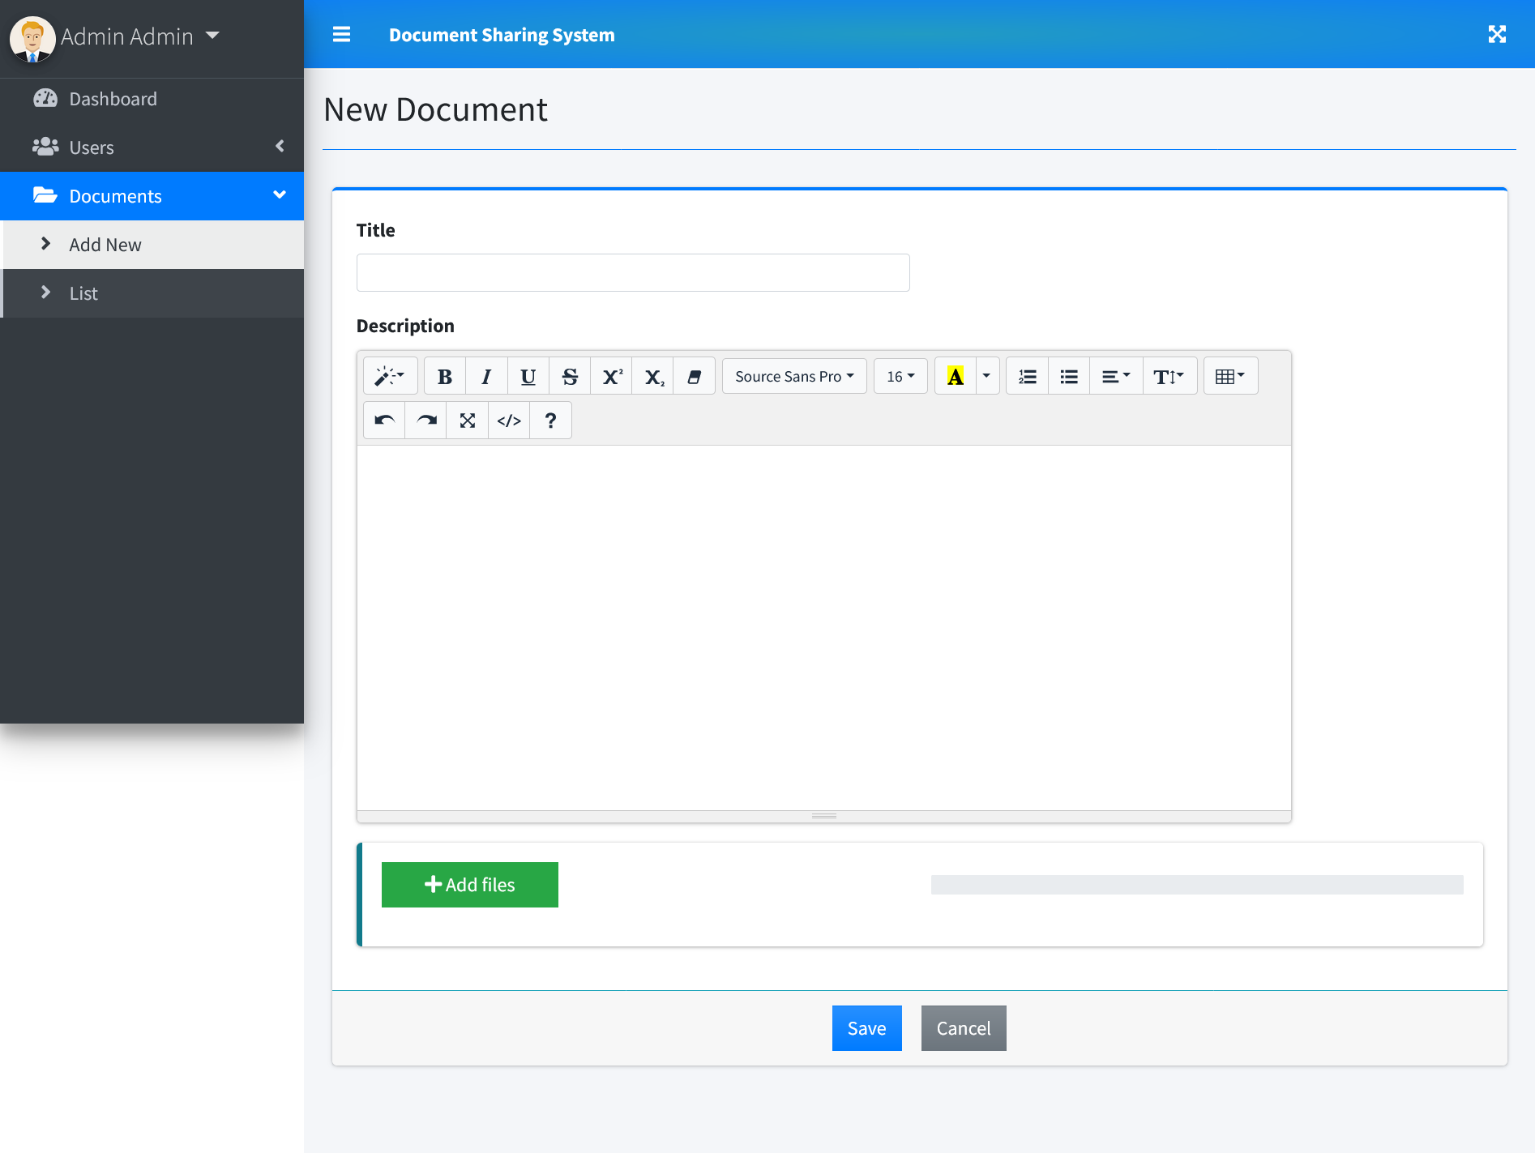
add new Documents

Slide 11
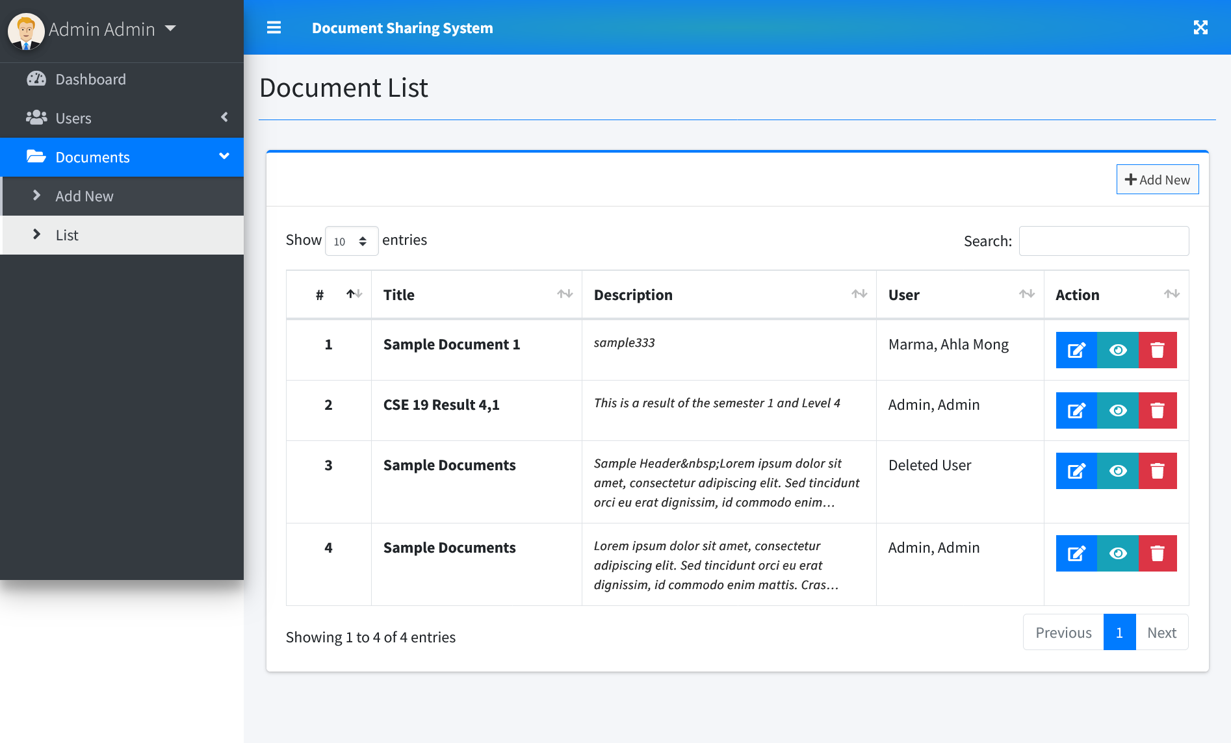
Documents - list

Slide 12
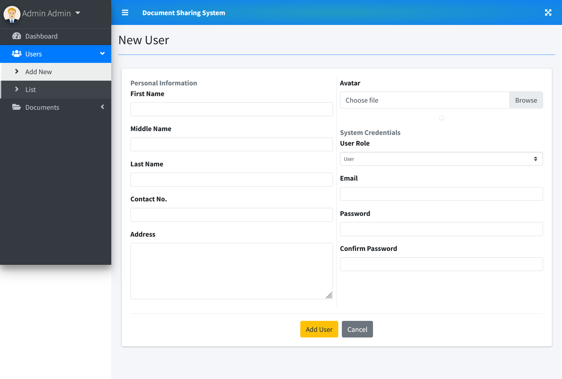
Add new user

Slide 13
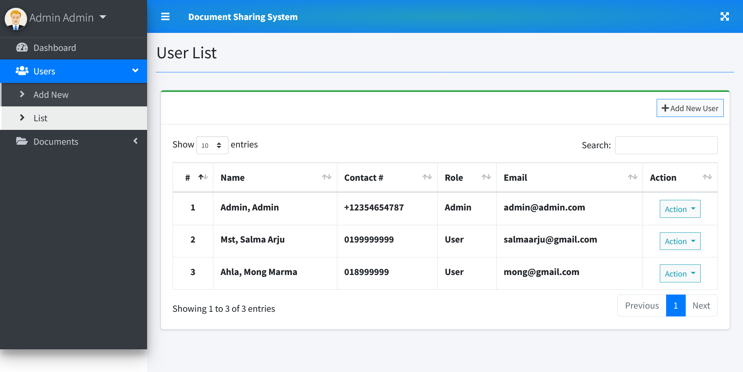
User list

Slide 14
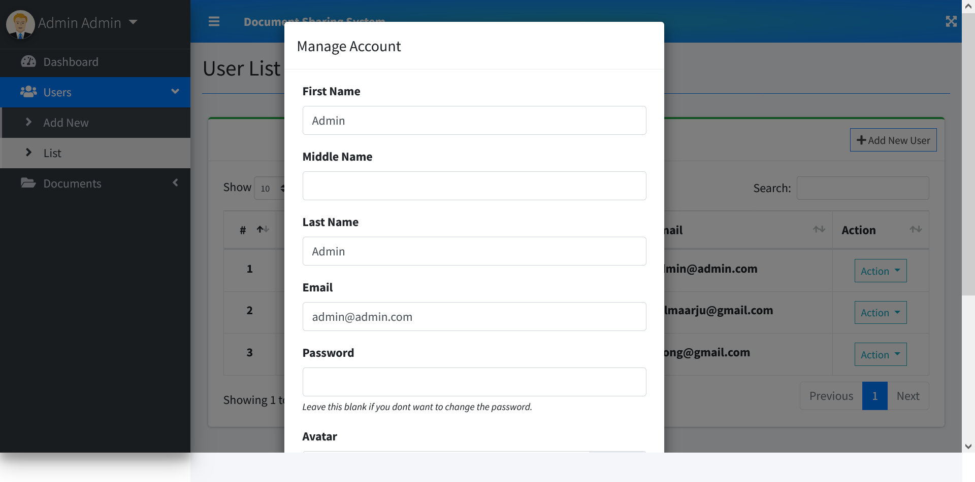
MANAGE ACCOUNT

Slide 15
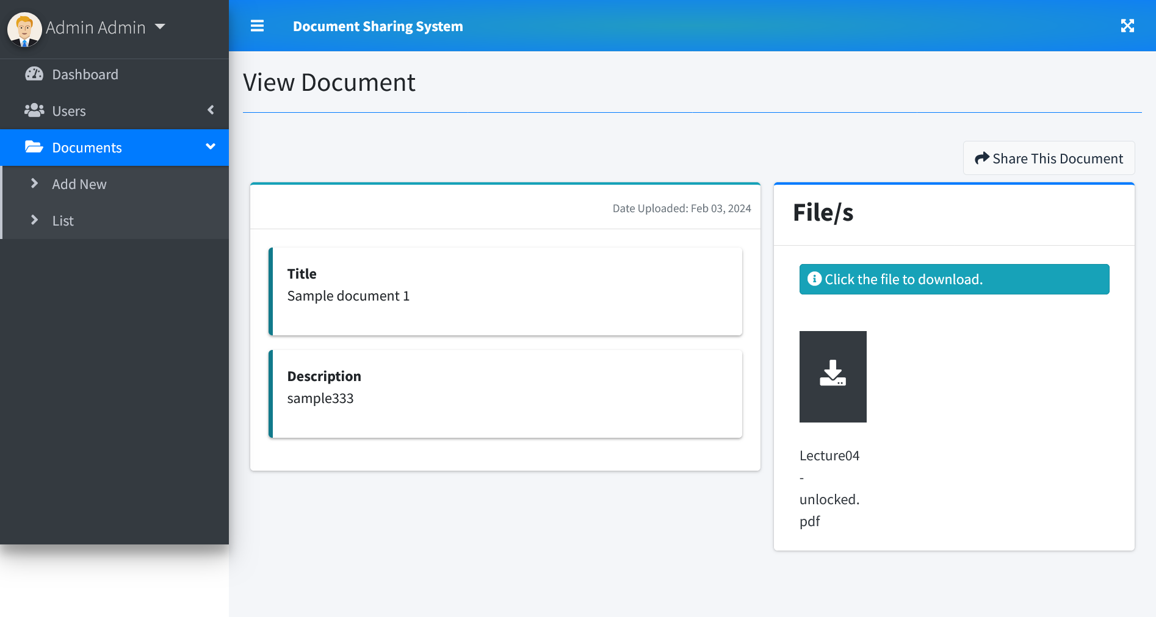
DOCUMENT VIEW

Slide 16
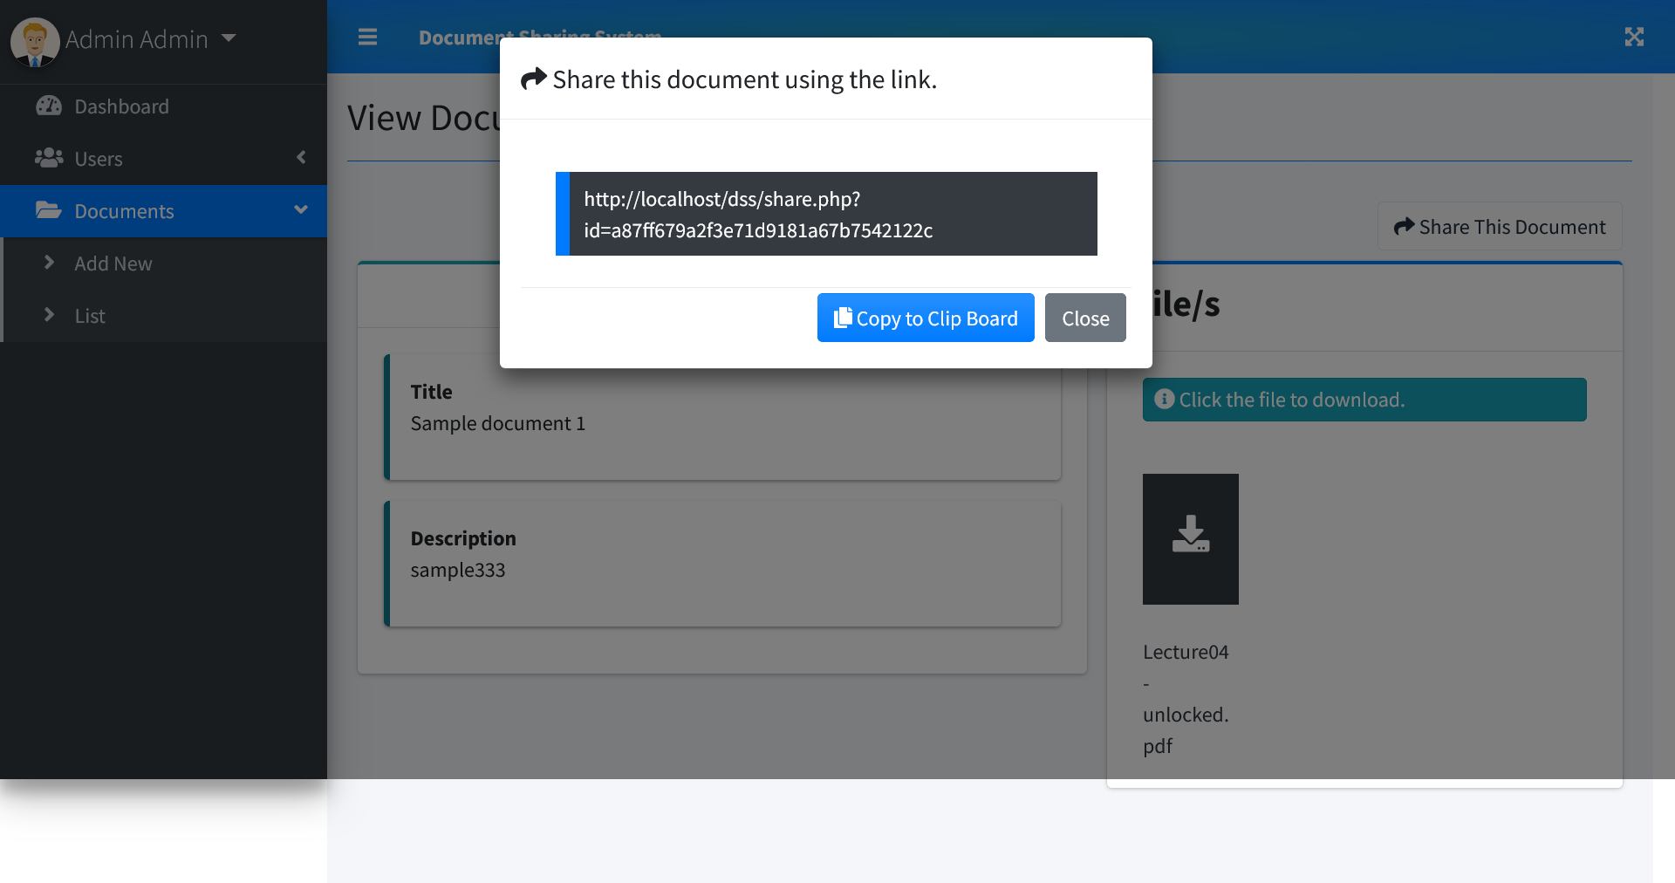
SHARE DOCUMENT

Slide 17
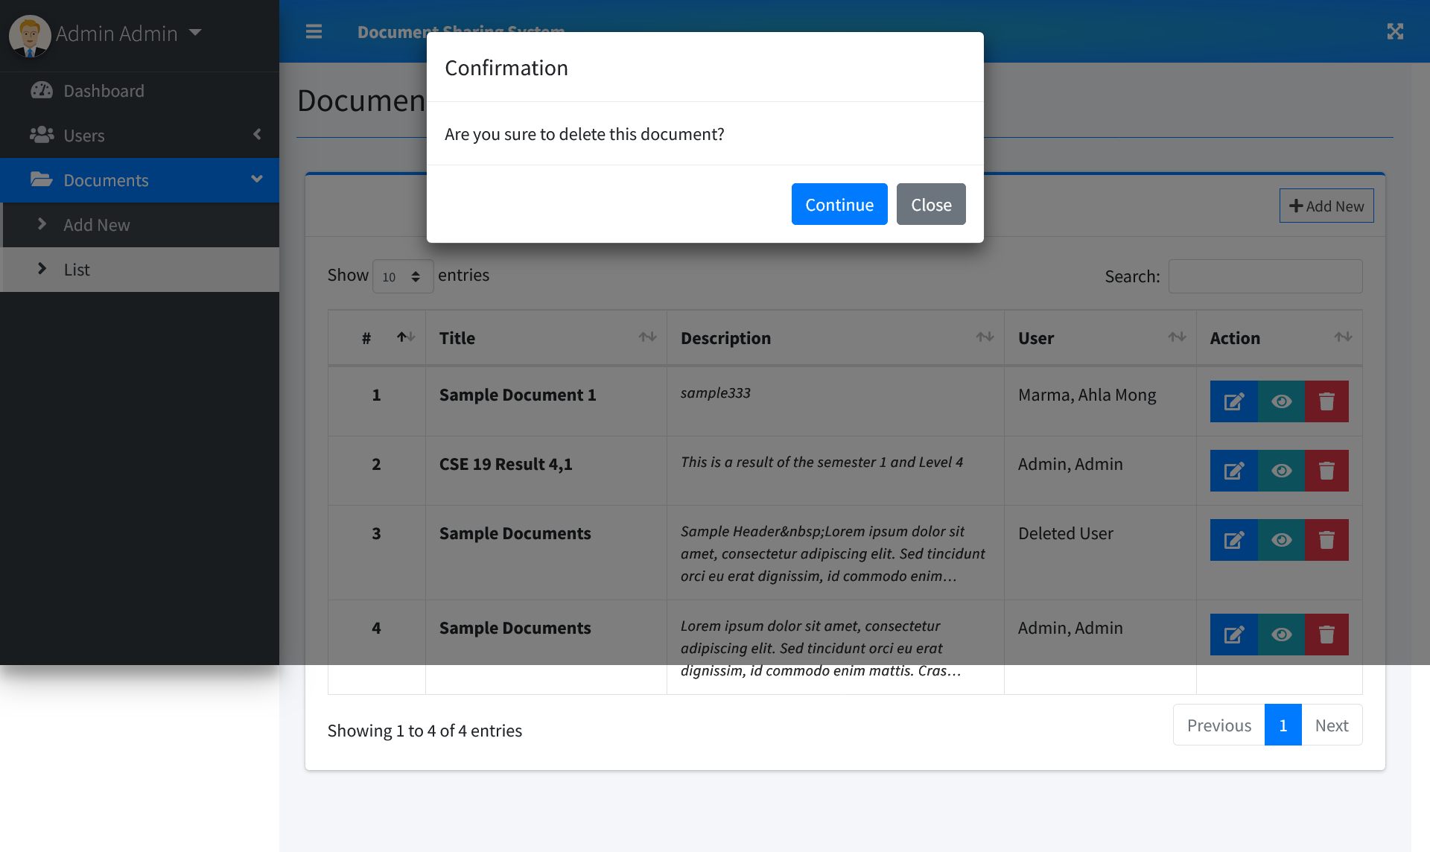
DELETE DOCUMENT

Slide 18
Future goals
We intend to update the software and add some new features in the future. We intend to fix the bugs in the upcoming updates. We intend to add additional features according to the users’ feedback. Also, we intend to make the software cross-platform in the future updates.

Slide 19


