Slide 1
Smart Vending Machine
CSE – 360
Team : Juliett_A

Slide 2
Pratyusha Kundu (201814014) Anika Zaman (201814018) Sabrina Afreen Haque (201814020) Md. Arr Rafi Islam (201814050)
Team Members

Slide 3
Discussed Topic
Project proposal
Project scheduling
User requirements
System Requirements Specification
System architecture
System model
UI design

Slide 4
Background and Present State of the Problem:
The prevailing vending machines cannot detect if any cash is deformed or discolored which is why, sometimes they accept cash but the product may not be successfully purchased. Moreover, using cash and coins to buy stuffs is not quite safe when any pandemic breaks.
That’s why using an app to buy from vending machine has been proposed.

Slide 5
Objectives
Successful purchase of products from a vending machine
Using BLUETOOTH and an app to connect with a vending machine to make the process quick
More use of credit or debit card to reduce the cash transactions in any urgent situation i.e., pandemic, war etc.
To lessen crowds in markets and shops by setting up vending machines in local areas
To show a simulation on how vending machines can be controlled remotely using BLUETOOTH

Slide 6
Database
Robotics
Covered Domains
Internet of Things (IoT)
Human Computer Interactions (HCI)

Slide 7
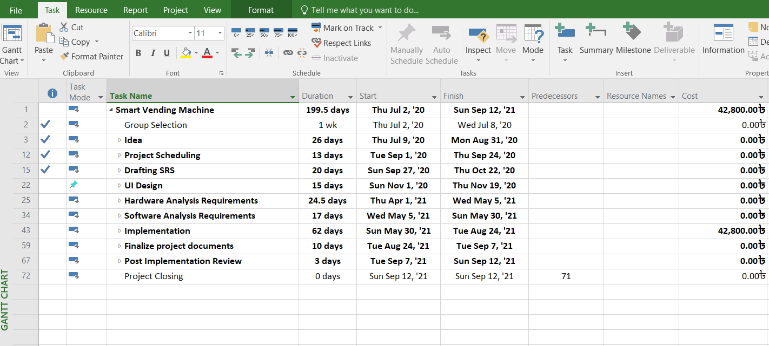
Project Scheduling

Slide 8
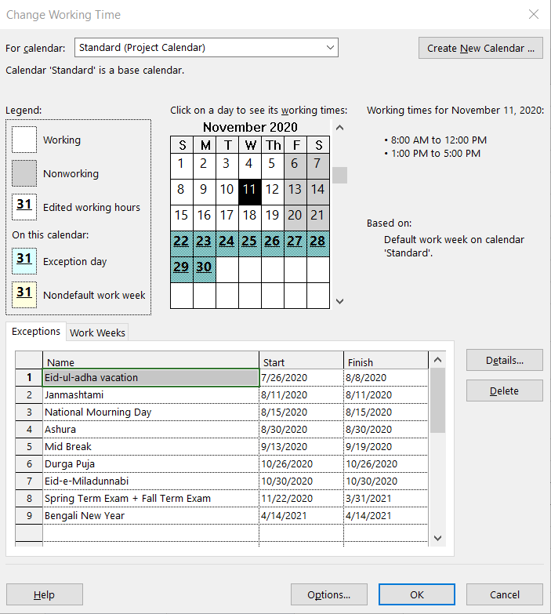
Project Scheduling

Slide 9
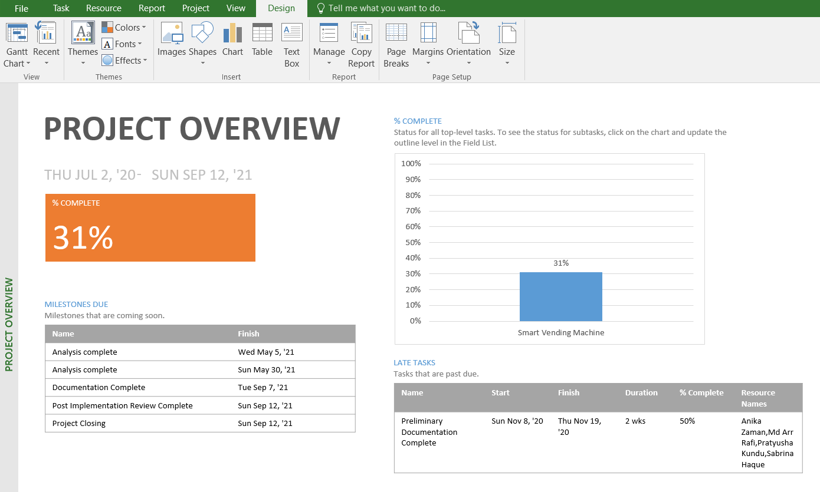
Project Scheduling

Slide 10
User Requirements
The app will be user friendly and free to use.
The user will be able to remote control the vending machine.
The user will pay as soon as he will receive the product from the take-out port.
The app will carry out online banking as it is preferred over cash transaction now-a-days.
The app will ensure strong security.
The system will provide compensation for providing a damaged product.

Slide 11
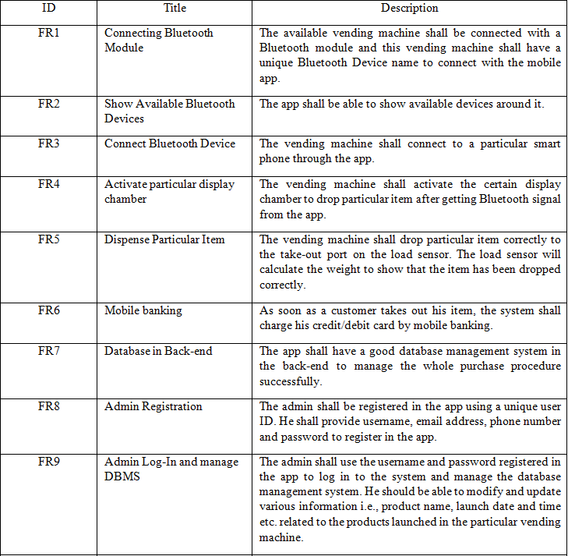
System Requirements
Functional Requirements

Slide 12
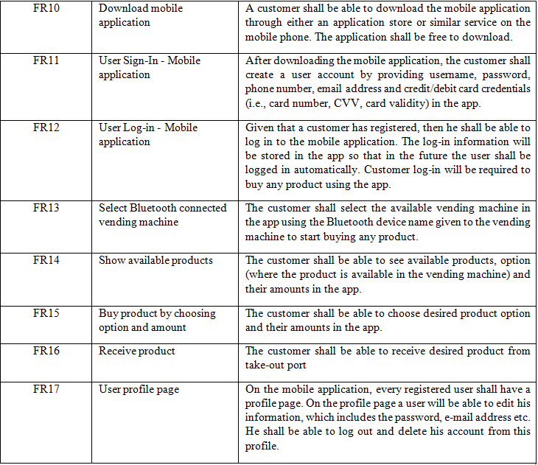
System Requirements
Functional Requirements

Slide 13
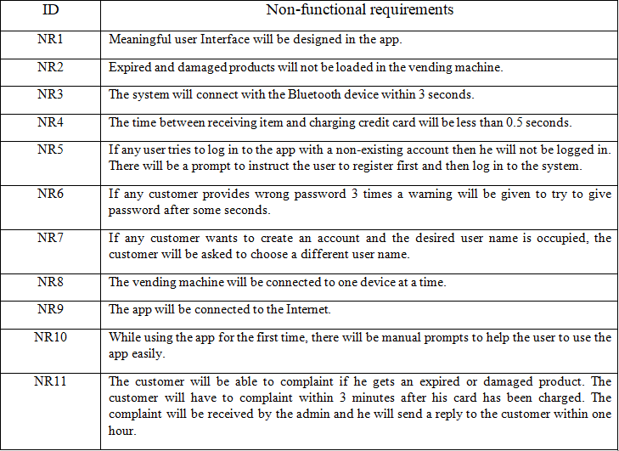
System Requirements
Non-functional Requirements

Slide 14
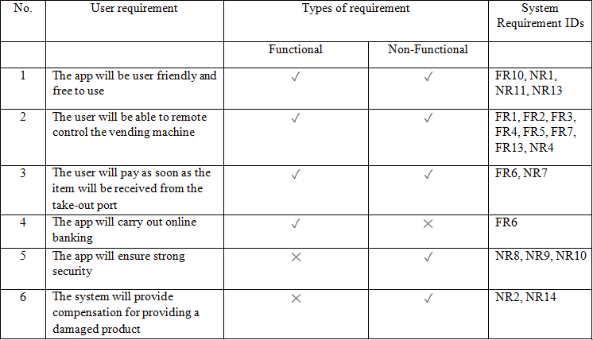
The relation among user requirements and system requirements

Slide 15
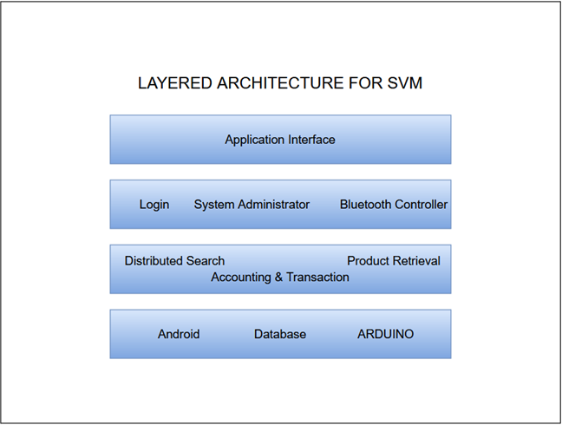
System Architecture

Slide 16
Context Diagram
Use-case Diagram
System Models
Sequence Diagram
Activity Diagram

Slide 17
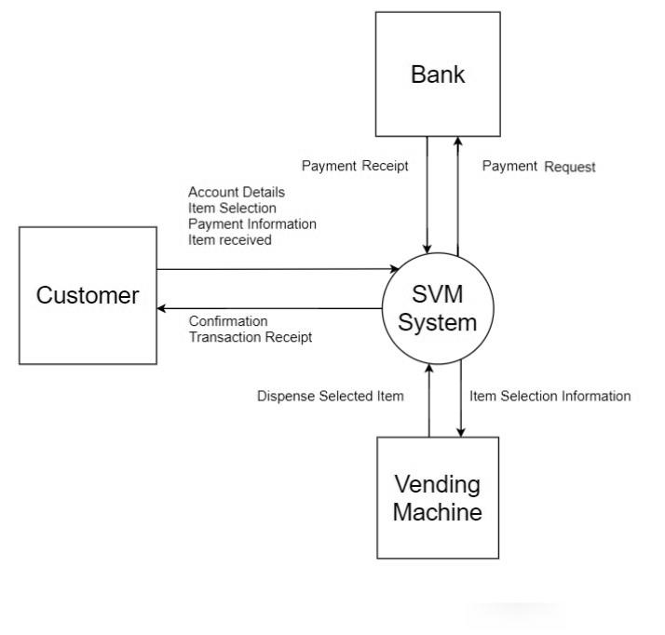
Context Diagram

Slide 18
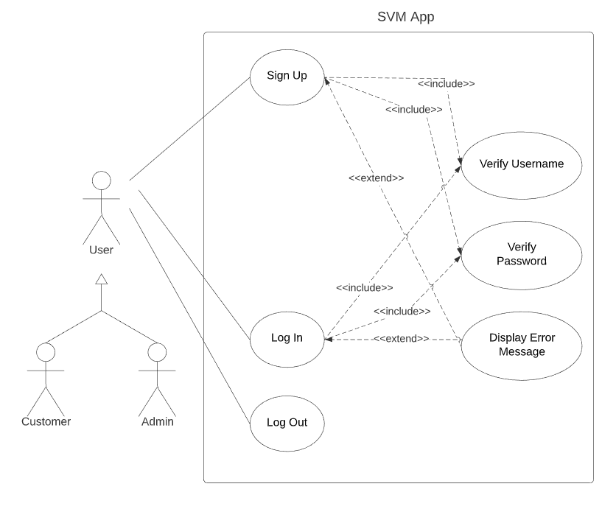
Use-case Diagram
Sign Up and Log in Scenario

Slide 19
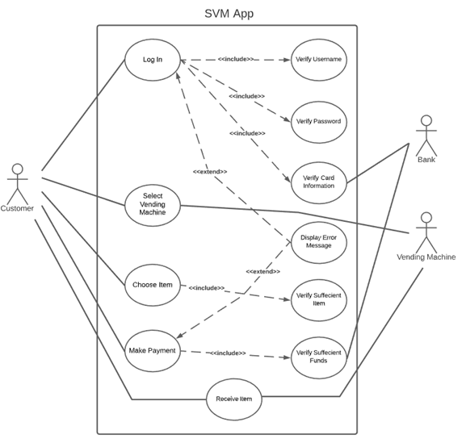
Use-case Diagram
Purchase Scenario

Slide 20
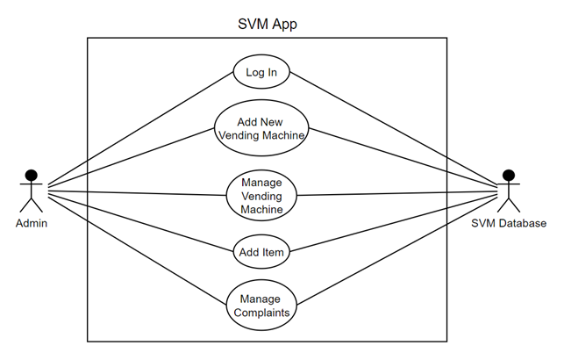
Use-case Diagram
Administration Scenario

Slide 21
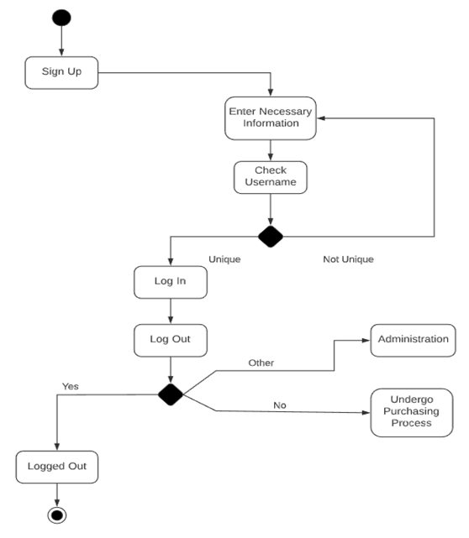
Activity Diagram
For Users to Sign Up and Log In

Slide 22
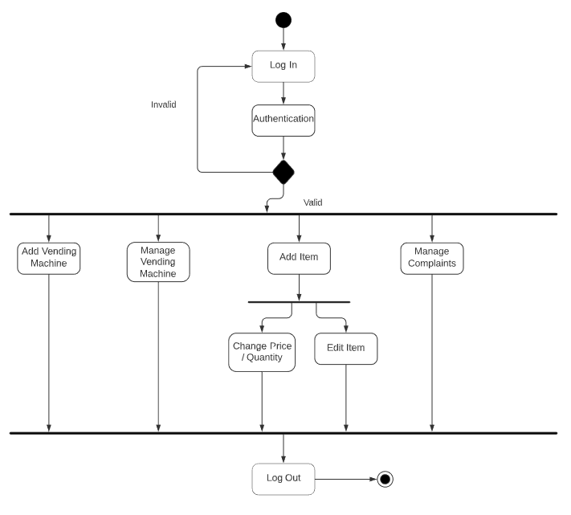
Activity Diagram
For Administrator Side

Slide 23
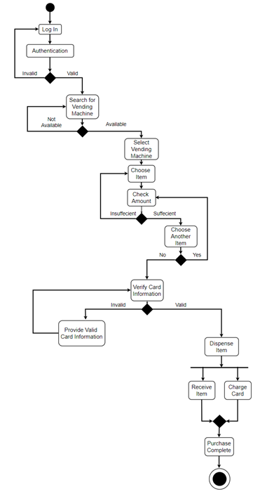
Activity Diagram
For Customer Side for Purchasing Items

Slide 24
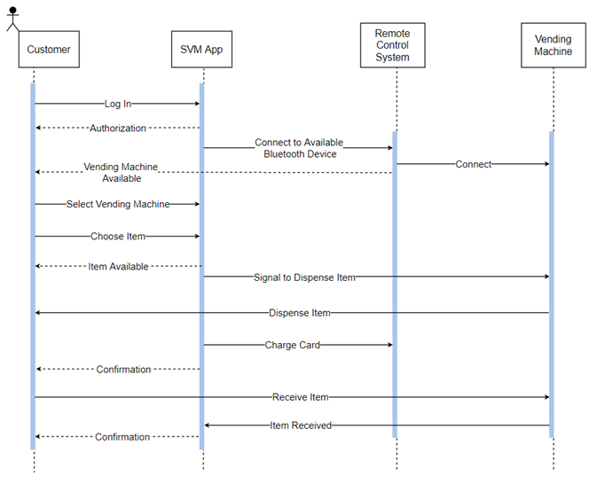
Sequence Diagram
For Purchase Part-1- controlling the vending machine

Slide 25
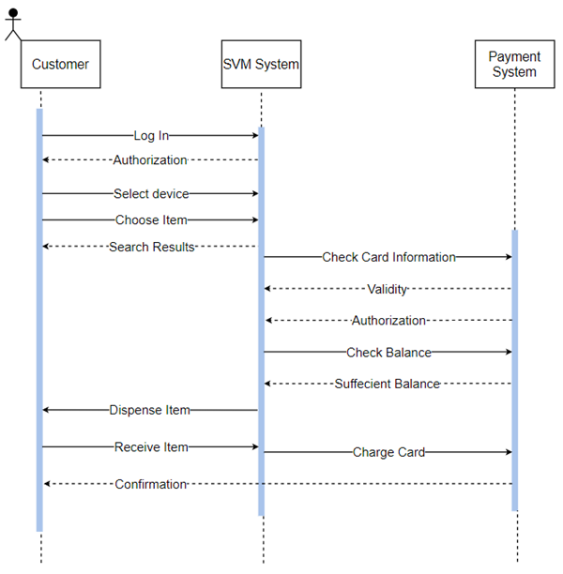
Sequence Diagram
For Purchase Part-2- Payment Process

Slide 26
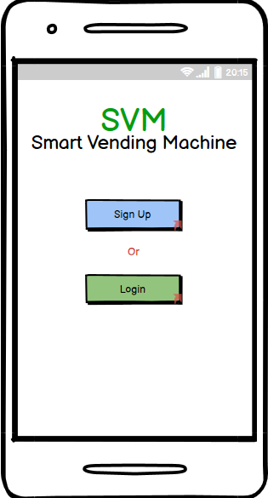
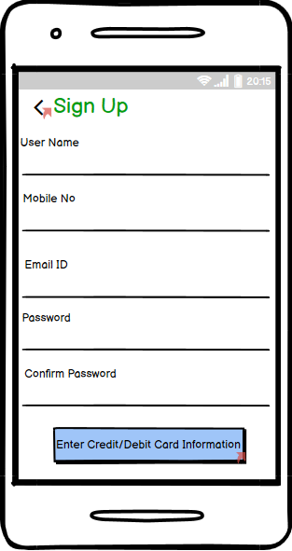
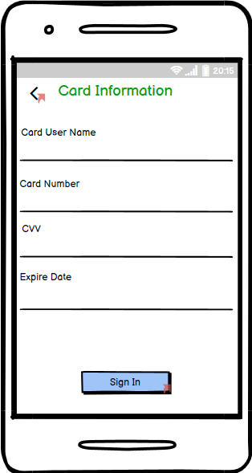
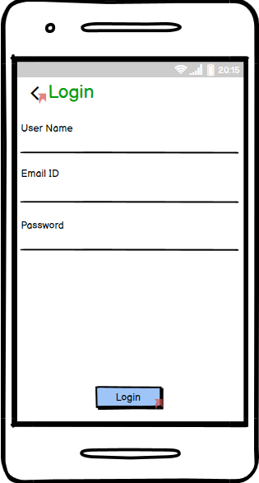
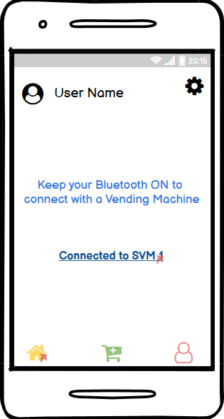
UI Design

Slide 27
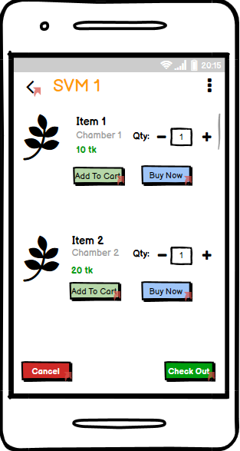
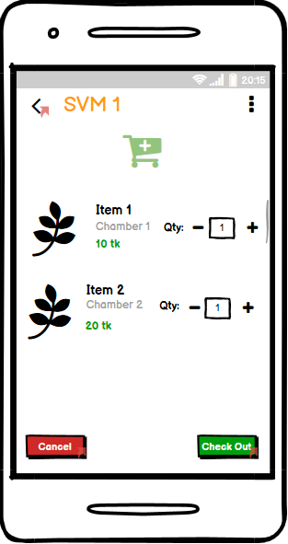
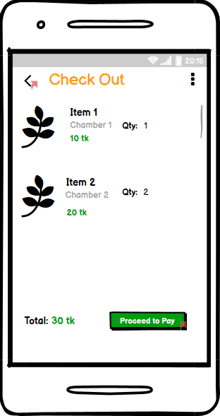
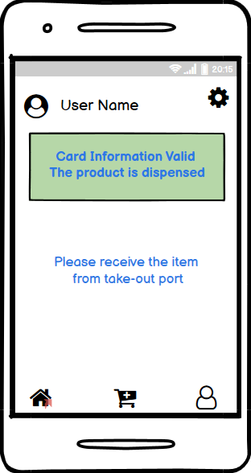
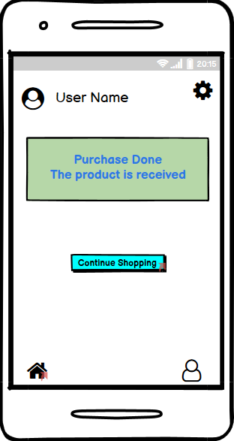
UI Design

Slide 28
THANK YOU

