Slide 1
Anti-aliasing
1

Slide 2
What Sampling Means?
>> Most things in the real world are continuous.
>> Everything in a computer is discrete.
<< The process of mapping a continuous function to a discrete one is called sampling.
<< The process of mapping a discrete function to a continuous one is called reconstruction.
<< The process of mapping a continuous variable to a discrete one is called discretization.
*** Rendering an image requires sampling and discretization.
2

Slide 3
What Does Aliasing Means?
Digital sampling of any signal, whether sound, digital photographs, or other, can result in apparent signals at frequencies well below anything present in the original. Aliasing occurs when a signal is sampled at a less than twice the highest frequency present in the signal. In images, the repetition is in space rather than signals sampled in time for digital audio. If the image data is not properly processed during sampling or reconstruction, the reconstructed image will differ from the original image, and an alias is seen.
An example of spatial aliasing is the moiré pattern one can observe in a poorly pixelized image.
3

Slide 4
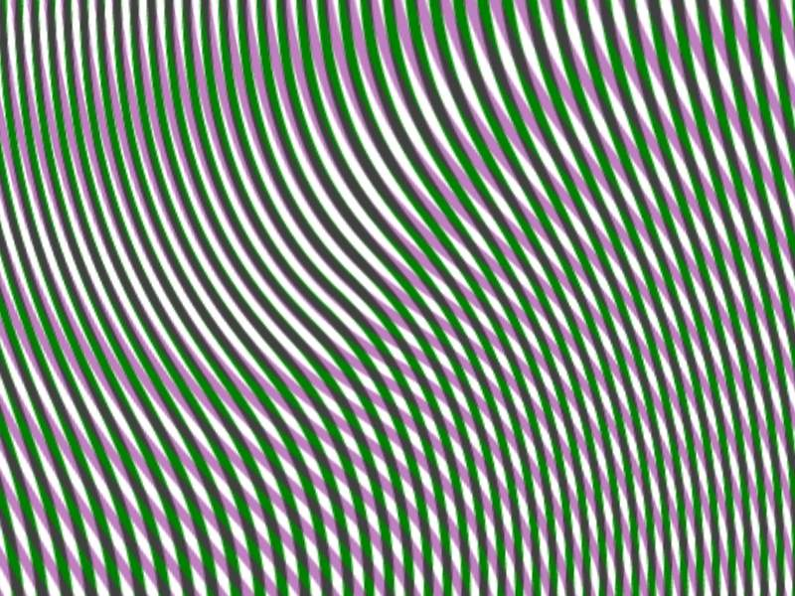
Example of a Moiré pattern
4

Slide 5
Line Segments
If we tried to sample a line segment so it would map to a 2D raster display.
We would see stair steps, or jaggies Since we “quantized” the pixel values to 0 or 1.
5

Slide 6
Anti-aliasing: Definition
Anti-aliasing is a technique used in digital imaging to reduce the visual defects that occur when high-resolution images are presented in a lower resolution output devices like the monitor or printer. Aliasing manifests itself as jagged or stair-stepped lines (Also known as jaggies) on edges and objects that should otherwise be smooth. With sound, aliases are removed by eliminating frequencies above half the sampling frequencies.
6

Slide 7
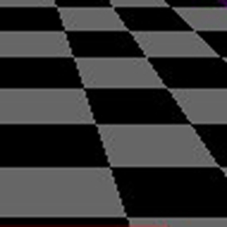
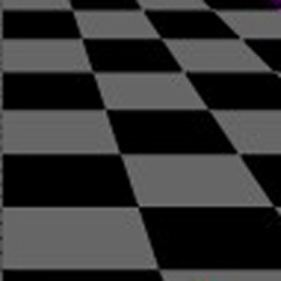
Before and After of Anti-Aliasing
Aliased polygons
(jagged edges)‏
Anti-aliased polygons
(smoothed edges)
7

Slide 8
What Does Anti-aliasing Do ?
Anti-aliasing makes these curved or slanting lines smooth again by adding a slight discoloration to the edges of the line or object, causing the jagged edges to blur and melt together. It also removes jagged edges by adding subtle color changes around the lines If the image is zoomed out a bit, the human eye can no longer notice the slight discoloration that antialiasing creates.
8

Slide 9
Do We really need Anti-aliasing?
Jaggies appear when an output device does not have a high enough resolution to represent a smooth line correctly. The pixels that make up the screen of the monitor are all shaped in rectangles or squares. Because lighting up only half of one of these square pixels is not possible.
The jagged line effect can be minimized by increasing the resolution of the monitor, making the pixels small enough that the human eye cannot distinguish them individually. This is not a good solution, however, because images are displayed based on their resolution. A single image pixel may take up many monitor pixels, making it impossible for a higher resolution monitor to mask the jagged edges. This is where anti-aliasing is required.
9

Slide 10
Anti-Aliasing Techniques
Anti-Aliasing techniques were developed to combat the effects of aliasing. There are three main classes of anti-aliasing algorithms :
1. As aliasing problem is due to low resolution, one easy solution is to increase the resolution. This increases the cost of image production. 2. The image can be calculated by considering the intensities over a particular region. This is called Area Sampling.
3. The image is created at high resolution and then digitally filtered. This method is called supersampling or postfiltering and eliminates high frequencies which are the source of aliases.
10

Slide 11
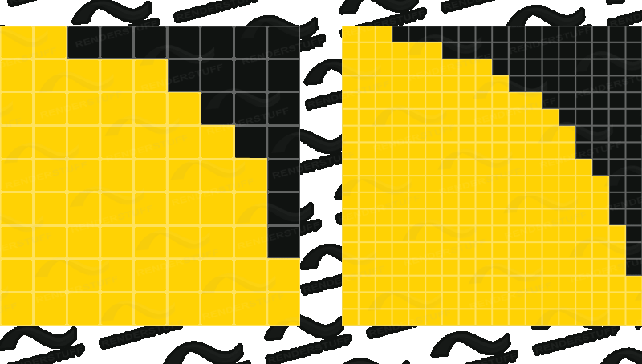
1. Anti-Aliasing : Increasing Resolution
• Doubling resolution in x and y
• This method only lessens the problem
• Costs 4 times memory, memory
bandwidth and scan conversion time
11

Slide 12
2. Anti-Aliasing : Area Sampling
Area sampling approaches sample primitives with a box rather than spikes.
-- Requires primitives that have area (lines with 1 pixel width).
-- Sometimes referred to as pre-filtering.
-- Shade pixels according to the area covered by thickened line.
-- This is unweighted area sampling.
12

Slide 13
Weighted Area Sampling
Consider a line as having thickness.
Consider pixels as little squares.
Fill pixels according to the proportion of their square covered by the line.
Other variations weigh the contribution according to where in the square the primitive falls.
0
0
0
1/8
0
0
0
1/4
.914
1/8
0
1/4
.914
0
1/4
1/8
.914
1/4
0
0
0
1/8
0
0
0
13

Slide 14
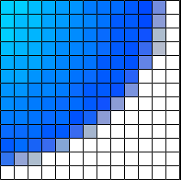
Anti-Aliasing : Prefiltering
Prefiltering methods treat a pixel as an area, and compute pixel color based on the overlap of the scene's objects with a pixel's area. A modification to Bresenham's algorithm was developed by Pitteway and Watkinson. In this algorithm, each pixel is given an intensity depending on the area of overlap of the pixel and the line. So, due to the blurring effect along the line edges, the effect of anti-aliasing is not very prominent, although it still exists. For sampling shapes other than polygons, this can be very computationally intensive.
14

Slide 15
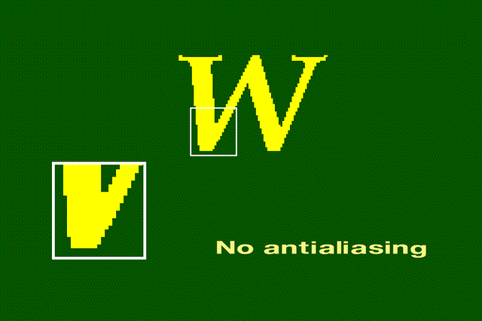
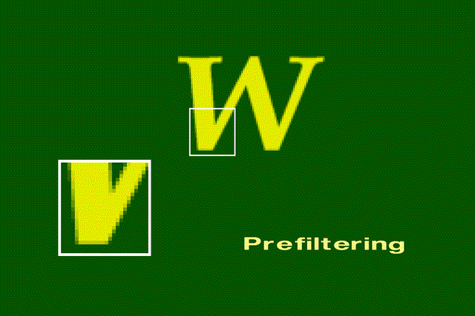
Original Image
Without antialiasing, the jaggies are harshly evident.
Prefiltered image
. Along the character's border, the colors are a mixture of the foreground and background colors.
15

Slide 16
3. Anti-Aliasing : Postfiltering
Supersampling or postfiltering is the process by which aliasing effects in graphics are reduced by increasing the frequency of the sampling grid and then averaging the results down. This process means calculating a virtual image at a higher spatial resolution than the frame store resolution and then averaging down to the final resolution. It is called postfiltering as the filtering is carried out after sampling.
Supersampling is basically a three stage process : * A continuous image I(x,y) is sampled at n times the frame resolution. This is a virtual image. ** The virtual image is then lowpass filtered. *** The filtered image is then resampled at the final frame resolution.
16

Slide 17
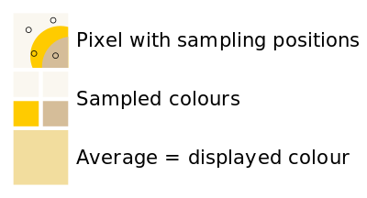
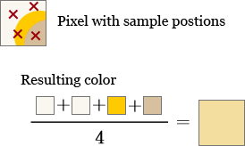
Anti-Aliasing : Postfiltering (Continues)
There are two drawbacks to this method :
# There is a technical and economic limit for increasing the resolution of the virtual image. ## Since the frequency of images can extend to infinity, it just reduces aliasing by raising the Nyquist limit - shift the effect of the frequency spectrum.
Calculating the end color value
17

Slide 18
Post-Filtering : Advantages
* It support arbitrary symmetric filters at a fixed cost..
** It allows a wider filter support. Most hardware anti-aliasing schemes only consider samples within a pixel.
*** This method is independent of hardware-specific anti-aliasing methods.
**** It is a simple, fast, and easy to implement Method.
18

