Slide 1
inverseKinematik(x, y, z, rx, ry, rz) -> a0, …, a4 inverseKinematik(x, y, z, rx, ry, rz) -> a0, …, a5

Slide 2
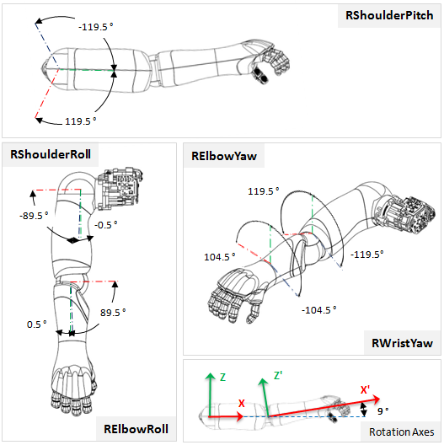
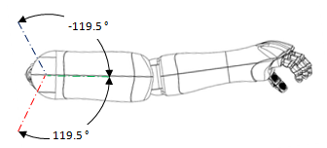

Online Documentation:
http://doc.aldebaran.com/2-4/family/pepper_technical/joints_pep.html
tool center
point (TCP)
up
elbow
circle
elbow
height
+
+
r_{s}
183.304736
230.117486
r_{e}
circle
center

Slide 3
Online Documentation:
http://doc.aldebaran.com/2-4/family/pepper_technical/joints_pep.html
elbow
plane
tool center
point (TCP)
up
elbow
elbow z
+
+
sphere
center

Slide 4
Calulation of x and y (Circle center, h = radius)
b
a
h
a^2 – x^2 = b^2 – y^2
x + y = d
x^2 = a^2 – b^2 + y^2
y = d - x
x^2 = a^2 – b^2 + (d-x)^2
x^2 = a^2 – b^2 + (d^2 – 2dx + x^2)
x^2 = a^2 – b^2 + d^2 – 2dx + x^2
x = (a^2 – b^2 + d^2) / 2d
y = (b^2 – a^2 + d^2)/2d
h = sqrt(a^2 – x^2)
x
y
shoulder
TCP
circleCenter

Slide 5
Calulation of x and y (Circle center, h = radius)
rt
rs
rc
rs^2 – rs^2 = b^2 – y^2
x + y = d
x^2 = a^2 – b^2 + y^2
y = d - x
x^2 = a^2 – b^2 + (d-x)^2
x^2 = a^2 – b^2 + (d^2 – 2dx + x^2)
x^2 = a^2 – b^2 + d^2 – 2dx + x^2
x = (a^2 – b^2 + d^2) / 2d
y = (b^2 – a^2 + d^2)/2d
h = sqrt(a^2 – x^2)
us
ut
shoulder
TCP
circleCenter

Slide 6
Calulation of elbow point
n … plane normal (vector from shoulder to TCP)
wanted: x … pt on elbow, r … circle radius
nx * x + ny * y + nz * z = d (Ebenengleichung)
(x – cx)^2 + (y – cy)^2 + (z – cz)^2 = r^2 (Kugelgleichung)
x = (d – ny * y – nz * z) / nx
x = d/nx – ny * y / nx – nz * z / nx
x = d/nx – nz * z / nx + y * (-ny / nx) = B*y + A
(B*y + A – cx)^2 + (y – cy)^2 + (z – cz)^2 = r^2
B^2*y^2 + 2*D*B*y + D^2 + y^2 – 2*y*cy + cy^2 + (z – cz)^2 = r^2
y^2 * (B^2 + 1) + y * (2*D*B - 2*cy) + (D^2 + cy^2 + (z – cz)^2 – r^2) = 0
y
x = B * y + A
A
B
D

Slide 7
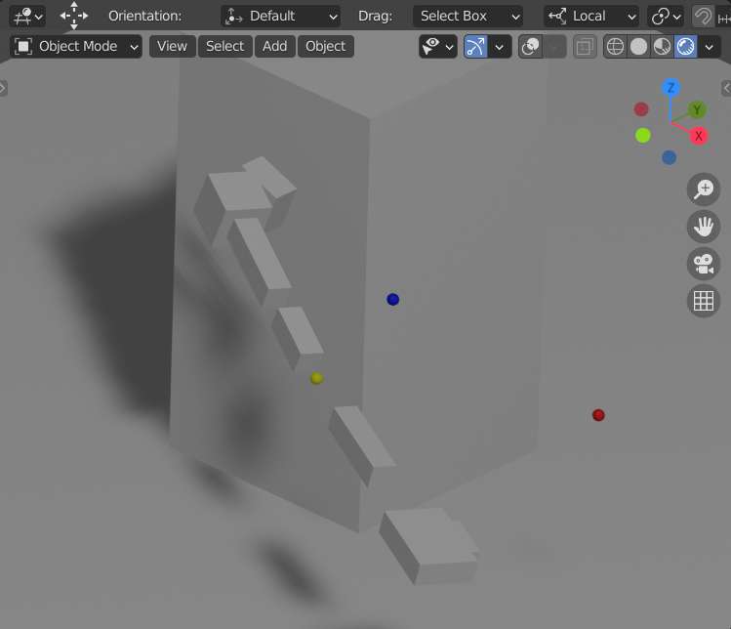
angles[0] RShoulderPitch
Z
X
α₀
circleCenter
elbow
TCP

Slide 8
angles[1] RShoulderRoll
Z
X
α₁
circleCenter
elbow
TCP

Slide 9
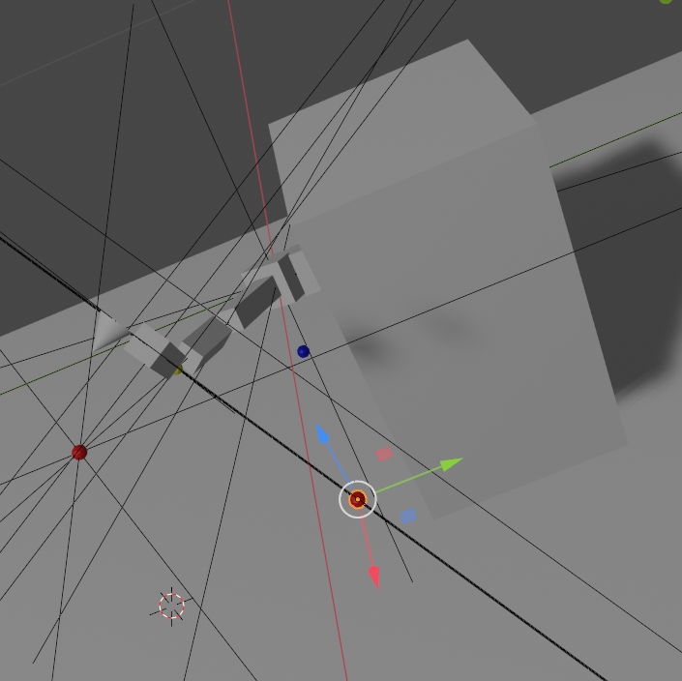
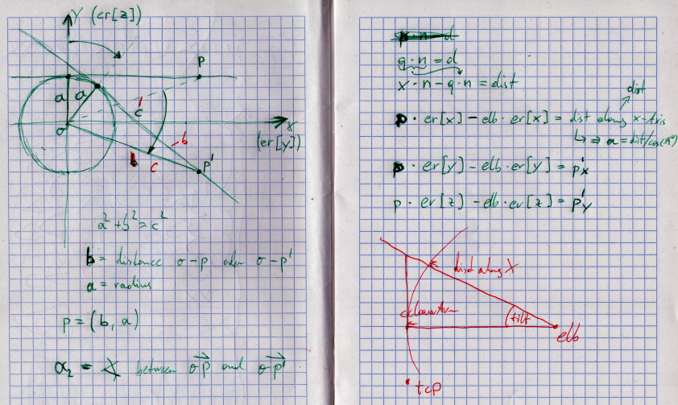
angles[2] RElbowYaw

Slide 10
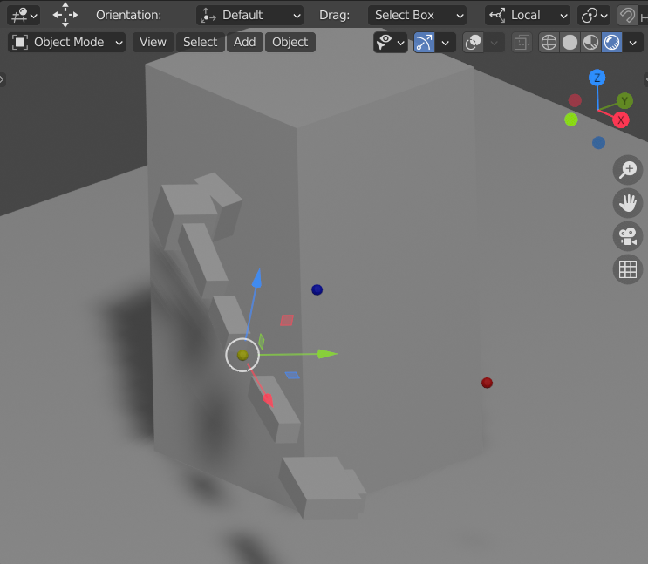
angles[3] RElbowRoll
Z
X
circleCenter
elbow
w
TCP
α₃

Slide 11
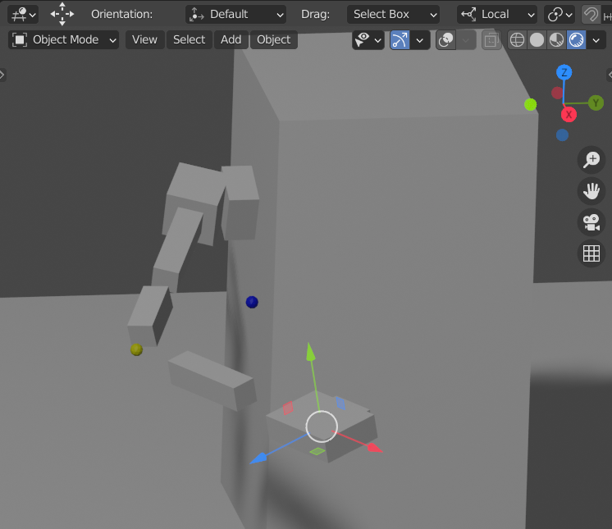
angles[4] RWristYaw
Z
X
circleCenter
elbow
w
α₄
TCP

