Slide 1

EMPLOYEE OFFBOARDING
Checklist Template
PAPERWORK
 | 401k information
 | Health check
 | NDA
 | Tax Documents
 | Outstanding reimbursements
KNOWLEDGE TRANSFER
 | Resources
 | Location of records
 | Ongoing projects
 | Outstanding tasks
 | List of contacts
RECOVER ASSETS
 | Mobile
 | Laptop
 | Uniforms
 | Access keys
 | ID cards
IT PERMISSIONS
 | Change Passwords
 | Remove employee from payroll
 | Update directory
 | Update website information
 | Redirect emails
EXIT INTERVIEW
 | Prepare questionnaire
 | Apply questionnaire
 | Discussion post-questionnaire
 | Analyze data
 | Collect insights

Slide 2
Employee
OFFBOARDING TEMPLATE

Slide 3
EMPLOYEE OFFBOARDING
Checklist Template
PAPERWORK
 | 401k information
 | Health check
 | NDA
 | Tax Documents
 | Outstanding reimbursements
KNOWLEDGE TRANSFER
 | Resources
 | Location of records
 | Ongoing projects
 | Outstanding tasks
 | List of contacts
RECOVER ASSETS
 | Mobile
 | Laptop
 | Uniforms
 | Access keys
 | ID cards
IT PERMISSIONS
 | Change Passwords
 | Remove employee from payroll
 | Update directory
 | Update website information
 | Redirect emails
EXIT INTERVIEW
 | Prepare questionnaire
 | Apply questionnaire
 | Discussion post-questionnaire
 | Analyze data
 | Collect insights

Slide 4
Employee
OFFBOARDING TEMPLATE

Slide 5

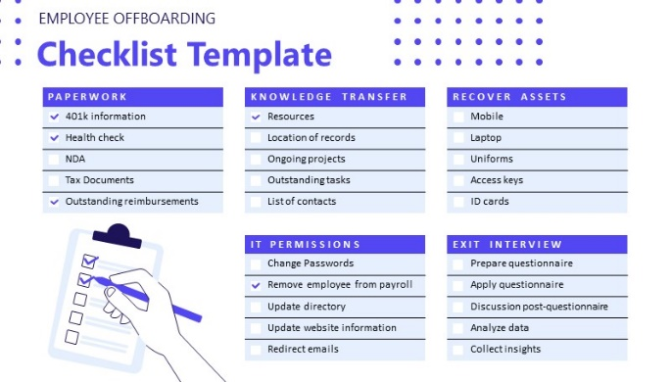
Put Your Screenshot
Here
Get 15% discount from regular price
Coupon Code:
FREEBUNDLE15
Apply this coupon code during sign up
Download PowerPoint templates and save hours of work.
SUBSCRIBE NOW
Easy to use
Fully customizable
Cutting edge designs
Visit slidemodel.com
Notes:
You can safely remove this slide. This slide design was provided by SlideModel.com – You can download more templates, shapes and elements for PowerPoint from http://slidemodel.com/

