Slide 1
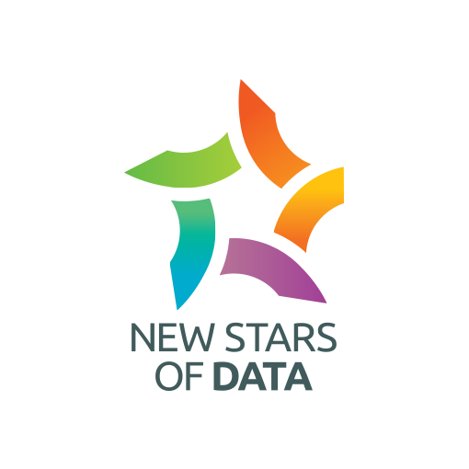
From Dev to Prod: Mastering Deployment in Microsoft Fabric
Practical strategies for enterprise-ready deployment pipelines

Slide 2


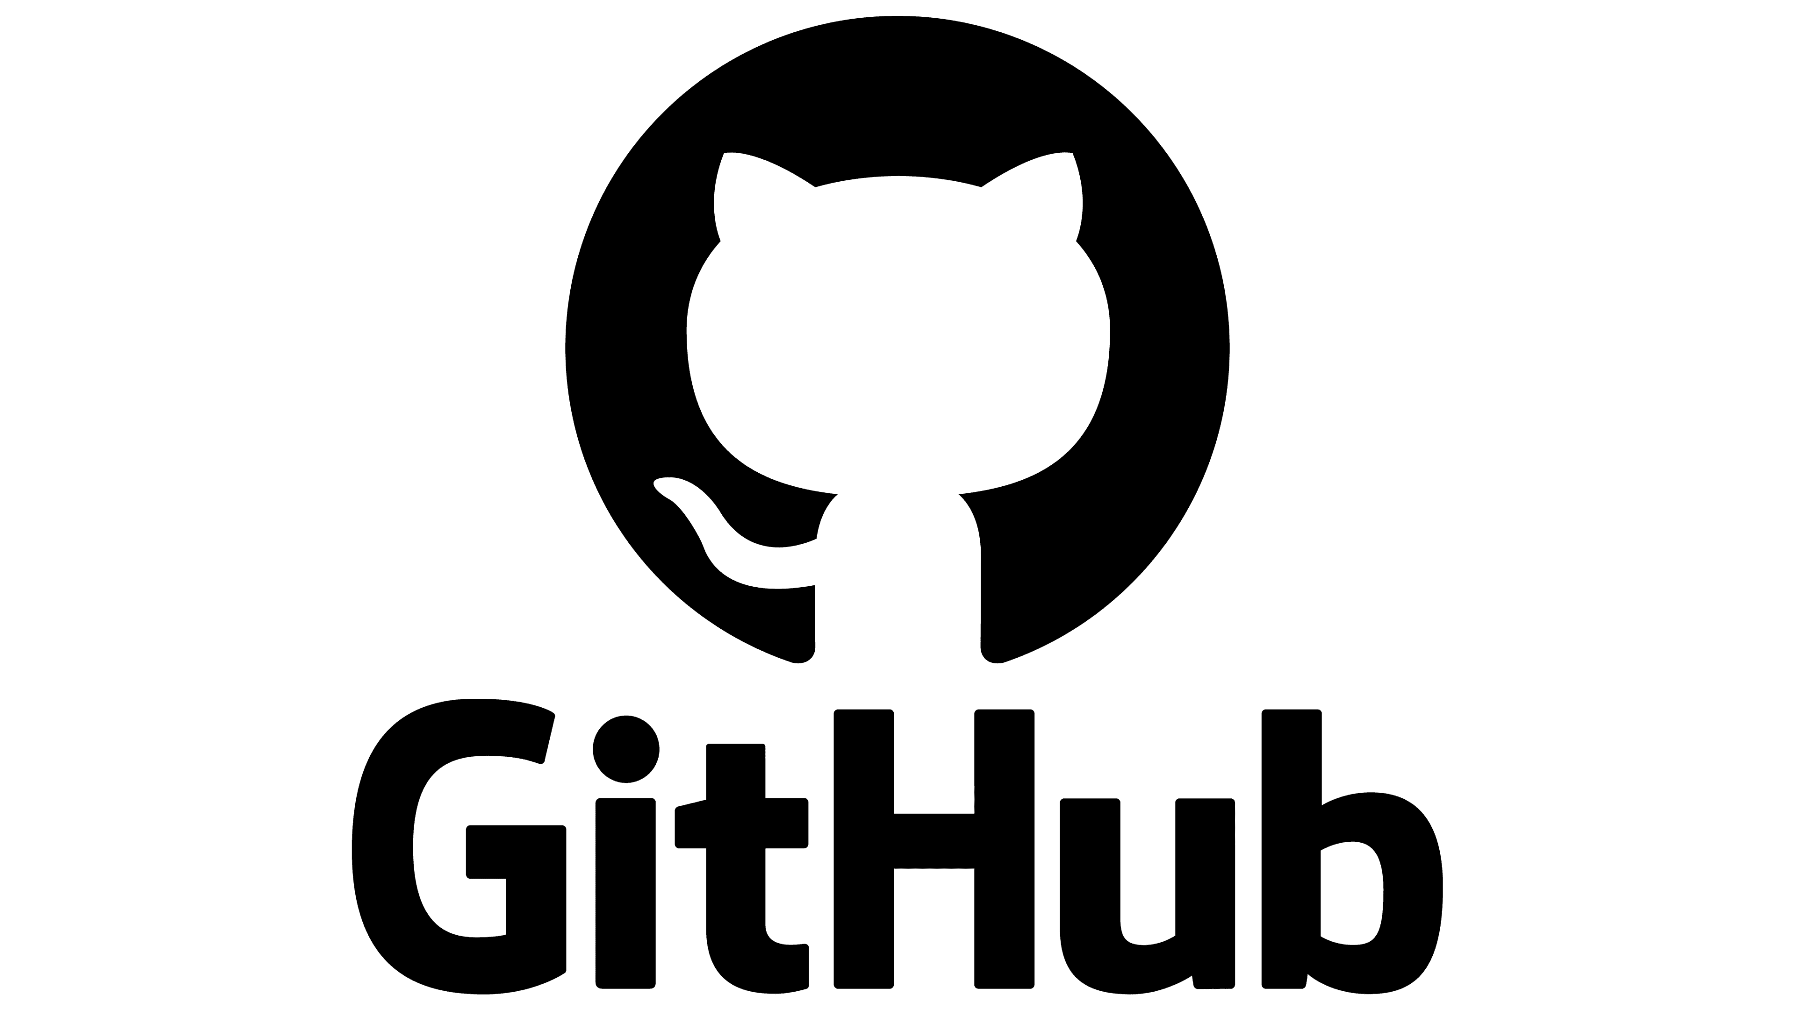

Short Introduction
Data Engineer from Slovenia
>7 years of experience using Microsoft Data Products– Azure, MS Fabric and Power BI
Husband and soon to be a father
Basketball enthusiast (Go Lakers Mavs!)
Žan Tavčar
https://github.com/zan-tavcar
tavcar.zan@outlook.com

Slide 3
Agenda
GIT integration
Overview of demo project (Workspace Structure)
Lifecycle management in theory
Deployment examples with a) Deployment Pipelines b) Smart use of Fabric APIs & abfss paths c) Azure DevOps pipelines with fabric-cicd

Slide 4
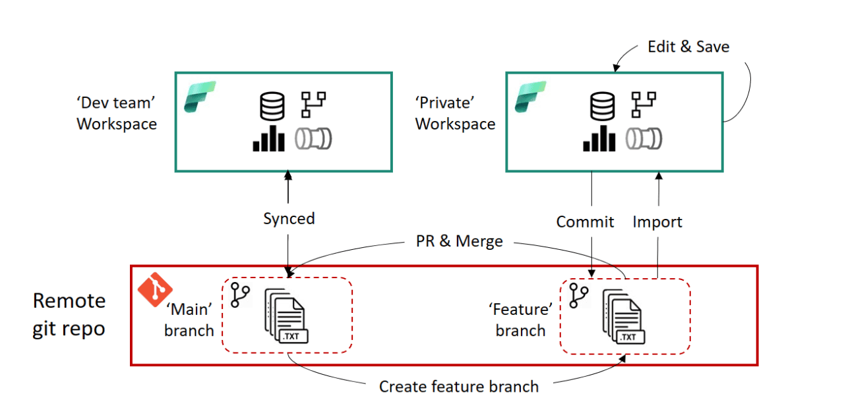
1. GIT Integration
- Why? It enables version control, collaboration and CI/CD workflows
- How? By connecting workspaces to a GIT repository, allowing users to collaborate
- Base Principles: a) Branching-out b) Commit c) Pull Request

Slide 5

GIT Integration Demo

Slide 6
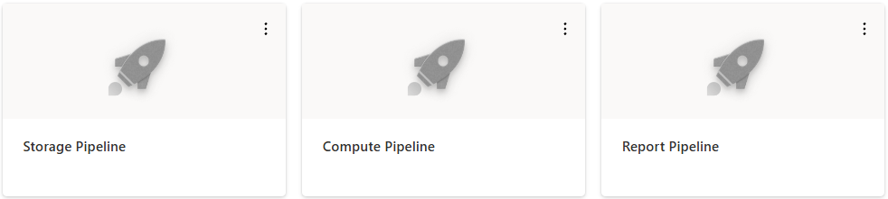
2. Overview of Demo Project & Workspace Structure
- Workspaces are separated into:
Compute workspace (Notebooks, Pipelines) Storage workspace(Lakehouse, DWH) Report workspace (Semantic Model, Report)
- Each workspace has development and production stage

Slide 7
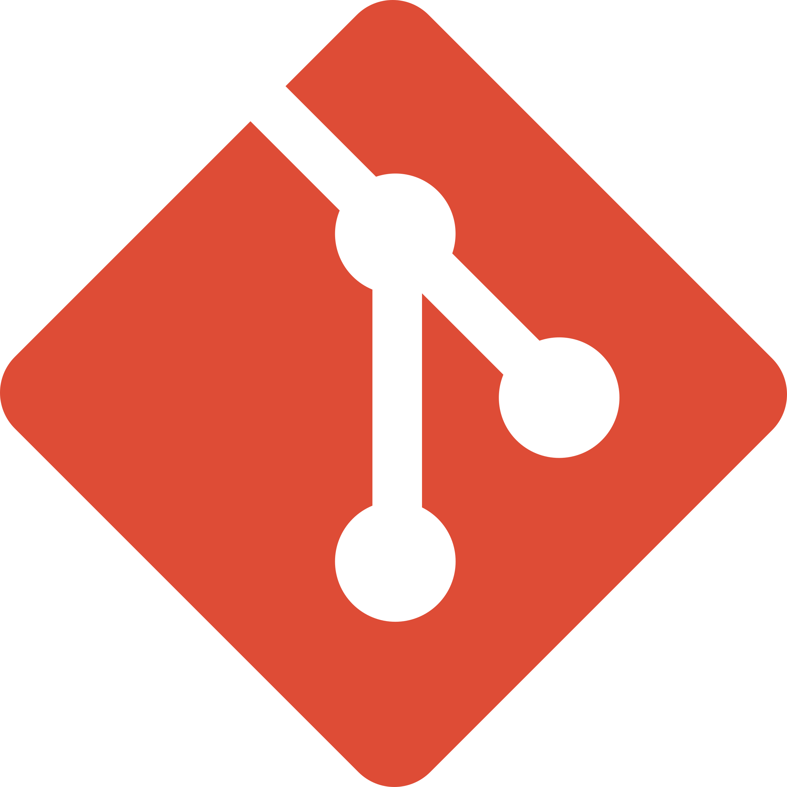



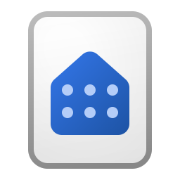
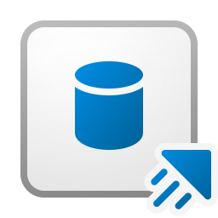
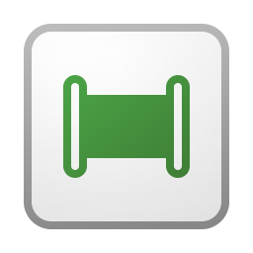
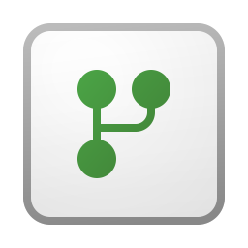
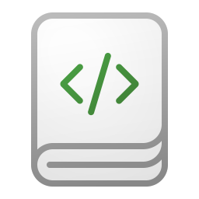



Dev
Prod
Storage
Storage
/Storage
/Compute
Compute
Compute
/Compute
/Reports
Reports
Reports

Slide 8
3. Lifecycle management in theory
- Scenario: We have development and production environment
- Main goal:
The goal is to ensure that Fabric Items dynamically point to the right artifact — development items in the dev environment and production items in the prod environment.

Slide 9
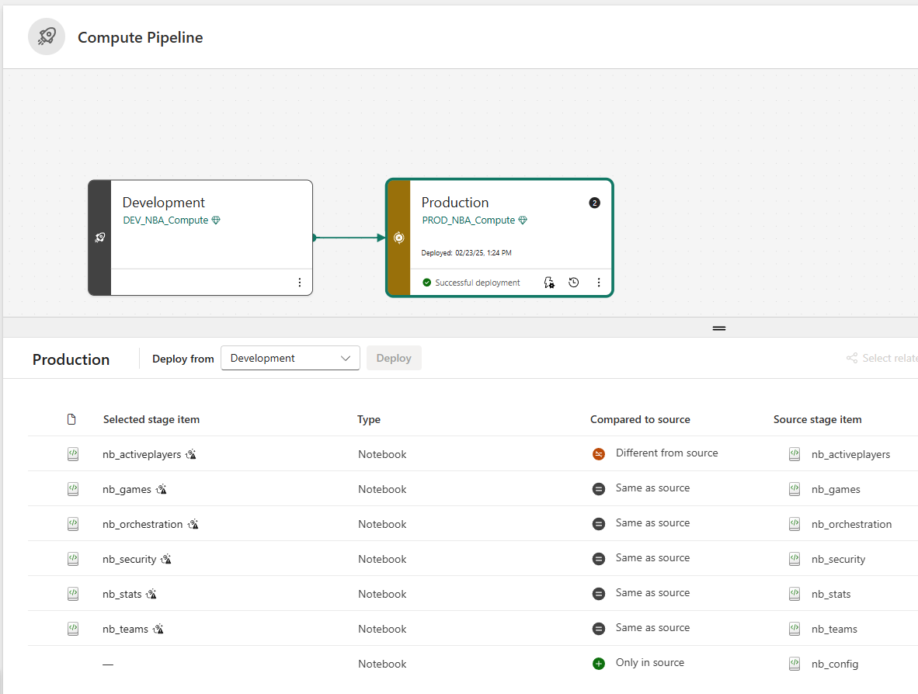
Option A: Power BI Deployment Pipelines
- How? Assign workspace to an empty stage and deploy content from one stage to another

Slide 10
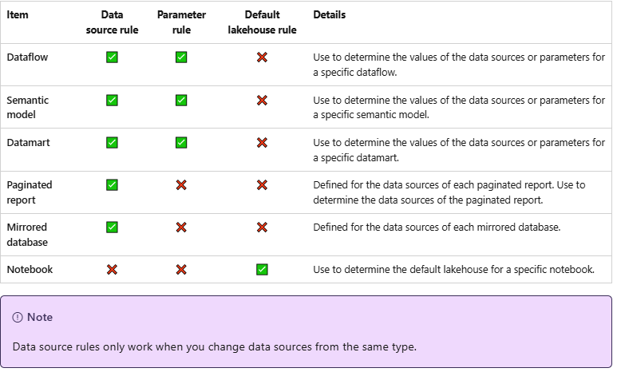
Option A: Power BI Deployment Pipelines
Deployment Rules in Microsoft Fabric simplify environment-specific configurations, enabling updates of connections, parameters, and data sources during deployment stages.

Slide 11
Option A: Demo

Slide 12
Option A: Pros and Cons
Pros: - Easy to navigate - No Code experience - Fast setup for small-medium sized projects Cons: - Hard to handle in enterprise environment (you need to configure rule for every Fabric item) - Not all items support deployment rules – Fabric Pipeline is on top of that list - No real “connection” with GIT – users can deploy changes that have not been committed

Slide 13

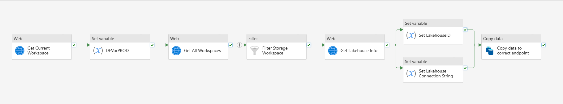
Option B: Fabric REST API & ABFSS Paths
- Why? Deployment rules can get “messy” and hard to handle in enterprise scale environment - Solution? Something that’s code based and easy to maintain
- How? a) For Pipelines: Microsoft Fabric APIs (now available with SPN) can present a low-code solution for pointing to correct endpoint depending on environment b) For Notebooks: Avoid using the attached lakehouse. Use a dictionary with abfss path definition for flexible and environment-specific access.

Slide 14
Option B: Demo

Slide 15
Option B: Pros and Cons
Pros: - Solution is easy to maintain via dictionary (nb_config) - No need to define deployment rules in UI Cons: - Limited use cases a)Notebook scenario: This can be applied to data sources that work well with Fabric Notebooks (other Lakehouses, OneLake, ADLS Gen2, jdbc, REST APIs), but not for on-prem SQL databases b) Pipeline scenario: Dynamic content can be set only for Lakehouse and Warehouse connection

Slide 16

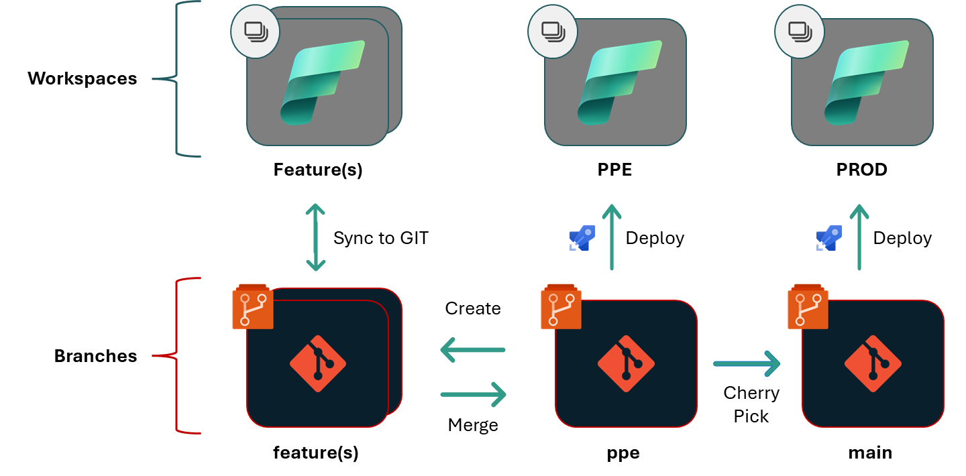
Option C: DevOps pipelines with fabric-cicd library
- Why? Low-code solution still isn’t fully flexible when it comes to deployment - Solution? Making deployments fully reliable and automated through Azure DevOps — and that’s exactly where fabric-cicd shines with the parameter.yml file
Base Expectations
Full deployment every time, without considering commit diffs
Deploys into the tenant of the executing identity
Only supports items that have Source Control, and Public Create/Update APIs

Slide 17
Option C: Demo

Slide 18
Option C: Pros and Cons
Pros: - Flexible solution that is based on item definition with find-replace logic - Can switch between connections (DEV/PROD) for all data sources, only requirement is that connections are defined - Not that hard to set up (I don’t come from DevOps background and was able to get it up and running ☺) Cons: - Always deploys whole Azure Repo (no diffs taken into account)

Slide 19
Summary
- 3 different deployment scenarios presented - Which one to choose? A) Deployment Pipelines: Easy UI experience allows everybody to adapt deployment scenario B) Smart use of Fabric API and notebookutils: Excellent low-code option for teams that are mostly working with cloud sources C) DevOps and Fabric cicd: Flexible solution for teams that are mature enough to deal with DevOps Pipelines

Slide 20
Grateful for your time — let’s keep learning, building, and sharing!
And special thanks to my mentor: Marisol Steinau

