Slide 1

Electricity Prices
in Sweden
An Interactive Dashboard of Electricity Prices in Sweden and Affecting Factors

Slide 2
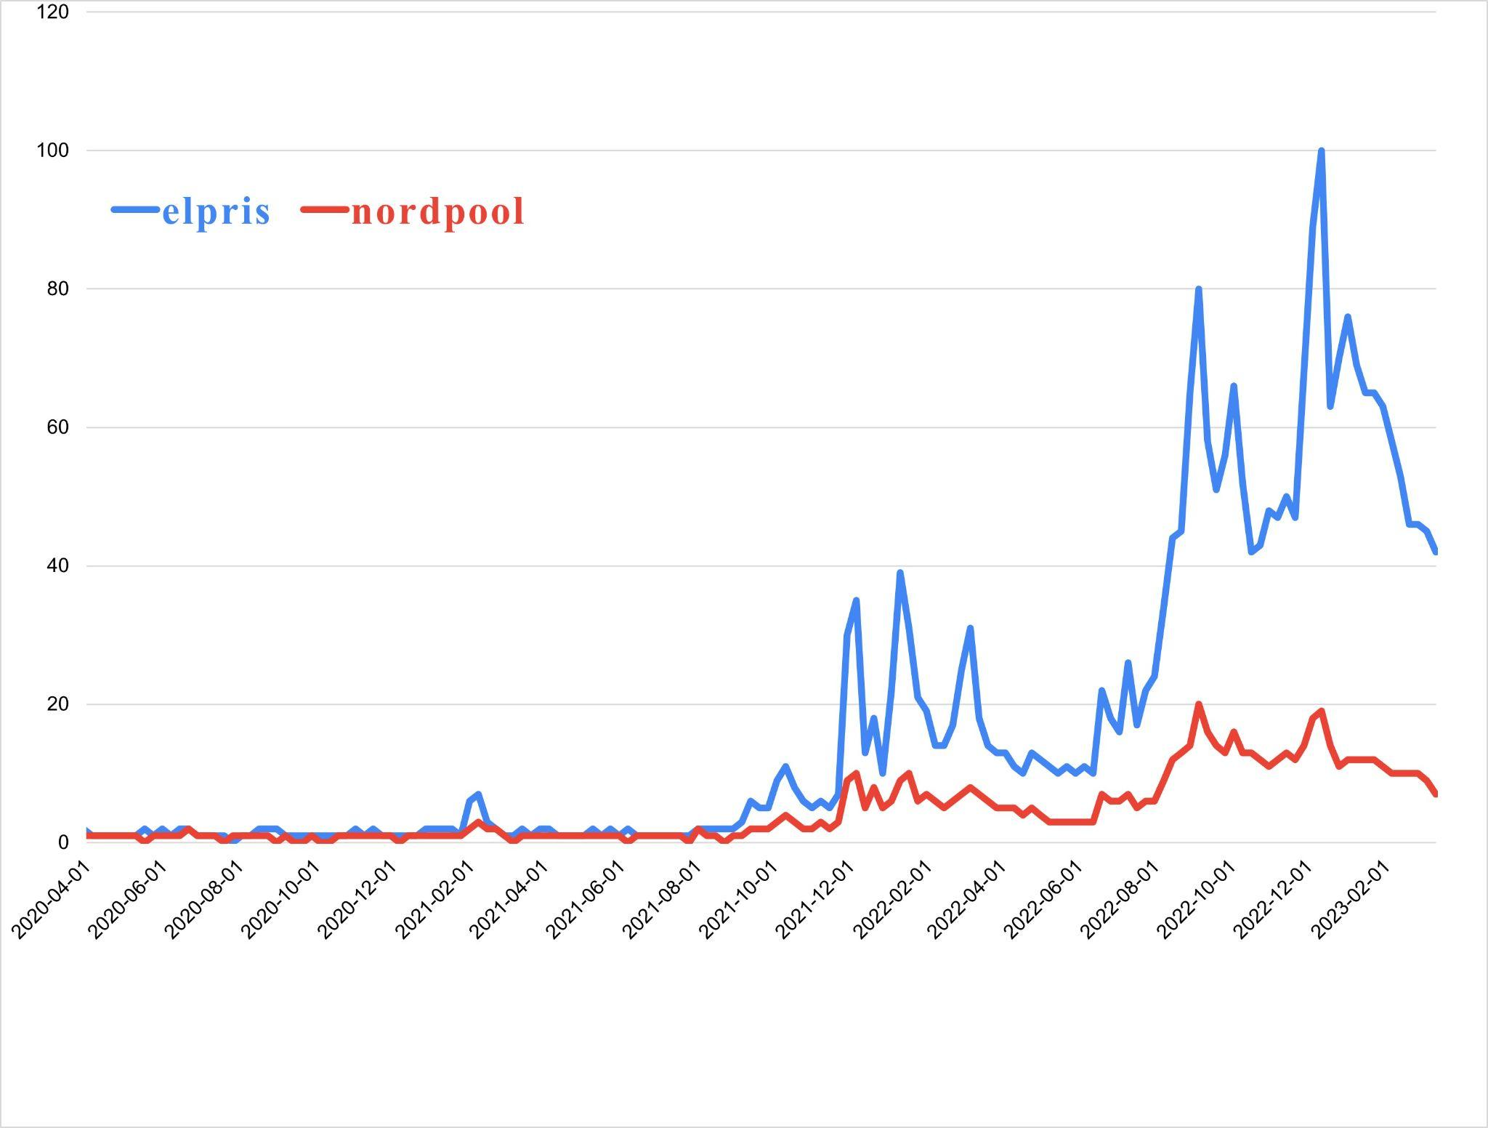
BACKGROUND
Increased Interest
An evolving market
Since autumn of 2021, there has been an explosion in interest, as seen by the trends for Google search terms “elpris”, and “nordpool”
.. that is not intuitive to understand, and the relationship between data is not always clear

Slide 3
TARGET AUDIENCE & PURPOSE
Non-professionals
Homeowners and consumers who want to gain a better understanding of the factors at play in the market
Provide insights
Provide insights which lead to more informed decisions.

Slide 4
OUR OBJECTIVES
ONE
THREE
Provide a comprehensive overview of current electricity price trends.
Help non-professional users identify patterns and trends in electricity prices.
TWO
FOUR
Aid consumers in educating themselves about the various factors that influence electricity prices in order for them to be able to make more informed decisions.
Create a user-friendly tool that is easy to navigate and understand.

Slide 5
OUR APPROACH
Graphs
Filters
Information
A combination of graphs allow the user to make comparisons and draw conclusions
Filters enable the user to display information that is relevant to them
A text box containing background information about global events gives context to the data, which aids in making richer insights

Slide 6

Lets go to Tableau

Slide 7


DATA PREPARATION
01
EXTRACT
• Structured data from Statistics Sweden (SCB).
• Export, import, prices, usage, and production
02
TRANSFORM
• Different formats & structures
• Excel & Tableau Prep
03
LOAD
• Ready to use data

Slide 8
THANKS!
Do you have any questions?
Feel free to ask us!
Please keep this slide for attribution

