Slide 1
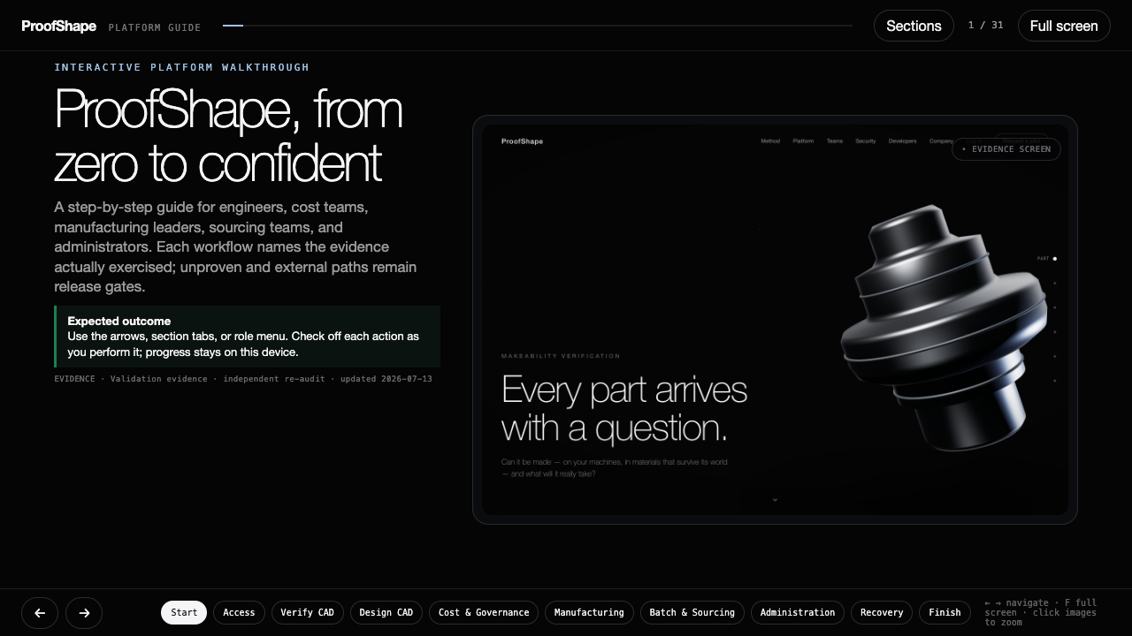
Notes:
ProofShape validated platform guide — slide 1 of 31.
Follow the visible actions and compare the result with the expected-outcome panel.
The interactive HTML companion provides role jumps, persistent checklists, zoom, and keyboard navigation.

Slide 2
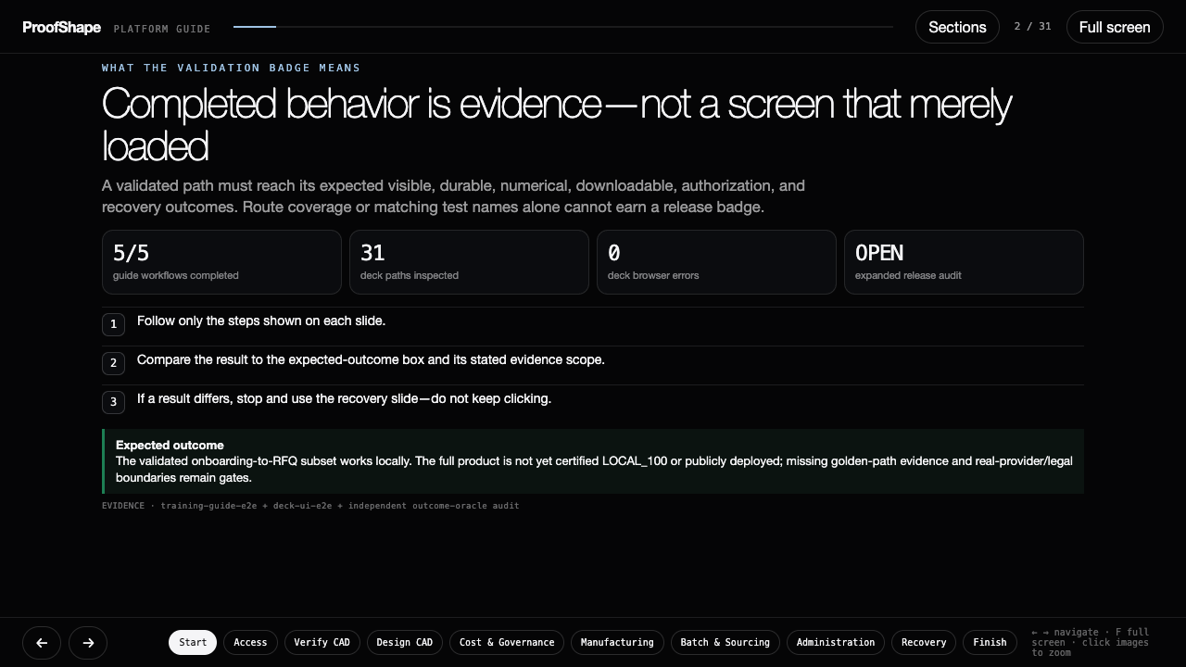
Notes:
ProofShape validated platform guide — slide 2 of 31.
Follow the visible actions and compare the result with the expected-outcome panel.
The interactive HTML companion provides role jumps, persistent checklists, zoom, and keyboard navigation.

Slide 3
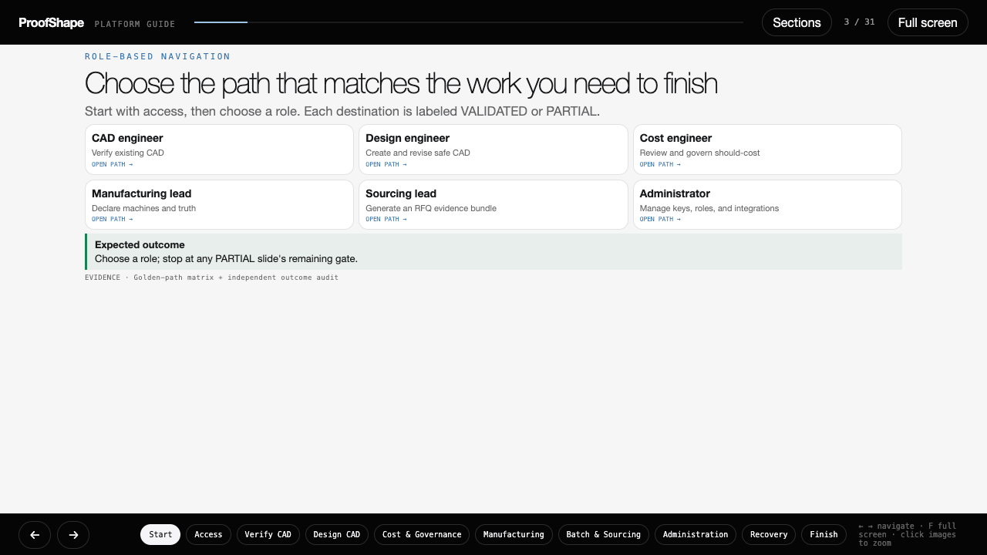
Notes:
ProofShape validated platform guide — slide 3 of 31.
Follow the visible actions and compare the result with the expected-outcome panel.
The interactive HTML companion provides role jumps, persistent checklists, zoom, and keyboard navigation.

Slide 4
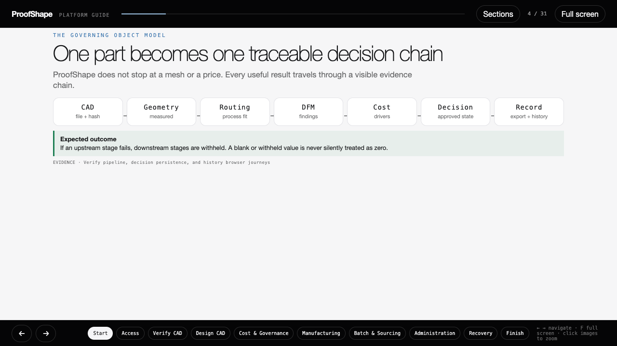
Notes:
ProofShape validated platform guide — slide 4 of 31.
Follow the visible actions and compare the result with the expected-outcome panel.
The interactive HTML companion provides role jumps, persistent checklists, zoom, and keyboard navigation.

Slide 5
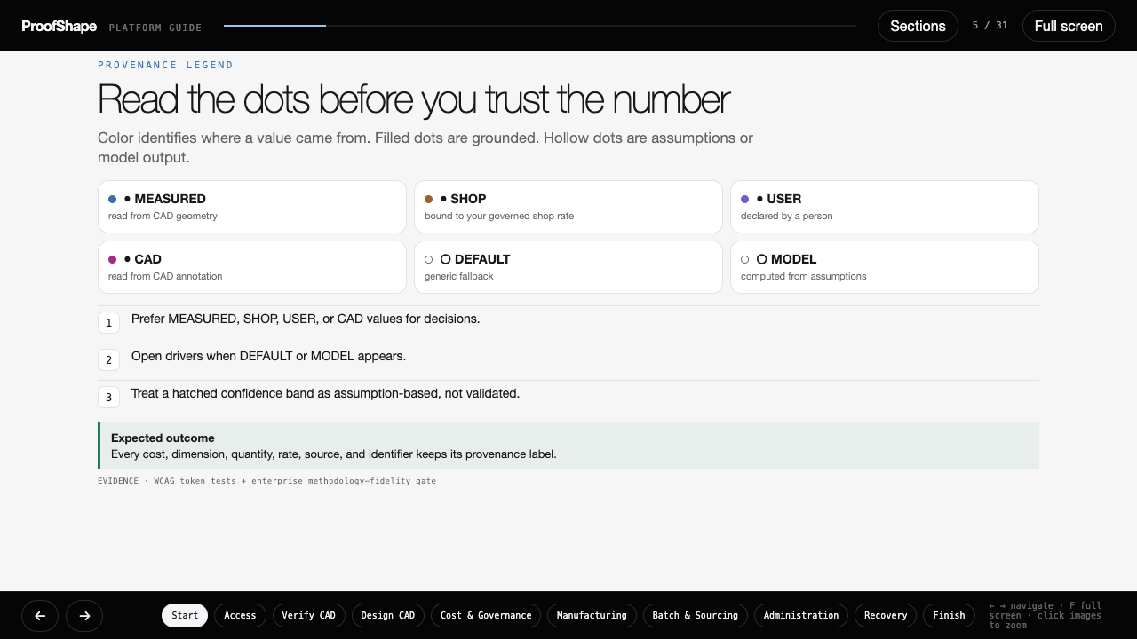
Notes:
ProofShape validated platform guide — slide 5 of 31.
Follow the visible actions and compare the result with the expected-outcome panel.
The interactive HTML companion provides role jumps, persistent checklists, zoom, and keyboard navigation.

Slide 6
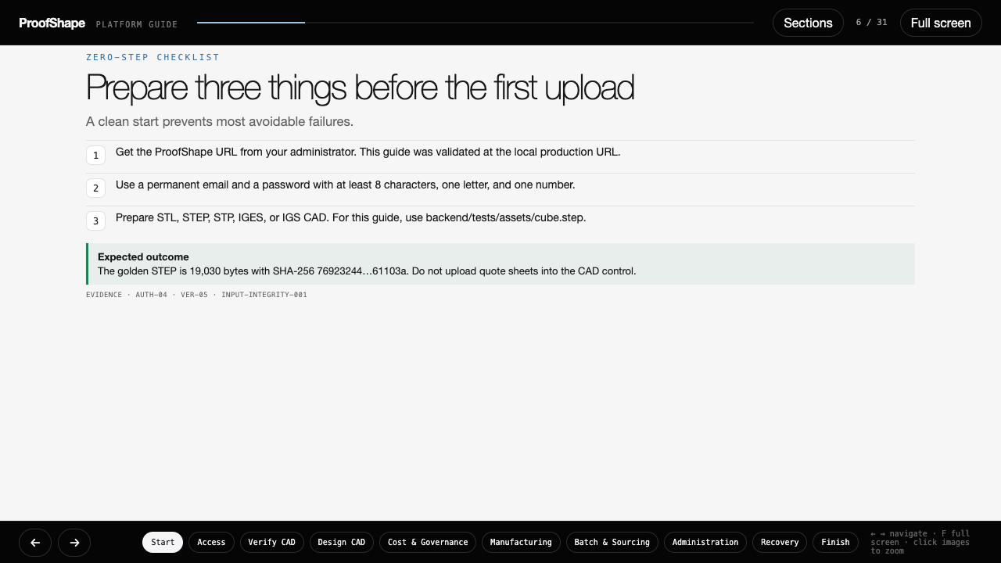
Notes:
ProofShape validated platform guide — slide 6 of 31.
Follow the visible actions and compare the result with the expected-outcome panel.
The interactive HTML companion provides role jumps, persistent checklists, zoom, and keyboard navigation.

Slide 7
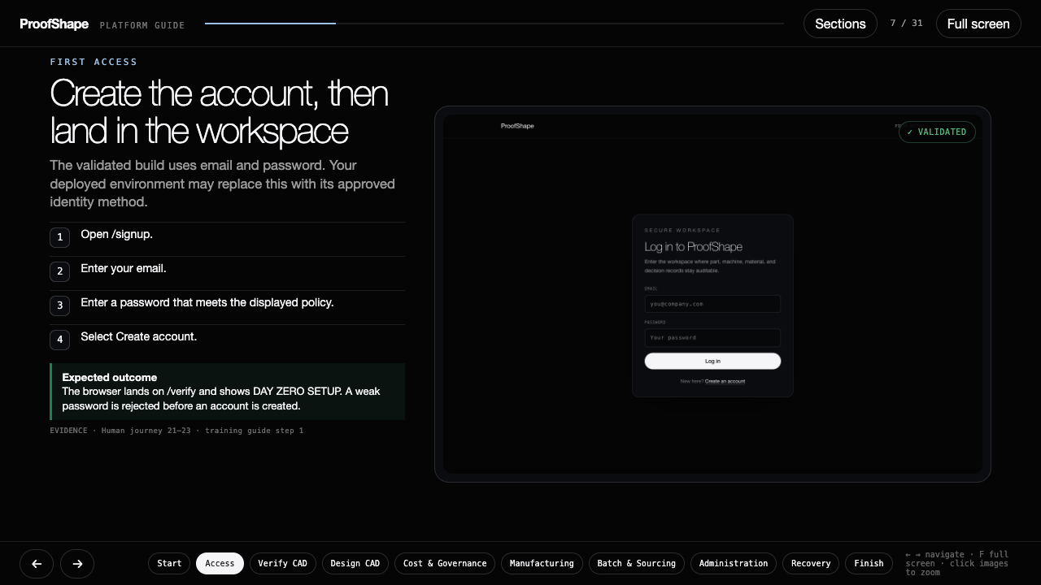
Notes:
ProofShape validated platform guide — slide 7 of 31.
Follow the visible actions and compare the result with the expected-outcome panel.
The interactive HTML companion provides role jumps, persistent checklists, zoom, and keyboard navigation.

Slide 8
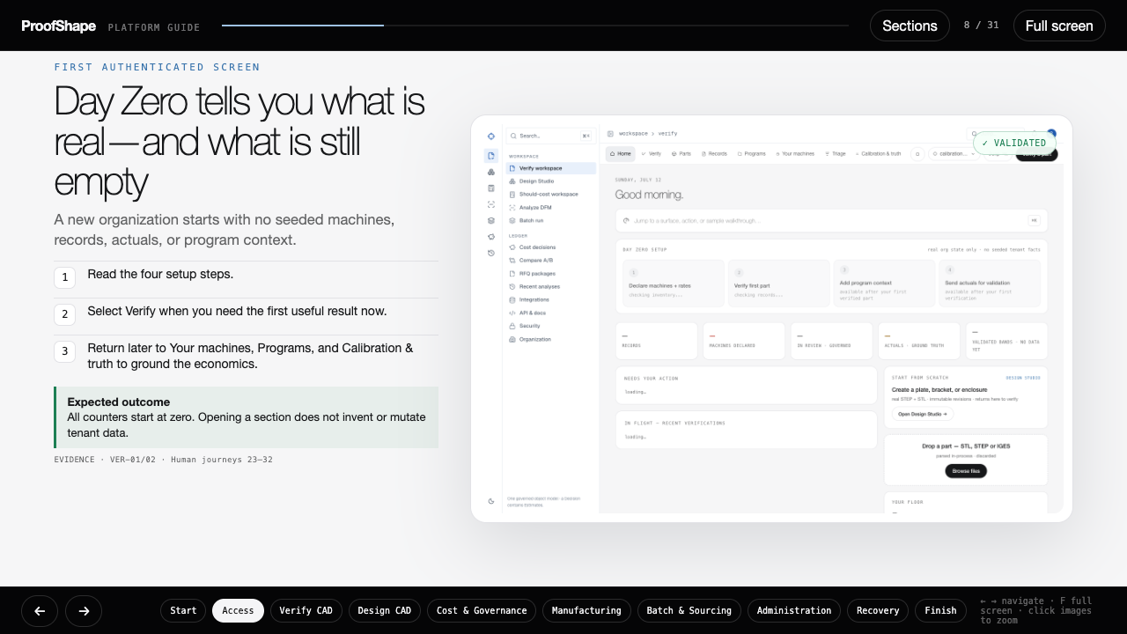
Notes:
ProofShape validated platform guide — slide 8 of 31.
Follow the visible actions and compare the result with the expected-outcome panel.
The interactive HTML companion provides role jumps, persistent checklists, zoom, and keyboard navigation.

Slide 9
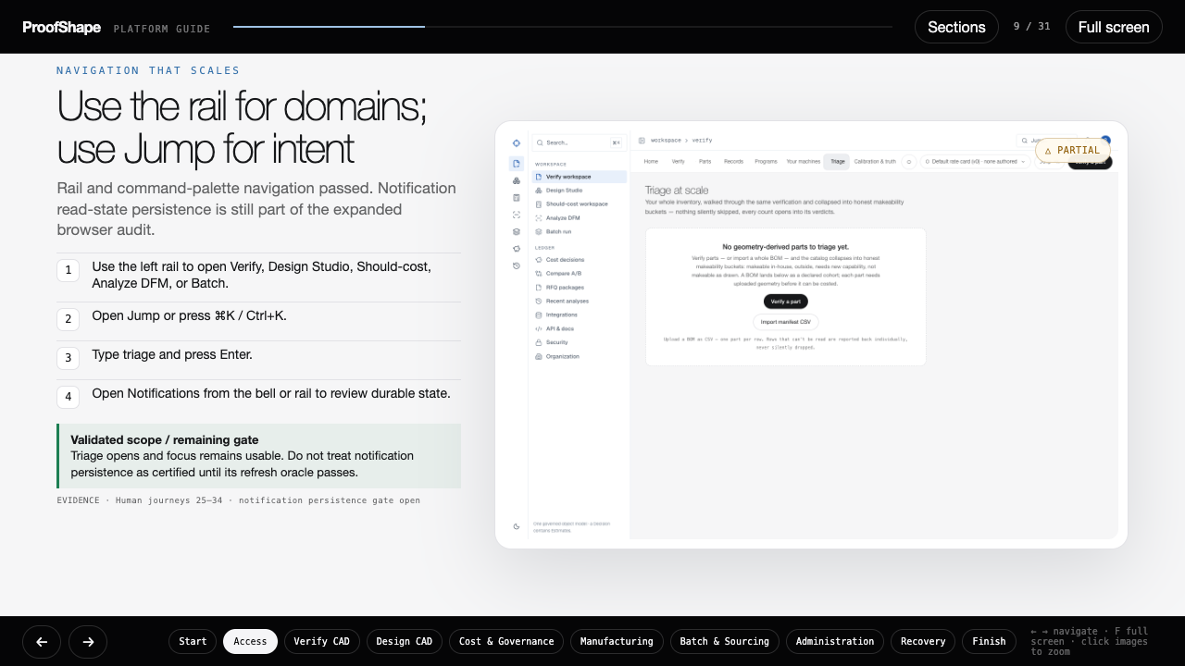
Notes:
ProofShape validated platform guide — slide 9 of 31.
Follow the visible actions and compare the result with the expected-outcome panel.
The interactive HTML companion provides role jumps, persistent checklists, zoom, and keyboard navigation.

Slide 10
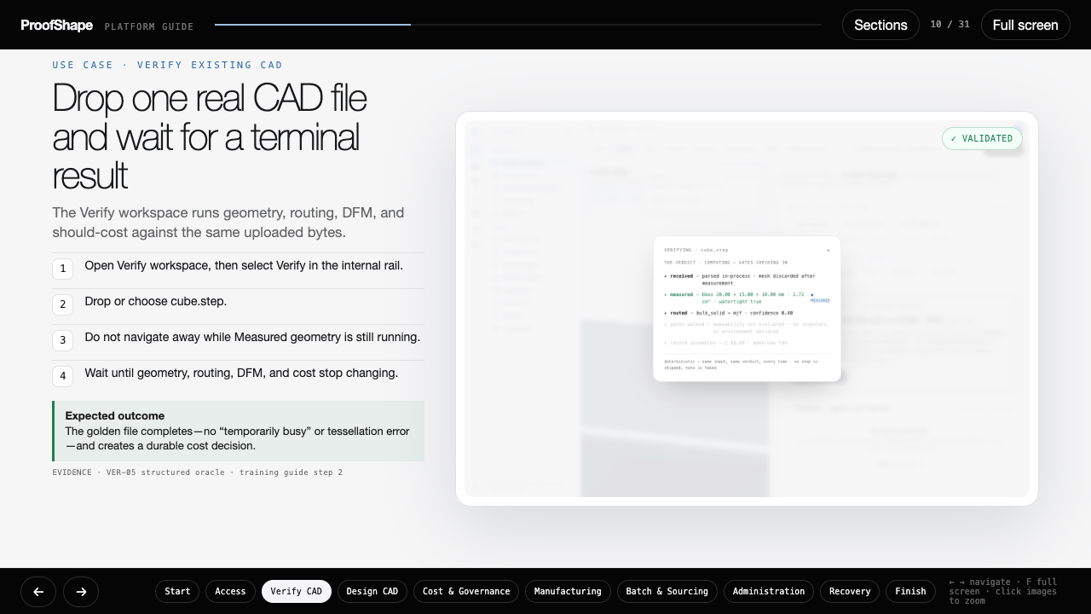
Notes:
ProofShape validated platform guide — slide 10 of 31.
Follow the visible actions and compare the result with the expected-outcome panel.
The interactive HTML companion provides role jumps, persistent checklists, zoom, and keyboard navigation.

Slide 11
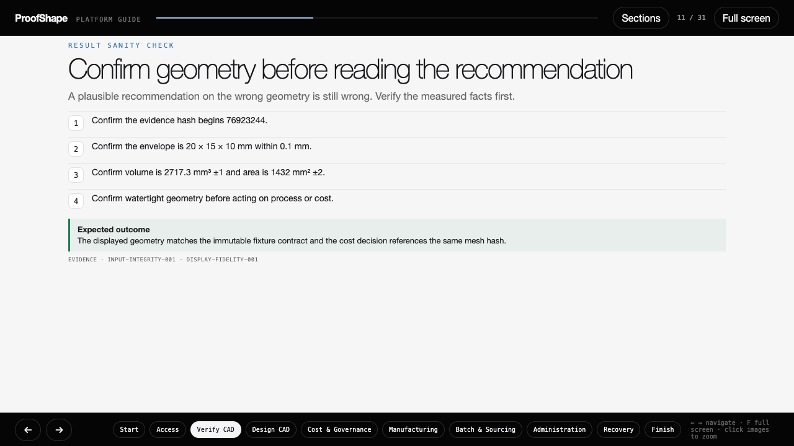
Notes:
ProofShape validated platform guide — slide 11 of 31.
Follow the visible actions and compare the result with the expected-outcome panel.
The interactive HTML companion provides role jumps, persistent checklists, zoom, and keyboard navigation.

Slide 12
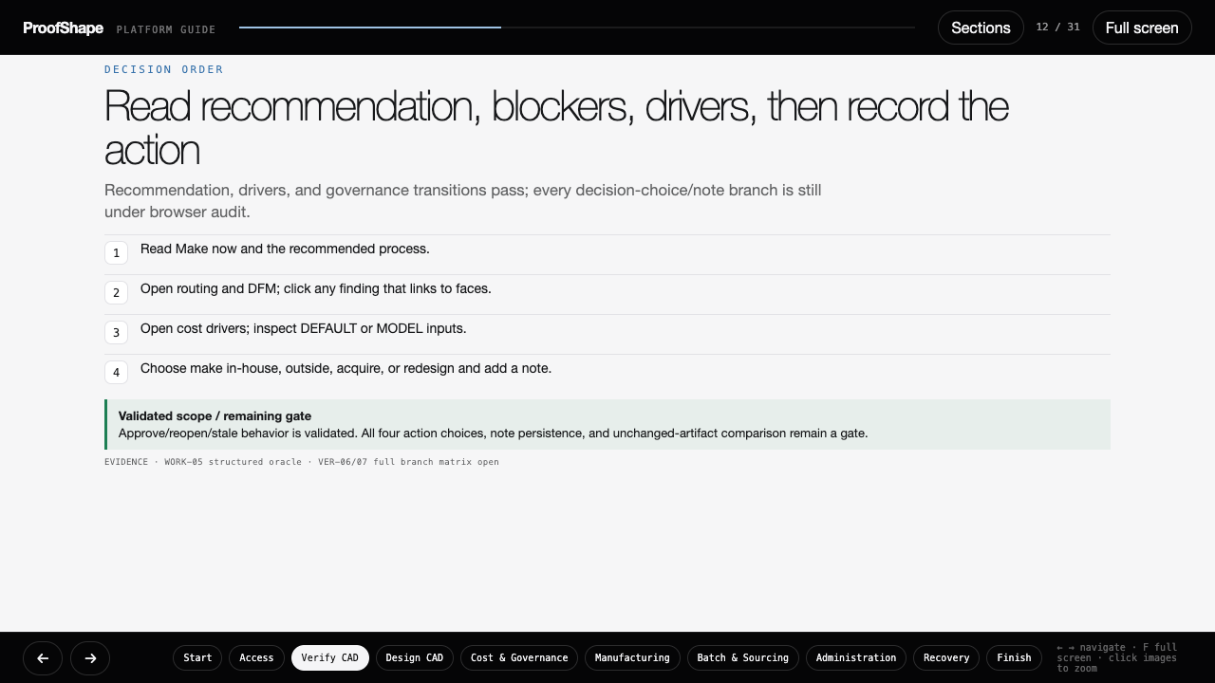
Notes:
ProofShape validated platform guide — slide 12 of 31.
Follow the visible actions and compare the result with the expected-outcome panel.
The interactive HTML companion provides role jumps, persistent checklists, zoom, and keyboard navigation.

Slide 13
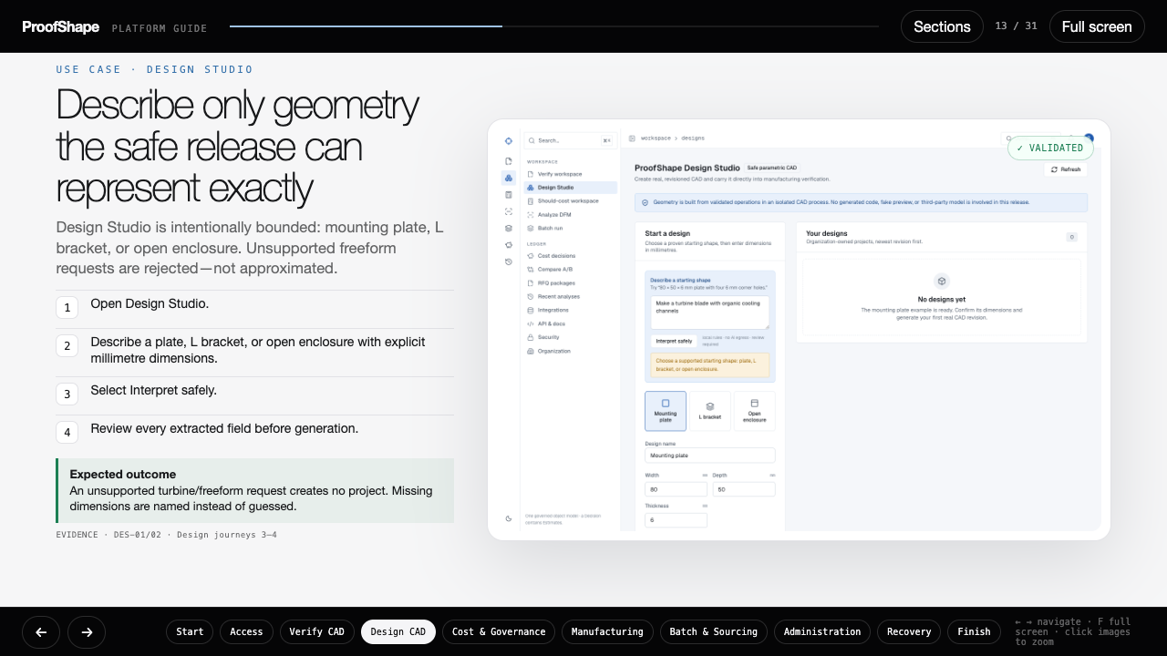
Notes:
ProofShape validated platform guide — slide 13 of 31.
Follow the visible actions and compare the result with the expected-outcome panel.
The interactive HTML companion provides role jumps, persistent checklists, zoom, and keyboard navigation.

Slide 14
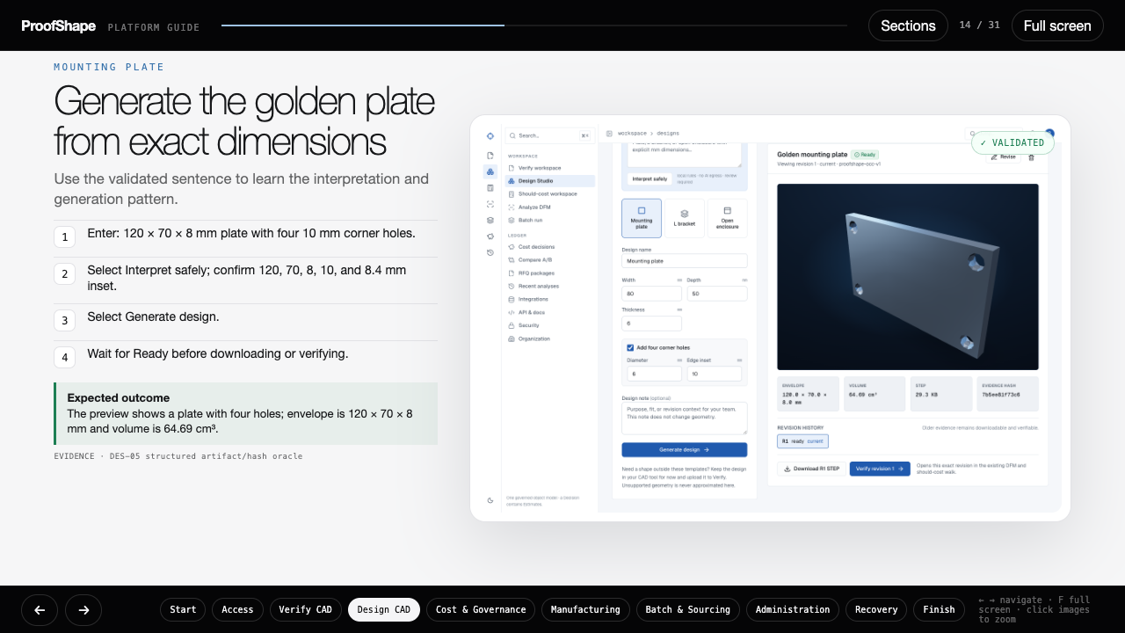
Notes:
ProofShape validated platform guide — slide 14 of 31.
Follow the visible actions and compare the result with the expected-outcome panel.
The interactive HTML companion provides role jumps, persistent checklists, zoom, and keyboard navigation.

Slide 15
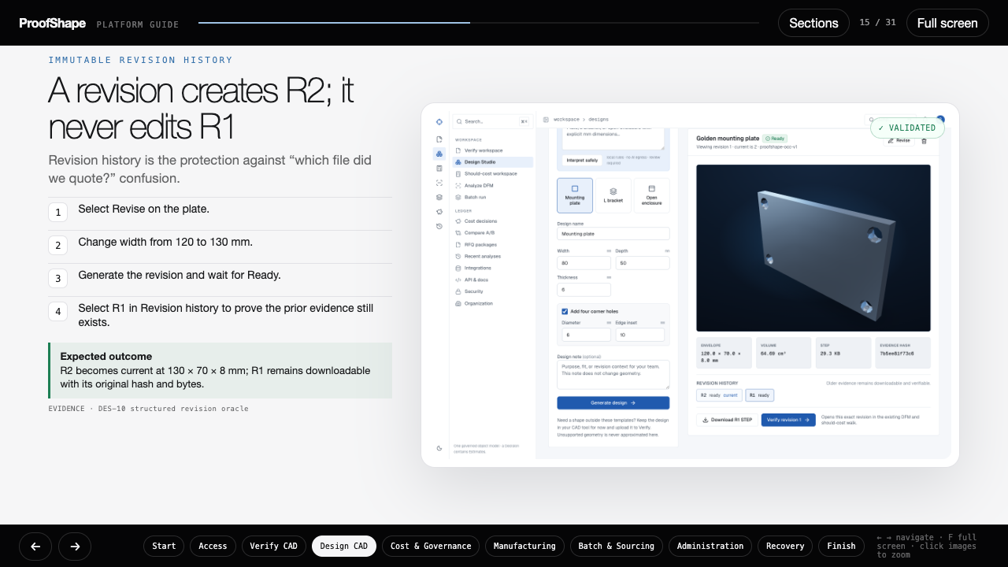
Notes:
ProofShape validated platform guide — slide 15 of 31.
Follow the visible actions and compare the result with the expected-outcome panel.
The interactive HTML companion provides role jumps, persistent checklists, zoom, and keyboard navigation.

Slide 16
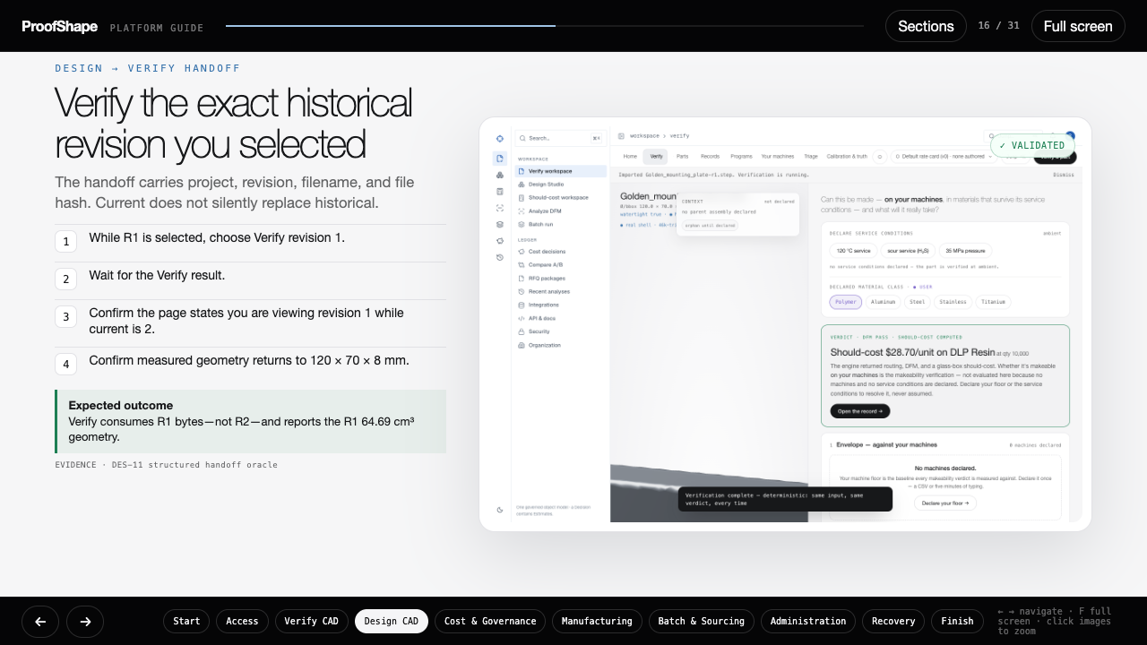
Notes:
ProofShape validated platform guide — slide 16 of 31.
Follow the visible actions and compare the result with the expected-outcome panel.
The interactive HTML companion provides role jumps, persistent checklists, zoom, and keyboard navigation.

Slide 17
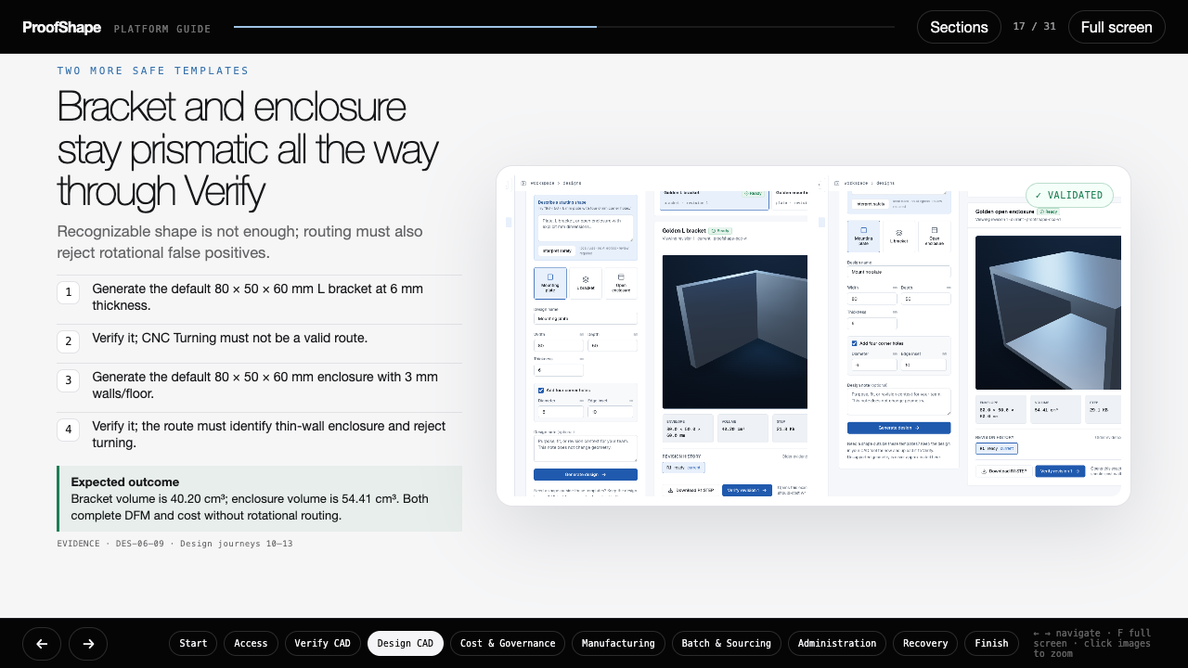
Notes:
ProofShape validated platform guide — slide 17 of 31.
Follow the visible actions and compare the result with the expected-outcome panel.
The interactive HTML companion provides role jumps, persistent checklists, zoom, and keyboard navigation.

Slide 18
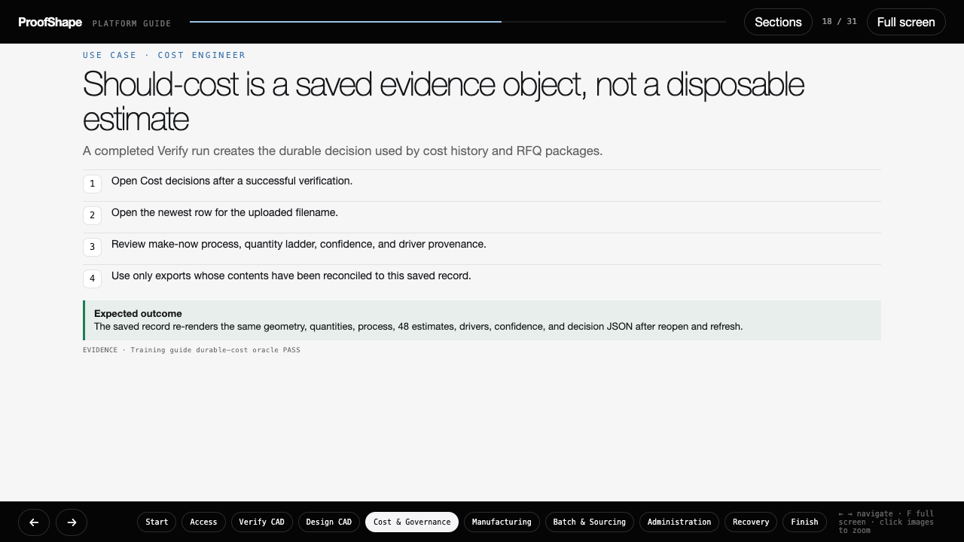
Notes:
ProofShape validated platform guide — slide 18 of 31.
Follow the visible actions and compare the result with the expected-outcome panel.
The interactive HTML companion provides role jumps, persistent checklists, zoom, and keyboard navigation.

Slide 19
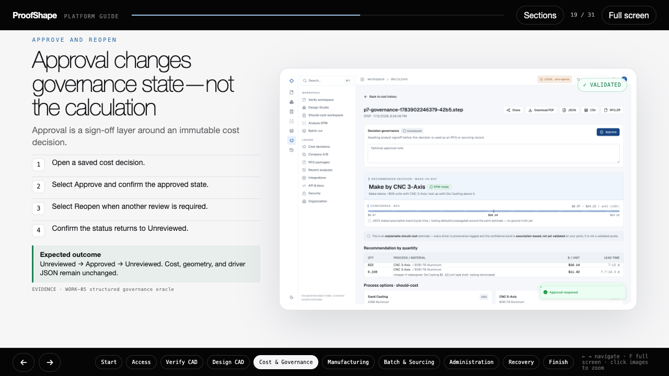
Notes:
ProofShape validated platform guide — slide 19 of 31.
Follow the visible actions and compare the result with the expected-outcome panel.
The interactive HTML companion provides role jumps, persistent checklists, zoom, and keyboard navigation.

Slide 20
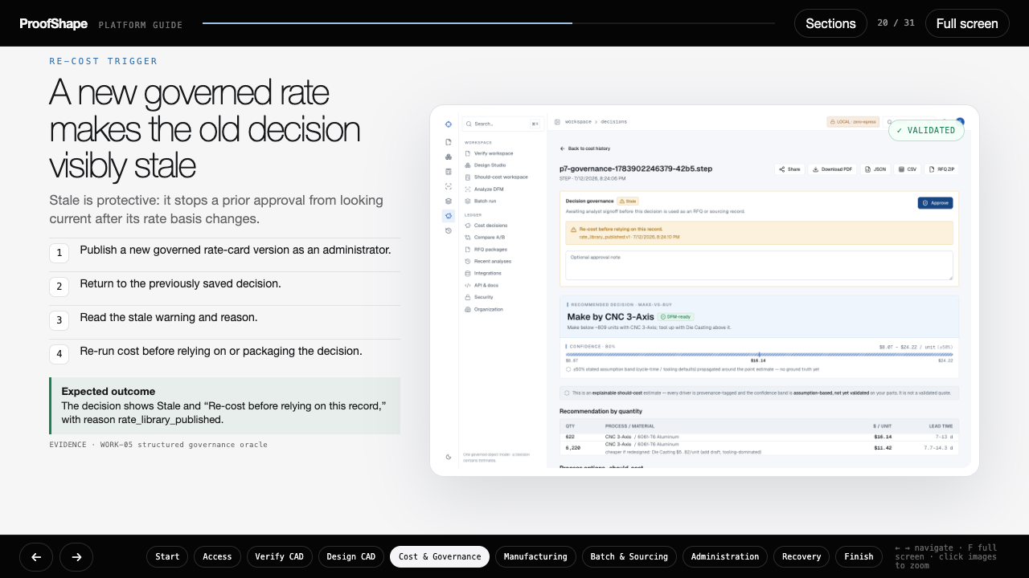
Notes:
ProofShape validated platform guide — slide 20 of 31.
Follow the visible actions and compare the result with the expected-outcome panel.
The interactive HTML companion provides role jumps, persistent checklists, zoom, and keyboard navigation.

Slide 21
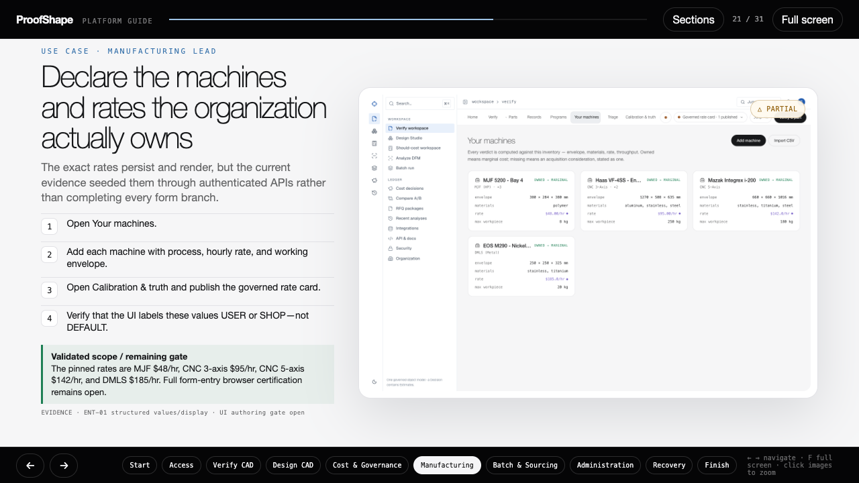
Notes:
ProofShape validated platform guide — slide 21 of 31.
Follow the visible actions and compare the result with the expected-outcome panel.
The interactive HTML companion provides role jumps, persistent checklists, zoom, and keyboard navigation.

Slide 22
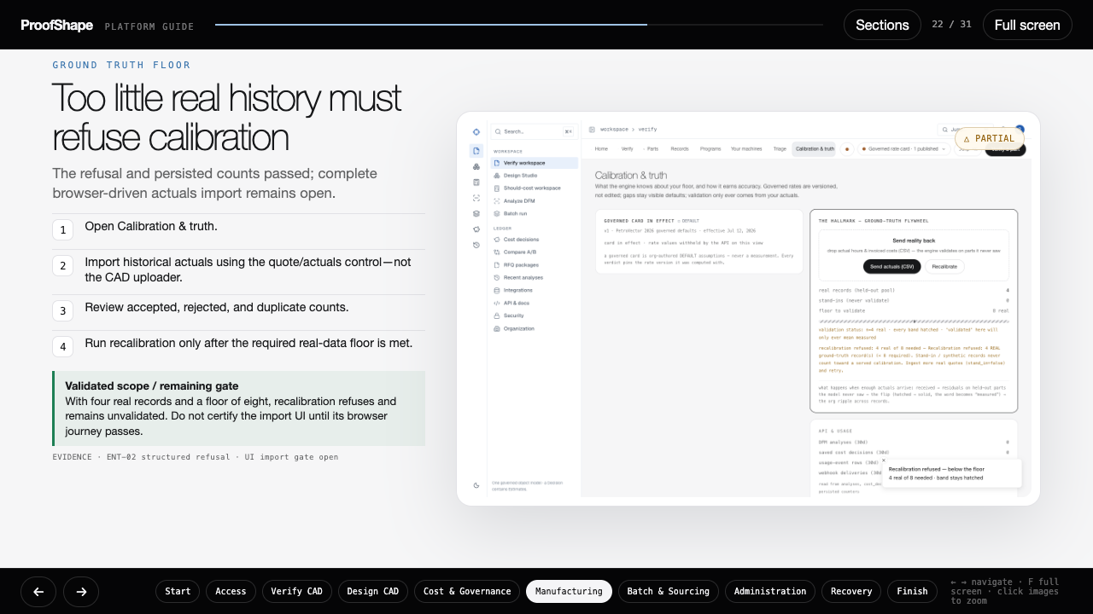
Notes:
ProofShape validated platform guide — slide 22 of 31.
Follow the visible actions and compare the result with the expected-outcome panel.
The interactive HTML companion provides role jumps, persistent checklists, zoom, and keyboard navigation.

Slide 23
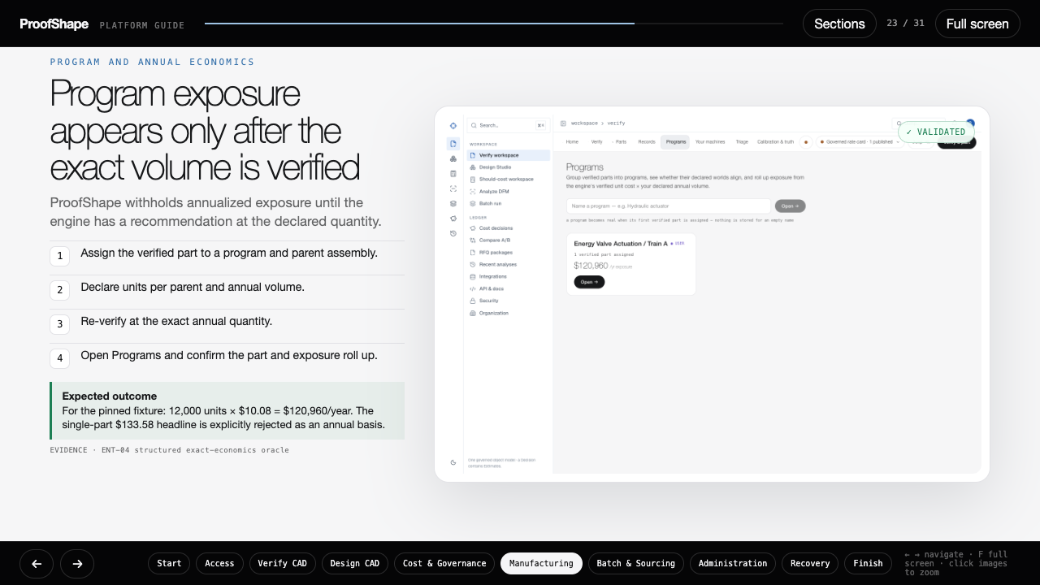
Notes:
ProofShape validated platform guide — slide 23 of 31.
Follow the visible actions and compare the result with the expected-outcome panel.
The interactive HTML companion provides role jumps, persistent checklists, zoom, and keyboard navigation.

Slide 24
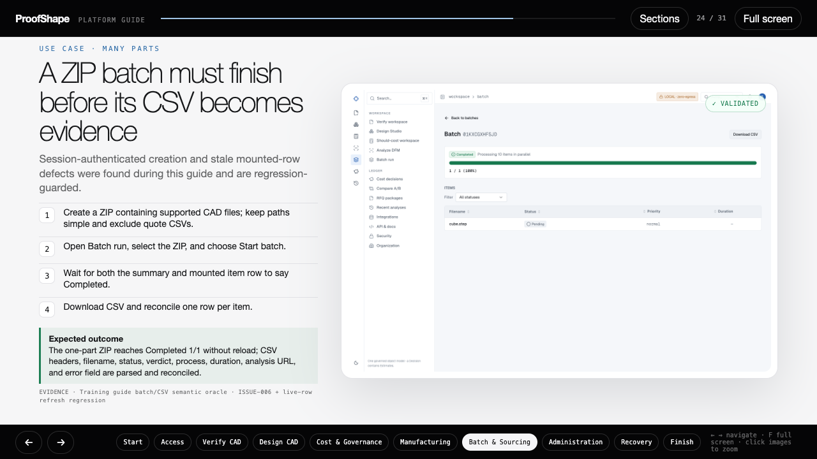
Notes:
ProofShape validated platform guide — slide 24 of 31.
Follow the visible actions and compare the result with the expected-outcome panel.
The interactive HTML companion provides role jumps, persistent checklists, zoom, and keyboard navigation.

Slide 25
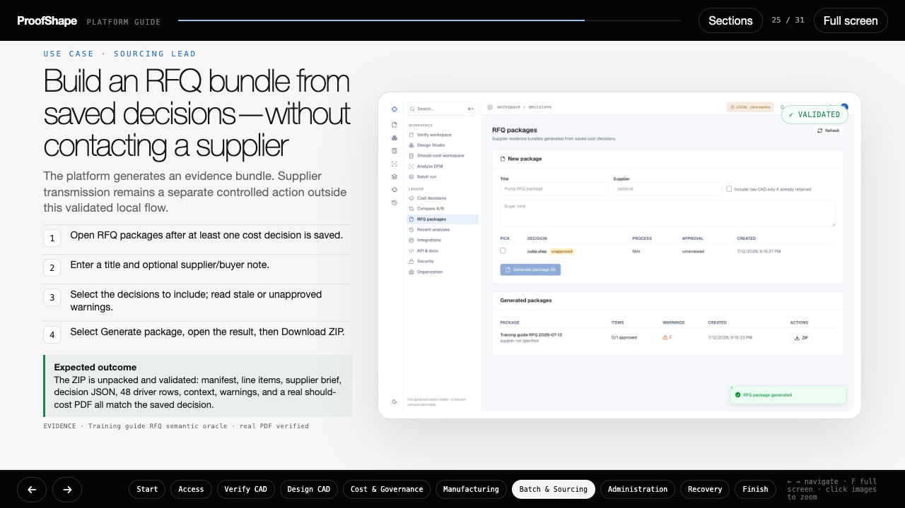
Notes:
ProofShape validated platform guide — slide 25 of 31.
Follow the visible actions and compare the result with the expected-outcome panel.
The interactive HTML companion provides role jumps, persistent checklists, zoom, and keyboard navigation.

Slide 26
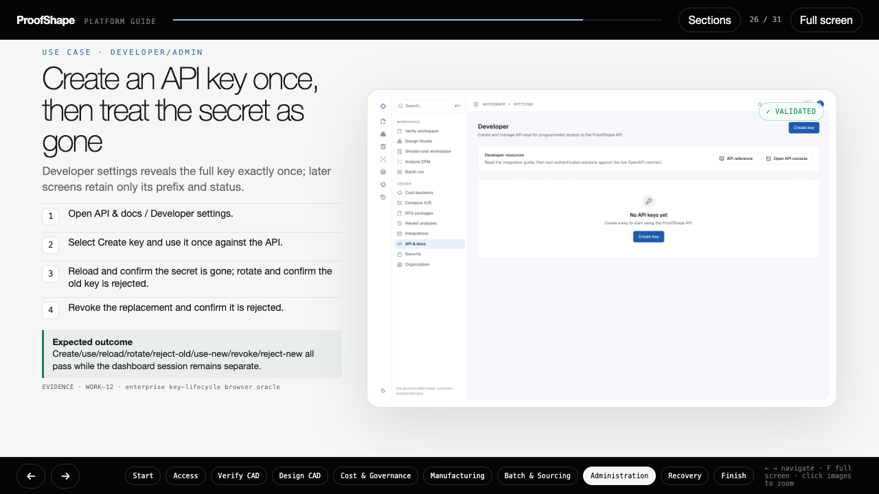
Notes:
ProofShape validated platform guide — slide 26 of 31.
Follow the visible actions and compare the result with the expected-outcome panel.
The interactive HTML companion provides role jumps, persistent checklists, zoom, and keyboard navigation.

Slide 27
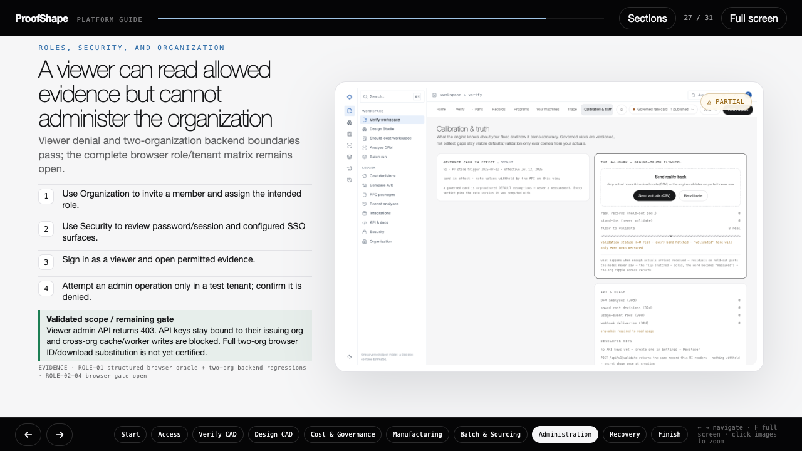
Notes:
ProofShape validated platform guide — slide 27 of 31.
Follow the visible actions and compare the result with the expected-outcome panel.
The interactive HTML companion provides role jumps, persistent checklists, zoom, and keyboard navigation.

Slide 28
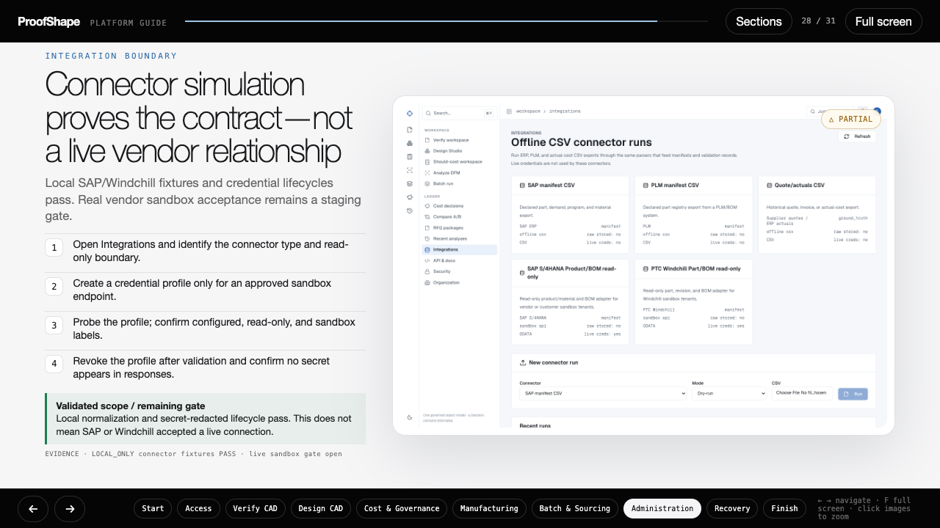
Notes:
ProofShape validated platform guide — slide 28 of 31.
Follow the visible actions and compare the result with the expected-outcome panel.
The interactive HTML companion provides role jumps, persistent checklists, zoom, and keyboard navigation.

Slide 29
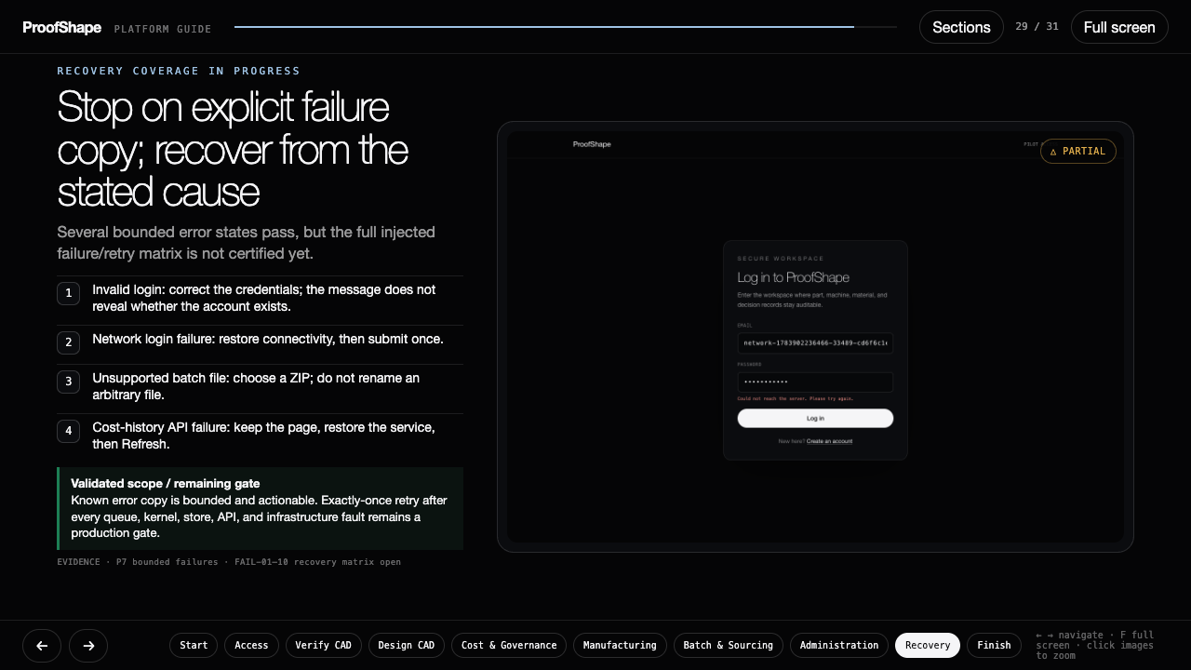
Notes:
ProofShape validated platform guide — slide 29 of 31.
Follow the visible actions and compare the result with the expected-outcome panel.
The interactive HTML companion provides role jumps, persistent checklists, zoom, and keyboard navigation.

Slide 30
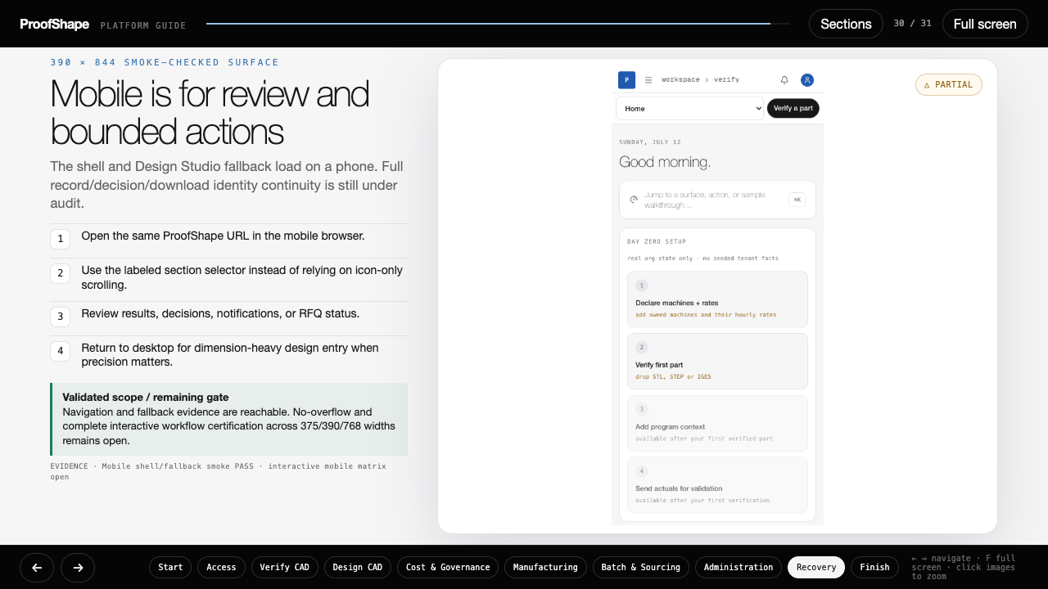
Notes:
ProofShape validated platform guide — slide 30 of 31.
Follow the visible actions and compare the result with the expected-outcome panel.
The interactive HTML companion provides role jumps, persistent checklists, zoom, and keyboard navigation.

Slide 31
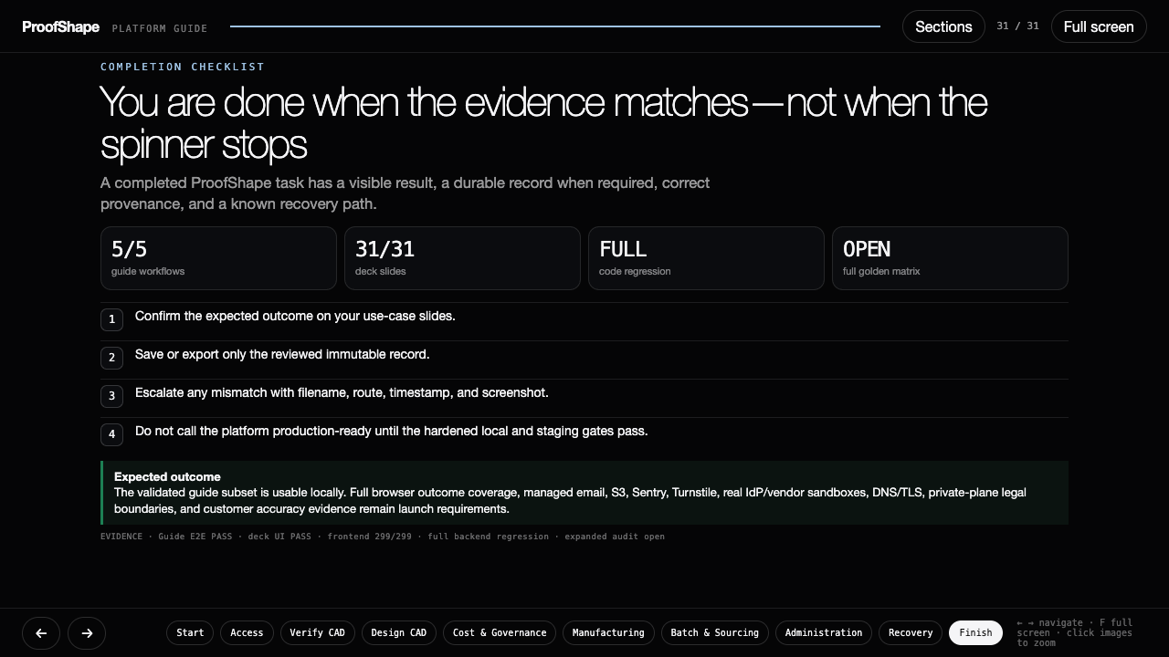
Notes:
ProofShape validated platform guide — slide 31 of 31.
Follow the visible actions and compare the result with the expected-outcome panel.
The interactive HTML companion provides role jumps, persistent checklists, zoom, and keyboard navigation.

