Slide 1
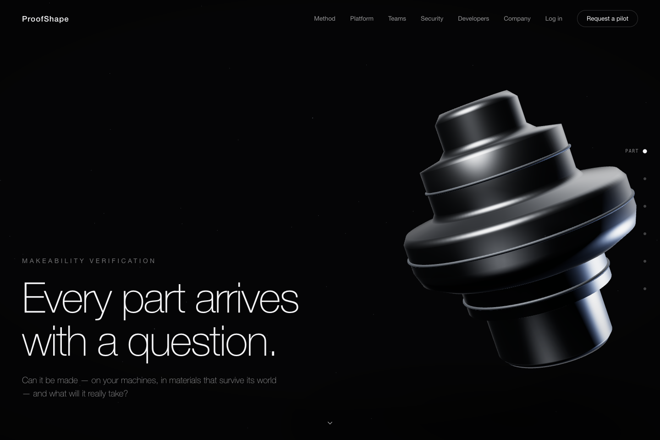
P
PROOFSHAPE · PLATFORM WALKTHROUGH
START
ACCESS
VERIFY
DESIGN
COST
MFG
BATCH
ADMIN
RECOVERY
JOURNEY
FINISH
EVIDENCE SCREEN
INTERACTIVE PLATFORM WALKTHROUGH
ProofShape, from zero to a defensible result
A role-based, step-by-step guide from account access through verified CAD, governed cost, manufacturing context, batch work, RFQ evidence, administration, and recovery.
Open the platform ↗
EXPECTED OUTCOME
Use the arrows, section tabs, or role menu. Check off each action as you perform it; progress stays on this device.
EVIDENCE · Production-candidate guide · browser-validated outcomes · updated 2026-07-13
01 / 53
NEXT →
Notes:
Source route: cover,Evidence: Production-candidate guide · browser-validated outcomes · updated 2026-07-13,Expected: Use the arrows, section tabs, or role menu. Check off each action as you perform it; progress stays on this device.

Slide 2
P
PROOFSHAPE · PLATFORM WALKTHROUGH
START
ACCESS
VERIFY
DESIGN
COST
MFG
BATCH
ADMIN
RECOVERY
JOURNEY
FINISH
EVIDENCE SCREEN
EVIDENCE STANDARD
A loaded screen is not proof that the work succeeded
EXPECTED OUTCOME
LOCAL_100 is earned only when all 64 required browser and recovery contracts pass against the exact clean commit. The numbers on this slide describe the contract; they do not certify the build you are viewing.
A validated path must reach its visible, durable, numerical, downloadable, authorization, and recovery outcomes on the same committed build.
1
Perform the stated action as a user would.
2
Compare the result to the exact expected-outcome box.
3
Stop if any identity, number, file, state, or recovery result differs.
EVIDENCE
local-100-golden-gate.mjs · no stale, generic, mixed-run, or dirty-build evidence accepted
EVIDENCE · local-100-golden-gate.mjs · no stale, generic, mixed-run, or dirty-build evidence accepted
← PREVIOUS
02 / 53
NEXT →
Notes:
Source route: guarantee,Evidence: local-100-golden-gate.mjs · no stale, generic, mixed-run, or dirty-build evidence accepted,Expected: LOCAL_100 is earned only when all 64 required browser and recovery contracts pass against the exact clean commit. The numbers on this slide describe the contract; they do not certify the build you are viewing.

Slide 3
P
PROOFSHAPE · PLATFORM WALKTHROUGH
START
ACCESS
VERIFY
DESIGN
COST
MFG
BATCH
ADMIN
RECOVERY
JOURNEY
FINISH
EVIDENCE SCREEN
ROLE-BASED NAVIGATION
Choose the path that matches the work you need to finish
EXPECTED OUTCOME
Choose a role; then use Next in my role until the itinerary says complete. On a PARTIAL slide, stop at the named external boundary.
Complete Access first, then choose a role. The guide will show Previous/Next in my role so you do not have to infer an itinerary.
CAD engineer
Verify and investigate CAD
Design engineer
Create, revise, and archive
Cost engineer
Cost, govern, compare, share
Manufacturing lead
Machines, DFM, truth, triage
Sourcing lead
Records, compare, RFQ bundle
Administrator
Access, roles, keys, providers
EVIDENCE
Role itineraries mapped to canonical browser paths and explicit provider boundaries
Viewer / auditor
Read evidence; prove boundaries
Public evaluator
Assess method before an account
EVIDENCE · Role itineraries mapped to canonical browser paths and explicit provider boundaries
← PREVIOUS
03 / 53
NEXT →
Notes:
Source route: roles,Evidence: Role itineraries mapped to canonical browser paths and explicit provider boundaries,Expected: Choose a role; then use Next in my role until the itinerary says complete. On a PARTIAL slide, stop at the named external boundary.

Slide 4
P
PROOFSHAPE · PLATFORM WALKTHROUGH
START
ACCESS
VERIFY
DESIGN
COST
MFG
BATCH
ADMIN
RECOVERY
JOURNEY
FINISH
EVIDENCE SCREEN
THE GOVERNING OBJECT MODEL
One part becomes one traceable decision chain
EXPECTED OUTCOME
If an upstream stage fails, downstream stages are withheld. A blank or withheld value is never silently treated as zero.
ProofShape does not stop at a mesh or a price. Every useful result travels through a visible evidence chain.
CAD
file + hash
Geometry
measured
Routing
process fit
EVIDENCE
DFM
findings
Verify pipeline, decision persistence, export, and history browser journeys
Cost
drivers
EVIDENCE · Verify pipeline, decision persistence, export, and history browser journeys
← PREVIOUS
04 / 53
NEXT →
Notes:
Source route: lifecycle,Evidence: Verify pipeline, decision persistence, export, and history browser journeys,Expected: If an upstream stage fails, downstream stages are withheld. A blank or withheld value is never silently treated as zero.

Slide 5
P
PROOFSHAPE · PLATFORM WALKTHROUGH
START
ACCESS
VERIFY
DESIGN
COST
MFG
BATCH
ADMIN
RECOVERY
JOURNEY
FINISH
EVIDENCE SCREEN
PROVENANCE LEGEND
Read the dots before you trust the number
EXPECTED OUTCOME
Every cost, dimension, quantity, rate, source, and identifier keeps its provenance label.
Color identifies where a value came from. Filled dots are grounded; hollow dots are assumptions or model output.
1
Prefer MEASURED, SHOP, USER, or CAD values for decisions.
2
Open drivers when DEFAULT or MODEL appears.
3
Treat a hatched confidence band as assumption-based, not validated.
EVIDENCE
Accessibility token tests + enterprise methodology-fidelity gate
EVIDENCE · Accessibility token tests + enterprise methodology-fidelity gate
← PREVIOUS
05 / 53
NEXT →
Notes:
Source route: trust,Evidence: Accessibility token tests + enterprise methodology-fidelity gate,Expected: Every cost, dimension, quantity, rate, source, and identifier keeps its provenance label.

Slide 6
P
PROOFSHAPE · PLATFORM WALKTHROUGH
START
ACCESS
VERIFY
DESIGN
COST
MFG
BATCH
ADMIN
RECOVERY
JOURNEY
FINISH
EVIDENCE SCREEN
ZERO-STEP CHECKLIST
Download the exact practice files before the first upload
EXPECTED OUTCOME
The golden STEP is exactly 19,030 bytes with SHA-256 76923244…61103a. Every downloadable fixture is independently hashed and parsed by the release suite; the README names its exact accepted and rejected outcomes.
Use the controlled fixtures first. That separates platform behavior from an unknown customer file, then you can repeat with your own CAD.
Download golden cube.step ↓
Download machine import CSV ↓
Download one-part batch ZIP ↓
Read every fixture outcome ↓
1
Get the ProofShape URL from your administrator or open it from this guide.
2
Download the three core fixtures and the outcome README above; do not rename or edit them.
EVIDENCE
3
Use the STEP in Verify and direct Should-cost, the CSV only in Your machines, and the ZIP only in Batch. Download advanced fixtures only on their use-case slides.
Fixture bytes + parser contracts + deck download/re-hash QA
EVIDENCE · Fixture bytes + parser contracts + deck download/re-hash QA
← PREVIOUS
06 / 53
NEXT →
Notes:
Source route: before,Evidence: Fixture bytes + parser contracts + deck download/re-hash QA,Expected: The golden STEP is exactly 19,030 bytes with SHA-256 76923244…61103a. Every downloadable fixture is independently hashed and parsed by the release suite; the README names its exact accepted and rejected outcomes.

Slide 7
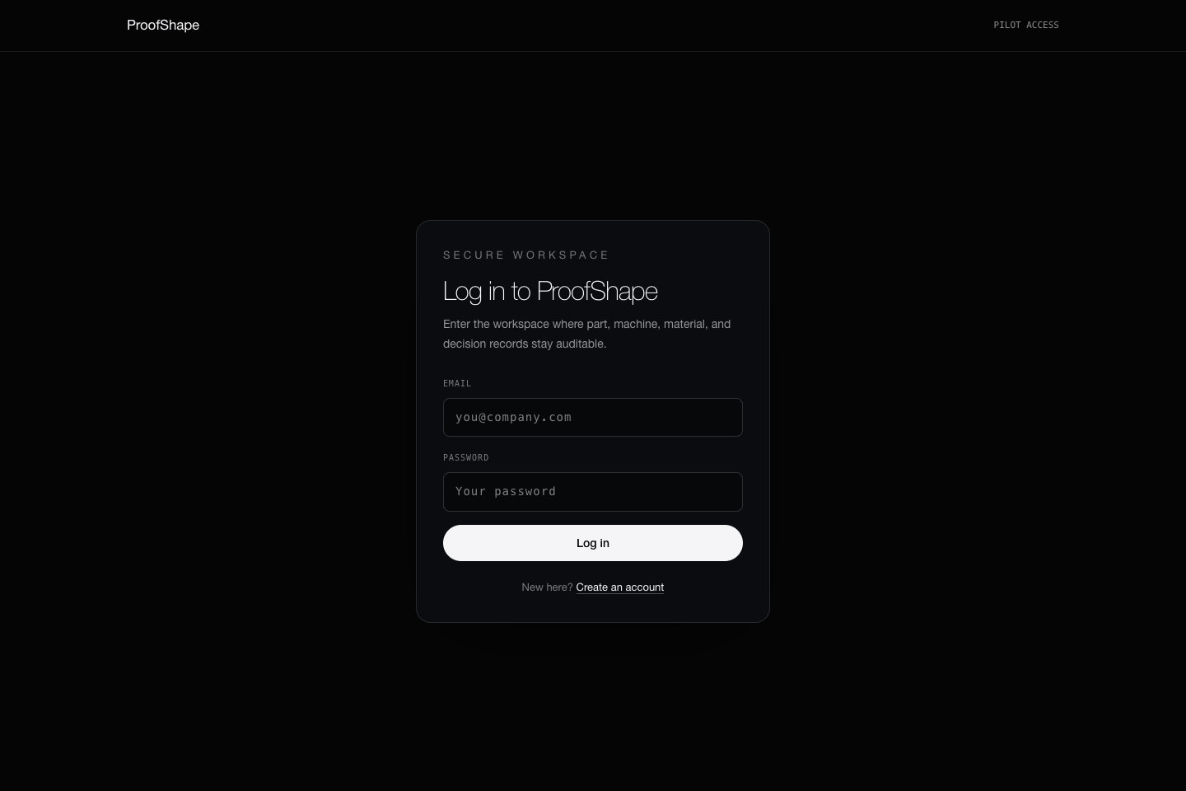
P
PROOFSHAPE · PLATFORM WALKTHROUGH
START
ACCESS
VERIFY
DESIGN
COST
MFG
BATCH
ADMIN
RECOVERY
JOURNEY
FINISH
TEST CONTRACT · BUILD EVIDENCE REQUIRED
FIRST ACCESS DECISION
Use the access method the screen actually offers
ProofShape supports distinct password, verified email-link, invitation, and enterprise SSO paths. Do not substitute one path for another.
Open sign in ↗
Open sign up ↗
1
Open Sign up and read the offered method before entering anything.
2
If email-link is offered, request the one-time link and open it in the same browser; then optionally set a password in Security.
If SSO is offered, use the named organization provider.
EXPECTED OUTCOME
3
Successful access lands on /verify and shows DAY ZERO SETUP. Weak credentials, expired links, wrong invited identities, and unsafe return paths are rejected without creating a false session.
4
Use direct email/password signup only when the screen explicitly offers it; the local development build does.
EVIDENCE · AUTH-01–05 · password/email-link exchange · safe-return-path regressions
← PREVIOUS
07 / 53
NEXT →
Notes:
Source route: access,Evidence: AUTH-01–05 · password/email-link exchange · safe-return-path regressions,Expected: Successful access lands on /verify and shows DAY ZERO SETUP. Weak credentials, expired links, wrong invited identities, and unsafe return paths are rejected without creating a false session.

Slide 8
P
PROOFSHAPE · PLATFORM WALKTHROUGH
START
ACCESS
VERIFY
DESIGN
COST
MFG
BATCH
ADMIN
RECOVERY
JOURNEY
FINISH
PARTIAL · EXTERNAL GATE
PASSWORD · EMAIL LINK · SSO
Know which access branches are locally proven and which need a real provider
VALIDATED SCOPE / REMAINING GATE
Local password and token-exchange contracts are validated. PARTIAL remains until the real email domain, Turnstile, and production IdP test tenant each pass delivery, expiry, replay, group, and logout acceptance.
The application contracts for all three modes are tested. Production email delivery and a customer IdP cannot be certified with local stand-ins.
1
Password branch: enter the registered email and password, then confirm the requested safe page opens.
2
Email-link branch: enter the email, pass Turnstile when configured, open the single-use link, then confirm replay fails.
3
SSO branch: choose the configured provider, complete its test-tenant policy, and return through the signed callback.
EVIDENCE
Auth canonical matrix · live email/Turnstile/IdP acceptance remains external
4
After any branch, sign out and confirm protected routes return to login.
EVIDENCE · Auth canonical matrix · live email/Turnstile/IdP acceptance remains external
← PREVIOUS
08 / 53
NEXT →
Notes:
Source route: access-modes,Evidence: Auth canonical matrix · live email/Turnstile/IdP acceptance remains external,Expected: Local password and token-exchange contracts are validated. PARTIAL remains until the real email domain, Turnstile, and production IdP test tenant each pass delivery, expiry, replay, group, and logout acceptance.

Slide 9
P
PROOFSHAPE · PLATFORM WALKTHROUGH
START
ACCESS
VERIFY
DESIGN
COST
MFG
BATCH
ADMIN
RECOVERY
JOURNEY
FINISH
TEST CONTRACT · BUILD EVIDENCE REQUIRED
INVITATION LIFECYCLE
An organization invitation belongs only to the invited identity
EXPECTED OUTCOME
One active membership is created for the invited identity at the intended role. Revocation and replay are durable; neither a token leak nor a different signed-in user can join the organization.
The token does not replace authentication. Sign in as the exact invited email, then redeem it once.
Open organization settings ↗
1
As an organization admin, enter the recipient’s permanent email and least-privileged role; select Send invite.
2
Copy the acceptance URL through the approved delivery channel.
EVIDENCE
3
In a separate browser, authenticate as that exact email, then open the acceptance URL.
AUTH-03 · ROLE-03 invitation create/revoke/accept boundary
4
Confirm membership and role; prove a second redemption, wrong identity, expired link, or revoked invite cannot grant access.
EVIDENCE · AUTH-03 · ROLE-03 invitation create/revoke/accept boundary
← PREVIOUS
09 / 53
NEXT →
Notes:
Source route: invite-accept,Evidence: AUTH-03 · ROLE-03 invitation create/revoke/accept boundary,Expected: One active membership is created for the invited identity at the intended role. Revocation and replay are durable; neither a token leak nor a different signed-in user can join the organization.

Slide 10
P
PROOFSHAPE · PLATFORM WALKTHROUGH
START
ACCESS
VERIFY
DESIGN
COST
MFG
BATCH
ADMIN
RECOVERY
JOURNEY
FINISH
TEST CONTRACT · BUILD EVIDENCE REQUIRED
PASSWORD AND SESSION HYGIENE
Finish account setup, then prove the session can end
EXPECTED OUTCOME
Password initialization never weakens email-link recovery; sign-out removes the session, protected pages stay protected after Back/refresh, and a new login restores only authorized tenant state.
Email-link users may initialize a password once when the configured auth mode allows it. Every user must be able to sign out cleanly.
Open Security ↗
1
Open Security and read the configured auth mode.
2
If Initial password is available, enter matching values that meet the displayed policy and submit once.
EVIDENCE
3
Sign out from the account menu; use Back and refresh on a protected route.
AUTH-02/05/07/08 · session boundary and password initialization
4
Sign in again through the approved method and confirm the intended tenant—not another recent tenant—opens.
EVIDENCE · AUTH-02/05/07/08 · session boundary and password initialization
← PREVIOUS
10 / 53
NEXT →
Notes:
Source route: session-security,Evidence: AUTH-02/05/07/08 · session boundary and password initialization,Expected: Password initialization never weakens email-link recovery; sign-out removes the session, protected pages stay protected after Back/refresh, and a new login restores only authorized tenant state.

Slide 11
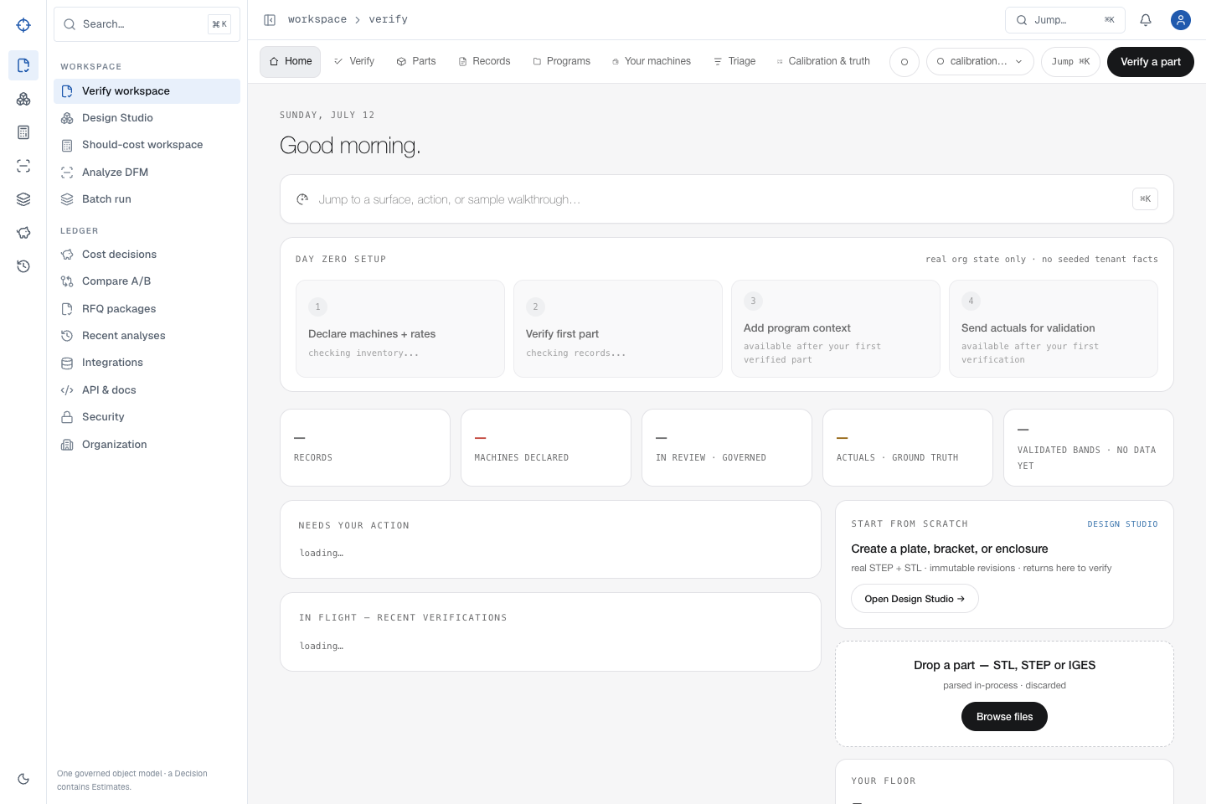
P
PROOFSHAPE · PLATFORM WALKTHROUGH
START
ACCESS
VERIFY
DESIGN
COST
MFG
BATCH
ADMIN
RECOVERY
JOURNEY
FINISH
TEST CONTRACT · BUILD EVIDENCE REQUIRED
FIRST AUTHENTICATED SCREEN
Day Zero tells you what is real—and what is empty
A new organization starts with no seeded machines, records, actuals, or program context.
1
Read the four setup steps.
2
Select Verify when you need the first useful result now.
3
Return later to Your machines, Programs, and Calibration & truth to ground the economics.
EXPECTED OUTCOME
All counters start at zero. Opening or revisiting a section does not invent or mutate tenant data.
EVIDENCE · VER-01/02 · public/auth golden matrix
← PREVIOUS
11 / 53
NEXT →
Notes:
Source route: day-zero,Evidence: VER-01/02 · public/auth golden matrix,Expected: All counters start at zero. Opening or revisiting a section does not invent or mutate tenant data.

Slide 12
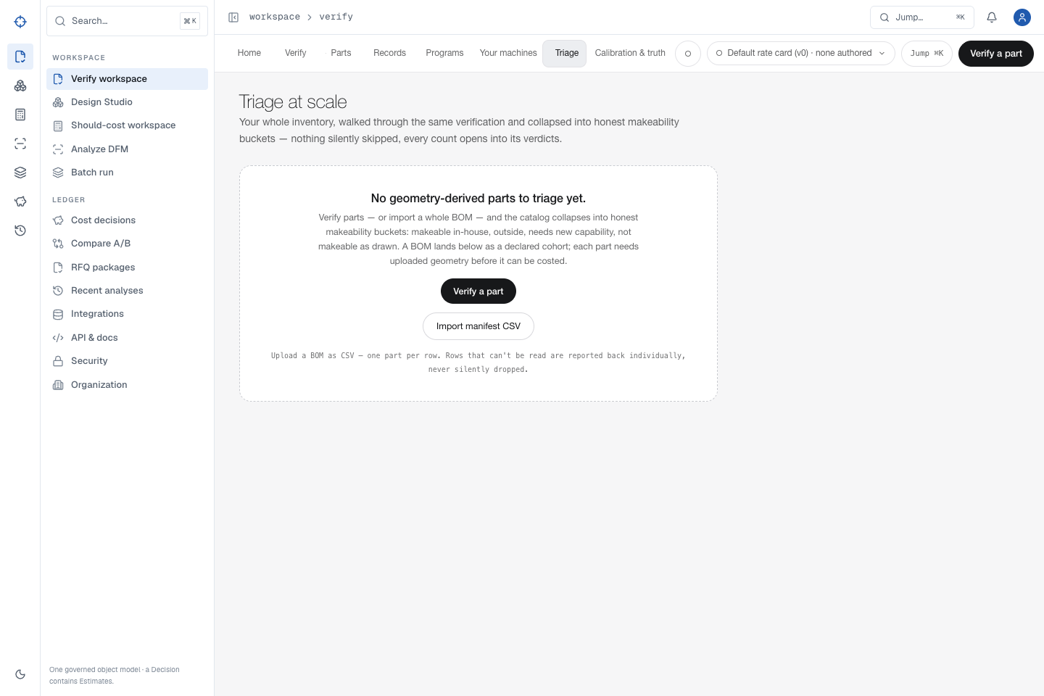
P
PROOFSHAPE · PLATFORM WALKTHROUGH
START
ACCESS
VERIFY
DESIGN
COST
MFG
BATCH
ADMIN
RECOVERY
JOURNEY
FINISH
TEST CONTRACT · BUILD EVIDENCE REQUIRED
NAVIGATION THAT SCALES
Use the rail for domains; use Jump for intent
Desktop, mobile selector, command palette, back/forward, refresh, and restart journeys preserve the user’s place and record identity.
1
Use the left rail to open Verify, Design Studio, Cost decisions, Analyze DFM, or Batch.
2
Open Jump or press ⌘K / Ctrl+K.
3
Type triage and press Enter.
EXPECTED OUTCOME
The requested surface opens, focus remains usable, and navigation never substitutes a different tenant, design, revision, or decision.
4
Use browser Back and Forward; confirm the same record remains selected.
EVIDENCE · AUTH-07/08 · VER-09 · mobile responsive-loop oracle
← PREVIOUS
12 / 53
NEXT →
Notes:
Source route: navigation,Evidence: AUTH-07/08 · VER-09 · mobile responsive-loop oracle,Expected: The requested surface opens, focus remains usable, and navigation never substitutes a different tenant, design, revision, or decision.

Slide 13
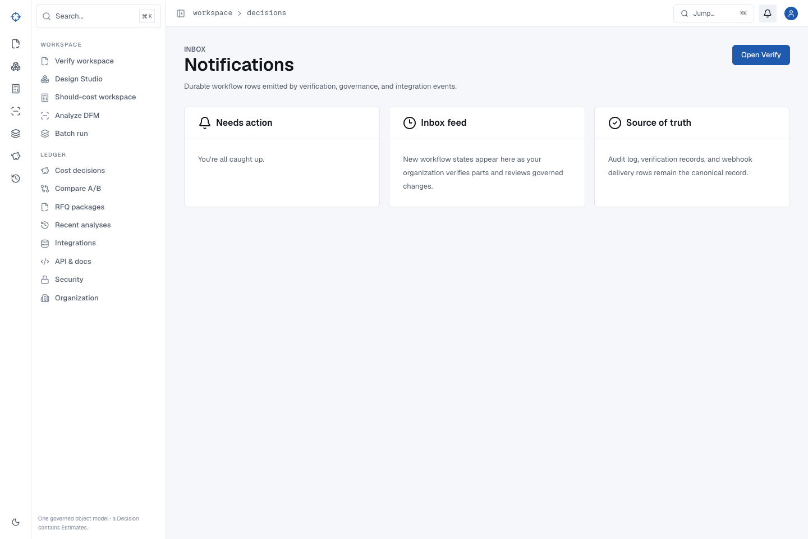
P
PROOFSHAPE · PLATFORM WALKTHROUGH
START
ACCESS
VERIFY
DESIGN
COST
MFG
BATCH
ADMIN
RECOVERY
JOURNEY
FINISH
TEST CONTRACT · BUILD EVIDENCE REQUIRED
READ, DISMISS, RESTORE, AND RETURN
Notifications are durable work state—not decorative toast
Unread counts, destinations, dismissal, restoration, mark-all-read, refresh, logout/login, and deletion behavior are browser-validated.
1
Open Notifications and select a row by its accessible title.
2
Return, dismiss it, then restore it.
3
Mark all read and refresh the page.
EXPECTED OUTCOME
The destination is correct, unread count reaches zero, read and dismissal timestamps survive the session boundary, and deleting the source produces an honest not-found state.
4
Sign out and back in; confirm the durable state remains.
EVIDENCE · VER-04 · ROLE-04 · FAIL-09 notification matrix
← PREVIOUS
13 / 53
NEXT →
Notes:
Source route: notifications,Evidence: VER-04 · ROLE-04 · FAIL-09 notification matrix,Expected: The destination is correct, unread count reaches zero, read and dismissal timestamps survive the session boundary, and deleting the source produces an honest not-found state.

Slide 14
P
PROOFSHAPE · PLATFORM WALKTHROUGH
START
ACCESS
VERIFY
DESIGN
COST
MFG
BATCH
ADMIN
RECOVERY
JOURNEY
FINISH
TEST CONTRACT · BUILD EVIDENCE REQUIRED
PUBLIC EVALUATOR PATH
Evaluate the method and boundaries before creating an account
EXPECTED OUTCOME
Public content loads without tenant facts; protected data remains 401/redirected; public claims never imply a live supplier send, certified quote, or configured customer provider.
The public site explains the platform, method, security posture, team use cases, and API boundary without exposing tenant data.
Read the method ↗
See the platform ↗
Review security ↗
Open developer docs ↗
1
Open each public page in a private browser with no ProofShape session.
2
Compare the method claims with the visible provenance and confidence language.
EVIDENCE
3
Confirm calls to protected organization, decision, machine, and batch APIs are rejected.
PUBLIC-01–04 · unauthenticated tenant-boundary matrix
4
Create an account only when you are ready to use a private workspace.
EVIDENCE · PUBLIC-01–04 · unauthenticated tenant-boundary matrix
← PREVIOUS
14 / 53
NEXT →
Notes:
Source route: public-evaluator,Evidence: PUBLIC-01–04 · unauthenticated tenant-boundary matrix,Expected: Public content loads without tenant facts; protected data remains 401/redirected; public claims never imply a live supplier send, certified quote, or configured customer provider.

Slide 15
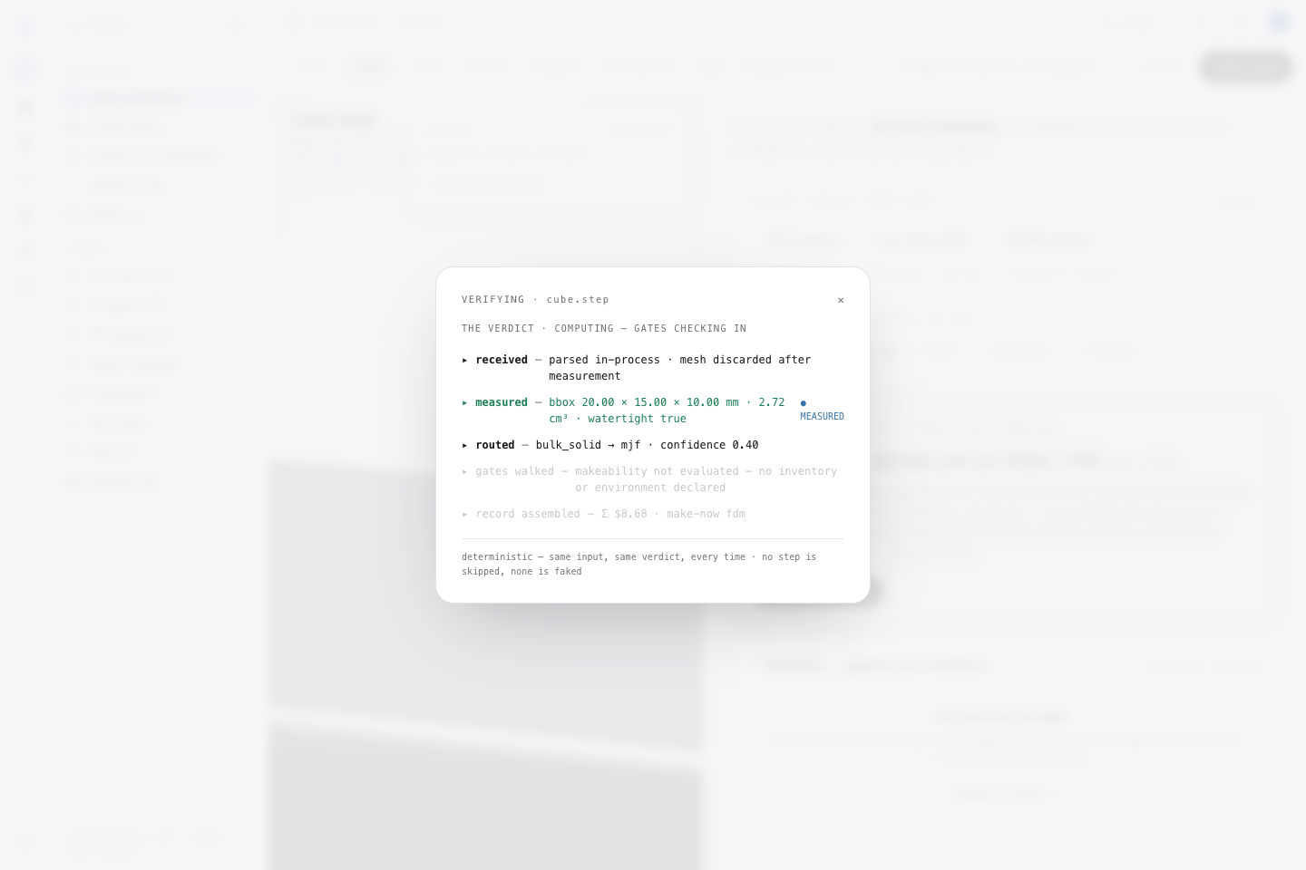
P
PROOFSHAPE · PLATFORM WALKTHROUGH
START
ACCESS
VERIFY
DESIGN
COST
MFG
BATCH
ADMIN
RECOVERY
JOURNEY
FINISH
TEST CONTRACT · BUILD EVIDENCE REQUIRED
USE CASE · VERIFY EXISTING CAD
Drop one real CAD file and wait for a terminal result
The Verify workspace runs geometry, routing, DFM, and should-cost against the same uploaded bytes.
1
Open Verify workspace, then select Verify in the internal rail.
2
Drop or choose cube.step.
3
Do not navigate away while Measured geometry is running.
EXPECTED OUTCOME
The golden file completes—without “temporarily busy” or tessellation error—and creates a durable cost decision.
4
Wait until geometry, routing, DFM, and cost stop changing.
EVIDENCE · VER-05 · training-guide semantic oracle
← PREVIOUS
15 / 53
NEXT →
Notes:
Source route: verify-upload,Evidence: VER-05 · training-guide semantic oracle,Expected: The golden file completes—without “temporarily busy” or tessellation error—and creates a durable cost decision.

Slide 16
P
PROOFSHAPE · PLATFORM WALKTHROUGH
START
ACCESS
VERIFY
DESIGN
COST
MFG
BATCH
ADMIN
RECOVERY
JOURNEY
FINISH
EVIDENCE SCREEN
RESULT SANITY CHECK
Confirm geometry before reading the recommendation
EXPECTED OUTCOME
The live UI and reopened private decision show the exact source SHA-256. Geometry, fdm make-now route, 923-unit crossover, six recommendation points, and 48 estimate rows match the versioned golden oracle; model-derived prices remain explicitly assumption-based.
A plausible recommendation on the wrong geometry is still wrong. Verify the measured facts first.
1
Confirm the full evidence SHA-256 is 76923244d66efcbf1eb1639a26a6b4b6bd20fd73eaf44ad1b95268dddf61103a.
2
Confirm the sorted envelope is 10 × 15 × 20 mm within 0.1 mm.
3
Confirm normalized volume is 2.72 cm³ ±0.005 and area is 14.32 cm² ±0.02.
EVIDENCE
INPUT-INTEGRITY-001 · DISPLAY-FIDELITY-001 · training-guide pinned cost oracle
4
Confirm watertight true, make-now fdm, quantities 1/100/1000/2000/5000/10000, and 48 estimate rows before acting.
EVIDENCE · INPUT-INTEGRITY-001 · DISPLAY-FIDELITY-001 · training-guide pinned cost oracle
← PREVIOUS
16 / 53
NEXT →
Notes:
Source route: verify-read,Evidence: INPUT-INTEGRITY-001 · DISPLAY-FIDELITY-001 · training-guide pinned cost oracle,Expected: The live UI and reopened private decision show the exact source SHA-256. Geometry, fdm make-now route, 923-unit crossover, six recommendation points, and 48 estimate rows match the versioned golden oracle; model-derived prices remain explicitly assumption-based.

Slide 17
P
PROOFSHAPE · PLATFORM WALKTHROUGH
START
ACCESS
VERIFY
DESIGN
COST
MFG
BATCH
ADMIN
RECOVERY
JOURNEY
FINISH
TEST CONTRACT · BUILD EVIDENCE REQUIRED
DECISION AND DISPOSITION BRANCHES
Read recommendation, blockers, drivers, then record the action
EXPECTED OUTCOME
Every choice and trimmed/empty note round-trips exactly; approve, reopen, stale, reload, and unchanged-artifact checks preserve the underlying calculation.
Recommendation, notes, governance, and every supported disposition are persisted and reopened through the browser.
1
Read Make now and the recommended process.
2
Open routing and DFM; inspect linked evidence.
3
Open cost drivers; inspect DEFAULT or MODEL inputs.
EVIDENCE
VER-06/07 · WORK-05 notification/decision matrix
4
Choose make in-house, outside, acquire, or redesign and add a note.
EVIDENCE · VER-06/07 · WORK-05 notification/decision matrix
← PREVIOUS
17 / 53
NEXT →
Notes:
Source route: verify-act,Evidence: VER-06/07 · WORK-05 notification/decision matrix,Expected: Every choice and trimmed/empty note round-trips exactly; approve, reopen, stale, reload, and unchanged-artifact checks preserve the underlying calculation.

Slide 18
P
PROOFSHAPE · PLATFORM WALKTHROUGH
START
ACCESS
VERIFY
DESIGN
COST
MFG
BATCH
ADMIN
RECOVERY
JOURNEY
FINISH
TEST CONTRACT · BUILD EVIDENCE REQUIRED
DIRECT DFM ANALYSIS
Use Analyze DFM when manufacturability—not cost—is the question
EXPECTED OUTCOME
The result persists under the exact bytes + process set + units + rule-pack version. Every displayed finding has structured severity/remediation/scope; localized findings link to geometry and governed findings retain citations.
Choose the intended process and governed rule pack before upload; a finding must identify what failed, where, why, and what to change.
Open Analyze DFM ↗
Download golden cube.step ↓
1
Open Analyze DFM and select the real target process; choose a rule pack only when it applies to this part.
2
Upload the golden STEP and wait for a terminal analysis.
EVIDENCE
3
Open each required-fix or advisory row; read code, severity, measured/required values, remediation, scope, and citation.
WORK-02 · exact analysis-variant/rule-pack cache regressions
4
Follow any face/geometry link and confirm it selects the corresponding region before sharing the result.
EVIDENCE · WORK-02 · exact analysis-variant/rule-pack cache regressions
← PREVIOUS
18 / 53
NEXT →
Notes:
Source route: analyze-dfm,Evidence: WORK-02 · exact analysis-variant/rule-pack cache regressions,Expected: The result persists under the exact bytes + process set + units + rule-pack version. Every displayed finding has structured severity/remediation/scope; localized findings link to geometry and governed findings retain citations.

Slide 19
P
PROOFSHAPE · PLATFORM WALKTHROUGH
START
ACCESS
VERIFY
DESIGN
COST
MFG
BATCH
ADMIN
RECOVERY
JOURNEY
FINISH
TEST CONTRACT · BUILD EVIDENCE REQUIRED
BASIC TO ADVERSARIAL CAD
Units, aliases, malformed bytes, and tolerance edges fail honestly
EXPECTED OUTCOME
Valid corpus files preserve exact geometry contracts. The wire-only STEP is structurally valid but has no tessellatable solid/shell, so it returns the documented bounded error and creates no analysis or cost evidence. Prior records and machine inventory remain unchanged.
Supported aliases and unit variants complete; mislabeled, empty, oversized, corrupted, and boundary cases produce bounded recovery instead of fabricated geometry.
Download valid-but-unmeshable STEP ↓
1
Use STEP/STP, IGES/IGS, or STL bytes with the correct extension.
2
Confirm inch-derived fixtures normalize to millimetres.
EVIDENCE
3
In the designated test tenant, upload the wire-only fixture above and read the geometry-specific recovery message.
CAD-01–09 · VER-05 · FAIL-01/02 · wire fixture SHA a5d464dc…23a7
4
Correct the actual file—not merely its filename—and retry once.
EVIDENCE · CAD-01–09 · VER-05 · FAIL-01/02 · wire fixture SHA a5d464dc…23a7
← PREVIOUS
19 / 53
NEXT →
Notes:
Source route: verify-formats,Evidence: CAD-01–09 · VER-05 · FAIL-01/02 · wire fixture SHA a5d464dc…23a7,Expected: Valid corpus files preserve exact geometry contracts. The wire-only STEP is structurally valid but has no tessellatable solid/shell, so it returns the documented bounded error and creates no analysis or cost evidence. Prior records and machine inventory remain unchanged.

Slide 20
P
PROOFSHAPE · PLATFORM WALKTHROUGH
START
ACCESS
VERIFY
DESIGN
COST
MFG
BATCH
ADMIN
RECOVERY
JOURNEY
FINISH
TEST CONTRACT · BUILD EVIDENCE REQUIRED
PORTFOLIO WORK QUEUE
Use Parts to find a part; use Triage to decide what needs attention
EXPECTED OUTCOME
Catalog filters, saved views, triage counts, and detail links reference the same organization-scoped part/hash. The fixture map parses two rows and rejects line 4; onboarding creates one real cube identity, reports missing.step, and fabricates no placeholder geometry.
Parts is the durable catalog. Triage is a filtered, explainable queue over those same identities—not a second copy of the data.
Open Parts ↗
Open Triage ↗
Download parts-master map ↓
Download mixed parts manifest ↓
1
Open Parts; filter Costed, Drafted, With findings, or No findings and open a row by exact part identity.
2
Import the map with the unmodified cube.step through the labeled parts-master onboarding control; confirm cube.step onboards, missing.step is reported missing, and mapping line 4 is rejected.
EVIDENCE
3
Open Triage; choose the exception class and review the reason each part entered the queue.
ENT-04/05 · Parts master and triage gates · fixture SHAs 118e15d1…ac5 / 567fc0c2…1268
4
Open a triaged part, act on its source record, then return and confirm the rollup updates without changing unrelated rows.
EVIDENCE · ENT-04/05 · Parts master and triage gates · fixture SHAs 118e15d1…ac5 / 567fc0c2…1268
← PREVIOUS
20 / 53
NEXT →
Notes:
Source route: parts-triage,Evidence: ENT-04/05 · Parts master and triage gates · fixture SHAs 118e15d1…ac5 / 567fc0c2…1268,Expected: Catalog filters, saved views, triage counts, and detail links reference the same organization-scoped part/hash. The fixture map parses two rows and rejects line 4; onboarding creates one real cube identity, reports missing.step, and fabricates no placeholder geometry.

Slide 21
P
PROOFSHAPE · PLATFORM WALKTHROUGH
START
ACCESS
VERIFY
DESIGN
COST
MFG
BATCH
ADMIN
RECOVERY
JOURNEY
FINISH
TEST CONTRACT · BUILD EVIDENCE REQUIRED
IMMUTABLE LOOKUP
Use Records and History to reopen the exact evidence—not just the filename
EXPECTED OUTCOME
The same immutable IDs, bytes/hash, analysis variant, cost decision, governance, and source links survive navigation. Missing sources fail honestly; history never substitutes newest-by-filename.
A filename may have many analyses and decisions. Open by record ID, timestamp, process context, and linked source identity.
Open Records ↗
Open analysis history ↗
Open cost history ↗
1
Open Records and locate the expected filename; compare record ID, status, timestamp, and governing context.
2
Open the row and follow its linked analysis and decision IDs.
EVIDENCE
3
Refresh, use Back/Forward, and reopen from History.
VER-04/09 · ENT-05 · durable record and source-identity oracles
4
If the source was deleted or revoked, confirm the old destination reports unavailable rather than selecting a different same-name record.
EVIDENCE · VER-04/09 · ENT-05 · durable record and source-identity oracles
← PREVIOUS
21 / 53
NEXT →
Notes:
Source route: records-history,Evidence: VER-04/09 · ENT-05 · durable record and source-identity oracles,Expected: The same immutable IDs, bytes/hash, analysis variant, cost decision, governance, and source links survive navigation. Missing sources fail honestly; history never substitutes newest-by-filename.

Slide 22
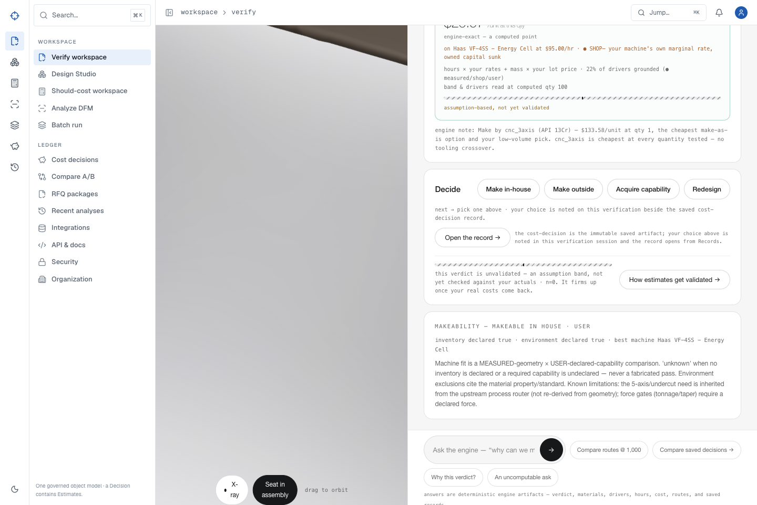
P
PROOFSHAPE · PLATFORM WALKTHROUGH
START
ACCESS
VERIFY
DESIGN
COST
MFG
BATCH
ADMIN
RECOVERY
JOURNEY
FINISH
TEST CONTRACT · BUILD EVIDENCE REQUIRED
COMPLEX ENGINEERING CONTEXT
A part can carry parent assembly and service-world context
Parent identity, coordinate system, transform, service environment, and seated render evidence stay attached to the verified part.
1
Assign the part to its parent assembly and program.
2
Declare material exposure, pressure, temperature, and corrosive environment.
3
Open the Verify stage and inspect the parent-context panel.
EXPECTED OUTCOME
The same parent, part, transform, and service values survive navigation; synthetic assembly fixtures render a real visual change from exploded to seated state.
4
Move between stages and reopen the record.
EVIDENCE · ENT-03/05 · assembly-visual-fidelity supplemental gate
← PREVIOUS
22 / 53
NEXT →
Notes:
Source route: assembly-context,Evidence: ENT-03/05 · assembly-visual-fidelity supplemental gate,Expected: The same parent, part, transform, and service values survive navigation; synthetic assembly fixtures render a real visual change from exploded to seated state.

Slide 23
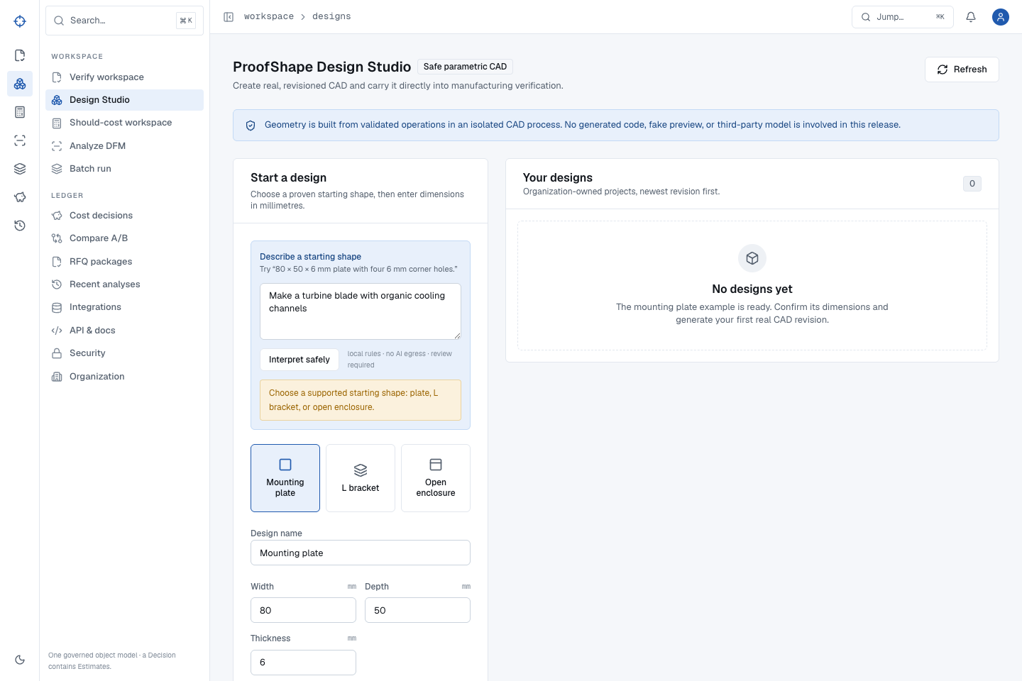
P
PROOFSHAPE · PLATFORM WALKTHROUGH
START
ACCESS
VERIFY
DESIGN
COST
MFG
BATCH
ADMIN
RECOVERY
JOURNEY
FINISH
TEST CONTRACT · BUILD EVIDENCE REQUIRED
USE CASE · DESIGN STUDIO
Describe only geometry the safe release can represent exactly
Design Studio is intentionally bounded: mounting plate, L bracket, or open enclosure. Unsupported freeform requests are rejected—not approximated.
1
Open Design Studio.
2
Describe a plate, L bracket, or open enclosure with explicit millimetre dimensions.
3
Select Interpret safely.
EXPECTED OUTCOME
An unsupported turbine or freeform request creates no project. Missing, contradictory, and unsafe dimensions are named instead of guessed.
4
Review every extracted field before generation.
EVIDENCE · DES-01–04 · Design Studio golden matrix
← PREVIOUS
23 / 53
NEXT →
Notes:
Source route: design-guardrails,Evidence: DES-01–04 · Design Studio golden matrix,Expected: An unsupported turbine or freeform request creates no project. Missing, contradictory, and unsafe dimensions are named instead of guessed.

Slide 24
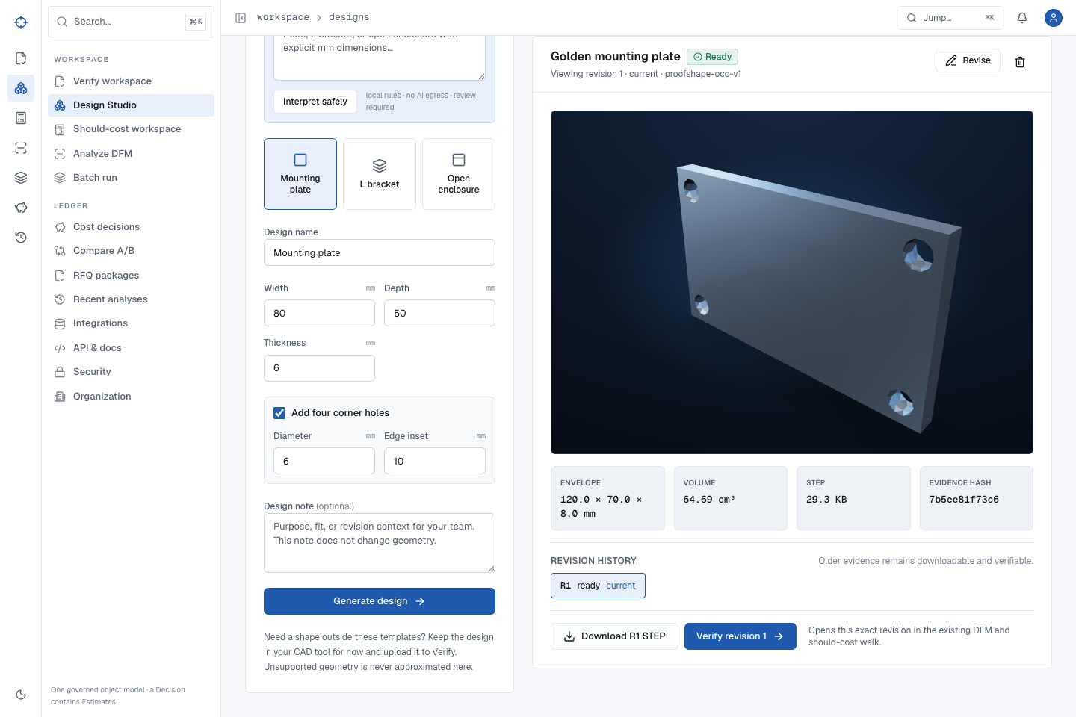
P
PROOFSHAPE · PLATFORM WALKTHROUGH
START
ACCESS
VERIFY
DESIGN
COST
MFG
BATCH
ADMIN
RECOVERY
JOURNEY
FINISH
TEST CONTRACT · BUILD EVIDENCE REQUIRED
MOUNTING PLATE
Generate the golden plate from exact dimensions
Use the validated sentence to learn the interpretation and generation pattern.
1
Enter: 120 × 70 × 8 mm plate with four 10 mm corner holes.
2
Select Interpret safely; confirm 120, 70, 8, 10, and 8.4 mm inset.
3
Select Generate design.
EXPECTED OUTCOME
The preview shows a plate with four holes; envelope is 120 × 70 × 8 mm and volume is 64.69 cm³, with deterministic STEP bytes and hash.
4
Wait for Ready before downloading or verifying.
EVIDENCE · DES-05 · structured artifact/hash oracle
← PREVIOUS
24 / 53
NEXT →
Notes:
Source route: design-plate,Evidence: DES-05 · structured artifact/hash oracle,Expected: The preview shows a plate with four holes; envelope is 120 × 70 × 8 mm and volume is 64.69 cm³, with deterministic STEP bytes and hash.

Slide 25

P
PROOFSHAPE · PLATFORM WALKTHROUGH
START
ACCESS
VERIFY
DESIGN
COST
MFG
BATCH
ADMIN
RECOVERY
JOURNEY
FINISH
TEST CONTRACT · BUILD EVIDENCE REQUIRED
IMMUTABLE REVISION HISTORY
A revision creates R2; it never edits R1
Revision history protects the answer to “which file did we quote?” even after refresh and archive/restore.
1
Select Revise on the plate.
2
Change width from 120 to 130 mm.
3
Generate the revision and wait for Ready.
EXPECTED OUTCOME
R2 becomes current at 130 × 70 × 8 mm; R1 remains downloadable with its original hash and bytes. Another project’s history never leaks into this view.
4
Select R1 in Revision history to prove the prior evidence still exists.
EVIDENCE · DES-10/12/13 · cross-design history regression
← PREVIOUS
25 / 53
NEXT →
Notes:
Source route: design-revise,Evidence: DES-10/12/13 · cross-design history regression,Expected: R2 becomes current at 130 × 70 × 8 mm; R1 remains downloadable with its original hash and bytes. Another project’s history never leaks into this view.

Slide 26
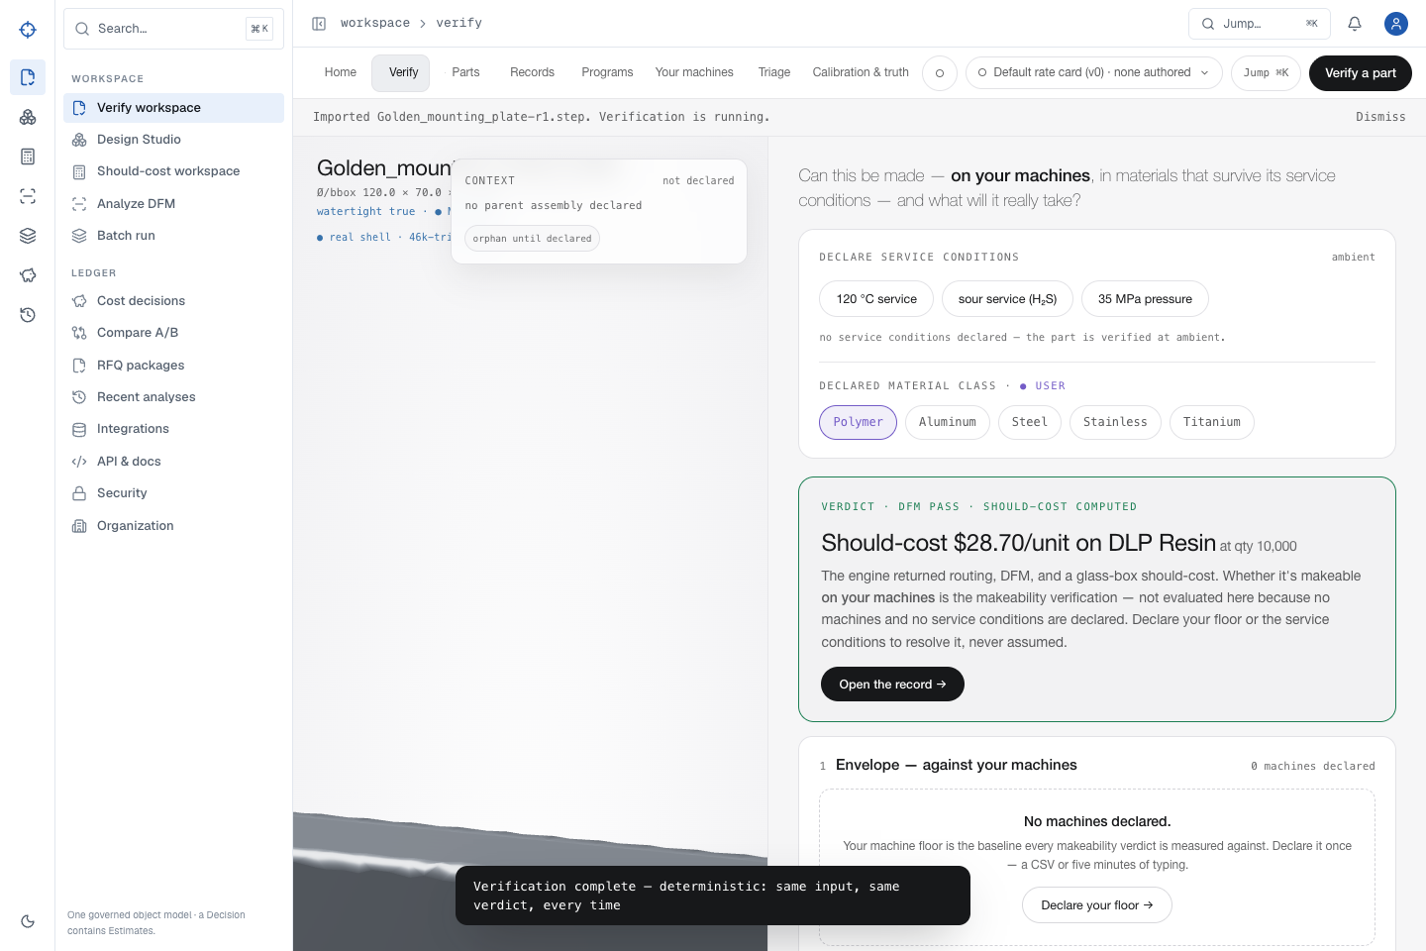
P
PROOFSHAPE · PLATFORM WALKTHROUGH
START
ACCESS
VERIFY
DESIGN
COST
MFG
BATCH
ADMIN
RECOVERY
JOURNEY
FINISH
TEST CONTRACT · BUILD EVIDENCE REQUIRED
DESIGN → VERIFY HANDOFF
Verify the exact historical revision you selected
The handoff carries project, revision, filename, file size, and file hash. Current does not silently replace historical.
1
While R1 is selected, choose Verify revision 1.
2
Wait for the Verify result.
3
Confirm the page states revision 1 while current is 2.
EXPECTED OUTCOME
Verify consumes R1 bytes—not R2—and reports the R1 64.69 cm³ geometry after refresh, back/forward, and restart.
4
Confirm measured geometry returns to 120 × 70 × 8 mm.
EVIDENCE · DES-11 · VER-09 identity continuity
← PREVIOUS
26 / 53
NEXT →
Notes:
Source route: design-history,Evidence: DES-11 · VER-09 identity continuity,Expected: Verify consumes R1 bytes—not R2—and reports the R1 64.69 cm³ geometry after refresh, back/forward, and restart.

Slide 27
P
PROOFSHAPE · PLATFORM WALKTHROUGH
START
ACCESS
VERIFY
DESIGN
COST
MFG
BATCH
ADMIN
RECOVERY
JOURNEY
FINISH
TEST CONTRACT · BUILD EVIDENCE REQUIRED
ARCHIVE AND RESTORE
Archive removes a project from active work without destroying its revisions
EXPECTED OUTCOME
Active → Archived → Active survives refresh with one project identity. Revision count, current revision, dimensions, STEP sizes, and hashes remain exact; repeated rapid actions create no duplicate project.
Use archive for lifecycle state, not deletion. Every deterministic STEP revision and hash must remain recoverable.
Open Design Studio ↗
1
From the project list, archive the completed test project and confirm the warning.
2
Switch to Archived and locate it by exact project identity.
EVIDENCE
3
Restore it once; refresh and confirm it returns to Active.
DES-12/13 · WORK-11 archive/restore responsive-loop oracle
4
Open R1 and R2, then re-download both to confirm the archive cycle did not alter bytes or hashes.
EVIDENCE · DES-12/13 · WORK-11 archive/restore responsive-loop oracle
← PREVIOUS
27 / 53
NEXT →
Notes:
Source route: design-archive,Evidence: DES-12/13 · WORK-11 archive/restore responsive-loop oracle,Expected: Active → Archived → Active survives refresh with one project identity. Revision count, current revision, dimensions, STEP sizes, and hashes remain exact; repeated rapid actions create no duplicate project.

Slide 28
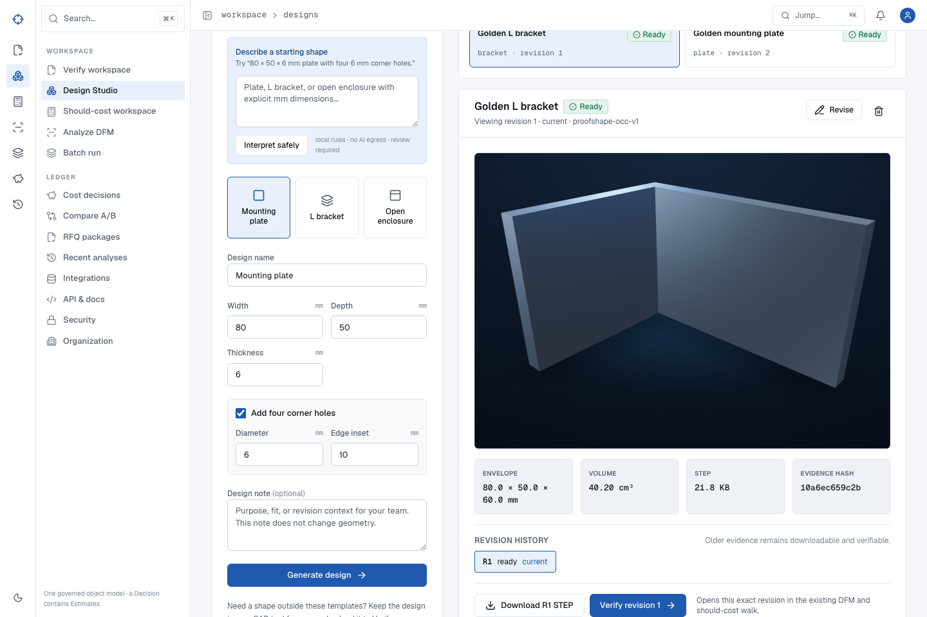
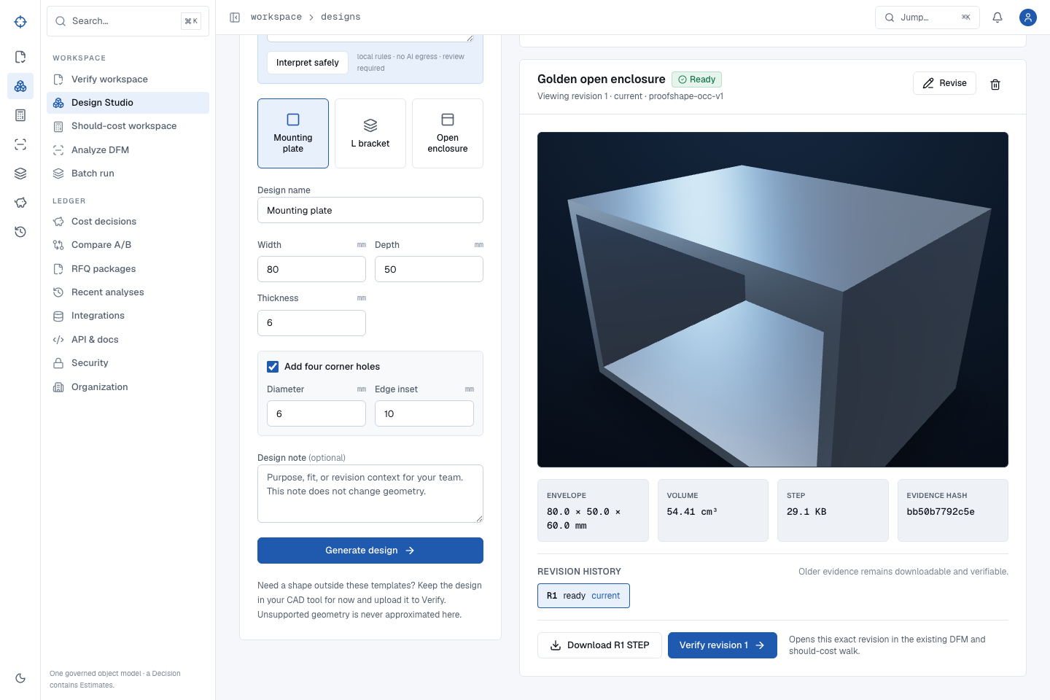
P
PROOFSHAPE · PLATFORM WALKTHROUGH
START
ACCESS
VERIFY
DESIGN
COST
MFG
BATCH
ADMIN
RECOVERY
JOURNEY
FINISH
TEST CONTRACT · BUILD EVIDENCE REQUIRED
TWO ADDITIONAL SAFE TEMPLATES
Bracket and enclosure stay prismatic through Verify
Recognizable shape is not enough; routing must also reject rotational false positives.
1
Generate the default 80 × 50 × 60 mm L bracket at 6 mm thickness.
2
Verify it; CNC Turning must fail as a route.
3
Generate the default 80 × 50 × 60 mm enclosure with 3 mm walls and floor.
EXPECTED OUTCOME
Bracket volume is 40.20 cm³; enclosure volume is 54.41 cm³. Both complete DFM and cost without rotational routing.
4
Verify it; identify thin-wall enclosure and reject turning.
EVIDENCE · DES-06–09 · geometry and route oracles
← PREVIOUS
28 / 53
NEXT →
Notes:
Source route: design-shapes,Evidence: DES-06–09 · geometry and route oracles,Expected: Bracket volume is 40.20 cm³; enclosure volume is 54.41 cm³. Both complete DFM and cost without rotational routing.

Slide 29
P
PROOFSHAPE · PLATFORM WALKTHROUGH
START
ACCESS
VERIFY
DESIGN
COST
MFG
BATCH
ADMIN
RECOVERY
JOURNEY
FINISH
TEST CONTRACT · BUILD EVIDENCE REQUIRED
DIRECT COST WORKFLOW
Use direct Should-cost when you need economics without the full Verify workspace
EXPECTED OUTCOME
Both real runs complete without timeout; the selected process changes the active result; each quantity has finite unit/fixed/variable cost, line items differ by less than $0.02 from unit cost, and the saved record reopens exactly.
The direct form uses the same real CAD parser and cost engine. Process, quantity, material, region, and shop context must be explicit enough to reproduce the result.
Open Should-cost ↗
Download golden cube.step ↓
1
Open Should-cost and upload the golden STEP.
2
Set quantities to 1, 10, 100, and 1000; select the intended material/region and leave no accidental hidden defaults.
EVIDENCE
3
Run the estimate, then change the process using the visible process selector and run again.
WORK-01 · human process-selector and numerical reconciliation oracle
4
Reconcile every unit cost to its line-item sum, confidence bounds, provenance, and saved decision ID.
EVIDENCE · WORK-01 · human process-selector and numerical reconciliation oracle
← PREVIOUS
29 / 53
NEXT →
Notes:
Source route: cost-direct,Evidence: WORK-01 · human process-selector and numerical reconciliation oracle,Expected: Both real runs complete without timeout; the selected process changes the active result; each quantity has finite unit/fixed/variable cost, line items differ by less than $0.02 from unit cost, and the saved record reopens exactly.

Slide 30
P
PROOFSHAPE · PLATFORM WALKTHROUGH
START
ACCESS
VERIFY
DESIGN
COST
MFG
BATCH
ADMIN
RECOVERY
JOURNEY
FINISH
TEST CONTRACT · BUILD EVIDENCE REQUIRED
USE CASE · COST ENGINEER
Should-cost is a saved evidence object—not a disposable estimate
EXPECTED OUTCOME
The record re-renders the same geometry, quantities, process, estimates, drivers, confidence, and decision JSON after reopen and refresh; the exact estimate count is read from that record, never assumed from this guide.
A completed Verify or direct Should-cost run creates the durable decision used by history, comparison, governance, and RFQ packages.
Open Cost history ↗
1
Open Cost decisions after a successful verification or direct cost run.
2
Open the newest row for the uploaded filename and confirm its record ID.
EVIDENCE
3
Review make-now process, quantity ladder, confidence, and driver provenance.
WORK-03/04 · training-guide durable-cost oracle
4
Refresh and reopen the same decision by identity.
EVIDENCE · WORK-03/04 · training-guide durable-cost oracle
← PREVIOUS
30 / 53
NEXT →
Notes:
Source route: cost-workspace,Evidence: WORK-03/04 · training-guide durable-cost oracle,Expected: The record re-renders the same geometry, quantities, process, estimates, drivers, confidence, and decision JSON after reopen and refresh; the exact estimate count is read from that record, never assumed from this guide.

Slide 31
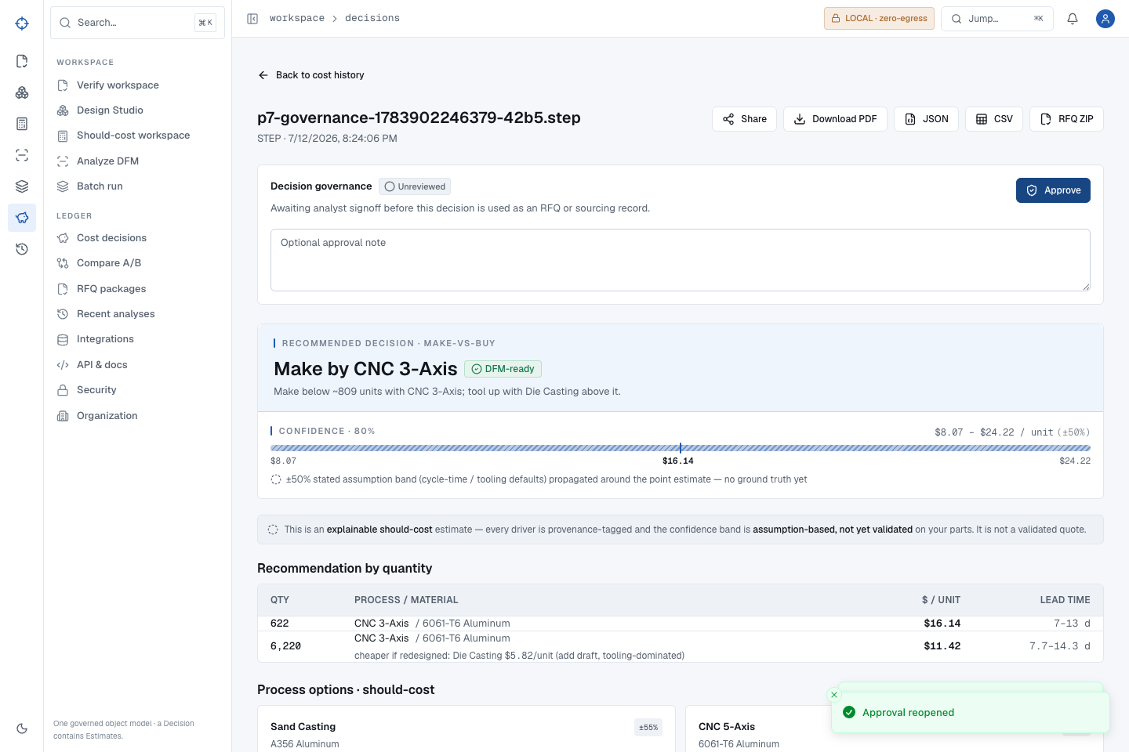
P
PROOFSHAPE · PLATFORM WALKTHROUGH
START
ACCESS
VERIFY
DESIGN
COST
MFG
BATCH
ADMIN
RECOVERY
JOURNEY
FINISH
TEST CONTRACT · BUILD EVIDENCE REQUIRED
APPROVE, NOTE, AND REOPEN
Approval changes governance state—not the calculation
Approval is a sign-off layer around an immutable cost decision.
1
Open a saved cost decision.
2
Add a decision note, select Approve, and confirm the approved state.
3
Refresh, then select Reopen when another review is required.
EXPECTED OUTCOME
Unreviewed → Approved → Unreviewed. Exact note, cost, geometry, drivers, and decision JSON remain unchanged.
4
Confirm the status returns to Unreviewed.
EVIDENCE · WORK-05 · governance branch oracle
← PREVIOUS
31 / 53
NEXT →
Notes:
Source route: decision-approve,Evidence: WORK-05 · governance branch oracle,Expected: Unreviewed → Approved → Unreviewed. Exact note, cost, geometry, drivers, and decision JSON remain unchanged.

Slide 32
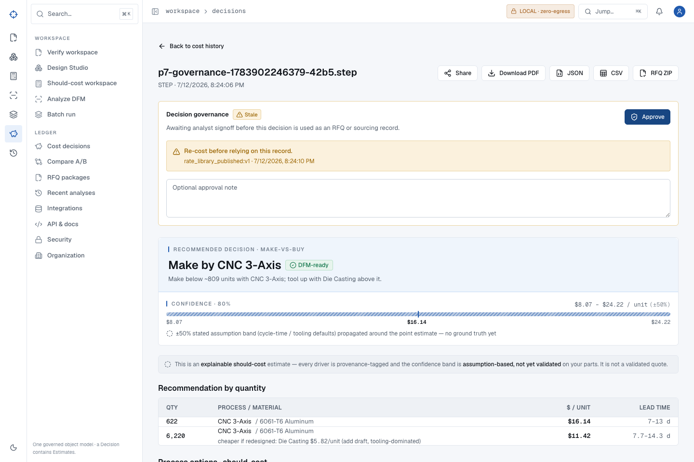
P
PROOFSHAPE · PLATFORM WALKTHROUGH
START
ACCESS
VERIFY
DESIGN
COST
MFG
BATCH
ADMIN
RECOVERY
JOURNEY
FINISH
TEST CONTRACT · BUILD EVIDENCE REQUIRED
RE-COST TRIGGER
A new governed rate makes the old decision visibly stale
Stale is protective: it stops a prior approval from looking current after its rate basis changes.
1
Publish a new governed rate-card version as an administrator.
2
Return to the previously saved decision.
3
Read the stale warning and reason.
EXPECTED OUTCOME
The decision shows Stale and “Re-cost before relying on this record,” with reason rate_library_published.
4
Re-run cost before relying on or packaging the decision.
EVIDENCE · WORK-05 · governed-rate transition oracle
← PREVIOUS
32 / 53
NEXT →
Notes:
Source route: decision-stale,Evidence: WORK-05 · governed-rate transition oracle,Expected: The decision shows Stale and “Re-cost before relying on this record,” with reason rate_library_published.

Slide 33
P
PROOFSHAPE · PLATFORM WALKTHROUGH
START
ACCESS
VERIFY
DESIGN
COST
MFG
BATCH
ADMIN
RECOVERY
JOURNEY
FINISH
TEST CONTRACT · BUILD EVIDENCE REQUIRED
COST COMPARISON
Compare A/B only after both decisions are durable
EXPECTED OUTCOME
Every displayed value matches the compare API and source records; order, quantities, approval, stale state, and numerical deltas remain exact after reload.
Comparison is a read of two saved records, not a recalculation that can quietly drift.
1
Open Compare A/B.
2
Select two durable decisions by filename and identity.
3
Read each quantity row, delta, process, approval, and stale flag.
EVIDENCE
WORK-06 · 199-assertion compare/RFQ/key matrix
4
Refresh and confirm the exact comparison reopens.
EVIDENCE · WORK-06 · 199-assertion compare/RFQ/key matrix
← PREVIOUS
33 / 53
NEXT →
Notes:
Source route: compare-ab,Evidence: WORK-06 · 199-assertion compare/RFQ/key matrix,Expected: Every displayed value matches the compare API and source records; order, quantities, approval, stale state, and numerical deltas remain exact after reload.

Slide 34
P
PROOFSHAPE · PLATFORM WALKTHROUGH
START
ACCESS
VERIFY
DESIGN
COST
MFG
BATCH
ADMIN
RECOVERY
JOURNEY
FINISH
TEST CONTRACT · BUILD EVIDENCE REQUIRED
DOWNLOAD AND HANDOFF
Treat exports as reconciled evidence, not convenient attachments
EXPECTED OUTCOME
Browser downloads are non-empty, named correctly, parse successfully, and reproduce the source decision or design without hidden fallback content.
A file is useful only when its content can be reconstructed back to the durable record that produced it.
1
Download only after the decision reaches the intended governance state.
2
Open the exported CSV, JSON, PDF, STEP, or ZIP.
3
Reconcile filename, identity, hash, quantity, cost, warnings, and approval.
EVIDENCE
DES-05/10/11 · WORK-06/08 · training-guide RFQ oracle
4
Keep raw CAD inclusion explicit when sharing an RFQ package.
EVIDENCE · DES-05/10/11 · WORK-06/08 · training-guide RFQ oracle
← PREVIOUS
34 / 53
NEXT →
Notes:
Source route: exports,Evidence: DES-05/10/11 · WORK-06/08 · training-guide RFQ oracle,Expected: Browser downloads are non-empty, named correctly, parse successfully, and reproduce the source decision or design without hidden fallback content.

Slide 35
P
PROOFSHAPE · PLATFORM WALKTHROUGH
START
ACCESS
VERIFY
DESIGN
COST
MFG
BATCH
ADMIN
RECOVERY
JOURNEY
FINISH
TEST CONTRACT · BUILD EVIDENCE REQUIRED
CONTROLLED EXTERNAL REVIEW
A public share is read-only, minimal, and revocable
EXPECTED OUTCOME
Before revocation, the public view is readable and mutation-free with a minimized payload. After revocation, both page and API return unavailable/404 while the owner record persists with sharing disabled.
Share only the reviewed should-cost view. The public payload must not disclose private organization, user, API-key, internal decision, or mesh-hash identifiers.
1
Open a reviewed cost decision and select Share; copy the generated public URL.
2
Open it in a private browser with no ProofShape session and confirm Shared should-cost · read-only.
3
Compare visible filename, governed result, and warnings; confirm there are no mutation controls or private identifiers.
EVIDENCE
WORK-07 · unauthenticated payload privacy + owner revoke lifecycle
4
Return as owner, revoke the share, then refresh both the public page and its API payload.
EVIDENCE · WORK-07 · unauthenticated payload privacy + owner revoke lifecycle
← PREVIOUS
35 / 53
NEXT →
Notes:
Source route: public-share,Evidence: WORK-07 · unauthenticated payload privacy + owner revoke lifecycle,Expected: Before revocation, the public view is readable and mutation-free with a minimized payload. After revocation, both page and API return unavailable/404 while the owner record persists with sharing disabled.

Slide 36
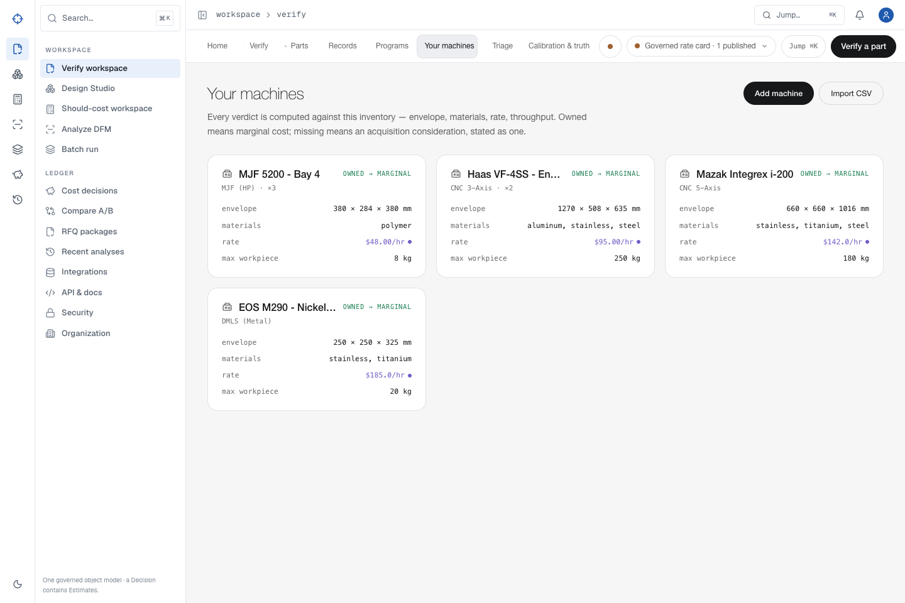
P
PROOFSHAPE · PLATFORM WALKTHROUGH
START
ACCESS
VERIFY
DESIGN
COST
MFG
BATCH
ADMIN
RECOVERY
JOURNEY
FINISH
TEST CONTRACT · BUILD EVIDENCE REQUIRED
USE CASE · MANUFACTURING LEAD
Declare the machines and rates the organization actually owns
Form authoring, zero-value handling, CSV mixed rows, retry, reload, and governed-rate display are exercised through the browser.
Open Your machines ↗
Download mixed machine import CSV ↓
1
Open Your machines and select Add machine.
2
For the practice row enter name QA CNC Mill, process cnc_3axis, $95/hour, 200 kg maximum workpiece, envelope x/y/z 500 × 400 × 300 mm, aluminum; count 1.
Import the provided mixed CSV; line 2 is valid and line 3 intentionally has count=not-a-number. Inspect the exact imported/skipped totals and line-3 reason.
EXPECTED OUTCOME
3
Exactly one valid cnc_3axis row imports and the intentional line 3 is skipped with count-not-an-integer copy. The authored machine persists; valid zero values remain zero; retry never removes existing machines.
4
Reload and confirm the valid inventory and provenance; retry the same CSV to prove it does not remove existing machines.
EVIDENCE · MFG-01–06 · ENT-01 manufacturing/CAD matrix · embedded fixture SHA dc96692c…5306
← PREVIOUS
36 / 53
NEXT →
Notes:
Source route: machine-floor,Evidence: MFG-01–06 · ENT-01 manufacturing/CAD matrix · embedded fixture SHA dc96692c…5306,Expected: Exactly one valid cnc_3axis row imports and the intentional line 3 is skipped with count-not-an-integer copy. The authored machine persists; valid zero values remain zero; retry never removes existing machines.

Slide 37
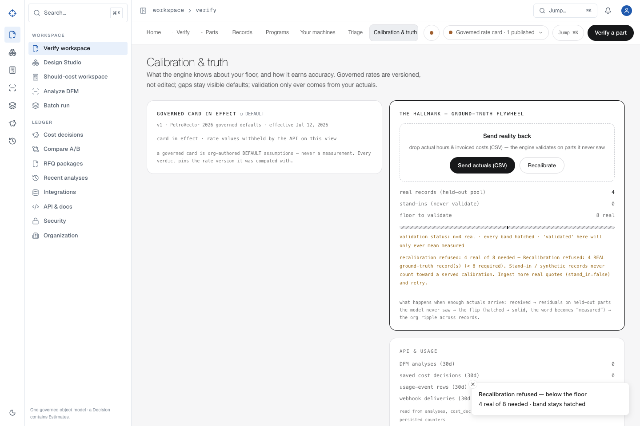
P
PROOFSHAPE · PLATFORM WALKTHROUGH
START
ACCESS
VERIFY
DESIGN
COST
MFG
BATCH
ADMIN
RECOVERY
JOURNEY
FINISH
TEST CONTRACT · BUILD EVIDENCE REQUIRED
GROUND TRUTH FLOOR AND SUCCESSFUL SOURCE BINDING
Practice data must never masquerade as measured accuracy
The downloadable rows are intentionally tagged demo/stand-in. They prove import and refusal safely; real calibration succeeds only with customer actuals bound to source hashes already accepted by Verify or Should-cost.
Open Calibration & truth ↗
Download safe mixed actuals CSV ↓
1
Successfully upload the unmodified cube.step first so its source SHA exists in the organization evidence store.
2
Import the provided CSV: exactly 8 rows import as stand-ins and line 10 is rejected with all stated field errors.
Select Recalibrate and confirm the safe practice result is refused as 0 real of 8 needed; refresh and confirm the state persists.
EXPECTED OUTCOME
3
The practice file can never flip a band solid. In the isolated release test, eight test-tenant actual records bound to a durably captured STEP source complete with zero skipped records and measured held-out metrics; customer accuracy is never inferred from those test facts.
4
For a real measured run, use at least eight genuine invoice/quote rows, source_type actual/quote/invoice, and each exact prior source SHA; then review held-out count, skipped reasons, and measured metrics before accepting the band.
EVIDENCE · ENT-02 · source-artifact/calibration success contract · safe fixture SHA 16cd702c…62a
← PREVIOUS
37 / 53
NEXT →
Notes:
Source route: calibration,Evidence: ENT-02 · source-artifact/calibration success contract · safe fixture SHA 16cd702c…62a,Expected: The practice file can never flip a band solid. In the isolated release test, eight test-tenant actual records bound to a durably captured STEP source complete with zero skipped records and measured held-out metrics; customer accuracy is never inferred from those test facts.

Slide 38
P
PROOFSHAPE · PLATFORM WALKTHROUGH
START
ACCESS
VERIFY
DESIGN
COST
MFG
BATCH
ADMIN
RECOVERY
JOURNEY
FINISH
TEST CONTRACT · BUILD EVIDENCE REQUIRED
120 °C · SOUR SERVICE · 35 MPA
Severe service rejects unsafe materials before recovering a route
EXPECTED OUTCOME
One or more unsafe polymer routes are excluded with standards-cited reasons visible in the UI; PEEK remains an explicit owned-capability gap; the declared stainless route recovers to makeable_in_house and the USER service context persists.
Complex service constraints must change feasibility—not merely decorate the record.
1
In Verify select Polymer, 120 °C service, sour service, and 35 MPa pressure; upload the golden STEP.
2
Read every returned environment exclusion and confirm each visible reason cites NACE, HDT, ASME, ASTM, or ISO evidence.
3
Confirm the surviving PEEK capability is explicit as makeable_not_on_owned on the declared inventory.
EVIDENCE
ENT-03 · exact context/verdict/citation browser oracle
4
Select Stainless without re-uploading; wait for a fresh result and confirm makeable_in_house.
EVIDENCE · ENT-03 · exact context/verdict/citation browser oracle
← PREVIOUS
38 / 53
NEXT →
Notes:
Source route: severe-service,Evidence: ENT-03 · exact context/verdict/citation browser oracle,Expected: One or more unsafe polymer routes are excluded with standards-cited reasons visible in the UI; PEEK remains an explicit owned-capability gap; the declared stainless route recovers to makeable_in_house and the USER service context persists.

Slide 39
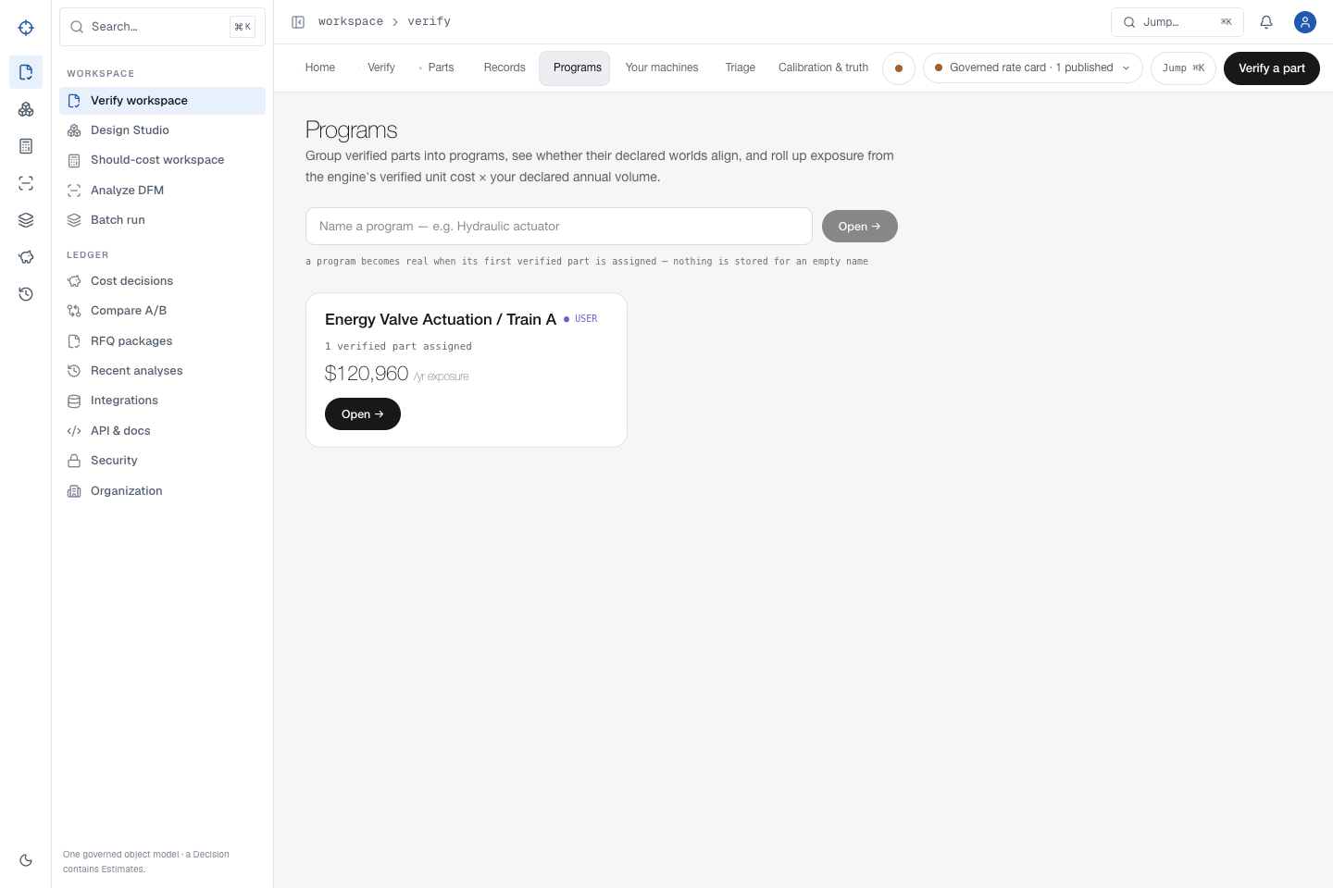
P
PROOFSHAPE · PLATFORM WALKTHROUGH
START
ACCESS
VERIFY
DESIGN
COST
MFG
BATCH
ADMIN
RECOVERY
JOURNEY
FINISH
TEST CONTRACT · BUILD EVIDENCE REQUIRED
PROGRAM AND ANNUAL ECONOMICS
Program exposure appears only after exact-volume verification
ProofShape withholds annualized exposure until the engine has a recommendation at the declared quantity.
Open Programs ↗
Download mixed parts manifest ↓
1
Import the manifest and confirm exactly two valid rows plus the intentional line-4 rejection.
2
Assign the verified part to a program and parent assembly; declare units per parent and annual volume.
Re-verify at the exact annual quantity.
EXPECTED OUTCOME
3
For the pinned program oracle: 12,000 units × $10.08 = $120,960/year. The single-part $133.58 headline and any row without exact-volume evidence are explicitly rejected as annual bases.
4
Open Programs and confirm the part, missing-evidence state, and exposure roll up without inventing economics for the rejected row.
EVIDENCE · ENT-04 · exact-economics oracle · manifest SHA 567fc0c2…1268
← PREVIOUS
39 / 53
NEXT →
Notes:
Source route: programs,Evidence: ENT-04 · exact-economics oracle · manifest SHA 567fc0c2…1268,Expected: For the pinned program oracle: 12,000 units × $10.08 = $120,960/year. The single-part $133.58 headline and any row without exact-volume evidence are explicitly rejected as annual bases.

Slide 40
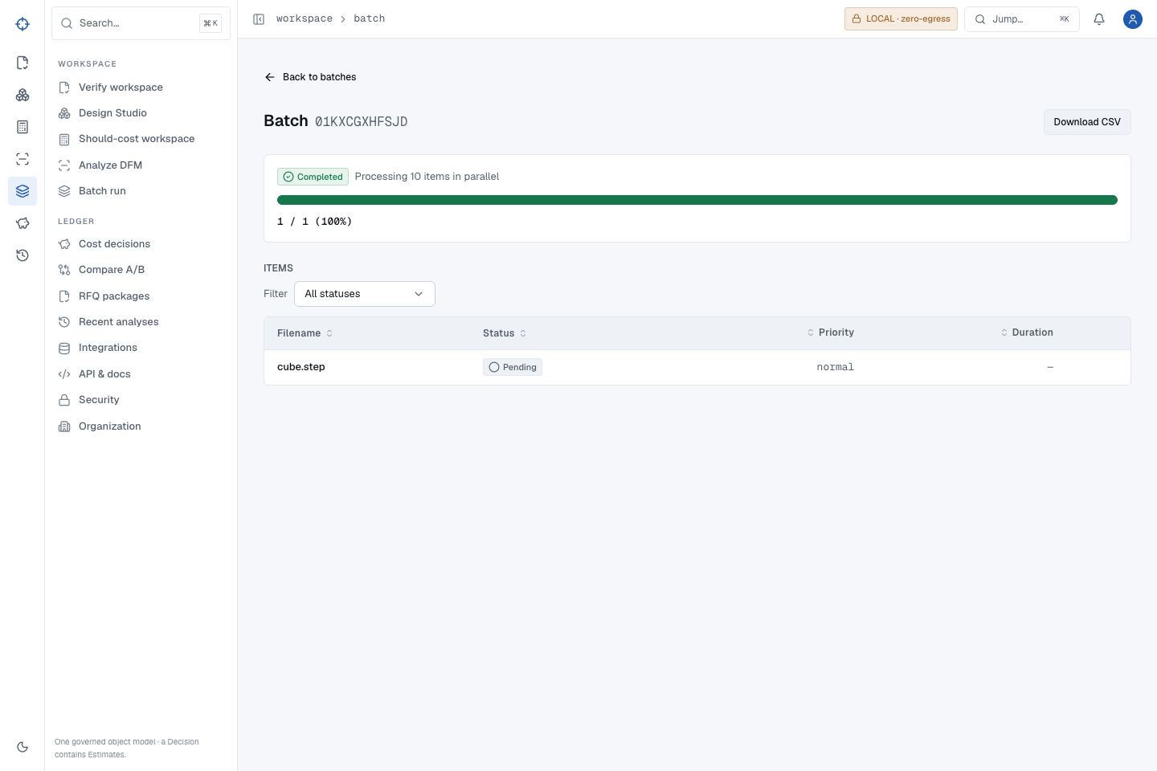
P
PROOFSHAPE · PLATFORM WALKTHROUGH
START
ACCESS
VERIFY
DESIGN
COST
MFG
BATCH
ADMIN
RECOVERY
JOURNEY
FINISH
TEST CONTRACT · BUILD EVIDENCE REQUIRED
USE CASE · MANY PARTS
A ZIP batch must finish before its CSV becomes evidence
Batch creation, worker progress, mounted-row refresh, result identity, CSV, and archive recovery are exercised as a user sees them.
1
Create a ZIP containing supported CAD files; exclude quote CSVs.
2
Open Batch run, select the ZIP, and choose Start batch.
3
Wait for both summary and mounted item row to say Completed.
EXPECTED OUTCOME
The one-part ZIP reaches Completed 1/1 without reload; CSV headers, filename, status, verdict, process, duration, analysis URL, and error field reconcile.
4
Download CSV and reconcile one row per item.
EVIDENCE · WORK-02/11 · batch/recovery golden matrix
← PREVIOUS
40 / 53
NEXT →
Notes:
Source route: batch,Evidence: WORK-02/11 · batch/recovery golden matrix,Expected: The one-part ZIP reaches Completed 1/1 without reload; CSV headers, filename, status, verdict, process, duration, analysis URL, and error field reconcile.

Slide 41
P
PROOFSHAPE · PLATFORM WALKTHROUGH
START
ACCESS
VERIFY
DESIGN
COST
MFG
BATCH
ADMIN
RECOVERY
JOURNEY
FINISH
TEST CONTRACT · BUILD EVIDENCE REQUIRED
QUEUE AND REFRESH RECOVERY
A worker or status fault must not strand or duplicate the batch
The browser is forced through create races, stale status, reload, injected 500, retry, and persisted-identity recovery.
1
Keep the batch page open when status becomes unavailable.
2
Read the actionable worker/status message; do not resubmit blindly.
3
Refresh or choose the stated retry action once.
EXPECTED OUTCOME
A single durable batch reaches Completed 1/1 after recovery; no duplicate analysis, stranded item, false success, or lost mounted-row state remains.
4
Confirm the original batch ID completes and CSV remains singular.
EVIDENCE · FAIL-04/05/10 · batch race and rollback regressions
← PREVIOUS
41 / 53
NEXT →
Notes:
Source route: batch-recovery,Evidence: FAIL-04/05/10 · batch race and rollback regressions,Expected: A single durable batch reaches Completed 1/1 after recovery; no duplicate analysis, stranded item, false success, or lost mounted-row state remains.

Slide 42
P
PROOFSHAPE · PLATFORM WALKTHROUGH
START
ACCESS
VERIFY
DESIGN
COST
MFG
BATCH
ADMIN
RECOVERY
JOURNEY
FINISH
TEST CONTRACT · BUILD EVIDENCE REQUIRED
CANCELLATION AND WORKER LEASE RECOVERY
Cancel the original batch; do not create a second one to escape it
EXPECTED OUTCOME
A cancelled parent has no pending/queued/processing children and never later becomes Completed. A worker cancellation releases the processing lease; stale-lease fallback requeues only after the hard timeout safety margin and links the exact persisted analysis variant.
Cancellation must settle every child item and survive a worker being interrupted after it durably claimed work.
Open Batch ↗
Download one-part batch ZIP ↓
1
Start the provided batch ZIP in the test tenant and note the durable batch ID.
2
While work is pending or processing, select Cancel and confirm the destructive action once.
EVIDENCE
3
Refresh the same batch ID and inspect every item state.
WORK-11 · cancellation BaseException regression · 660-second stale lease recovery
4
In the recovery test, interrupt a claimed worker; confirm the item is released or reclaimed, then allow the original batch to finish on retry.
EVIDENCE · WORK-11 · cancellation BaseException regression · 660-second stale lease recovery
← PREVIOUS
42 / 53
NEXT →
Notes:
Source route: batch-cancel,Evidence: WORK-11 · cancellation BaseException regression · 660-second stale lease recovery,Expected: A cancelled parent has no pending/queued/processing children and never later becomes Completed. A worker cancellation releases the processing lease; stale-lease fallback requeues only after the hard timeout safety margin and links the exact persisted analysis variant.

Slide 43
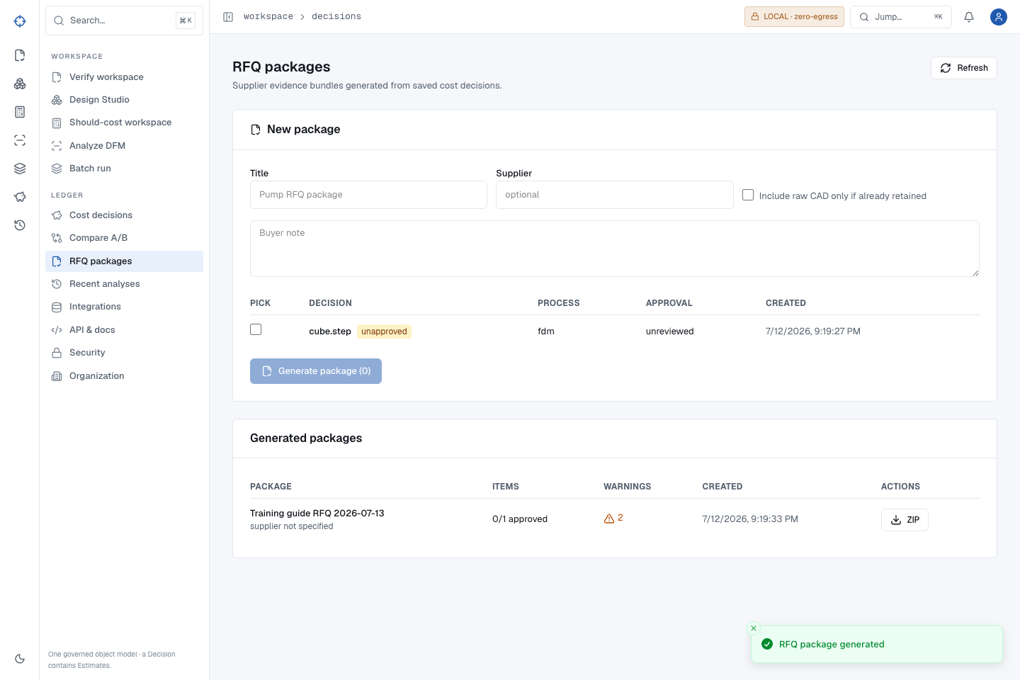
P
PROOFSHAPE · PLATFORM WALKTHROUGH
START
ACCESS
VERIFY
DESIGN
COST
MFG
BATCH
ADMIN
RECOVERY
JOURNEY
FINISH
TEST CONTRACT · BUILD EVIDENCE REQUIRED
USE CASE · SOURCING LEAD
Build an RFQ bundle from saved decisions—without contacting a supplier
ProofShape generates a durable evidence bundle. Supplier transmission remains a separate controlled action.
1
Open RFQ packages after saving cost decisions.
2
Enter title, supplier, and optional buyer note.
3
Select decisions; read stale, unapproved, and raw-CAD warnings.
EXPECTED OUTCOME
For the pinned cube, manifest, line item, supplier brief, exact decision JSON, 48 estimate/driver rows, required part context, warnings, raw-CAD boundary, and a real parsed PDF reconcile with the immutable package snapshot. PDF-unavailable is a release failure for this golden path.
4
Generate, reopen, then Download ZIP.
EVIDENCE · WORK-08 · training-guide RFQ semantic PDF/ZIP oracle
← PREVIOUS
43 / 53
NEXT →
Notes:
Source route: rfq,Evidence: WORK-08 · training-guide RFQ semantic PDF/ZIP oracle,Expected: For the pinned cube, manifest, line item, supplier brief, exact decision JSON, 48 estimate/driver rows, required part context, warnings, raw-CAD boundary, and a real parsed PDF reconcile with the immutable package snapshot. PDF-unavailable is a release failure for this golden path.

Slide 44
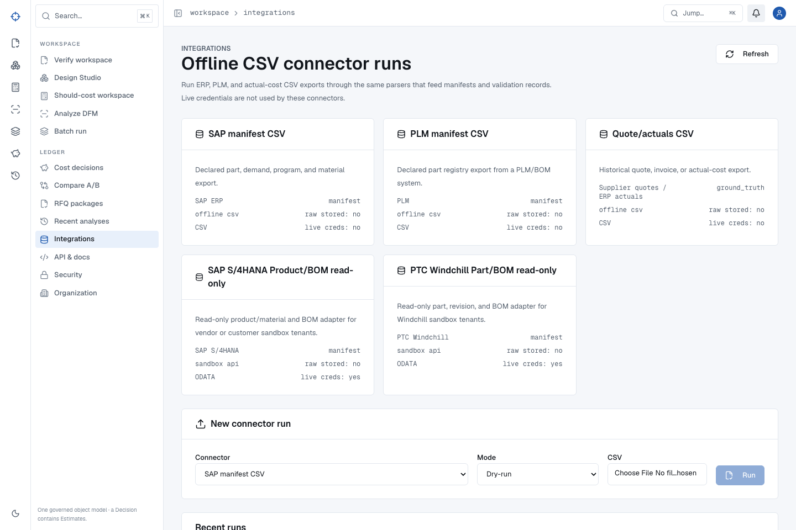
P
PROOFSHAPE · PLATFORM WALKTHROUGH
START
ACCESS
VERIFY
DESIGN
COST
MFG
BATCH
ADMIN
RECOVERY
JOURNEY
FINISH
PARTIAL · EXTERNAL GATE
INTEGRATION BOUNDARY
Connector simulation proves the contract—not a live vendor relationship
Local SAP and Windchill fixtures, CSV normalization, credential lifecycle, import, idempotent retry, and secret redaction pass. Vendor acceptance requires a real sandbox.
Open Integrations ↗
Download SAP sandbox replay ↓
Download Windchill sandbox replay ↓
Download normalized manifest ↓
1
Open Integrations and read the connector and read-only boundary.
2
Use the offline replays to confirm SAP normalizes 2 products + 1 BOM edge and Windchill normalizes 2 parts + 1 usage edge, each with zero warnings.
Create a profile only for an approved real sandbox endpoint; dry-run, import, and retry while comparing normalized rows.
VALIDATED SCOPE / REMAINING GATE
3
Offline fixture rows remain exact and retry creates no duplicates. PARTIAL means no claim that SAP or Windchill accepted a live connection until their real sandboxes are configured and accepted.
4
Revoke the profile and confirm no secret appears in responses.
EVIDENCE · WORK-09/10 · SAP SHA 31aa45fe…664f · Windchill SHA 5ff55031…307 · live vendor gate external
← PREVIOUS
44 / 53
NEXT →
Notes:
Source route: integrations,Evidence: WORK-09/10 · SAP SHA 31aa45fe…664f · Windchill SHA 5ff55031…307 · live vendor gate external,Expected: Offline fixture rows remain exact and retry creates no duplicates. PARTIAL means no claim that SAP or Windchill accepted a live connection until their real sandboxes are configured and accepted.

Slide 45
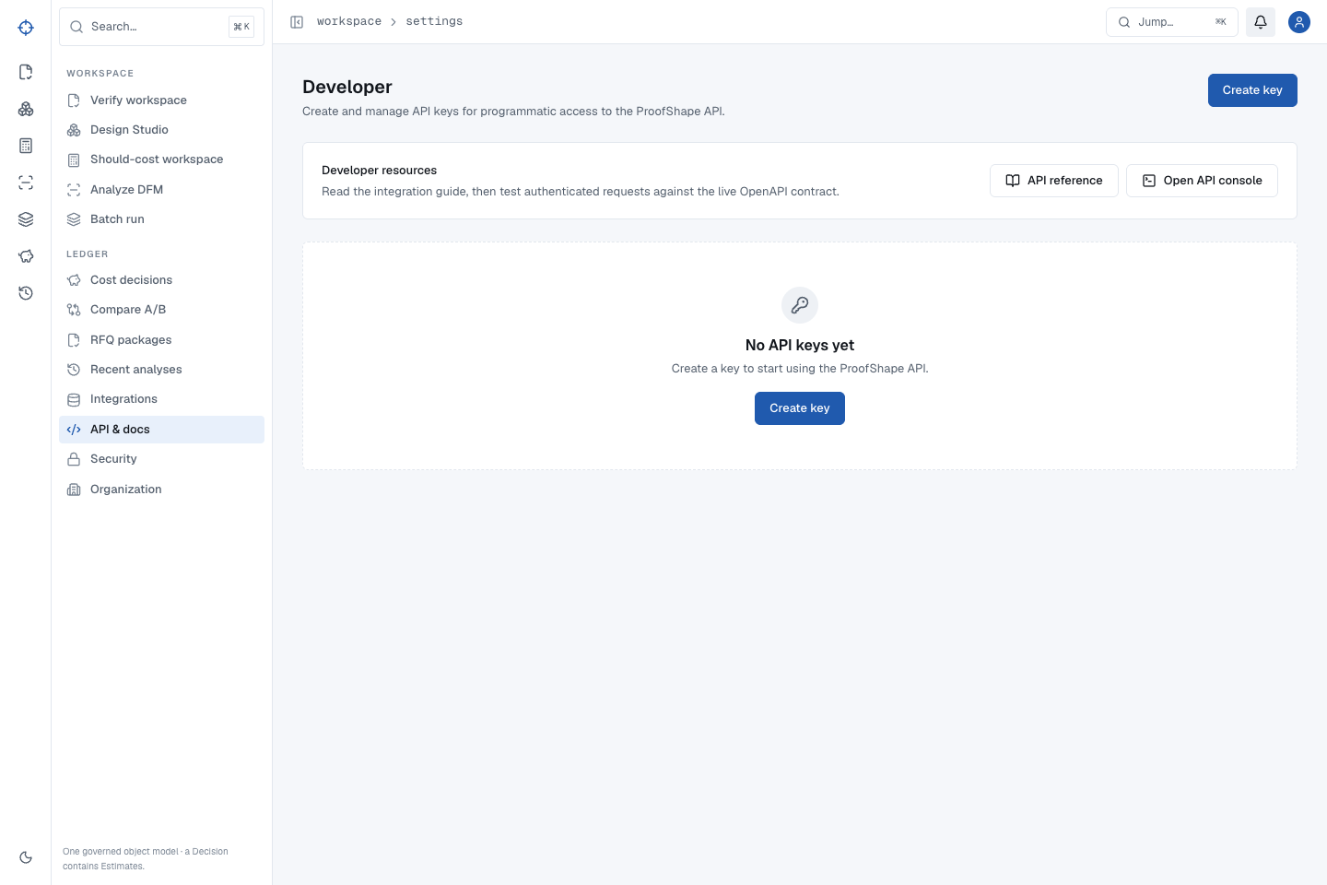
P
PROOFSHAPE · PLATFORM WALKTHROUGH
START
ACCESS
VERIFY
DESIGN
COST
MFG
BATCH
ADMIN
RECOVERY
JOURNEY
FINISH
TEST CONTRACT · BUILD EVIDENCE REQUIRED
USE CASE · DEVELOPER/ADMIN
Create an API key once, then treat the secret as gone
Developer settings reveals the full key exactly once; later screens retain only its prefix and current status.
1
Open API & docs / Developer settings.
2
Create a key and use it once against the API.
3
Reload, rotate, and confirm the old key is rejected.
EXPECTED OUTCOME
Create/use/reload/rotate/reject-old/use-new/revoke/reject-new all pass; durable status and audit state survive reload while the dashboard session remains separate.
4
Revoke the replacement and confirm it is rejected and visibly Revoked.
EVIDENCE · WORK-12 · compare/RFQ/key browser matrix
← PREVIOUS
45 / 53
NEXT →
Notes:
Source route: api-keys,Evidence: WORK-12 · compare/RFQ/key browser matrix,Expected: Create/use/reload/rotate/reject-old/use-new/revoke/reject-new all pass; durable status and audit state survive reload while the dashboard session remains separate.

Slide 46
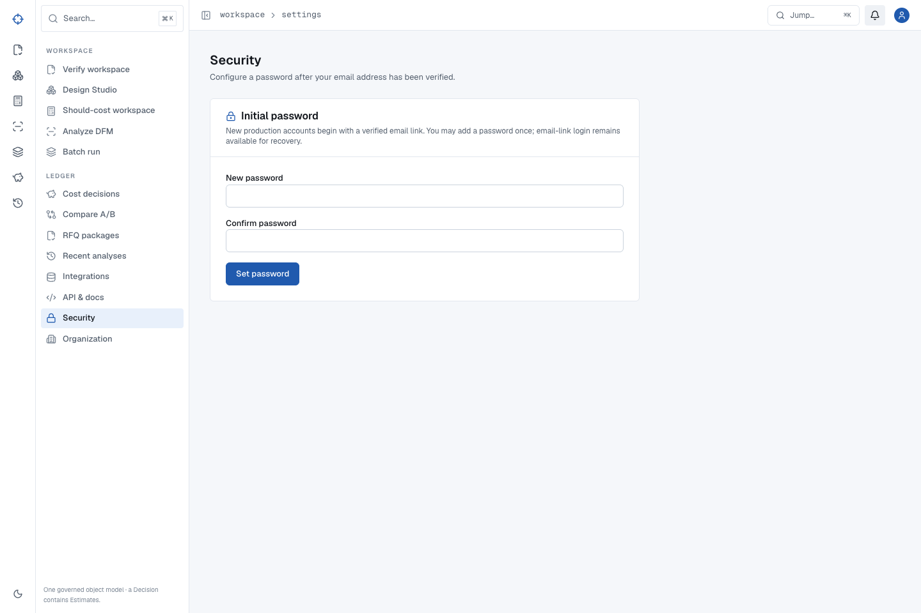
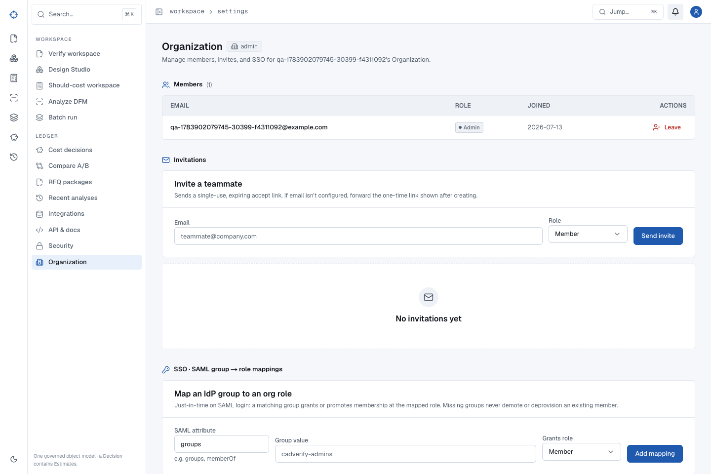
P
PROOFSHAPE · PLATFORM WALKTHROUGH
START
ACCESS
VERIFY
DESIGN
COST
MFG
BATCH
ADMIN
RECOVERY
JOURNEY
FINISH
TEST CONTRACT · BUILD EVIDENCE REQUIRED
ADMINISTRATIVE ONBOARDING
Configure organization and security surfaces before inviting work
Organization identity, member roles, password/session controls, and provider-specific SSO/SCIM boundaries are explicit.
1
Open Organization and confirm the tenant identity.
2
Invite only the intended person and assign the least-privileged role.
3
Open Security and review password, session, SSO, and SCIM state.
EXPECTED OUTCOME
The organization and security pages show real configured state, not seeded facts. Local SAML/SCIM lifecycle contracts pass; a live IdP remains an external staging acceptance gate.
4
Use test users before changing production access.
EVIDENCE · AUTH-03 · SCIM/IdP lifecycle supplemental gate
← PREVIOUS
46 / 53
NEXT →
Notes:
Source route: org-security,Evidence: AUTH-03 · SCIM/IdP lifecycle supplemental gate,Expected: The organization and security pages show real configured state, not seeded facts. Local SAML/SCIM lifecycle contracts pass; a live IdP remains an external staging acceptance gate.

Slide 47
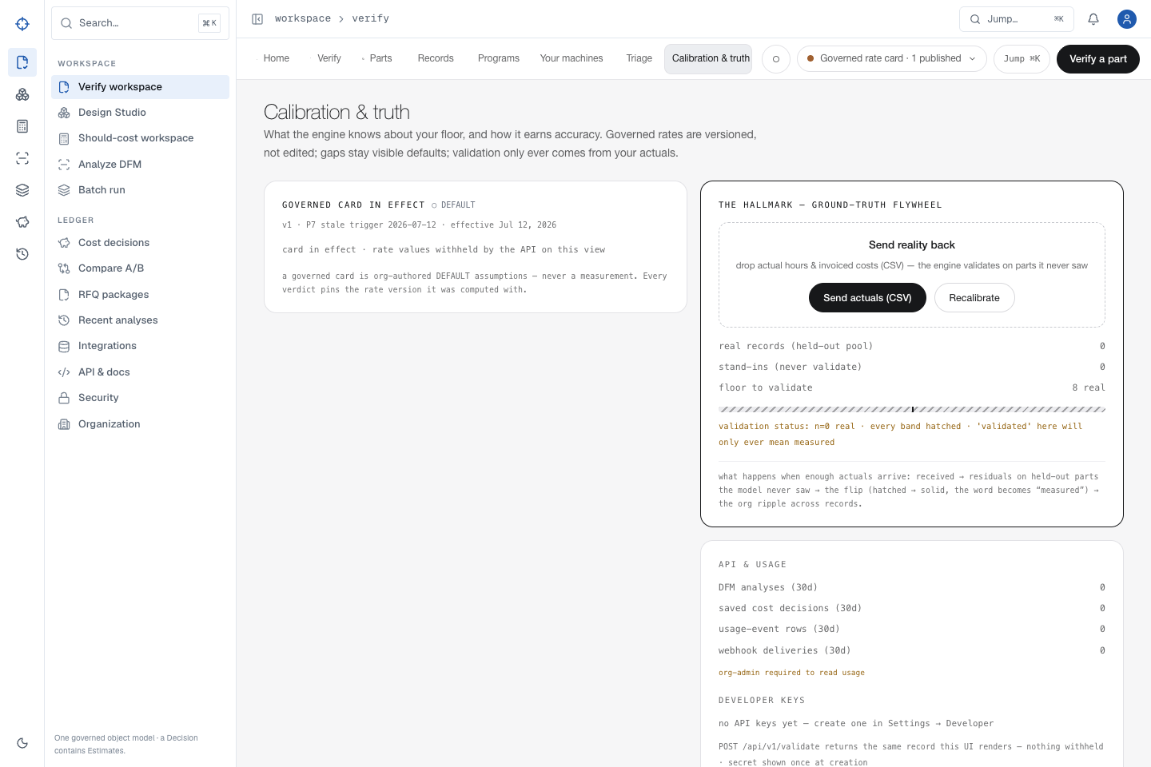
P
PROOFSHAPE · PLATFORM WALKTHROUGH
START
ACCESS
VERIFY
DESIGN
COST
MFG
BATCH
ADMIN
RECOVERY
JOURNEY
FINISH
TEST CONTRACT · BUILD EVIDENCE REQUIRED
ROLE AND TENANT ISOLATION
A viewer can read allowed evidence but cannot administer the organization
The full browser matrix substitutes IDs, downloads, cache/worker paths, and credentials across two organizations and role levels.
1
Sign in as viewer and open permitted evidence.
2
Attempt an administrator operation in the test tenant.
3
Substitute another organization’s record and download IDs.
EXPECTED OUTCOME
Viewer administration returns 403; cross-tenant records never render or download; API keys, cache values, worker writes, notifications, and recovery remain bound to the issuing organization.
4
Repeat after refresh and worker-backed operations.
EVIDENCE · ROLE-01–04 · two-tenant browser boundary matrix
← PREVIOUS
47 / 53
NEXT →
Notes:
Source route: role-boundaries,Evidence: ROLE-01–04 · two-tenant browser boundary matrix,Expected: Viewer administration returns 403; cross-tenant records never render or download; API keys, cache values, worker writes, notifications, and recovery remain bound to the issuing organization.

Slide 48
P
PROOFSHAPE · PLATFORM WALKTHROUGH
START
ACCESS
VERIFY
DESIGN
COST
MFG
BATCH
ADMIN
RECOVERY
JOURNEY
FINISH
PARTIAL · EXTERNAL GATE
HONEST CAPABILITY BOUNDARY
Reconstruction is available only with an approved geometry backend
VALIDATED SCOPE / REMAINING GATE
Without an approved backend, the endpoint returns an actionable 501 boundary and creates no fabricated mesh. A live reconstruction claim requires provider, accuracy, security, and customer-file acceptance.
The local production candidate intentionally has no model endpoint or remote egress for reconstruction. It must not fake a mesh.
1
Open reconstruction only when the organization has an approved backend configured.
2
If the service is unavailable, read the stated upload recovery.
3
Upload the source CAD through Verify instead.
EVIDENCE
ENT-05 actionable recovery · external provider/accuracy gate
4
Escalate provider configuration to an administrator.
EVIDENCE · ENT-05 actionable recovery · external provider/accuracy gate
← PREVIOUS
48 / 53
NEXT →
Notes:
Source route: reconstruction-boundary,Evidence: ENT-05 actionable recovery · external provider/accuracy gate,Expected: Without an approved backend, the endpoint returns an actionable 501 boundary and creates no fabricated mesh. A live reconstruction claim requires provider, accuracy, security, and customer-file acceptance.

Slide 49
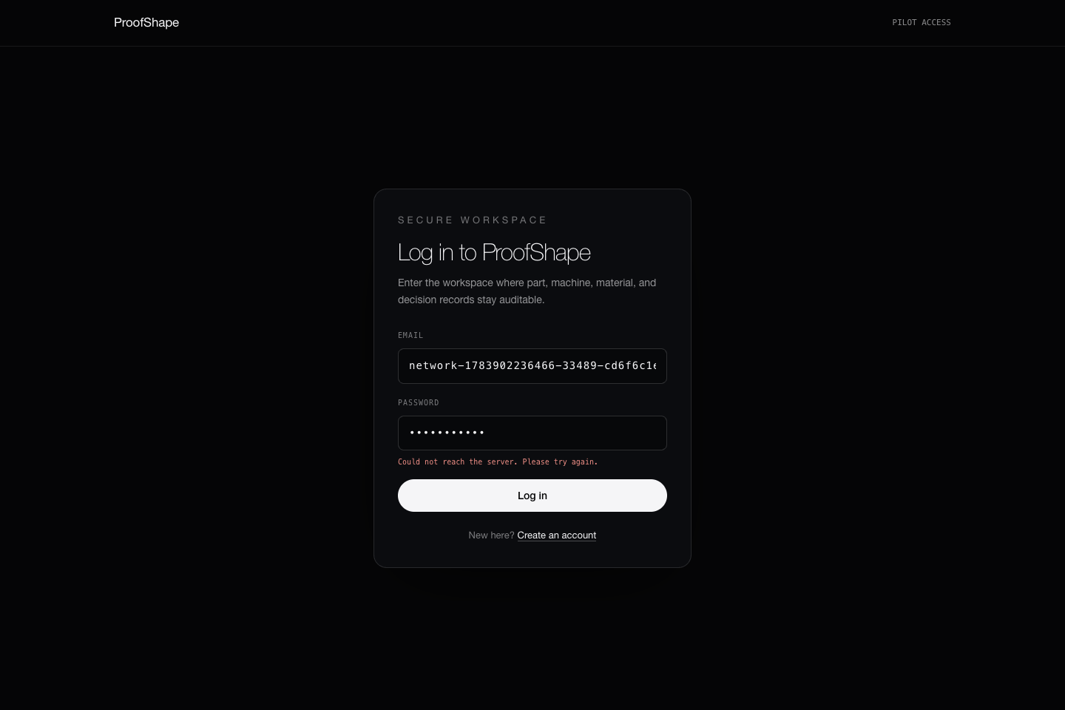
P
PROOFSHAPE · PLATFORM WALKTHROUGH
START
ACCESS
VERIFY
DESIGN
COST
MFG
BATCH
ADMIN
RECOVERY
JOURNEY
FINISH
TEST CONTRACT · BUILD EVIDENCE REQUIRED
TEN REQUIRED RECOVERY CONTRACTS
Recover from the stated cause
Authentication, validation, throttling, missing records, conflicts, worker/store faults, offline, and restart paths are exercised through the browser.
1
Preserve the filename, route, timestamp, and record ID.
2
Correct credentials, bytes, permissions, or service health.
3
Use the displayed retry or refresh action once.
EXPECTED OUTCOME
401, 403, 404, 409, 422, 429, and 500 states show bounded next actions; FAIL-01–10 recover without duplicate or corrupted evidence.
4
Confirm the original object completes or remains safely unchanged.
EVIDENCE · FAIL-01–10 · mobile/recovery and domain matrices
← PREVIOUS
49 / 53
NEXT →
Notes:
Source route: recovery,Evidence: FAIL-01–10 · mobile/recovery and domain matrices,Expected: 401, 403, 404, 409, 422, 429, and 500 states show bounded next actions; FAIL-01–10 recover without duplicate or corrupted evidence.

Slide 50
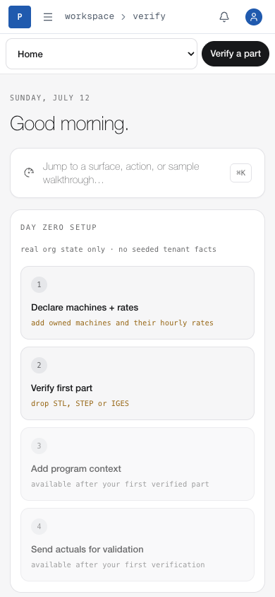
P
PROOFSHAPE · PLATFORM WALKTHROUGH
START
ACCESS
VERIFY
DESIGN
COST
MFG
BATCH
ADMIN
RECOVERY
JOURNEY
FINISH
TEST CONTRACT · BUILD EVIDENCE REQUIRED
390 × 844 HUMAN SIMULATION
Mobile can complete bounded work—not merely display a shell
Account access, navigation, design, historical verify, batch, downloads, archive/restore, errors, Back/Forward, refresh, and restart are exercised with touch-sized controls.
1
Access: sign in, open the section selector, navigate to Verify, and sign out.
2
Engineering: open the exact historical design revision, verify it, and preserve project/revision/file identity.
3
Operations: open a batch, refresh progress, download CSV, cancel only the intended batch, and recover an injected status fault.
EXPECTED OUTCOME
Every guide slide remains horizontally usable at 390 × 844; all controls are touch sized; tested bounded app workflows complete without duplicate mutations; persisted design, revision, batch, decision, and file identities remain exact across responsive and restart loops.
4
Governance: open a decision, download evidence, archive/restore where allowed, then use Back/Forward, refresh, and a new browser context.
EVIDENCE · Deck all-slide mobile sweep + VER-09 · WORK-11 · FAIL-03–10 app matrix
← PREVIOUS
50 / 53
NEXT →
Notes:
Source route: mobile,Evidence: Deck all-slide mobile sweep + VER-09 · WORK-11 · FAIL-03–10 app matrix,Expected: Every guide slide remains horizontally usable at 390 × 844; all controls are touch sized; tested bounded app workflows complete without duplicate mutations; persisted design, revision, batch, decision, and file identities remain exact across responsive and restart loops.

Slide 51
P
PROOFSHAPE · PLATFORM WALKTHROUGH
START
ACCESS
VERIFY
DESIGN
COST
MFG
BATCH
ADMIN
RECOVERY
JOURNEY
FINISH
PARTIAL · EXTERNAL GATE
EXTERNAL PRODUCTION GATE
Public launch requires real providers and ownership—not placeholders
VALIDATED SCOPE / REMAINING GATE
Public go-live occurs only after each provider health check, DNS/TLS check, backup/restore drill, alert route, owner, rollback, and legal approval is real. No simulated dependency can satisfy this slide.
The application can be locally release-certified while public availability remains blocked by infrastructure, identity, vendor, domain, and legal facts outside the repository.
1
Acquire and control the production domain and DNS.
2
Configure isolated staging/production apps, S3, Sentry, email/domain, Turnstile, and deployment environments.
3
Complete live IdP and vendor-sandbox acceptance.
EVIDENCE
External launch runbook · user/provider/legal ownership required
4
Complete IP/name, terms, privacy, regulated-boundary, and incident-owner approvals.
EVIDENCE · External launch runbook · user/provider/legal ownership required
← PREVIOUS
51 / 53
NEXT →
Notes:
Source route: external-launch,Evidence: External launch runbook · user/provider/legal ownership required,Expected: Public go-live occurs only after each provider health check, DNS/TLS check, backup/restore drill, alert route, owner, rollback, and legal approval is real. No simulated dependency can satisfy this slide.

Slide 52
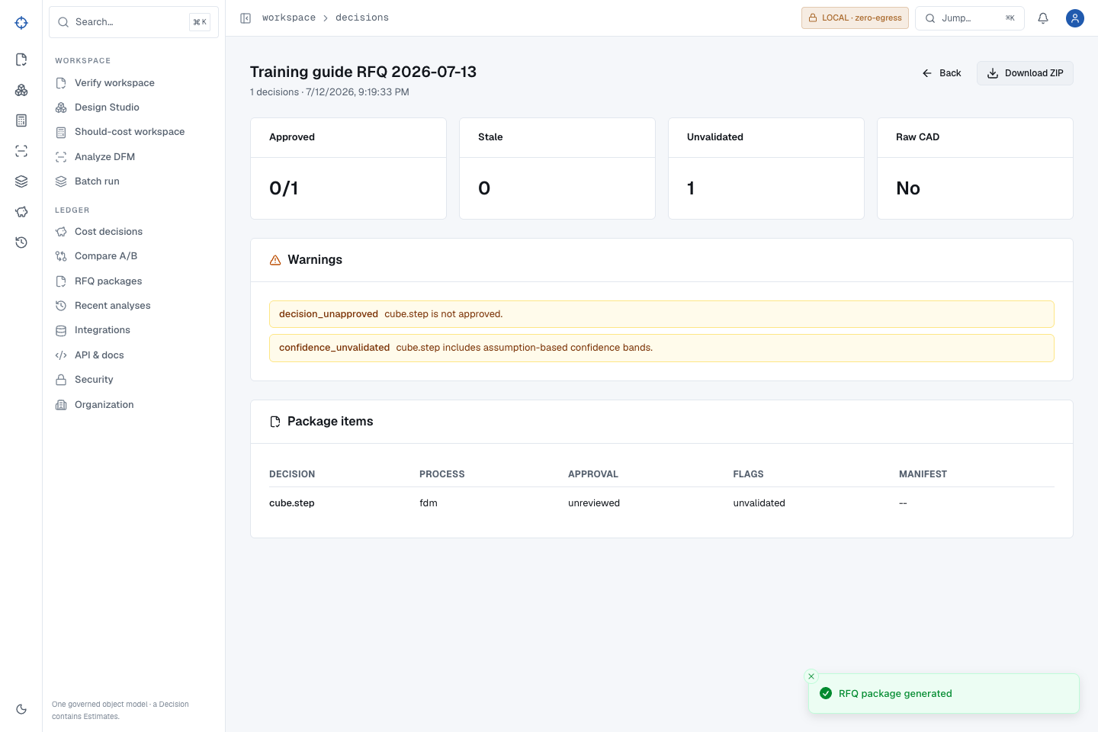
P
PROOFSHAPE · PLATFORM WALKTHROUGH
START
ACCESS
VERIFY
DESIGN
COST
MFG
BATCH
ADMIN
RECOVERY
JOURNEY
FINISH
TEST CONTRACT · BUILD EVIDENCE REQUIRED
ONE RECORD CHAIN, NO COMPOSITE CLAIMS
Exact golden path: new account → verified CAD → durable decision → RFQ ZIP
This is the single-account, single-source chain exercised by the guide runner. Machine, program, compare, and provider journeys have their own validated slides and are not silently claimed as steps in this record.
Download golden cube.step ↓
Open Sign up ↗
1
Create a fresh test account and reach Day Zero; upload the embedded golden STEP in Verify.
2
Reconcile 19,030 bytes, SHA-256 76923244…61103a, 20 × 15 × 10 mm envelope, 2.72 cm³ volume, 14.32 cm² area, watertight true, quantities, line items, and saved decision ID.
Open Cost history by that exact ID; refresh and prove all durable result fields remain byte-for-byte JSON-equivalent.
EXPECTED OUTCOME
3
One traceable account and decision ID connects the exact source bytes to measured geometry, governed should-cost evidence, a durable record, and an immutable RFQ package—without contacting a supplier or borrowing evidence from another test account.
4
Create one RFQ package from that decision; reopen, refresh, download ZIP, and reconcile manifest, line-items CSV, per-decision JSON/driver CSV, warnings, raw-CAD boundary, and real PDF or explicit PDF-unavailable artifact.
EVIDENCE · training-guide-e2e exact record chain + semantic ZIP/PDF reconciliation
← PREVIOUS
52 / 53
NEXT →
Notes:
Source route: whole-journey,Evidence: training-guide-e2e exact record chain + semantic ZIP/PDF reconciliation,Expected: One traceable account and decision ID connects the exact source bytes to measured geometry, governed should-cost evidence, a durable record, and an immutable RFQ package—without contacting a supplier or borrowing evidence from another test account.

Slide 53
P
PROOFSHAPE · PLATFORM WALKTHROUGH
START
ACCESS
VERIFY
DESIGN
COST
MFG
BATCH
ADMIN
RECOVERY
JOURNEY
FINISH
EVIDENCE SCREEN
COMPLETION CHECKLIST
You are done when the evidence matches—not when the spinner stops
EXPECTED OUTCOME
Only an exact clean-build LOCAL_100 report can certify all 64 local contracts for the build being served. Public production additionally requires real managed services, DNS/TLS, IdP/vendor acceptance, legal/IP approval, monitoring, backup, rollback, and accountable owners.
A completed ProofShape task has a visible result, a durable record when required, correct provenance, exact identity, a reconciled export, and a known recovery path.
1
Confirm the expected outcome on every use-case slide you performed.
2
Save or export only reviewed immutable records.
3
Open the release report for this exact build; do not infer PASS from the contract counts printed in this guide.
EVIDENCE
Exact clean release gate + browser deck QA + full regressions; this slide never self-certifies
4
Complete the external launch slide before inviting public production users.
EVIDENCE · Exact clean release gate + browser deck QA + full regressions; this slide never self-certifies
← PREVIOUS
53 / 53
Notes:
Source route: finish,Evidence: Exact clean release gate + browser deck QA + full regressions; this slide never self-certifies,Expected: Only an exact clean-build LOCAL_100 report can certify all 64 local contracts for the build being served. Public production additionally requires real managed services, DNS/TLS, IdP/vendor acceptance, legal/IP approval, monitoring, backup, rollback, and accountable owners.

