Slide 1
Display Input Lag/Response Time Tester
Zihan (Simon) Zhao, Shizhang (Steven) Yin
Notes:
Hello, We are Simon Zhao and Steven Yin. Our project is a display input lag and response time tester.

Slide 2

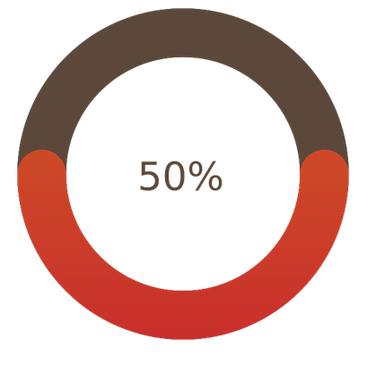
Project Description
Display testing device for
Input lag
Pixel response time
Key Functional Requirements
Results can be measured within 1ms margin
Light sensor have to be sampled at a high rate
Able to support different display technologies
Results can be stored on server
Notes:
As we have talk about in the earlier presentations, we have two goals in this project. The first one is to measure the input lag of the screen, which is the time between the start of the frame output to the time until the screen starts displaying output, and the second one is pixel response time, which is the time it takes between the start of the pixel color transition until the end of the transition.
Here I highlighted some of our key functional requirements and how well we met them:
Results measured within 1ms margin, for input lag due to recent situation we are unable to obtain an oscilloscope to verify it, for pixel response time we found our measurement is within 1ms of manufacture specification for the monitors we have tested
Light sensor has to be sampled at a high rate, we design our hardware to be able to use the sensor to sample at 200 thousand-samples per second
Our tester need to be able to support different display technologies, so far we have only tested VA and IPS display
Results can be stored on server, as in the demo we will show the measurement result being displayed on the server
Now I will let Simon talk about the technical detail of our project

Slide 3
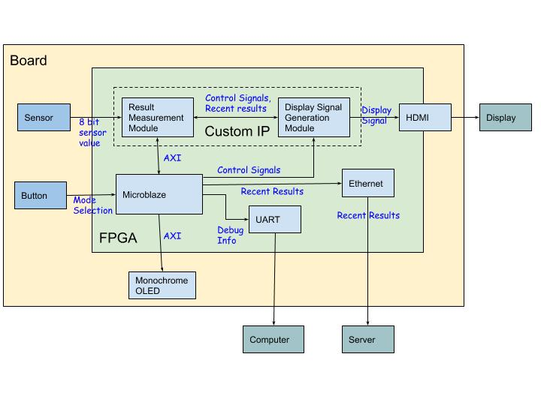
Project Structure: Original
Notes:
Thank Steven.
Here is our design diagram. This is the original one, and this is the final version.
The change is that we removed switches to select test mode and use UART to control the mode selection since there is some issue with my switches and buttons on our physical board.
The remaining parts are successfully implemented. There are two main components in our design diagram.
************************************
The results exactly match pixel response time range specification of my monitor.
In conclusion, besides my VA screen, IPS display is also tested at Steven’s home. The input lag and pixel response time results are both acceptable.
There are two worst cases that we can do better:
Firstly for input lag testing verification, we originally want to use oscilloscope to determine the exact number of lag time and compare with our result. Under current issue, we cannot do that. We only follows the general input lag time specification of different monitors.
Secondly, we can do better for switching modes during testing. But there is some issue with our switches and buttons so we use UART to control mode before testing. As for improvement, we can set UART Rx as interrupt or use switches.
This is our final demo. Thanks for watching.

Slide 4
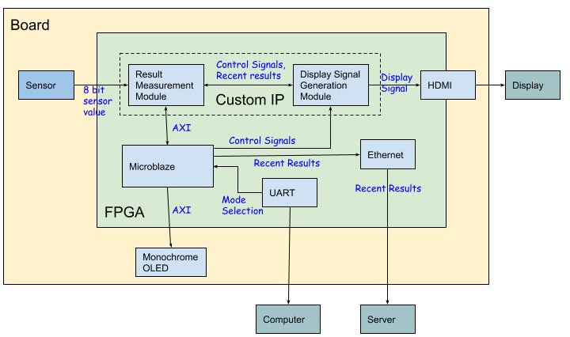
Project Structure: Final
Notes:
Thank Steven.
Here is our design diagram. This is the original one, and this is the final version.
The change is that we removed switches to select test mode and use UART to control the mode selection since there is some issue with my switches and buttons on our physical board.
The remaining parts are successfully implemented. There are two main components in our design diagram.

Slide 5
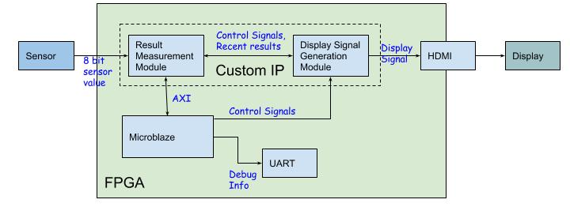
Project Structure
Control system
Notes:
The first component is control system.

Slide 6
Project Structure
Control system
Software Control
Hardware Top FSM
Result Measurement Control
Display Generation Control
PMOD Interface Control
Data Process Control
Notes:
Contro system is a hierarchical structure. In software layer, it is responsible to control modules initialization and sensor driver and HDMI driver configuration. It also controls the start and stop of screen time test. In hardware layer, There is FSM as a top control. The second layer involves Result measurement control and Display Generation Control. Result measurement involves PMOD interface control and Data Process control as third layer.
Such a hierarchical structure is to make sure the critical path of testing is as short as possible. In this way the time can be measured more accurately.

Slide 7
Project Structure
Testing loop Datapath
Notes:
As shown in red circle, the second component is testing loop datapath. Let’s take a look into it.

Slide 8
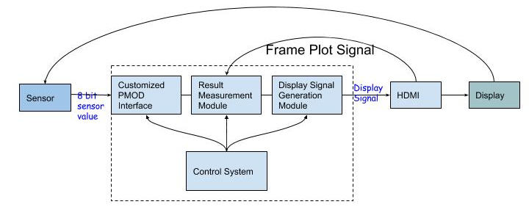
Project Structure
General Testing Loop Datapath
Color Pattern
Notes:
The general data flow is shown in such a datapath.
Firstly, after getting start signal from software, Control system sends plot enable and color pattern selection to Display generation module. At meantime, it talks to PMOD module to be ready to read lightness from screen and it talks to result measurement module to be ready to receive frame plot signal and lightness data from PMOD module.
Secondly, according to different color pattern mode, display generation module will read DDR to acquire desired frames and send frame to HDMI module. The HDMI module will start to plot frames on Monitor. At the same time, it will send plot enable signal to result measurement module. The signal marks the start time of the frame plotting.
Thirdly, After Monitor shows the frame then ambient light sensor will read it and send bitstream to customized PMOD interface. The interface between sensor and FPGA follows SPI protocol. According to the protocol, we designed the logic to receive its bitstream and forms 8 bit data.
Finally, result measurement module will process incoming data and figure out time results. It stores into memory-mapped register. Software can read the result through AXI interface. Besides, once getting lightness data, the result measurement module will tell display module to plot next frame. The purpose of not allowing display module to automatically send frame is to avoid the misalignment btw frame pattern and the lightness measurement.

Slide 9
Project Structure
Datapath Flow Chart
Initialization of all IPs
including mem, register values
Pixel Response mode?
Input Lag mode?
Calibration
Input lag test
Pixel Response Test
Result Stored
Notes:
Here is the whole datapath flow chart.
Firstly, initialize each driver, write necessary frames into memory. As well as control registers of all AXI IPs.
Secondly, take user input to choose which test mode. If pixel response time mode is chosen, in testing loop, calibration is performed to determine double threshold when transiting btw black and white. Then run pixel response test. If under input lag mode, input lag time can be performed directly. Finally, the results are stored and read by Software layer.

Slide 10
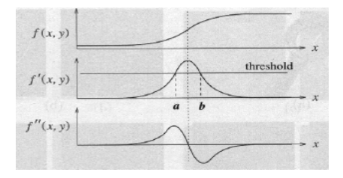
Major Problems and Solutions
For Pixel Response Time measurement, double thresholds are hard to set during initialization.
Solution: Edge Detection using double derivative
Notes:
A major problem we have is to get accurate pixel response time.
When dealing with measuring pixel response time, we need to determine how long did the black to white/white to black transition take. We need to be able to detect the start and the end of the transition. These threshold values are hard to set at initialization time. To solve this problem, we used a technique borrowed from image edge detection - double derivative. To find the raise time, we simple take the second derivative by using taylor series approximation and find the time difference between the two peaks.

Slide 11
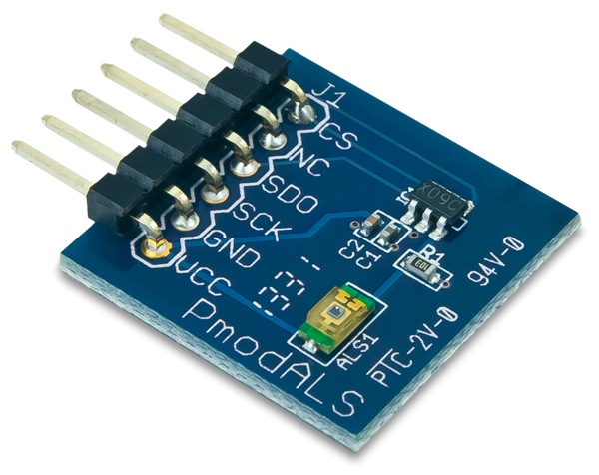

Major Problems and Solutions
Design compilation takes a long time
IP documentation are difficult to understand
Notes:
Additionally there are two more problems:
Design compilation takes a long time
This affect our ability to iterate quickly on our development.
On our home machine, design compilation can take up ward of 45 minutes, and on lab computer the process takes 1.5 hours
We tried our best to address this by construct each components separately hence reducing the total number of full project compilations
IP documentation are difficult to understand
Each unique IP requires specialized knowledge to use, using hardware to control complexed IP can especially be very complicated
We tried to tackle this issue mainly by looking at example designs and study how these IPs are used

Slide 12
Design Process
Hierarchical and parallel structure
Parts designed, implemented and tested independently
Easy to assign to team members
Merge parts and testing
Based on project requirements
Compared with monitor specification
Notes:
In terms of design process, We divided our design from top to bottom into many parallel portions, these parts can be worked on by our team in parallel. This way we assign each of our teammates a part and we can all talk about the design together, then implement and test it individually. After all the components are done, we merged our parts together and did system level testing. For each of our project requirement, we make sure that our overall design meets it. Because our design is a measurement tool, we compared our result with monitor manufacturer specifications.

Slide 13
Project Learned
System level block design
Working in group
Hardware development is hard
Notes:
Throughout this project, we design our the components from top to bottom. It is interesting to see that some of the implications are not recognized at the time we design the project and only during implementation phase, we begin to notice the hardware-hardware and software-hardware interaction limitation we put on. In the future, we will be more aware of the impact of any design decision, and careful research it’s potential effects.
We learned a valuable lesson on working in group. The project being a hardware project made it difficult for us to cooperate. Since FPGA is a limited resource, we resort to simulation and only use FPGA hardware when it is absolutely necessary.
Last but not least, hardware development is hard. There is too many factors involved, the EDA tool, the electrical components on the PCB, Third Party IP, if anything is broken/not understood the whole system cannot function. However, hardware development is also extremely rewarding, it gives you the ability to have unmatched performance and power efficiency. Thank you listening!

