Slide 1

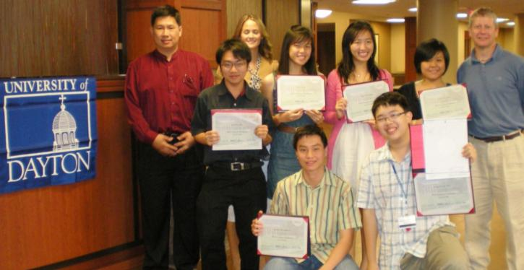
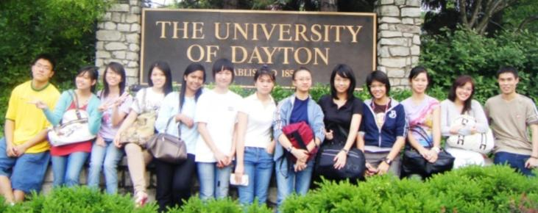
Business, Engineering, Science & Technology (BEST) Program
Tue, Jun 1 – Sun, Jun 13, 2010
• A unique 13-day 3-college credit program for students keen to
explore and experience U.S. undergraduate education on campus
• BEST participants must be:
a) ready to commence undergraduate studies in either August 2010,
January 2011 or August 2011;
b) between 16 and 18 years old in June 2010;
c) willing to consider non-Ivy League universities for their undergrad education
To register or for assistance, please email asiapacific@udayton.edu for details before Thu, Apr 15, 2010
Notes:
USD$30 fee for paper applications.

Slide 2
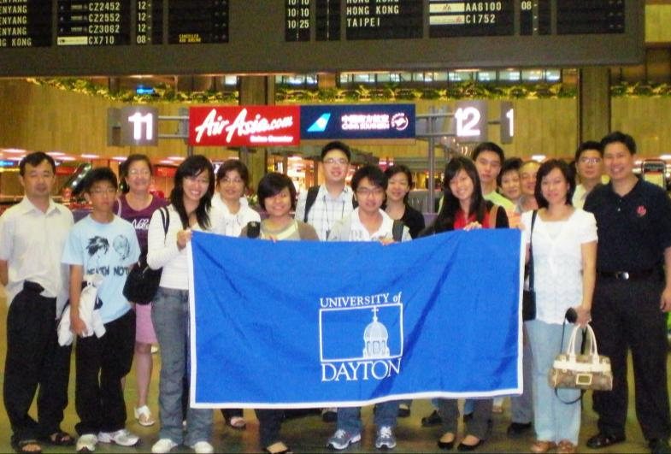
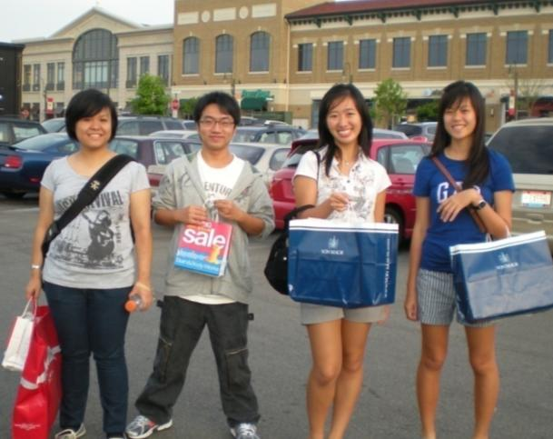
2010 BEST Program
June 1 (Tue) Depart Singapore; Arrive Dayton
June 2 - 4 Science module
June 5 - 6 Explore Dayton (shopping & baseball game)
June 7 - 9 Business module
June 9 - 11 Engineering module
June 12 Explore Dayton
  (cultural activities)
June 13 (Sun) Depart Dayton for GYLC, MED or Singapore

Slide 3
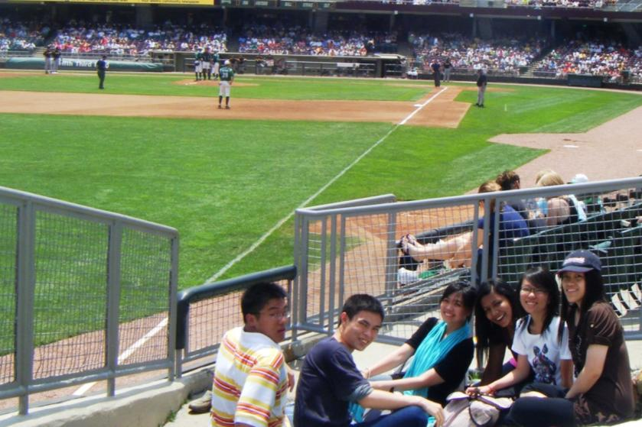
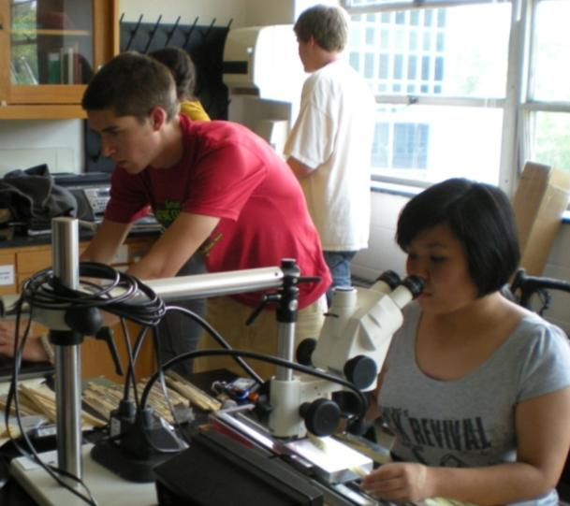
Participation Fee
The cost of this program is S$2,650 nett. This amount is all-inclusive and it covers:
A) The tuition for this 3-undergraduate credit program;
B) Twin-sharing accommodation in the university dorm;
C) Three meals per day;
D) Domestic transportation within Dayton;
E) All excursions and educational site visits conducted as part of the BEST program;
F) Return economy class air ticket (Singapore – Dayton – Singapore); and
G) Travel and medical insurance.
Students are only responsible for their personal spending money.
(US$100 for the frugal student to US$500 or more for the active shopper)

Slide 4

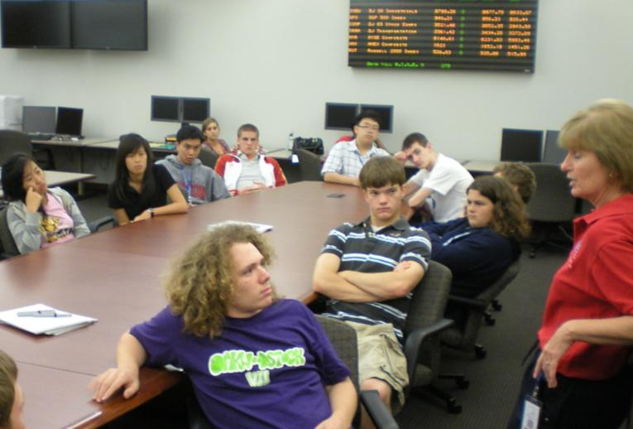
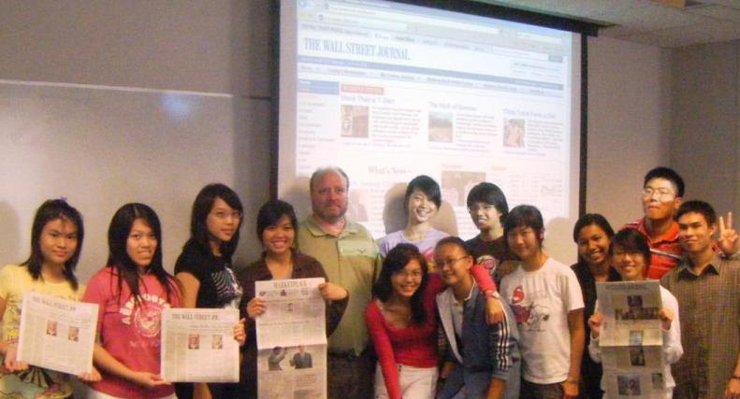
Business Module
In this introduction to business decision making, you will focus on marketing, operations and finance. By participating in a stock market simulation, you’ll be introduced to the sophisticated analytical tools used by business and investment professionals. Through case study discussion, you will consider the interactions among marketing, operations and finance.

Slide 5
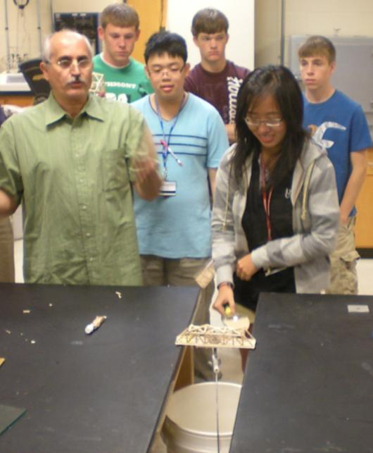

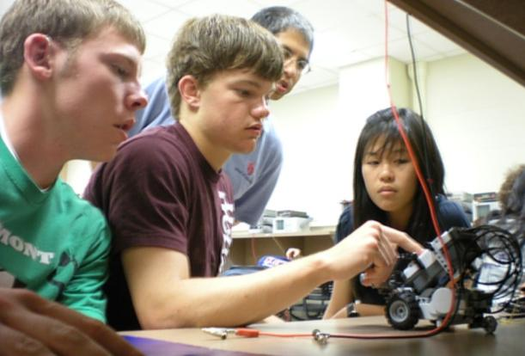
Engineering Module of BEST Program
COMPOSITE BRIDGE PROJECT
Students will be introduced to the subject of bridge design using composite materials and will be provided with the necessary background to conduct such a design. They will compute the stress in the bridge structural members, the load capability of the bridge and the weight of the bridge. Students will design a bridge to meet design goals specified in the course. They will then test the bridges to determine the degree of compliance with the design goals. The students will prepare a design report which documents their work.
ROBOTICS PROJECT
Students will be introduced to the process of solving an engineering problem using robotics. Students will be given an introduction to robotics and a short introduction to programming the robots. The students will then design a robot to meet the requirements of the design problem, test the robots to see how well the requirements are met, and document the results in a design report.

Slide 6

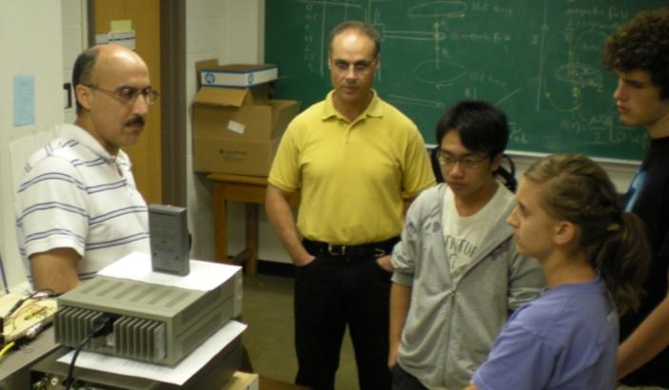
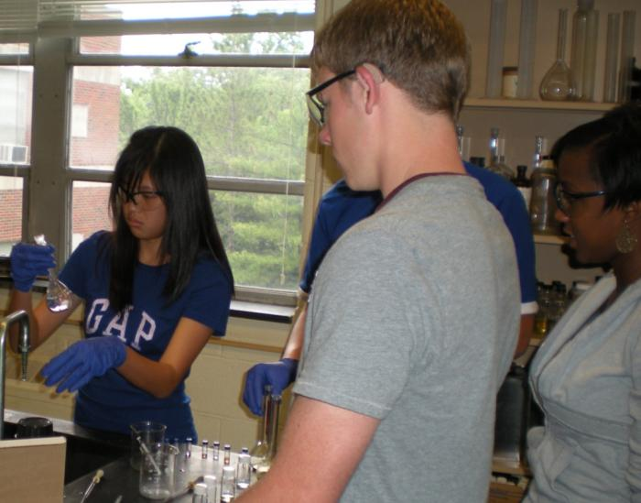
Science & Technology Module
Students work with UD faculty on at least one of the following projects:
Participate in semiconductor research for communication, recording, and solid state lighting
Utilize optical and gamma ray spectroscopy in physics research
Study mathematics modules in rates of growth, the PascGalois Triangle, and pebbling theory
Investigate the development of more reliable lithium batteries
Utilize the Drosophila (fruit fly) eye model to study retinal development and disease
Use Geographic Information Systems (GIS) to explore flood protection and climate change
Participate in an ongoing interdisciplinary wetland restoration project
Study the impact of invasive species on eastern deciduous forests in the U.S.
Investigate ancient geologic and modern environments in the American Midwest

Slide 7
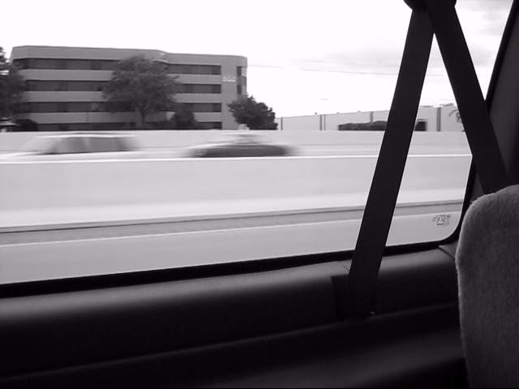
2008 UD BEST Program -
A Multimedia presentation done by the participants
TO VIEW, PLEASE SELECT “SLIDE SHOW” OPTION

