Slide 1
Systems Management with Matahari
Zane Bitter
Senior Software Engineer, Red Hat
FOSDEM 2012
http://matahariproject.org/

Slide 2
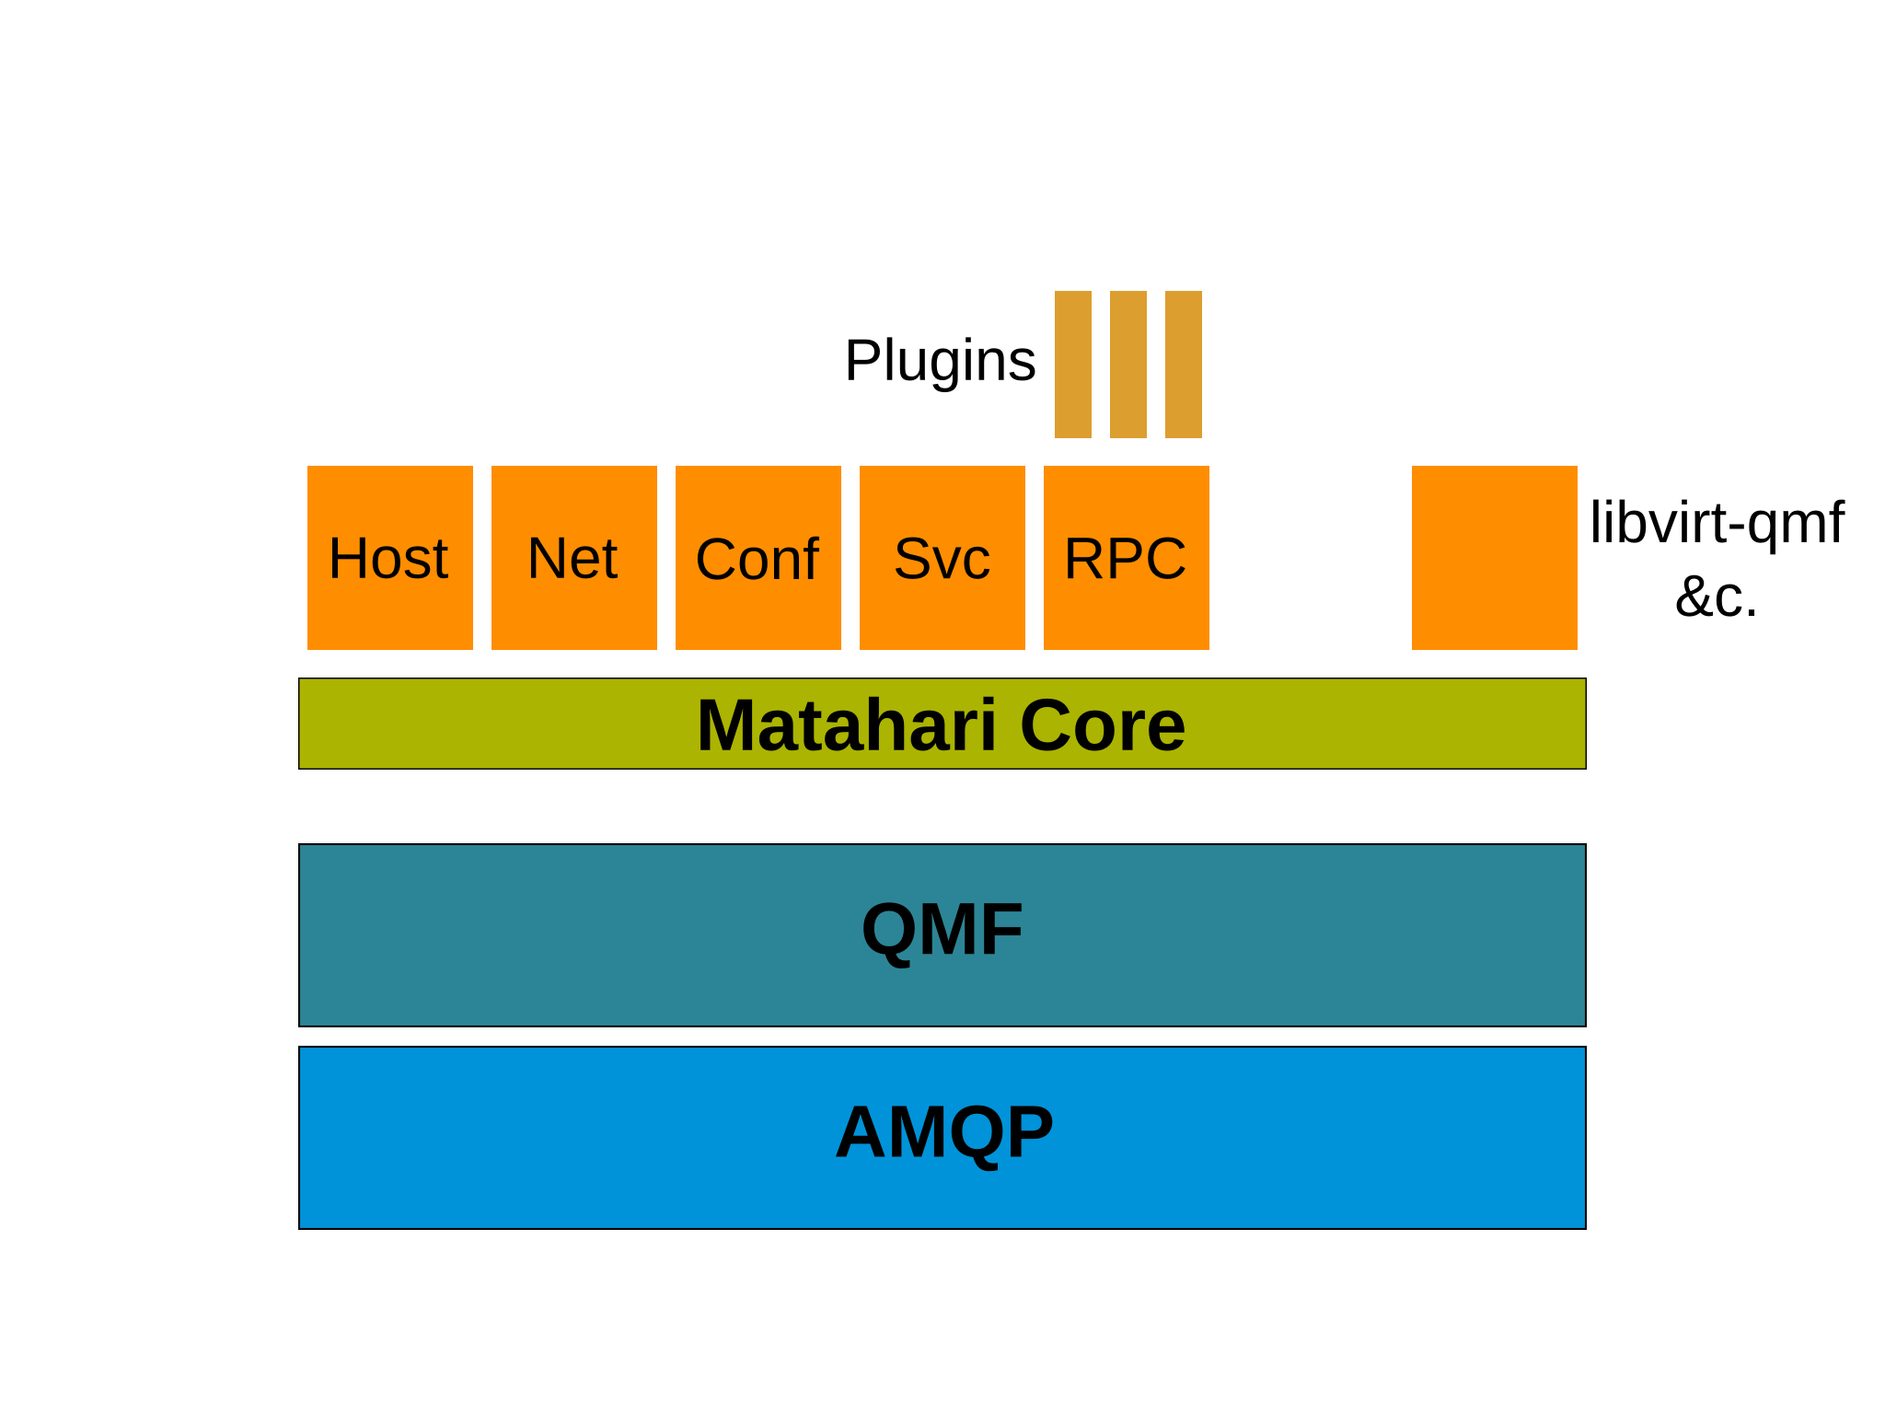
Architecture

Slide 3
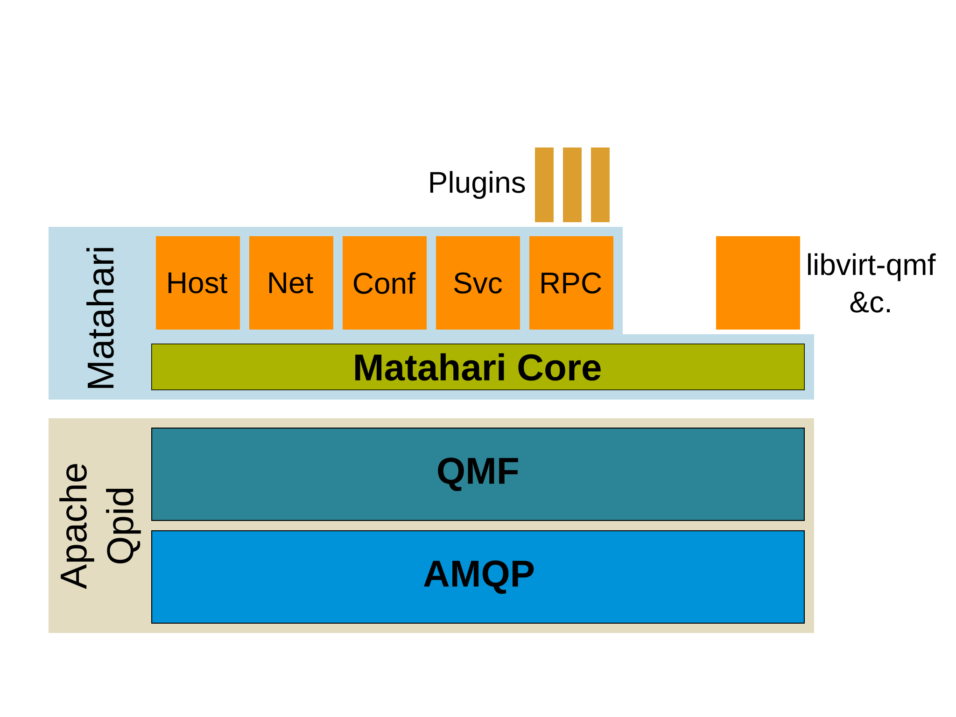
Architecture

Slide 4
Example RPC Plugin
import subprocess
def num_calls():
cl_args = ["asterisk",
"-rx",
"core show channels count"]
return subprocess.check_output(cl_args)
/usr/lib/matahari/plugins/asterisk.py

Slide 5
Example Agent Schema
<schema package="org.matahariproject.testagent">
<class name="TestClass">
<property name="hostname" type="sstr" access="RO" desc="Hostname" index="y" />
<method name="sum" desc="Sum of two numbers">
<arg name="x" dir="I" type="int32" />
<arg name="y" dir="I" type="int32" />
<arg name="result" dir="O" type="int32" />
</method>
</class>
</schema>

Slide 6
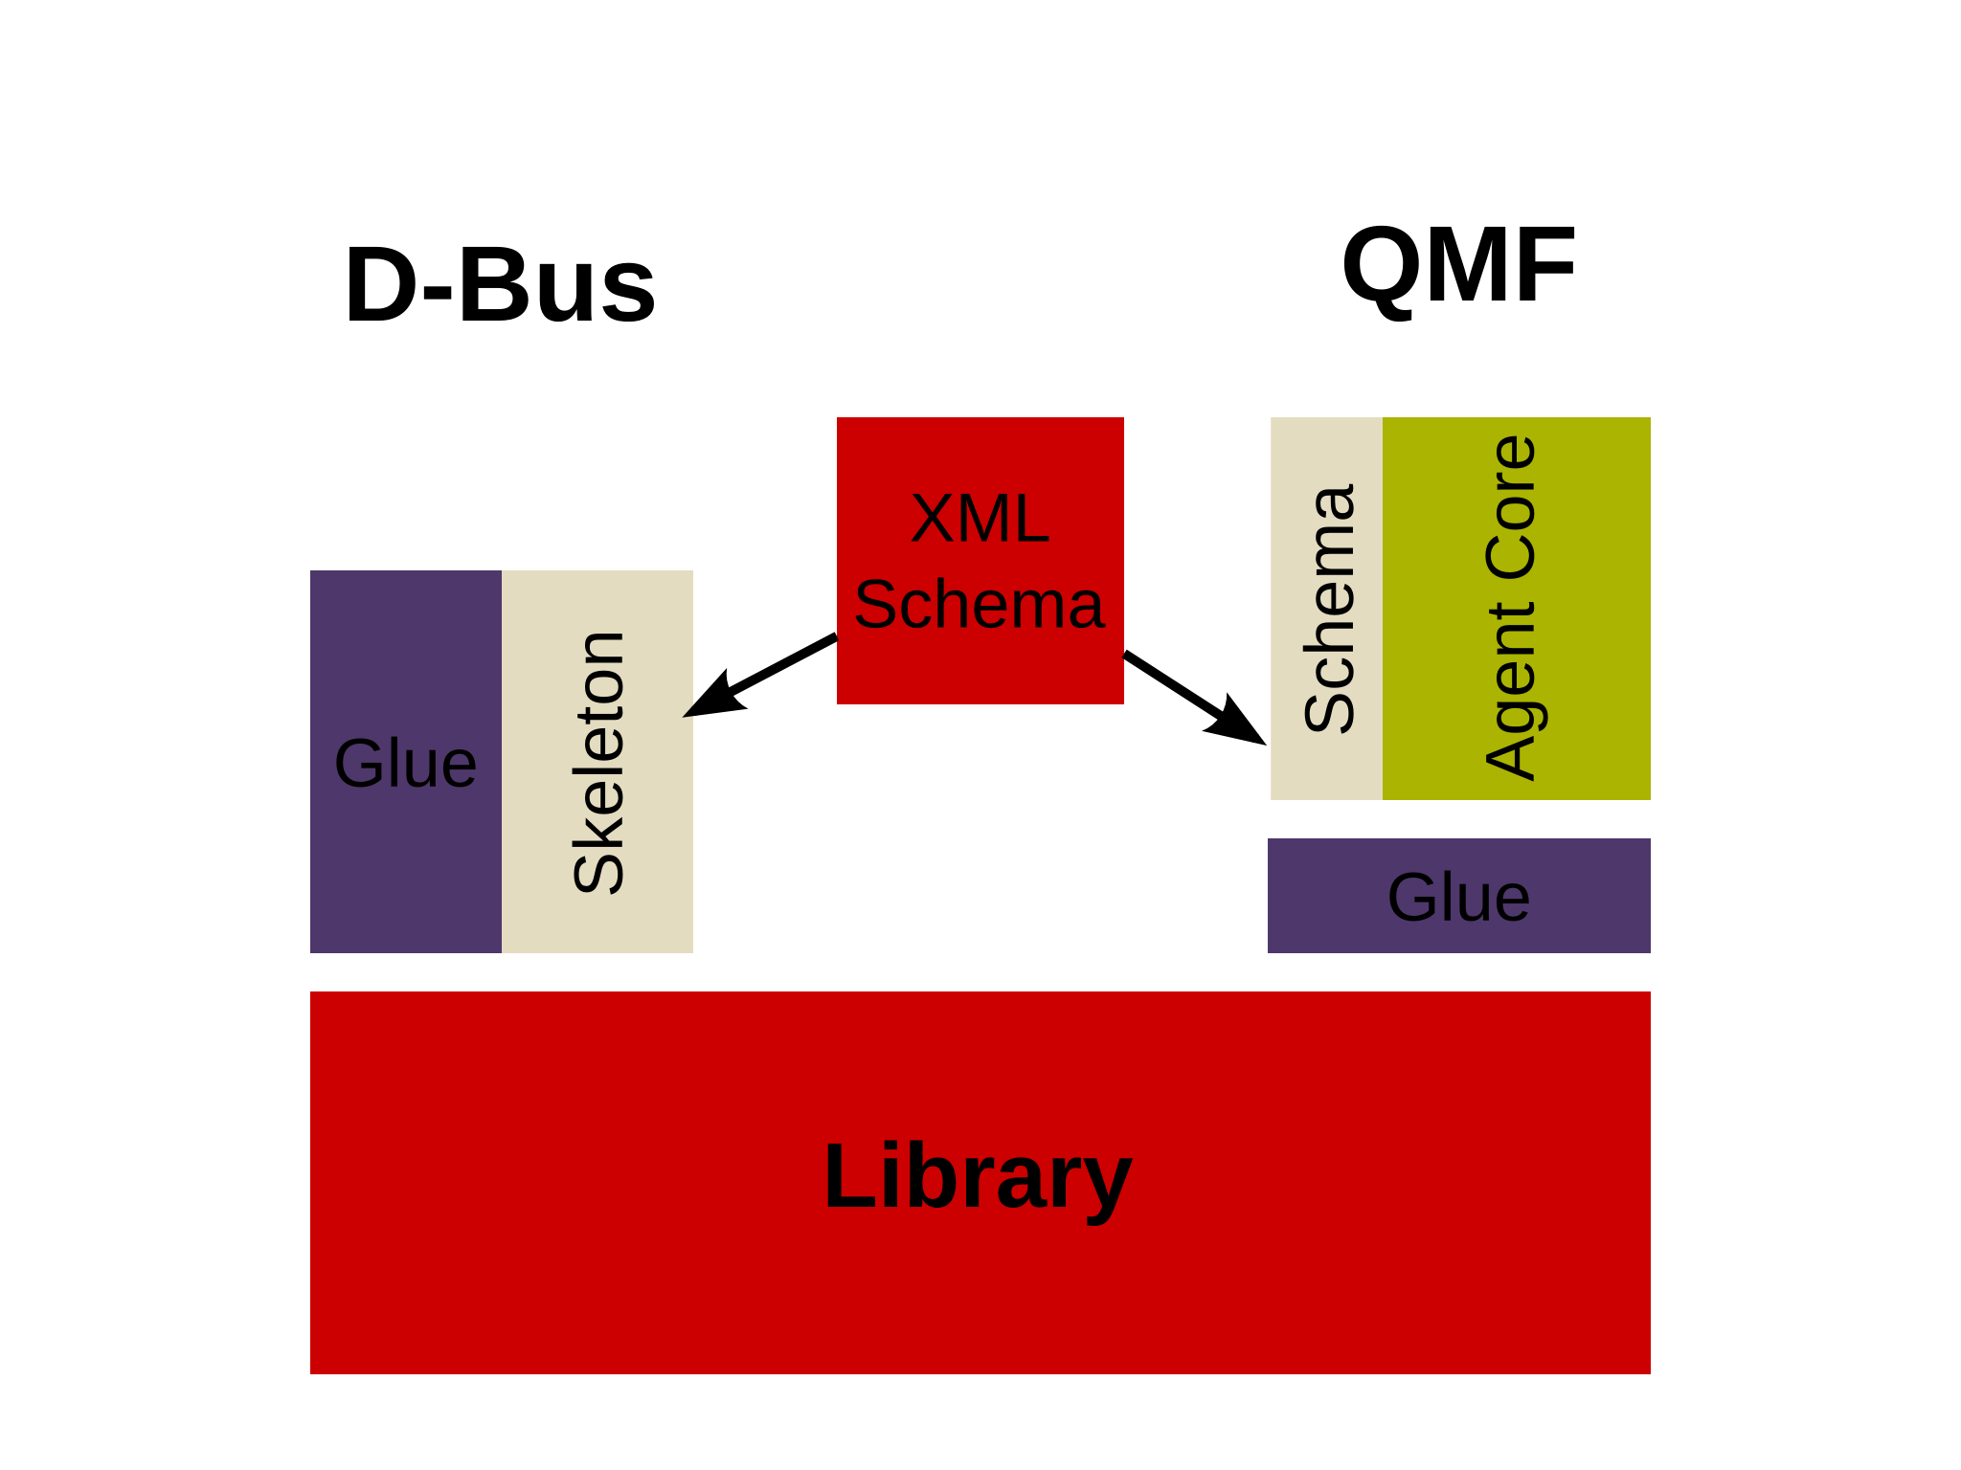
Anatomy of an Agent

Slide 7
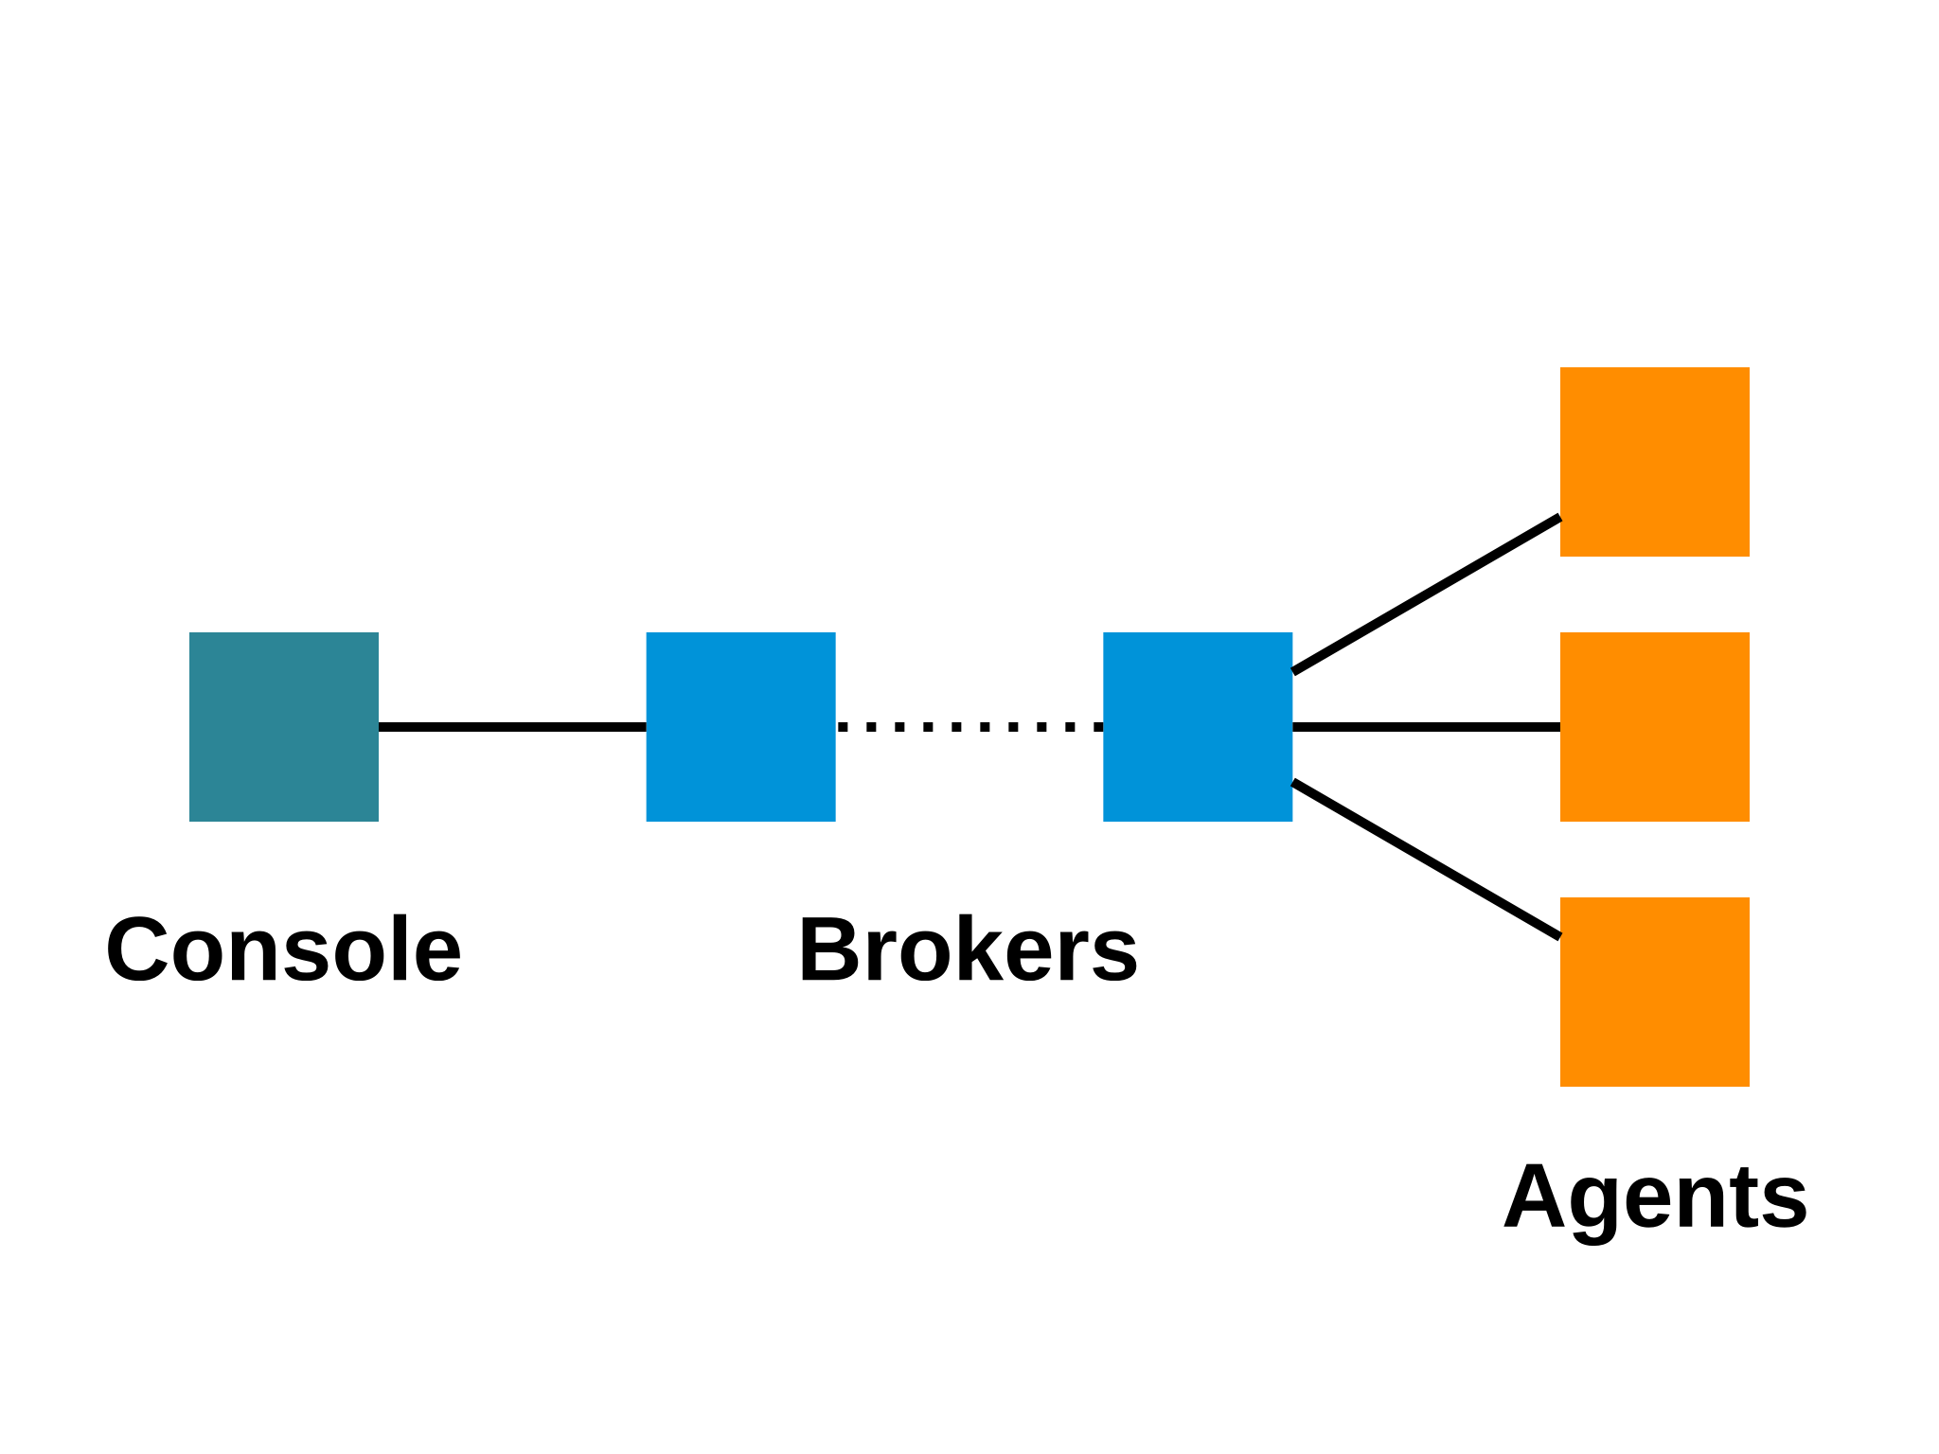
QMF Terminology

Slide 8
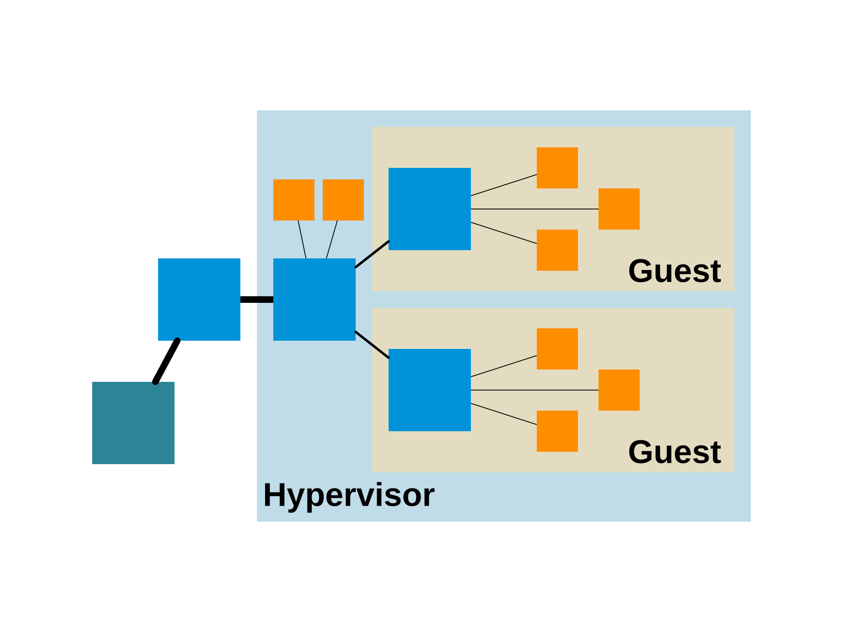
Topology

Slide 9
A Matahari Shell session
$ mhsh
mhsh> list hosts
ast1
ast2
mhsh> select class package org.matahariproject.rpc.plugin asterisk
mhsh [org.matahariproject.rpc.plugin:calls]> call num_calls
OK (0) – {u'result': '"0 active channels\\n0 active calls\\n0 calls processed\\n"'}
OK (0) – {u'result': '"0 active channels\\n0 active calls\\n0 calls processed\\n"'}
mhsh [org.matahariproject.rpc.plugin:calls]> select class Host
mhsh [org.matahariproject:Host]> select host ast1
mhsh (host)[org.matahariproject:Host]> get load
{u'1': 0.0, u'5': 0.01, u'15': 0.05}
mhsh (host)[org.matahariproject:Host]> quit
$

Slide 10
Questions?
Web: http://matahariproject.org/
IRC: #matahari on OFTC
Email: zaneb@fedoraproject.org
Twitter: @zerobanana

