Slide 1

OpenStack Orchestration with Heat
Zane Bitter
Senior Software Engineer, Red Hat
2013-10-24
zbitter@redhat.com
@zerobanana

Slide 2
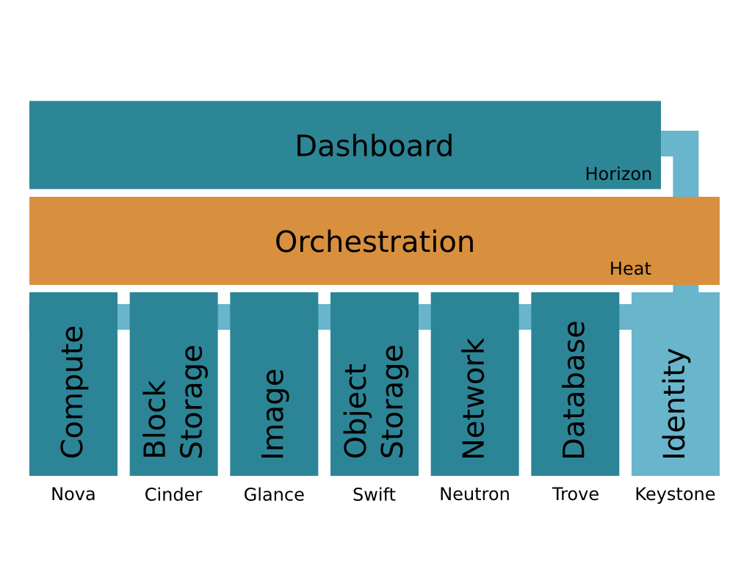
OpenStack Architecture

Slide 3
Template Example
Parameters:
ssh_key_name:
Type: String
Description: ssh keypair name
image_name:
Type: String
Description: The image to boot
Outputs:
server_ip:
Description: The server IP
Value: {"Fn::GetAtt":
["my_server",
"first_address"]}
Resources:
my_server:
Type: OS::Nova::Server
Properties:
flavor: m1.small
key_name: {"Ref": "ssh_key"}
block_device_mapping:
device_name: vda
volume_id: {"Ref": "my_vol"}
my_vol:
Type: OS::Cinder::Volume
Properties:
size: 20
image: {"Ref": "image_name"}

Slide 4
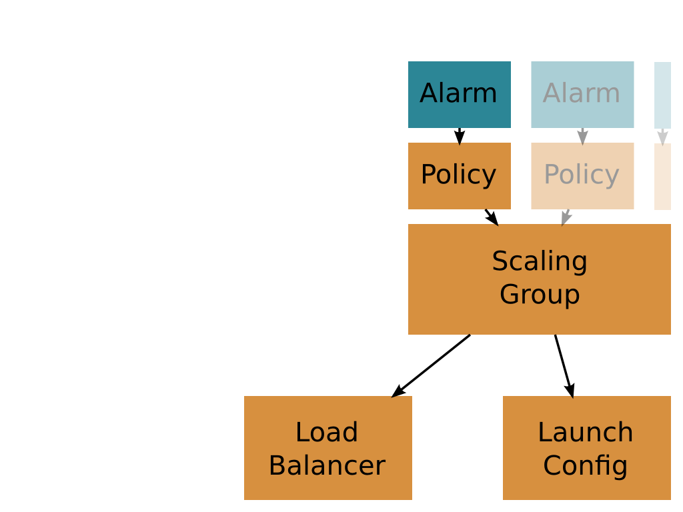
Autoscaling

Slide 5
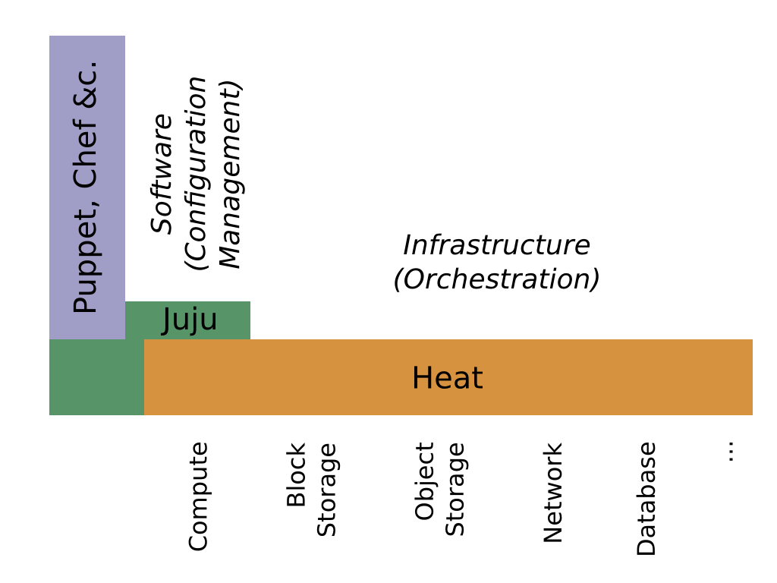
Orchestration and
Configuration Management

Slide 6
Questions?
zbitter@redhat.com
@zerobanana

