Slide 1
Heat – Orchestration for OpenStack
Overview, Template Concepts, Roadmap
Steven Hardy (shardy@redhat.com)
Zane Bitter (zbitter@redhat.com)
10th September 2013

Slide 2
Heat Overview
Orchestration for Openstack
Declarative, template defined deployment
Compatibility with AWS Cloudformation (Template/API)
Many Cloudformation-compatible resources
Developing Openstack native DSL and native resources
Resource plugin interface, fully customizable
Template-defined Resources (“Provider Resources”)
Notes:
KEY POINTS
Provides orchestration service for openstack
Integrates all openstack core projects
Converts either a JSON or YAML template into an openstack cloud application

Slide 3
Heat Overview
Horizon
Dashboard
Heat
Orchestration
Keystone
Identity
Service
Nova
Compute
Node
Glance
Image
Service
Swift
Object
Store
Neutron
Networking
Cinder
Volume
Service
Provides AWS Cloudformation and native ReST API
Abstract configuration of services to single-template
Templates may be nested
Notes:
KEY POINTS
Heat provides a way of defining all your openstack resources / services from a single template
Ties together the underlying IAAS services, so you can provide a consolidated infrastructure service, single integration point
Compatible with AWS Cloudformation (templates and API)
Has Autoscaling and HA features
Recently became an incubated project

Slide 4
Heat Overview
User Portal (Horizon)
Stack/Resource
Templates
Orchestration (Heat)
REST
REST
REST
REST
REST
REST
REST
Compute
(Nova)
Identity
(Keystone)
REST
Network
(Neutron)
Glance
(Image Store)
Instance
- cloud-init
- cfn-init
- cfn-hup
-cfn-push-stats
Block Storage
(Cinder)
Object Storage
(Swift)
Metrics/Alarms
(Ceilometer)
Notes:
KEY POINTS

Slide 5
Template Overview
Currently aligned with Cloudformation template format
Work in-progress to add a new superset native DSL
Template specifies:
  Input Parameters (optional)
  Key/Value Mappings (optional)
  Resource definitions (mandatory)
  Outputs (optional)
Resource relationships (implicit and explicit) build dependency-graph
Imperative configuration is not well encapsulated (embedded scripts)
Notes:
KEY POINTS
Provides orchestration service for openstack
Integrates all openstack core projects
Converts either a JSON or YAML template into an openstack cloud application

Slide 6
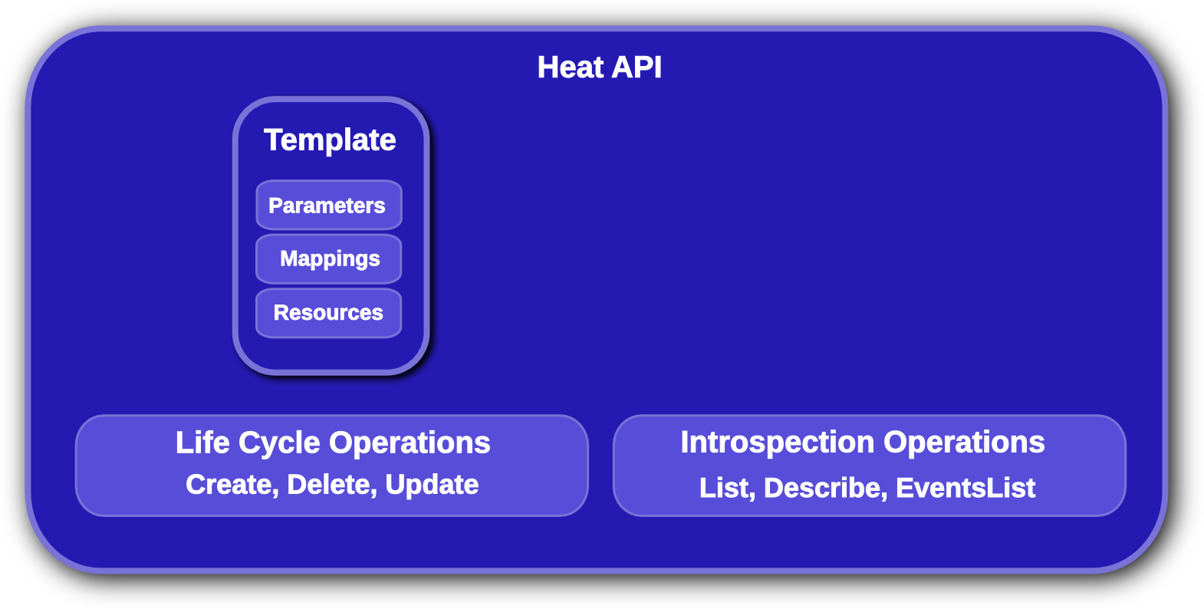
Template Overview
Templates can be nested, directly or via Provider Resources
Declarative template, can also include imperative sections
Can be combined with other tools, e.g chef/puppet
Notes:
KEY POINTS
Lifecycle operations
Create creates a stack from a template
Delete deletes an existing instantiated stack
Update updates an existing instantiated stack
Introspection operations
List obtains a list of existing stacks
Describe obtains details of existing stacks
Events List obtains events that have occurred for a stack
List resources lists resources associated with a stack
Template describes a stack

Slide 7
Heat Stack Example
App Portal
Network definition
(EIP, VPC, Quantum,
SecurityGroups)
Load Balancer
DB
Block Storage
LaunchConfig
AutoScaling
InstanceGroup
HA
Object Storage
Notes:
KEY POINTS

Slide 8
Heat Resource Types
AWS::AutoScaling::AutoScalingGroup
AWS::AutoScaling::LaunchConfiguration
AWS::AutoScaling::ScalingPolicy
AWS::CloudFormation::Stack
AWS::CloudFormation::WaitCondition
AWS::CloudFormation::WaitConditionHandle
AWS::EC2::EIP
AWS::EC2::EIPAssociation
AWS::EC2::Instance
AWS::EC2::InternetGateway
AWS::EC2::NetworkInterface
AWS::EC2::RouteTable
AWS::EC2::SecurityGroup
AWS::EC2::Subnet
AWS::EC2::SubnetRouteTableAssocation
AWS::EC2::Volume
AWS::EC2::VolumeAttachment
AWS::EC2::VPC
AWS::EC2::VPCGatewayAttachment
AWS::ElasticLoadBalancing::LoadBalancer
AWS::IAM::AccessKey
AWS::IAM::User
AWS::RDS::DBInstance
AWS::S3::Bucket
OS::Ceilometer::Alarm
OS::Cinder::Volume
OS::Cinder::VolumeAttachment
OS::Heat::AccessPolicy
OS::Heat::CWLiteAlarm
OS::Heat::HARestarter
OS::Heat::InstanceGroup
OS::Neutron::Firewall
OS::Neutron::FirewallPolicy
OS::Neutron::FirewallRule
OS::Neutron::FloatingIP
OS::Neutron::FloatingIPAssociation
OS::Neutron::HealthMonitor
OS::Neutron::IKEPolicy
OS::Neutron::IPsecPolicy
OS::Neutron::IPsecSiteConnection
OS::Neutron::LoadBalancer
OS::Neutron::Net
OS::Neutron::Pool
OS::Neutron::Port
OS::Neutron::Router
OS::Neutron::RouterGateway
OS::Neutron::RouterInterface
OS::Neutron::Subnet
OS::Neutron::VPNService
OS::Nova::Server
OS::Swift::Container
Notes:
KEY POINTS
Heat implements most functionality
Heat upstream has more work to do on network functionality

Slide 9
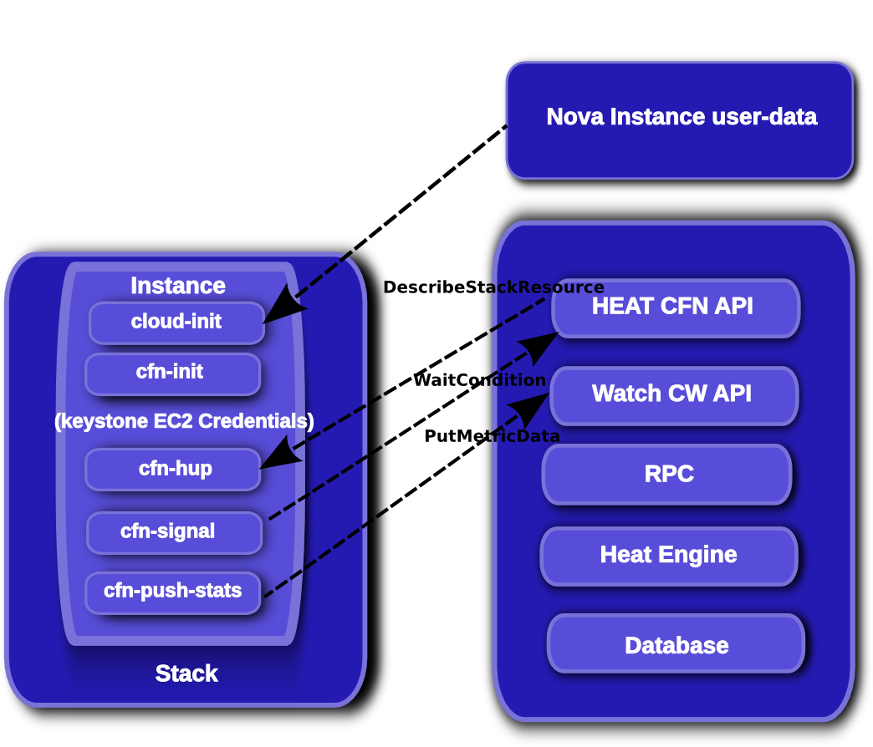
Software Configuration
Notes:
KEY POINTS

Slide 10
Software Configuration
Data passed to instance via nova user-data
Cloud-init tool used to bootstrap customization
Cfn-init compatibility tool does most of the work atm
Mixed declarative/imperative definitions in template
Work in progress:
  Option to use only cloud-init
  Better encapsulation of imperative definitions
  Closer integration with existing config-management tools (Chef/Puppet/...)
Notes:
KEY POINTS
Heat implements most functionality
Heat upstream has more work to do on network functionality

Slide 11
Providers/Environments
Template defined “provider” resources
  Provides flexibility and control for user
Environments allows easy control of resource-profile
Easier management of staging workflow or layered deployments
Enables users to override built-in resource implementations as needed
Notes:
KEY POINTS
Heat implements most functionality
Heat upstream has more work to do on network functionality

Slide 12
Image Building
Heat can use any image stored in Glance
  No specific dependency on image building tools
Images need cloud-init and heat-cfntools
  Previously we used oz
  Moving towards diskimage-builder
Notes:
KEY POINTS
Heat implements most functionality
Heat upstream has more work to do on network functionality

Slide 13
“HOT” Native DSL
Developing a native template language
  Remove dependence on Cloudformation format and abstractions (although we will still support CFN)
  Enable more complex application topologies to be defined
  Better support for software configuration
  Users want a vendor-neutral DSL and native resources
  Basic parser implementation landed for Havana (mostly cosmetic so far)
Notes:
KEY POINTS
Heat implements most functionality
Heat upstream has more work to do on network functionality

Slide 14
Icehouse Roadmap
Developing HOT DSL further
Native in-instance tools
Template-function plugins
Software configuration resources
More native resource types
Notes:
KEY POINTS
Heat implements most functionality
Heat upstream has more work to do on network functionality

Slide 15
In Closing
Flexible and rapidly evolving orchestration system
Version your infrastructure like code
Define custom resources
Single-template interface to all of openstack

Slide 16
Questions?

