Slide 1
Heat: Beyond the Basics
3 November 2014
OpenStack Summit, Paris
Zane Bitter (@zerobanana)
Steve Baker (@stevebake)

Slide 2
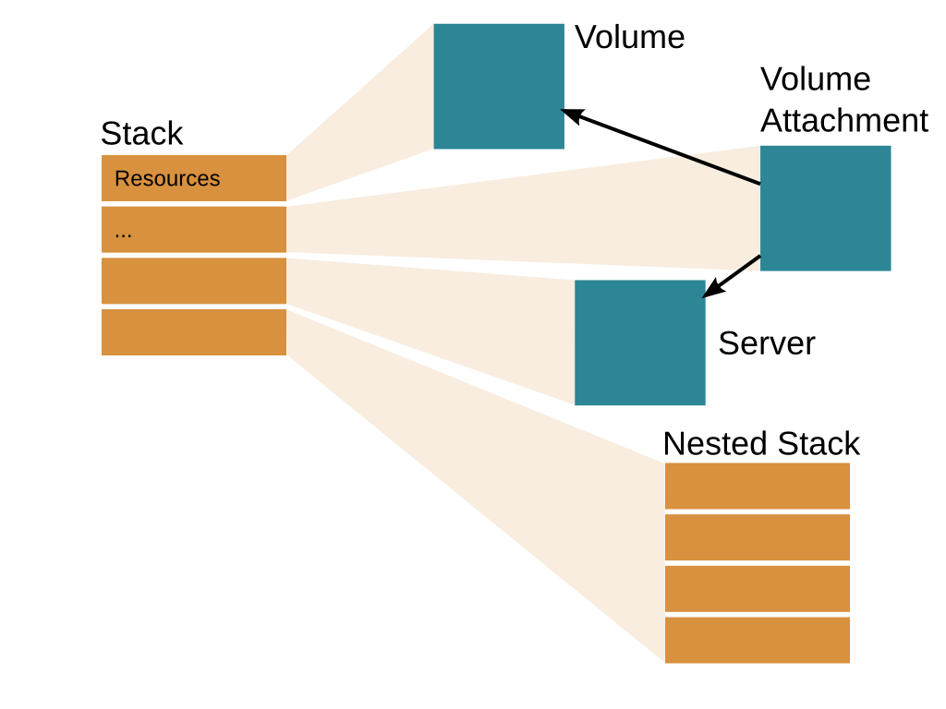
Stacks and Resources

Slide 3
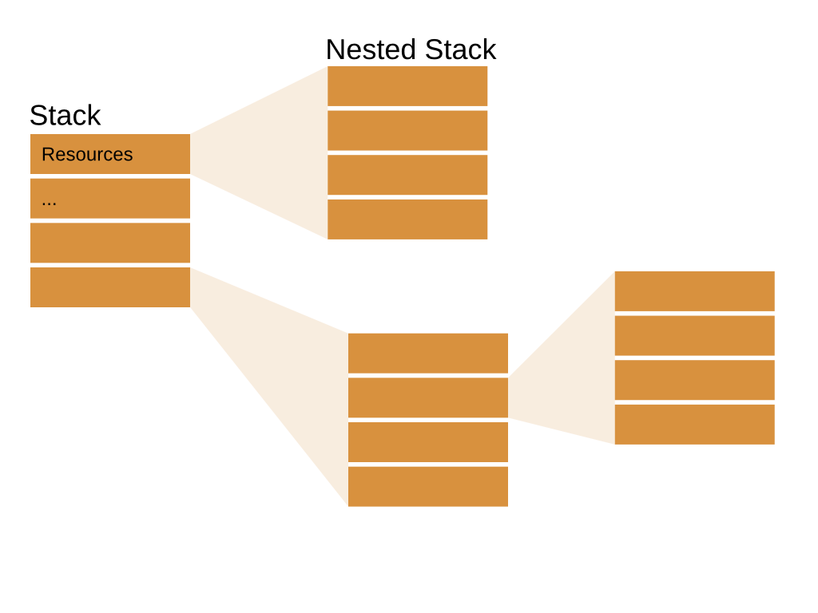
Nested Stacks

Slide 4
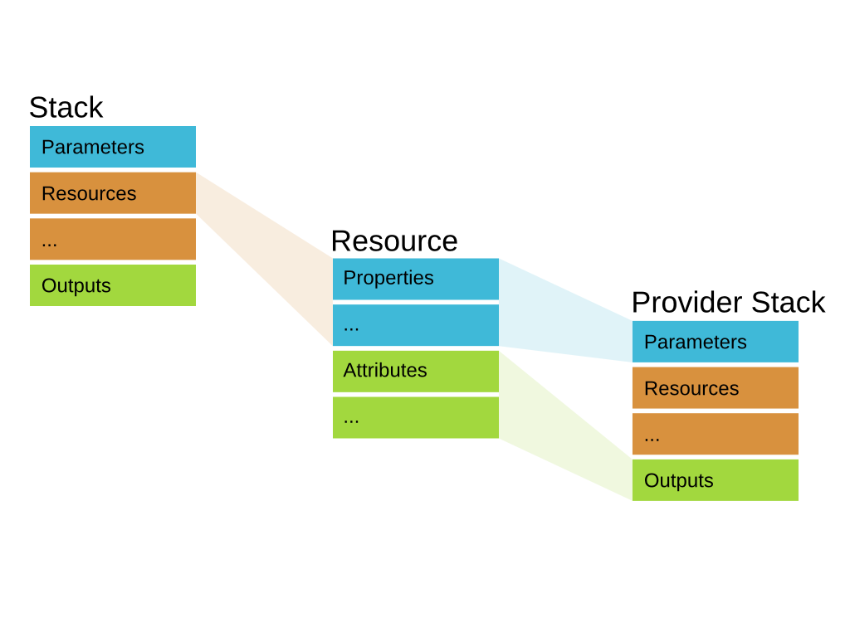
Template Resources

Slide 5
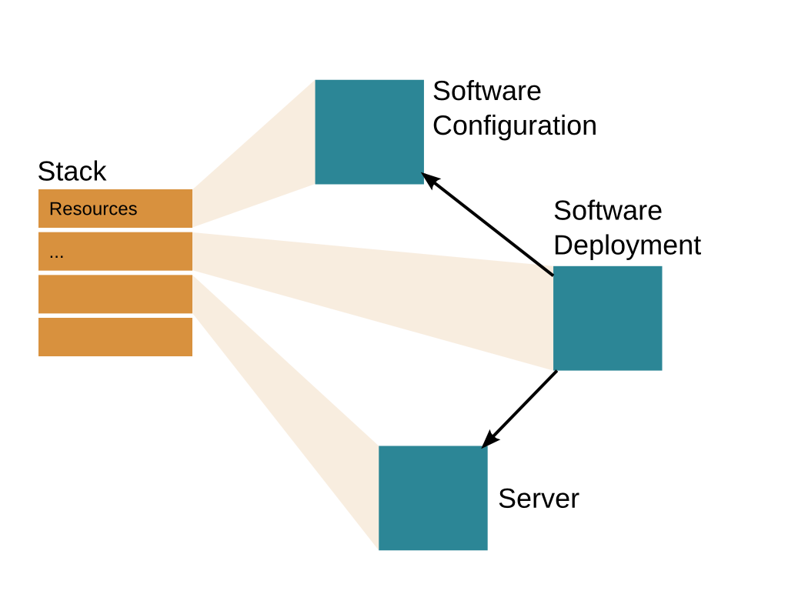
Software Deployments

Slide 6
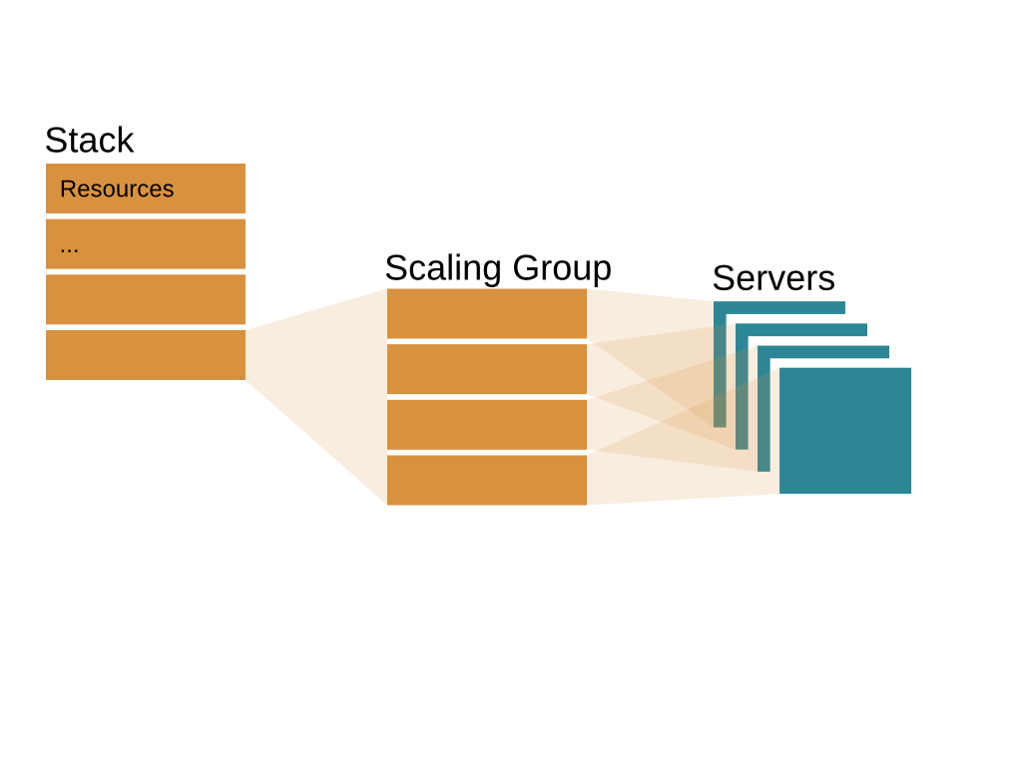
Scaling Groups

Slide 7
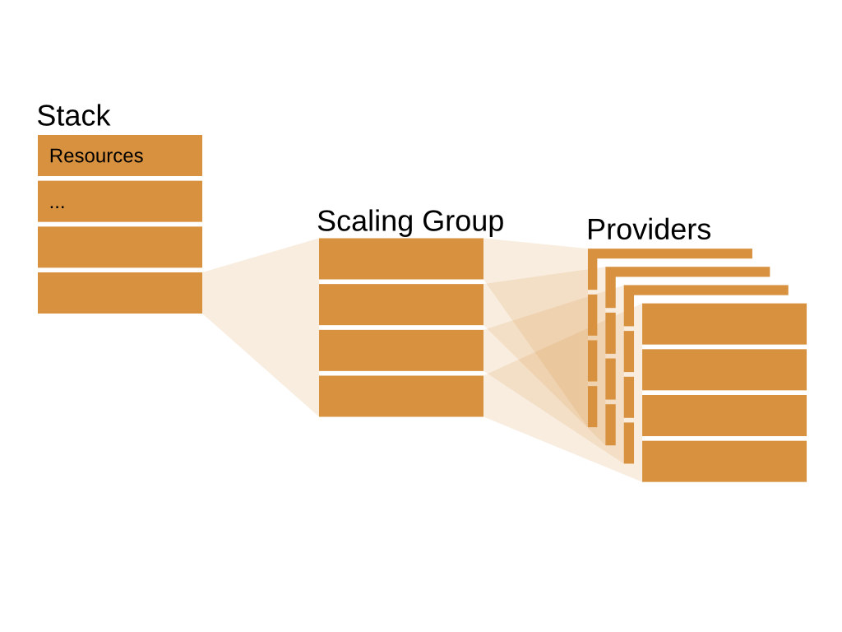
Scaling Groups

Slide 8
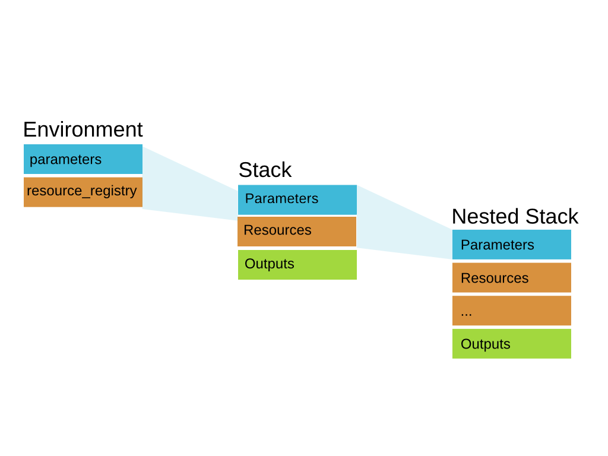
Template Resource Example

Slide 9
Template Resource Example
environment.yaml
parameters:
key_name: stack_key
image_id: cirros-0.3.3-x86_64-disk
volume_size: 1
instance_type: m1.nano
resource_registry:
My::Server::WithVolume: server_with_volume.yaml

Slide 10
Template Resource Example
stack.yaml
...
resources:
instance:
type: My::Server::WithVolume
properties:
key_name: {get_param: key_name}
image_id: {get_param: image_id}
volume_size: {get_param: volume_size}
instance_type: {get_param: instance_type}

Slide 11
Nested Stack Introspection
heat stack-list --show-nested
heat resource-list –-nested-depth 2 <stack name>
heat resource-show <stack name> <template resource>
heat resource-list <nested ID>

Slide 12
Software Deployment Example
server:
type: OS::Nova::Server
properties:
image: {get_param: image}
flavor: {get_param: flavor}
key_name: {get_param: key_name}
user_data_format: SOFTWARE_CONFIG

Slide 13
Software Deployment Example
config:
type: OS::Heat::SoftwareConfig
properties:
group: script
inputs:
- name: message
default: "No message"
config:
get_file: example-script.sh

Slide 14
Software Deployment Example
deployment:
type: OS::Heat::SoftwareDeployment
properties:
config:
get_resource: config
server:
get_resource: server
signal_transport: HEAT_SIGNAL
input_values:
message: "Hello Paris!"

Slide 15
Questions?
IRC (#heat) | Twitter
zaneb | @zerobanana
stevebaker | @stevebake

