Slide 1
Cortex Loss Runs
Relevant information extraction in Loss Run reports based on Natural Language Processing and Regular Grammar
A brief description of the core modules.
Assym Developers, Now Insurance. March 2021
Eric C., Ari L. Phill C., Eduardo S. Alberto de O. Romulo T. Raul V., Marvin H., Hugo G.

Slide 2
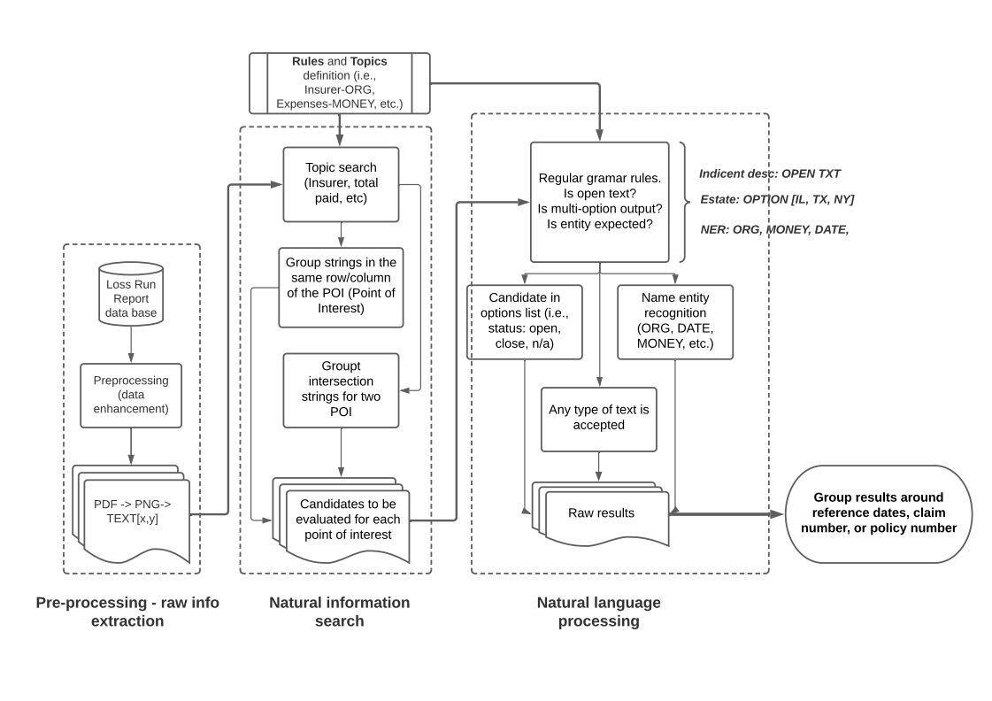
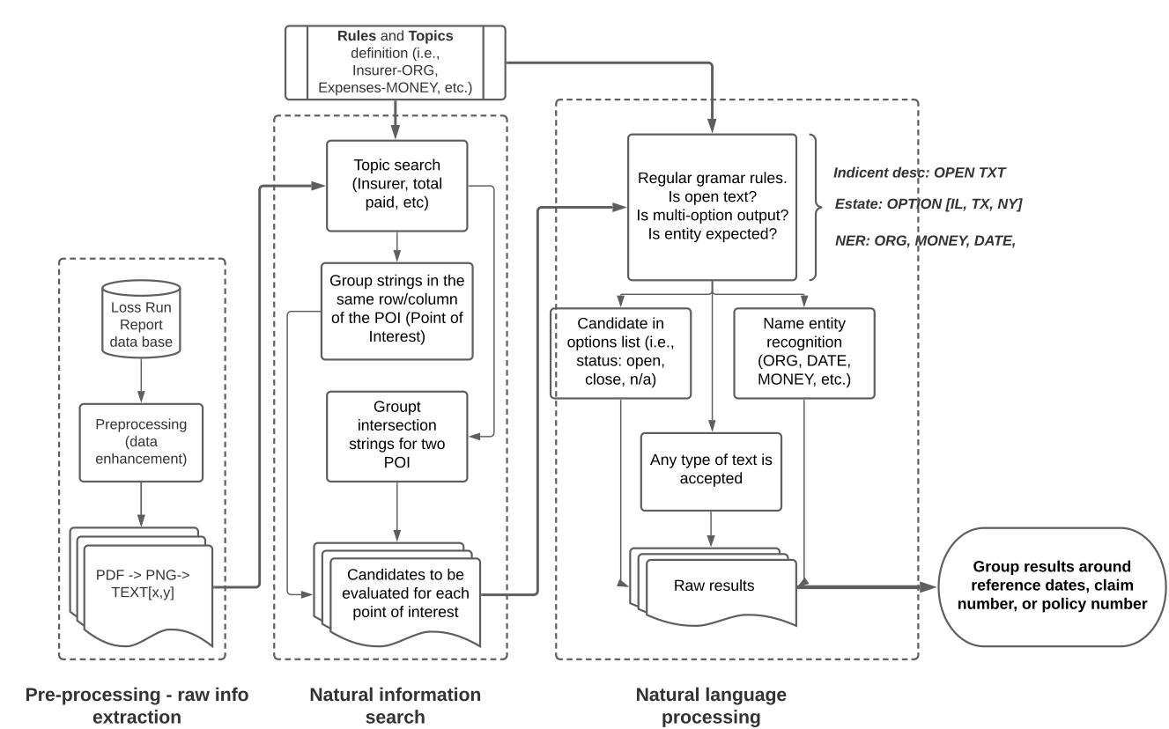
Approach overview

Slide 3
Optical Character Recognition
Optical Character Recognition (OCR) is a Machine Learning (ML) technique that extracts the text and its respective spatial distribution in a loss report.
The OCR is based on an English dictionary.
The results are stored in a list of words with x, and y coords.
OCR is an open source engine (Tesseract, apache 2.0 [1]).

Slide 4
Natural information search
At this stage of the algorithm, the aim is to filter the information in the reports through two processes [3]:
Mathematical analysis of the spatial distribution: associates the coherence of the spatial relationship between the points of interest and the rest of the words extracted by the OCR.
Search for the natural distribution of the text: complements the spatial relationship between words with the way the text is naturally associated in language (forward and downward).

Slide 5
Forward search, same row
Since each word (string) extracted by the OCR has four coordinates (beginning and end in x and y) it is possible to group the words that are in the same row. So the following should apply.
Get x1 and x2 coords for each entity.
Keep all the words which coords wx1, wx2 that fits with the same row (x1 < wx2 and x2 > wx1).
Limit the search range based on the size of the report.
Check if the obtained value match with the expected value (TOPIC, OPTIONAL, OPEN TEXT).

Slide 6
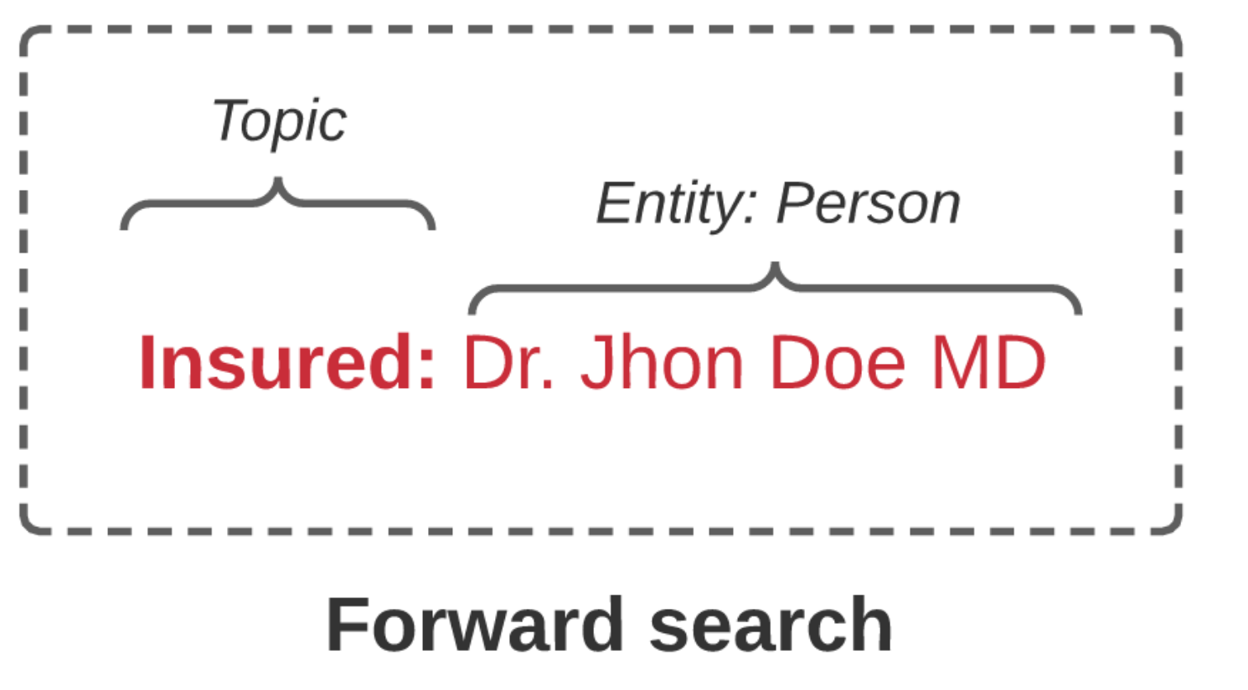
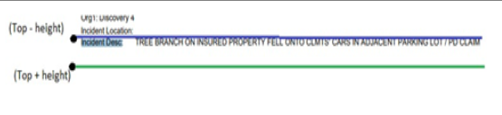

Slide 7
Search under, same column
Since each word (string) extracted by the OCR has four coordinates (beginning and end in x and y) it is possible to group the words that are in the same column. So the following should apply.
Get y1 and y2 coords for each entity if any match in forward search.
Keep all the words which coords wy1, wy2 that fits with the same column (y1 < wy2 and y2 > wx1).
Check if the obtained value match with the expected value (TOPIC, OPTIONAL, OPEN TEXT).

Slide 8
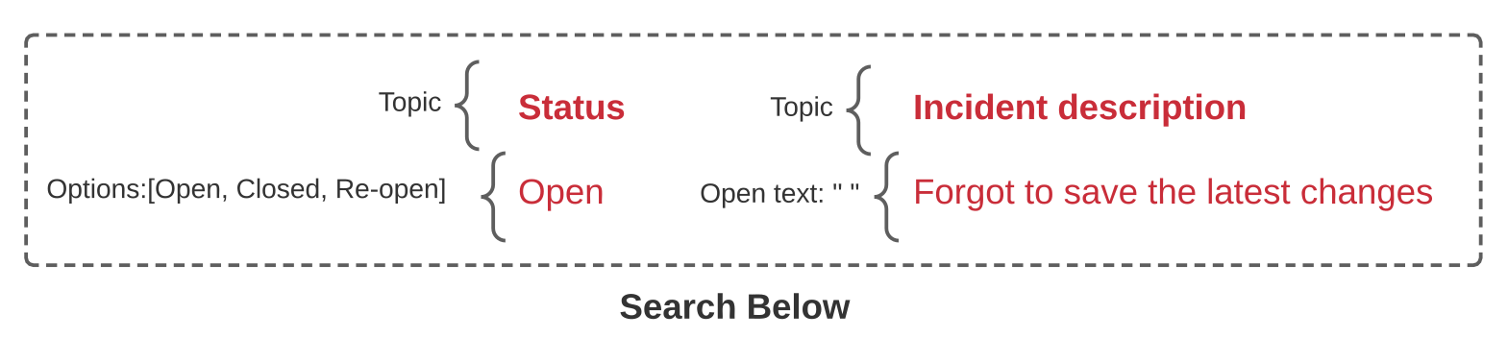
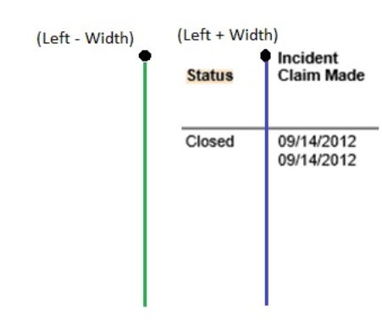

Slide 9
Intesection seacrch
The intersection search will be carried out in the event that the value to be found is composed of two entities [Total (entity) - Paid (entity)]. The steps to follow are:
Find the coordinates of the two entities.
Find the upper entity.
Then, elements in the same column.
Find the entity with the lowest height.
Then, elements in the same row
Get the value where both searches intersect (same row for Total, same column for Paid).
Verify that the value obtained is the expected one.

Slide 10
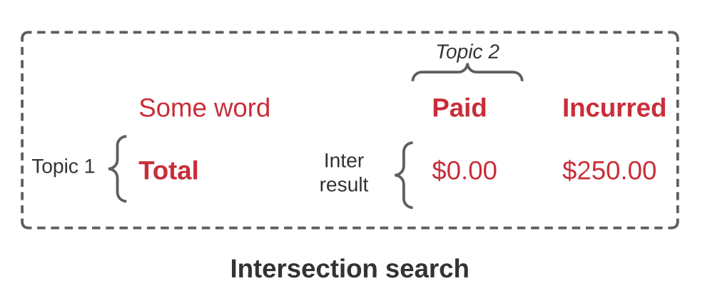
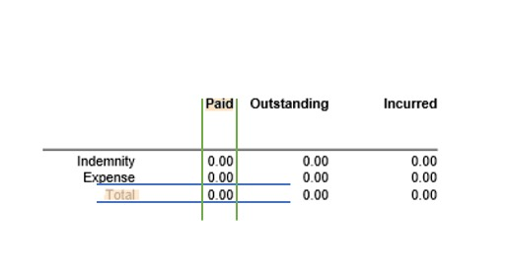

Slide 11
Natural Language processing
The Natural Language Processing is a sub-field of computational linguistics and machine learning that is applied in this case, to identify entities (DATES, ORGANIZATIONS, PERSONS, etc.) given a specialized linguistic context in the lexicon of Loss Run reports. For this module it is necessary to configure two sections:
Natural Language Model[2] whit the Name Entity Recognition module in the pipeline (English-Loss Run lexicon based).
Entities associated with each topic if applicable (INSURED [TOPIC] – ORGANIZATION[ENTITY].

Slide 12
References
[1] Smith, R. (2007, September). An overview of the Tesseract OCR engine. In Ninth international conference on document analysis and recognition (ICDAR 2007) (Vol. 2, pp. 629-633). IEEE. https://ieeexplore.ieee.org/abstract/document/4376991
[2] Srinivasa-Desikan, B. (2018). Natural Language Processing and Computational Linguistics: A practical guide to text analysis with Python, Gensim, spaCy, and Keras. Packt Publishing Ltd.
https://books.google.es/books
[3] Cortex-NLP, Assym Developers, Now Insurance (2021). Cortex NLP applied to relevant Information Extraction in Loss Run reports.
https://github.com/Asymm-Developers/cortex-npdb

