Slide 1
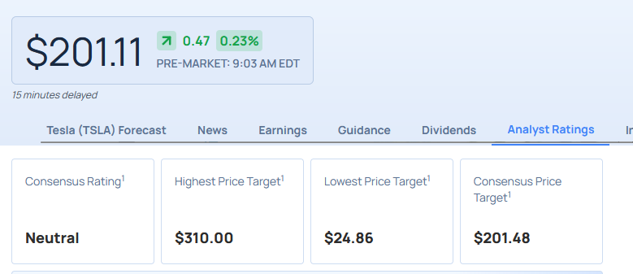
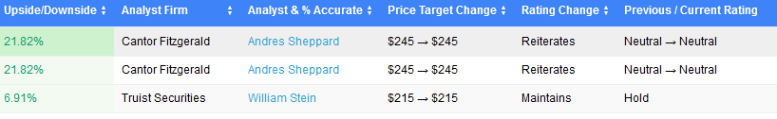
Aggregation of equity researchers’ buy, hold or sell forecasts
Equity researchers (expert judgement) at investment banks and research firms put out
Proposing to aggregate these as forecasts from experts to try and make a better prediction than simply taking the “consensus” (the average) as advertised by Bloomberg, CNBC, FT, Barrons, WSJ etc
Finding immediate success over the consensus when predicting the probability of the stock being
Stock price > +5% : buy
-5%<stock<+5%: hold,
Stock price < -5% :sell
Using all of the FTSE 100

Slide 2
Support from Literature
(Forecasting Stock Returns Through an Efficient Aggregation of Mutual Fund Holdings Werners 2012)
We develop a stock return–predictive measure based on an efficient aggregation of the portfolio holdings of all actively managed U.S. domestic equity mutual funds, and use this model to study the source of fund managers’ stock selection abilities. This “generalized inverse alpha” (GIA) approach reveals differences in the ability of managers to predict firms’ future earnings from fundamental research.
(Analyzing the Analysts: When Do Recommendations Add Value?, JEGADEESH 2004)
“In fact, among stocks with unfavorable quantitative characteristics, higher consensus recommendations are associated with worse subsequent returns. In contrast, we find that the quarterly change in consensus recommendations is a robust return predictor that appears to contain information orthogonal to a large range of other predictive variables”
(Changes in analysts’ stock recommendations following regulatory action against their brokerage Call et al 2019)
We find that after a sanction, analysts at sanctioned brokerages lower their stock recommendations, both in absolute terms and relative to the recommendations of other analysts following the same firms. These analysts are also more likely than analysts at other brokerages to downgrade a company’s stock after the receipt of unfavorable information about the firm.
(How Do Analyst Recommendations Respond to Major News? Conrad 2006)
We model the determinants of analysts’ recommendation changes following large stock price movements. We find evidence of an asymmetry following large positive and negative returns. Following large stock price increases, analysts are equally likely to upgrade or downgrade. Following large stock price declines, analysts are more likely to downgrade. This asymmetry exists after accounting for investment banking relationships and herding behavior. This result suggests recommendation changes are “sticky” in one direction, with analysts reluctant to downgrade. Moreover, this result implies that analysts’ optimistic bias may vary through time.
(Target Price Accuracy in Equity Research, Bonini et al 2010)
Our analysis shows that forecasting accuracy is very limited: prediction errors are consistent, auto-correlated, non-mean reverting and large (up to 36.6%). The size of forecasting errors increases with the predicted growth in the stock price, the size of the company and for loss making firms. Additionally, the intensity of research and the market momentum negatively affect accuracy. These results suggest that analysts’ research is systematically biased which supports theoretical predictions by Ottaviani and Sorensen (2006). Since stock price forecastingis largely an unmonitored activity, market participants may fail in fully understanding this behavior, thus not arbitraging away these inefficiencies.
(Do brokerage houses add value? The market impact of UK sell-side analyst recommendation changes Ryan 2004)
We find that UK analysts’ investment recommendations in practice appear less susceptible to potential conflicts of interest than their US counterparts. The ratio of new sell to buy recommendations is higher in the UK and a greater proportion of such recommendations are accompanied by same-sign earnings forecast revisions than their equivalents in the US. We find brokerage house investment banking relationships do not appear to impact (adversely) on abnormal returns
(Buys, holds, and sells: The distribution of investment banks’ stock ratings and the implications for the profitability of analysts’ recommendations: 2006 Barber)
Upgrades to buy (downgrades to hold or sell) issued by brokers with the smallest percentage of buy recommendations significantly outperformed (underperformed) those of brokers with the greatest percentage of buys.

Slide 3
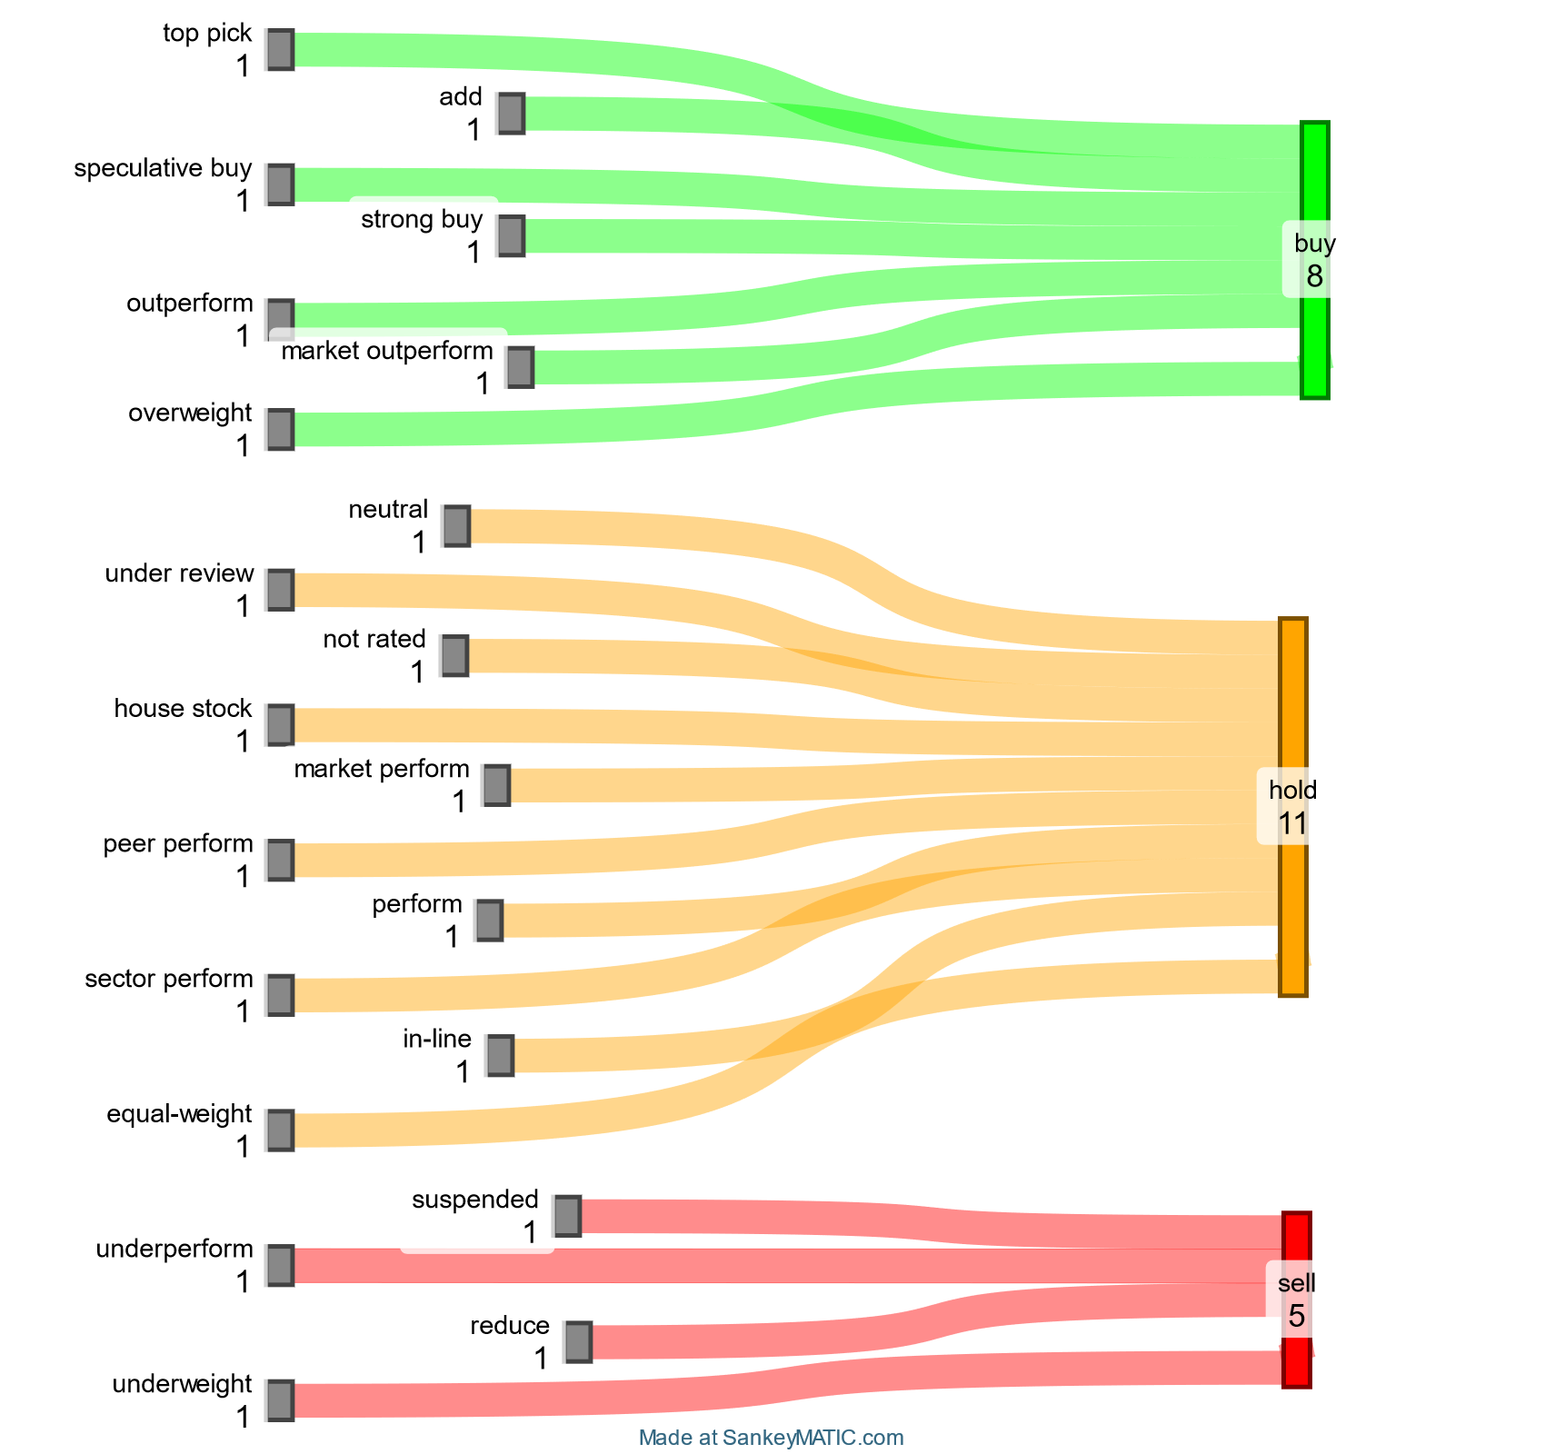

Slide 4
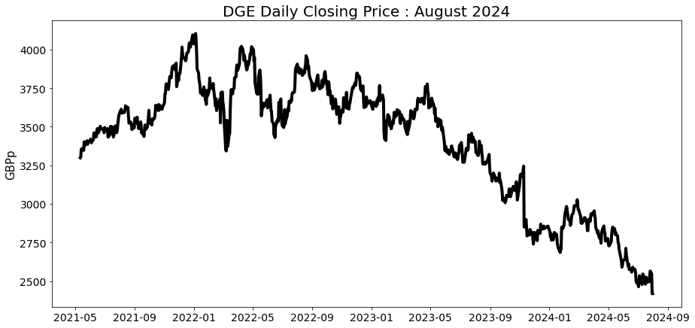
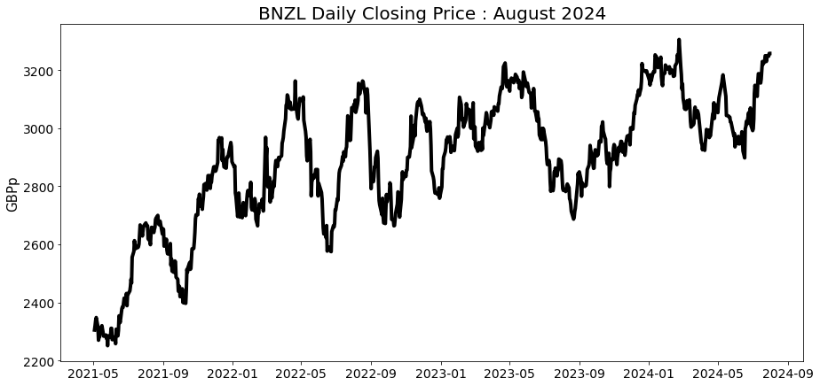
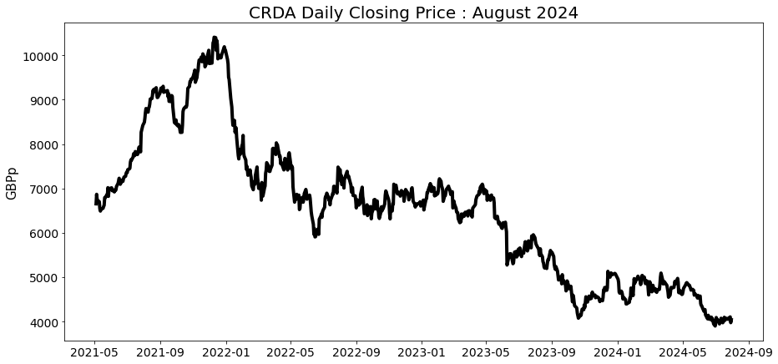
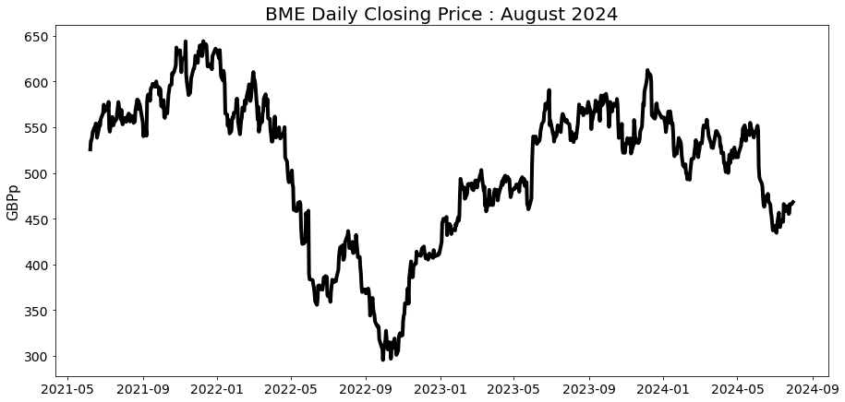

Slide 5
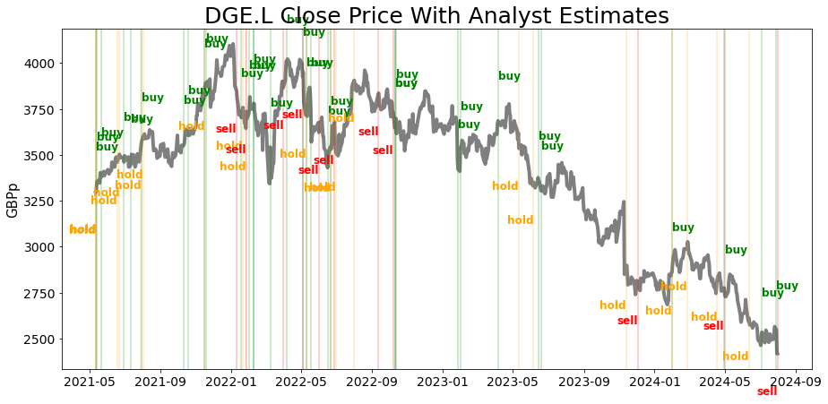
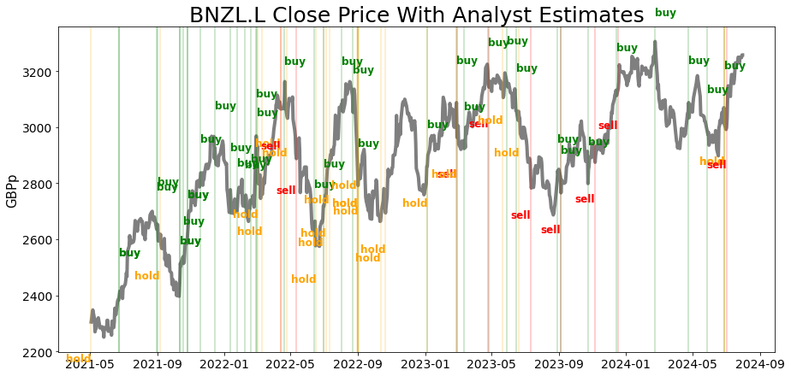
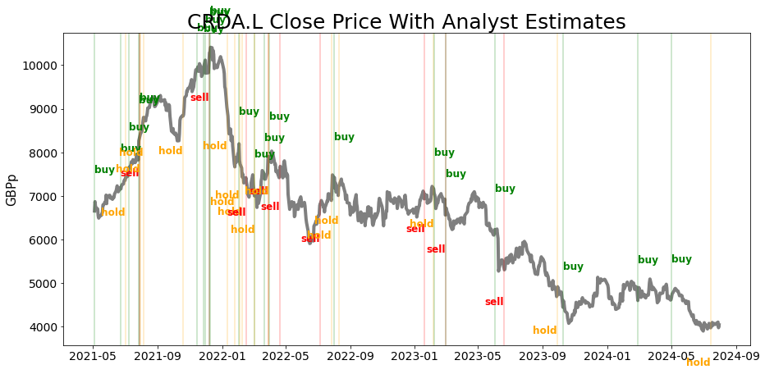
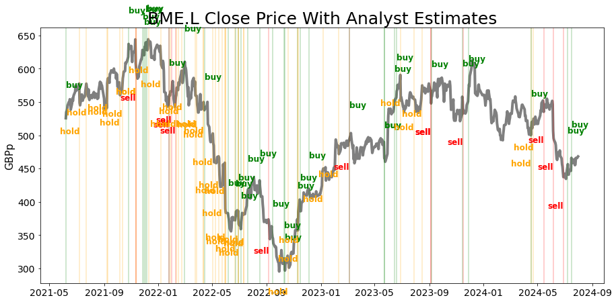

Slide 6
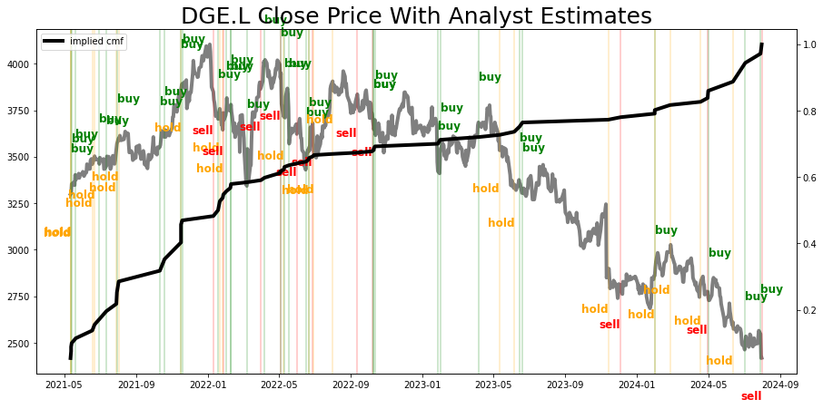
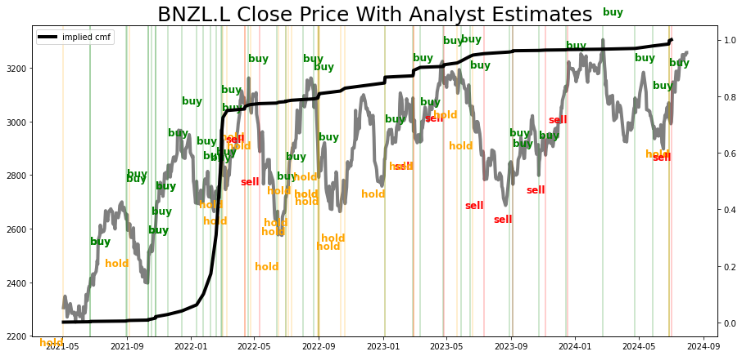
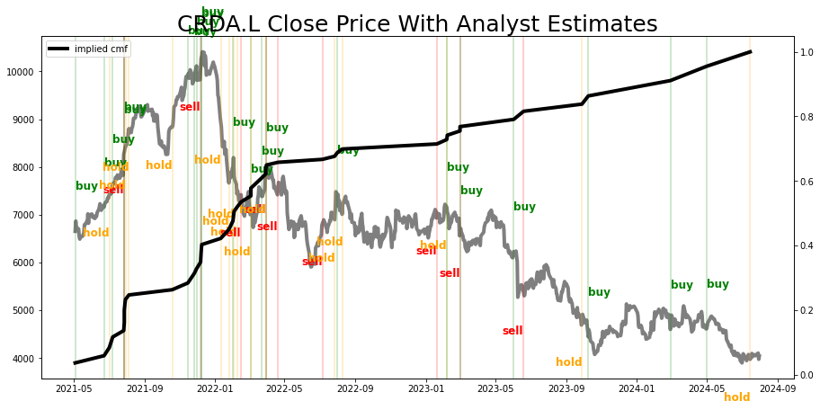
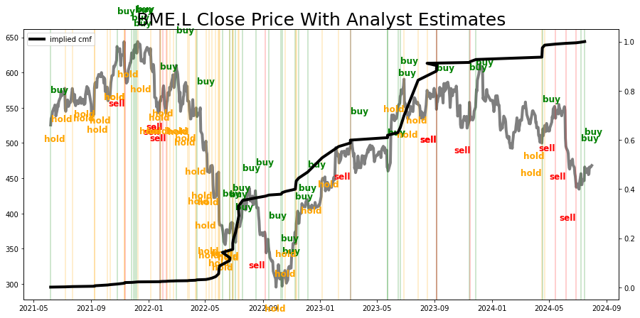

Slide 7
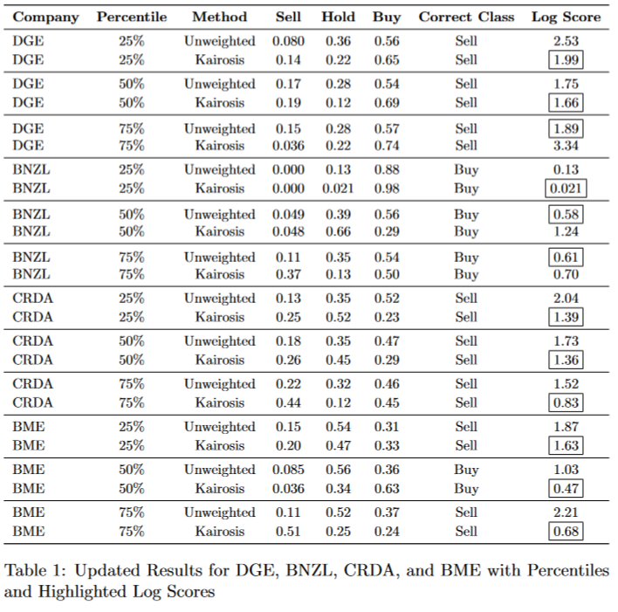
Diageo plc (DGE.L)
Bunzl plc (BNZL.L)
Croda International Plc (CRDA.L), B&M
European Value Retail S.A. (BME.L)

Slide 8
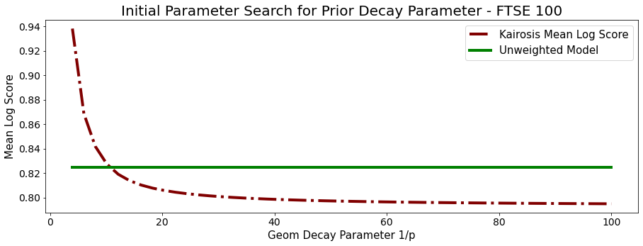

Slide 9
Further Thoughts
Better loss function?
More candidate weights
These are FTSE 100
There probably is correlation with Market Cap
I don’t want to get into portfolio management ideas
How do you parlay an old idea with a new one and write some short article about it
Bins from slide A can be more or less granular
Could be another idea after?

