Slide 1
1810.HK | Xiaomi Corporation
Executive Summary
Industry Overview | Two-sided Industry Reset: Cost Inflation and Value Migration Supply-side: AI infrastructure CapEx is tightening memory supply, with DRAM and NAND expected to reach 43% of the reference smartphone BoM by Q3 2026E, up from 13% in Q1 2025. DRAM is expected to remain constrained into 2027 as capacity prioritises HBM and server demand, while NAND supply could partially ease in 2H27. Demand-side: Weak shipment growth and component inflation are shifting competition from volume to value, forcing low-end portfolio rationalisation and higher ASPs, while increasing the importance of pricing power. Structural Supply-chain Reconfiguration Amid Geopolitical Fragmentation Expansions overseas are transferring from stage #1 volumn-based competition to stage #2 sustainable building Manufacturing diversification is evolving beyond assembly relocation towards local sourcing and regional operations with higher execution risks.
Company Overview | Global Smartphone Franchise with Established Market Leadership Xiaomi ranked No.3 globally with 11.5% shipment share in Q2 2026, ranking Top 3 in 53 markets and Top 5 in 67 markets. Over 640 overseas new retail stores support continued market penetration. smartphone ASP reached RMB1,351 in Q2 2026, while the segment gross margin remained under pressure at 8.5%. Four-layer Consumer Ecosystem with Distinct Strategic Roles Smartphones — Acquisition: The primary gateway to Xiaomi's 766.5mn global monthly active users. AIoT — Attachment: 1.16bn connected devices deepen ecosystem penetration and cross-selling opportunities. Internet Services — Monetisation: 76.8% Q2 gross margin and 32% of group gross profit provide a high-margin earnings pool. Smart EV — Extension: 104k Q2 deliveries expand consumer touchpoints and potential lifetime value, although profitability remains under development.
What We Like | Premiumisation Near-term defence: Higher launch prices and low-end portfolio optimisation help absorb memory inflation and protect unit economics. Long-term opportunity: Flagship innovation and premium mix expansion can lift pricing power and widen Xiaomi's addressable market, creating potential margin upside once component costs stabilise. Ecosystem Flywheel Hardware expansion: Smartphones acquire users, while AIoT and EVs increase device attachment, engagement and potential customer lifetime value. Services monetisation: Xiaomi's high-margin Internet business offers a potential long-term profit-mix opportunity, analogous to Apple's historical shift towards services; AI-enabled experiences could further strengthen retention and monetisation. Global Scale Strong positions in Southeast Asia, Latin America and Europe, alongside expanding overseas retail channels, provide a platform to introduce higher-value smartphones and additional AIoT categories.
Process & Next Steps | Margin Recovery: Validate Pricing Power Against Memory Cost Inflation Track DRAM/NAND prices, smartphone BoM, ASP and segment gross margins to assess pricing pass-through and the timing of margin recovery. Ecosystem Monetisation: Verify the Conversion from User Scale to Profit Monitor connected-device growth, user engagement, Internet services ARPU, gross margin and contribution from advertising, gaming and other services. Growth Sustainability and Valuation: Separate Core Earnings from Long-term Optionality Assess smartphone premiumisation, overseas market execution and IoT profitability as core earnings drivers. Evaluate EV investment requirements, profitability and cash-flow contribution separately, while testing whether current valuation adequately reflects sustainable earnings growth.
Notes:
Source:
Notes:
Good morning, and thank you for the opportunity.
Today, I'd like to present my investment analysis of Xiaomi, focusing on how the company is navigating the current consumer electronics cycle and whether its broader ecosystem can create sustainable shareholder value.
My central thesis is that Xiaomi is transitioning from a volume-driven smartphone manufacturer into a more diversified consumer technology platform. However, its near-term investment attractiveness depends on whether that transition can translate into higher margins and stronger earnings.
There are three main drivers behind this view.
First, on the industry side, AI infrastructure investment is creating significant demand for memory, driving up component costs for smartphone manufacturers. As a result, the industry is gradually shifting from competing primarily on shipment volumes towards pricing power, product mix and profitability.
Second, Xiaomi has an established position to navigate this transition. It remains the world's third-largest smartphone vendor by shipments, while its IoT ecosystem, Internet services and automotive business provide additional growth opportunities.
Third, and most importantly, Xiaomi's Internet services business is becoming a more meaningful contributor to group gross profit, suggesting opportunities to improve earnings quality beyond hardware sales.
That said, the key uncertainties remain smartphone margin pressure, the monetisation of its growing ecosystem, and the capital requirements of newer businesses.
I'll first discuss the industry backdrop, then Xiaomi's competitive positioning, and finally the investment thesis and the financial indicators I would use to validate it.

Slide 2
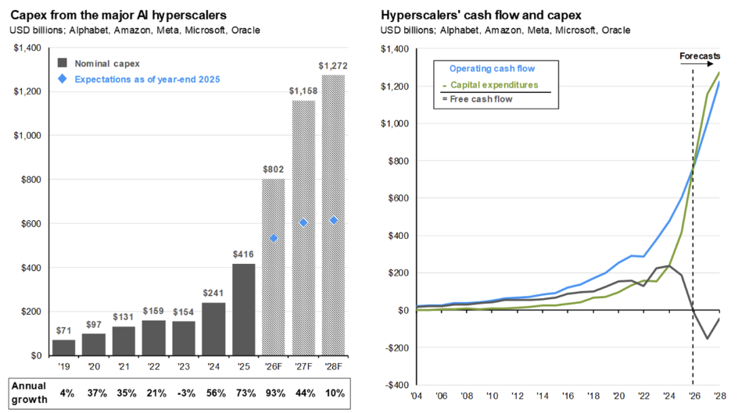
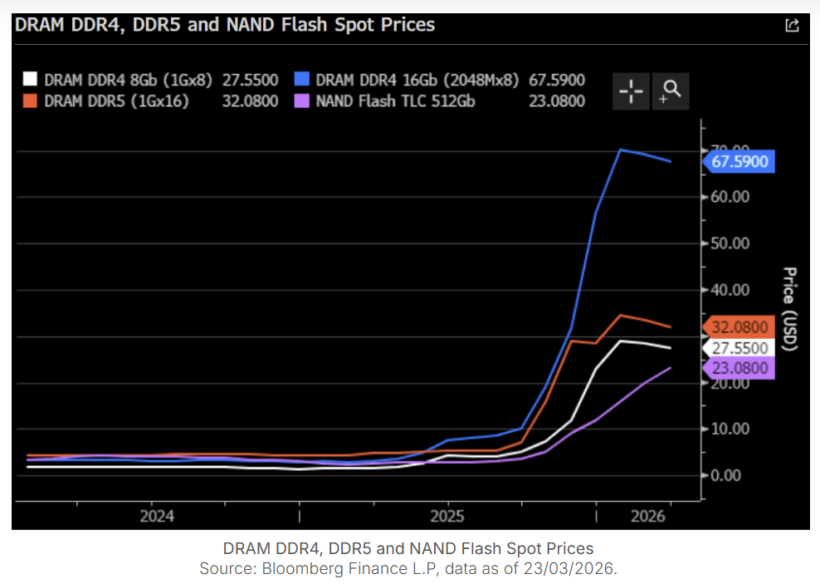
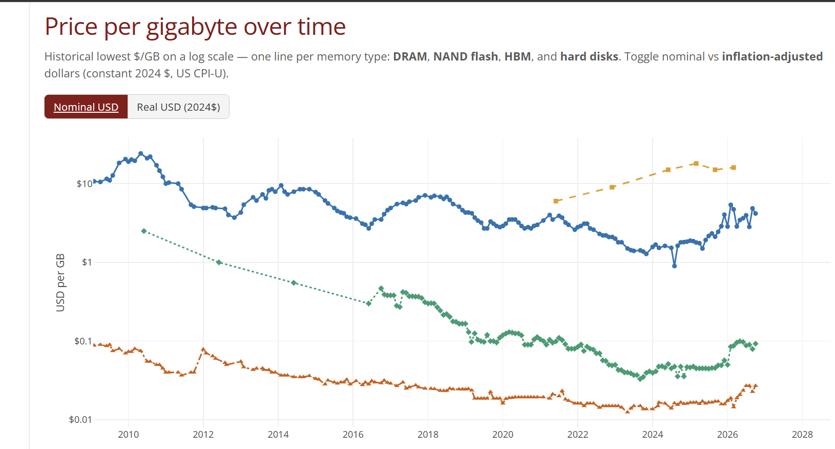
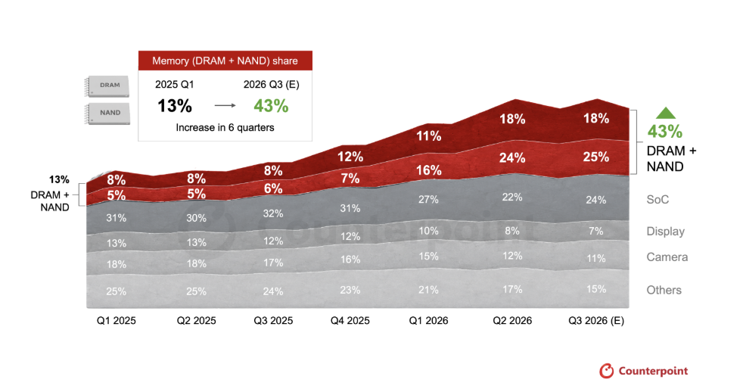
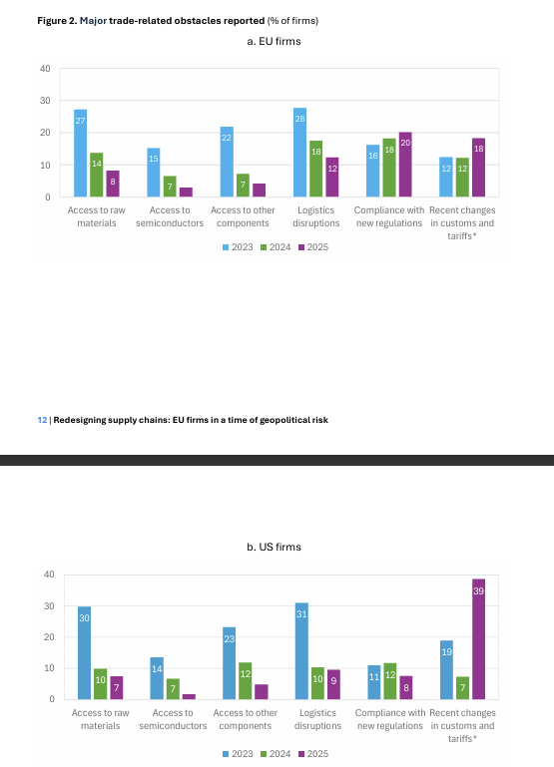
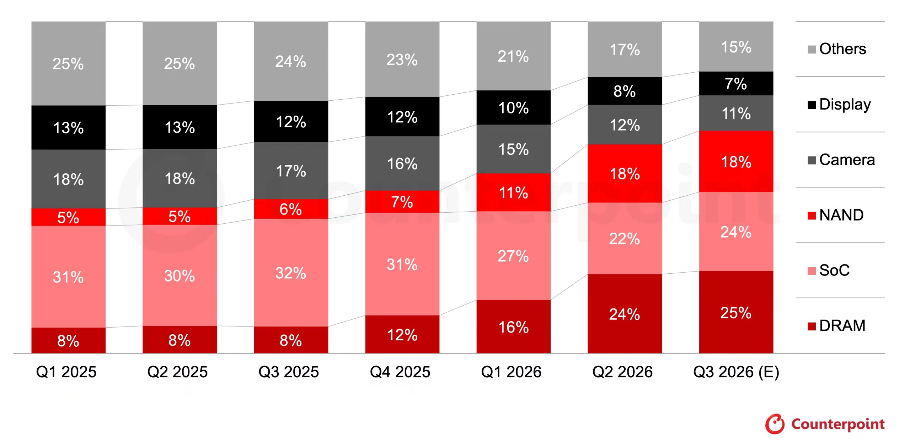
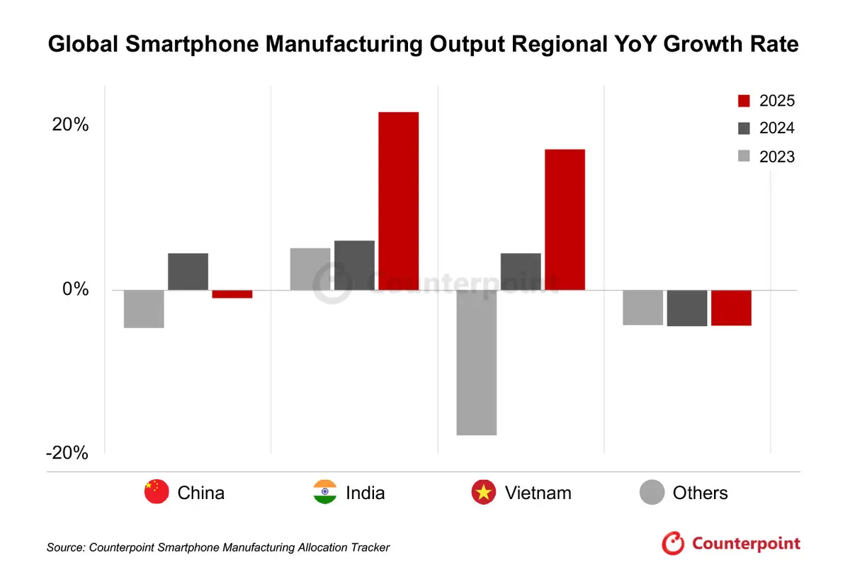
1810.HK | Xiaomi Corporation
Industry Overview: AI Infrastructure Boom Is Reshaping Smartphone Economics
The unprecedented expansion of AI infrastructure investment is creating structural demand for advanced memory, tightening supply conditions and driving up DRAM. Memory components are becoming an increasingly significant portion of smartphone manufacturing costs. Meanwhile, geopolitical tensions is accelerating supply-chain diversification, putting pressure on handset economics and increasing the importance of pricing power and operational flexibility.
AI Investment Entering an Exponential Expansion Phase
Memory Prices Are Entering a New Inflationary Cycle
Algebris Investment_Global Equity Bullets | Wednesday, 25 March 2026
Jpmorgan guide to the markets 2026Q4 ----P22
Stanford DAM, histrocal ptice for
Memory Becoming Major Smartphone Cost Center
Trade Fragmentation Is Reshaping Suppliment
Counterpoint: Reshuffling the BoM - Component Cost Dynamics Amid Memory Price Spikes
Counterpoint – Global Smartphone Manufacturing to Weaken in 2025
EIB – Redesigning Supply Chains ---P12
Notes:
Source: JP Morgan Asset Management, Counterpoint Research, Stanford DAM lab, EIB
Notes:
Let me begin with the industry backdrop.
I believe the consumer electronics industry is facing a significant cost reset, driven by two forces: AI-related memory demand and geopolitical supply-chain restructuring.
Starting with the chart on the top left, hyperscaler capital expenditure is expected to continue expanding rapidly.
According to J.P. Morgan Asset Management, aggregate capital expenditure among five major hyperscalers is projected to reach approximately 800 billion US dollars in 2026 and exceed 1.1 trillion in 2027.
Although these figures include company-wide spending rather than AI infrastructure alone, they illustrate the scale of investment being directed towards computing capacity.
This matters for smartphone manufacturers because memory suppliers are increasingly prioritising higher-value products such as HBM and server DRAM.
As we can see from the memory price chart, DRAM and NAND prices have risen sharply.
The resulting cost transmission is substantial.
Counterpoint estimates that DRAM and NAND could account for 43% of the bill of materials of a representative premium smartphone by the third quarter of 2026, compared with just 13% in early 2025.
In other words, memory has evolved from a relatively manageable cost item into one of the largest determinants of smartphone profitability.
Looking forward, I would distinguish between DRAM and NAND.
DRAM supply may remain structurally tight because of AI-related capacity allocation, while NAND could potentially experience some supply normalisation in the second half of 2027.
Therefore, I would not assume a broad-based memory price decline in the near term.
The second major development is geopolitical fragmentation.
As shown by the manufacturing data, India and Vietnam are gaining importance as smartphone assembly locations, while tariffs and regulatory uncertainty are encouraging manufacturers to diversify their supply chains.
This creates additional operating complexity, but also increases the importance of global sourcing capabilities and geographic flexibility.
My key takeaway is that industry competition is no longer only about manufacturing scale. Pricing power, cost management and supply-chain resilience are becoming increasingly important.
And this leads to the next question: how are consumer electronics companies adapting?

Slide 3
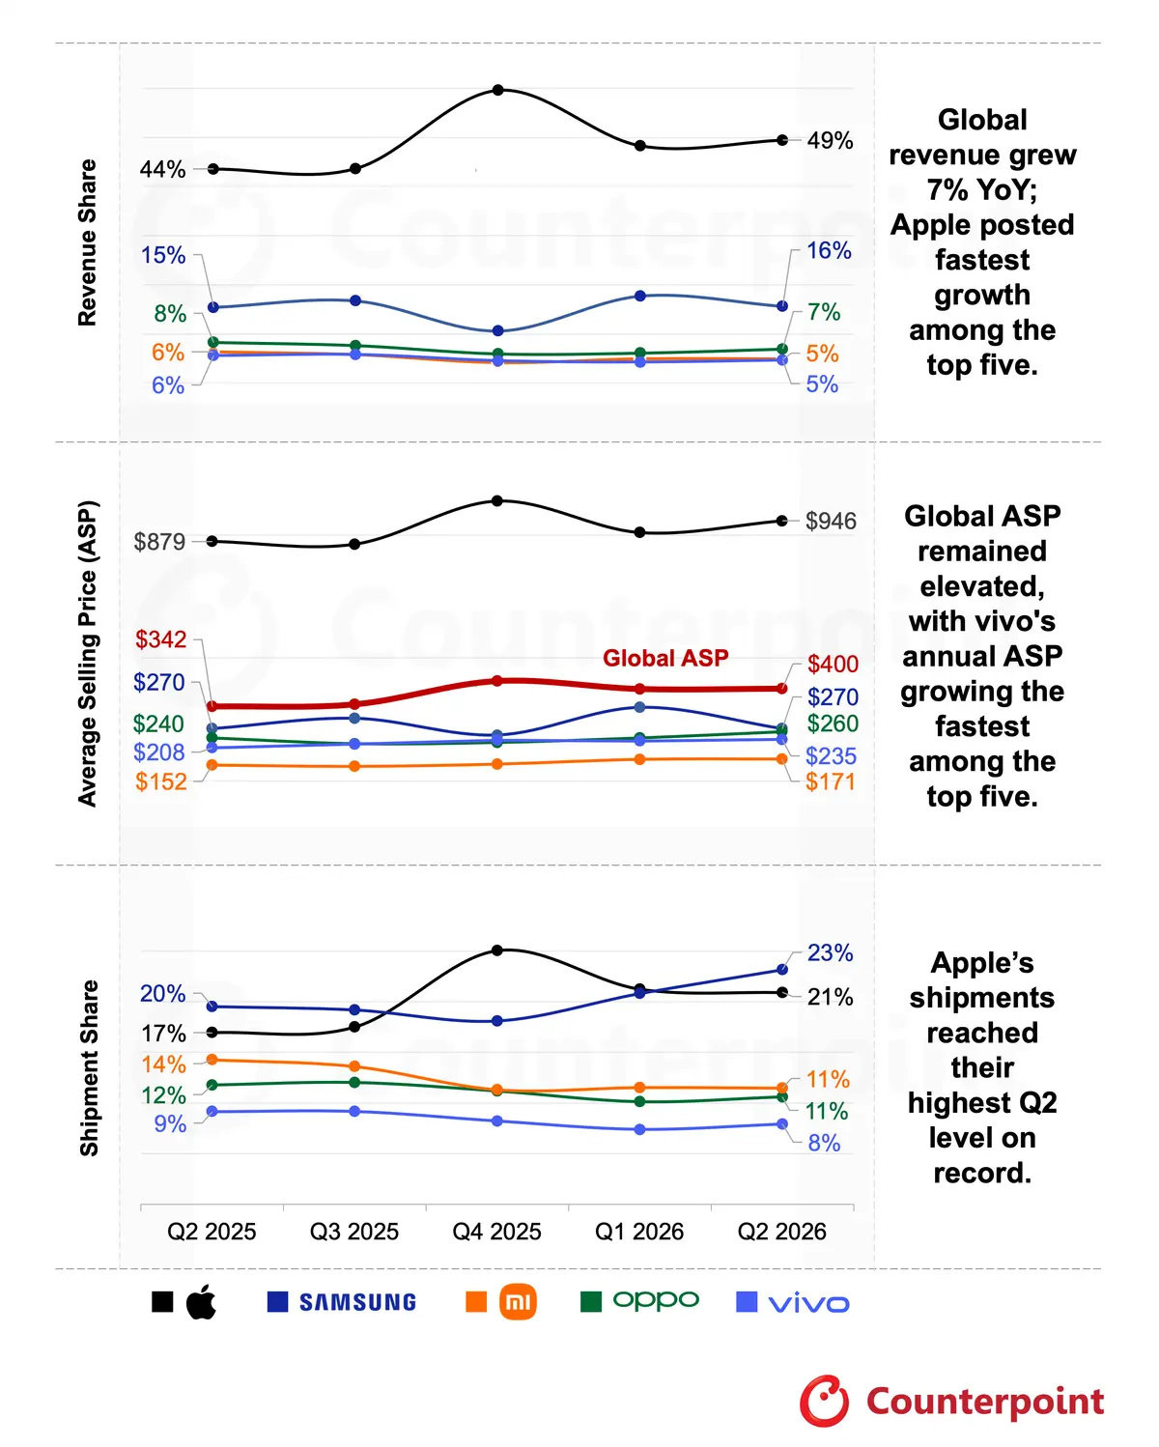
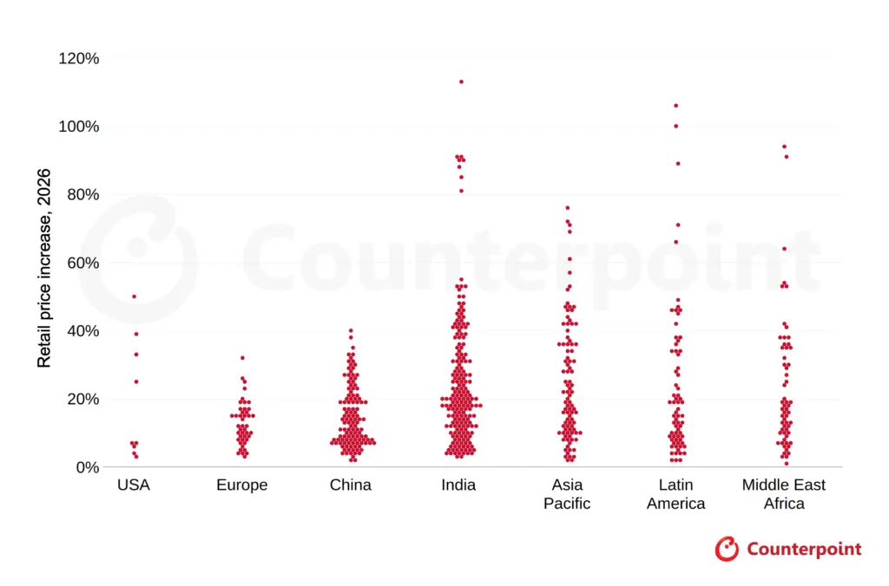
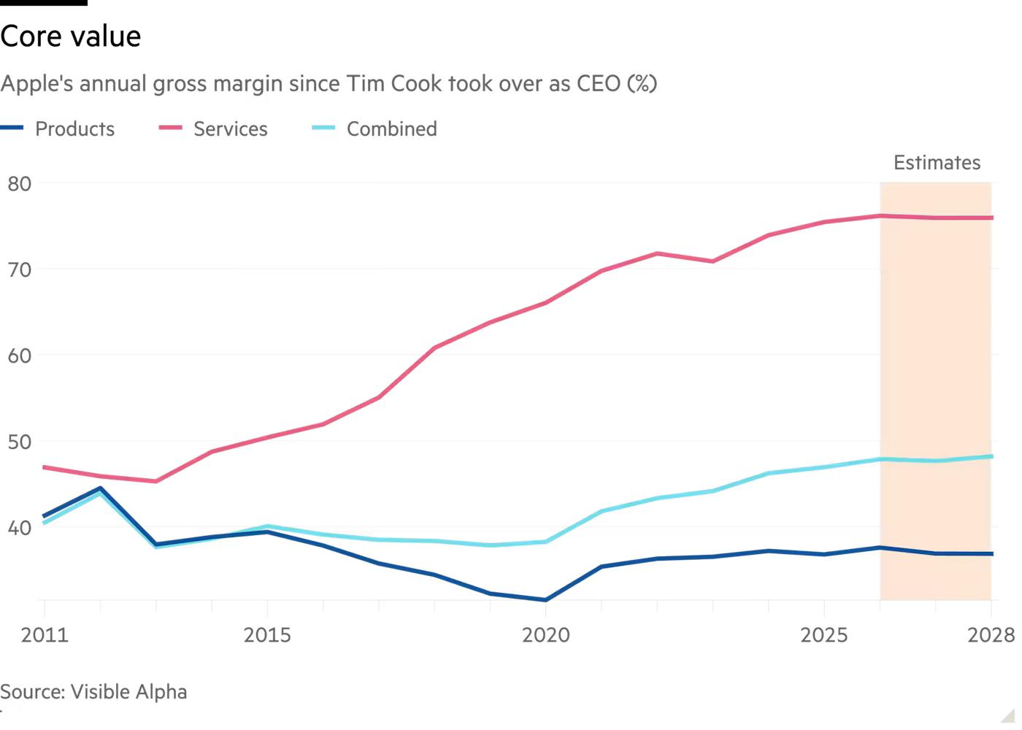
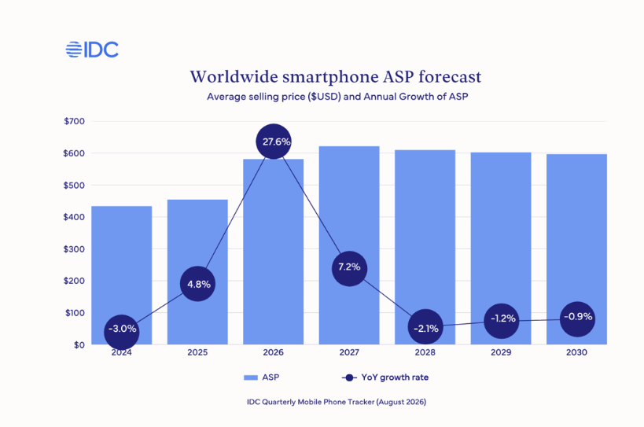
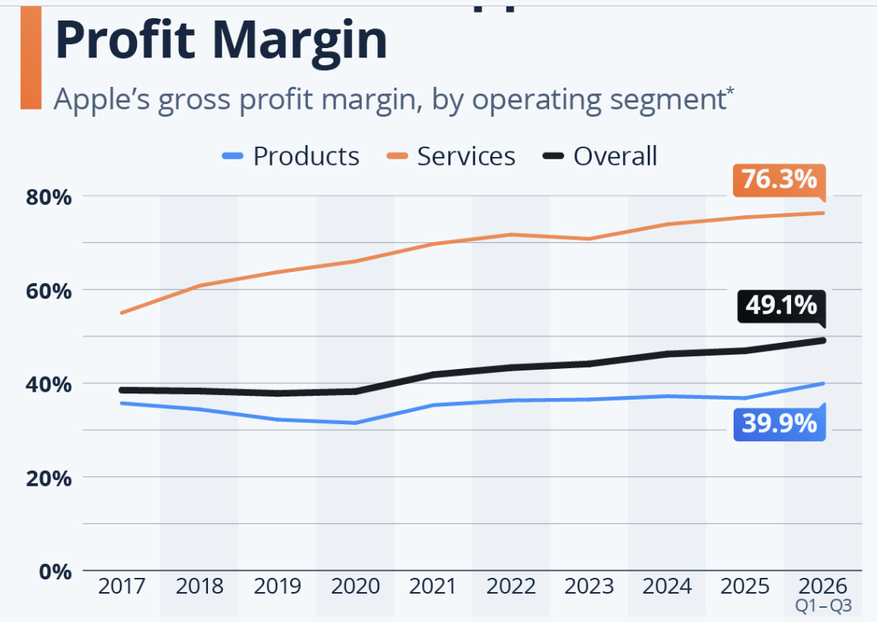
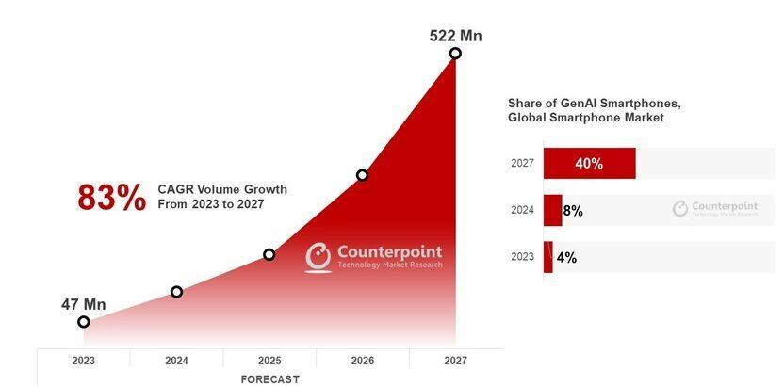
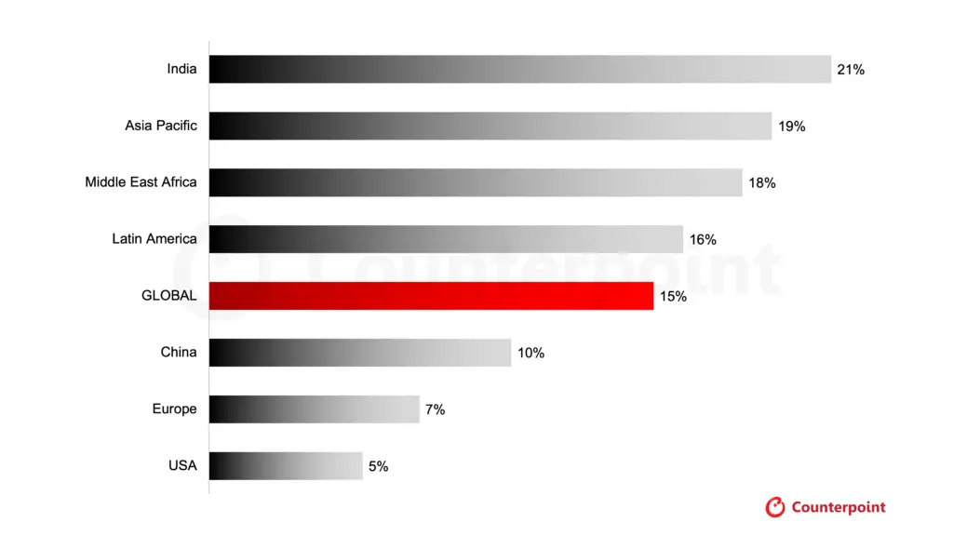
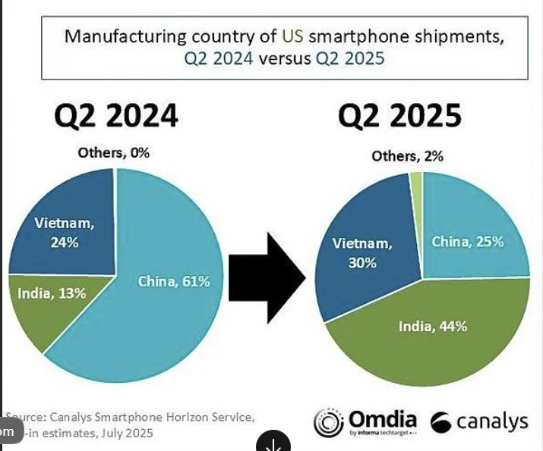
1810.HK | Xiaomi Corporation
Industry Transmission: From Volume-led Growth to Value-driven Competition
Rising component costs are accelerating margin squeeze, while premium devices and AI-enabled products are creating demand for higher ASPs. At the same time, hardware manufacturers are increasingly expanding into connected ecosystems and recurring services to capture greater customer lifetime value.
#1: Premiumisation and Price Adjustments
#2: Ecosystem Expansion and Recurring Monetisation
Apple
Services Boost Apple's Profit Margin
Counter Research: Global Smartphone Revenue Up 7% in Q2 2026 Despite Shipment Slump
UK CMA AAPL B.2
#3: GenAI Penetration with premiumization
#4: Supply-chain Diversification
Counterpoint Research，2026年6月22日
GenAI Smartphone Share to Rise to 45% of Global Shipments in 2026
Counterpoint – Global Existing Smartphone Prices Climb About 15% in 2026
Manufacturing Relocation Amid Trade Tensions
Notes:
Source:
Notes:
I see four major responses to these industry changes, which can be grouped into revenue-side adaptation and operational adaptation.
First, premiumisation and price adjustments.
Historically, smartphone manufacturers relied heavily on shipment growth, particularly in emerging markets.
However, rising component costs and relatively weak consumer demand are changing that model.
The Counterpoint data shows that smartphone prices have been increasing across major regions, with particularly significant increases in price-sensitive markets.
This reflects both deliberate premiumisation and the pass-through of rising component costs.
The distinction is important: higher ASP does not automatically mean higher profitability.
Second, ecosystem expansion and recurring monetisation opportunities.
The Apple example provides an interesting benchmark.
Apple's Services gross margin has reached approximately 76%, substantially higher than its hardware gross margin.
The broader implication is that software, advertising, digital services and subscriptions can generate disproportionately high profit contributions relative to their revenue.
For smartphone manufacturers, this creates an opportunity to monetise the installed user base beyond the initial device purchase.
However, the ability to monetise users varies considerably across brands, so Apple's profitability should be viewed as an illustration rather than a direct forecast for Xiaomi.
Third, AI-enabled product innovation.
GenAI smartphones are expected to represent an increasing share of global shipments.
This could support more differentiated products, higher memory configurations and new consumer experiences.
But an important uncertainty remains whether AI functionality can generate enough consumer value to accelerate replacement cycles.
Fourth, supply-chain regionalisation.
As manufacturing shifts towards India, Vietnam and other locations, global operating capabilities are becoming more important.
Together, these trends suggest that successful manufacturers will need to combine stronger product differentiation, broader ecosystem monetisation and more flexible international operations.
I believe Xiaomi is particularly interesting because it is pursuing several of these strategies simultaneously.

Slide 4
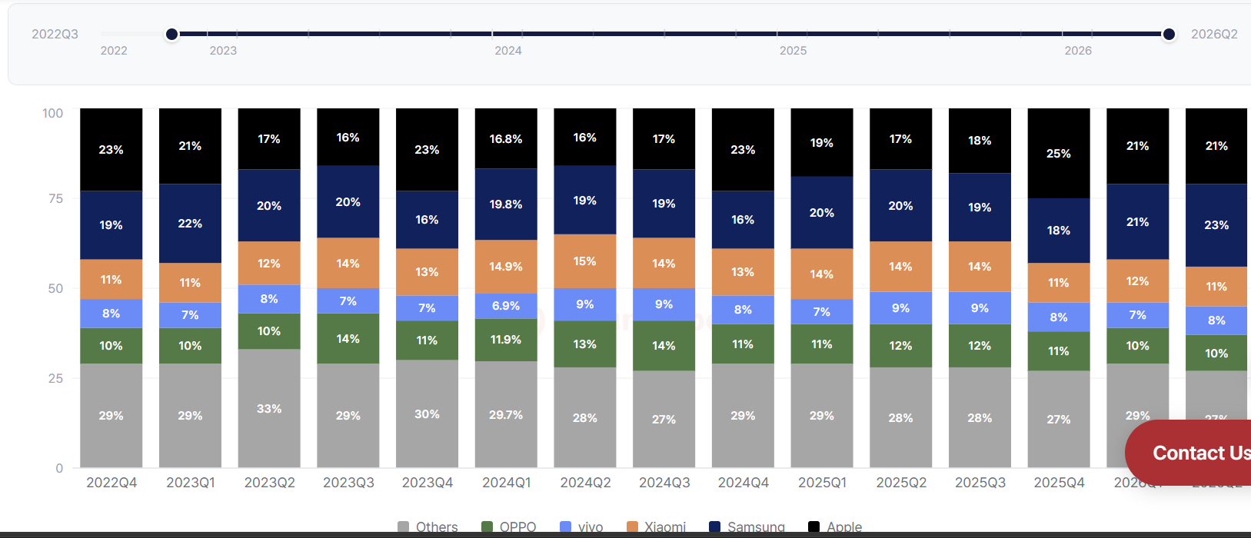
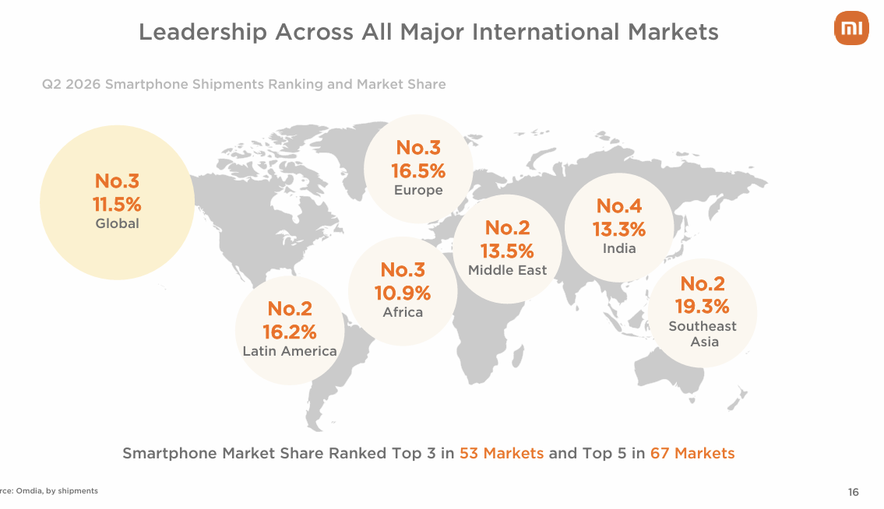
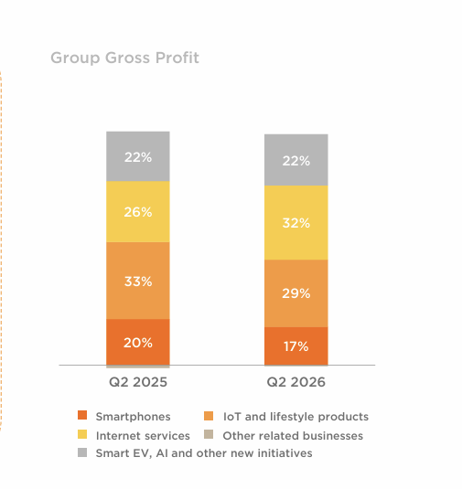
1810.HK | Xiaomi Corporation
Xiaomi Positioning: Capture Industry Shift with Product & Channel Expansion
Xiaomi is positioned to benefit from these structural industry changes through two ways of expansions. Its smartphone portfolio is moving towards higher-value segments, supported by flagship launches and improving premium penetration. Its automotive and IoT businesses expand the connected ecosystem, creating additional consumer touchpoints and opportunities to increase lifetime value. HyperOS and Internet services provide the monetisation layer, while Xiaomi's established international footprint offers scale and geographic diversification. Together, these capabilities create a broader platform for growth beyond traditional smartphone shipments.
Premiumization Through a Higher ASP Upgrade
Premiumization Through a Broader Product Portfolio
CNBC sub-100 smartphone
Counterpoint Global market share
Penetration through Internet expansion
Penetration through global channel expansion
Xiaomi Q2 financial preseantation
汽车
智能手机
智能手机
Volume-to-value
汽车
76.7% 毛利率 in
Internet
Higher launch prices
+ low-end exit
互联网服务
互联网服务
17 & 15T + premium mix
IoT业务
IoT业务
Notes:
Source:
Notes:
Turning to Xiaomi, I would characterise its positioning through two complementary forms of expansion: moving up the value chain within existing products, and expanding horizontally across products and markets.
Starting with smartphones, Xiaomi has been actively upgrading its product portfolio.
In the second quarter of 2026, its smartphone ASP reached a record 1,351 renminbi, increasing nearly 26% year on year.
At the same time, smartphones priced above 3,000 renminbi accounted for 32.1% of Xiaomi's smartphone sales volume in mainland China, indicating a continued shift towards more premium products.
However, there is an important qualification.
Despite the ASP improvement, smartphone gross margin remained at 8.5%, reflecting substantial pressure from memory costs.
This suggests that premiumisation is progressing, but its profitability benefits have not yet been fully realised.
The second area is ecosystem expansion.
Xiaomi now has approximately 1.16 billion connected IoT devices and over 766 million monthly active users.
These devices create multiple points of interaction with the same consumer, including smartphones, wearables, smart appliances and home products.
HyperOS is designed to connect these devices and increase engagement across the ecosystem.
The third element is monetisation.
Internet services generate a gross margin of approximately 77% and accounted for 32% of Xiaomi's group gross profit in the second quarter.
This is particularly meaningful because Internet services contribute a much smaller share of group revenue.
It demonstrates that Xiaomi already has a high-margin business alongside its hardware operations.
Automotive is another extension of this ecosystem. Xiaomi delivered over 104,000 vehicles in the second quarter.
While I see significant opportunities for cross-device engagement, I would treat automotive primarily as a long-term growth option rather than assuming it will immediately improve group profitability.
Finally, Xiaomi has a broad international footprint.
It ranks among the top three smartphone vendors in 53 markets, with strong positions in Southeast Asia, Latin America and Europe.
This provides both geographic diversification and a distribution platform for introducing higher-value products.
Overall, Xiaomi's advantage is not any single product category, but the combination of smartphone scale, connected devices, monetisation capabilities and global distribution.

Slide 5





1810.HK | Xiaomi Corporation
Xiaomi Thesis: A Scalable Ecosystem Platform with Multiple Earnings Drivers
Xiaomi’s smartphone franchise provides a large user acquisition base, while IoT products and HyperOS strengthen user engagement and retention. Internet services offer a higher-margin monetisation layer, and the automotive business creates an additional long-term growth opportunity
PLATFORM LTV MODEL
Ecosystem Flywheel: Monetising the Lifetime Value of Users
1
Acquire
2
Attach
3
Engage
4
Monetize
5
Reinvest
Operating logic
More users
More devices
More touchpoints
Higher ARPU
Higher GM mix
More R&D
Hardware = CAC
Phones + entry AIoT acquire users at scale
Ecosystem = retention
HyperOS links devices and raises switching costs
Services = monetization
Ads, gaming, cloud and in-car touchpoints harvest profit
Reinvestment = flywheel
R&D and premium products improve next-cycle CAC efficiency
Earnings Recovery Through Margin Normalisation
Valuation Upside Contingent on Earnings Delivery
Notes:
Source:
Notes:
To conclude, I would focus on three investment drivers and one critical valuation question.
The first driver is the ecosystem flywheel.
As illustrated on the left, Xiaomi's model begins with smartphones and accessible AIoT products acquiring customers.
Additional connected devices then increase engagement, while HyperOS helps create a more integrated user experience.
Internet services provide monetisation opportunities through advertising, gaming and digital services.
Over time, cash generated from these businesses can support further R&D, product innovation and user acquisition.
I believe this is an attractive long-term model.
However, connected-device growth alone does not prove higher customer lifetime value. The important test is whether Xiaomi can increase revenue and gross profit per user.
The second driver is smartphone profitability recovery.
The smartphone segment remains a major revenue contributor, but current margins are under pressure.
To illustrate the sensitivity, based on quarterly smartphone revenue of approximately 42 billion renminbi, a one-percentage-point improvement in gross margin would add roughly 420 million renminbi of quarterly gross profit, before operating expenses.
Therefore, even moderate margin recovery could have a meaningful earnings impact.
However, the timing depends on memory prices, product mix and Xiaomi's ability to maintain volumes while increasing ASP.
The third driver is more disciplined monetisation of new businesses.
Internet services already represent a high-margin profit pool, while IoT and automotive offer opportunities to expand the customer relationship.
For automotive, I would focus on operating leverage, investment intensity and the path towards sustainable profitability, rather than delivery growth alone.
Finally, on valuation, Xiaomi's share price has experienced a significant correction, as shown in the chart.
But I would not interpret a lower share price as sufficient evidence of undervaluation.
Before arriving at a price target, I would separate the value of the core hardware businesses, Internet services and automotive, and test the results under different earnings scenarios.
The three metrics I would monitor most closely are smartphone gross margin, Internet services monetisation per user, and automotive operating profitability.
In summary, I am constructive on Xiaomi's long-term ecosystem potential, but I believe the investment case ultimately rests on earnings conversion rather than ecosystem expansion alone.
The company has established the platform. The next stage is demonstrating that this platform can generate structurally higher profitability and sustainable free cash flow.
Thank you. I look forward to your questions.

