Slide 1
1810.HK | Xiaomi Corporation
Executive Summary:
Industry Overview | Electrification Drives Higher Performance Requirements: EV motors demand bearings with higher rotational speeds, lower friction and greater thermal stability, creating opportunities for high-precision rolling elements. Ceramic Bearings Offer a New Growth Frontier: Advanced ceramic materials can improve bearing performance in demanding applications, including high-speed EV drivetrains and precision machinery. Geopolitical Shifts Accelerate Supply-chain Diversification: OEMs are seeking more resilient and diversified sourcing networks, creating opportunities for qualified domestic component suppliers.
Company Overview | Leading Precision Rolling-element Manufacturer: Lixing specialises in bearing steel balls and rollers, serving automotive, industrial machinery and other high-end manufacturing applications. Established Global Customer Relationships: Over 20 years of cooperation with SKF and participation in the global procurement systems of leading bearing manufacturers demonstrate its manufacturing capabilities and customer qualification credentials. Established Revenue Base with Global Reach: 2025 revenue reached RMB 1.11bn, with steel balls accounting for approximately 85% of revenue and overseas markets contributing approximately 31%.
What We Like | Long-standing Customer Relationships and High Entry Barriers: Precision requirements, quality consistency and lengthy OEM qualification processes create meaningful switching costs and support customer stickiness. Upgrading Towards Higher-value Products: G3/G5 precision products and ceramic-ball development provide opportunities to move beyond conventional steel balls into more demanding applications. Multiple Growth Opportunities Beyond Traditional Automotive: EV electrification provides a nearer-term growth driver, while industrial automation and robotics offer additional long-term upside.
Process & Next Steps | Validate Technology and Commercialisation: Assess ceramic material capabilities, manufacturing yields, product performance and progress from OEM testing to mass production. Monitor Capacity Expansion and Earnings Conversion: Track new production lines, capacity utilisation, customer orders, product mix and gross margin improvement. Stress-test the Investment Thesis: Evaluate FX exposure, raw material costs, customer concentration and competitive threats; distinguish near-term earnings volatility from sustainable operating improvements.
Notes:
Source:

Slide 2
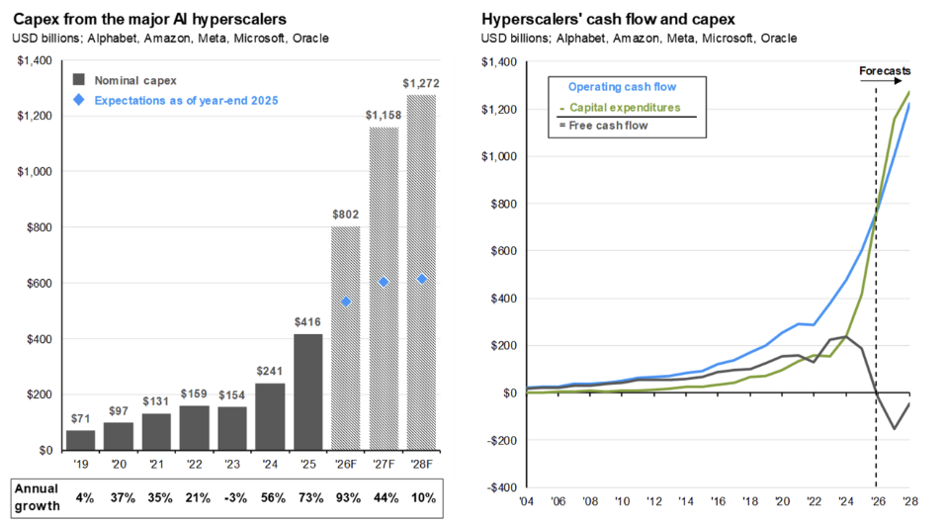
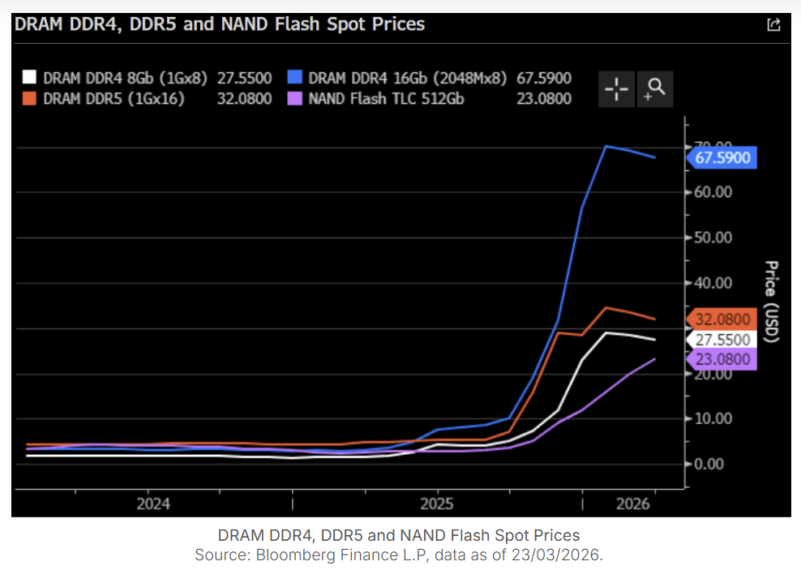
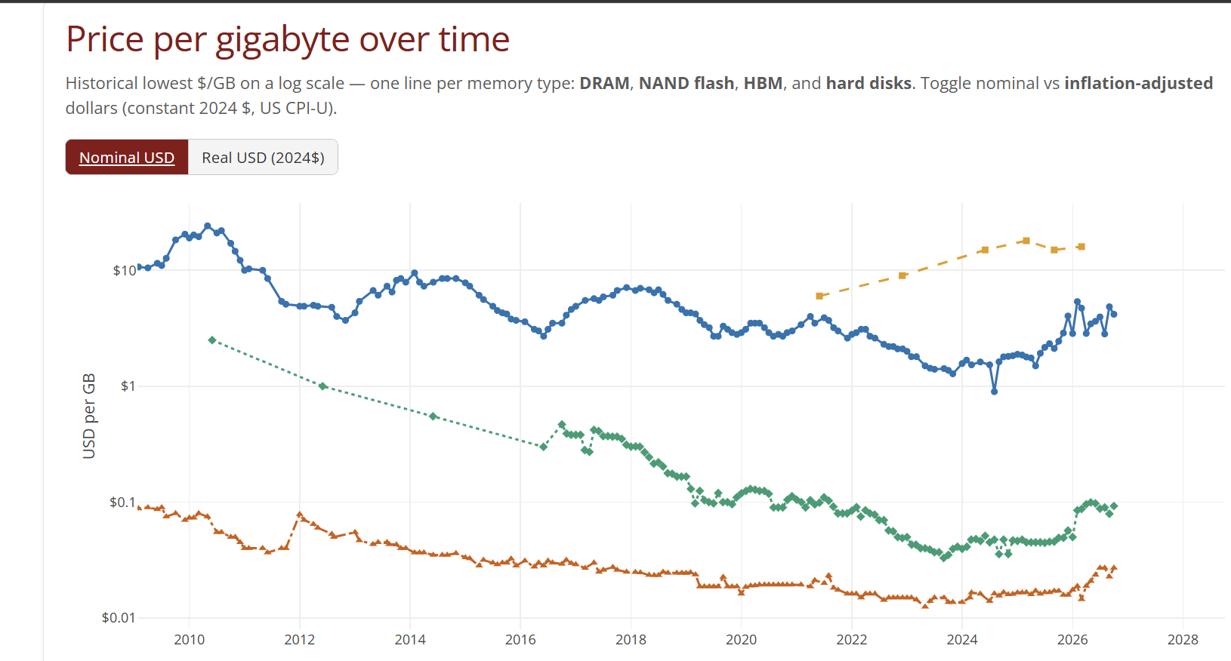
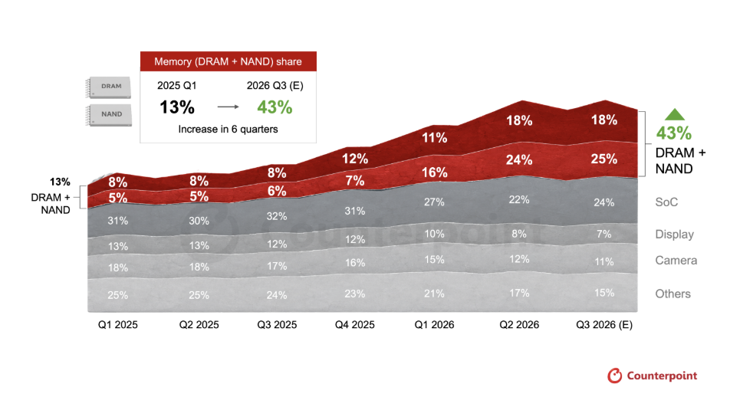
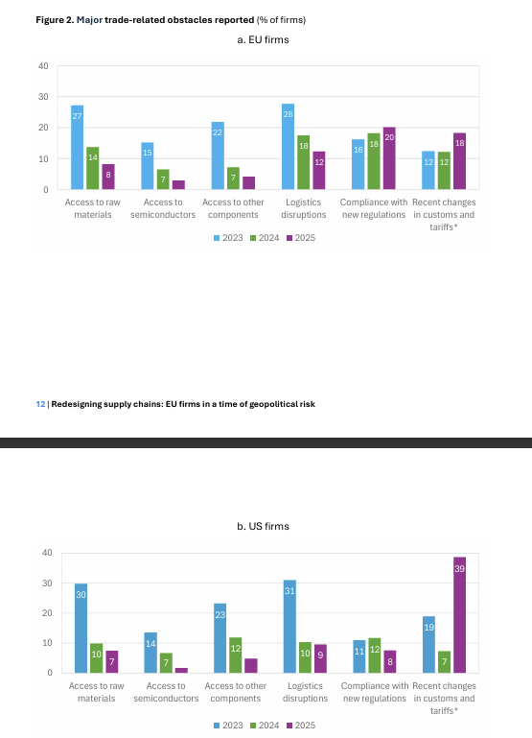
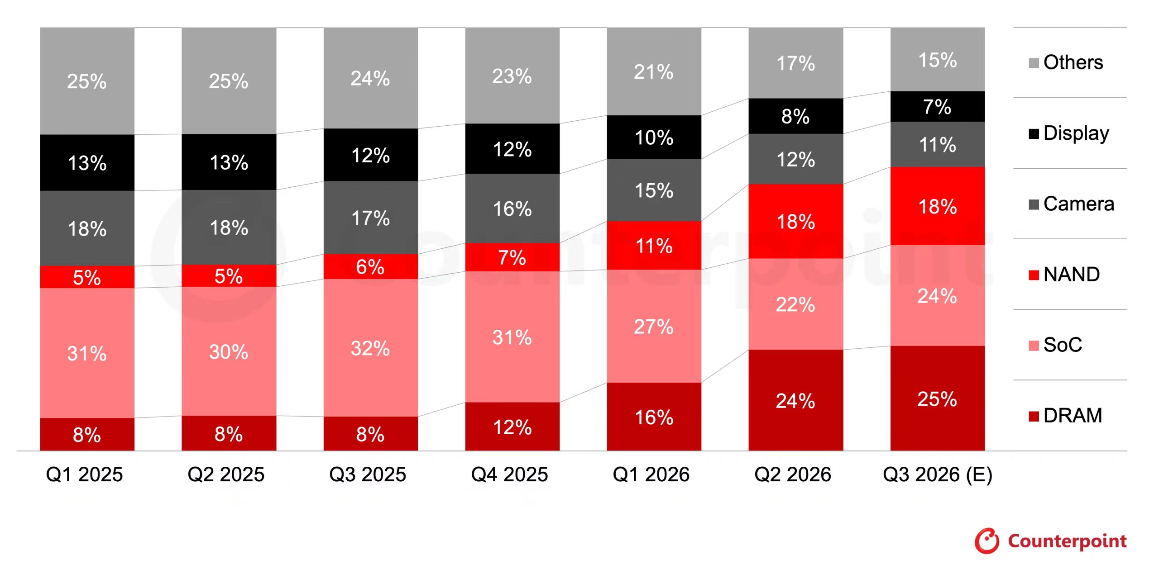
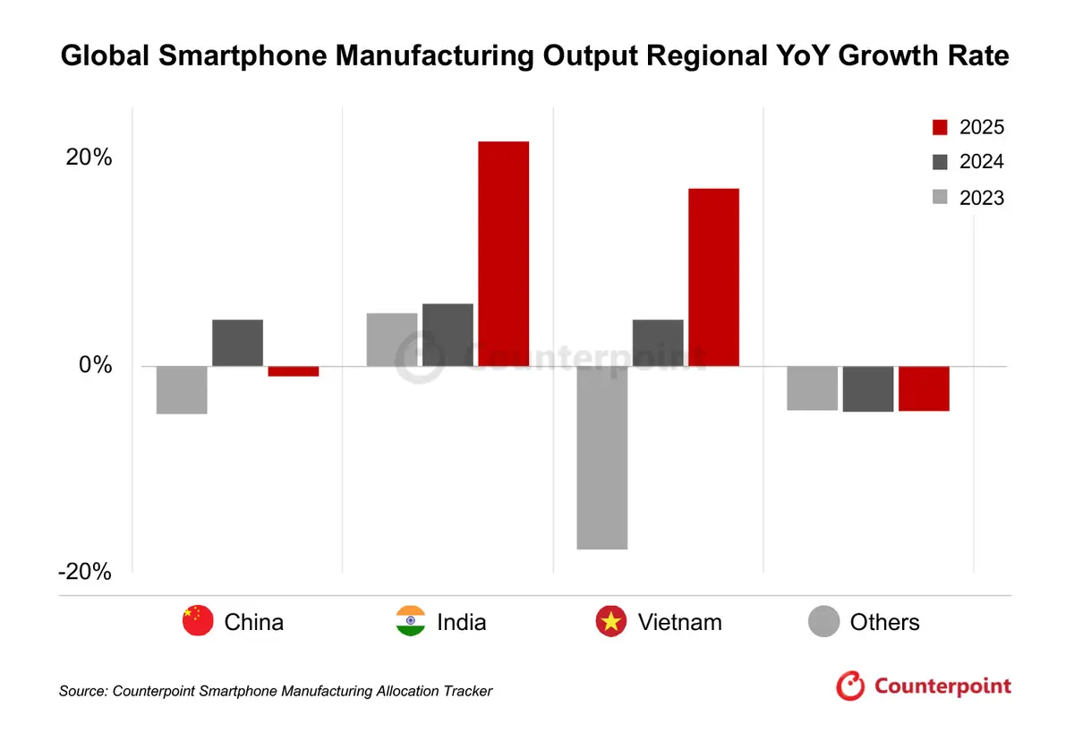
1810.HK | Xiaomi Corporation
Industry Overview: AI Infrastructure Boom Is Reshaping Smartphone Economics
The unprecedented expansion of AI infrastructure investment is creating structural demand for advanced memory, tightening supply conditions and driving up DRAM. Memory components are becoming an increasingly significant portion of smartphone manufacturing costs. Meanwhile, geopolitical tensions is accelerating supply-chain diversification, putting pressure on handset economics and increasing the importance of pricing power and operational flexibility.
AI Investment Entering an Exponential Expansion Phase
Memory Prices Are Entering a New Inflationary Cycle
Algebris Investment_Global Equity Bullets | Wednesday, 25 March 2026
Jpmorgan guide to the markets 2026Q4 ----P22
Stanford DAM, histrocal ptice for
Memory Becoming Major Smartphone Cost Center
Trade Fragmentation Is Reshaping Suppliment
Counterpoint: Reshuffling the BoM - Component Cost Dynamics Amid Memory Price Spikes
Counterpoint – Global Smartphone Manufacturing to Weaken in 2025
EIB – Redesigning Supply Chains ---P12
Notes:
Source:

Slide 3
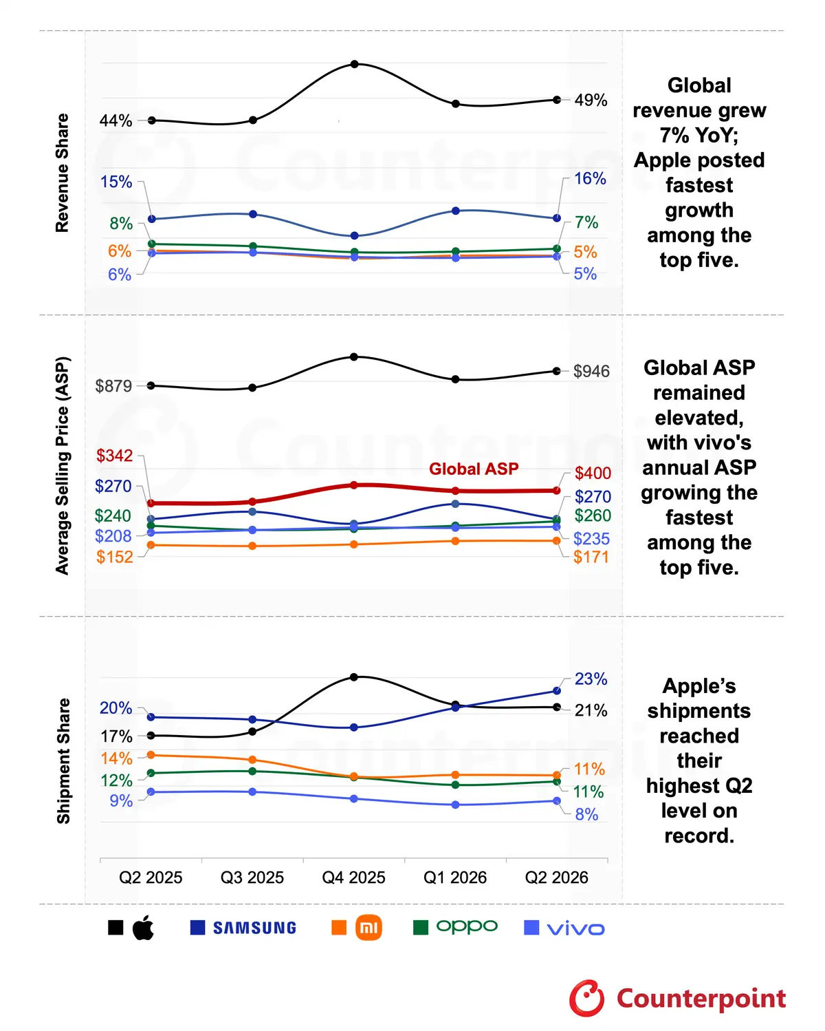
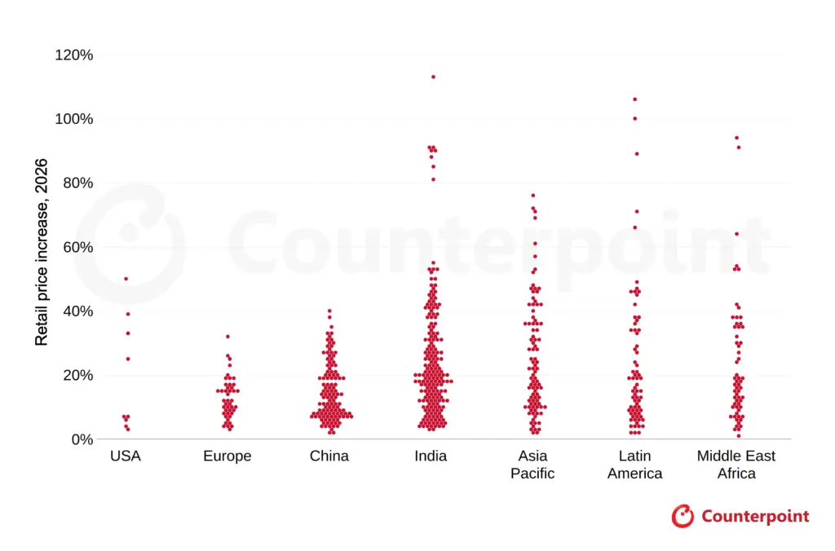
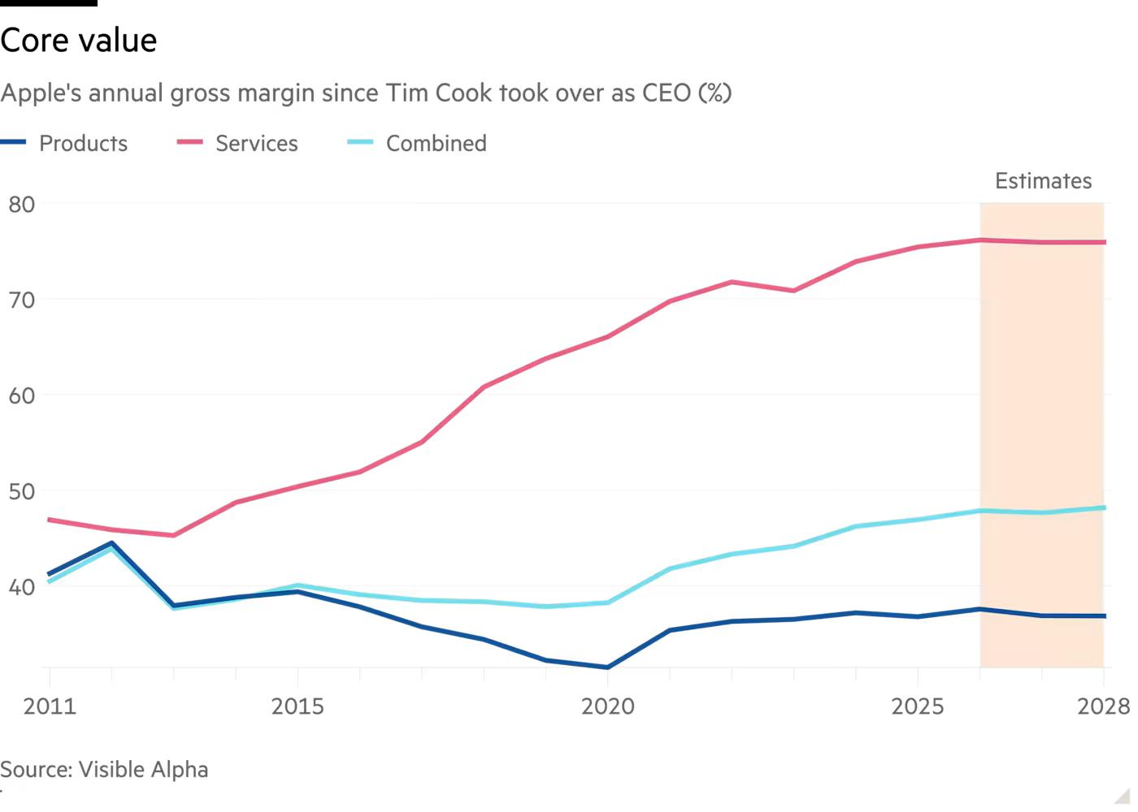
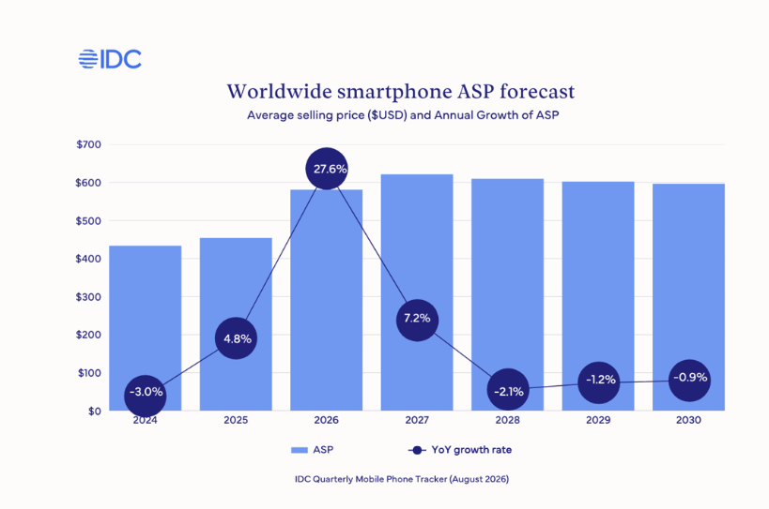
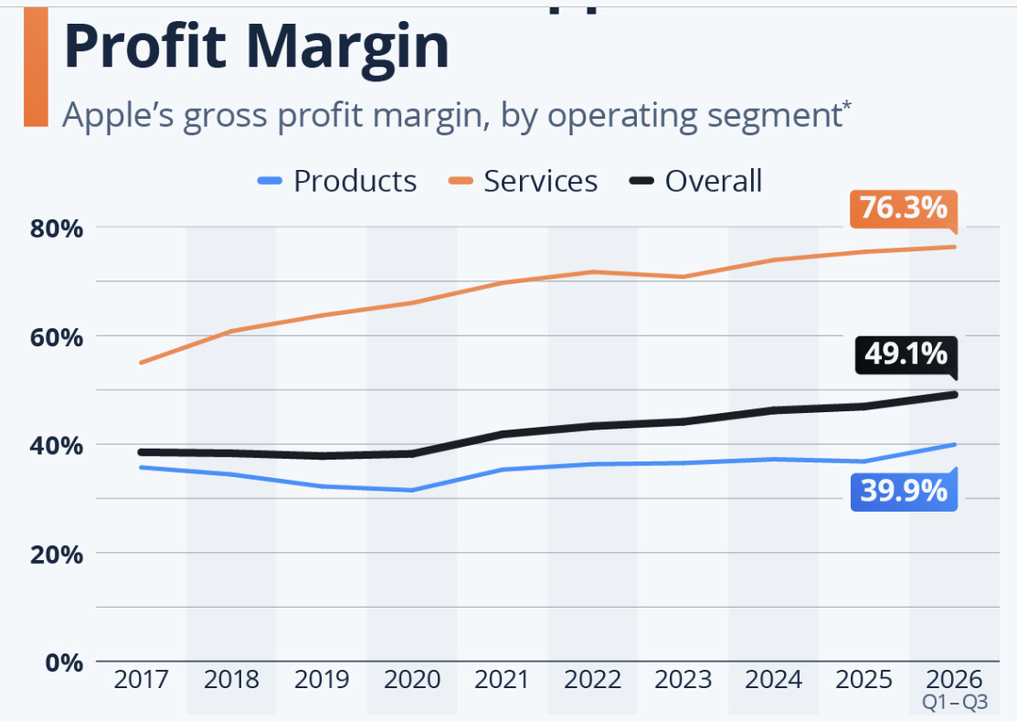
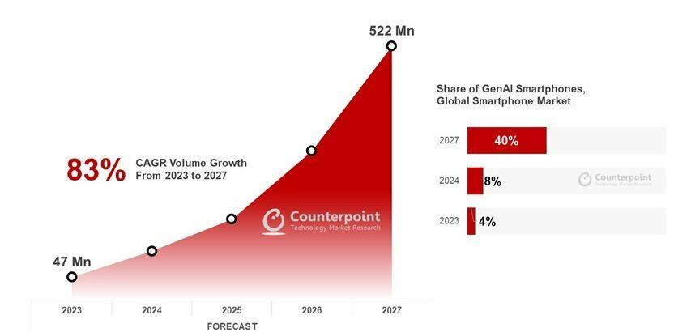
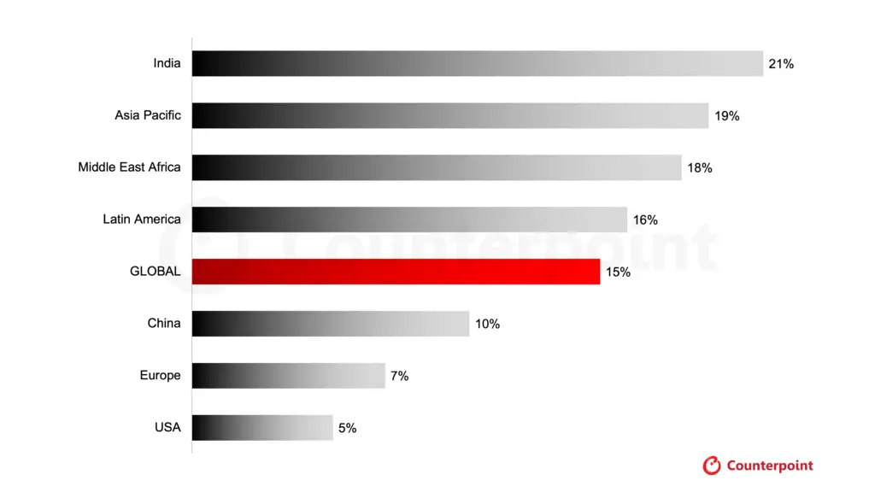
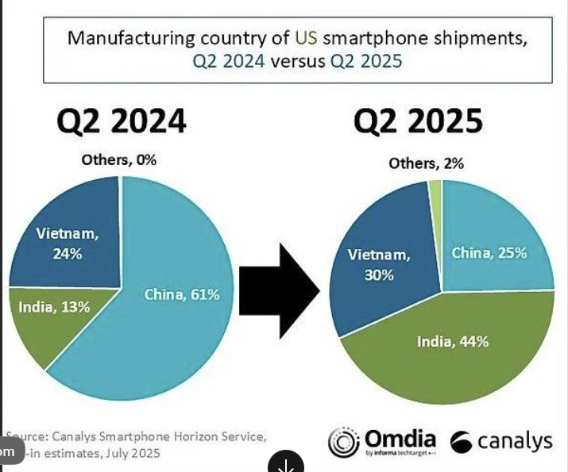
1810.HK | Xiaomi Corporation
Industry Transmission: Shifting from Volume to Value Attributing to Demand and Supply Side
Rising component costs are accelerating margin squeeze, while premium devices and AI-enabled products are creating demand for higher ASPs. At the same time, hardware manufacturers are increasingly expanding into connected ecosystems and recurring services to capture greater customer lifetime value.
#1: Premiumisation and Price Adjustments
#2: Ecosystem Expansion and Recurring Monetisation
Apple
Services Boost Apple's Profit Margin
Counter Research: Global Smartphone Revenue Up 7% in Q2 2026 Despite Shipment Slump
UK CMA AAPL B.2
#3: GenAI Penetration with premiumization
#4: Supply-chain Diversification
Counterpoint Research，2026年6月22日
GenAI Smartphone Share to Rise to 45% of Global Shipments in 2026
Counterpoint – Global Existing Smartphone Prices Climb About 15% in 2026
Manufacturing Relocation Amid Trade Tensions
Notes:
Source:

Slide 4
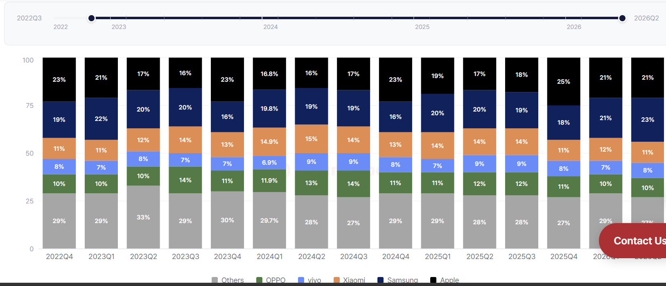
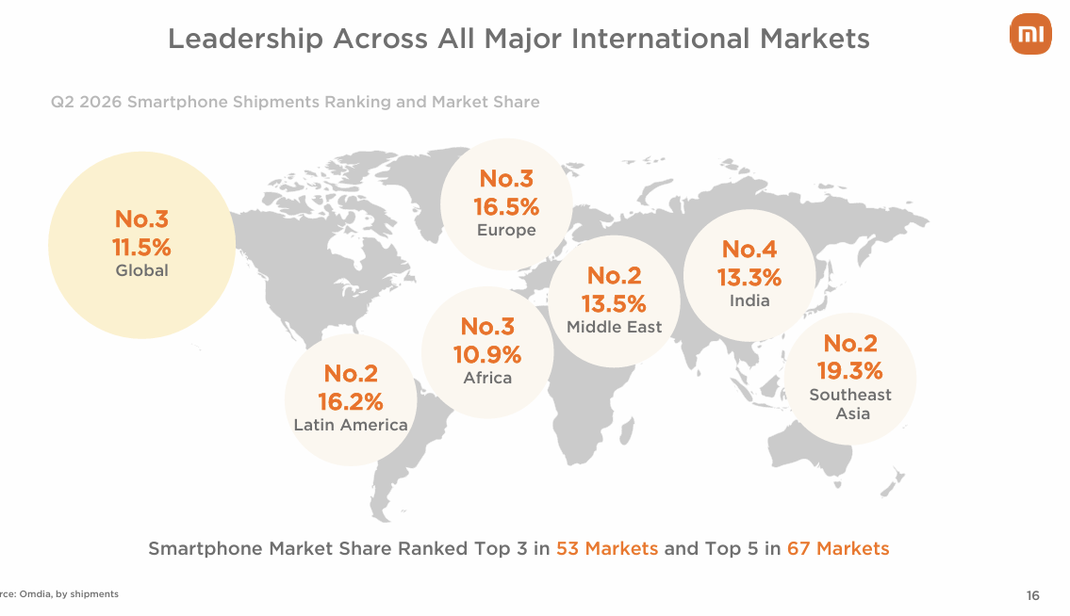
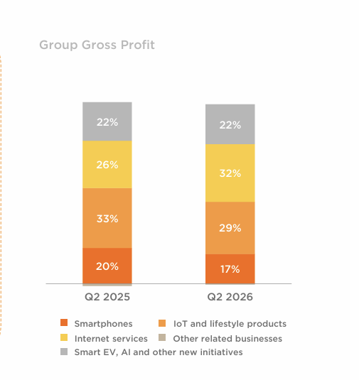
1810.HK | Xiaomi Corporation
Xiaomi Positioning: Capture Industry Shift with Product & Channel Expansion
Xiaomi is positioned to benefit from these structural industry changes through two ways of expansions. Its smartphone portfolio is moving towards higher-value segments, supported by flagship launches and improving premium penetration. Its automotive and IoT businesses expand the connected ecosystem, creating additional consumer touchpoints and opportunities to increase lifetime value. HyperOS and Internet services provide the monetisation layer, while Xiaomi's established international footprint offers scale and geographic diversification. Together, these capabilities create a broader platform for growth beyond traditional smartphone shipments.
Premiumisation Through a Higher ASP Upgrade
Premiumisation Through a Broader Product Portfolio
CNBC sub-100 smartphone
Counterpoint Global market share
Pennetration through Internet expansion
Penetration through global channel expansion
Xiaomi Q2 financial preseantation
汽车
智能手机
智能手机
Volume-to-value
汽车
76.7% 毛利率 in
Internet
Higher launch prices
+ low-end exit
互联网服务
互联网服务
17 & 15T + premium mix
IoT业务
IoT业务
Notes:
Source:

Slide 5

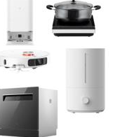



1810.HK | Xiaomi Corporation
Xiaomi Thesis: A Scalable Ecosystem Platform with Multiple Earnings Drivers
Xiaomi’s smartphone franchise provides a large user acquisition base, while IoT products and HyperOS strengthen user engagement and retention. Internet services offer a higher-margin monetisation layer, and the automotive business creates an additional long-term growth opportunity
PLATFORM LTV MODEL
Ecosystem Flywheel: Monetising the Lifetime Value of Users
1
Acquire
2
Attach
3
Engage
4
Monetize
5
Reinvest
Operating logic
More users
More devices
More touchpoints
Higher ARPU
Higher GM mix
More R&D
Hardware = CAC
Phones + entry AIoT acquire users at scale
Ecosystem = retention
HyperOS links devices and raises switching costs
Services = monetization
Ads, gaming, cloud and in-car touchpoints harvest profit
Reinvestment = flywheel
R&D and premium products improve next-cycle CAC efficiency
Financial recovery through margin
Valuation to be verified in transmission
Notes:
Source:

