Slide 1
Version Control System

Slide 2
Agenda
Version Control Systems
Git basics
Creating repository
Recording changes
Working with remotes
Branching out

Slide 3
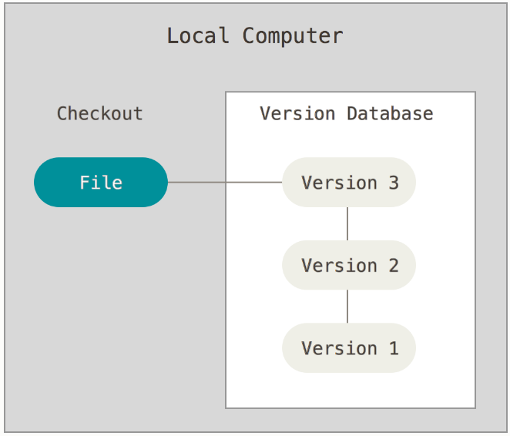
Version Control System (VCS)
Source: https://git-scm.com/doc

Slide 4
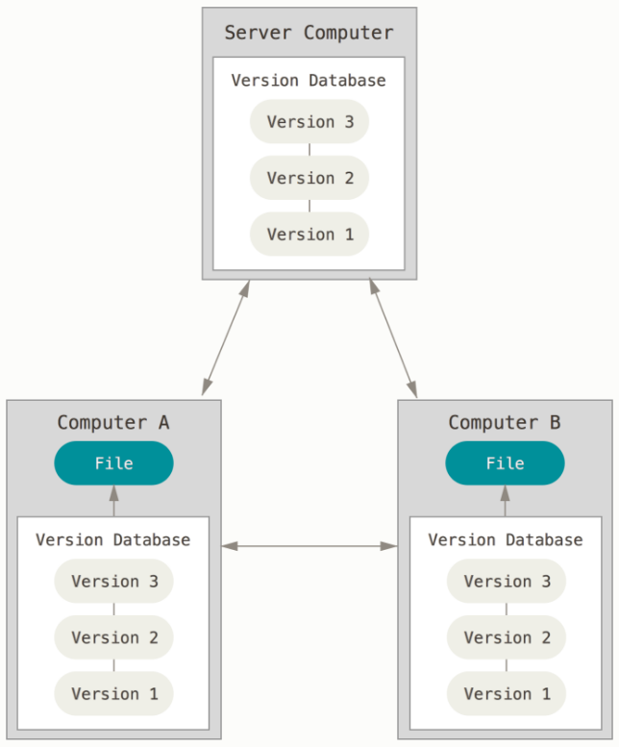
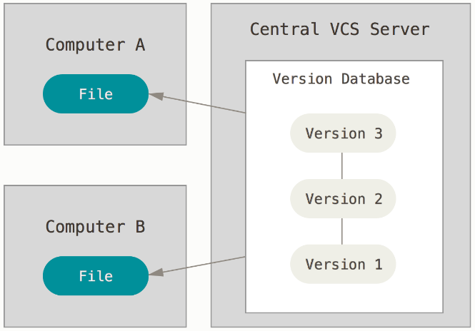
Centralised vs Distributed VCS
Source: https://git-scm.com/doc

Slide 5

Git
Speed
Support for non-linear dev.
Fully distributed
Handle large projects (Linux)
Linus Torvalds ☺
Distributed Version Control System

Slide 6
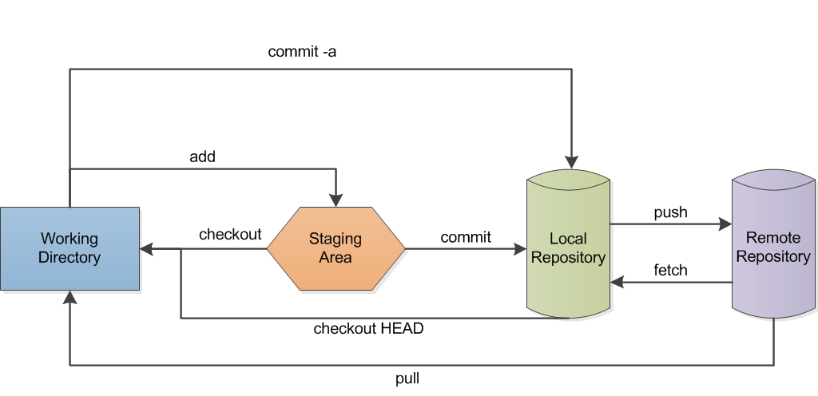
Git data flow

Slide 7




Remote repositories
Git Local Repository

Slide 8

Tools
Command line
GUI
https://git-scm.com/

Slide 9
Initialising repository
cd <folder> // going to the project folder
git init // initialising local repository

Slide 10
Cloning existing repository
git clone <url> // getting a copy of existing repo
cd <folder> // going to git repo

Slide 11
Setting user identity
git config --local user.name ”your name and surname”
git config --local user.email ”your email address”
git config --local --list // checking repo config

Slide 12
Recording changes
git status // tracking info
git add [files] // tracking new files
git add [files] // staging modified files
git commit –m ”message” // committing changes
git log // viewing commit history
git log --oneline // viewing commit history

Slide 13
Working with remotes
git remote -v // showing remotes
git remote add <name> <url> // adding remote
git remote show <name> // inspecting remote
git push [remote-name] [branch-name]
git fetch [remote-name]
git pull [remote-name]

Slide 14
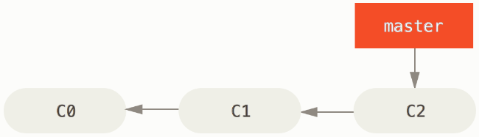
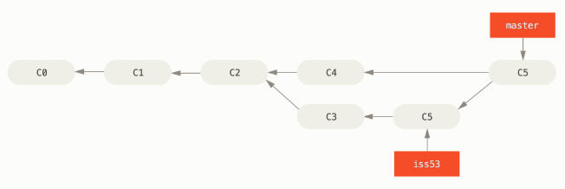
Branching out
Working on features
Working on bugs
Trying out new ideas
Creating history of work
Making separate commits
Source: https://git-scm.com/doc

Slide 15
Working on branches
git branch // listing branches
git branch <branch-name> // creating new branch
git checkout <branch-name> // switching branches
git commit … // storing branch changes
git merge <branch-name> // merging branch
git branch –d <branch-name> // deleting branch
git push … // pushing changes

Slide 16

Documentation
Book EN - PL translation
CCA Non Commercial Share
PDF, Mobi, ePub
Screencasts
Amazon – printed version
https://git-scm.com/doc

Slide 17
References
Simple guide http://rogerdudler.github.io/git-guide/
Crash course https://www.youtube.com/watch?v=SWYqp7iY_Tc
Understanding the Github Flow https://guides.github.com/introduction/flow/
Become a git guru https://www.atlassian.com/git/tutorials

Slide 18

To do

Slide 19
Create github account
On the github, create your personal account (if you do not have yet)
https://github.com/

Slide 20
Create repository from scratch
On the github, create an empty MyFirstProject repository. Familiarise yourself with the Quick setup info (MyFirstProject repository code tab).
On the computer desktop, create MyFirstProject folder with three empty files: a.txt, b.txt, and c.txt. Initialise a git repository in the MyFirstProject folder. Then for the repository, set user identity.
Start tracking files, and then show repository status.
In MyFirstProject, add an empty file author.txt and start tracking the file. Show repository status.
In the first line of the file, add your name and surname, and then show repository status.
Add files to the staging area. Then show repository status.
Commit changes . Use ‘My first commit’ message. Then show commit logs. Show repository status.
Add remote and push changes from local to remote repository (github).
On the github, check out the MyFirstProject repository contents (should be the same as local repo).
On the computer desktop, remove the MyFirstProject folder.

Slide 21
Clone existing remote repository
On the computer desktop, clone the MyFirstProject remote repository into a local folder.
Complete author.txt with your email.
Commit changes. Use ‘Added email address’ message.
Push changes from local to remote repository (github).
On the github, check out the MyFirstProject repository (author.txt content).
On the computer desktop, delete MyFirstProject folder.

Slide 22
Use git GUI
Do the ‘Create repository from scratch’ assignment. Instead of command line tool, use git Graphical User Interface (git GUI).

Slide 23
Create and merge branches
Clone MyFirstProject.
Display branch list. What is the name of the default branch?
Add a new branch ‘interests’. Then display branch list (please note that only one branch is active).
Switch to ‘interests’ branch.
Add new file myinterests.txt. Type two-three sentences about your hobby.
Commit changes.
Switch between ‘master’ and ‘interests’ branches. Can you see the differences in the working directory?
Merge ‘interests’ branch into ‘master’.
Check the differences in the working directory.
Remove ‘interests’ branch.
Push changes from local to remote repository (github) and check the remote repo content.

Slide 24
Collaborate on project
On your local computer, create a new repository Books.
In the repo, add a new file books.txt with your three favourite book titles, on separate lines.
Commit changes and push the repo to the github. Make sure to create an empty remote repo before.
On the github, add your colleague as the repository collaborator.
Ask your collaborator to
clone the repository
add bookstores.txt with two names and URLs of the Internet bookstores
commit changes and push them to the github
On your local computer, add a new file itbooks.txt with three titles of information technology books.
Commit changes and try to push the repo to the github. Why is that not possible?
Fetch the repo from the github, merge it with your local one, and then push the repo to the github.
Check the final repo content on the github.

Slide 25
Resolve conflicts
Create a completely new git repository with at least three files, one of them should be authors.txt.
Add your colleague as a collaborator.
With your collaborator, complete the authors.txt with your name and surname in the same time. Then you and your collaborator try pushing changes on the github.
How to compare and display differences between the two versions of authors.txt?
How to resolve the conflict?
Try to find a solution in the Pro Git book, git manual or on the Internet.

Slide 26
Undo changes
Create a folder with three files. You can copy and paste any existing files.
Initialise a local git repository in the created folder.
Start tracking the files, and then show repository status.
Commit changes . Use ‘Repo with 3 files’ message. Then show commit logs.
Add to the folder a file.
Start tracking this file and commit changes . Use ‘Repo with 4 files’ message. Then show commit logs.
Add to the folder a file.
Start tracking this file and commit changes . Use ‘Repo with 5 files’ message. Then show commit logs.
Roll back last two changes (adding two files).

Slide 27
Git-it tutorial
Familiarise yourself with the Git-it tutorial
https://try.github.io/
Download and unzip the Git-it app
You can find the app in the section: What to Install | Git-it (releases)
Move on to the Get started section and face all the challenges contained in the Git-it app

