Slide 1
Document Object Model

Slide 2
Agenda
Document Object Model
HTML DOM structure
JS HTML DOM basics
JS programming simplification

Slide 3
Document Object Model
HTML, XHTML, XML documents
Cross-platform, language-neutral programming interface (API)
Document node -> object
Access and update the document content dynamically
W3C Recommendation

Slide 4
HTML DOM structure
document
<html>
<head>
<body>
<title>
<h1>
<p>
Hello
It’s me
My page
<a>
href
<table>
Some page
<tr>
<td>
www.onet.pl
<link>
<meta>

Slide 5
HTML DOM
Defines:
HTML elements as objects
Properties of all HTML elements
Methods to access all HTML elements
Events for all HTML elements
Introduction to the DOM
JavaScript HTML DOM

Slide 6
JS HTML DOM basics
Finding elements in DOM structure
var element = document.getElementById(id); var element = document.getElementsByTagName(name);
Changing elements
element.innerHTML = new html content; element.attribute = new value; element.onclick = function(){code};

Slide 7
JS programming simplification
JQuery – cross-platform JavaScript library
Write less, do more
HTML DOM manipulation
Ajax (asynchronous JavaScript and XML)
Tutorials
jQuery Learning Center
jQuery Tutorial (w3schools)

Slide 8
JQuery basic syntax
$(selector).action()
Selector
By element name $("h1").hide();
By element id $("#student").val("Adam");
By element class $(".studentdata").focus( function(){ $(this).css("color", "red"); });

Slide 9
To do

Slide 10
Translate the phrase
Open the translate.html document.
Create a JavaScript code to translate the English phrase to the Polish one.
When the user moves the mouse over the text, The English text is to be replaced with the Polish one.
When the user moves the mouse away from the Polish translation, the original English text is to appear again
See JavaScript Events.

Slide 11
Alter the DOM
Open the alter.html document.
Create a JavaScript program in which:
After clicking on the song title, the Part 2 is to be added at the end of the song title
After clicking on the band name, the band description is to be displayed below the lyrics
After clicking on the lyrics, the text is to be displayed in italics
After double clicking on the page, the page background colour is to be changed to yellow
When you try to copy the part of the lyrics, the copyright message is to be displayed in a popup window
When you click on the visible band description, the band picture is to be displayed below the description (https://upload.wikimedia.org/wikipedia/en/d/d6/Pink_Floyd_-_all_members.jpg); note: to display the band picture, create a JavaScript code to add an <img> element below the description paragraph (see JavaScript HTML DOM Elements (Nodes), HTML DOM setAttribute() Method)

Slide 12
Create DOM elements
In the node.html, create a JavaScript program to create the table below.
Scour the Internet for a JavaScript code on how to add new elements to your webpage.
Email | Connecting to the Internet
receive/get/open an email | use/access/log onto the Internet
exchange email addresses | access/connect to/locate the server
open/send/contain an attachment | browse/surf/search/scour the Internet
open/check your inbox | install/use/configure a firewall

Slide 13
Do the typing test
In the typing.html, create a program to do a typing test.
Run a timer when you start typing the given text in the text area.
After 30 seconds, stop the timer and calculate, how many words and characters you managed to type.
Display the results below the text area.
To measure the time, use the JavaScript setTimeout() function.

Slide 14
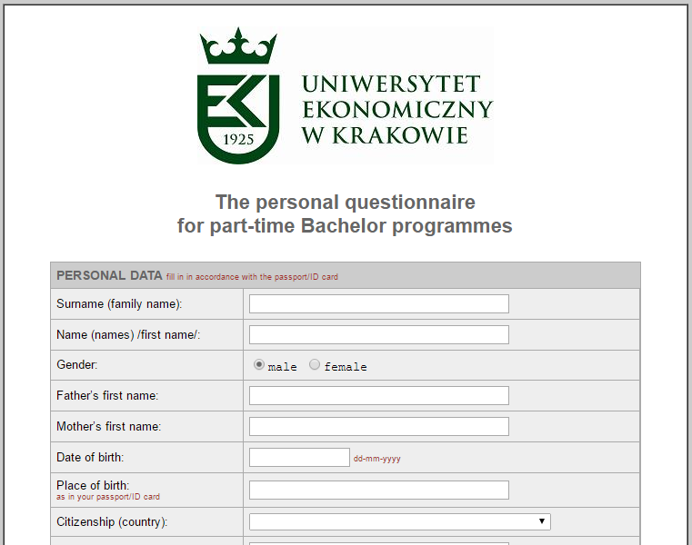
Fill in a form
In the form.html document, create a form according to the university form excerpt.
The form does not have to look exactly the same, as shown, but it must contain the same information.
To improve the form quality, use the bootstrap framework.
Create an object to store the form data. Add a method ‘display()’ for displaying the object properties in the console.
Add a ‘Submit’ button below the form.
After clicking on the button, save the form data (input fields) in the object. To retrieve the input field values, you can use the jQuery framework.
Then call the object method for displaying data in the console.

