Slide 1

Replication and Extension
Heterogenous Spillovers of Housing Credit Policy
Pidkuyko 2023
Connor Lewis and Prashant Bista
14 May 2026

Slide 2
Outline
What is the shock (Connor)
Context of paper (Prashant)
Identification Strategy (Prashant)
Data (Connor)
Theoretical Framework (Connor)
Empirical Framework (Connor)
Why does the ID Strategy work (Prashant)
Main findings/results (Connor)
Key assumptions (Prashant)
Threats to interpretation (Prashant)

Slide 3
What is the shock
Expansionary credit policy
1% net increase in net purchases by FNMA and FHLMC anticipated 2 quarters ahead of time
Increase in government holding of mortgages via secondary market

Slide 4
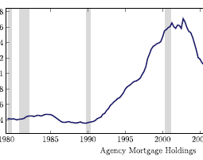
Context of Paper
Government activity in secondary mortgage markets affects mortgage lending and interest rates
Expansionary credit policy increases agency purchases of mortgages
Lower mortgage rates may increase household consumption
Paper studies how these policy interventions affect the largest component of GDP: household spending

Slide 5
Identification Strategy
Expansionary credit policy is endogenous to the business cycle
Agency purchases may respond to economic conditions
Authors use narrative news shocks as instruments (For example, long range goal to increase access to home ownership in US)
Fieldhouse & Mertens (2017) identify policy shocks unrelated to short-run business cycle movements
Estimation uses IV Local Projections

Slide 6

Data
Compilation of Consumer Expenditure Survey (BLS and ICPSR)
Survey of Consumer Finances (Federal Reserve)
Set of macro variables from FRED and researcher calculations
Use Fieldhouse and Mertens (2017) for the news shocks series
Extension: used compilation of consumer expenditure to create groups based on race, education level, and family size

Slide 7
Theoretical Framework
Gov (GSEs) purchases mortgages in secondary market
Decreases risk and cost for primary market lenders
Lower prices (mortgage rates)
Cheaper mortgages frees up spending, i.e. consumption
This policy lever can stimulate GDP growth
Notes:
Government sponsored enterprises

Slide 8
Theoretical Framework: Heterogeneous Agent Life-Cycle Model
Huggett (1996) heterogeneous agent life-cycle model
Mechanisms of empirical results:
Agency purchases push down mortgage rates
Lower rates improve refinancing options
refinancing reduces mortgage payments, allows for more spending
mortgagors use some relief for consumption
Though mechanism can raise home prices and homeownership, main mechanism is the effect on mortgage rates, spread between rates, refinancing incentives, and disposable cash flow

Slide 9
Empirical Framework
IV Local Projection estimation
Effect of shock on nondurable consumption among different groups
IV needed for for exogeneity of treatment
Models:
Overall
Housing Tenure
Age
Race
Education Achievement
Family Size

Slide 10
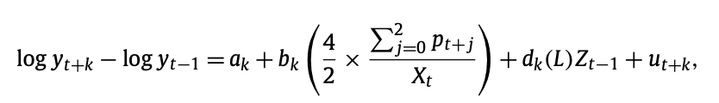
Empirical Framework: Estimating Equation
Control variables Z:
lagged growth rates of core PCE price index, nominal house price index, and total mortgage debt
log level of real mortgage originations
housing starts
lags of interest rate variables: 3-month t bill, 10yr treasury, mortgage interest rate, BAA-AAA corporate bond spread
Response d.y: household expenditure on non-durable goods and services (and other macro variables)
Parentheses: net agency purchases over 2 quarter period/annualized originations

Slide 11
Key Assumptions
News shocks are orthogonal to the business cycle
Instrument affects consumption only through agency purchase activity (IV exclusion)
Outcome variables are stationary after differencing
Lag structure correctly captures dynamic responses
Heterogeneous effects can be consistently estimated across groups

Slide 12
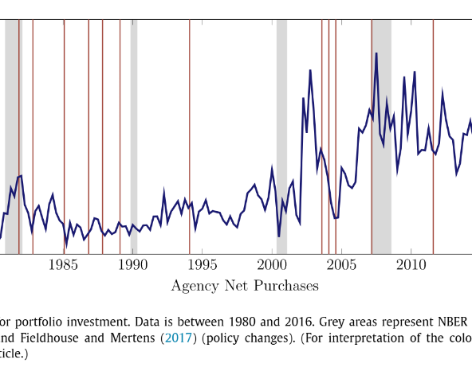
Why does the ID Strategy work?
Policy shocks are constructed to be unrelated to short-run business cycle
conditions
Narrative news shocks isolate exogenous variation in agency mortgage purchases
Instruments affect mortgage market activity directly
IV Local Projections trace dynamic responses over time
Helps separate causal effects from endogenous policy responses

Slide 13
Replication findings/results
Expansionary credit policy increases overall consumption
Heterogeneous effects
Homeowners with mortgage debt: significant increase
Non-homeowners: smaller
Homeowners without mortgaincreasege debt: small, insignificant effect
Young and middle aged: strong positive response
Old: no significant response
Distributional concerns: households with mortgage debt gain more
Renters could reduce spending bc lower rates may incentivize saving for homeownership
Replication confirms results

Slide 14
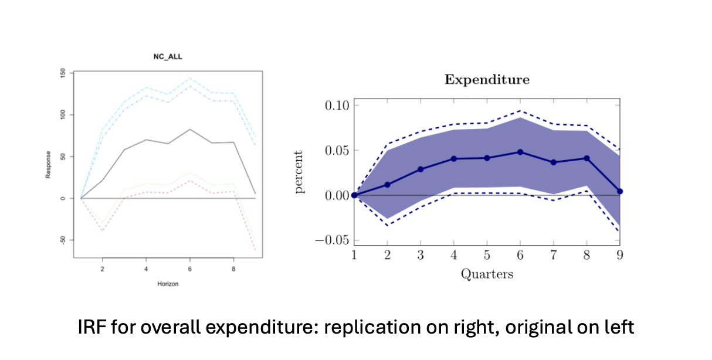
Replication IRFs Overall

Slide 15
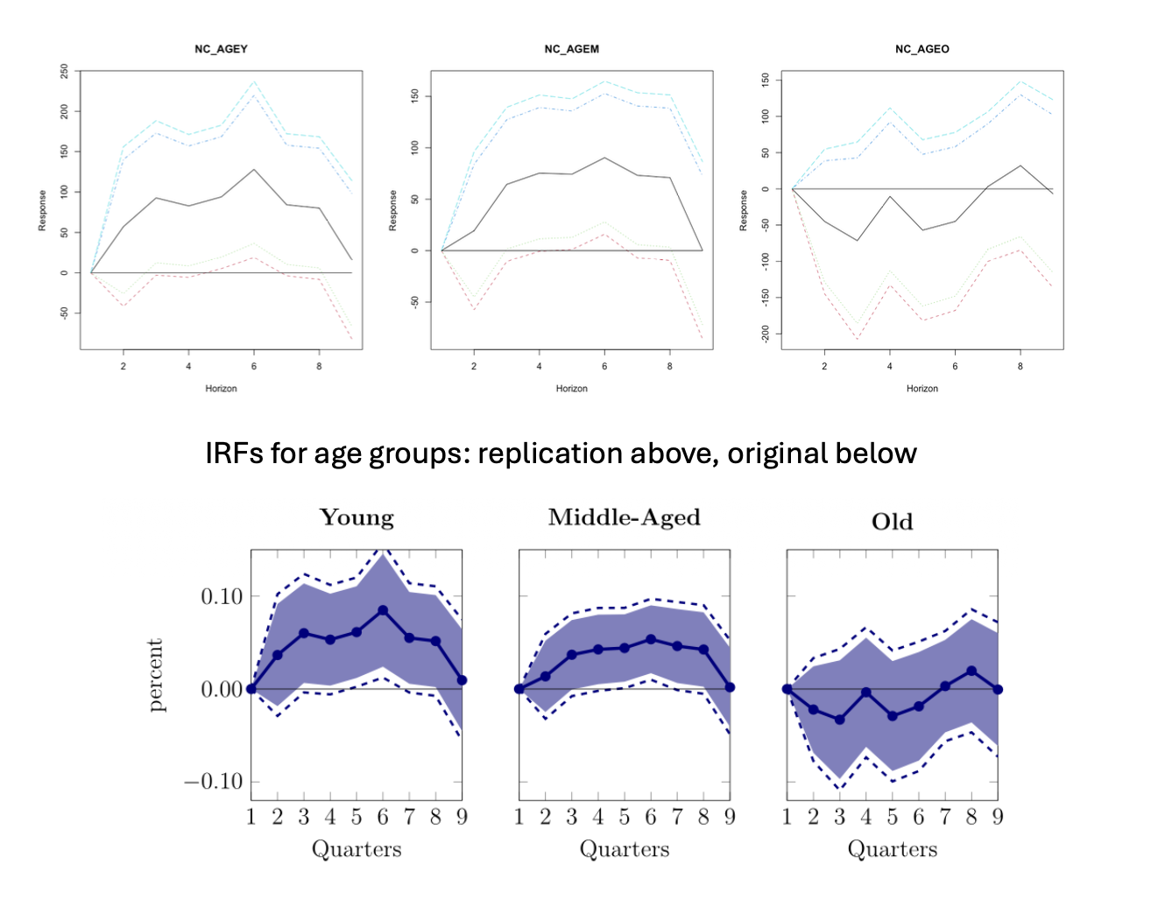
Replication IRFs Age

Slide 16
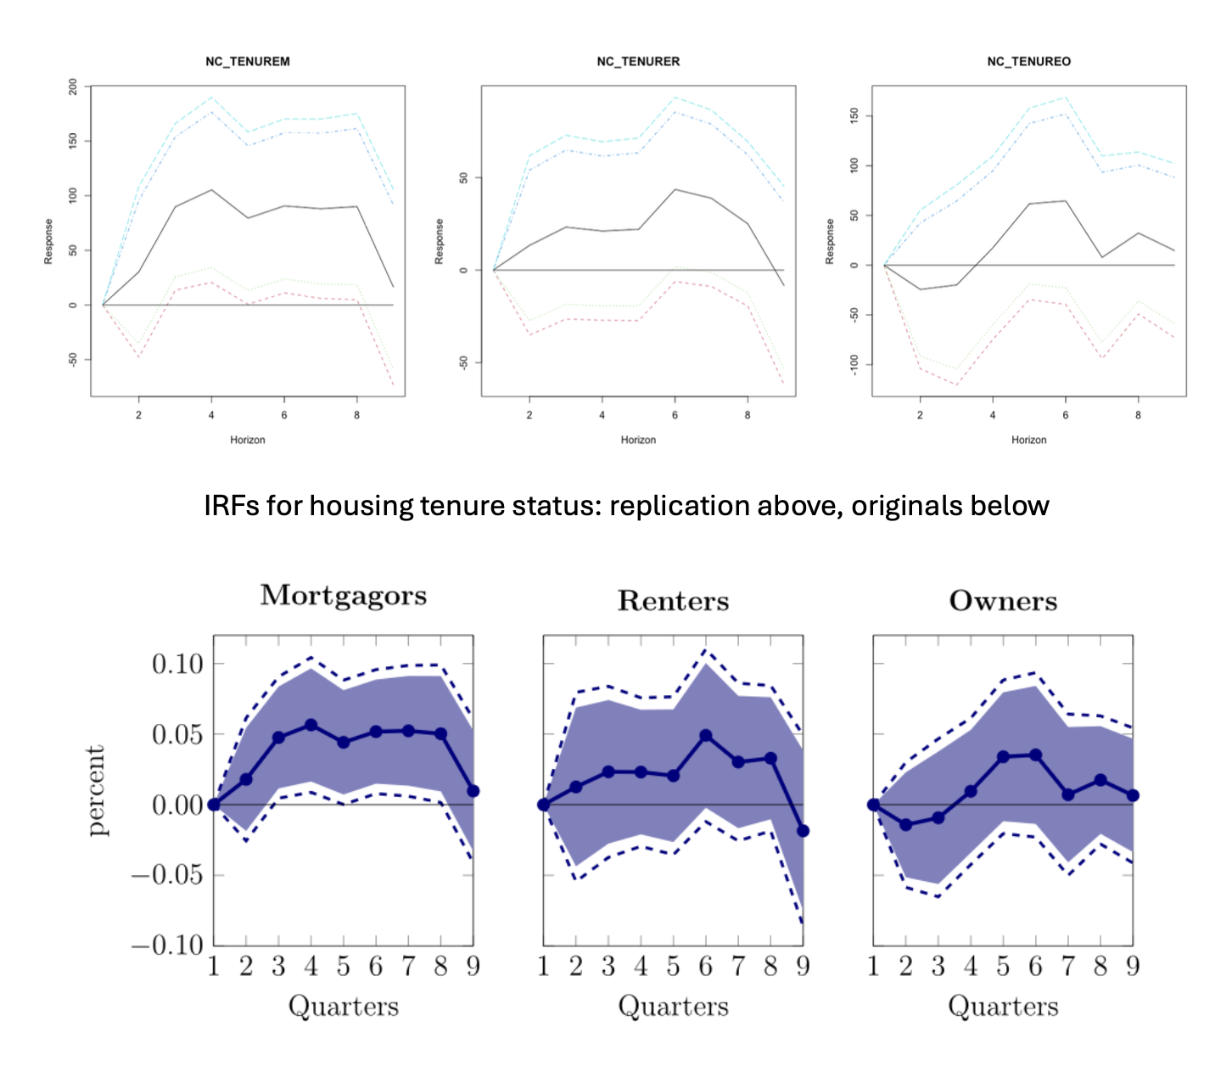
Replication IRFs Housing Tenure

Slide 17
Extension Findings/Results
Investigated heterogeneous effects in other subgroups of population
Race
Black, white, other
Educational attainment
No HS degree, HS degree, college degree
Family size/household size
Single person, two-person, family (3+)
Found disparities in the distribution of treatment effects
White households benefit the most
Black households less and not significant
Other has no effect
Benefits increase with degree achievement
Benefits vary less with household size, but favor two-person and families

Slide 18
Extension Findings/Results
POLICY EFFECTS HAVE LIMITED EFFECTS FOR THOSE WHO ARE GENERALLY MARGINALIZED
PROVIDES EVIDENCE OF SUSTAINED IMPACT OF REDLINING
IMPORTANT FOR POLICY MAKERS TO UNDERSTAND HOW IMPACTS VARY

Slide 19
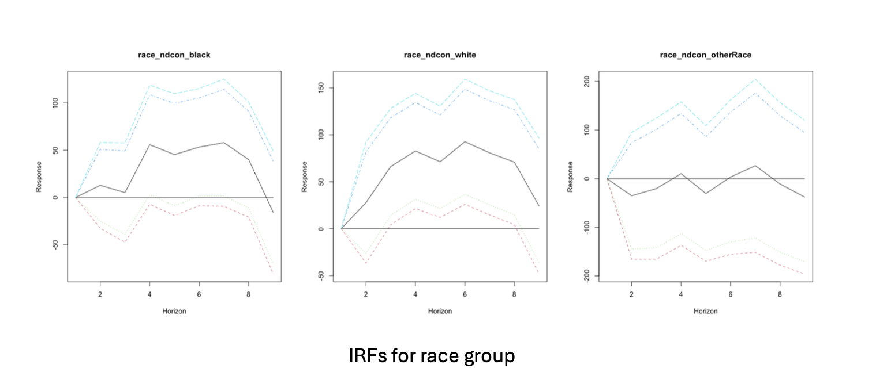
Extension IRFs Race

Slide 20
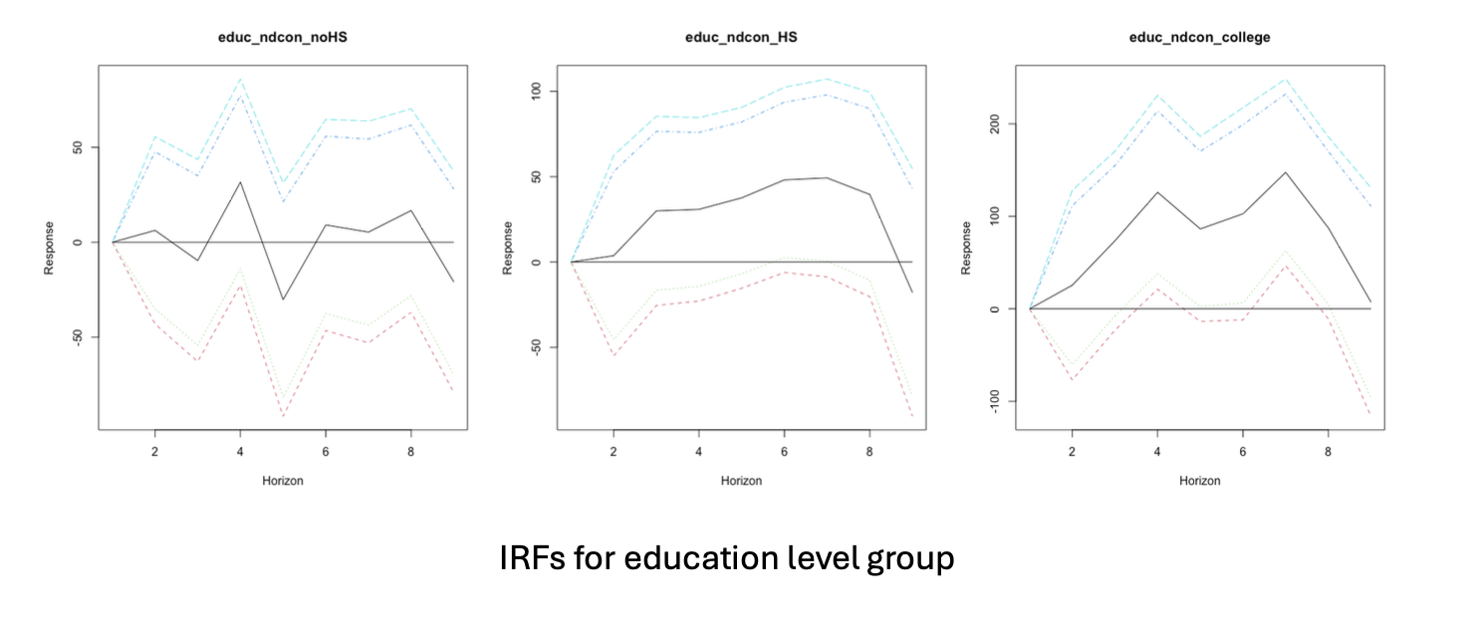
Extension IRFs Education Level

Slide 21
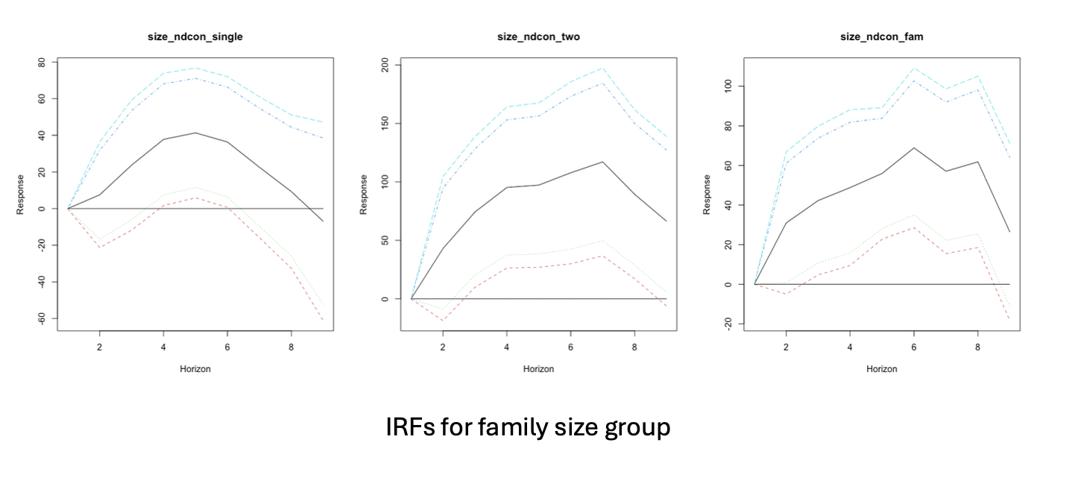
Extension IRFs Family Size

Slide 22
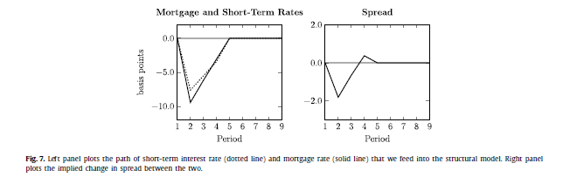
Threats to Interpretation
Agency purchases may still respond to macroeconomic conditions
Mortgage interventions can also affect broader interest rates and financial markets
Difficult to fully isolate mortgage-channel effects from other transmission mechanisms
Small number of policy intervention episodes limits statistical precision
Potential omitted macroeconomic factors may still influence results

Slide 23

Conclusion
When the government intervenes in the secondary mortgage market, it provides relief that increases consumption
Can be a valid tool for reducing downturn effects
Disparities in distribution of effects
Notable along racial, wealth, educational, and generational lines
This makes sense because mortgages are for houses
However, policy makers should be aware of these mechanics

