Slide 1

DriverPass System Analysis
Zane Milo Deso

Slide 2

System Requirements
Functional Requirements
Validate user credentials when logging in
Allow Scheduling of lessons
Non-Functional Requirements
Azure Back End
CosmosDB
Notes:
For DriverPass’s system, I identified two key types of requirements: functional and non-functional requirements. The functional requirements include validating user credentials when logging in and allowing the scheduling of lessons. Validating user credentials functions when a user tries to access the system, their username and password are checked for accuracy before they are allowed in. This is essential for maintaining the security of the system by making sure that only authorized users can access their accounts and schedule lessons. The scheduling of lessons allows users to book their driving lessons through the system. It’s a core function of DriverPass, making it so that students can manage their learning schedule easily and that lessons are tracked in the system. The non-functional requirements include Azure back end and CosmosDB database. Azure provides a reliable and scalable cloud infrastructure for the DriverPass system. This back end ensures that the system remains operational, even as the number of users grows, and provides the flexibility to expand features as needed. CosmosDB is a globally distributed database service provided by Azure. It saves user information and lesson schedules, to store and retrieve it quickly and securely, no matter where the user is located. This non-functional requirement creates a seamless experience for maintaining fast and efficient operations across different regions for the business. These requirements collectively capture the need that DriverPass operates efficiently and securely, meeting the core needs of its users while also providing a robust infrastructure that can scale as the business grows.

Slide 3
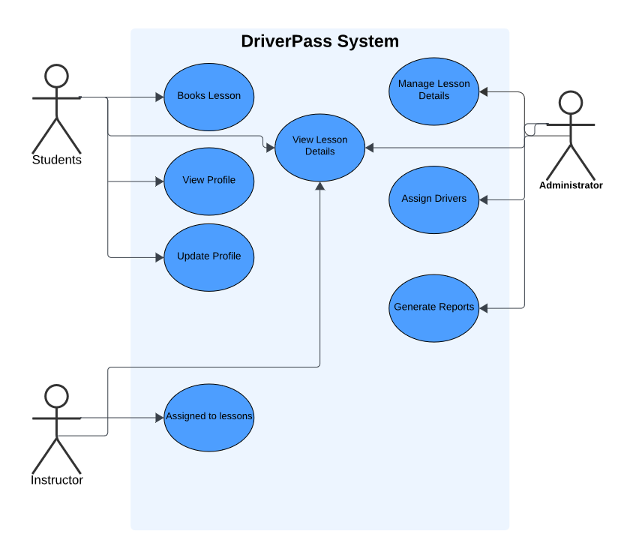
Use Case Diagram
Notes:
This diagram outlines how different people interact with the DriverPass system to perform their tasks. The system is designed for three main groups: students, instructors, and administrators. Students can book lessons, view and update their profiles, and check the details of their lessons. This allows them to easily manage their learning schedule and personal information. Instructors are assigned to lessons, and they can view which lessons they are scheduled to teach. Administrators have more control; they manage lesson details, assign drivers to students, and generate reports. This role is important for keeping the system organized and making sure that all operations run as expected. The design of this system addresses DriverPass’s needs by making sure that each group has the tools and information they need to fulfill their responsibilities effectively. By organizing the system this way, it’s easier to manage operations, track progress, so that every user has access to the specific features they need.

Slide 4
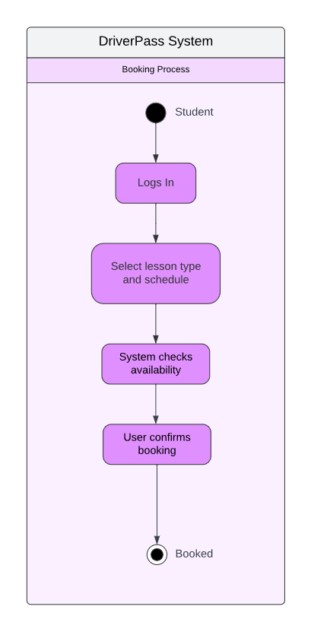
Activity Diagram
Notes:
This diagram illustrates the booking process for a student using the DriverPass system. The steps are straightforward: First, the student logs into their account. Then, they choose the type of lesson they want and select a time and date for it. The system automatically checks if that time slot is available. If everything is good to go, the student confirms their booking, and the lesson is scheduled. In designing this process, I focused on making it as simple and user-friendly as possible. Extra steps can deter users, and I wanted to avoid that. This design meets DriverPass’s needs by making a smooth booking experience, helping to reduce any potential frustration for students by making it easier for them to prepare for their driving tests.

Slide 5
Security
Users require following info:
First, Last name
Address
Phone Number
State
Credit card number
Expiration date
Security Code
Lock out account
After failed account recovery
Wrong password more than 5 times in 24 hours
Notify Admin of locked out account or attempted breach
Security Groups for all user levels
Each group has tokens that have access to varying scopes
General/User key cannot access higher levels
Secretary can access General/User level functions and their own
Admin/Owner key can access all levels
Notify Admin if API call with incorrect token/key
Notify Admin of anomalies in network traffic, latency, increased lookup times and failed tests
Notes:
When designing the DriverPass system, security was a top priority to protect our users and their information. We require users to provide up front details like their name, address, and credit card information, which is stored securely. If someone tries to access an account with the wrong password too many times, the system automatically locks them out and notifies the admin to prevent unauthorized access. We also have different levels of access for users, secretaries, and admins. This way each group can only perform specific actions within the system. Additionally, if anything unusual happens, like slow performance or suspicious activity, the system alerts the admin immediately to address the issue. This approach helps always keep our users' data safe and secure.

Slide 6
System Limitations
Limited number of users accessing resources simultaneously
Secretary availability
System drag or slowing as databases grow in size
Learning content may not be comprehensive
Differing state regulations
Different classes of driver’s licenses
Number of instructors available
System Admin availability
Payment options are limited to only credit cards
Credit Card info required to sign up
Email required to sign up
Lacking online test and lesson variety
Leading to memorization instead of internalizing lesson information
Budget may not be large enough to incorporate all requirements initially
Notes:
The DriverPass system has some limitations that could affect its performance and user experience. For instance, if too many users try to access resources at the same time, the system might slow down or not work as smoothly. Additionally, the availability of key staff, like secretaries and system administrators, cannot be understated since they manage important parts of the system. Their absence could cause delays or issues. As the system grows, particularly as more data is added over time, it might experience slower performance, which can impact how quickly users can complete tasks. Moreover, the content provided for learning might not cover every aspect needed for different states or types of driver’s licenses, which could limit its effectiveness. Lastly, budget constraints might mean that not all features or improvements can be implemented immediately, potentially delaying some system enhancements.

