Slide 1
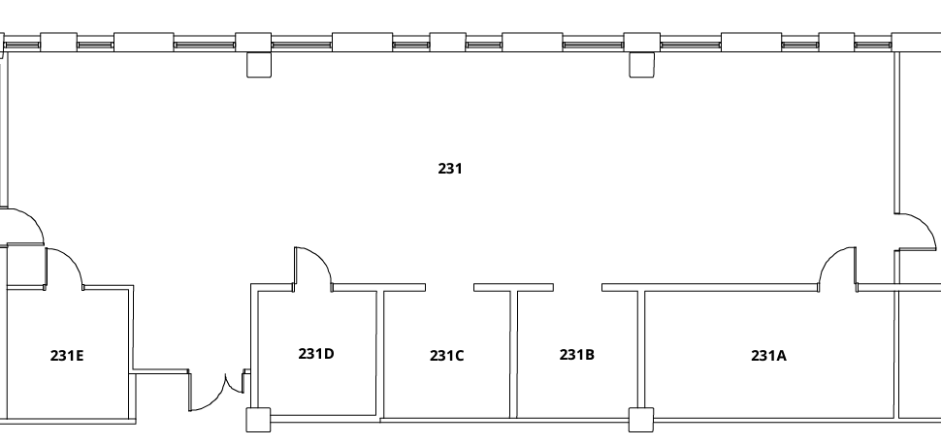












INV-231 Floor Plan
Jesse Zanevald
Jesse Zanevald
Marc Servetinick
Kristina
Kristina
Marc Servetinick
Fire Extinguisher
First Aid Kit
Gas Valve
Gas Cylinder
Sink w/ Eye Wash
Chemical Spill Kit
Electric Panel
Freezer
Emergency Shower
Fire Alarm
Flammables Cabinet
Gloves

