Slide 1

Object Oriented Programming
Java Standard Edition

Slide 2

Course objectives
Object Oriented Programming
By completing this course you will be able to:
Explain the concept of OOP
Create complete Java classes
Explain the different types of methods and attributes
Apply encapsulation concepts
Design class hierarchy using abstract classes and interfaces
Explain the concept of garbage collection

Slide 3


Course objectives
Object Oriented Programming
Classes
Kind of attributes/methods
Member Visibility
Aggregation & Encapsulation
Inheritance
Polymorphism
Immutable Types
Garbage Collector
Package Design

Slide 4
Classes
Object Oriented Programming
What is an object ? What is a class ?

Slide 5

What is an object?
Classes
An entity has a state and a behavior
Modeling real entities …
Cars, Person, Bank account, …
… objects having a name …
porsche, johnDoe, myAccount, …
… having attributes …
color, weight, a balance, …
… and methods.
to slow down, to speak, to credit, …

Slide 6
What is a class?
Classes
A structure having attributes and methods
Definition of a group of objects having :
Same characteristics
Same behavior
Example: every car can slows down, has 4 wheels, …
A data type :
That we can make instances of it

Slide 7


What is a class?
Classes
The Car class
String color
float currentSpeed
String brand
make instance
make instance
int break()
int accelerate()
int start()
Each car has the same attributes but not the same value for them.
Each car has the same behavior.

Slide 8
How to make a class?
Classes
Create a file with the .java extension
Usually each file contain only one class
Each file MUST contain only one public class and they must have the same name
The class keyword is used to declare a class
public class Car {
}

Slide 9

Conventions
Classes
The class name begins by
an upper case
We also put an upper case for each
word in the name

Slide 10
How to create instances?
Classes
Use the new keyword to create an instance
Instantiation return an object having :
The same attributes (but with different values)
The same methods (the same behavior)
Car myCar = new Car();
Car yourCar = new Car("orange");
The Heap
Object1
myCar | 0xE29
yourCar | 0xF5A
Object2
The Stack

Slide 11
What is a constructor?
Classes
A special method :
Executed when a new instance of an object is created
Called with the new keyword
Must have the SAME name than the class
If you don't create one, the compiler create a default one
public class Car {
// The default constructor
public Car(){
//The constructor body
}
}

Slide 12
Constructor overloading
Classes
You can overload a constructor:
Like any other methods!
It allows to create specialized constructors
public class Car {
public Car(){
//Constructor with no parameter
}
public Car( String color ){
//Overloaded constructor with a parameter
}
}

Slide 13
Design of instanciation
Classes
Instantiate is creating an exemplary of our class:
Like a car factory create exemplars of cars
My class
My program
I use new to
create a new
object
new calls the constructor of my class
Instance
Now, I can use my object
and instantiate as many
other objects as I want
the class constructor create an object
and gives a reference to my program

Slide 14
Accessing attributes/Methods
Object Oriented Programming
How to access the attributes and methods?

Slide 15
Instance variables
Accessing attributes/Methods
Also called attributes
Define the state of objects
Their value is specific to one and only one instance !
public class CatLike {
String color;
String name;
float weight;
}

Slide 16
Instance methods
Accessing attributes/Methods
Code block defining a behavior of the instance
Declared in the class
Can be overloaded
public class MyClass {
// ...
public void myMethod() {
// my actions
}
}

Slide 17
Instance access
Accessing attributes/Methods
Define properties and functions are great!
But how can we access it?
Call an attribute: instanceName.instanceAttribute;
Call a method: instanceName.instanceFunction();
myBeautifulCat.name;
myInstance.myMethod();

Slide 18
Class variables
Accessing attributes/Methods
Linked to the class itself, not to a particular instance
Every instance will have the same value for them !
Declared with the static keyword
No need to have a class instance to access them
public class CatLike {
String color;
String name;
float weight;
static int numberOfCatLike;
}

Slide 19
Class methods
Accessing attributes/Methods
Code block defining a general behavior or a service
Declared with the static keyword
Can be overloaded
No need to have a class instance to access them
public class MyClass {
public static void myMethod() {
//our actions
}
}

Slide 20
Class access
Accessing attributes/Methods
Be careful, we can’t call them the same way!
So how can we access it?
Call an attribute: ClassName.classAttribute;
Call a method: ClassName.classFunction();
CatLike.numberOfCatLike;
MyClass.myMethod();

Slide 21
Conventions
Accessing attributes/Methods
The variable and method names
begins by a lower case
We use an upper case for each word
in this name

Slide 22
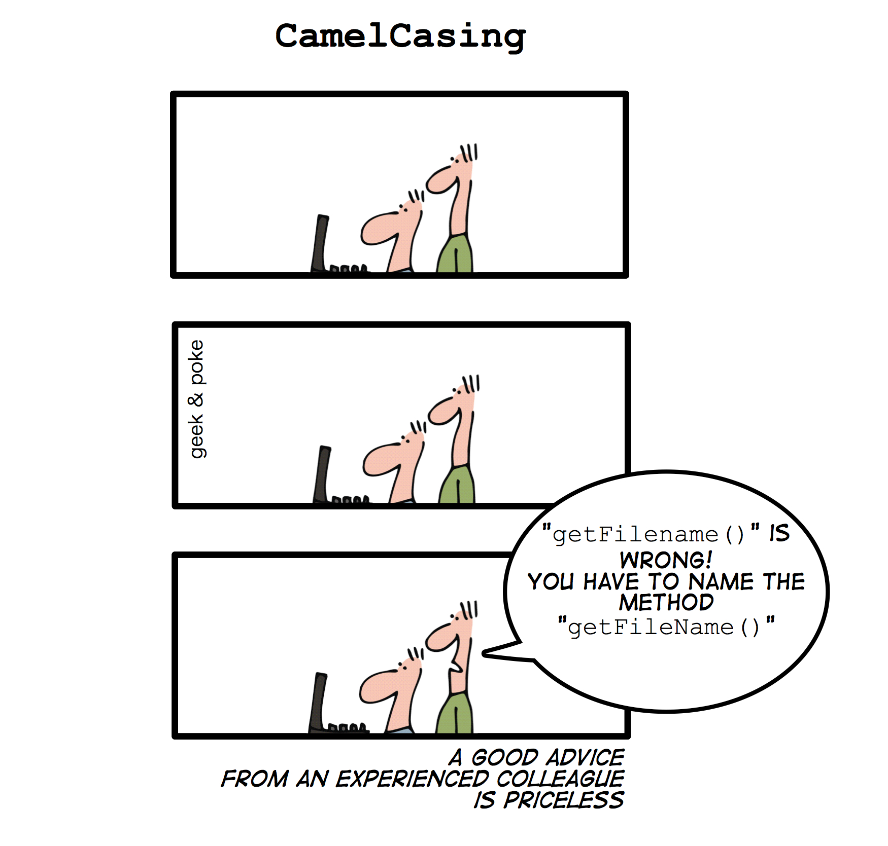
Conventions
Accessing attributes/Methods

Slide 23
The "this" pointer
Accessing attributes/Methods
Keyword used to :
Refer to the current instance :
this
Use the own attributes/methods of the current instance :
this.myVariable;
Call the instance own constructor (in another one)
MUST be the first instruction !
this("Tomi","White");

Slide 24
Quizz
Accessing attributes/Methods
What does it display?
public class MyClass {
static int test = 6;
public MyClass() {
int test = 4;
System.out.println("Test = " + test);
}
public static void main(String args[]) {
new MyClass();
MyClass.test = 8;
}
}

Slide 25

Member visibility
Object Oriented Programming
Who can access what.

Slide 26

Presentation
Member visibility
Methods and instance fields can have visibility modifiers, but local variables cannot
Java has four different access controls :
Public
Private
Default
Protected
We’re gonna see each of them

Slide 27
Public Access
Member visibility
A public method or attribute is accessible everywhere in your application
public class MyClass { // Public class
public int myVar; // Public attribute
public MyClass() { // Public constructor
}
public void doSomething() { // Public method
}
}

Slide 28
Private Access
Member visibility
Only accessible inside the class :
Impossible to access it outside !
private class MyClass { // Private class
private int myVar; // Private attribute
private MyClass() { // Private constructor
}
private void doSomething() { // Private method
}
}

Slide 29
Default Access
Member visibility
Default access doesn’t have keyword
It is the default access when nothing else is defined
A method or attribute with default access is only accessible by classes in the same package
class MyClass { // Default access class
int myVar; // Default access attribute
void doSomething() { // Default access method
}
}

Slide 30
Protected Access
Member visibility
Only accessible by classes in the same package AND classes which extend it
Perfect access control to share a method or an attribute with subclasses ! (we’ll see them later)
class MyClass {
protected int myVar; // Protected attribute
protected void doSomething() { // Protected method
}
}

Slide 31
public class BankAccount {
private String accountNumber;
private double balance;
private int nbActions;
public void creditAccount(double amount) {
balance += amount;
addTransaction();
}
public void debitAccount(double amount) {
balance -= amount;
addTransaction();
}
public double getBalance() { return balance; }
private void addTransaction() { nbActions++; }
}
Class example

Slide 32
public class Main {
public static void main(String[] args) {
BankAccount acc = new BankAccount();
System.out.println(acc.getBalance()); // 0.0
acc.creditAccount(3.2);
System.out.println(acc.getBalance()); // 3.2
acc.debitAccount(1.2);
System.out.println(acc.getBalance()); // 2.0
// Compilation error !
System.out.println(acc.balance);
System.out.println(acc.addTransaction());
}
}
Program example

Slide 33
Aggregation & Encapsulation
Object Oriented Programming
Use other objects in a class and encapsulate fields.

Slide 34
Aggregation
Aggregation & Encapsulation
The fact to associate an objet to another …
An attribute has a class type
Declared like any other attributes
In two words, it’s putting an object as attribute of another one

Slide 35
Aggregation
Aggregation & Encapsulation
Example:
I want to add an Owner with a lastname, a firstname and an age to my Cat. But the Owner also have an Address with a street, a city, a country and a zip code
CatLike
Address
String name
String color
float weight
Owner myOwner
Owner
String street
String city
String zipCode
String country
String name
String firstName
int age
Address myAddress

Slide 36
Encapsulation
Aggregation & Encapsulation
The fact the object is a kind of “black box”
Attributes are declared private or protected
The only way to modify the state of the object ?
Use instance methods ! To modify attributes from outside the class, use public methods !

Slide 37
Encapsulation
Aggregation & Encapsulation
My Object
Other parts of my program
My public methods
My private attributes

Slide 38
Encapsulation
Aggregation & Encapsulation
Why use it?
You can protect the attributes value
You can validate new values
What does it induce?
You have a full control on your attributes
Do you have to write "special" methods?
Yes, let's go to the next slide ☺

Slide 39
Getter/Setter
Aggregation & Encapsulation
The way to access private attributes
An object oriented norm
The getter :
Retrieve the value of an attribute
Its common name: getXXX();

Slide 40
Getter/Setter
Aggregation & Encapsulation
The setter:
Set the new value of an attribute
Its common name: setXXX(newValue);
Example of use:
Put a String in upper case
Don't replace a number by a negative value

Slide 41
Getter/Setter
Aggregation & Encapsulation
Syntax for:
A private/protected attribute named myNumber (int):
A private/protected attribute named checked (boolean):
public int getMyNumber() { ... }
public void setMyNumber(int myNumber) { ... }
public boolean isChecked() { ... }
public void setChecked(boolean checked) {...}

Slide 42
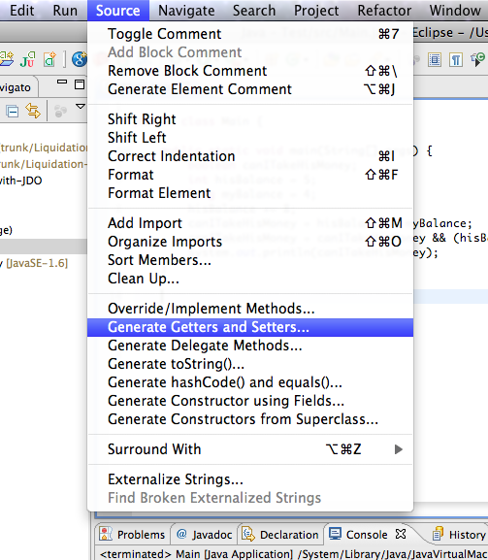
Getter/Setter
Aggregation & Encapsulation
Do not be frightened by all this code to write!
Eclipse is your friend and can do that for you ☺

Slide 43
JavaBean
Aggregation & Encapsulation
Particular class used to encapsulate many objects into a single object (the bean)
A JavaBean is a class having :
A default constructor with no parameters
But you can overload it
Only private attributes
Getters/setters for each attribute.
Commonly, a JavaBean implements Serializable

Slide 44

Inheritance
Object Oriented Programming
What is that? And how to use it?

Slide 45
From the concept…
Inheritance
Consider the human race…
A child inherits some characteristics of his parents :
Maybe the hair color …
A child inherits some behavior of his parents :
Maybe their kindness ☺
Maybe a special recipe
But can do it differently !

Slide 46
…to the code
Inheritance
A class inherits some properties of its "mother” class:
Has access to the public & protected attributes/methods
Can redefine (override) the behavior of the mother (super) class for its own
Overriding methods
Kind of specialization
It is done via the extends keyword!
A class can inherit only one class:
Like you, yes you, only have one biological mother ☺

Slide 47
Illustration
Inheritance
CatLike
Subclasses have a is-a relationship with their mother
String name
String color
float weight
Owner myOwer
Cat extends CatLike
Tiger extends CatLike
The Cat has automatically all the methods and attributes of the CatLike
The Tiger has automatically all the methods and attributes of the CatLike

Slide 48
super keyword
Inheritance
You can call constructors, methods from the super class (mother class) thanks to the super keyword!
public class Cat extends CatLike {
public Cat(String name, String color, Owner owner) {
// We call the super class constructor
// Must be the first intruction ...
super(name,color,weight,owner);
}
public void eat() {
super.shout(); // We call the super class method
}
}

Slide 49
Note
Inheritance
A constant variable in Java is declared like any other variable except that it is declared final and static
By convention, a constant variable is fully uppercase and words and separed by an underscore

Slide 50

Polymorphism
Object Oriented Programming
Polymorphism, abstraction, interface…

Slide 51




Presentation
Polymorphism
Allows to use an instance with its mother type
Example:
Create an array of Poultry and put Ducks and Chickens (where Chickens and Ducks are Poultries)
Array of Ducks
Duck georges
Duck gertrude
Chicken georgette
Chicken alberta

Slide 52
Presentation
Polymorphism
Allows to declare a variable with the mother type and instantiate it with the subclass type:
public static void main (String args[]) {
CatLike myCat = new Cat("Fifou","Blue",70, "me","Tigrou");
CatLike myCatLike = new CatLike("Doudou","Green",6);
CatLike [] tabCatLike = new CatLike [4];
tabCatLike[0] = myCat;
tabCatLike[1] = myCatLike;
System.out.println("The first cat of my table is: " + tabCatLike[0].getName());
}

Slide 53
Presentation
Polymorphism
You can only call methods defined into CatLike class on array elements :
Because for the compiler, elements have CatLike type
To call a Cat method, cast the result into Cat type!
Cat myCat = (Cat) myCatLikeVariable;
You have the declared type and the real type.
You can put in an array of declared type, instances of declared type and real type (as long as real type extends declared type)

Slide 54
Object superclass
Polymorphism
The Object superclass:
Is the root class of all classes! (Even if you don't extend it…)
Has methods you can override:
Method | Description
public boolean equals(Object o) | Indicates whether the object is equal to this one, according your choice.
public String toString() | Returns a String representation of the object.
public int hashCode() | Returns the hash code value of this object.
public void finalize() | Method called when the instance is destroyed by the Garbage Collector.

Slide 55
Object superclass
Polymorphism
The toString() method:
Useful to return a textual representation of an object
public class MyClass {
public String toString() {
return "Here is my wonderful object :)";
}
}

Slide 56
Object superclass
Polymorphism
The equals() method :
Returns true if two objects’ references are equals. It is:
Reflexive: x.equals(x) should return true
Symmetric: x.equals(y) should return true if and only if y.equals(x) returns true
Transitive: if x.equals(y) returns true and y.equals(z) returns true, then x.equals(z) should return true
Consistent: multiple invocations of x.equals(y) consistently return true or consistently return false
For any non-null reference value x, x.equals(null) should return false

Slide 57
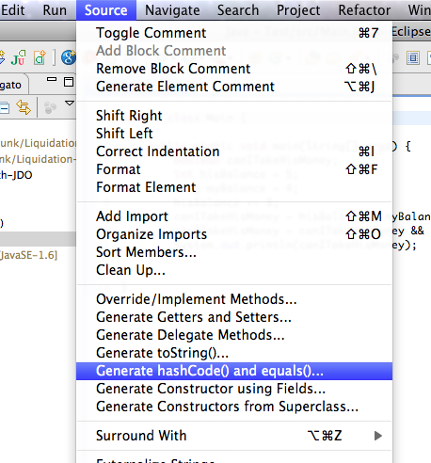
Object superclass
Polymorphism
The hashCode() and equals() method:
Note that it is generally necessary to override the hashCode method whenever the equals one is override!
Don’t be afraid, Eclipse can generate these methods ☺

Slide 58
Abstract methods
Polymorphism
Do not have a body
Can only be in abstract classes or in interfaces
Subclasses must define the body
Why use it?
To generalize a behavior in all subclasses

Slide 59
Abstract methods
Polymorphism
Example:
public abstract class CatLike {
public abstract void shout ();
//The subclasses MUST redefine this method !!
}
public class Cat extends CatLike {
// Override → Method redefinition
public void shout () {
System.out.println("Miaouuuu");
}
}

Slide 60
Abstract class
Polymorphism
Kind of skeleton for subclasses
Declared with the abstract keyword
Can not be instantiated !!
No new MyAbstractClass();
Can contains :
Instance attributes and methods, class attributes and methods
Constructors !!
Abstract methods :
Without body
Obligatory defined in the subclasses

Slide 61
Interface
Polymorphism
An agreement of class
Defines the methods to implement :
Abstract Methods!
Can contain public static final variables
Can not be instantiated
Declared with the interface keyword
A class can implements several interfaces
An interface can extends several interfaces

Slide 62
Interface
Polymorphism
Example:
public interface CatLike {
void shout(); //Methods are implicitly abstract
void eat();
void hunt();
}

Slide 63
Interface
Polymorphism
interface Animal {
Example:
In Tiger, we must define the methods of the Animal & Wild interfaces and abstract methods of CatLike
extends
abstract class CatLike {
interface Wild {
extends
implements
class Tiger extends CatLike implements Wild {

Slide 64

Exercises (1/9)
Polymorphism
Do you know the Conway’s Game of Life ?
It’s a cellular automation devised by the British mathematician John Horton Conway in 1970.
It’s a zero-player game :
Its evolution is determined by its initial state, requiring no further input.
We’re gonna develop one in Java Language !
More information is available on Wikipedia :
http://en.wikipedia.org/wiki/Conway%27s_Game_of_Life

Slide 65
Exercises (2/9)
Polymorphism
What are the rules ?
The universe of the Game of Life is an infinite two-dimensional grid of cells.
Each cell is in one of two possible states :
Live or Dead.
Every cell interacts with its eight neighbors.

Slide 66
Exercises (3/9)
Polymorphism
What are the rules ?
At each new generation, the following transitions occur :
Any live cell with fewer than two live neighbours dies, as if caused by under-population.
Any live cell with two or three live neighbours lives on to the next generation.
Any live cell with more than three live neighbours dies, as if by overcrowding.
Any dead cell with exactly three live neighbours becomes a live cell, as if by reproduction.

Slide 67
Exercises (4/9)
Polymorphism
Let’s go to code it :
Create a new Java Project
Create a new package named com.myschool.gameoflife
We are going to create five java file inside it:
Launcher : Just a simple class containing the main method
World : Represent the world of the game
Cell : Represent a cell of the game
DeadCell : Special cell representing a dead one
AliveCell : Special cell representing an alive one

Slide 68
Exercises (5/9)
Polymorphism
Let’s go to code it :
Create an interface named Cell :
It must contain some abstract methods :
Cell newGeneration(int nbNeighbours) :
Return the next generation cell depending on the number of neighbours.
String getAsString() :
Return a String representation of the cell state.
boolean isAlive() :
Return if the cell is currently alive or not.

Slide 69
Exercises (6/9)
Polymorphism
Let’s go to code it :
Create a class named DeadCell:
It must implement the Cell interface, following the game rules
When you’ll implement getAsString() method, represent dead cells by a minus ( - )
Create a class named AliveCell:
It must implement the Cell interface, following the game rules
When you’ll implement getAsString() method, represent alive cells by a zero ( 0 )

Slide 70
Exercises (7/9)
Polymorphism
Let’s go to code it :
Create a class named World :
It must have one constructor :
World(int nbColumns, int nbRows) :
Initialize a random world with the specified size.
The world will be represented as a double dimension array of Cell

Slide 71
Exercises (8/9)
Polymorphism
Let’s go to code it :
Create a class named World :
Define a public method :
void newGeneration() :
Change the world to the next generation.
Override the toString() method :
It must return a String value containing the current generation number and the world content with all its cells.

Slide 72

Exercises (9/9)
Polymorphism
Let’s go to code it :
Create a class named Launcher :
It must contain the main method which will create the World object and manipulate it.

Slide 73

Package design
Object Oriented Programming
Why is it useful to divide our application?

Slide 74
Presentation
Package design
Each Java class is located in a package
A package gathers classes :
fr.mycompany.myproject.myobjectstype
Use the package keyword to indicate in which package the class is
Packages make physical folders on your project folder
Each dot in the package name indicates a new folder

Slide 75
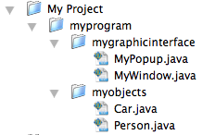
Illustration
Package design
MyProject
myprogram.mygraphicinterface
MyPopUp.java
MyWindow.java
myprogram.myobjects
Car.java
Person.java

Slide 76
Declaration
Package design
MUST be the first instruction of your class if it is inside a package
Naming convention :
Reverse domain name – eg: com.myschool.myproject
The name of your program or module – eg: myproject
The name of your submodules – eg: model or ui or dao
package com.myschool.myproject.model;
public class User {...}

Slide 77
Note
Package design
We use a dot "." to separate
the package parts
By convention, the whole package name must be in lower case and
only contains letters

Slide 78
Import
Package design
Importing a class allows us to work with it:
If not, how Java knows which User definition you use?
Done with the import keyword :
package com.myschool.myproject.vehicle;
import com.myschool.myproject.model.User;
// Now you can use the User class in the current // class
public class Car {
String color;
float currentSpeed;
User user; // Let’s use the class included
}

Slide 79

Garbage collector
Object Oriented Programming
Removing unused references …

Slide 80
Design of object referencing
Garbage Collector
Two memory areas
The Stack
The Heap
The Stack contains primitive types and references to objects
Heap contains objects values

Slide 81
Design of object referencing
Garbage Collector
Stack memory
Memory schema:
1001…0001
1001…0001
1011…1101
Heap memory
Object which resides in heap memory at
Object which resides in heap memory at
1001…0001
1011…1101

Slide 82
Remove a reference
Garbage Collector
Affect to a reference variable :
A null value
A new object
CatLike myCat = new CatLike("White");
System.out.println(myCat.color); // White
myCat = new CatLike("Red"); // Remove old ref.
System.out.println(myCat.color); // Red
myCat = null;
System.out.println(myCat.color); // NullPointerException !!

Slide 83
Design of object dereferencing
Garbage Collector
Stack memory
null
1001…0001
myCat
New instruction
The instance is no more referenced
CatLike myCat =
new CatLike()
Heap memory
myCat = null
New CatLike Object created
…
1001…0001
…

Slide 84
Concept
Garbage Collector
The Garbage Collector…
Cleans the memory
Destroys no more referenced instances
Is called automatically, but you can suggest the JVM to execute it with:
System.gc();
The object method finalize() is called before the instance is destroyed:
protected void finalize() throws Throwable { }

Slide 85
Exercises (1/2)
Garbage Collector
Modify your Game of Life project :
In your main method :
Create a big world (>= 1000x1000 for instance).
Write a loop to compute the 1000 next generations.
Between each iteration, add a 3-second pause thanks to the following instruction :
Thread.sleep(3000);
Run your application!

Slide 86
Exercises (2/2)
Garbage Collector
Launch VisualVM!
It is supposed to be inside the bin folder of your JDK installation folder
Connect you to your running application
Observe the Monitor and Sampler tabs and look the Garbage Collector in action!
Try to launch yourself the Garbage Collector and look at the memory graph

