Slide 1

Exceptions
Java Standard Edition

Slide 2

Course objectives
Exceptions
By completing this course you will be able to:
Explain what exceptions are
Manage them and keep your code clear and efficient
Create and throw your own exceptions
Use exception and make your code safer

Slide 3


Course plan
Exceptions
Introduction. What are exceptions?
The try/catch/finally blocks. Several ways to handle them.
The throw/throws keywords. Centralize handling and throw exception.
Create your own exceptions. What to do to redefine the process?
Read a Stack Trace. How understand a Stack Trace.

Slide 4

Introduction
Exceptions
How to manage abnormal situations in Java?

Slide 5

Definition
Exceptions
“An exception is an event, which occurs during the execution of a program, that disrupts the normal flow of the program's instructions.”
– Sun Microsystems

Slide 6

What is an exception?
Introduction
Exception This is an exception
ARGHH ! An exception is thrown !
An error ? No, this is NOT necessarily an error
...
public void doSomething() {
doSomeStuff();
doSomeOtherStuff();
doItAgain();
}
...
Kinds There are two kinds of exceptions
(we’ll see it later)
Your program is executing fine but...

Slide 7
What is an exception?
Introduction
Exceptions are Java Objects like others
They are all subclasses of Throwable

Slide 8
Why use exception handling?
Introduction
Would you be happy if your program stops at the first exception ?
A calculator crashes when you divide by 0 ?
Your phone explodes when you enter a wrong number ?
Computers always display a blue screen ? (some yes but we can’t do anything for them…)
Exception handling separates application's code from handling one

Slide 9
The try/catch/finally blocks
Exceptions
Several ways to handle them

Slide 10

The try block
The try/catch/finally blocks
The try block is used to encapsulate risky code:
That might throw an exception!
public void doSomething() {
doSomeStuff();
doSomeOtherStuff();
doItAgain();
int a = 2/0;
}
public void doSomething() {
doSomeStuff();
doSomeOtherStuff();
doItAgain();
int a = 2/0;
}
try {
} ...

Slide 11
The catch block
The try/catch/finally blocks
The try block is NEVER alone :
Either followed by one or more catch blocks, either a finally block, either both
The catch block is used to handle the exception
Contains what to do instead crash ☺

Slide 12
The catch block
The try/catch/finally blocks
public void doSomething() {
doSomeStuff();
doSomeOtherStuff();
doItAgain();
try {
int a = 2/0;
}
}
public void doSomething() {
doSomeStuff();
doSomeOtherStuff();
doItAgain();
try {
int a = 2/0;
} ...
}
catch (Exception e) {
e.printStackTrace();
}

Slide 13
The finally block
The try/catch/finally blocks
The finally block is executed whatever an exception is thrown or not
try {
doSomeStuff();
doOtherStuff();
} catch (IOException ioe) {
doHandleIOException();
} finally {
doSomethingInAnyCase();
}
try {
doSomeStuff();
doOtherStuff();
} finally {
doSomethingInAnyCase();
}

Slide 14
Simple handling
The try/catch/finally blocks
Try it ! Use it when exceptions can occur.
Some code This code may throw an exception.
try {
doSomeStuff();
} catch (Exception e) {
doHandleException();
}
Exception e The type and name of the exception we may catch.
Catch it ! Use it with a try block to handle exceptions.
Handle it ! Any code to execute when an exception occurs

Slide 15
Complex handling with Java 7
The try/catch/finally blocks
Java 7 introduces the multi-catch notation :
try {
doSomeStuff();
doOtherStuff();
} catch (IOException|SQLException ex) {
doHandleException();
}

Slide 16

Two kinds of exceptions
The try/catch/finally blocks
Checked Exceptions :
The programmer have to anticipate them
The program should recover from
You have to write some code in case they appear
If you do not, the program won't compile
Example: trying to load a file that may not exist

Slide 17

Two kinds of exceptions
The try/catch/finally blocks
Runtime Exceptions (unchecked) :
Exceptions which extend the RuntimeException class
Exceptions which are caused by internal state of a program
Can't be predicted (in the most case)
In some cases, it's better to prevent them to appear than to handle them
Example: you try to read a value out of the array's bounds

Slide 18
Quizz
The try/catch/finally blocks
Fill the blanks:
2
Exceptions can have .... Kinds : Checked and unchecked
In order to manage an exception, we HAVE TO use the .......... keyword. Then, we must add at least one of the following keywords : ............................ .
You can use several ............ blocks in one exception handling.
The ........... block ensure you that its instructions will be executed whatever happens.
try
catch or finally
catch
finally

Slide 19
The throw/throws keywords
Exceptions
Centralize handling and throw exception

Slide 20
The throw keyword
The try/catch/finally blocks
The throw keyword is used to … throw an exception whenever you want
public void isPositive(int v) {
try {
if (v < 0)
} catch (Exception e) {
doHandleException();
}
}
public void isPositive(int v) {
try {
if (v < 0)
// Add something here
} catch (Exception e) {
doHandleException();
}
}
throw new Exception("negative value");

Slide 21
The throws keyword
The try/catch/finally blocks
The throws keyword is used to indicate that the method doesn't handle the exception locally
Useful to create a global error handling system

Slide 22

The throws keyword
The try/catch/finally blocks
public void methode1() {
try {
methode2();
} catch (IOException ioe) {
System.err.println(ioe.getMessage());
}
}
public void methode2() throws IOException {
methode3();
}
public void methode3() throws IOException {
throw new IOException("File missing");
}

Slide 23
throw/throws
The try/catch/finally blocks
The throw keyword is always placed inside a method
The throws keyword is always placed on the declaration of the method
throws Can be Throwable or any subclass
public void methode3() throws IOException {
throw new IOException("File missing");
}
throw Can be Throwable or any subclass

Slide 24
Create your own exceptions
Exceptions

Slide 25
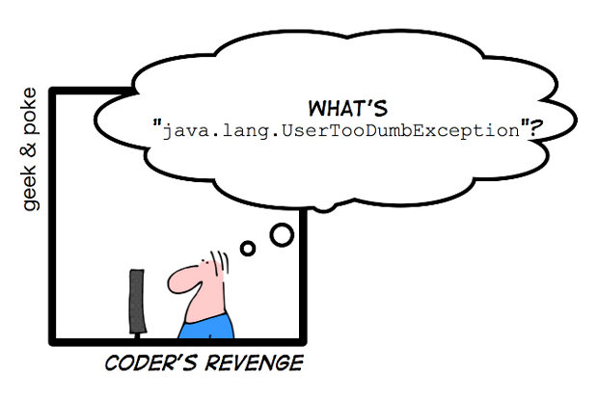
Create an exception
Create your own exceptions
Just inherit from :
Exception if you want to create a Checked Exception
RuntimeException otherwise
public class MyException extends Exception {
// This is valid exception !
}

Slide 26
Create an exception
Create your own exceptions
Define your own logic in contructor
Obviously you can also extends an existing exception
public class NegativeNumberException extends NumberException {
public NegativeNumberException(int num) {
super("The number "+num+" is negative");
}
// This is valid exception too !
}

Slide 27
Use it
Create your own exceptions
Just like any other exceptions:
public void throw1() throws MyException {
throw new MyException();
}
public void throw2() {
try {
// Do some stuff
if (a == -2) throw new NegativeNumberException(a);
} catch (Exception e) {
e.printStackTrace();
}
}

Slide 28


Exercises (1/3)
The try/catch/finally blocks
Update your main method :
At the beginning of the execution, the program must ask to the user to enter the number of columns and rows he want for his world.
Use the Scanner class to retrieve the use input (look at the Javadoc for more information).

Slide 29
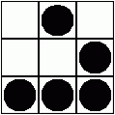
Exercises (2/3)
The try/catch/finally blocks
Run your program and enter a bad value when it demand you to enter column or row number.
You must see a pretty exception…
Use try / catch block to manage bad user entry without make stop your program !

Slide 30
Exercises (3/3)
The try/catch/finally blocks
When bad values are passed to the world constructors, exception which is thrown is not very explicit… Why NegativeArraySizeException?
The user of the class must look at inside the World class to well understand where the problem is…
Improve the clarity of the exceptions :
Update the World class constructors :
Check that the values received in parameters are valid.
If not, throw an InvalidArgumentException with an explanatory message.

