Slide 1

Collections
Java Standard Edition

Slide 2

Course objectives
Collections
By completing this course you will be able to:
Explain what collections are.
Use them and choose the best solution.
Enumerate the most common collections.

Slide 3


Course plan
Collections
Presentation. What is a collection? What is it used for? Why use them?
Interfaces and implementations. Several kind for every needs
Iterators. How iterate over a collection.
Comparator & Comparable. How to sort elements in a collection.
Arrays & Collections. Two utility classes for your arrays and collections.

Slide 4

Presentation
Collections
What collections are?

Slide 5

Why Collections
Presentation
In programming we need :
To store elements
Cards lists, properties, …
To manipulate whole elements
Retrieve all Campus Booster students
To link some elements with others
A property has a value
An adapted management, easy and powerful
Read quickly all stored data
Insert quickly data…

Slide 6
Overview
Presentation
Collections are classes which store objects
Automatic and dynamic management
Allow to sort elements easily
Many kind of collections:
Adapted to your needs
Best performances

Slide 7

Arrays
Presentation
With arrays you can :
Gather objects like the Collections do …
… but the arrays size is not dynamic
Remember…
Declaration (three ways but only one shown here)* :
Access :
int myTab[] = {1,2,3,4};
int firstElement = myTab[0];
Notes:
*Other ways to declare arrays:
int[] myTab = new int[10];
int myTab[] = new int[10];
Multi-dimensional array:
int myTab[][] = new int[10][5];
Array of objects:
MyObject[] m = new MyObject[10];

Slide 8

Collections advantages
Presentation
With collections :
The size is dynamic
Methods provide common operations :
Add, remove, get, … elements
ArrayList<String> myStringList = new ArrayList<String>();
myStringList.add("String 1");
myStringList.add("String 2");
//a collection is never too small
myStringList.add("String 3");
Notes:
*Other ways to declare arrays:
int[] myTab = new int[10];
int myTab[] = new int[10];
Multi-dimensional array:
int myTab[][] = new int[10][5];
Array of objects:
MyObject[] m = new MyObject[10];

Slide 9
Generics
Presentation
It specifies the data type stored in the collections
New feature since Java 5
Avoid different object types stored in the collections
The stored data are checked at the compilation time instead of at the runtime
Notes:
generics enable types (classes and interfaces) to be parameters when defining classes, interfaces and methods.

Slide 10
Generics example and comparison
Presentation
ArrayList<Cat> myCats = new ArrayList<Cat>();
myCats.add(new Cat());
myCats.add(new Dog());// Error at compilation...
Cat cat = myCats.get(0);

Slide 11
Interfaces & implementations
Collections
Several kind for every needs

Slide 12
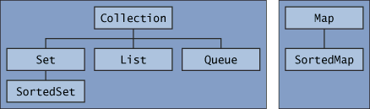
The knowledge tree
Interfaces & implementations
Core collection interfaces :
Two distinct trees on this hierarchy
All interfaces use generics
Each interface has its pros and cons
Ex: a Queue can act like a stack (LIFO)
You have to choose the best strategy according your needs

Slide 13
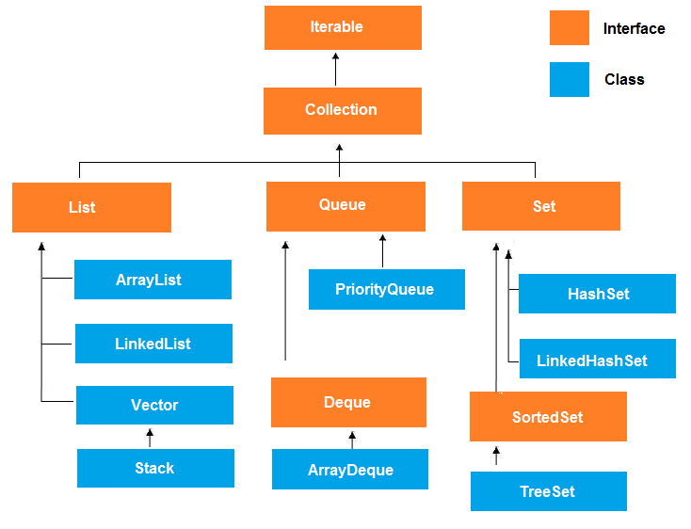

Slide 14
List interface
Interfaces & implementations
An ordered collection
All elements inside are accessible by an integer index
The position inside the List!
Can contain several time the same element
Interface
List<E>
Class
Vector<E>
Class
ArrayList<E>
Class
LinkedList<E>
Notes:
ArrayList is implemented as a resizable array. As more elements are added to ArrayList, its size is increased dynamically. It's elements can be accessed directly by using the get and set methods, since ArrayList is essentially an array.
LinkedList is implemented as a double linked list. Its performance on add and remove is better than Arraylist, but worse on get and set methods.
Vector is similar with ArrayList, but it is synchronized.

Slide 15
List implementations
Interfaces & implementations
ArrayList :
Good performance for get and set
LinkedList :
Best performance for add/remove
Poorer performance to get and set value
Vector :
Thread safe (all the methods are synchronized)
Bad performance

Slide 16
List common methods
Interfaces & implementations
add(<any> element) :
Add an element at the end of the list
<any> get(int index) :
Returns the element at the specified position
<any> remove(int index) :
Remove the element at the specified position
Return the removed element

Slide 17
List common methods
Interfaces & implementations
int size() :
Returns the size of the List
For more, look at the Javadoc :
http://download.oracle.com/javase/6/docs/api/java/util/List.html

Slide 18

Example
Interfaces and implementations
List<String> myList = new ArrayList<String>();
myList.add("Monday");
myList.add("Tuesday");
myList.add("Wednesday");
myList.add("Thursday");
myList.add("Friday");
myList.add("Saturday");
myList.add("Sunday");
String day = myList.get(3);
System.out.println("The fourth day is " + day );
String removeDay = myList.remove(6);
System.out.println("I removed " + removeDay );

Slide 19
Map interface
Interfaces & implementations
A set of key/value
Each key are unique
A value can have more than one key
Keys and Values are Objects
Similar to an associative array

Slide 20
Map interface
Interfaces & implementations
Interface
SortedMap<K,V>
Class
TreeMap<K,V>
Class
HashMap<K,V>
Interface
Map<K,V>
Class
WeakHashMap<K,V>
Class
IdentityHashMap<K,V>
Notes:
A TreeMap is sorted by keys.
Hashmap : Note : L'ordre d'itération des éléments est aléatoire.

Slide 21
Map implementations
Interfaces & implementations
HashMap :
Manipulate hash value of the key to be efficient
Can have on null key and several null values
IdentityHashMap :
Like HashMap
Use the == operator to check if two keys are equal
TreeMap :
Sort by key, in ascending order

Slide 22
Map common methods
Interfaces & implementations
put(<any> key, <any> value) :
Add a key/value pair in the Map
<any> get(<any> key) :
Returns the value linked to the key
<any> remove(<any> key) :
Remove the element at the specified position
Return the removed element

Slide 23
Map common methods
Interfaces & implementations
boolean containsKey(<any> key) :
Check if the key exists in the Map
boolean containsValue(<any> value) :
Check if the value exists in the Map
For more, look at the Javadoc :
http://download.oracle.com/javase/6/docs/api/java/util/List.html

Slide 24
Example
Interfaces and implementations
Map<String, int[]> myMap = new HashMap<String, int[]>();
String student = "Bob";
int[] marks = {12,14,10,7};
myMap.put(student , marks);
int[] result = myMap.get(student);
System.out.println(student+ " has got " + result[1]);

Slide 25
Set interface
Interfaces & implementations
Set of unique elements:
Interface
SortedSet<E>
Class
TreeSet<E>
Interface
Set<E>
Class
HashSet<E>
Class
LinkedHashSet<E>

Slide 26
Set implementations
Interfaces & implementations
HashSet :
Manipulate hash value of the element to be efficient
Only one null element
LinkedHashSet :
Like HashSet
Keep the order in which elements were inserted into the Set
TreeSet :
Sort element with ascending order

Slide 27
Example
Interfaces and implementations
Set<String> set = new HashSet<String>() ; // ajout d'élément System.out.println("J'ajoute un : " + set.add("un")) ;
System.out.println("J'ajoute deux : " + set.add("deux")) ;
// ajout d'un doublon : échec
System.out.println("J'ajoute encore un : " + set.add("un")) ;
// affichage de la taille du set
System.out.println("Taille du set : " + set.size()) ;

Slide 28
Iterators
Collections

Slide 29
Presentations
Iterators
An Iterator :
Is a generic object
Allows to iterate on a Collection in a linear way
Reads only in the ascending order
Can delete an element in the Collection thank to the remove() method

Slide 30
Iterator implementations
Interfaces & implementations
Some methods :
boolean hasNext(); //Check if there is a next element
E next(); //Get the next element
void remove(); // Remove the current element

Slide 31
Collection<String> myCollection = new
ArrayList<String>();
// Add elements to the collection.
myCollection.add("Remove me");
myCollection.add("Keep me");
Iterator<String> it = myCollection.iterator();
while (it.hasNext()) {
String myElement = it.next();
if (myElement.equals("Remove me")) {
it.remove();
} else {
System.out.println(myElement);
}
}
Iterator example

Slide 32
ListIterator interface
Iterators
Allows to read a List in either directions :
Only available for List implementations
Works like Iterator
Methods :
ListIterator<String> listIt = myList.listIterator(startingIndex);
boolean hasNext(); //Check if there is a next element
boolean hasPrevious(); //Check if there is a previous element
E next(); //Get the next element
E previous(); //Get the previous element
void remove(); // Remove the actual element

Slide 33
Foreach
Iterators
Remember that: "For each element type that I call xxx in my collection/array, I do that" …
For each
String
that I call s
in
my array tab
for (
String
s
:
tab )
{
…
}
I do that

Slide 34
Sort a collection
Collections

Slide 35
Comparator
Sort a collection
Used to sort Collections
Class implementing the Comparator<E> interface
Method to define :
The return value is an integer :
Negative if the first element is inferior than the second one
0 if equal
Positive if the first element is superior than the second one
int compare(E e1, E e2);

Slide 36
Comparator – Example 1/3
Sort a collection
Define an implementation :
Here we sort from the smallest length to the biggest
public class MyComparator implements Comparator<String> {
@Override
public int compare(String s1, String s2){
if(s1.length() == s2.length()) return 0;
else if(s1.length() > s2.length()) return 1;
else return -1;
}
}

Slide 37
Comparator – Example 2/3
Sort a collection
Sort elements inside a TreeSet :
The iteration will display the name from the smallest length to the biggest: John, Maria, Michael
Set<String> mySet = new TreeSet<String>(new MyComparator());
mySet.add("John");
mySet.add("Michael");
mySet.add("Maria");

Slide 38
Comparator – Example 3/3
Sort a collection
Sort element inside a List:
The iteration will display the name from the smallest length to the biggest: John, Maria, Michael
List<String> myList= new ArrayList<String>();
myList.add("John");
myList.add("Michael");
myList.add("Maria");
Collections.sort(myList, new MyComparator());

Slide 39
Comparable
Sort a collection
Another way to sort Collections
Class implementing the Comparable<E> interface for classes we want to sort
Method to define :
int compareTo(E e2);

Slide 40
Comparable
Sort a collection
The return value is an integer :
Negative if the current instance is inferior than the parameter
0 if equal
Positive if the current instance is superior than the parameter
Wrappers and String already implement Comparable
int compareTo(ObjectType e2);

Slide 41
public class Fruit implements Comparable<Fruit>{
private String fruitName;
private String fruitDesc;
private int quantity;
public Fruit(String fruitName, String fruitDesc, int quantity) {
super();
this.fruitName = fruitName;
this.fruitDesc = fruitDesc;
this.quantity = quantity;
}
@Override
public int compareTo(Fruit compareFruit) {
int compareQuantity = compareFruit.getQuantity(); //ascending order
return this.quantity - compareQuantity;
}
}
Comparable example

Slide 42
Arrays and collections
Collections

Slide 43
Presentation
Arrays and Collections
JDK provide two utility classes to manipulate arrays and collections (and with very easy names ☺) :
Arrays
Collections
Those classes are exclusively composed of static methods
You can’t create instances with them ! (Singleton)
Utility classes to common manipulations

Slide 44
Collections common methods
Arrays and Collections
static int binarySearch(List<T>, T) :
Search a “sorted” List for a given value, return an index
static void reverse(List<T>) :
Reverse the order of elements in a List
static Comparator reverseOrder(Comparator) :
Return a Comparator that sorts the reverse of the one passed as parameter

Slide 45
Collections common methods
Arrays and Collections
static void sort(List<T>, Comparator) :
Sort a list by a Comparator
For more, look at the Javadoc :
http://download.oracle.com/javase/6/docs/api/java/util/Collections.html

Slide 46
Arrays common methods
Arrays and Collections
static List asList(T[]) :
Convert an array to a List
static int binarySearch(Object[], Object) :
Search a sorted array for a given value, return an index
static void sort(Object[], Comparator) :
Sort an array by a Comparator

Slide 47
Exercises - Collections
Arrays and Collections
- Create a new project ExerciseCollectionProject
Create a new JavaBean class named Student
It has 4 attributs : long id, String name, char gender, double averageGrade
Create a class named Launcher that contains the main method
Instanciate five students and store them in a sorted list (ArrayList e.g.)
Use the two sorting strategies you have learned in the class in order to sort the list using the student’s average grade.
Print inside the console your list forward and backward using a listIterator

