Slide 1

Language Basics
Java Standard Edition

Slide 2

Objectives
Language Basics
By completing this course you will be able to:
Manipulate variables in Java
Explain the difference between a primitive and an object
Develop some basic instructions in Java

Slide 3


Course topics
Language Basics
Primitive / Reference Type
Variables
Operators
Common Object Types
More Syntax
Control Flow
Methods

Slide 4
Primitive / Reference type
Language Basics

Slide 5

Primitive types
Primitive / Reference type
The only non object Java items
Simple value
The memory zone allocated to a primitive type holds the value associated to the identifier
Live on the stack
variable_4 | 45
variable_3 | true
variable_2 | c
variable_1 | 56.8
The Stack

Slide 6
Primitive types
Primitive / Reference type
Type | Size (bits) | Signed | Min. size | Max. size | Initial value
boolean | 1 | NA |  |  | false
byte | 8 | Yes | -2⁷ | 2⁷-1 | 0
char | 16 | No | 0 | 2¹⁶-1 | '\u0000'
short | 16 | Yes | -2¹⁵ | 2¹⁵-1 | 0
Notes:
Signed data types can hold both positive and negative values.
Unsigned data types can hold large positive values but cannot hold negative values.

Slide 7
Primitive types
Primitive / Reference type
Type | Size (bits) | Signed | Min. size | Max. size | Initial value
int | 32 | Yes | -2³¹ | 2³¹-1 | 0
float | 32 | Yes | -2³¹ | 2³¹-1 | 0.0F
long | 64 | Yes | -2⁶³ | 2⁶³-1 | 0L
double | 64 | Yes | -2⁶³ | 2⁶³-1 | 0.0

Slide 8
Variables
Language Basics

Slide 9
Syntax
Variables
Variable declarations:
Initialization during declaration:
int toto;
double t1, t2;
boolean test;
int toto = 10;
double t1 = 1.25, t2 = 1.26;
boolean test = true;

Slide 10
Number Literals
Variables
The default data type of a non floating-point literals is integer
However, you can append the suffix L (or l) to designate the data type as Long
int x = 5;
long y = 5L;
Notes:
A Literal is the source code representation of a fixed value; literals are represented directly in your code.
Exemple : 5, is a literal implicitly converted into a java primitive type int.

Slide 11
Number Literals
Variables
The default data type of floating-point literals is double.
However, you can append the suffix F (or f) to designate the data type as float.
double x = 5.23;
float y = 5.125F;

Slide 12
Number Literals
Variables
A value of char type
Delimited by: '
Escape character: \
Unicode sequence: \u00e9
char x = 'é';
char x = '\u00e9';
Notes:
https://en.wikipedia.org/wiki/List_of_Unicode_characters

Slide 13
Quiz
Variables
Predict the result – What will be printed?
public static void main(String[] args) {
long aLong = 0;
System.out.println(aLong);
aLong = 3;
System.out.println(aLong);
boolean aBoolean = false;
System.out.println(aBoolean);
double aDouble;
System.out.println(aDouble);
}

Slide 14
Operators
Language Basics

Slide 15
Assignment operators
Operators
Operator | Use | Same as … | Precedence
= | int x = 10 |  | 15
+= | x += 10 | x = x + 10 | 15
-= | x -= 10 | x = x – 10 | 15
*= | x *= 10 | x = x * 10 | 15
/= | x /= 10 | x = x / 10 | 15

Slide 16
Conditional operators
Operators
Operator | Definition | Precedence
&& | Conditional AND | 12
|| | Conditional OR | 13
! | NOT | 2

Slide 17
Comparison operators
Operators
Operator | Definition | Precedence
< | Inferior | 7
<= | Inferior or equal | 7
> | Superior | 7
>= | Superior or equal | 7
== | Equal | 8
!= | Different | 8

Slide 18
Mathematical operators
Operators
Operator | Definition | Precedence
++ / -- | Increment / Decrement | 1
* | Multiplication | 4
/ | Division | 4
% | Modulus | 4
+ / - | Addition / Subtraction | 5

Slide 19
Pre/Post incrementation
Operators
++ and -- can be used as:
When the ++ or -- operator is before the operand, the increment/decrement is compute first, and conversely
int x = 5 ; // 5 is assigned to x.
int y = x++ ; // 5 is assigned to y, and then x is
// incremented.
int z = ++x ; // x is incremented, and then the x value is
// assigned to z.

Slide 20
Quizz
Operators
Predict the result of this code. What will be the variables’ value?
int a = 5;
boolean b;
b = a < 10;
int i = 4;
int j = 5 + 9 * i;
int k = 124 % 10;

Slide 21
Quizz
Operators
Predict the result of the following code. What will be printed?
int v = 0;
v++;
int amount = v++;
System.out.println(++v + " " + amount);
System.out.println(v);

Slide 22
Quizz
Operators
Predict the result of the following code. What will be printed?
boolean canITakeHisMoney;
int hisBalance = 5;
long myBalance = 4;
hisBalance += 8;
canITakeHisMoney = hisBalance > myBalance;
canITakeHisMoney = canITakeHisMoney
&& (hisBalance >= 3);
System.out.println(canITakeHisMoney);

Slide 23
Common Object Types
Language Basics

Slide 24
Introduction
Common Object Types
There is complex data types, called Objects :
Array
String
List
Custom classes …
Objects are referenced type :
The variable contains the memory address of the object
Very similar to a C++ pointer

Slide 25
Objects
Common Object Types
An object can be composed of:
Attributes (also called variables)
Constructors
Methods
We will learn how to create and use objects later.
Remember, String is an object, not a primitive type.
String hello = "Hello World !";

Slide 26
Wrappers
Common Object Types
Wrappers are objects that handle primitive values
Allow to manipulate numeric values as objects instead of primitive
Numeric wrappers allow to convert String into a number:
Thanks to the parseXXX(String s) method
Convert the string value "10" into the integer value 10
Character wrapper allow to test if a character is a letter, a digit, …

Slide 27
Wrappers
Common Object Types
List of wrappers
Primitive type | Wrapper | Primitive type | Wrapper
char | Character | long | Long
byte | Byte | float | Float
short | Short | double | Double
int | Integer | boolean | Boolean

Slide 28
Wrappers
Common Object Types
Example:
int i = 3;
Integer in = new Integer(i);
int j = Integer.parseInt("10");
char c = 'a';
Character ch = new Character(c);

Slide 29
Enumerations
Common Object Types
Something between the primitive and reference type
Allow to define predefined value:
Color: RED, BLUE, YELLOW, …
Example:
public enum Color {
RED, BLUE, YELLOW
}
Notes:
Enums enumerate a fixed set of values, in a self-documenting way. They make your code more explicit, and also less error-prone.

Slide 30
Arrays
Common Object Types
An array is an object too!
It can contains :
Primitive types
Reference types
Enumerations
Its size is fix :
It can not be modified after initialization!

Slide 31
Array Creation
Common Object Types
Two ways of declaring an array:
Three ways of initializing an array:
itemsType[] arrayName;
itemsType arrayName[];
int[] array1 = new int[4];
int[] array2 = {3, 4, 3, 4};
int[] array3 = new int[]{3,4,3,4};
array3
3
4
3
4

Slide 32
Array Creation
Common Object Types
The new operator instantiate the array.
Example :
With the following instantiation, each item will have the default value:
int arrayOfInteger[] = new int[10];
// Array of 10 items of int type initialize to zero.
arrayOfInteger
0
0
0
0
0
0
0
0
0
0

Slide 33
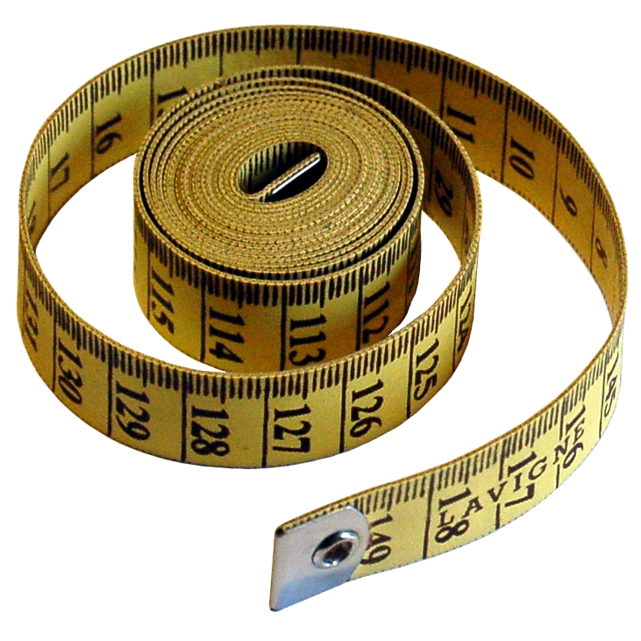
Array Size
Common Object Types
The length attribute return the size of the array:
int[] tab = {1, 10, 12, 9};
System.out.println("Size: " + tab.length);

Slide 34
Manipulate Array Content
Common Object Types
The first element is at index 0.
The last element is at the index length – 1.
Access to the item :
Set the value for the second item
int[] tab = {1, 10, 12, 9};
System.out.println("Fourth value: " + tab[3]);
tab[1] = 25;

Slide 35
Multidimensional Array
Common Object Types
The number of pair braces indicates the number of dimension of the array
Example: A two dimensional array (an array of arrays)
float[][] dimension = new float [10][10];
// 10 × 10 bidimensional array float items
int[][] grids = { {1, 3}, {7, 5} };
grids
ref
1
3
ref
7
5

Slide 36

More syntax
Language Basics

Slide 37
Statements and Blocks
More Syntax
Statement instructions are always terminated by a semi column
Blocks are groups of instructions delimited by curly brackets → { }
Often used with tests and loops (next chapter)
{
int length = 10; // Assignment
setName("John"); // Method call
}

Slide 38
Local Variable Scope
More Syntax
A variable declared inside a block, may only be used in the block itself.
Java integrates the same notion of stack for local variables as most programming languages
At block end, all variable declared inside are destroyed
int i = 3;
if (i > 0) { // block begins
int j = 25;
System.out.println(j);
} // j does not exists outside the block anymore.

Slide 39
Comments
More Syntax
One line comments begins with a double slash and ends at the end of the line:
Multiple line comments begins with a slash-star and ends with a star-slash:
int i = 0; // A single line comment
int i = 0; /* A multiple line
comment */

Slide 40
Control flow
Language Basics

Slide 41
if/else
Control Flow
The condition must return a boolean type :
true or false
The else statement is not compulsory.
Be careful : You cannot use a number as condition !
if (condition) {
// instruction1
} else {
// instruction2
}

Slide 42
if/else
Control Flow
Example:
int a = 5;
if (a <= 5) {
System.out.println("a lower than 5");
} else if (a < 10) {
System.out.println("a between 5 and 10");
} else if (a == 10) {
System.out.println("a equal 10");
} else {
System.out.println("a greater than 10");
}

Slide 43
switch
Control Flow
The value is compared to the label
Before Java 7, the value could only be a primitive type or an enumeration value
Now, the value can also be a String
The switch instruction is composed of case
The break keyword ends a case
The default case is chosen if any case match the value

Slide 44
int days = 7;
switch (days) {
case 1:
System.out.println("Monday"); break;
case 2:
System.out.println("Tuesday"); break;
case 3:
System.out.println("Wednesday"); break;
case 4:
System.out.println("Thursday"); break;
case 5:
System.out.println("Friday"); break;
case 6:
case 7:
System.out.println("Weekend!"); break;
default:
System.out.println("Invalid day!");
}
Switch example

Slide 45
Ternary operator
Control Flow
Like an if/else
Example
( condition ? condition_true : condition_false)
int j = (i > 2 ? i : 0);
//j=i if i is greater than 2, else j=0

Slide 46
while
Control Flow
Loop while the condition is true.
Example :
while (condition) {instruction}
int i = 10, sum = 0, j = 0;
while (j <= i) {
sum = sum + j;
j = j + 1;
}
System.out.println("Sum value: " + sum);

Slide 47
do/while
Control Flow
Execute the instruction block and loop while the condition is true
Example
do {instruction} while (condition);
int i = 10, j = 0, sum = 0;
do {
sum = sum + j;
j = j + 1;
} while (j <= i);
System.out.println("Sum: " + sum) ;

Slide 48
for
Control Flow
Like a while loop
Example
for ([initialization]; [condition]; [operation]){}
for (int i = 0; i < 10; i++) {
myMethod(i);
System.out.println(i) ;
}

Slide 49

Exercises
Control Flow
The FizzBuzz Challenge :
Display numbers from 1 to 100, replacing :
The word 'fizz' for multiples of 3.
The word 'buzz' for multiples of 5.
The word 'fizzbuzz' for multiples of both 3 and 5.
Insert a line break after 9, 19, 29, …
Result :
1 2 fizz 4 buzz fizz 7 8 fizz
buzz 11 fizz 13 14 fizzbuzz 16 17 fizz 19
buzz fizz 22 23 fizz buzz 26 fizz 28 29 ...

Slide 50
Methods
Language Basics

Slide 51
Definition
Methods
A method…
Has a function:
Retrieve list of products.
Open a database connection.
…
Can be called many times:
Avoid code duplication
Can have parameters
Can return a value

Slide 52
Writing a method
Methods
A method may need:
A return value
Parameters
The code of a method is in a block delimited by curly braces → { }
The accessibility of the code is limited to the block
<return-type> <method-name>(<parameters>...) {
<instructions>...
}

Slide 53
Returned value
Methods
A method can return any type of value:
Must declare the type of returned value
The last statement of the method must be the return statement
int myMethod(){
return 10;
}

Slide 54
Returned value
Methods
A method can return no value:
The return type must be void
No return statement!
void myMethod(){
...
}

Slide 55
Parameters
Methods
A method can have zero parameters:
A method can have many parameters:
Not obligatorily of the same type
void myMethod(){
...
}
void myMethod(String myParam, int myOtherParam){
...
}

Slide 56
Parameters
Methods
A method can have an unknown number of parameters (varargs)
Varargs parameters are treated like an array
Access the first user: users[0]
Parameters number: users.length
void myMethod(int... myIntArray){
...
}

Slide 57
Calling a method
Methods
Without parameters:
myMethod();
With parameters "direct" values:
myMethod(“Hello”, 5000);
With parameters as variables:
myMethod(name, numberOfStudents);

Slide 58
Overloading
Methods
Methods can have the same name but :
Must be different by their parameters
Number of parameters
Type of the parameters
Methods with the same name and not the same return type are only possible when parameters are different.
Compiler use only the name and the parameters of the method call to resolve overloading!

Slide 59
Valid examples
Methods
void myMethod(String s){
...
}
void myMethod(){
...
}
void myMethod2(String s){
...
}
void myMethod2(int i, String s){
...
}
Notes:
In the first example, the number of parameters is different
In the second example, the number and the type of parameters are different

Slide 60
Invalid examples
Methods
void myMethod3(String s){
...
}
void myMethod3(String s2){
...
}
void myMethod4(String s){
...
}
int myMethod4(String s2){
...
}
Notes:
In the first example, the type of parameters are the same
In the second example, the return type is different but not the parameters type

Slide 61
Constructors
Methods
Each Java objects has one or more constructors
Constructors are special method:
They create objects
Don't declare a return type…
Their name must be the same as the class

Slide 62
Constructors
Methods
Example of a Person constructors:
// The "default" constructor
public Person() {
}
// Overloaded constructor ...
public Person(String firstname) {
...
}

Slide 63
The main
Methods
The entry point of each Java program
Has to be public and static.
Can take arguments from the command line :
Two possible syntaxes:
java MyFirstJavaProgram I am 20
public static void main(String[] args) { ... }
public static void main(String... args) { ... }

Slide 64
Static methods
Methods
For now, we haven’t seen Object Oriented programming (OOP)…
So, you can only use methods preceded by the keyword: static
We’ll see later why our main method can only called static methods without use objects

Slide 65
Exercises (1/4)
Methods
Pratice your Java skills by converting pseudo-code to Java Code
Create a new Java project in Eclipse named “ArraySortProject”
Create a package named “fr.myschool.arraysort”
Notes:
Pseudo-code : https://en.wikipedia.org/wiki/Pseudocode

Slide 66
Exercises (2/4)
Methods
Create inside it a new class named “Sorter” with five methods:
void bubbleSort(int[] array)
This method must sort the array received in parameter with Bubble Sort algorithm and return it
void selectionSort(int[] array)
This method must sort the array received in parameter with Selection Sort algorithm and return it
void insertionSort(int[] array)
This method must sort the array received in parameter with Insertion Sort algorithm and return it
Notes:
«

Slide 67
Exercises (3/4)
Methods
static void displayArray(int[] array) :
This method must display each element of the array received in parameter inside the console.
public static void main(String[] args) :
This method must :
Create an integer array of size 10
Initialized it with random values between 0 and 100 (See Random class into the Javadoc)
Call the displayArray(int[]) method to display the initial content
Pass it to each sort methods
Call the displayArray(int[]) method to display the sort result

Slide 68
Exercises (4/4)
Methods
For more information about sort algorithms:
http://en.wikipedia.org/wiki/Sorting_algorithm
http://www.youtube.com/user/AlgoRythmics#p/u/3/lyZQPjUT5B4

