Slide 1

JDBC
Java DataBase Connectivity

Slide 2

Course objectives
Sockets
By completing this course you will be able to:
Connect to a Database from Java code
Manage Database with JDBC

Slide 3


Course plan
Sockets
Introduction
DataBase connection
Querying
Transaction Management
Meta data

Slide 4
introduction
JDBC

Slide 5

DBMS presentation
Introduction
DataBase Management System
Software allowing to manage databases :
Create/Modify tables
Maintenance
Query the database
Manage transactions
Assume data integrity

Slide 6
JDBC API presentation
Introduction
Java DataBase Connectivity
API with methods allowing to :
Send SQL queries
Retrieve data
…
Independent of the DBMS used

Slide 7
JDBC API presentation
Introduction
Many constructors provides their implementation for their Database :
MySQL
Oracle
PostgreSQL
SQL Server
…

Slide 8
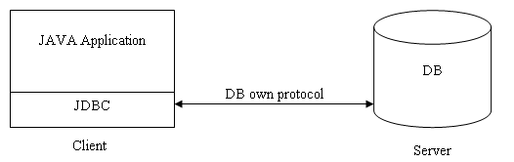
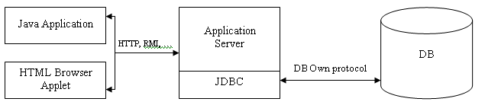
Client/Server architecture
Introduction
2/tiers architecture :
3/tiers architecture :

Slide 9
DataBase Connection
JDBC

Slide 10



Overview
DataBase connection
To carry out a treatment on a DB, it is necessary :
Loading
Disconnection
Connection
Management

Slide 11
Step by step: Load the Driver
DataBase connection
First step is to load the Driver into the memory
The Driver is provided by your DataBase constructor
How to load it ?
Example with MySQL :
Class.forName(String driver)
throws ClassNotFoundException
try {
Class.forName(com.mysql.jdbc.Driver.class.getName());
} catch(ClassNotFoundException e) {
e.printStackTrace();
}

Slide 12
Step by step: Establish the connection
DataBase connection
Then establish the connection with a DriverManager
How to get a connection ?
Two methods of DriverManager returns a java.sql.Connection :
getConnection(String url)
getConnection(String url, String login, String password)
The URL for MySQL looks like :
jdbc:mysql://<hostname>/<databaseName>
Example: jdbc:mysql://localhost/SunGamer

Slide 13
The Connection class
DataBase connection
Represents the connection to the database
Retrieve Statement with it (seen later ☺)
Useful method :
void setAutoCommit(boolean autoCommit)
void commit()
void rollback()
Savepoint setSavepoint()
Savepoint setSavepoint(String name)
void close()

Slide 14
Querying
JDBC

Slide 15
Statement
Querying
An interface
Use it to make queries
Get it with your java.sql.Connection :
createStatement()
How to query the DB ?
ResultSet executeQuery(String query)
int executeUpdate(String query)
Statement stmt = connection.createStatement();
ResultSet rs = stmt.executeQuery("SELECT * FROM dummy");

Slide 16
PreparedStatement
Querying
Many of the more mature databases support the concept of prepared statements
A prepared query only needs to be parsed (or prepared) once, but can be executed multiple times with the same or different parameters
The database will analyze, compile and optimize it's plan for executing them
Avoid repeating the analyze/compile/optimize cycle
Protects against SQL injection
This means that prepared statements use fewer resources, run faster and are more secure !

Slide 17
PreparedStatement
Querying
Classic Statement
or
first execution cycle of a prepared statement.
Analyze
Compile
Next execution cycle for a prepared statement.
Optimize
Run

Slide 18
PreparedStatement
Querying
Get it with your java.sql.Connection :
prepareStatement(String query)
Lot of methods to set parameters :
setInt(int index, int value)
…
PreparedStatement pstmt = myConnection.prepareStatement(
"SELECT * FROM dummy ”
+ "WERE lastname = ? AND firstname = ?");
pstmt.setString(1, "GEORGES");
pstmt.setString(2, "Ron");

Slide 19
ResultSet
Querying
Contains the results of your query
"Iterate" on the ResultSet by the methods :
boolean previous() :
Returns true if the cursor has been moved on the previous result.
boolean next() :
Returns true if the cursor has been moved on the next result
Get the data in a column :
getXXX(int columnIndex)
getXXX(String columnName)

Slide 20
ResultSet
Querying
Example:
// ...
ResultSet rs =
stmt.executeQuery("SELECT * FROM dummy");
while(rs.next()) {
int id = rs.getInt(1);
String name = rs.getString("name");
// ...
}
// ...

Slide 21
Transaction Management
JDBC

Slide 22

Presentation
Transaction Management
Transaction is useful when you want defined a unified set of queries
If they all succeed, changes are applied
If one fails, no changes are applied
We name commit the operation that applied changes in Database

Slide 23

Case study
Transaction Management
For instance, transactions are very important in banking applications :
Imagine a bank transfer
The operation is in two steps :
Withdraw money of one account
Add it to an other
Imagine each step is a Database query
What happen if the second query failed ? Where is the money ?

Slide 24
Provided methods
Transaction Management
Connection instances provide three methods to manage transactions :
void setAutoCommit ( boolean ) :
Sets this connection's auto-commit mode to the given state. If a connection is in auto-commit. By default, new connections are in auto-commit mode.
void commit ( ) :
Makes all changes made since the previous commit/rollback permanent.
void rollback ( ) :
Undoes all changes made in the current transaction.

Slide 25
Example
Transaction Management
Connection connection =
DriverManager.getConnection(URL,USER,PASSWORD);
connection.setAutoCommit(false);
try {
String sql1 =
"INSERT INTO author (id, firstname, lastname)"
+ " VALUES (1, 'Clark', 'Kent' )";
connection.createStatement().executeUpdate(sql1);
String sql2 =
"INSERT INTO article(id, title, body, author_id)"
+ " VALUES(1, 'Plop', '...’, 1)";
connection.createStatement().executeUpdate(sql2);
connection.commit();
} catch (Exception e) {
connection.rollback();
}

Slide 26
Meta data
JDBC

Slide 27
DatabaseMetaData
Meta data
Get them with a java.sql.Connection :
DatabaseMetaData getMetaData()
You can get all information about the database :
The catalogs
The schemas
The version
…

Slide 28
ResultSetMetaData
Meta data
Get them with a ResultSet :
ResultSetMetaData getMetaData()
You can get all information about the columns
The name
The type
The number of column
…

Slide 29
Exercise (1/8)
JDBC
We’re going to develop a new Project :
A management software for a Travel Agency
This project is named TravelAgencyProject
For now, we’ll develop a CLI version using a MySQL Database
Later, we’ll develop a graphical version with Swing API

Slide 30
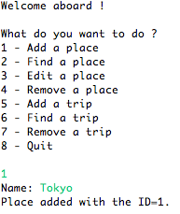
Exercise (2/8)
JDBC
The CLI version must be something like that :

Slide 31
Exercise (3/8)
JDBC
Your application must be composed of at least five classes :
Place : a JavaBean composed of the following fields :
Long id : The unique identifier of the place
String name : The name of the place
Trip : a JavaBean composed of the following fields :
Long id : The unique identifier of the trip
Place departure : The departure place of the trip
Place destination : The destination place of the trip
Double price : The price of the trip

Slide 32
Exercise (4/8)
JDBC
Your application must be composed of at least two interfaces :
PlaceDao, defining the following abstract methods :
Long createPlace(Place p)
Place findPlaceById(Long id)
void updatePlace(Place p)
void removePlace(Long id)
TripDao, defining the following abstract methods :
Long createTrip(Trip t)
Trip findTripById(Long id)
void removeTrip(Long id)

Slide 33
Exercise (5/8)
JDBC
Your application must be composed of at least five classes :
JdbcPlaceDao : an implementation of the PlaceDao interface using JDBC
JdbcTripDao : an implementation of the TripDao interface using JDBC
Launcher : the class containing the main method of the application
Optionally, you can create a Factory class for your DAOs

Slide 34
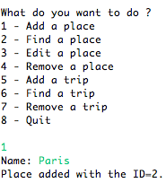
Exercise (6/8)
JDBC

Slide 35
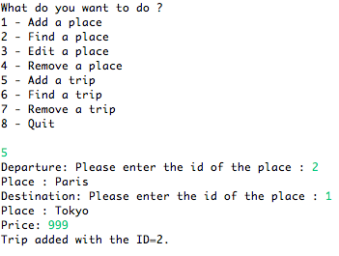
Exercise (7/8)
JDBC

Slide 36
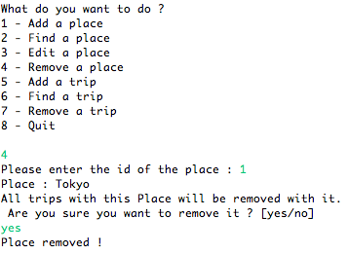
Exercise (8/8)
JDBC

