Slide 1

Swing
Graphical User Interfaces

Slide 2

Course objectives
Swing
By completing this course you will be able to:
Build your own GUIs
Know how to handle main components like TextField, Buttons…
Manage events
Paint custom surfaces
Use the look and feel

Slide 3


Course plan
Swing
Introduction
Containers
Common components
Layout Manager
Events
Menus
Listing
Painting
Internationalization
Look and feel

Slide 4
introduction
Swing

Slide 5

History of Swing
Introduction
Swing is part of Java Foundations Class :
Main libraries producing display and GUIs
Drag'n'Drop, I18N, Java 2D, Accessibility, …
Works above Abstract Window Toolkit (AWT) :
Deal with native components
Portability problems
Always used in the lower levels of Swing

Slide 6
WYSIWYG Tools
Introduction
What You See Is What You Get
Allows to build GUIs by dragging components
IDE provide their own plugins :
Eclipse's one is WindowBuilder:
http://www.eclipse.org/windowbuilder/
NetBeans' one Matisse :
Integrated in the IDE
IntelliJ’s one Swing GUI Designer :
Integrated in the IDE

Slide 7
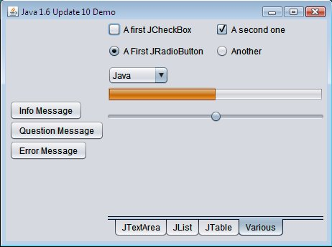
Architecture
Introduction
Window, main container
(JFrame)
JCheckBox
JComboBox
JRadioButton
JProgressBar
Buttons
(JButton)
JSlider
Window's container
(JPanel)
JTabbedPane

Slide 8
Containers
Swing

Slide 9
JFrame: description
Containers
A high level container.
Represents a window for your software.
Can have :
A size.
A title.
A close operation.
Components (like buttons, form fields, …).
…

Slide 10
JFrame: methods
Containers
setSize(int width, int height) or setSize(Dimension dim) :
Set the size of the window.
setTitle(String title) :
Set the title of the window.
setVisible(boolean visible) :
Define if the window is displayed or hidden.
setDefaultCloseOperation(int op) :
Set the operation when the window is closed.
By default, nothing is done.
setResizable(boolean resizable) :
Make the window resizable or not.

Slide 11
JFrame: example
Containers
public class MyFrame extends JFrame {
…
public MyFrame() {
this.setSize(300, 200);
// define the default operation when
// the frame is closed
this.setDefaultCloseOperation(JFrame.EXIT_ON_CLOSE);
// define the title of the frame
this.setTitle("My wonderful frame");
this.setVisible(true);
}
…
}

Slide 12
JPanel: description
Containers
Allows to aggregate components.
Can be used as the main container of a window.
Has a layout.
We'll see that later…

Slide 13
JPanel: example
Containers
public class MyFrame extends JFrame {
…
public MyFrame() {
...
JPanel panel = new JPanel();
panel.add(new JButton("My button"));
// add more elements if you like
this.setContentPane(panel);
}
…
}

Slide 14
Common components
Swing

Slide 15
JLabel
Common components
Displays a text, a picture or both.
To display a text :
setText(String text)
To display a picture :
setIcon(Icon icon)
Common constructors :
JLabel()
JLabel(String text)
JLabel(Icon icon)

Slide 16

JButton
Common components
A classic button.
You have to define the action when you click on it :
Method addActionListener(ActionListener event) (be patient, we'll see it later ☺).
Common constructors :
JButton()
JButton(String text)
JButton(Icon image)

Slide 17
JTextField
Common components
A text field to enter values.
Have a number of columns (= kind of width).
Common constructors :
JTextField(int columns)
JTextField(String defaultText)
JTextField(String defaultText, int columns)
Useful methods :
void setText(String text)
Set the text in the text field.
String getText()
Get the text typed in the text field.

Slide 18

JTextArea
Common components
A text area with a number of columns and rows.
Common constructors :
JTextArea(int rows, int columns)
JTextArea(String defaultText)
JTextArea(String defaultText, int rows, int columns)
Useful methods :
String getText() / void setText(String text)
Get or set the text in the text area.
int getRows() / void setRows(int nbOfRows)
int getColumns() / void setColumns(int nbOfCol)

Slide 19
JCheckBox
Common components
Represents a check box.
Common constructors :
JCheckBox(String text)
JCheckBox(String text, boolean selected)
Useful methods :
boolean isSelected() :
Returns true if the check box is checked.
void setSelected(boolean selected) :
Set if the check box must be selected.
String getText() / void setText(String label) :
Get or set the label for the check box.

Slide 20
JRadioButton
Common components
A radio button.
Common constructors :
JRadioButton(String text)
JRadioButton(String text, boolean selected)
Useful methods :
boolean isSelected() / void setSelected(boolean) :
Get or set if the radio button is selected.

Slide 21
ButtonGroup
Common components
Allows to "gather" radio buttons :
In order to make exclusive selection.
Useful methods :
void add(AbstractButton btn) :
Add a button (also radio button) in the group.
void remove(AbstractButton btn) :
Remove a button from the group.

Slide 22
JProgressBar
Common components
A progress bar.
Common constructor :
JProgressBar(int minValue, int maxValue).
Useful methods :
int getValue() / void setValue() :
Get or set the progression value.
void setString(String text) :
A text written on the bar.
void setStringPainted(boolean painted) :
Indicates if the text is written on the bar.
false by default.

Slide 23
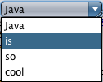
JComboBox
Common components
A drop down list.
Constructors :
JComboBox(Object[] items)
JComboBox(Vector<?> items)
Useful methods :
int getSelectedIndex()
Object getSelectedItem()
Note: the text displayed in the JComboBox is the toString() of the items.

Slide 24
The ActionCommand
Common components
Available on many components.
Is a String.
Has nothing to do with action you do on a component :
Click, focus, select …
Could be used as an identifier of the components.
Set it by: void setActionCommand(String command).
Get it by: String getActionCommand().

Slide 25
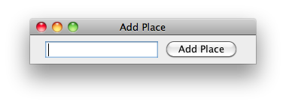
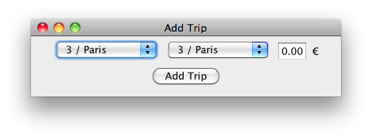
Exercise
Common components
Update the TravelAgency project.
Create a new class named GuiLauncher :
We’ll use it to launch the graphical version of our application.
Create a package com.myschool.travelagency.gui.
Create two classes extending JFrame :
AddPlaceFrame :
AddTripFrame :

Slide 26
Layout Manager
Swing

Slide 27
Definition
Layout Manager
Manage the components placement.
In containers :
Class extending Container class such as JPanel.
Many exists :
Choose the best according you needs !
Set it up :
For all containers :
setLayout(LayoutManager layout).
For JPanel only :
JPanel(LayoutManager layout).

Slide 28
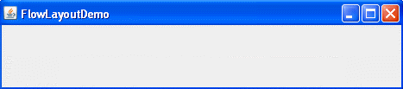
FlowLayout
Layout Manager
The default layout of JPanel.
Place the component from the left to the right :
On the same "line”.
Create a "new line" if needed.
Each line is centered.

Slide 29
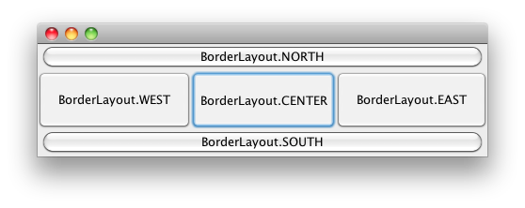
BorderLayout
Layout Manager
Separated in 5 regions.
Default region is BorderLayout.CENTER.
It is the default layout of the JFrame default content pane.
Example :
JPanel panel = new JPanel(new BorderLayout());
panel.add(new JButton("My Button"), BorderLayout.EAST);

Slide 30
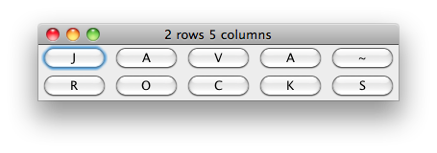
GridLayout
Layout Manager
Display components in an "array”.
All cells have exactly the same size.
The component take all available place in the cell.
Example :
JPanel panel = new JPanel(new GridLayout(2, 5));
panel.add(new JButton("J"));
panel.add(new JButton("A"));
// …

Slide 31
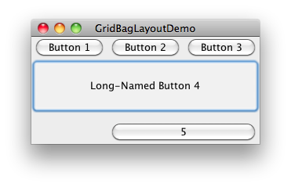
GridBagLayout
Layout Manager
One of the most flexible and complex layout managers.
Place components in a grid of rows and columns like simple GridLayout but :
It allows specified components to span multiple rows or columns.
All rows and columns have not necessarily the same height and width.

Slide 32
GridBagLayout
Layout Manager
To specify the characteristics of a component, you must use a GridBagConstraints object.
Common instance variables you can set on it are :
int gridx, gridy : Specify the position of the component in the grid.
int gridwidth, gridheight : Specify the number of cells the component uses.
int fill : Specify how to resize the component when the component's display area is larger than the component's size. Valid values are defined as GridBagConstraints constants.
int anchor : Determine where to place the component inside the component's display area. Valid values are defined as GridBagConstraints constants.

Slide 33
GridBagLayout
Layout Manager
Complete example :
pane.setLayout(new GridBagLayout());
GridBagConstraints c = new GridBagConstraints();
c.fill = GridBagConstraints.HORIZONTAL;
JButton button1 = new JButton("Button 1");
pane.add(button1, c);
JButton button2 = new JButton("Button 2");
c.weightx = 0.5;
pane.add(button2, c);
JButton button3 = new JButton("Button 3");
pane.add(button3, c);
JButton button4 = new JButton("Long-Named Button 4");
c.ipady = 40; c.weightx = 0.0; c.gridwidth = 3; c.gridy = 1;
pane.add(button4, c);
// ...

Slide 34
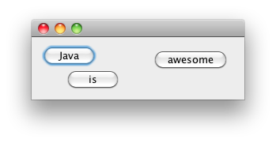
Absolute positioning
Layout Manager
You can place your components wherever you want.
Set it up :
Set the Layout container to null.
Add your components to the container.
Specify the bounds for each added component.
(x,y)
width
height

Slide 35
Absolute positioning
Layout Manager
But what are the bounds ? They are composed of :
An X coordinate.
A Y coordinate.
The width of the component.
The height of the component.
Set them with :
setBounds(int x, int y, int width, int height)
Example :
Dimension dim = myLabel.getPreferredSize();
myLabel.setBounds(10, 10, dim.width, dim.height);

Slide 36
Absolute positioning
Layout Manager
Complete example :
// …
JPanel panel = new JPanel();
panel.setLayout(null);
JButton playButton = new JButton("Play");
JButton exitButton = new JButton("Exit");
Dimension playSize = playButton.getPreferredSize();
Dimension exitSize = exitButton.getPreferredSize();
playButton.setBounds(10, 10, playSize.width, playSize.height);
exitButton.setBounds(10, 50, exitSize.width, exitSize.height);
panel.add(playButton);
panel.add(exitButton);
// …

Slide 37
Exercises (1/2)
Layout Manager
Update your AddTripFrame class :
The content pane of the frame must use a BorderLayout as layout manager.
Add a JPanel with a GridBagLayout and add your form fields without the submit button inside it.
The labels must be aligned to the right.
Add another JPanel with a FlowLayout and put the submit button with a cancel button inside it.
Then place your two JPanel into your frame.
See the illustration on the next slide ☺

Slide 38
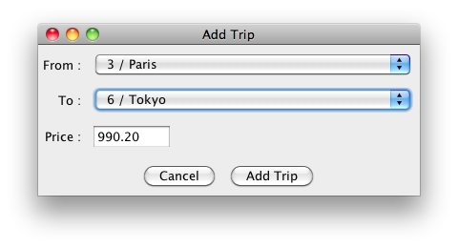
Exercises (2/2)
Layout Manager
GridBagLayout
BorderLayout
FlowLayout

Slide 39
Events
Swing

Slide 40
The rule of subscription
Events
Graphical elements …
Buttons, windows, …
… have to subscribe to listeners !
Listeners are :
Interfaces which manage an event :
a click on a button, maximizing a window …
The developer choose to do something when an event appears.
Automatically called when an event happens.

Slide 41
The rule of subscription
Events
It is very flexible :
You can do whatever you want.
It is easy to set up.
It is even easier to use.

Slide 42
ActionListener
Events
ActionListener is an interface.
Catch the event of clicking on a button.
You have to define the actionPerformed(ActionEvent e) method :
This method is automatically called when you click on a button.
The JButton class contains the method addActionListener(ActionListener listener)
When you call this method on a JButton, we say the listener subscribe to the event.

Slide 43
Define a Listener
Events
You have three possibilities :
Make your current class implements it.
Create a new class implementing it.
Create an anonymous class.
Each of these possibilities have advantages and disadvantages.
We’re gonna see each of them.

Slide 44
Define a Listener
Events
Make your current class implements it :
public class MyFrame extends JFrame implements ActionListener {
private JButton button;
public MyFrame() {
button = new JButton("My button");
button.addActionListener(this);
}
@Override
public void actionPerformed(ActionEvent ae) {
System.out.println("I performed a click ! It works !!");
}
}

Slide 45
Define a Listener
Events
Create a new class implementing it :
public class MyFrame extends JFrame {
private JButton button;
public MyFrame() {
button = new JButton("My button");
button.addActionListener(new MyListener());
}
}
public class MyListener implements ActionListener {
@Override
public void actionPerformed(ActionEvent ae) {
System.out.println("I performed a click ! It works !!");
}
}

Slide 46
Define a Listener
Events
Create an anonymous class :
public class MyFrame extends JFrame {
private JButton button;
public MyFrame() {
button = new JButton("My button");
button.addActionListener(new ActionListener() {
@Override
public void actionPerformed(ActionEvent e) {
System.out.println("I performed a click ! It works !!");
}
});
add(button);
}
}

Slide 47
Other Listeners
Events
WindowListener :
When the window is activated, iconified, …
MouseListener :
When the mouse is pressed, clicked, …
KeyListener :
When a key is pressed, released, …
FocusListener :
When the focus is gained or lost.
…

Slide 48
ActionEvent
Events
In the java.awt.event package.
Contains the information about the event.
Useful methods :
String getActionCommand() :
Get the action command set on the button.
Object getSource() :
Get the component which throws the event (the button).

Slide 49
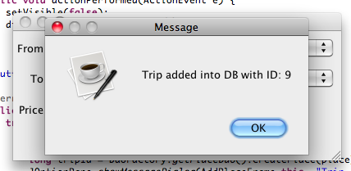
Exercise
Events
Update your TravelAgency frames :
Add listeners to your cancel and submit buttons.
Handle bad values for fields.
Display a popup to inform the user when the object is correctly persisted with the generated ID.

Slide 50
Menus
Swing

Slide 51
JMenuBar
Menus
A bar Containing all the … JMenu.
Can be set to a JFrame :
myJFrame.setJMenuBar(JMenuBar menuBar)
Add menus to it :
myJMenuBar.add(JMenu menu)

Slide 52
JMenu
Menus
Contains all the … JMenuItems.
Is contained in a JMenuBar.
Add item to a menu :
myJMenu.add(JMenuItem item)
Can have a shortcut :
void setMnemonic(int mnemonic)
Example :
JMenu menu = new JMenu("File");
// keyboard shortcut: ALT+F
menu.setMnemonic(KeyEvent.VK_F);

Slide 53
JMenuItem
Menus
An item for a menu.
Works the same way as a JButton :
Can have an ActionCommand.
Use an ActionListener for when the user click on it.
Other kind exists :
JRadioButtonMenuItem :
Works as JRadioButton.
JCheckBoxMenuItem :
Works as JCheckBox.

Slide 54
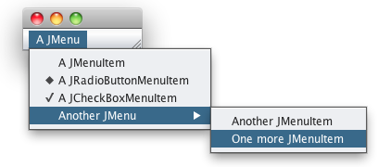
Example
Menus
A JMenuBar containing a JMenu …

Slide 55
JPopupMenu
Menus
A contextual menu.
Usually when the user performed a right-click somewhere.
Can be filled with JMenuItem.
Like a JMenu.

Slide 56
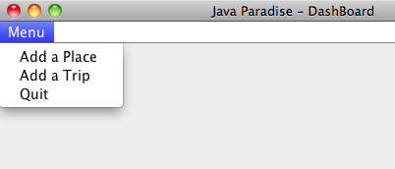
Exercise (1/2)
Menus
Create a DashBoardFrame class extending JFrame with :
A size of 600 x 400.
A title ”Travel Agency– Dashboard”.
EXIT_ON_CLOSE as default close operation.
A JMenuBar containing JMenu and JMenuItems as follow :

Slide 57
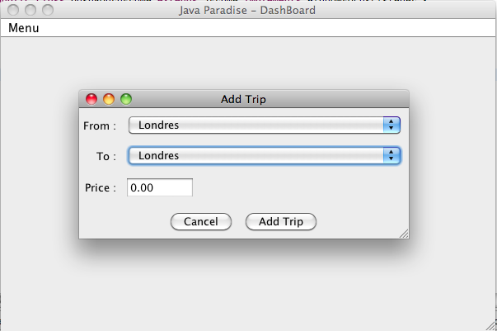
Exercise (2/2)
Menus
Implement the Action Listeners of the JMenuItems to display the corresponding frame.
Update GuiLauncher class and display only the Dashboard frame when the application start.

Slide 58
Listing
Swing

Slide 59
JComboBox
Listing
A drop down list.
Constructors :
JComboBox(Object[] items)
JComboBox(Vector<?> items)
Useful methods :
int getSelectedIndex()
Object getSelectedItem()
Note: the text displayed in the JComboBox is the toString() of the items.

Slide 60
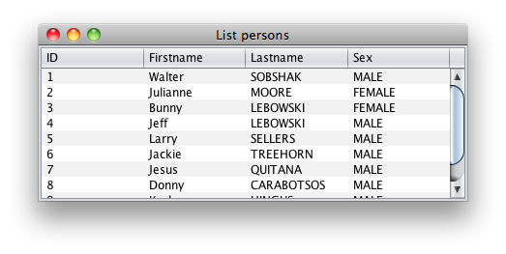
JTable
Listing
Used to display data in an spread sheet.
Use a model to arrange data presentation.
Commonly placed in a JScrollPane.

Slide 61
Table model
Listing
Main interface : TableModel.
Main abstract class : AbstractTableModel.
Main concrete class : DefaultTableModel.
It manage each cell.
Editable or not.
The view is automatically managed !
Usually you define your own model by extending the abstract class or implementing the interface :
How many columns are displayed?
How many rows?
What are the text header of the table?
…

Slide 62
Table model
Listing
You can override some methods :
int getColumnCount()
Returns the number of columns you decide to display.
int getRowCount()
Returns the number of displayed row.
String getColumnName(int col)
Returns the header of the column col.
First column has the index 0.
Object getValueAt(int row, int col)
Returns the value in the cell (row; col).

Slide 63
Table model
Listing
You can override some methods :
boolean isCellEditable(int row, int col)
Specifies if the cell is editable by the user.
void setValueAt(Object value, int row, int col)
Set the new value at the cell (row; cell).
Must be redefined if the cell is editable !

Slide 64
Table model
Listing
Example:
public class MyModel extends AbstractTableModel {
private List<Person> persons;
// ...
@Override
public int getColumnCount() {
return 4;
}
@Override
public int getRowCount() {
return getPersons().size();
}
@Override
public boolean isCellEditable(int row, int col) {
return false;
} // ...

Slide 65
Table model
Listing
Example:
// ...
@Override
public String getColumnName(int col) {
if(col == 0) return "ID";
else if(col == 1) return "Firstname";
// ...
}
@Override
public Object getValueAt(int row, int col) {
Person p = getPersons(row);
if(col == 0) return p.getId();
else if(col == 1) return p.getFirstname();
// ...
}
}

Slide 66
Table model
Listing
If you want to update the view …
When a line is added/removed.
When data is updated.
…
… call the method fireTableDataChanged()
The view will refresh itself ☺

Slide 67
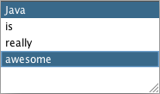
JList
Listing
A simple list.
Can have multi selection.
Can also have a model.
Constructors :
JList(Object[] items)
JList(Vector<?> items)
Useful methods :
int getSelectedIndex()
int[] getSelectedIndices()
Object getSelectedValue()
Object[] getSelectedValues()

Slide 68

JTree
Listing
Like an explorer.
Composed of nodes and leafs.
Contains MutableTreeNode :
For nodes.
For leafs.
DefaultMutableTreeNode root = new DefaultMutableTreeNode("Root");
root.add(new DefaultMutableTreeNode("Leaf"));
DefaultMutableTreeNode node = new DefaultMutableTreeNode("Node");
node.add(new DefaultMutableTreeNode("Another leaf"));
node.add(new DefaultMutableTreeNode("One more leaf..."));
root.add(node);

Slide 69
JTree
Listing
Retrieve the selection :
Useful methods on a DefaultMutableTreeNode :
boolean isLeaf()
Indicates wether the node is a leaf or not.
boolean isRoot()
Indicates if the node is the root one of the tree.
TreeNode[] getPath()
Get the path from to root to go to the node.
DefaultMutableTreeNode node =
(DefaultMutableTreeNode) getLastSelectedPathComponent();

Slide 70
Exercises (1/4)
Listing
Update DashBoardFrame :
Add a JTable component to your frame to display the list of all the Trips in Database.
Use a custom TableModel…
Allow the user to sort the table by a column.

Slide 71
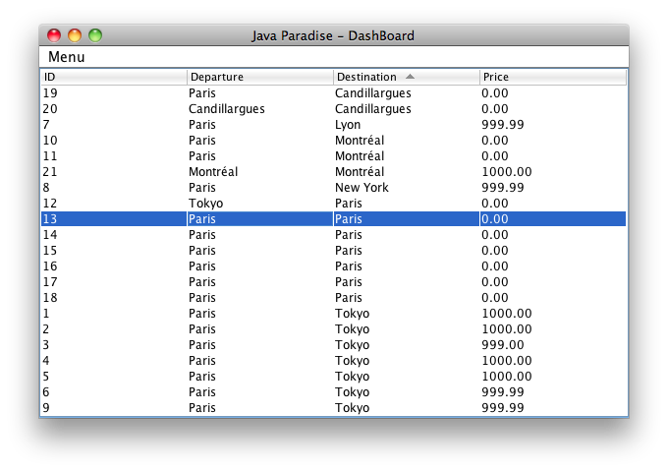
Exercises (2/4)
Listing

Slide 72
Exercises (3/4)
Listing
If you have time :
Add two ComboBox to the NORTH of the frame to filter the JTable by departure and destination places.
To do that :
Add Item Listeners to the Combo Box.
Use RowFilter class on your JTable.

Slide 73
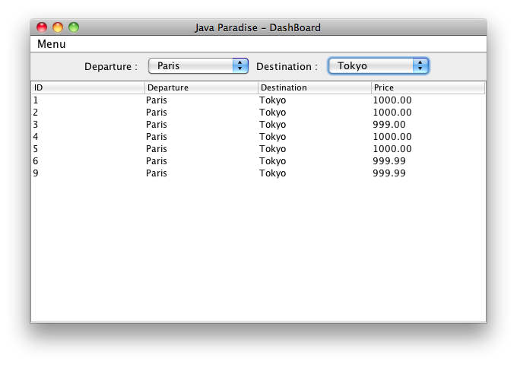
Exercises (4/4)
Listing

Slide 74
Painting
Swing

Slide 75

Presentation
Painting
We saw how to create simple Frame with Swing components.
But how develop your own components ? How develop some custom shapes inside a Swing Frame ?
Thanks to a JComponent method you can override :
void paintComponent(Graphics g)
Commonly, we draw inside a pane as JPanel.
And override the method to define the custom shapes to draw.

Slide 76
Graphics
Painting
A Graphics object encapsulates state information needed for the basic rendering operations that Java supports.
How to get one ?
Implicitly as a parameter of the method :
void paintComponent (Graphics)
Explicitly thanks to the JComponent method :
Graphics getGraphics()
The first solution is the better choice.
But the second can sometimes be useful.

Slide 77
Graphics
Painting
Useful methods are :
getColor() and setColor(Color c) :
Gets or sets this graphics context's current color.
getFont() and setFont(Font f) :
Gets or sets the current font.
drawLine(int x1, int y1, int x2, int y2) :
Draws a line, using the current color, between the points (x1, y1) and (x2, y2).
drawRect(int x, int y, int width, int height) :
Draws the outline of the specified rectangle.
fillRect(int x, int y, int width, int height) :
Fills the specified rectangle.

Slide 78
Graphics
Painting
Useful methods are :
drawOval(int x, int y, int width, int height) :
Draws the outline of an oval.
fillOval(int x, int y, int width, int height) :
Fills an oval bounded by the specified rectangle with the current color.
drawImage(Image img, int x, int y, ImageObserver observer) :
Draws the specified image at the specified coordinate.
drawString(String str, int x, int y) :
Draws the text given by the specified string, using this graphics context's current font and color.

Slide 79
Repaint
Painting
paintComponent (Graphics) is only invoked by Swing to draw components.
You can’t call it manually to redraw / refresh your component.
To do that, use of the following methods :
repaint() :
Demands to repaint the component.
repaint(Rectangle r) :
Demands to repaint the specified region of the component.

Slide 80
Example
Painting
public class MyPanel extends JPanel {
@Override
protected void paintComponent(Graphics g) {
super.paintComponent(g);
g.setColor(Color.YELLOW);
g.fillOval(0, 0, getWidth(), getHeight());
g.setColor(Color.BLACK);
g.drawOval(0, 0, getWidth(), getHeight());
g.drawString("Hello World !", getWidth() / 3, getHeight() / 2);
}
}

Slide 81
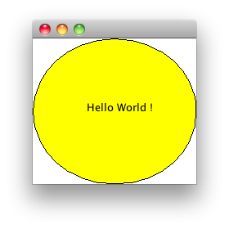
Example
Painting

Slide 82

Homework
Painting
Now you know how to draw shapes with Swing :
Try to create a Graphical version of the Game of Life !
Represent it like you want, depending on your tastes.
Be imaginative ☺

Slide 83
Internationalization
Swing

Slide 84
Introduction
Internationalization
Java is based on :
ResourceBundle.
Properties file.
Java supports UTF-8 encoding :
Majority of languages supported.

Slide 85
Properties file
Internationalization
They contain the translation of every language you provide :
Syntax is: key=value
Must respect some rules on their name to be valid :
The files' suffix must be :
_<lang>_<country>.properties
Canada's french: lang_fr_CA.properties
American english: lang_en_US.properties
_<lang>.properties
French: lang_fr.properties
No such suffix indicates the file is the default language file.

Slide 86
Properties file
Internationalization
Examples :
myLang_fr.properties
myLang_en.properties
cancel=Annuler
validate=Valider
personList=Liste des personnes
cancel=Cancel
validate=Validate
personList=List of persons

Slide 87
ResourceBundle
Internationalization
A class handling the properties files.
To get one :
ResourceBundle.getBundle(String basename)
Example :
Retrieve the value of keys :
String getString(String key);
ResourceBundle.getBundle("com.myschool.sun.myapp.lang.myLang");
myBundle.getString("cancel");

Slide 88
Locale class
Internationalization
Represents a specific geographical region.
Useful methods :
static Locale getDefault()
Get the default locale used by the JVM.
static void setDefault(Locale l)
Set the default locale used.
static Locale[] getAvailableLocales()
Get all Locales supported by the JVM.
String getCountry()
String getLanguage()

Slide 89
Exercise
Internationalization
Create a com.myschool.travelagency.lang package.
Create a default language file named travelagency.properties which contain English translation.
Create a language file for the language of your choice.
Make travelagency I18N-ed ☺

Slide 90
Look and feel
Swing

Slide 91
Introduction
Look and feel
You can change the appearance of your application.
Some can be found on :
https://substance.dev.java.net/
Java 1.6 Update 10 introduces a skin called Nimbus.

Slide 92
Classes
Look and feel
UIManager :
Allows to manage the look and feel.
LookAndFeelInfo[] UIManager.getInstalledLookAndFeels()
UIManager.setLookAndFeel(String className) LookAndFeel UIManager.getLookAndFeel()
Get the current look and feel in use.
LookAndFeelInfo :
Get information about a LookAndFeel.
String getName()
String getClassName()

Slide 93
Exercise (1/2)
Look and feel
Try to set the Nimbus look and feel :
FQDN of the class :
com.sun.java.swing.plaf.nimbus.NimbusLookAndFeel
Try the other Look & Feels and choose your favorite one for your TravelAgency application !

Slide 94
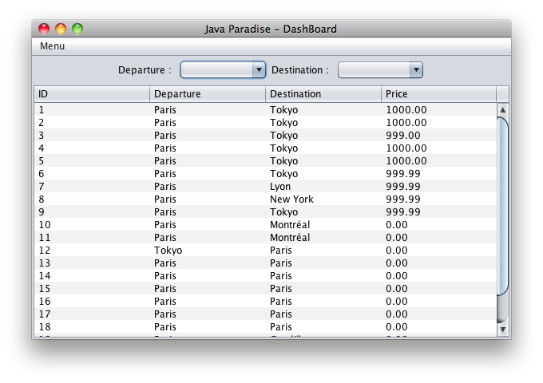
Exercise (2/2)
Look and feel

