Slide 1
Content Accuracy of the Gpt4all-Falcon Model
Patrick Hanfstingl | Florian Zanotti | Jakob Zenz
Group 3
23.01.2024

Slide 2

How do LLMs rank?
Rise of Large Language Models (ChatGPT etc.)
Ranking of generated content
Relevancy of the content
Validation of our pipeline
[1]
[1] https://www.linkedin.com/pulse/llm-revolution-how-ai-language-models-transforming-lives-ahmed-jawed

Slide 3
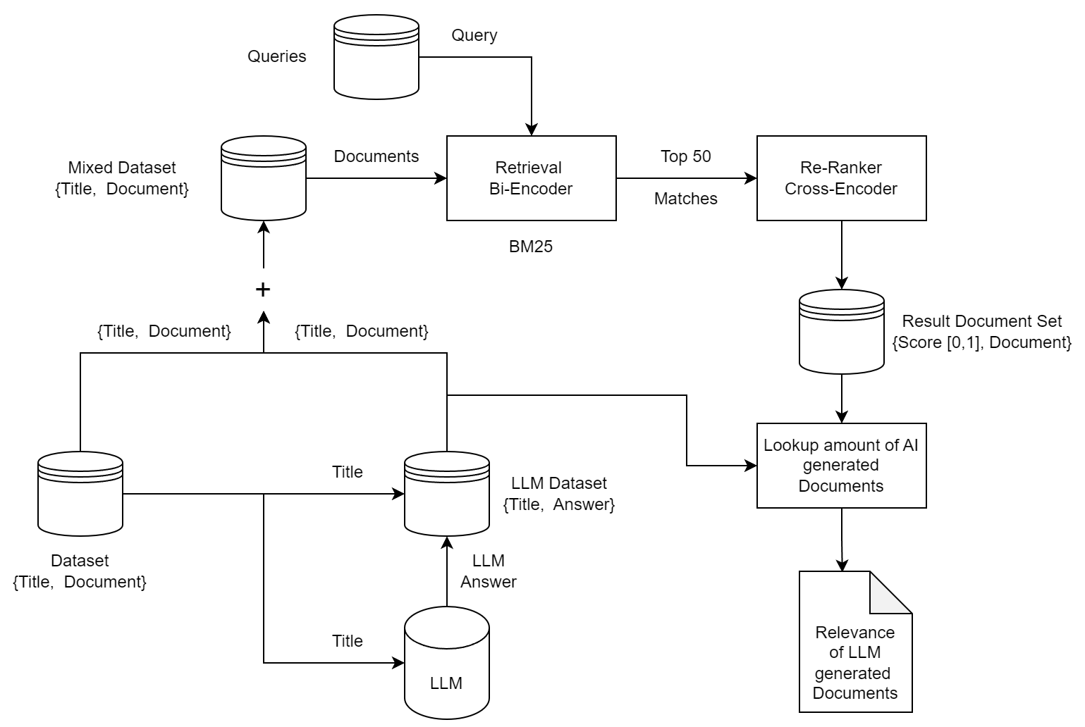
Project Pipeline

Slide 4
Choosing the Transformer
Requirements:
Capable of relevance classification
Performs well on our validation data
MonoBert [1]:
MonoBert adapts Bert for relevance classification
Open source and well known
Easy to use
[1] https://huggingface.co/castorini/monobert-large-msmarco

Slide 5
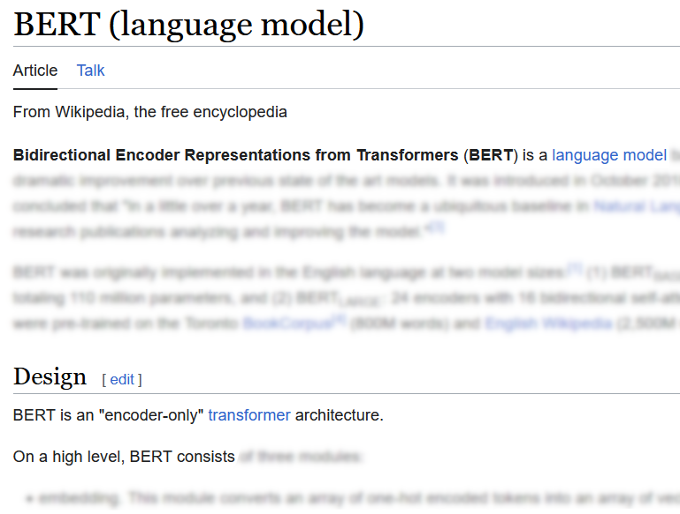
Choosing the Dataset
Requirements:
Collection of general, broad knowledge
Contains queries
Not too large
Wikipedia summary dataset [1]:
Contains summaries of Wikipedia pages
Titles as queries
subset “sport”
Wikipedia entry of “Bert“
[2]
[1] https://github.com/tscheepers/Wikipedia-Summary-Dataset
[2] https://en.wikipedia.org/wiki/BERT_(language_model)

Slide 6
LLM (GPT4-ALL)
Locally run, train and deploy LLMs
Open source
Maintained by Noimic AI
GPT4All-Falcon: very fast, good quality
Processed titles from dataset to get query
Problems with chat session:
Optimized it to take less time
Get right format as response

Slide 7
Validation of our pipeline
Important that our model is sound
nDCG@k and f1@k
Dataset Wikipedia articles [1]
Subset of the same topic
BM25
f1@k: 0.824
nDCG@k: 0.9816
BM25 + MonoBert
f1@k: 0.824
nDCG@k: 0.9886
[1] https://ir-datasets.com/wikir.html

Slide 8
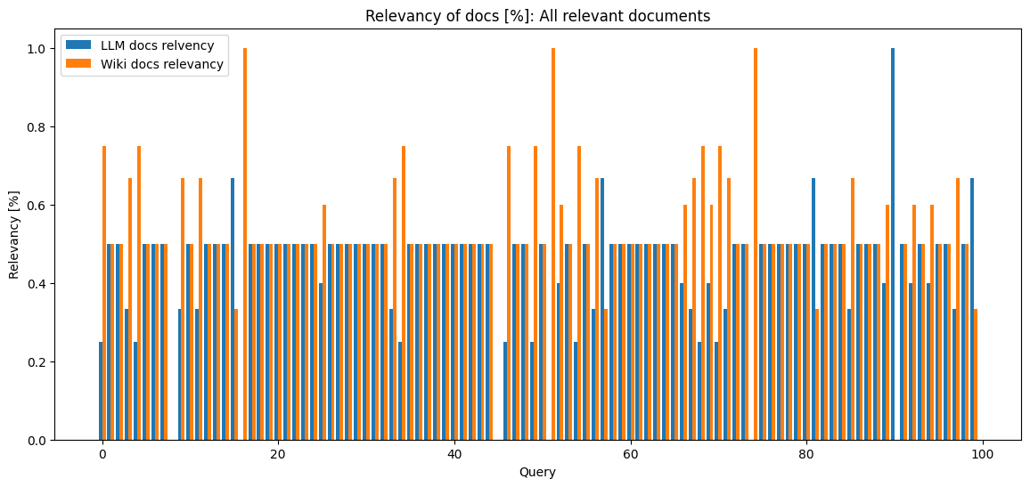
Amount of LLM documents [%]
LLM $≈$ 45%; Wiki $≈$ 55%

Slide 9
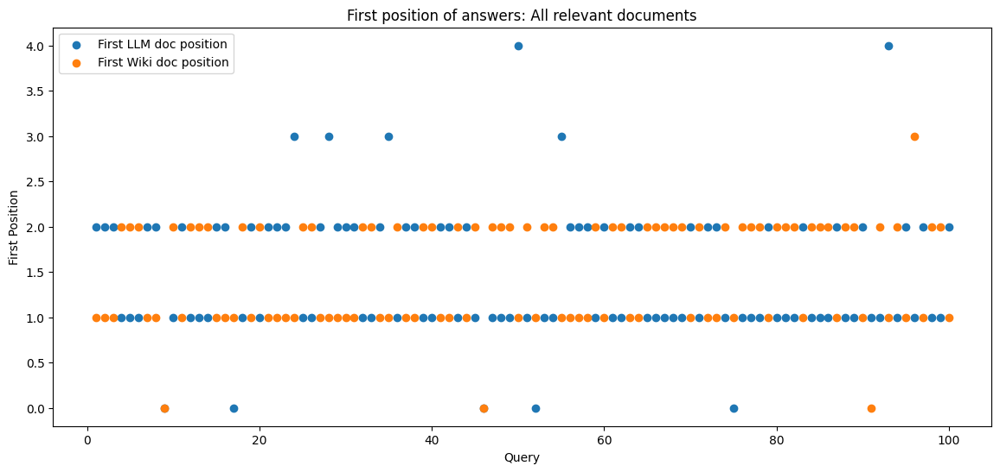
Position of first LLM document
LLM $≈$ 1.47; Wiki $≈$ 1.48

Slide 10
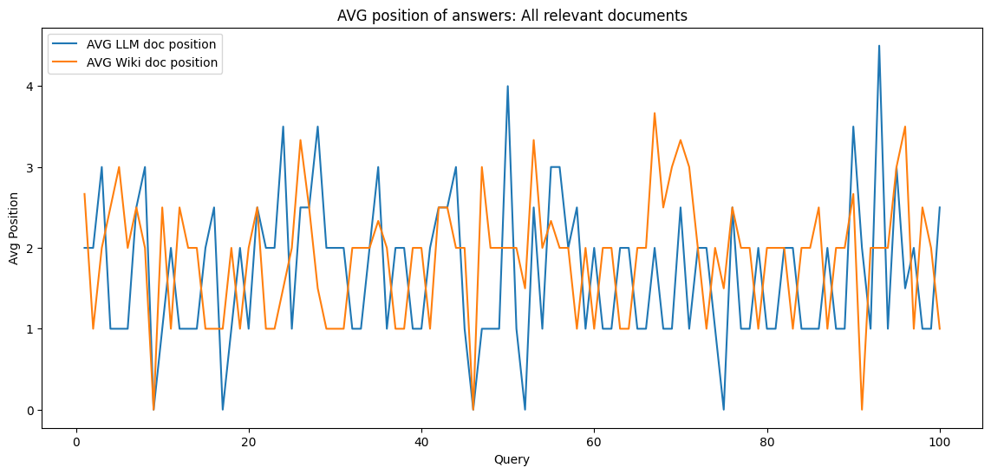
Average position
LLM $≈$ 1.69; Wiki $≈$ 1.88

Slide 11
Results:
Valuable information
Ranks as high as Wiki
Some outliers
Details: README [1]
[1] https://github.com/zanflo/AdvancedInformationRetrieval

Slide 12
Conclusion
Gpt4all-falcon is content accurate
… out of the box
... on general sport topics
Content is nearly as accurate as (human written) facts

Slide 13
Future Improvements
Select a different dataset for testing
Different query – stronger semantics
Get more resources
use larger datasets to exclude outliers
test the model on general knowledge

Slide 14

Questions?
https://github.com/zanflo/ AdvancedInformationRetrieval

