Slide 1
Jordan food price

Slide 2
Introduction
As discussed in assignment 1, the data presented relates to the prices of different types of food and fuel derivatives in the governorates of Jordan from 2011 to 2022. The data was divided into training data, which is all data in 2021 and earlier and the test data was for 2022.
The presentation contains how we choose the best results for the prediction of price.
Several models were tested, which we will see in the next slides.

Slide 3
Overview
The data that we have is labeled data, so it is of the type of supervised learning data, and it is continuous through which future values are predicted, so we must use regression models from machine learning models, but before that we must make sure that the data has been completely processed.
We have previously processed the data, but we still have to do the best and most appropriate encoding work to convert categorical data into numerical.

Slide 4
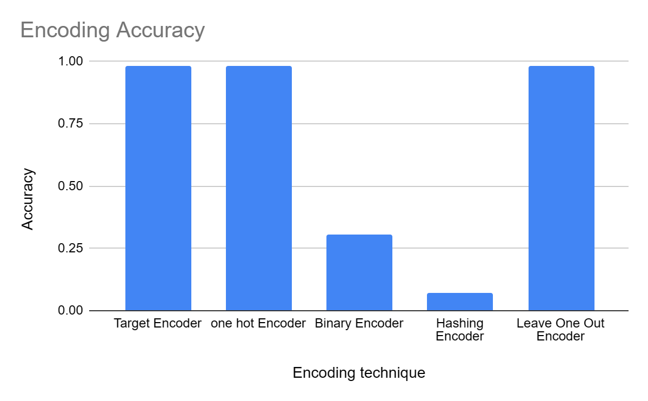
Encoding
As we notice the highest accuracy encoding techniques are (Target encoder ,one hot encoder and leave one out encoder). We prefer the target encoder because there is a strong relationship between the categorical variable and the target in the dataset.

Slide 5
What is ML models?
A program that can find patterns or make decisions from a previously unseen dataset. AI models are designed to replicate human intelligence using algorithms, whereas machine learning (ML) is designed to teach machines to operate and optimize themselves.

Slide 6
ML models
We will define and compare the accuracy of each of these models:
Linear regression: a process for determining a line that best represents the general trend of a data set.
Ridge regression: its an adaptation of linear regression algorithm. It enhances regular linear regression by slightly changing its cost function, which results in less overfit models.
Decision tree: type of flowchart that shows a clear pathway to a decision. In terms of data analytics, it is a type of algorithm that includes conditional ‘control’ statements to classify data.
K-nearest neighbor: is an approach to data classification that estimates how likely a data point is to be a member of one group or the other depending on what group the data points nearest to it are in.

Slide 7
ML models
Random forest: Random Forest is a robust machine learning algorithm that can be used for a variety of tasks including regression and classification. It is an ensemble method, meaning that a random forest model is made up of a large number of small decision trees, called estimators, which each produce their own predictions.
Neural network regression: Neural network regression refers to the use of neural networks, which are a type of machine learning model inspired by the human brain's structure, for solving regression problems. Regression, in general, involves predicting continuous numeric values based on input data.
XGboost regression: XGBoost regression refers to the application of the XGBoost algorithm for solving regression problems. XGBoost (eXtreme Gradient Boosting) is a popular and powerful machine learning algorithm that belongs to the gradient boosting framework. It is widely used for regression tasks due to its ability to handle complex nonlinear relationships and produce accurate predictions.

Slide 8
Accuracy
The accuracy in the next slides is the accuracy of the model's prediction within a range of 20% plus or minus. This means that if the actual value is, for example, 100, the model's prediction is considered accurate if it falls within the range of 80 to 120 (20% of 100 is 20, so 100 ± 20).
The range of ±20% is commonly used to provide a measure of tolerance or margin of error for regression models.

Slide 9
Linear regression
After conducting the test, the accuracy of the model was: 0.827

Slide 10
Ridge regression
After conducting the test, the accuracy of the model was: 0.828

Slide 11
Random forest regression
After conducting the test, the accuracy of the model was: 0.818

Slide 12
Decision tree
After conducting the test, the accuracy of the model was: 0.809

Slide 13
Neural network regression
After conducting the test, the accuracy of the model was: 0.754

Slide 14
K-nearest neighbor (KNN)
After conducting the test, the accuracy of the model was: 0.750

Slide 15
XGboost regression
Best accuracy
After conducting the test, the accuracy of the model was: 0.831

Slide 16
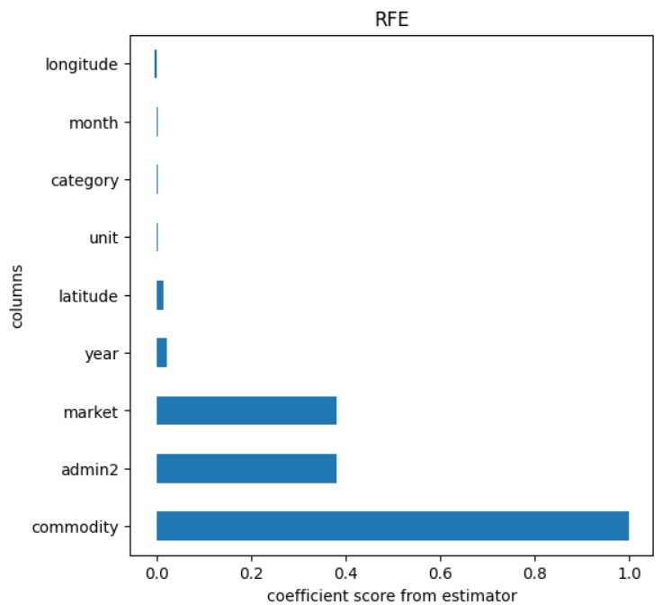
Feature Selection
Feature selection is the process by which a subset of relevant features, or variables, are selected from a larger data set for constructing models. We use Recursive Feature Elimination (RFE) it is iterative feature selection method that works by recursively eliminating features from the dataset. As we notice the commodity column has the highest feature score.

Slide 17
Evaluation Metrics
Evaluation metrics are indeed used to measure the quality of machine learning models. When dealing with continuous data, there are several specific evaluation metrics that are commonly used: (Root Mean Squared Error (RMSE), Mean Absolute Error (MAE), R-squared score (R²) and explained variance score.
Root Mean Squared Error | 0.259
Mean Absolute Error | 0.148
R-squared score | 0.988
Explained variance score | 0.989

Slide 18
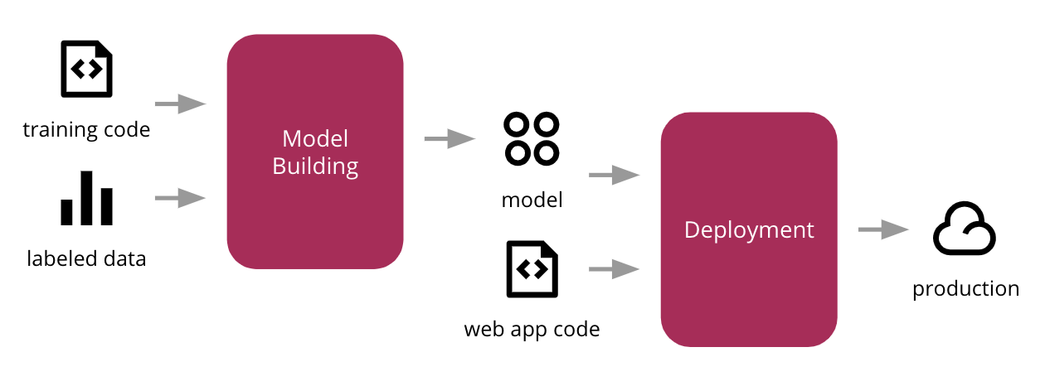
Deployment
Deploying a machine learning model, known as model deployment, simply means to integrate a machine learning model and integrate it into an existing production environment where it can take in an input and return an output. The purpose of deploying your model is so that you can make the predictions from a trained ML model available to others, whether that be users, management, or other systems.

Slide 19
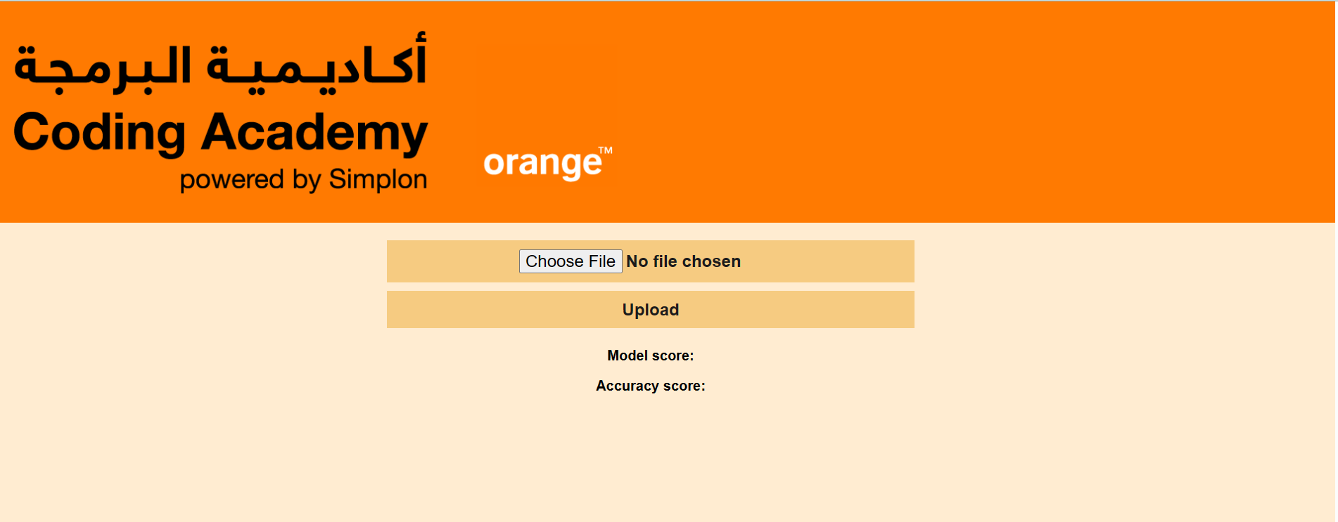
Website and UI design before data upload

Slide 20
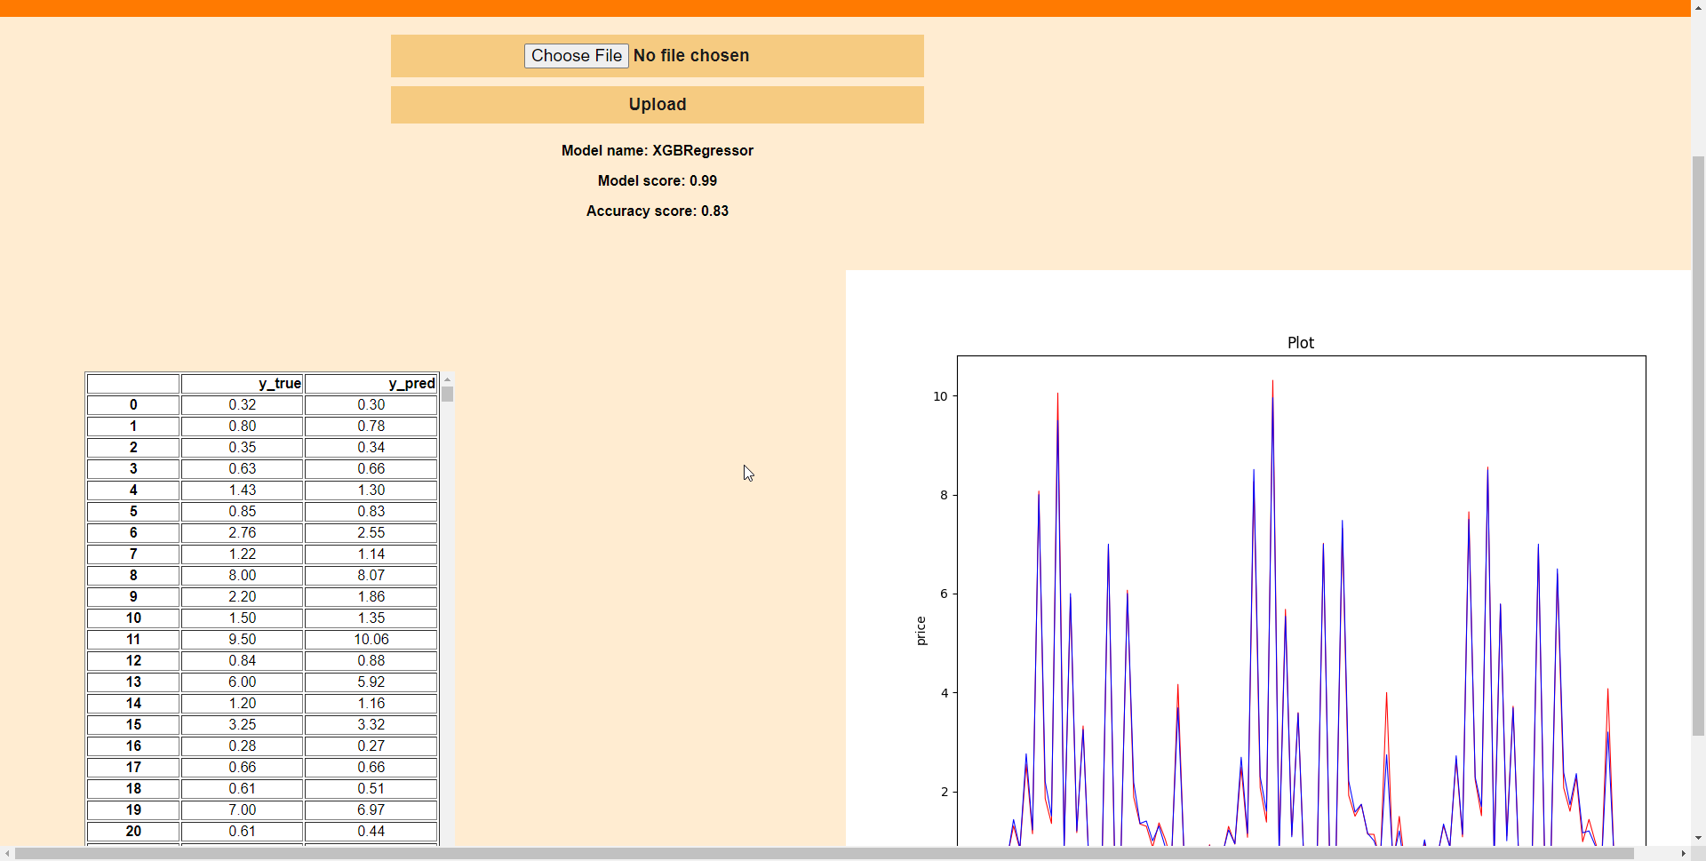
Website and UI design after data upload

Slide 21
Thank you
Group (1)
Dana mohammad Daoud
Abdalrhman Jad
Sief Addeen Freitekh

