Slide 1
Multipath Model
with Eavesdropper
Team 6
讲解：57119105 夏汉宁

Slide 2
Content
根据具有窃听用户的无线多径模型
同时获取发送方、接收方和窃听者的信道脉冲响应(CIR)
（发送方向接收方发送消息，接收方在1ms后向Alice发送消息）
绘制发送方、接收方和窃听者的信道频率幅值响应（512 点）的图像，并比较发送方和接收方，接收方和窃听者之前信号的相关性。

Slide 3

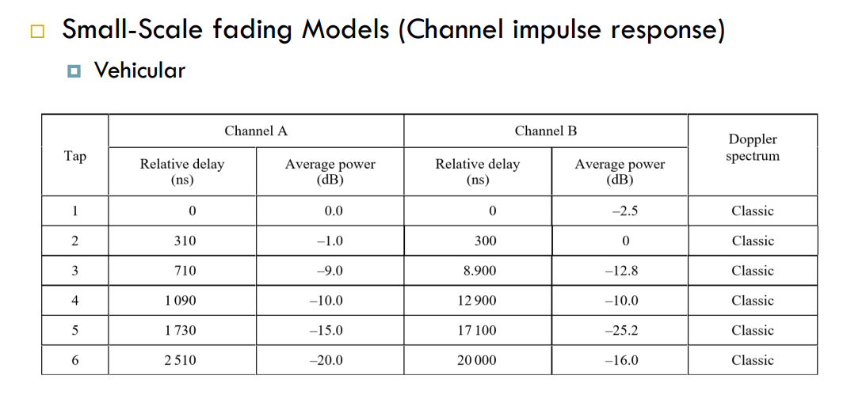
Model Establishment
ITU-RM.1225 中的多路径延迟模型
只考虑小规模衰落 （使用室外到室内和行人模型和车辆模型）

Slide 4
Model Establishment
考虑两个合法的传播者 Alice 和 Bob，一个非法的窃听者 Eve。
其中，Eve 和 Bob 之间的距离在半波长之内，但是 Eve 的位置是不确定的。
假定 Alice 的移动速度为 5km/h, Alice 和 Bob 相互传输信息的时间间隔为 1ms，载波频 率为 2400MHz，采样率为 20MS/s。

Slide 5
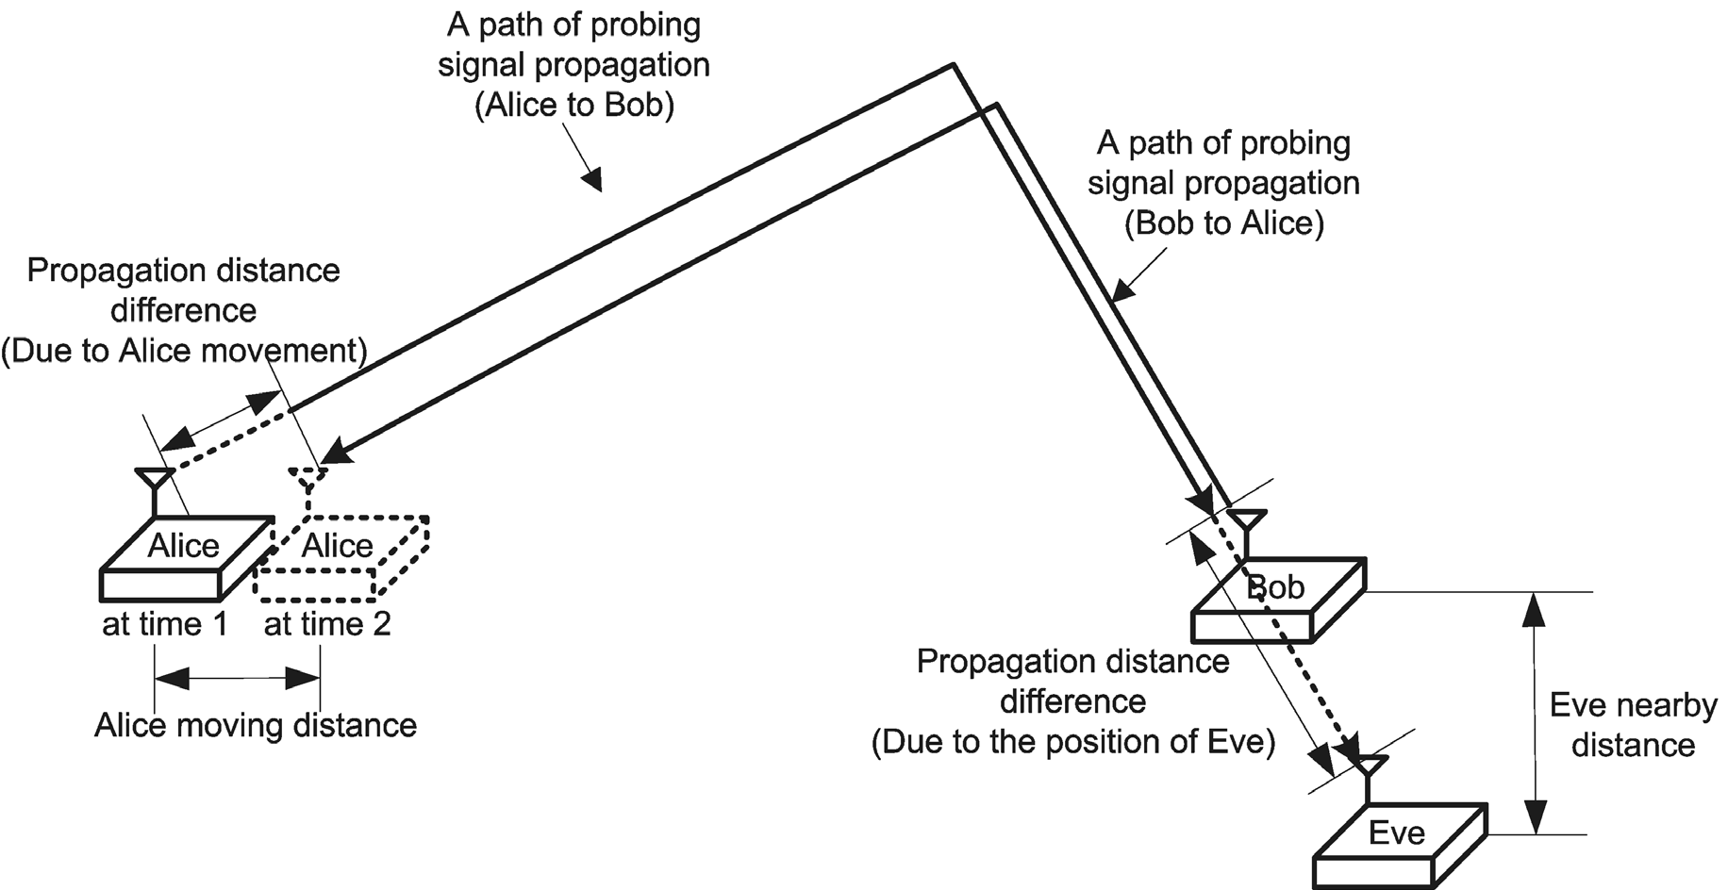
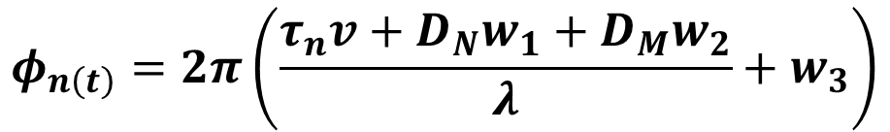
Model Establishment
$$φ_{n\left(t\right)}=2π\left(\frac{τ_{n}v+D_{N}w_{1}+D_{M}w_{2}}{λ}+w_{3}\right)$$

Slide 6
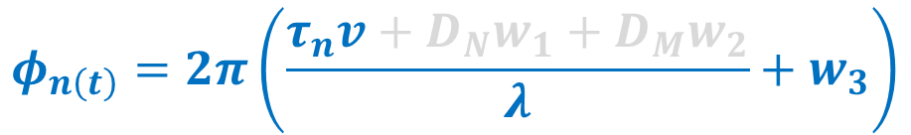
Model Establishment
$$φ_{n\left(t\right)}=2π\left(\frac{τ_{n}v+D_{N}w_{1}+D_{M}w_{2}}{λ}+w_{3}\right)$$
Alice to Bob

Slide 7
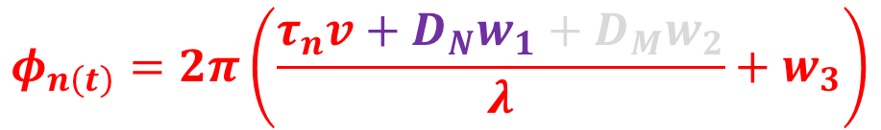
Model Establishment
$$φ_{n\left(t\right)}=2π\left(\frac{τ_{n}v+D_{N}w_{1}+D_{M}w_{2}}{λ}+w_{3}\right)$$
Bob to Alice

Slide 8
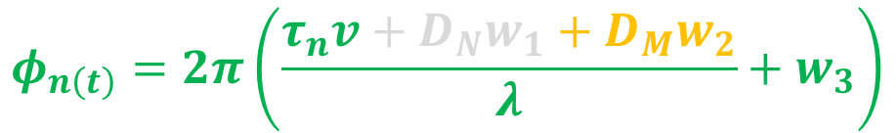
Model Establishment
$$φ_{n\left(t\right)}=2π\left(\frac{τ_{n}v+D_{N}w_{1}+D_{M}w_{2}}{λ}+w_{3}\right)$$
Alice to Eve

Slide 9
Code
Channel_Tau = [0 310 710 1090 1730 2510]*1e-9; % [second]
Channel_Gain = [0 -1 -9 -10 -15 -20]; % [dB]
Sampling_Rate = 20 * 1e6; % [points/second]
Sample_Length = 1 / Sampling_Rate; % [second]
Channel_Tau_Index = round(Channel_Tau / Sample_Length) + 1;
Moving_Speed = 5 * 1000 / 3600; % [meter/second]
TDD_Interval = 1e-3; % [second]
Moving_Distance = TDD_Interval * Moving_Speed; % [meter]
Carrier_Frequency = 2.4 * 10^9; % [Hz]
Transmission_Frequency = 3 * 1e8; %[meter/second]
Wavelength = Transmission_Frequency / Carrier_Frequency; % [meter]
Nearby_Distance = 0.06; % [meter]
Channel_Seed = 0;
Definition of Constants

Slide 10
Code
rng(Channel_Seed, 'twister');
for n = 1:512
Channel_CIR1(n) = 0i;
end
for n = 1:6
phi(n) = 2 * pi * (2 * (rand - 0.5) + (Channel_Tau(n) * Transmission_Frequency) / Wavelength);
c(n)=10^(Channel_Gain(n) / 10) * exp(-1i * phi(n));
Channel_CIR1(Channel_Tau_Index(n)) = c(n);
end
Channel_CFR1 = abs(freqz(Channel_CIR1, 512));
x = 1:512;
line1 = plot(x, Channel_CFR1,'b');
hold on
Alice to Bob

Slide 11
Code
rng(Channel_Seed, 'twister');
for n = 1:512
Channel_CIR2(n) = 0i;
end
for n = 1:6
phi(n) = 2 * pi * (2 * (rand - 0.5) + (Channel_Tau(n) * Transmission_Frequency + (Moving_Distance) * 2 * (rand - 0.5)) / Wavelength);
c(n)=10^(Channel_Gain(n) / 10) * exp(-1i * phi(n));
Channel_CIR2(Channel_Tau_Index(n)) = c(n);
end
Channel_CFR2 = abs(freqz(Channel_CIR2, 512));
x = 1:512;
line2 = plot(x, Channel_CFR2,'r');
hold on
Bob to Alice

Slide 12
Code
rng(Channel_Seed, 'twister');
for n = 1:512
Channel_CIR3(n) = 0i;
end
for n = 1:6
phi(n) = 2 * pi * (2 * (rand - 0.5) + (Channel_Tau(n) * Transmission_Frequency + rand * 0 + (Nearby_Distance) * 2 * (rand - 0.5)) / Wavelength);
c(n)=10^(Channel_Gain(n) / 10) * exp(-1i * phi(n));
Channel_CIR3(Channel_Tau_Index(n)) = c(n);
end
Channel_CFR3 = abs(freqz(Channel_CIR3, 512));
x = 1:512;
line3 = plot(x, Channel_CFR3,'g');
Alice to Eve

Slide 13
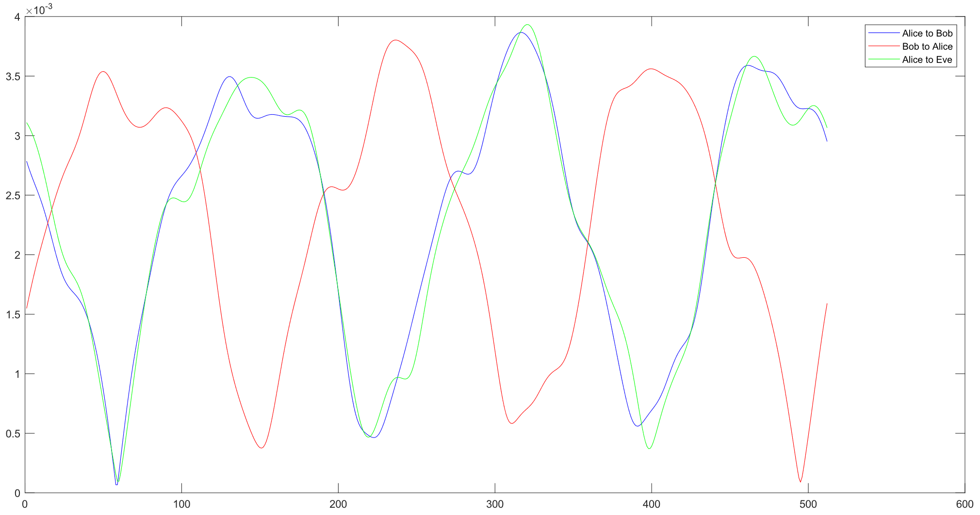
Results

Slide 14
Results
Alice to Bob 和 Bob to Alice 相关度较高

Slide 15
Results
Alice to Bob 和 Bob to Alice 相关度较高
而 Alice to Eve 与另外两者相关性较低

Slide 16
Results
>> corrcoef(Channel_CIR1,Channel_CIR2)
ans =
1.0000 + 0.0000i 0.9260 - 0.0434i
0.9260 + 0.0434i 1.0000 + 0.0000i
>> corrcoef(Channel_CIR1,Channel_CIR3)
ans =
1.0000 + 0.0000i -0.1470 + 0.1568i
-0.1470 - 0.1568i 1.0000 + 0.0000i

Slide 17
Q & A Times
Team 6
讲解：57119105 夏汉宁

