Slide 1
Project 4
Group 6
Members : 吴桐 马运聪 李政君 夏汉宁 唐翠霜 王晨阳

Slide 2
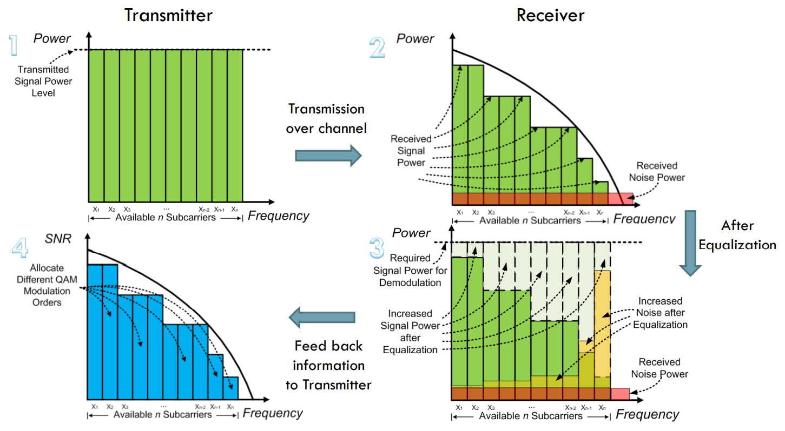
比特加载的原理
比特加载
根据每个载波的信息质量参数将每对发射器/接收器的调制参数进行匹配。对每个载波的信噪比进行测量并选择优化调制，以实现最大传输速率，同时将比特错误率(BER)保持在预期水平。这种方法能够将来自其他电路连接设备的干扰降到最低。
→ 根据实际情况选择每个载波的调制方式，以实现最大传输速率，保证比特错误率(BER)

Slide 3
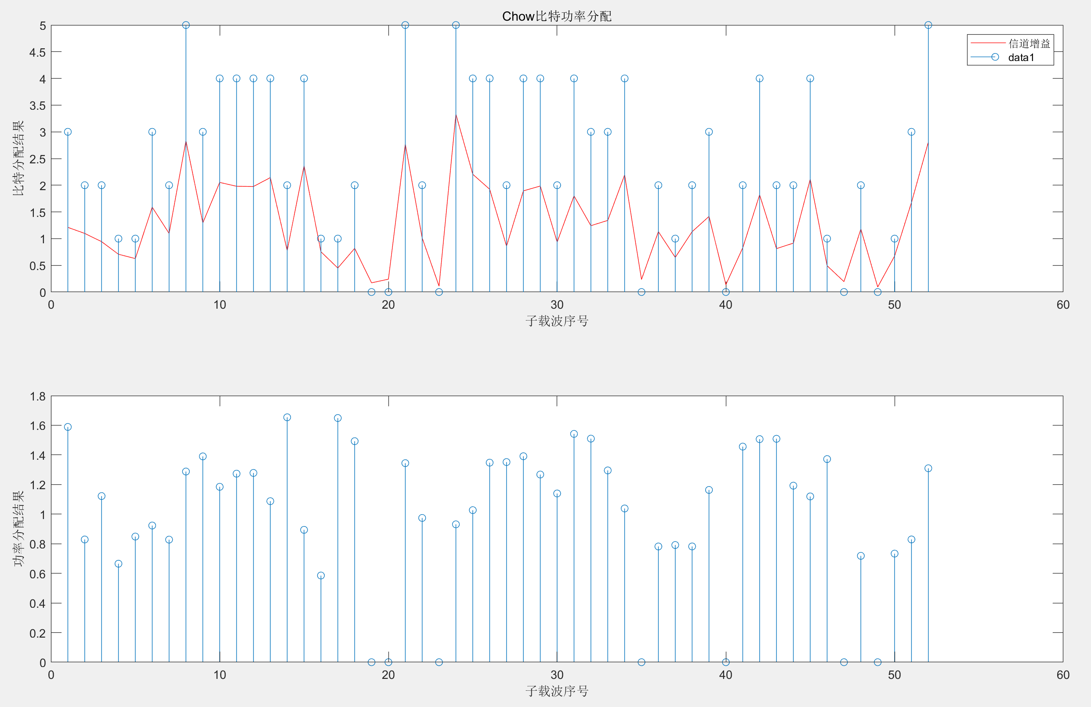
Chow比特功率分配算法
Chow算法是根据各个子信道的信道容量来分配比特的。它的优化准则是在维持目标误比特率的前提下，使系统的余量最大。该算法通过迭代过程，逐步分配比特，同时使系统的余量逐步增大，直到所有的比特都分配完毕。
subcar_gains=random('rayleigh',1,1,N_subc); SNR=(subcar_gains.^2)./(noise*gap);
其中，gap为SNR间距，定义为系统达到传输容量Ｃ时的理想SNR和实际传输容量R的SNR之比，是BER和信道编码方式的函数
仿真瑞利衰落，计算子载波增益
平均信噪比：20
误比特率：10^-3
子载波数目：52
平均发射功率：1
比特总数上限：128

Slide 4
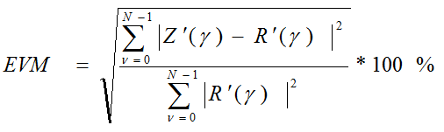

SNR: 20 dB Channel: 1 EVM = 1.86e-01 Channel_SNR = 14.59
SNR: 20 dB Channel: 2 EVM = 8.38e-02 Channel_SNR = 21.54
SNR: 20 dB Channel: 3 EVM = 4.03e-02 Channel_SNR = 27.90
SNR: 20 dB Channel: 4 EVM = 2.19e-01 Channel_SNR = 13.18
SNR: 20 dB Channel: 5 EVM = 2.28e-01 Channel_SNR = 12.84
SNR: 20 dB Channel: 6 EVM = 1.20e-01 Channel_SNR = 18.44
SNR: 20 dB Channel: 7 EVM = 1.00e-01 Channel_SNR = 20.00
EVM
注意这里的SNR是功率比，如果折算到dB，需要进行10*log10(SNR)的计算
SNR: 20 dB Channel: 1 EVM = 2.00e-01 Channel_SNR = 13.99 dB
SNR: 20 dB Channel: 2 EVM = 1.61e-01 Channel_SNR = 15.87 dB
SNR: 20 dB Channel: 3 EVM = 5.43e-02 Channel_SNR = 25.30 dB
SNR: 20 dB Channel: 4 EVM = 2.21e-01 Channel_SNR = 13.11 dB
SNR: 20 dB Channel: 5 EVM = 2.28e-01 Channel_SNR = 12.83 dB
…
SNR: 20 dB Channel: 40 EVM = 7.38e-02 Channel_SNR = 22.64 dB
SNR: 20 dB Channel: 41 EVM = 1.37e-01 Channel_SNR = 17.27 dB
SNR: 20 dB Channel: 42 EVM = 1.05e-01 Channel_SNR = 19.55 dB
SNR: 20 dB Channel: 43 EVM = 6.59e-02 Channel_SNR = 23.63 dB
SNR: 20 dB Channel: 44 EVM = 7.29e-02 Channel_SNR = 22.75 dB
Notes:
SNR: 20 dB Channel: 1 EVM = 2.00e-01 Channel_SNR = 13.99
SNR: 20 dB Channel: 2 EVM = 1.61e-01 Channel_SNR = 15.87
SNR: 20 dB Channel: 3 EVM = 5.43e-02 Channel_SNR = 25.30
SNR: 20 dB Channel: 4 EVM = 2.21e-01 Channel_SNR = 13.11
SNR: 20 dB Channel: 5 EVM = 2.28e-01 Channel_SNR = 12.83
SNR: 20 dB Channel: 6 EVM = 1.37e-01 Channel_SNR = 17.27
SNR: 20 dB Channel: 7 EVM = 1.06e-01 Channel_SNR = 19.49
SNR: 20 dB Channel: 8 EVM = 4.23e-02 Channel_SNR = 27.48
SNR: 20 dB Channel: 9 EVM = 1.79e-01 Channel_SNR = 14.96
SNR: 20 dB Channel: 10 EVM = 1.74e-01 Channel_SNR = 15.18
SNR: 20 dB Channel: 11 EVM = 1.30e-01 Channel_SNR = 17.74
SNR: 20 dB Channel: 12 EVM = 2.09e-01 Channel_SNR = 13.59
SNR: 20 dB Channel: 13 EVM = 6.15e-02 Channel_SNR = 24.23
SNR: 20 dB Channel: 14 EVM = 2.25e-01 Channel_SNR = 12.98
SNR: 20 dB Channel: 15 EVM = 2.35e-01 Channel_SNR = 12.58
SNR: 20 dB Channel: 16 EVM = 7.19e-02 Channel_SNR = 22.86
SNR: 20 dB Channel: 17 EVM = 1.41e-01 Channel_SNR = 17.03
SNR: 20 dB Channel: 18 EVM = 1.62e-01 Channel_SNR = 15.82
SNR: 20 dB Channel: 19 EVM = 5.71e-03 Channel_SNR = 44.86
SNR: 20 dB Channel: 20 EVM = 9.88e-02 Channel_SNR = 20.10
SNR: 20 dB Channel: 21 EVM = 1.53e-01 Channel_SNR = 16.31
SNR: 20 dB Channel: 22 EVM = 1.37e-01 Channel_SNR = 17.29
SNR: 20 dB Channel: 23 EVM = 7.73e-02 Channel_SNR = 22.24
SNR: 20 dB Channel: 24 EVM = 1.67e-01 Channel_SNR = 15.53
SNR: 20 dB Channel: 25 EVM = 1.46e-01 Channel_SNR = 16.69
SNR: 20 dB Channel: 26 EVM = 2.49e-01 Channel_SNR = 12.07
SNR: 20 dB Channel: 27 EVM = 2.05e-02 Channel_SNR = 33.76
SNR: 20 dB Channel: 28 EVM = 6.74e-02 Channel_SNR = 23.42
SNR: 20 dB Channel: 29 EVM = 5.22e-02 Channel_SNR = 25.65
SNR: 20 dB Channel: 30 EVM = 2.92e-02 Channel_SNR = 30.69
SNR: 20 dB Channel: 31 EVM = 1.58e-01 Channel_SNR = 16.01
SNR: 20 dB Channel: 32 EVM = 1.63e-02 Channel_SNR = 35.74
SNR: 20 dB Channel: 33 EVM = 1.20e-01 Channel_SNR = 18.40
SNR: 20 dB Channel: 34 EVM = 6.58e-02 Channel_SNR = 23.64
SNR: 20 dB Channel: 35 EVM = 6.95e-02 Channel_SNR = 23.15
SNR: 20 dB Channel: 36 EVM = 6.59e-02 Channel_SNR = 23.62
SNR: 20 dB Channel: 37 EVM = 4.61e-02 Channel_SNR = 26.72
SNR: 20 dB Channel: 38 EVM = 5.51e-02 Channel_SNR = 25.18
SNR: 20 dB Channel: 39 EVM = 6.23e-02 Channel_SNR = 24.11
SNR: 20 dB Channel: 40 EVM = 7.38e-02 Channel_SNR = 22.64
SNR: 20 dB Channel: 41 EVM = 1.37e-01 Channel_SNR = 17.27
SNR: 20 dB Channel: 42 EVM = 1.05e-01 Channel_SNR = 19.55
SNR: 20 dB Channel: 43 EVM = 6.59e-02 Channel_SNR = 23.63
SNR: 20 dB Channel: 44 EVM = 7.29e-02 Channel_SNR = 22.75
SNR: 20 dB Channel: 45 EVM = 1.03e-01 Channel_SNR = 19.77
SNR: 20 dB Channel: 46 EVM = 1.55e-01 Channel_SNR = 16.17
SNR: 20 dB Channel: 47 EVM = 1.03e-01 Channel_SNR = 19.78
SNR: 20 dB Channel: 48 EVM = 1.26e-01 Channel_SNR = 17.96
SNR: 20 dB Channel: 49 EVM = 7.12e-02 Channel_SNR = 22.95
SNR: 20 dB Channel: 50 EVM = 1.39e-01 Channel_SNR = 17.15
SNR: 20 dB Channel: 51 EVM = 2.42e-02 Channel_SNR = 32.31
SNR: 20 dB Channel: 52 EVM = 5.30e-03 Channel_SNR = 45.51

Slide 5
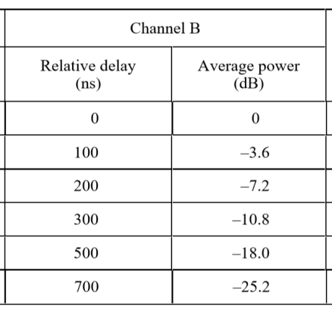
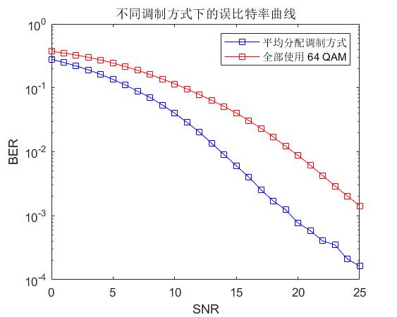
手动实现子载波的不同调制
每13个子载波一组，依次进行BPSK，QPSK，16QAM和64QAM调制
SNR: 5 dB BER = 5.35e-02
SNR: 6 dB BER = 3.80e-02
SNR: 7 dB BER = 2.53e-02
SNR: 8 dB BER = 1.59e-02
SNR: 9 dB BER = 9.50e-03
SNR: 10 dB BER = 4.86e-03
SNR: 11 dB BER = 2.31e-03
SNR: 12 dB BER = 1.01e-03
SNR: 13 dB BER = 3.48e-04
SNR: 14 dB BER = 1.12e-04
SNR: 15 dB BER = 2.51e-05
SNR: 16 dB BER = 2.96e-06
与仅使用16QAM调制相比，误码率下降

Slide 6
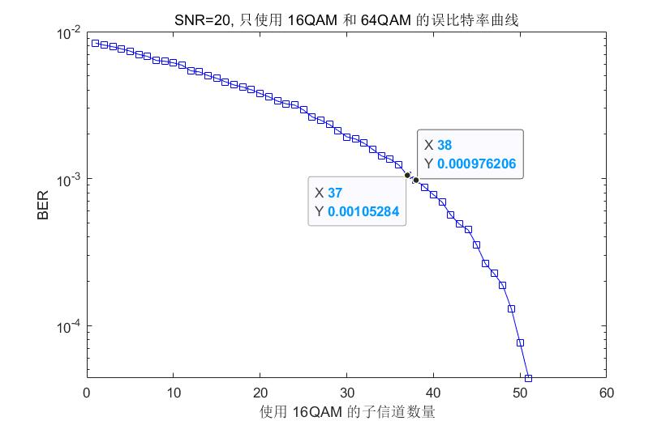
手动实现子载波的不同调制

Slide 7
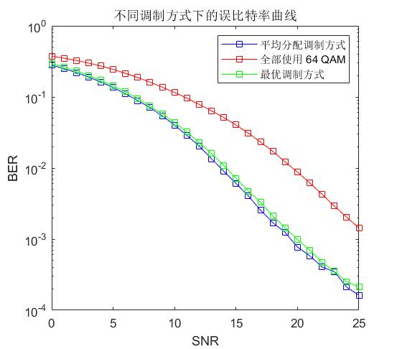
手动实现子载波的不同调制
SNR: 0 dB BER = 2.93e-01
SNR: 1 dB BER = 2.63e-01
SNR: 2 dB BER = 2.31e-01
SNR: 3 dB BER = 2.01e-01
SNR: 4 dB BER = 1.71e-01
SNR: 5 dB BER = 1.43e-01
SNR: 6 dB BER = 1.18e-01
SNR: 7 dB BER = 9.48e-02
SNR: 8 dB BER = 7.50e-02
SNR: 9 dB BER = 5.78e-02
SNR: 10 dB BER = 4.39e-02
SNR: 11 dB BER = 3.22e-02
SNR: 12 dB BER = 2.30e-02
SNR: 13 dB BER = 1.60e-02
SNR: 14 dB BER = 1.09e-02
SNR: 15 dB BER = 7.28e-03
SNR: 16 dB BER = 4.82e-03
SNR: 17 dB BER = 3.23e-03
SNR: 18 dB BER = 2.14e-03
SNR: 19 dB BER = 1.45e-03
SNR: 20 dB BER = 9.75e-04
1-38子载波使用16QAM调制
39-52子载波使用64QAM调制
误码率略微上升，
但是传输速率提升

Slide 8
实验心得
进一步理解比特加载和功率分配
理解并尝试实现EVM的计算
调制方式复杂会使误码率上升，但是传输速率也会提升，要寻找到二者之间的平衡
实现了手动的子载波不同调制方法，可以根据实际情况人工进行参数调整
之后可以尝试进行自适应比特功率分配的实验

Slide 9
Thanks for listening!
Group 6
Members : 吴桐 马运聪 李政君 夏汉宁 唐翠霜 王晨阳

