Slide 1
Using Phoneme Representations to Build Predictive Models Robust to ASR Errors

Slide 2
Outline
1. Background
2. Pipeline
3. Datasets
4. Experiment

Slide 3
Outline
1. Background
2. Pipeline
3. Datasets
4. Experiment

Slide 4
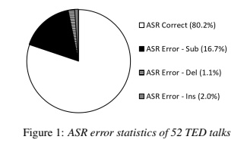
types of ASR errors
Mirzaei, Maryam & Meshgi, Kourosh & Kawahara, Tatsuya. (2017). Detecting listening difficulty for second language learners using Automatic Speech Recognition errors. 156-160. 10.21437/SLaTE.2017-27.
Traditionally, researchers distinguish between three main types of ASR errors:
substitutions, deletions and insertions

Slide 5
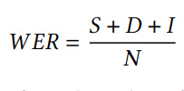
Word Error Rate
Word Error Rate (WER) is the most popular metric for ASR evaluation:
Phoneme Error Rate (PER) are the extensions of WER to phonemes.
If ASR confuses similar sounding words or phrases, PER will be smaller than WER.
I = total number of insertions
D = total number of deletions
S = total number of substitutions
N = the number of words in the reference text

Slide 6
Outline
1. Background
2. Pipeline
3. Datasets
4. Experiment

Slide 7
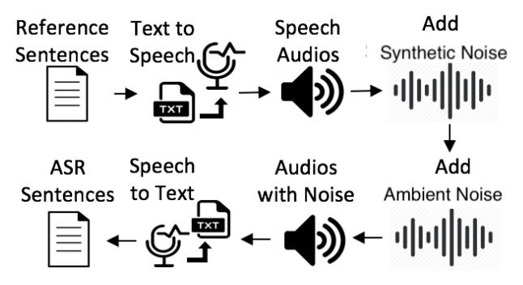
data generation pipeline
*Tools used in this paper for TTS and ASR are Amazon Polly and Amazon Transcribe

Slide 8
Room for improvement
Shortcomings:
Only 20-30% of transcriptions contain ASR errors
Only use one random ambient noise
Use a single speaker
Improvement:
If the transcription does not contain ASR error, repeat with the pipeline on it and add another noise. Continue in this loop until ASR errors occurs
Use different speakers to simulate dialogue scenarios

Slide 9
Outline
1. Background
2. Pipeline
3. Datasets
4. Experiment

Slide 10
Comparison of datasets
N S, Mukuntha & Kumar, Ayush & Vepa, Jithendra. (2021). Phoneme-BERT: Joint Language Modelling of Phoneme Sequence and ASR Transcript.
Using Phoneme Representations to Build Predictive Models Robust to ASR Errors
SST
TQ
SQuAD
SUBJ
transcriptions has WER > 0%
PhonemeBERT: Joint Language Modelling of Phoneme Sequence and ASR Transcript
pre-training (LibriSpeech corpus, Amazon reviews and Squad v1.1)
SST-5
TREC
ATIS
transcriptions has WER >= 5% and <= 40%
Unfortunately, these datasets are not used for dialogue tasks

Slide 11
Error Categories
Traditionally, there are three types of ASR errors:
insertions
list flights from chicago to kansas city in the morning → let's flights from chicago to kansas the city in the morning
indianapolis to orlando december twenty seventh → in the indianapolis to orlando december twenty seventh
deletions
list direct flights from new york city to los angeles after 10 am → direct flights from new york city for los angeles
list flights from boston to pittsburgh daily → list flights from boston to Pittsburgh
Substitutions
……

Slide 12
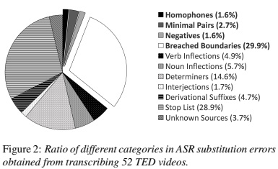
root-cause analysis
Mirzaei, Maryam & Meshgi, Kourosh & Kawahara, Tatsuya. (2017). Detecting listening difficulty for second language learners using Automatic Speech Recognition errors. 156-160. 10.21437/SLaTE.2017-27.
Further division of substitution cases

Slide 13
root-cause analysis
Homophones
sunday's flights between tampa and charlotte → sundays flights between tampa and charlotte
Minimal pairs
show flights from philadelphia to dallas on saturday → sure flights from philadelphia to dallas on saturday
Negatives
show me the nonstop flights from dallas to Houston → show me the stop flights from dallas to houston
Breached boundaries
i want a flight from houston to memphis on tuesday morning → i want apply from houston memphis on tuesda

Slide 14
root-cause analysis
Verb inflections
i want to fly from baltimore to Philadelphia → i wanted to fly from baltimore to philadelphia
Noun inflections
show me the direct flights from charlotte to minneapolis on tuesday morning → show me the direct flight from charlotte on tuesday mornings
Determiners
information on a flight from san francisco to philadelphi → information on the flight from san francisco to philadelphia
Interjections
Okay let's see do you have a flight on delta airline from atlanta to boston → ok let's see do you have a flight on delta from atlanta to boston

Slide 15
root-cause analysis
Derivational suffixes
list the flights from cincinnati to westchester county on june seventh→ list the flights from cincinnati to west chester county on june seven
Stop list
list flights from seattle to salt lake city on delta be → list flights from seattle to salt lake city and delta b one
Unknown sources
what is airline nw → what is airline and w
most of sentences in the dataset contain 2-3 errors of different types

Slide 16
Outline
1. Background
2. Pipeline
3. Datasets
4. Experiment

Slide 17
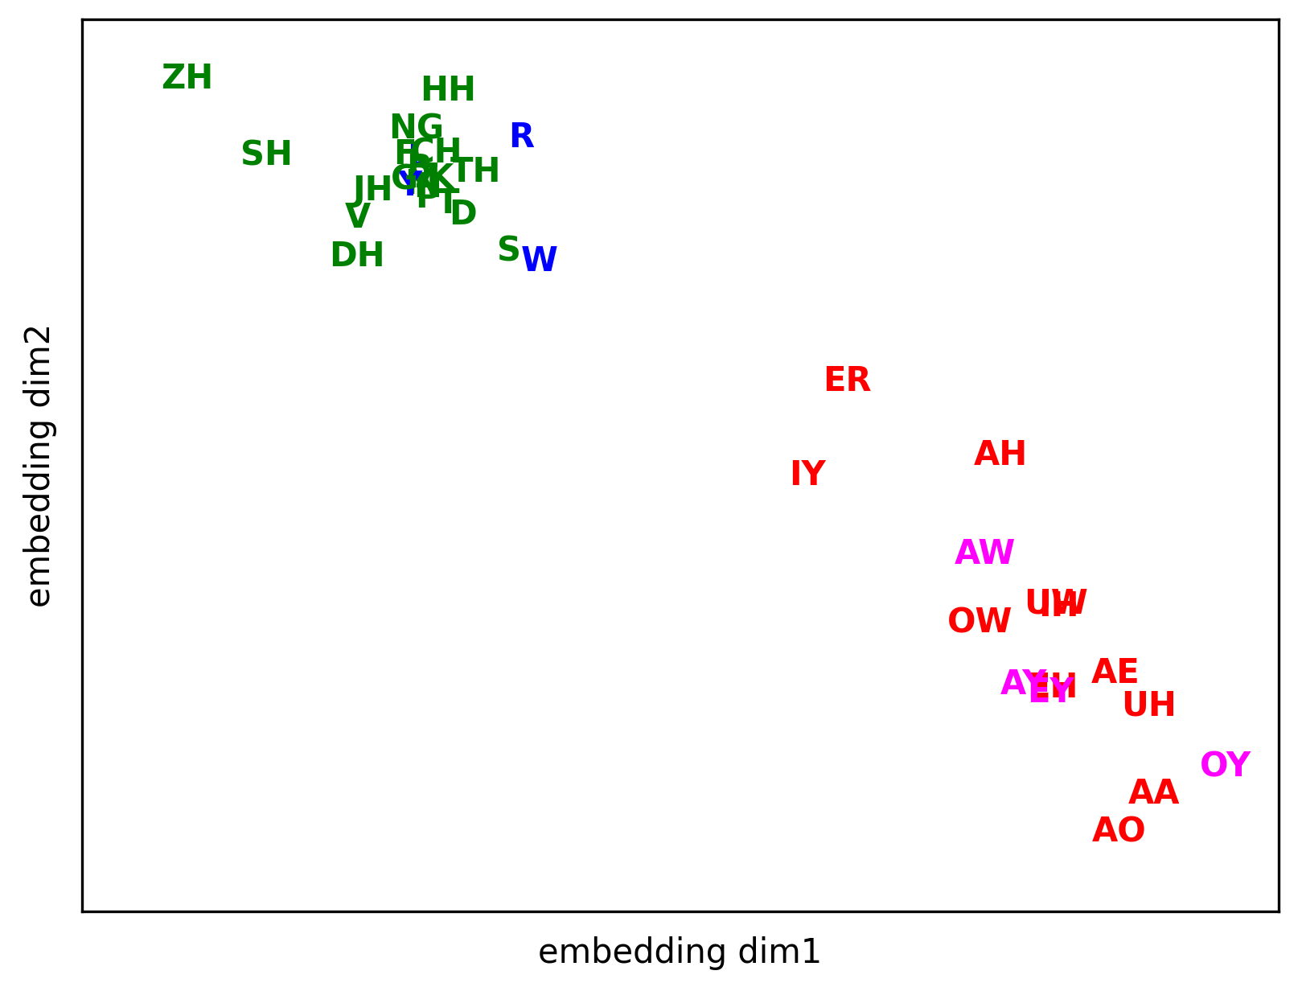
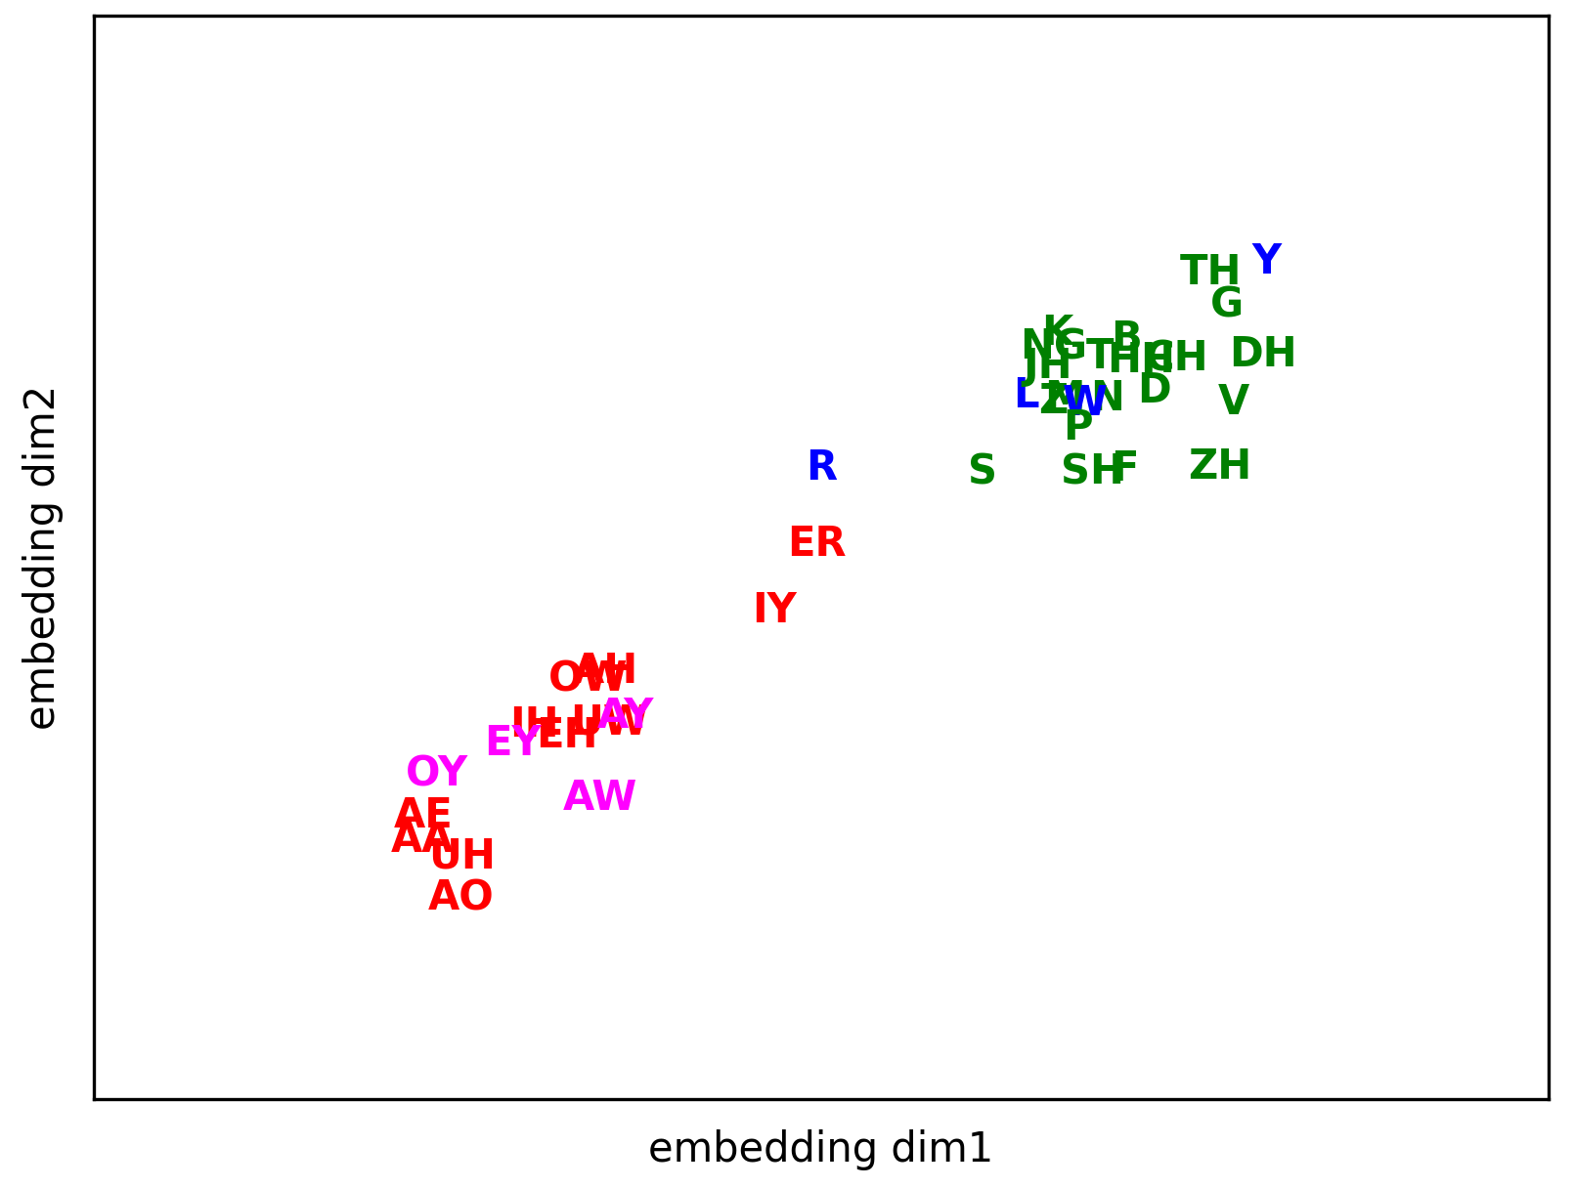
Phoneme2Vec
continuous bag-of-words
skip-gram
The pipeline only confuses similar phonemes in this dataset.
It can quantify the similarity between phonemes in the target domain.

Slide 18
Reference
Anjie Fang, Simone Filice, Nut Limsopatham, and Oleg Rokhlenko. 2020. Using Phoneme Representations to Build Predictive Models Robust to ASR Errors. <i>Proceedings of the 43rd International ACM SIGIR Conference on Research and Development in Information Retrieval</i>. Association for Computing Machinery, New York, NY, USA, 699–708. https://doi.org/10.1145/3397271.3401050
Mirzaei, Maryam & Meshgi, Kourosh & Kawahara, Tatsuya. (2017). Detecting listening difficulty for second language learners using Automatic Speech Recognition errors. 156-160. 10.21437/SLaTE.2017-27.
N S, Mukuntha & Kumar, Ayush & Vepa, Jithendra. (2021). Phoneme-BERT: Joint Language Modelling of Phoneme Sequence and ASR Transcript.

Slide 19
Thank you for watching!

